Slide 1
Announcements
Momentum Assignment due next TUESDAY
Keep trading

Slide 2
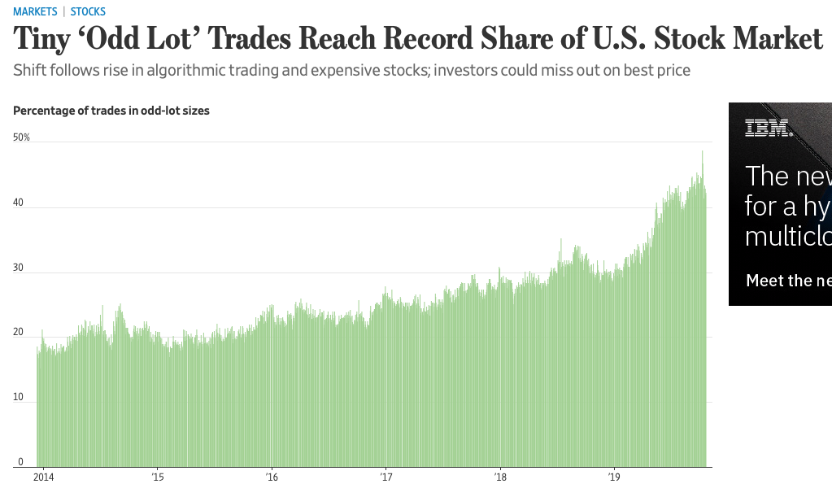
News
The shift to smaller trades is being driven by the growing number of expensive stocks such as Amazon.com Inc., with prices above $1,000 a share, and the rise of computerized trading strategies that, unlike human traders, don’t think in multiples of 100.

Slide 3
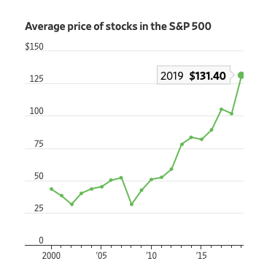
News

Slide 4
“We now live in a world of algos and slicing and dicing,” said Maureen O’Hara, a finance professor at Cornell University and former board member of brokerage ITG.
. Banks often execute clients’ trades by slicing them into small orders to buy or sell shares.
High-frequency trading firms, which took off in the 2000s, use odd-lot trades in some strategies. One tactic involves sending small orders to multiple markets to check for the presence of large buyers or sellers.
“For some reason, companies think it’s uncool to split stocks,” said Phil Mackintosh, chief economist at Nasdaq Inc.
Regulators say brokers should execute investors’ trades at the best price posted on any U.S. exchange, or better. But the best price is defined by quotes posted in round-lot increments, of 100 or more shares.
Critics say that lets brokers overlook odd-lot quotes available at better prices.
odd-lot quotes aren’t broadcast on the two main public data feeds for U.S. stock prices, effectively making them invisible to many investors

Slide 5
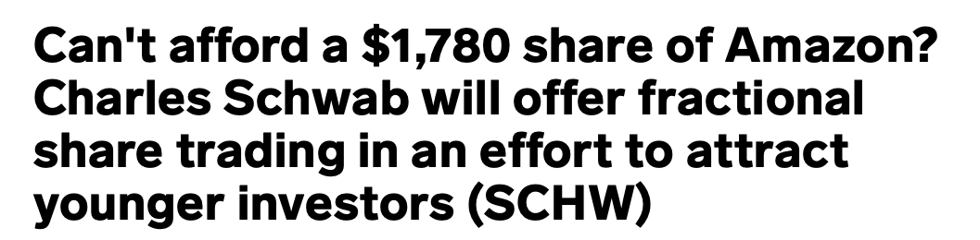
Related

Slide 6
Factor Theory
Notes:
5 minutes

Slide 7
Today’s Question
What determines expected returns on financial assets?
Today’s focus: systematic risk factors
Notes:
Risk, what risks? Nondiversifiable risks.

Slide 8
Market Efficiency

Slide 9
Notions of Market Efficiency
Efficient Market Hypothesis: financial markets process information into prices quickly and efficiently
Classical notions of market efficiency were laid out by Fama (1970):
Weak Form: Can’t predict returns using historical prices
Semi-Strong: Can’t predict returns using all publicly available information
Strong: Can’t predict returns using private information

Slide 10
Notions of Market Efficiency
The implications of the efficient markets hypothesis (EMH) for investors are:
The expected return on a trading strategy should be determined by its risk exposure
To the extent that speculative trading is costly, speculation must be a loser’s game
Notes:
The EMH has been refined over the past several decades to reflect information, transactions, financing and agency costs. Many behavioral explanations have the same effect and some frictions are modeled as behavioral biases.

Slide 11
Near-Efficient Markets
Modern notion of market efficiency is due to Grossman and Stiglitz (1980)
Conundrum: Can a market be efficient in the strong form? Suppose it is costly to collect information and to trade based on it.
If all information is in the price, why ever invest in gathering the information?
But if no one invests in gathering the information, how would the information get to be reflected in the price?
“Near efficient” markets
Active managers search for pockets of inefficiency

Slide 12
Explaining Performance
If we find a trading strategy that on average earns a positive excess return, it could be:
1. The strategy is exposed to some risk that the marginal investor cares about (i.e., has low payoffs in bad times)
Focus of today’s lecture: what are some risks (risk factors) investors care about?
2. The strategy is taking advantage of assets being mispriced (markets are not weak/semi-strong/strong-form efficient)
E.g., other investors must be making systematic mistakes
3. We found a spurious relationship that will not hold out of sample

Slide 13
Multifactor Models

Slide 14
Outline
What is a factor?
Multifactor models
Macro factors
Dynamic factors
Fama-French
Value-growth
Size
Momentum

Slide 15
What is a Factor?
A systematic factor is a variable that affects the returns of all assets—it is only a question of degree as to how a particular asset is affected
Exposure to the factor cannot be diversified away
Factors can be
Fundamental or macro, which are usually non-tradable (at least not in scale)
Investment or tradable
Exposure to factor risk earns a risk premium.
Because of general risk aversion in the economy, investors require a positive risk premium to be exposed to assets which lose, on average, when factor realizations are high.
For example, assets which tend to have low returns when inflation is high are risky, and so over the long run earn an inflation risk premium.

Slide 16
Multifactor Models
Assets that covary with “bad times” demand lower risk premiums
For CAPM: High covariances with –r_{m} = low covariances with +r_{m} (low beta) => low risk premium
To summarize, if the payoff of an asset tends to be
High in bad times => valuable asset to hold => low returns
Low in bad times => high returns
In a multi-factor model, bad times are defined by more than low returns of just one factor
Linear multi-factor model (with k factors):

Slide 17
Multifactor Models
If the factor carries a positive premium, then when stocks covary more with that factor (high factor beta), this is an unattractive stock to hold because it tends to have low payoffs during the bad times defined by that factor’s negative realizations.
This stock then has to have high returns to compensate investors.
High returns, on average, represent compensation for investors bearing very negative returns during certain periods
Can a factor have a negative risk premium?
Yes, then stocks with high betas to a factor with a negative risk premium will have low returns

Slide 18
Searching for risk factors
Theory driven: some proposed factors are grounded in economic theory and intuition:
For example, consumption growth is motivated by the consumption CAPM
Typically, the connection between “bad times” and the proposed risk factor is apparent and intuitive (low consumption growth = bad times)
Data driven: some proposed factors are based on empirical patterns
Assuming “exposure to factor risk earns a risk premium” and markets are efficient, then:
If we find a trading strategy that earns a return premium, then it is likely this trading strategy is exposed to a risk factor investors care about
E.g., value stocks outperform growth stocks.
We “build” a factor based on that strategy. E.g., the value factor
(Alternatively, markets may be inefficient or the discovered premium is the result of data mining)
Sometimes the relationship between “bad times” and a risk factor based on a trading strategy is tenuous
For example, the “momentum” factor (more on this in a bit)
Ideally, a risk factor will have both theoretical and empirical support

Slide 19
Multifactor Models
The $64K question is how do you define bad times?
Marginal utility is high, or times when that extra $1 is very valuable to you
When you’ve just lost your job
When your consumption is low relative to your neighbor (“catching up with the Joneses”)
When your consumption is low relative to your past consumption (“habit”)
Economic recessions, or periods where aggregate consumption growth is low
Financial crises
High inflation
High uncertainty or aggregate volatility
CAPM: market return is low

Slide 20
Multifactor Models
Factors
Must affect all assets, the only question is how much they affect a particular asset
Cannot be diversified away
Ideally have economic motivation
Types of multifactor models
Fundamental models: factors based on observable macro factors
Investment (style) factors

Slide 21
Macro Factors

Slide 22
Economic Motivation and Relevance
For macro factors:
Does the macro factor plausibly capture bad times?
Do the returns or return distributions of different securities covary with the factor?
Can the differences in covariation explain average return differences across securities?

Slide 23
Macro Factors
Main factors:
GDP growth
Inflation
Market-wide volatility
Unexpected changes (or shocks) to the macro factor typically matter more than the level
If markets are efficient, asset prices will change with the arrival of new information

Slide 24
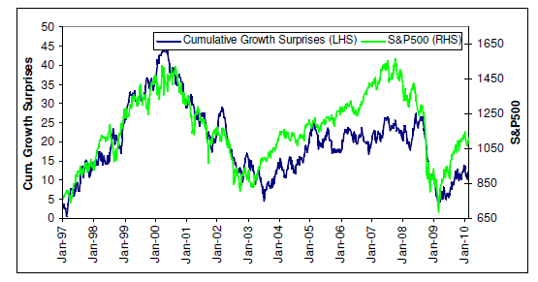
Economic Growth
Bad times = periods of low economic growth
US equities have closely tracked economic growth surprises well
Exhibit 14.4 from Ilmanen

Slide 25
Economic Growth
Notes:
Corp bond inv grade full sample average should be 7%, not 5%

Slide 26
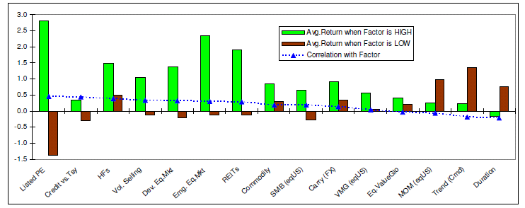
Economic Growth
Growth factor = monthly change in consensus forecast of next-year U.S. real GDP growth
Most asset classes are positively exposed to growth news; long Treasury positions and momentum-oriented strategies are the main exception
Exhibit 14.7 from Ilmanen

Slide 27
Inflation
Bad times = periods of high inflation
Notes:
Corp bond inv grade full sample average should be 7%, not 5%

Slide 28
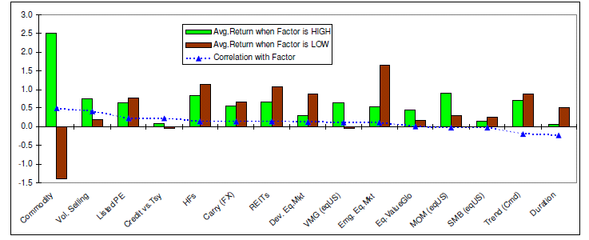
Inflation
Inflation factor = monthly change in consensus forecast of next-year U.S. inflation rate (Consensus Economics)
Commodity futures have benefited most from rising inflation expectations while Treasury positions suffer
Exhibit 15.7 from Ilmanen

Slide 29
Volatility
Bad times = periods of high market volatility
Average return for large stocks:
24.9% in stable times
-4.6% in volatile times
Stocks -0.39 correlation with VIX changes
Bonds 0.12 correlation
Volatility has a negative price of risk
Assets that payoff when volatility spikes have lower risk premiums

Slide 30
Other Macro Factors
Productivity risk
In the long-run, investors should probably care about long-run productivity risk
Demographic risk
Relevant for really long-run investors
Political risk
Especially important for developing economies
Becoming more important for developed economies

Slide 31
Investment Factors

Slide 32
Static Factors

Slide 33
Simple Investment Factors
Equities
Bonds
Bad times = periods of low returns
Cheap index management delivers these long-only factors at essentially zero cost in very large size
Based on market capitalization weights—represent the aggregate average investor

Slide 34
Dynamic Factors

Slide 35
Investment Factors
Theory and long investing experience have identified classes of assets that have consistently higher (or lower) average returns than the market portfolio
These are like systematic trading strategies

Slide 36
Dynamic Factors
Classics
Value-Growth Premium = Value stocks minus growth stocks
Size Premium = Small stocks minus large stocks
Momentum Premium = Winning stocks minus losing stocks
Others
Illiquidity Premium = Illiquid securities minus liquid securities
Credit Risk Premium = Securities with high default risk minus securities with low default risk
Low Volatility Risk Premium = Stocks with low volatility minus stocks with high volatility

Slide 37
Dynamic Factors
Dynamic factors take a long position in securities with similar characteristics, which tend to comove with each other, and offsetting short positions in securities with the opposite characteristics
The market portfolio, by definition, has no dynamic factor exposure
The average investor, who holds the market, does not practice dynamic factor investing!

Slide 38
Economic Motivation and Relevance
Does the investment factor exhibit outperformance relative to the market portfolio?
If so, what is the explanation for the outperformance?
Rational stories (risk): the investment factor performs poorly during bad times
Macro factors may be embedded in the investment factor
Behavioral stories (mispricing): systematic errors made by investors are not arbitraged away

Slide 39
Value vs Growth

Slide 40
Small vs Large

Slide 41
Winners vs Losers

Slide 42
Equity Factors

Slide 43
Dynamic Factors
Sort stocks into deciles based on
Size
Book/Price (measure of “value”)
Past 12-month return
Use data 1927:01 to 2013:12

Slide 44
44
44

Slide 45
Going Beyond Equities
Value
Fixed Income: “Riding the yield curve” or “Roll-down” related to duration
Foreign Exchange: “Carry”
Equities: “Value/Growth”
Commodities: “Roll” related to normalization/backwardation
Momentum
Equities, Fixed Income, Foreign Exchange: “Momentum”
Commodities: “CTA”
Also called “Trend”
Notes:
There is some common variation in value strategies across asset classes – not much theory as to why.
CTA: commodity trading advisors – basically trade on momentum
Riding the yield curve: Selling shorter maturity bonds and buying longer maturity bonds. Longer maturity bonds typically have higher yields to compensate investors for a longer period of uncertainty. As maturity decreases, yields fall and prices rise.
Carry trade: Sell a currency with a relatively low interest rate and use the funds to purchase a different currency yielding a higher interest rate.
Commodities ”roll”: (Wikipedia) The roll yield is the yield that a futures investor captures as their long position in a futures contract converges to the spot price; in a backwardated futures market the price rolls up to the spot price, so the roll yield is positive, whereas when the market is in contango the price rolls down to the spot price, so the roll yield is negative. The spot price can stay constant, but the investor will still earn returns from buying discounted futures contracts, which continuously roll up to the constant spot price.

Slide 46
Fixed Income Factors
Notes:
Term is the riding the yield curve type factor
Yields spike in downturns/the crisis and prices fall. Term does well.

Slide 47
Dynamic Factors
Investing in dynamic factor strategies requires some skill, and is somewhat costly
Factor risk premiums do not come for free
Similar to collecting “insurance premiums”

Slide 48
Fama-French 3-Factor Model

Slide 49
Dynamic Factors
We can use factor benchmarks with dynamic factors, which involve long-short positions in different portfolios with opposite characteristics (value vs growth, small vs large, winner vs loser, etc)
The same intuition as the simple factor benchmark holds: the factors represent returns that an investor could receive from holding that factor
To receive the factor premium, the investor takes both long and short positions
Consider two dynamic factors
Small minus large
Value minus growth

Slide 50
Fama-French
Fama and French (1993)
Includes a small and value factor in addition to the market factor (MKT)
SMB = small minus big stocks
HML = high book/price (value) minus low book/price (growth)
The SMB and HML factors are zero cost:
SMB = $1 in small stocks minus $1 in large stocks
HML = $1 in value stocks minus $1 in growth stocks
SMB and HML are zero-cost portfolios
β_{i,SMB} and β_{i,HML} are centered around zero
These are called factor mimicking portfolios
A common addition is a long-short momentum factor UMD or MOM originally due to Carhart (1997)

Slide 51
Uses of Factor Models Beyond Portfolio Analysis

Slide 52
What Can We Do With Factor Models?
1. Calculate a stock’s expected return using different factor models
We can compare our forecasts for expected returns to the model implied expected return to see if the stock is over- or undervalued
2. Calculate the firm’s cost of equity capital (which is the same as the stock’s expected return)
3. Evaluate a fund manager’s performance
Did the manager earn higher average returns (alpha) than what would be predicted by the factor model?

Slide 53
Evaluating a fund manager
A fund manager “specializing” in small stocks has a positive loading on SMB, and a fund manager tilting towards value stocks has a positive loading on HML
The alpha is the “risk-adjusted return” or the “excess return”. It is the unique return generated by the manager in excess of what could be done mechanically through passive exposures to factors.
Dynamic factors assume you can short! If you can’t, you must use simple factor benchmarks with positivity constraints.

Slide 54
Calculate Apple’s expected return
Use the 3-factor model to calculate Apple’s expected return:
Beta (with the market) = 0.95
s_{i} (coeff. on SMB) = -1.5
h_{i} (coeff. on HML) = -1
E[r_{m}] = 15%
Risk-free rate = 1%
E[SMB] = 3.90%
E[HML] = 6.19%
What is Apple’s expected return based on FF3 and CAPM?

Slide 55
Answer
Based on CAPM:
Why is Apple’s expected return so low based on FF3?

Slide 56
Calculate Apple’s Alpha
If we forecast Apple’s return is 10%, what is the alpha on Apple (using the FF3 model)? Is it under or overpriced?
Our forecasted return is 7.74% above the expected return implied by the three-factor model. Based off our forecast, Apple is underpriced.

Slide 57
Coke and UPS Example
Calculate the expected return on Coke and UPS stock (i.e., their equity cost of capital)
First, estimate using the CAPM:
(1) Estimate their betas using regression
(2) Plug the beta into the CAPM formula.
For the risk-free rate, use the 1-year Treasury yield.
For the market risk premium, use VIX to calculate the market risk premium using A x Var(r_{m}).
Next, estimate using the Fama-French 3 Factor Model

Slide 58
Coke and UPS Example
3 Factor Model:
Market returns, risk-free rate, SMB, and HML are from Ken French’s website
They are returns to ZNI portfolios
The coefficients are beta, s, and h
To calculate the forward looking cost of capital. Estimate expected market excess return, expected SMB, and expected HML.
For SMB and HML use historical averages
Multiply each price of risk (e.g., expected value of the factor) by the firm’s sensitivity to that risk (e.g., s, h, p)
Ignore alpha, assume it is zero

