Slide 1
Capital Allocation Line

Slide 2


Capital Allocation Line
Suppose now we have just one risky asset, equities, and a risk-free asset (say T-bills). Equities have expected return E(r_{p}) and volatility σ_{p}. The risk-free rate is r_{f}.
The set of possible portfolios of equities and the T-bills is described by the Capital Allocation Line (CAL)
The CAL is described in portfolio mean-standard deviation space by:
The Sharpe ratio is the reward per unit of risk:

Slide 3





The Capital Allocation Line

Slide 5
5

Slide 6
Utility
Substitute for w:
Utility is increasing in the risk-free rate, the return on the risky portfolio and decreasing in the standard deviation and risk aversion
U-shaped in terms of the weight in the risky portfolio

Slide 7
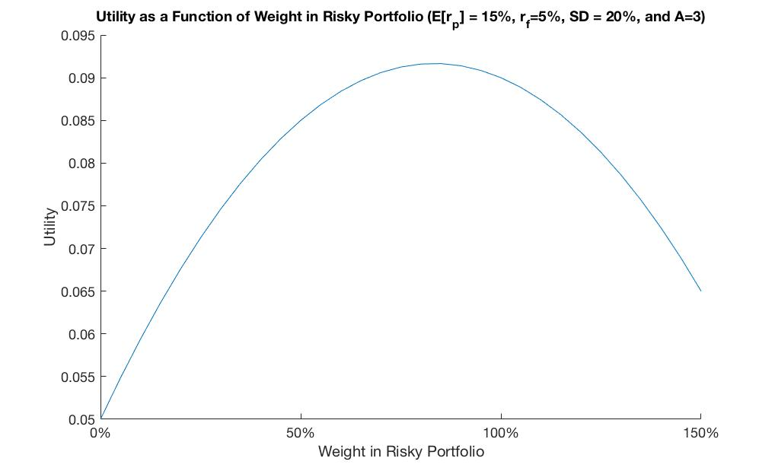
Utility Example
Ɣ

Slide 8
Investor’s Problem:
Find the weight that maximizes investor’s utility

Slide 9
To Solve
We need to take the derivative of our utility with respect to the weight in the risky portfolio and set the derivative to zero (first order condition)
This will find where the slope of the utility function is zero (“top of the arch”)

Slide 10
Solution
How do Ɣ, E[r], σ² affect the weight in risky?

Slide 11
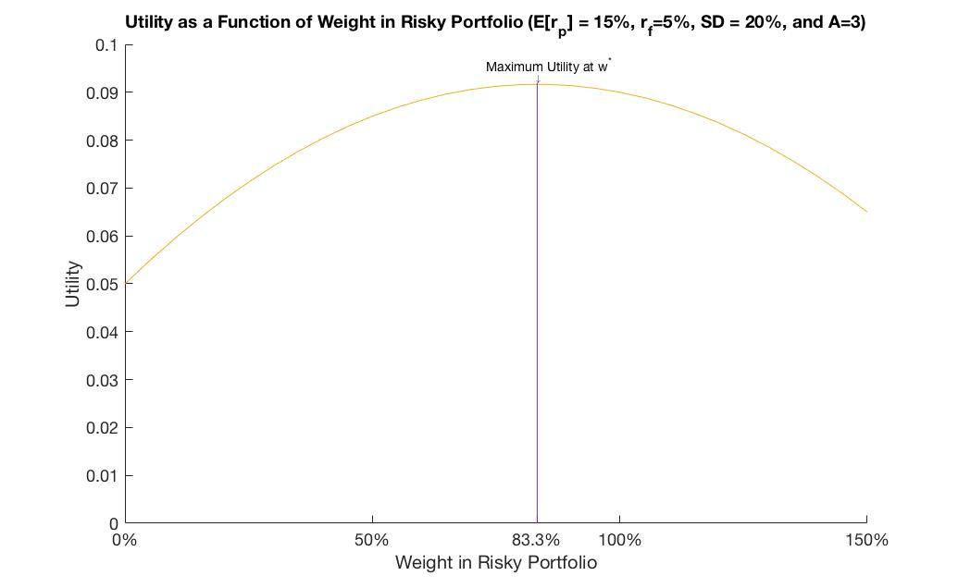
Utility Example
Ɣ

Slide 12
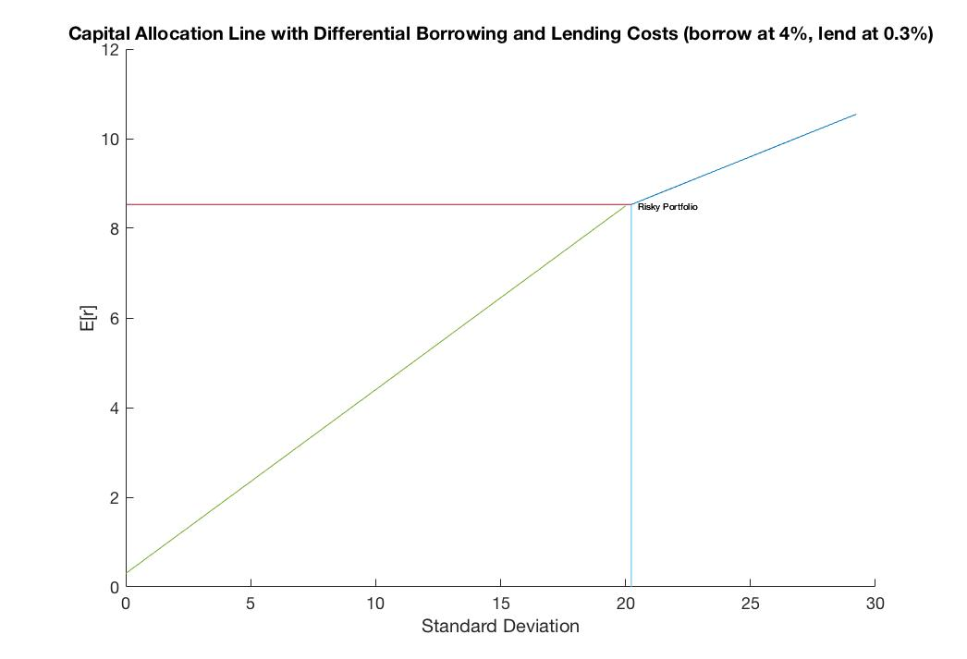
Differential Borrowing and Lending Rates

Slide 13
Ch. 3: Mean-Variance Investing
July 2014

Slide 14
Optimal Risky Portfolio

Slide 15
How should we choose our portfolio?
With mean-variance utility and a risk-free asset:
1. Find the risky portfolio with the highest Sharpe ratio
Every investor’s optimal portfolio of risky assets is the same!
2. Find the optimal weight in the risky vs. risk-free
Weight in risky will depend on investor’s risk aversion
The result that the investment problem can be decomposed into two steps is called: Two-fund separation
It is a key result in Modern Portfolio Theory

Slide 16
Choosing Between Portfolios
If we’re choosing between two risky portfolios to include in our complete portfolio:
Choose the portfolio with the highest Sharpe ratio
Capital Allocation Line:

Slide 17

Higher Sharpe Ratio
Better off with A
As risky portfolio
Slope of CAL
is the Sharpe Ratio
E[r]
15%
A
A
10%
B
B
3%
20%
σ
12%

Slide 18
Maximum Utility
Plug the optimal weight (w*) into the mean-variance utility function, then the maximum utility achievable is:
Maximum utility is increasing in the Sharpe ratio

Slide 19
No risk-free asset
If there is no risk-free asset available, then we cannot create different combinations of risk-free and risky
Our weight in risky assets is stuck at 100%
Cannot rely on Sharpe ratio to determine the best risky portfolio
Need to calculate utility from investing in each possible risky portfolio
Can be different across investors

Slide 20
No Risk-Free Asset
If unable to invest in the risk-free asset.
Investor may prefer B to A depending on their level of risk aversion.
E[r]
Better off
15%
A
A
10%
B
B
3%
20%
σ
12%

Slide 21
Optimal Portfolio
Optimal complete portfolio is always the portfolio that maximizes utility
With mean-variance utility:
Without a risk-free asset:
Find the utility maximizing portfolio
With a risk-free asset:
The utility maximizing risky portfolio will be the highest Sharpe ratio portfolio
Need to find weight in risky and risk-free

