Slide 1
Announcements
StockTrak initial report due Oct. 10th
Today: lecture on mean-variance investing
Next class: in-class assignment on the HMC case

Slide 2
Notes on mean-variance investing

Slide 3
Efficient Frontier: the set of efficient risky portfolios

Slide 4
Efficient Frontier
Given a set of risky assets, the efficient frontier is:
The weights that maximize expected return for each level of risk
Equivalently, the weights that minimize risk for each level of expected return
See Appendix for more details

Slide 5
Mean-Variance Frontiers
Mathematically this is a quadratic programming problem:
where r_{p} is the portfolio return, w_{i} are asset weights, which must sum to 1 for a valid portfolio, and μ* is a target return. By varying μ*, we trace out the mean-variance frontier

Slide 6
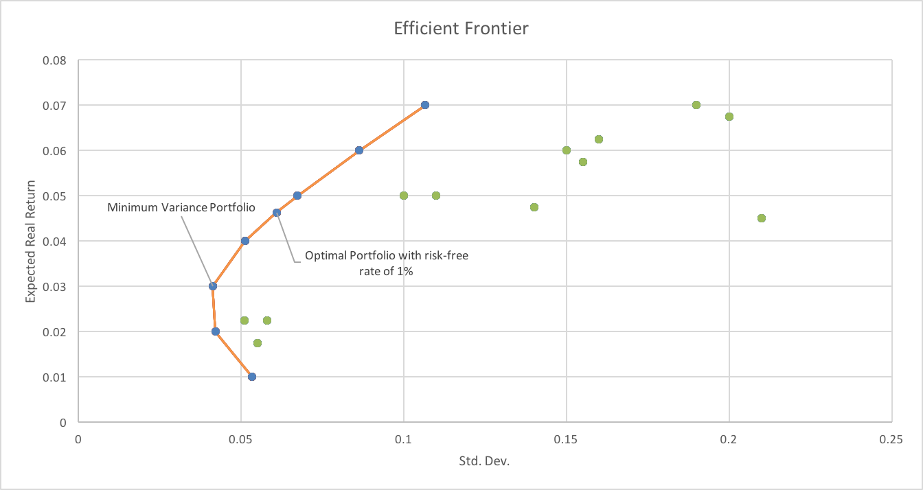
CAL with optimal portfolio

Slide 7
Mean-Variance Frontiers
The left-most point on the mean-variance frontier is called the minimum variance portfolio, which obtains the lowest variance
Only portfolios on the top half of the mean-variance frontier are efficient: there is no higher mean obtainable for the same standard deviation
As assets are added, the mean-variance frontier expands
It shifts leftwards (so the minimum variance decreases).
The wings shift outwards
Both increase the maximum Sharpe ratio that can be obtained

Slide 8
Sensitivity to Inputs
The optimal portfolio is very sensitive to the inputs (estimated return distribution)
Later in the semester, we will discuss strategies for dealing with estimation error

Slide 9
Diversification

Slide 10
Diversification
By combining assets that are not perfectly correlated, we achieve lower risk for the same level of expected return
By investing in many risky assets, we can minimize our exposure to idiosyncratic risks
Total risk = systematic risk + idiosyncratic risk
Systematic risk = nondiversifiable risk. These are risks that cannot be easily diversified away.
E.g., the S&P 500 is fairly diversified, but it still moves up and down with news about the U.S. and international economies
E.g., Ford’s stock price will move with the broad U.S. market and consumer tastes for the Explorer, F150, etc.
By combining Ford, with Apple, Home Depot, bonds, etc. we will minimize our exposure to Ford’s idiosyncratic risk

Slide 11
Diversification
Portfolio
Risk
Diversifiable
(Idiosyncratic)
Risk
Total
Risk
Nondiversifiable
(Systematic)
Risk
Number of Securities
Notes:
http://www.kellogg.northwestern.edu/faculty/papanikolaou/htm/finc460/ln/lecture1.pdf

Slide 12
What determines the diversification “benefit”?

Slide 13
Correlation/Covariance
The covariance between assets, not the individual security standard deviations, determines the portfolio risk
Note:
Spreading our capital across assets is most beneficial when assets are less correlated with each other
Example:
Combining Ford with GM is not going to have as great a diversification benefit as combining Ford with Wal-Mart

Slide 14
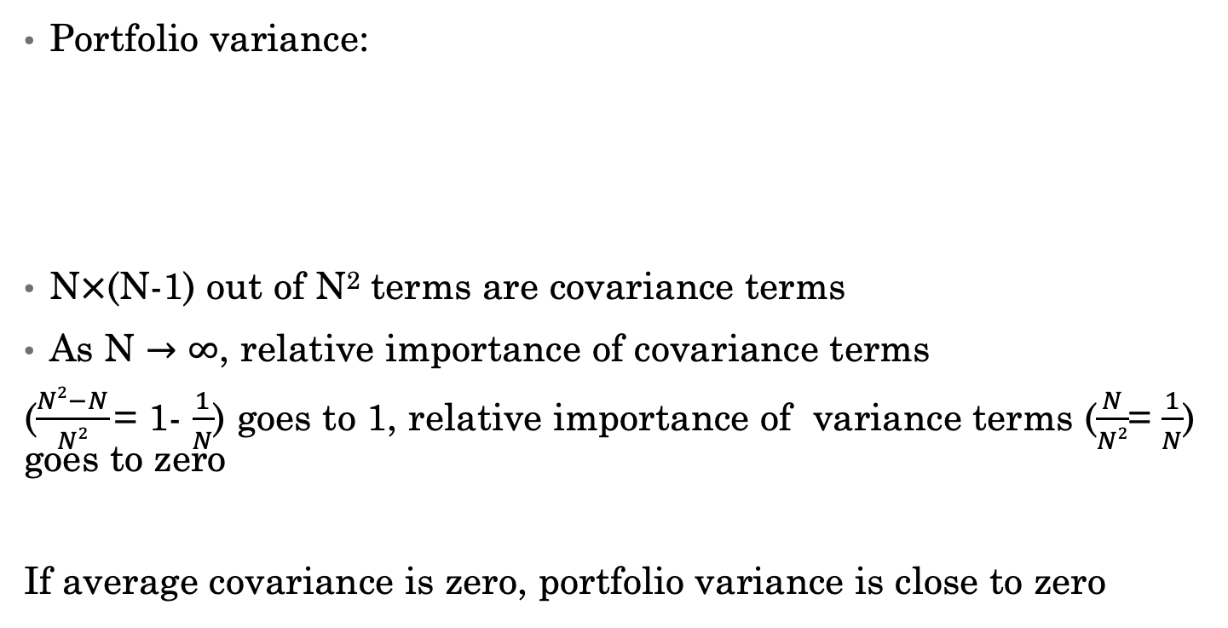
Understanding Diversification
Portfolio variance:
N$×$(N-1) out of N² terms are covariance terms
As N $→∞$, relative importance of covariance terms
($\frac{N2−N}{N2}$= 1- $\frac{1}{N}$) goes to 1, relative importance of variance terms ($\frac{N}{N2}$= $\frac{1}{N}$) goes to zero
If average covariance is zero, portfolio variance is close to zero

Slide 15
Covariance
The average (annual) return standard deviation is about 50%
Average (annual) covariance between stocks is 0.037 and average correlation is about 39%
Can’t eliminate all risk (left with systematic risk)
What are risks common to most stocks?
Fed policy
Financial crisis
GDP growth
Weather

Slide 16
Portfolio Constraints

Slide 17
Constrained Portfolios
In the real world, there are usually constraints put on investors portfolios
The cost of a constrained portfolio is a reduction in the Sharpe ratio

Slide 18
Constrained Portfolios
Limits on the set of assets:
Location
Social responsibility
Short sale constraints
Other constraints:
Minimum dividend-yield (dividend/price)
Constrain average D/P

Slide 19
Short Sale Constraints
Hard to sell short some securities
Some money managers are not allowed to sell short
Have to add additional constraints into optimization (e.g., w_{i} >=0 for all i)
Single assets may be on the efficient frontier
Highest E[r] asset will be, only way to achieve

Slide 20

Summary
Mean-variance analysis:
Assumes investors only care about expected return and variance.
Appropriate if returns are normally distributed
Lessons
Optimal risky portfolio the same for all
Change risk exposure by changing weight in risk-free asset
Only covariance matters for large portfolios

Slide 21
Beyond Mean-Variance (skipped last class)

Slide 22
Mean-Variance Utility Drawbacks
Symmetry of upside and downside movements
Variance treats upside and downside returns the same, relative to the mean. People are generally more risk averse over downside losses than over upside gains.
Only first two moments matter
People prefer positive skewness than negative skewness. People dislike fat tails, especially on the downside.
Real-world vs. subjective probabilities
The actual return distributions of assets are different to those perceived by agents
More realistic utility functions (see appendix for more details):
Safety first
Loss aversion or prospect theory
Disappointment aversion
Habit
Keeping up with the Jones
Uncertainty Aversion

Slide 23
Ambiguity Aversion
Sometimes we don’t know the probability distribution, beliefs about possible probability distributions – Knightian uncertainty (ambiguity)
Example: You have an urn containing 30 red balls and 60 other balls either white or black.
Choose between these two gambles
A: Receive $1,000 if you draw a red ball
B: Receive $1,000 if you draw a black ball
Choose A if and only if you believe # of white > # of black
Different choice: choose between these two gambles
C: $1,000 if you draw a red or white ball
D: $1,000 if you draw a white or black ball
Choose C if and only if you believe # of white > # of black
Most people choose A (# white># black) and D (# black< # white)
Ellsberg paradox – evidence of ambiguity aversion
Prefer gambles with known odds to gambles with ambiguous odds (uncertainty about the probability distribution)

Slide 24
Summary

Slide 25
Redux: volatility strategy vs S&P 500
A mean-variance investor would be relatively indifferent between the two
What about an investor that is averse to crash risk?
 | Vol Strategy | S&P 500
Mean | 9.9% | 9.7%
Std. Deviation | 15.2% | 15.1%
Skewness | -8.3 | -0.6
Kurtosis | 104.4 | 4.0

Slide 26
Summary
Utility functions quantitatively rank good to bad outcomes
Incorporating utility functions allows us to account for our preferences in the portfolio optimization problem
The more risk averse an investor, the lower the utility during bad times, and the greater the difference in utility between good and bad times. Risk aversion can be measured by questionnaires, certainty equivalents, and revealed portfolio holdings.
In mean-variance utility, there is only one preference parameter: risk aversion. Investors care only about means (which they like) and volatility (which they dislike). It is the most widely used utility function in industry, sadly.

Slide 27
Appendix: Steps for Calculating the Efficient Frontier

Slide 28
Calculating the Efficient Frontier
Constrain the expected return equal to some value X
Search over all possible weight combinations (portfolios) that give an expected return of X%
Find the portfolio with the minimum standard deviation

Slide 29
Calculating the Efficient Frontier
Repeat for a new value of expected return like (X+1%)
Continue to repeat for a reasonable range of expected returns
Look at the range of expected returns on the individual assets
Achievable portfolio returns will not be too far outside of this range

Slide 30
Calculating the Efficient Frontier
With many assets, solving for the optimal portfolio can be arduous
To calculate the risk of the portfolio, we need to find the covariance between all assets
N x (n-1) covariance terms
N variances
Luckily, we have Excel and stat programs that can solve for the optimal portfolio weights

