Slide 1
Announcements
Keep trading
New assignment: Black-Litterman
Assignment due Monday, October 21st
Let’s see how we are doing:
https://www.stocktrak.com

Slide 2
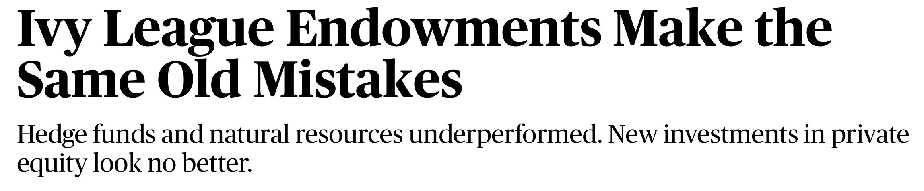

News
None of the Ivy endowments beating a 60-40 portfolio in the 2008-2018 period, though a couple did come close.
The biggest contributors to the weak performance of endowments were high exposure to hedge funds (2019 returns = 1.1%) and natural resources (2019 returns = -6.8%), while many endowments’ high operating costs also acted as a drag on returns.

Slide 3
Today’s Class
Finish Tuesday’s lecture: Testing the CAPM
Estimation error and portfolio optimization
Advanced mean-variance optimization

Slide 4
Advanced Mean-Variance Optimization
Notes:
5 minutes

Slide 5
Mean-Variance Optimization
The Markowitz method for portfolio optimization:
1. Estimate historical average returns and covariances
2. Optimize portfolio given the estimated distribution of returns
We saw with the HMC case that using historical data can lead to “extreme” portfolios
Why?
Ignores estimation error

Slide 6
Sensitivity to Inputs

Slide 7
Sensitivity to Inputs
Mean-variance frontiers are sensitive to inputs
Small changes in inputs result in extremely different portfolios with similar expected returns and volatilities
Errors are easily “magnified”. Garbage in, garbage out problem. Michaud (1989) calls mean-variance frontiers “error maximizing portfolios”.
For example, a small increase in one asset’s mean can drive half the asset positions to fall to zero (with a “no short-sale” constraint)

Slide 8
Estimation Risk Example (From Assness 2014)
Consider monthly returns on 3 asset classes from 1970-2014
Bonds: U.S. 10-Year
Stocks: S&P 500
Commodities: GSCI
Which is riskier? Which has higher return?
Example: 5 year rolling window estimates
Source: https://www.aqr.com/cliffs-perspective/efficient-frontier-theory-for-the-long-run

Slide 9
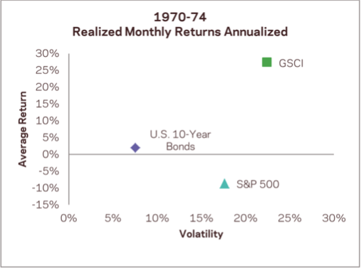

Slide 10
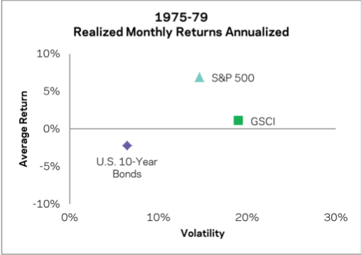

Slide 11
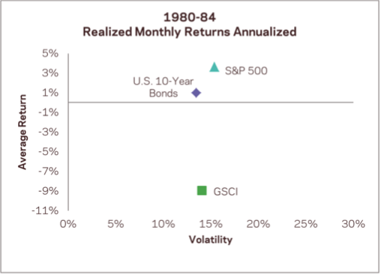

Slide 12
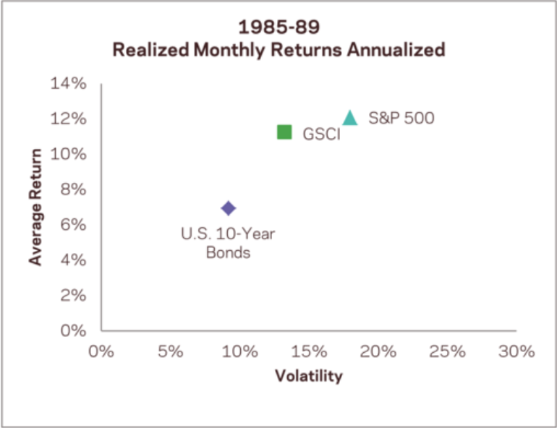

Slide 13
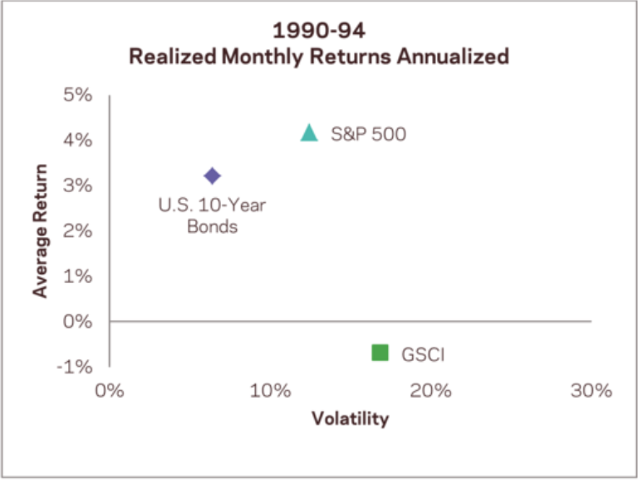

Slide 14
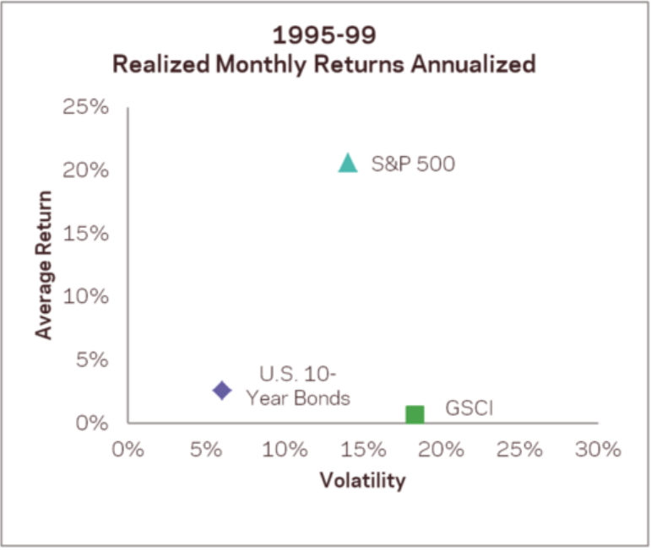

Slide 15
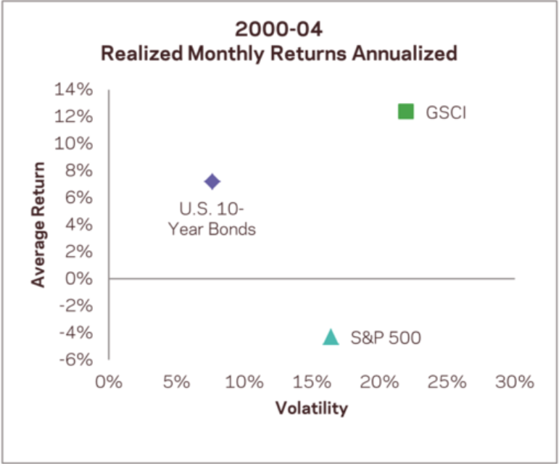

Slide 16
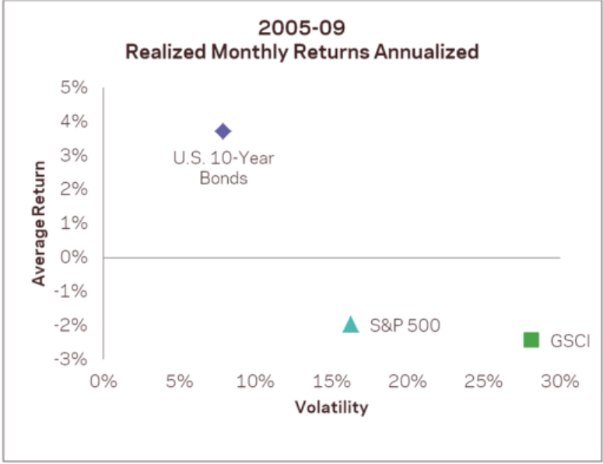

Slide 17
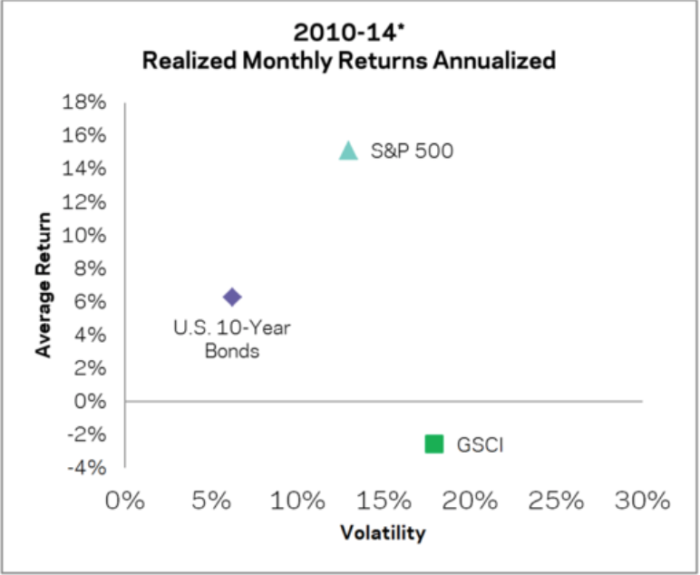

Slide 18
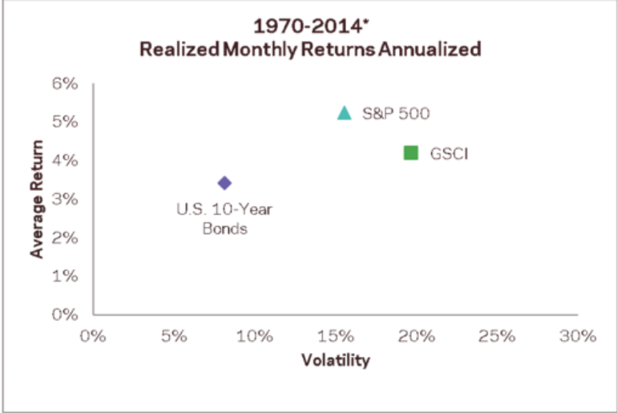

Slide 19
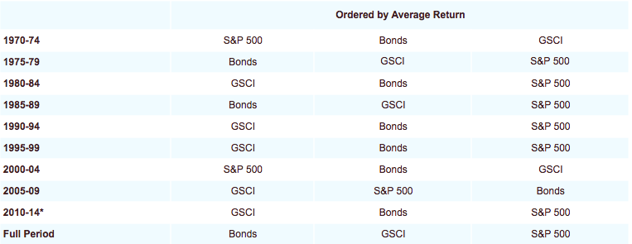

Slide 20
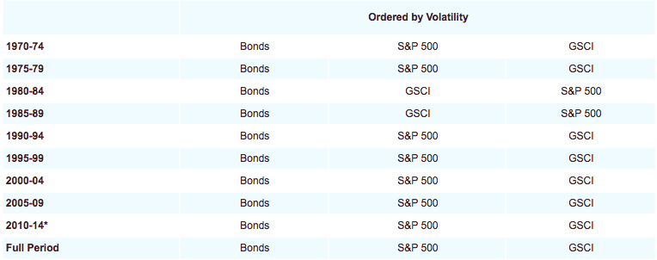

Slide 21
Examples
 | Average | Confidence Interval (95%)
U.S. Equities (1990-2013) | 7.45% | 5.7% to 9.2%
Foreign Equities (1990-2013) | 3.02% | 0.57% to 6.71%
Emerging Equities (1990-2013) | 7.50% | 6.71% to 8.29%

Slide 22
Dealing with the Sensitivity Problem
One should be cautious when using purely historical data
Using short, moving averages of data leads to pro-cyclicality
Past high returns imply high valuations => low future expected returns
Past low volatilities may actually imply risk is high:
“The received wisdom is that risk increases in the recessions and falls in booms. In contrast, it may be more helpful to think of risk as increasing during upswings, as financial imbalances build up, and materializing in recessions.” – Andrew Crockett, Bank of England

Slide 23
Dealing with the Sensitivity Problem
Take account of sampling error in estimating the frontier
Monte Carlo (Michaud (1998))
“Robust” estimates of means and covariances
Statistical methods which take care of outliers and extreme values. One method is Bayesian “shrinkage” methods. These shrink the means back to a model, e.g. CAPM, and the covariance back to a highly structured estimator
see e.g. Ledoit and Wolf (2003))
Shrink historical covariance matrix towards a covariance matrix with correlations and volatilities that are identical across pairs of assets

Slide 24
Dealing with the Sensitivity Problem
Use an economic model
CAPM or multi-factor models
Black-Litterman (1991), which “reverse engineers” expected returns from market cap weights [Morningstar Direct provides an option to do this]
Use a valuation model to determine inputs
Use simple, diversified portfolios
1/N (equal weight) works very well (DeMiguel, Garlappi and Uppal (2009))
“Risk parity” portfolios, originally advocated by Qian (2005)
Risk parity examples:
Assets are given weights inversely proportional to their variance
Assets are given weights inversely proportional to their standard deviation
Assets are given weights such that each asset contributes the same amount to overall variance (with this strategy covariance matters)
Minimum variance

Slide 25
Horse Race

Slide 26
Horse Race

Slide 27
Black-Litterman Model Video link: https://mediaspace.gatech.edu/media/t/1_8zrhi5tn

Slide 28
Black-Litterman
Portfolio optimization procedure
Really, procedure for estimating expected returns
Usually used to combine broad asset classes together
Combine U.S. equity, foreign equity, U.S. bonds, etc.

Slide 29
Black-Litterman Overview
(1) Starts with a prior distribution of expected returns based off market values and covariance with the market
The weight of each asset is proportional to its market value
The expected return is based off covariance with the market
(2) Incorporates manager’s views
Example: “U.S. stocks are going to outperform emerging markets stocks by 3% this month”
Take risk in assets in which they have views
Take the most risk where they have the most confidence

Slide 30
Black-Litterman
Why use Black-Litterman?
1. Reasonable asset class weights
Prior is the market portfolio
2. Incorporate our forecasts with discipline
Based on our confidence

Slide 31
Black-Litterman Overview
(1) Establish prior distribution of returns and the distribution of expected returns based on CAPM
(2) Establish views about expected returns (manager generated)
(3) Combine prior and views to create posterior distribution of returns
(4) Optimize portfolio using posterior distribution of returns

Slide 32
Expected Returns

Slide 33
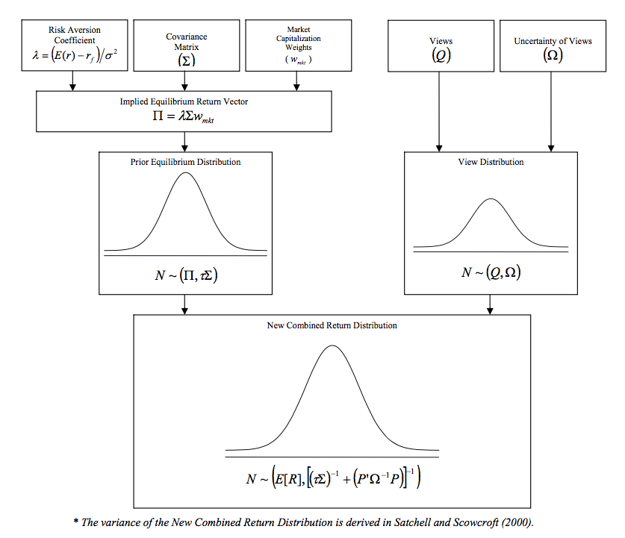

CAPM Prior:
Manager’s Views:
$γ=$
Idzorek (2002)

Slide 34
Expected Returns
Where is a n x 1 vector of the baseline expected returns

Slide 35
Expected Returns
Capital R is for excess returns here…
Weights are market cap weights

Slide 36
CAPM Prior:
Manager’s Views:
$γ=$
Idzorek (2002)

Slide 37
Precision of Expected Returns
Variance of baseline expected returns
BL suggest weighting the variance-covariance matrix of returns by a scalar, , e.g. .01 or .05
Distribution of baseline expected returns:

Slide 38
CAPM Prior:
Manager’s Views:
$γ=$
Idzorek (2002)

Slide 39
Manager’s Views
The manager has a set of views
Views can be relative or not
Examples:
“U.S. stocks are going to outperform emerging markets stocks by 3% this month”
“U.S. bonds are going to have a return of 5%”

Slide 40
Expressing Manager’s Views
Manager has k views
is a (k x n) matrix of manager’s views
is a (n x 1) matrix of excess returns for all n assets
is a (k x 1) matrix of excess returns for each view

Slide 41
Example
“U.S. stocks are going to outperform emerging markets stocks by 3% this month”
“U.S. Bonds are going to have an expected return of 5%”
Let’s assume these are the only three asset classes in the market portfolio

Slide 42
CAPM Prior:
Manager’s Views:
$γ=$
Idzorek (2002)

Slide 43
Uncertainty in Views
There are no restrictions on
Not much guidance either…
One strategy:
Can set off-diagonals to zero
Adjust , which is just a scalar
If , we’ll give equal weight to prior and manager

Slide 44
Combine Baseline with Manager’s Views

Slide 45
CAPM Prior:
Manager’s Views:
$γ=$
Idzorek (2002)

Slide 46
Combine Views with Baseline
Posterior expected returns:
Larger , less precise manager’s views. Less expected returns move towards manager’s views.
Larger , less precise the baseline, more weight given to manager’s views
Variance of expected returns:

Slide 47
CAPM Prior:
Manager’s Views:
$γ=$
Idzorek (2002)

Slide 48
Posterior Distribution of Returns
Need to adjust the variance-covariance of returns
Because there is uncertainty in the expected returns
Where:
Notes:
See Page 21 of: http://www.blacklitterman.org/Black-Litterman.pdf

Slide 49
Portfolio Optimization
Use the distribution as our expected return and variance-covariance inputs
Find the weights that maximize the Sharpe ratio of the portfolio

Slide 50
Black-Litterman
Portfolio optimization procedure
Combines a CAPM prior with manager’s views
Provides structure to the return distribution, while still giving the manager flexibility to incorporate views

