Slide 1
Announcements
Initial StockTrak assignment due Thursday, October 10th

Slide 2
News (last year this time)
Market correction:
DJIA, S&P 500, NASDAQ down 3-4% yesterday
FANG stocks had their worst day ever
6% decline
$125B loss in market value
“The money lost is more than roughly 460 companies in the S&P 500 are individually worth.” – Bloomberg
“The drop extended the group’s decline since their July peak to 15 percent. Still, up 24 percent since January, their gains easily beat the 4 percent for the S&P 500.”
“What’s clear is that as the broad market catered, the most liquid and best performing stocks such as FANG were vulnerable to profit taking.”
Why?
U.S.- China trade war
Falling margins and reduced profits for U.S. corporations
Slow down of stock buybacks by corporations
End of accommodative Fed policies
Trump: the Fed has “gone crazy”
Trump’s advisor: don’t worry the Fed is still independent
Doesn’t seem like panic: risky currencies like Turkish Lira, South African rand appreciated
Other concerns: Italy, China, Saudi Arabia, Brazil, U.S. midterms, Brexit negotiations…

Slide 3

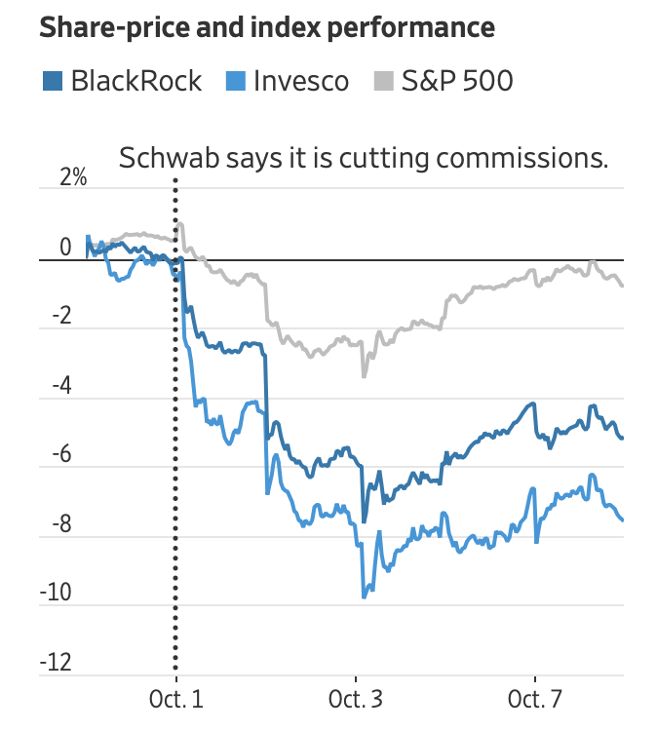
New News
“A combination of liquidity strains, insufficient support from the Federal Reserve and uncertainty surrounding political-economic issues could combine to impose pressure on markets in coming weeks, Ben Emons, a managing director of macro strategy at Medley Global Advisors, told Bloomberg Television.”
S&P 500 down 1.3% mid-day
Only up <2% in the past year
FAANG – FB, AMZN, NFLX down about 5% in the past month
ETF providers down month-to-date
BlackRock -6.8%
Invesco -8.5%
WisdomTree -8.3%
Fell more today…
Why?

Slide 4
WeWork Investors Turned Off by ‘Sloppy’ IPO Filings (WSJ)
Numerous current and former We employees believe the IPO prospectus was poorly written and delivered a muddled message about their business. They cite the document’s dedication, “to the energy of we—greater than any one of us but inside each of us.”
The document leaves unanswered some basic questions about the company’s finances. For example: How many new workstations did We deliver in the first half of this year? The prospectus filed in August said 273,000. Barely a month later, an amended version said 106,000. What was the total gross cost? In August, We said $1.3 billion. In September: $800 million. The reason for the dramatic changes is that the first version was wrong, people familiar with the matter said.
Several metrics that analysts and investors said were crucial to assessing how the company’s breakneck growth is affecting its profitability and cash burn weren’t disclosed in the prospectus. For example: What does it take for an individual location to be profitable? How much future revenue is the company committed to sharing with landlords?
“There is no mention that Mr. Neumann sold hundreds of millions of dollars of stock since WeWork was formed in 2010, as the Journal has reported.” Not required, but somewhat expected.

Slide 5
Factor Theory
Notes:
5 minutes

Slide 6
Today’s Question
What should determine our expected return on an asset?
Risk:
Idiosyncratic risk or exposure to systematic risks?
Systematic risks – we can diversify away idiosyncratic risks
Notes:
Risk, what risks? Nondiversifiable risks.

Slide 7
Outline
Factors = Nutrients
CAPM
Testing the CAPM

Slide 8
Factors = Nutrients

Slide 9
Factors = Nutrients
Nutrient Analogy
Nutrients = Factors: Foods are different ways to access nutrients
Foods = Assets: Peas, wheat, rice all have fiber just like certain sovereign bonds, corporate bonds, stocks, CDS all have credit risk
Male/Female/Child = Investors: Each investor has an optimal mix of factors with different liabilities and risk aversions

Slide 10
Factor: Definition
A factor is a variable which influences the returns of assets
Exposure to factor risk over the long run yields a risk premium
The premium does not come for free: it is compensation for bearing losses during bad times. Being exposed to the factor results in holding risk that other investors seek to avoid.
Types of factors
Macro factors: economic growth, inflation, political risk, uncertainty, …
Investment static, or simple, factors: equities, bonds, …
Dynamic factors: value-growth, momentum, low volatility, …
Notes:
Equities and bonds: cheap index management delivers these long-only factors at essentially zero cost in very large size
Based on market capitalization weights—represent the aggregate “average” investor

Slide 11
CAPM
One-factor model with the market portfolio return as the factor

Slide 12
CAPM
The CAPM is an equilibrium model which specifies risk-return trade-offs of (1) an individual stock relative to the market portfolio and (2) the market portfolio return and risk. It is derived assuming
Single-period investment horizon
Individual investors are price takers
Investments are limited to traded financial assets
No taxes and transaction costs
Information is costless and available to all investors
Investors are rational mean-variance optimizers
Homogeneous expectations

Slide 13
CAPM
Under mean-variance utility, investors hold the risk-free asset and the mean-variance efficient (MVE) portfolio (Two-fund separation).
The MVE, which consists only of risky assets, has the highest attainable Sharpe ratio.
The precise holdings of the risk-free asset and the MVE are determined by an investor’s risk aversion
E(r)
MVE =
Max SR tangency portfolio
Vol

Slide 14
CML
In a CAPM world, the MVE is the “market portfolio”
Market portfolio: portfolio for which each security is held in proportion to its market value
Capital Market Line: (the Capital Allocation Line when the MVE portfolio is the market)
In a CAPM world, everyone’s complete portfolio is on the CML
E(r)
MVE =
Max SR tangency portfolio
Vol
14

Slide 15
CAPM
The economic concept of diversification underlies the CAPM. Investors hold the market portfolio because it diversifies away idiosyncratic risk.
The CAPM is an equilibrium model: prices are set where supply = demand
E.g., (Supply) the number of shares outstanding = number of shares held by investors (Demand)
Market value of the asset = aggregate investor holdings of an asset
Example: suppose everyone’s optimal portfolio assigns w_{IBM} = 0
This cannot be an equilibrium, someone must hold them!
What happens? If no-one wants to hold it, IBM must be overpriced
IBM’s expected return is too low
What happens? Price falls (expected returns increase), until investors want to hold exactly the number of IBM shares outstanding.
Find prices so that supply = demand (equilibrium)
15

Slide 16
CAPM Derivation

Slide 17
CAPM
The CAPM gives two risk-return results:
The market risk premium (price of risk):
Security Market Line: (risk premiums of individual stocks relative to the market):
Beta, which is the CAPM’s measure of risk, involves diversification benefits. The lower the stock’s beta, the lower the covariance (or correlation) with the market portfolio, and hence the higher the diversification benefits. Thus, low beta stocks are less risky and do not need high expected returns to be held in equilibrium.
17

Slide 18
Expected Return-Beta Relationship
CAPM holds for portfolios:
For the market portfolio:
Beta of the market portfolio is 1
Cov(r_{m},r_{m}) / Var(r_{m}) = 1

Slide 19
CAPM Lessons
Don’t hold an individual asset, hold the factor (market)
The market portfolio is efficient
The idea that the market portfolio is efficient has led to the rise of index funds
Actively managed funds underperform index funds on average
Each investor has her own optimal exposure of factor (market) risk
The average investor holds the market
The factor risk premium has an economic story
Risk is factor (market) exposure = beta
Assets paying off in bad times (assets with low betas) have low risk premiums
Bad time = low (negative) market return
Losses during bad times are more likely with high beta assets
High beta assets are risky and require high expected returns to be held in equilibrium

Slide 20
Market Risk Premium

Slide 21
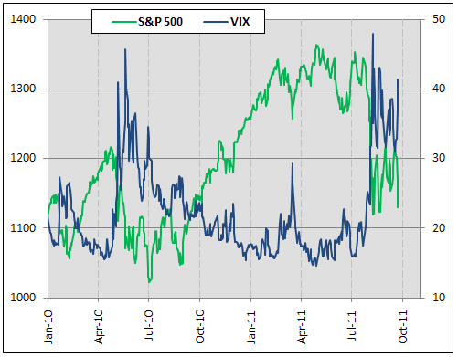
Market Risk Premium:
VIX vs. S&P 500 snapshot
Remember: price and expected return are
Inversely related
Notes:
http://www.stock-options-made-easy.com/images/wi-hedging-1.gif

Slide 22
Security Market Line (SML)

Slide 23
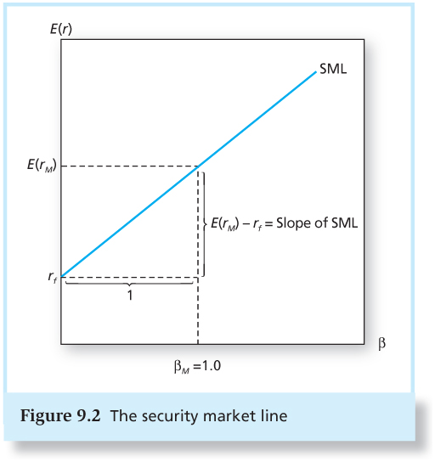
Plotting the SML
SML plots the expected return
for all assets in relationship to beta
Notice the difference
between the CML and the SML:
CML plots the expected returns
for the optimal combinations
of the market and risk-free
in relationship to portfolio SD

Slide 24
Simple Example
Apple
Beta = 1.26
Wal-mart
Beta = 0.40
These are approx. their estimated betas. Do they make sense?
Assume the expected return on the market is 11% and risk-free rate is 3%
Find the CAPM expected return for these two stocks

Slide 25
Example answer

Slide 26
SML and Alpha
CAPM predicts that alpha is zero for all securities
In the real world, securities may have non-zero alphas:
If a security has an expected return greater (smaller) than predicted by the CAPM, we say it has positive (negative) CAPM-alpha

Slide 27
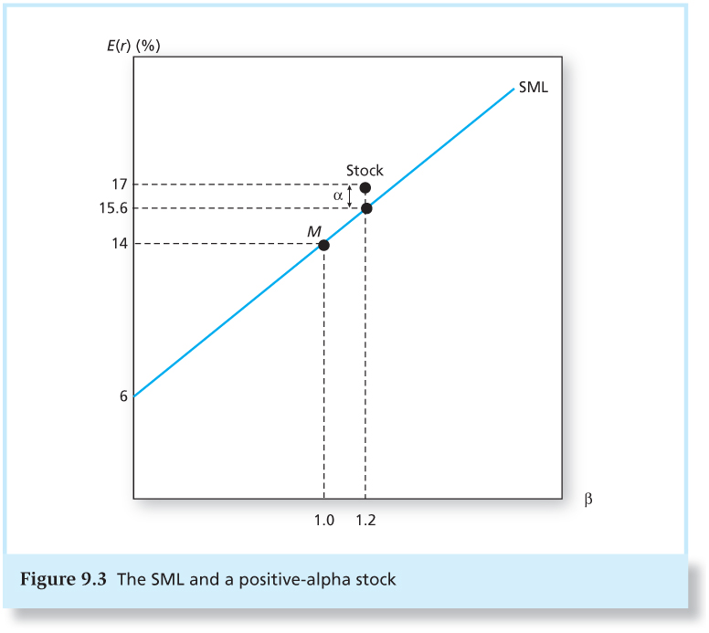
CAPM and Alpha

Slide 28
Simple Example
Apple
Expected return = 7%
Wal-mart
Expected return = 7%
Find the alphas for these two stocks.
Alpha = Actual Expected return – CAPM Expected Return

Slide 29
Example answer

Slide 30
Testing the CAPM

Slide 31
Testing the CAPM
To test the CAPM, we test whether or not alpha is equal to zero for a set of test assets
To do this, we compare the test assets’ average excess returns to the return we would expect based on the asset’s estimated beta and the market average excess return
Individual assets are very volatile, which makes estimating coefficients with any precision difficult
Instead, typically, sort stocks into portfolios based on some characteristic like past beta, firm size and/or book-to-market and use the portfolios as our test assets
E.g., a portfolio of high b/m stocks, a portfolio of mid b/m stocks and a portfolio of low b/m stocks.

Slide 32
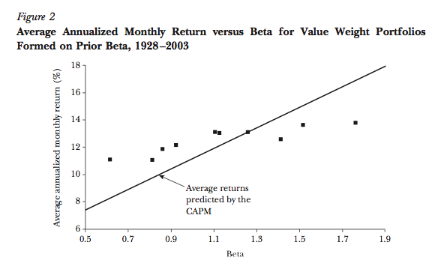
Fama & French (2004)

Slide 33
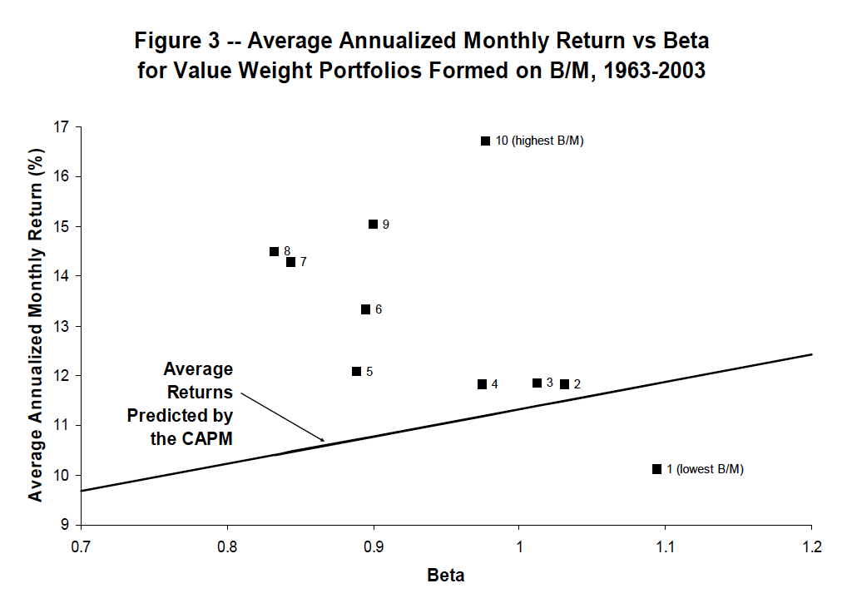
Fama & French (2004)

Slide 34
Description of Plot
Each year, sort stocks into 10 portfolios based on their B/M
B/M = Book value of equity/ market value of equity
Calculate the value-weighted return for each of the 10 portfolios each month over the next year
Value-weighted: each stock’s weight is proportional to its market value
Create a time-series over the entire sample period for each decile portfolio
Regress each portfolio’s returns on a market index to estimate beta. [this is the x-axis]
Use returns for the entire sample period
Calculate the average monthly return and annualize it [this is the y-axis]
Use returns for the entire sample period

Slide 35
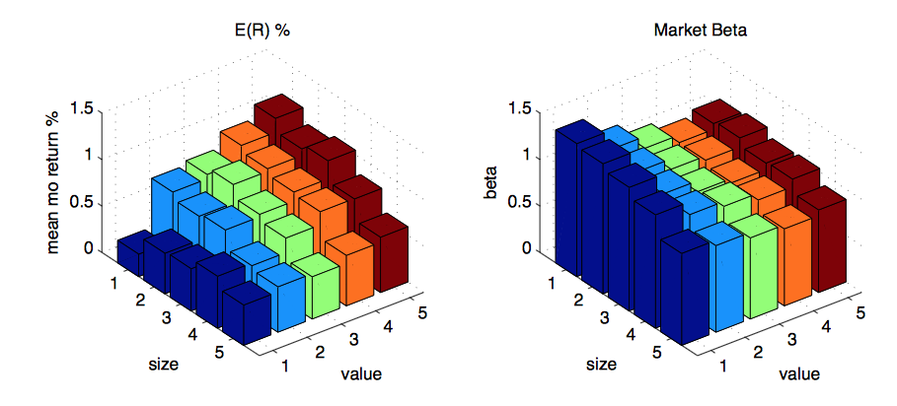
From solutions to Asset Pricing by John Cochrane
Notes:
http://faculty.chicagobooth.edu/john.cochrane/teaching/35904_Asset_Pricing/ff_problems_answers.pdf

Slide 36
CAPM Evidence
There is little evidence that expected returns are increasing in estimated betas
Why?
Econometric issues
Many of the CAPM assumptions do not hold
Investors do not have homogenous beliefs
May care about more than mean and standard deviation of returns
There are transaction costs

Slide 37
Why Does the CAPM Fail?
Betas can change over time
Betas can change in response to economic conditions (conditional CAPM)
There may be other risk factors that are priced that the market factor does not capture
There are stock characteristics that predict returns better than the CAPM (book-to-market, size, momentum, firm investment and profitability, liquidity)
Are they capturing other risks?

Slide 38
Why Study the CAPM?
To build a framework for thinking about risk and return
Investors care about the risk in their entire portfolio (the risk exposure of their entire wealth)
Not SD of individual asset returns
Investors like assets that payoff when their wealth (portfolio) is relatively low more than assets that payoff when their wealth (portfolio) is relatively high
Lower expected returns for assets that payoff in bad times

Slide 39
Why Study The CAPM?
CAPM is widely used by firms to calculate costs of capital
Mutual fund investors appear to use CAPM-alpha as a measure of mutual fund managers skill. Invest more in funds with higher CAPM-alpha.
Berk and Van Binsbergen (2014) Barber, Huang and Odean (2014)
CAPM betas are ubiquitous in the financial world
Notes:
http://papers.ssrn.com/sol3/papers.cfm?abstract_id=2340784
http://papers.ssrn.com/sol3/papers.cfm?abstract_id=2408231

Slide 40
Summary
Investor’s make investment decisions in relation to their entire portfolio
Risks that affect the riskiness of their portfolio will be priced, idiosyncratic risks will not
Each security and portfolio will have the same ratio of risk premium to covariance with the market portfolio

Slide 41
Next Class
Extending the theory:
Consumption CAPM
More general stochastic discount factor (pricing kernel) approach
Portfolio Optimization with a CAPM prior (Black-Litterman)

