Slide 1
✖
✔
✔
✔
✔
✔

Slide 2

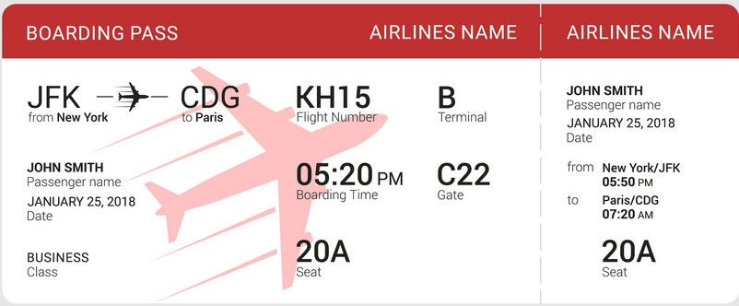
_{BOARDING PASS}
New York
Guangzhou
CA0001
1
Jack
Passenger name
from
to
Flight Number
Terminal
2022/5/19
Date
Jack
05:20
C22
from
New York
05:50
Passenger name
Gate
2022/5/19
Boarding Time
Guangzhou
17:50
Date
to
Seat Premium
20A
20A
Class
Seat
Seat

Slide 3
_{BOARDING PASS}
Passenger name
from
to
Flight Number
Terminal
Date
Passenger name
from
Boarding Time
Gate
Date
to
Class
Seat
Seat

Slide 4
×
×

