Slide 1

Crypto Flash A world of wonders
BY Team TG_Magnificent

Slide 2

OUTLINE
INTRODUCTION
PROBLEM STATEMENT
AIM AND OBJECTIVES
PROJECT’S UNIQUENESS
METHODOLOGY
SYSTEM DESIGN: HOW THE CRYPTO FLASH WORKS
RESULTS
SYSTEM EVALUATION
CONCLUSION
LIMITATION AND RECOMMENDATION
REFRENCES

Slide 3
INTRODUCTION
The purpose for development of the block chain application is to provide a faster and more secured way of transacting business.

Slide 4
PROBLEM STATEMENT
The of waiting on a queue for a very long time to get a thing. E.g Transportation, Super-Market, P2P transactions etc.

Slide 5
AIM AND OBJECTIVE
AIM: This project is to develop and implement a blockchain application.
OBJECTIVE: The objectives of this project are to:
Connecting react application to the blockchain.
Pairing Meta mask to Ethereum wallet.
Evaluate the performance of the blockchain application.

Slide 6
PROJECT’S UNIQUENESS
Usage of web 3.0

Slide 7
METHODOLOGY
Use of react, Vite.js, Node.js, Virtual Studio
Code, Meta mask extension and a web browser.

Slide 8
SYSTEM DESIGN: HOW CRPTO FLASH WORKS
Localhost via CLI.
One can buy a hosting and a domain to lunch it to the internet

Slide 9
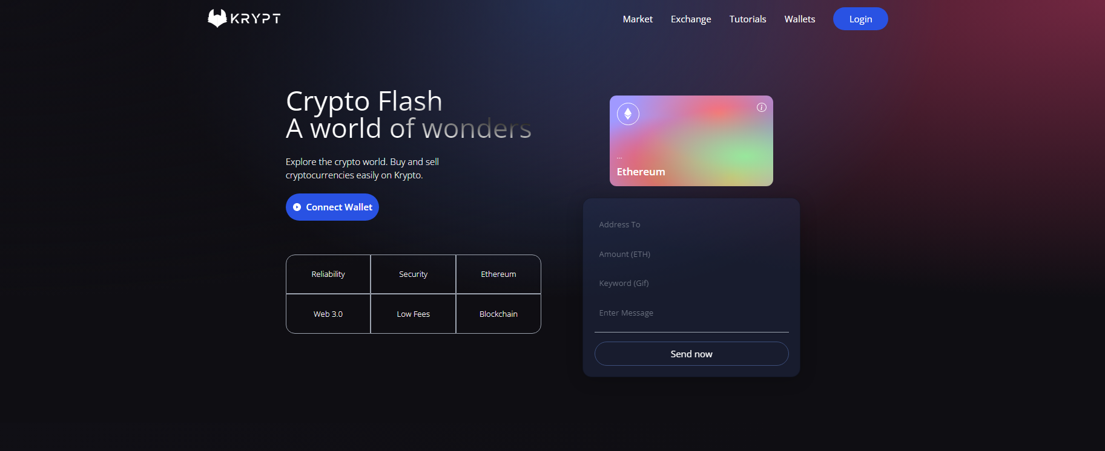
Crypto Flash
RESULTS

Slide 10
SYSTEM EVALUATION
The established system is analyzed using queue theory. :
ρ ​​ = ​ λ /μ , where λ = 0.3333, 0.2 and 0.1 respectively for three time instances and µ = 10
ρ = 0.3333/10, for inter-arrival time of 3 minutes
ρ = 0.2/10., for inter-arrival time of 5 minutes
ρ = 0.1/10., for inter-arrival time of 10 minutes
Instance 1 = (7:30AM - 9:30AM and 4:30PM – 6:30PM) ρ = 0.03​
Instance 2 =) (9:31AM to 4:29PM) ρ = 0.02
Instance 3 = ​(6:30AM - 7:29AM and 6:31PM – 10PM) ρ = 0.01

Slide 11
SYSTEM EVALUATION
computed for the three instances as follows:
ρ = λ/ µ , where λ = 0.66666 (1/6) customers per minutes arrive at the shuttle stance and µ = 10 customer per minutes second are served
ρ = 0.06

Slide 12
Proposed System
SYSTEM EVALUATION
Established System

Slide 13
CONCLUSION
To conclude, Crypto flash uses web3.0 in quick payment of a services and thus this fulfills SDG 9

Slide 14
RECOMMENDATION
More ideas and concepts on block chain.
Better programming language.

Slide 15
RERENCES
https://github.com/Jerryblessed/Crypto-Flash

Slide 16


