Slide 1
Business Plan
Business Title: Institute based shuttle management system (IBTROS)
Name: Jeremiah Ope
Phone number: 09053517461
State code: FC/23A/1729
Call-Up number: NYSC/CVU/2023/004086
Email: jeremiah.ope@stu.cu.edu.ng

Slide 2
Table of content
Executive Summary
Introduction
Problem Statement
Target Audiece
Personas
Feedback and system evaluation
How it works
Core technology
Business Plan and financial analysis
Competitions
Business Model and Business model canvas
References

Slide 3
Executive Summary
IBTROS is a business which its sole purpose is to give people in institutions access to cheap and fast-to-call vehicle ride for transportation purpose. The idea came up through Covenant University shuttle system. The industry size currently is less than 10 workers and hope to reach more than 200 worker by the year ending. The major challenge is workers and students in institute lacking access to shuttle for eveday task due to financial constraints. IBTROS provided cheap vehicle ride. The funding for the project is 800,000N and this would be used for cost including: software backend deployment cost, database storage cost, web hosting cost, RFID production cost , labor cost and other charges .The revenue projected for the first and second year is 11,000,000N and 12,000,000N respectively.

Slide 4
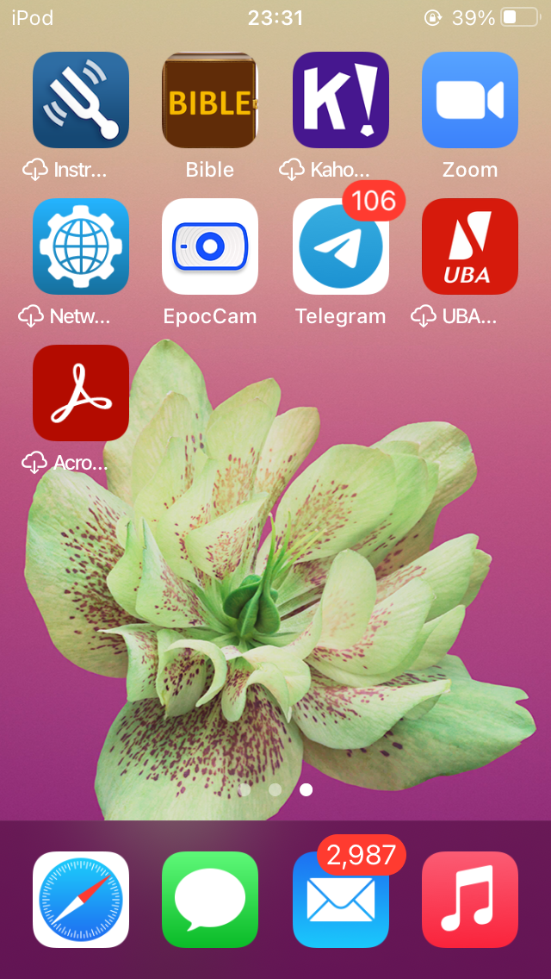
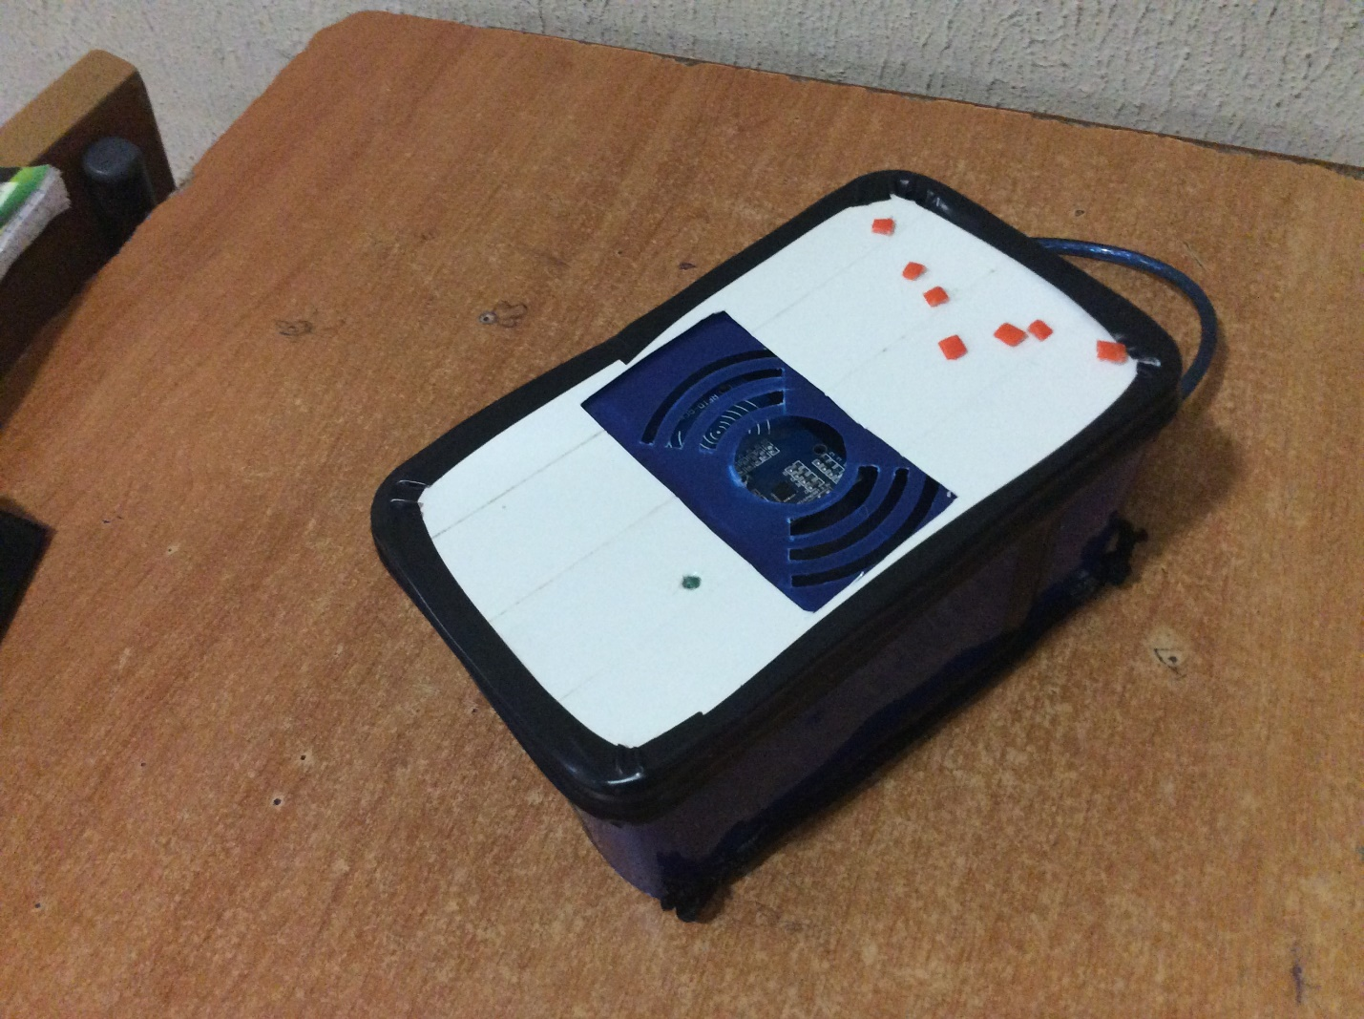
Introduction
A system which uses Telegram bot and Radio frequency identification system (RFID) to call and make payment for quick and accessible shuttle rides for institutions.
Fig 1: RFID Reader.
Fig 2: Mobile device interface with telegram app.

Slide 5
Problem Statement
Slowness in queing for shuttle
Funding Constaints [1]
Underutilization of shuttles and vehicles.
Target Audience
Workers and Students in instituttion are the target audience. IBTROS will be using telegram mobile application which has 700million users globally [2].
Persona 1: Emmanuel, National Youth Service corper
Student name: Emmanuel Musa
Place of primary assignment: Educational institute.
Demographics: 24 years old, lives around a university campus, comes from a middle-income-level family.
Challenge: The distance between campus and work place is a challenge he needs to overcome due to cost.
Pain point: cost of transportation

Slide 6
Persona 2: Jousha, a Farmer
Student name: Jousha Ore
occupation: Farming
Demographics: 28 years old. Lives in Nigeria, From a middle-income family.
Challenges: Lack of efficient ways to deliver his farm produce to the market
Pain point: Transportation shortage
Feedback
CU was used as case study and the project’s core concept was pitched to about 9 people. 7 were cutomers and 2 were drivers. For customers, It was observed that what is needed is an quick payment method like a mixture of RFID tag and electronic vouchers to make quick payment. Also, a need to have an admin who will oversee the entire project from a point of view.

Slide 7
Feedback
For drivers, I learned about the times shuttle operate, the amount of cars and their policy. This data was used to carry out test from slides 6 - 10 using Queue thory.
Feedback
Queue thoery is the mathemical studies of waiting on queue [3].
Fig 3: Queuing theory Formulas.

Slide 8
FEEDBACK AND SYSTEM EVALUATION
The project was tested out using queue thoery’s utilization factor, a mesure to know how well a system is being utilized. Since the formula for utilization factor in queue is the same for both single queue multiple server and single server single queue systems, three inter-arrival time instances of CU shuttle’s most occupied time was analysied.
ρ ​​ = ​ λ /μ , where λ = 0.3333, 0.2 and 0.1 respectively for three time instances and µ = 10
ρ = 0.3333/10, for inter-arrival time of 3 minutes
ρ = 0.2/10., for inter-arrival time of 5 minutes
ρ = 0.1/10., for inter-arrival time of 10 minutes
Instance 1 = (7:30AM - 9:30AM and 4:30PM – 6:30PM) ρ = 0.03​
Instance 2 =) (9:30AM to 4:30PM) ρ = 0.02
Instance 3 = ​(6:30AM - 7:30AM and 6:30PM – 10PM) ρ = 0.01

Slide 9
SYSTEM EVALUATION
The proposed system is analyzed using queue theory. Since utilization factor is same formula for both single queue multiple server and single server single queue the analysis using the three instances is given below.
computed for the three instances as follows:
ρ = λ/ µ , where λ = 0.66666 (1/6) customers per minutes arrive at the shuttle stance and µ = 10 customer per minutes second are served
ρ = 0.006
The efficiency of the proposed system at λ = 0.3333.
The service rate should be doubled since it would take about 2—3 seconds to use RFID system
P = 1 - λ / µ. Where λ = 0.333, µ = 10 * 2 = 20
P = 1 – 0.666/20 = 0.96666. i.e. 0.96667 * 100 = 96%.
Efficiency = 96 percent efficiency

Slide 10
SYSTEM EVALUATION
The efficiency of the normal system at λ = 0.6666.
P = 1 - λ / µ. Where λ = 0.6666, µ = 10 = 10
P = 1 – 0.3333/10 = 0.9334. i.e. 0.9334 * 100 = 93.34%.
Efficiency = 93 percent efficiency
The efficiency of the proposed system at λ = 0.6666.
The service rate should be doubled since it would take about 2—3 seconds to use RFID
P = 1 - λ / µ. Where λ = 0.66666, µ = 10 * 2 = 20
P = 1 – 0.666/20 = 0.96666. i.e. 0.96667 * 100 = 96%.
Efficiency = 96 percent efficiency

Slide 11
Proposed System
SYSTEM EVALUATION GRAPH
Existing System
The graph shows that the proposed system is being utilized to the maximum while the existing system isn’t utilized to the maximum. Hence the proposed system gives more money to the drivers and makes customers access shuttle more easily
Fig 4:
Fig 5:
Fig 6: Graph line
Fig 7: Graph Line

Slide 12
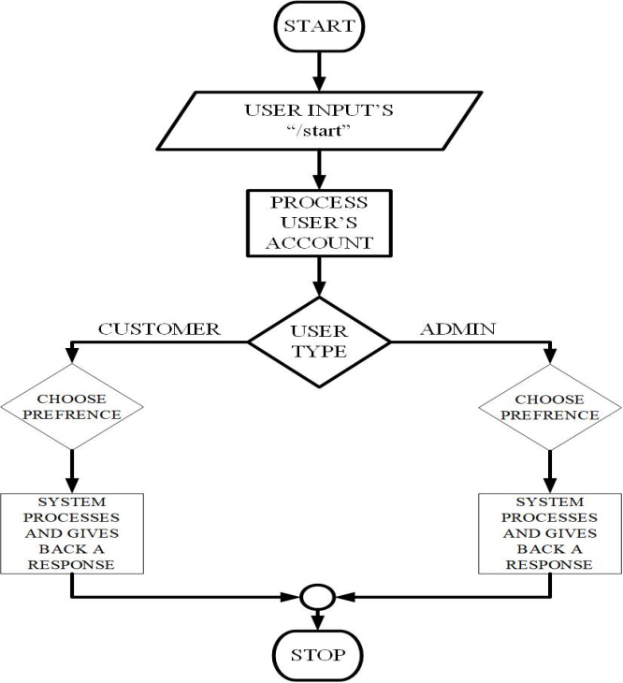
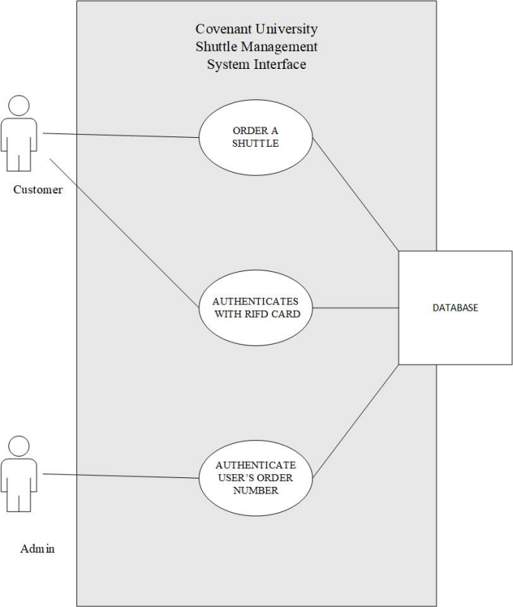
How it works
Unique location routes is been assigned to different drivers. Students and workers can for a cheap price use these unique vehicles as transportation to there destination.
Fig 8:
Flow chart of shuttle management system
Fig 9:
Flow chart of shuttle management system

Slide 13

RFID payment system
How it works
The figure above is an RFID payment system and it gives a buzzing sound for an invalid user and an LED comes up for the authenticated user.
Fig 10:

Slide 14
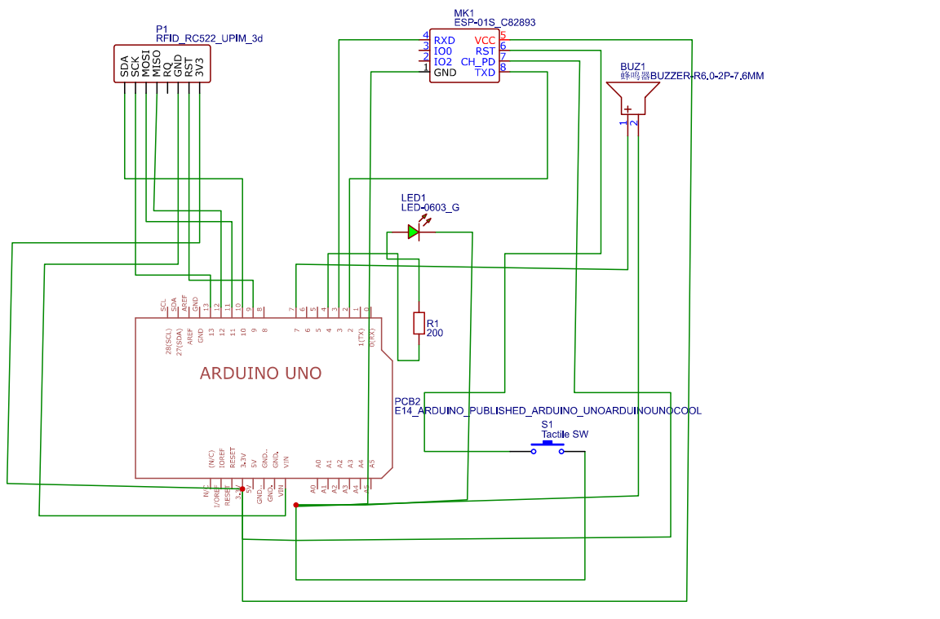
SCHEMATIC DIAGRAM OF THE SHUTTLE MANAGEMENT RFID PAYMENT SYSTEM
Fig 11: Arduino Uno

Slide 15
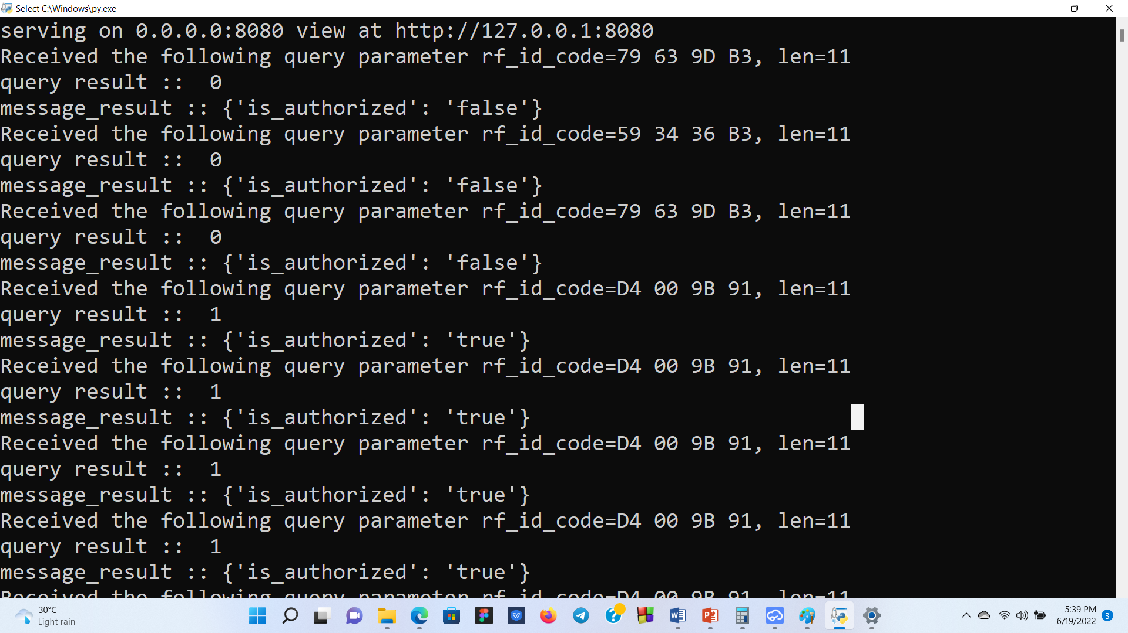
RFID payment system backend user’s interface
How it works
The figure above shows the user interface of the payment system of the RFID for administrator. The Boolean true is for “1” which means the RFID card/tag is valid and the Boolean false is for “0” which means the RFID card is not a valid card/tag.
Fig 12:

Slide 16
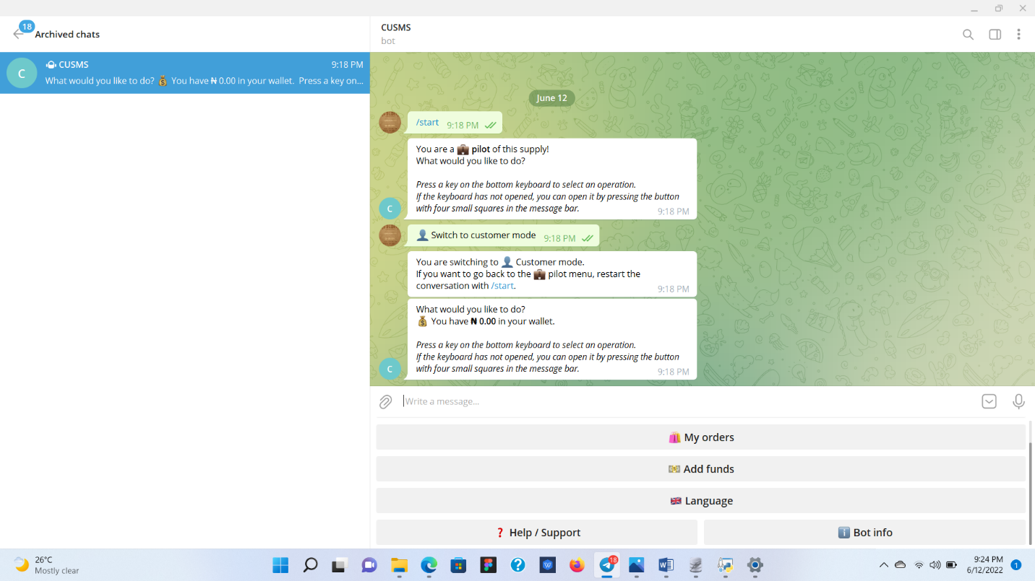
How it works
Customer’s interface.
Fig 13:

Slide 17
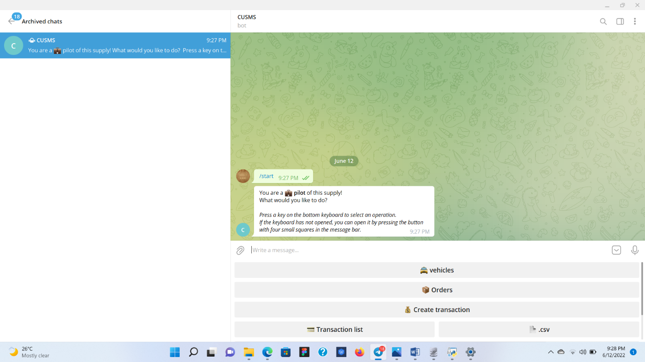
How it works
Admin’s interface.
Fig 14:

Slide 18
Core Technologies
Telegram software
myQLite for local database
Azure for online database
RFID Tags and readers
Arduino Uno Integrated development Environment (IDE)
Arduino Uno
Python Programming Language
The Business Plan
IBTORS would use telgram bot and later use mutiple meduim like mobile and web applications. More profit should be made in year 2 because of corrections of business weak spot identified in the months.
Identity cards can be used as RFID tags. University tution fee can be added for shuttle ride fee hence students would easily access shuttle. Mutlitple payment methods including electronic vouchers, RFID swiping and cash note. Since it is a shuttle system majorly for institutions, rides would be cheaper. And becuase it is a shuttle software application records would be taken for transactions.

Slide 19
Financial analysis
 |  | Year 1 (N) | Year 2 (N)
 | Revenue (A)
A1 | Revenue from products and services | 10,000,000 | 11,000,000
A2 | Other sources of revenue if any | 1,000,000 | 1,000,000
B | TOTAL REVENUE (A1+A2) | 11,000,000 | 12,000,000
C | Cost of Goods Sold (raw material and labor) | 6,000,000 | 5,000,000
D | Gross profit (B-C) | 5,000,000 | 7,000,00
 | Operating expenses (E)
E1 | Rent | 1,000,000 | 1,000,000
E2 | General and Adm expenses | 2,000,000 | 2,000,000
E3 | EQUIPMENT AND TOOLS | 500,000 | 500,000
E4 | Other Operational expenses | 500,000 | 500,000
F | Total Operating Expenses (E1+E2+E3+E4) | 4,000,000 | 4,000,000
G | Operating Profit (D-F) | 1,000,00 | 3,000,000
 | Financing Expenses (H)
H1 | Income tax | 200,000 | 200,00
H2 | Loan Repayment/Shareholder payment if any | 0 | P
I | Total Financial Expenses (H1 + H2) | 200,000 | 200,000
J | Net Income (G-I) | 800,000 | 2,800,000

Slide 20
Financial analysis
Capital Requirements: 800,000 N ◦ Revenue: 11,000,000N for year 1 and 12,000,000 for year 2 ◦ Gross Profit: 5,000,000 N and 7,000,000 for year 1 and 2, respectively ◦ Net Profit: 8,000,000 N and 2,000,000 N for year 1 and 2, respectively.

Slide 21
Competition
Uber and bolts are competitors in the business but IBTROS hope to use telegram bot which provides quick solution to ride request. IBTROS will be using multiple payment medium such as evocuheres, RFID system and currency note.
The Business Model
Telegram would be used because it is a chat software hence more users are on the platform. It is used in Covenant Univiersity and other varous institutions.
Money would be made for IBTROS through charges incured upon drivers.
Service would be sustained by offering ride for cheaper prices to customers and better shuttle systems to both customer and drivers.
By usage of Azure technologies for data storage, IBTROS can get institutions around the world to get a quick solution to storing large amount of their transaction data.
IBTROS will be partnering with existing shuttle other existing shuttle provider comanies.

Slide 22
The Business Model Canvas
 |  |  |  |  | Designed by: |  | Date: |  | Version:
Business Model Canvas |  |  |  |  | Ope Jeremiah |  | 10/31/22
Key Partners | Key Activities | Value Propositions |  |  | Customer Relationships |  | Customer Segments
School drivers , bus drivers and other shuttle car providing companies | Telegram application, RFID cards and RFID readers | Ride offering for larger groups at Cheaper price and lesser wait time |  |  | We offer customers on-demand vehicle |  | Workers and student in institutions.
 | Key Resources |  |  |  | Channels
 | Internet connection |  |  |  | Telegram cahtbot and RFID readers
Cost Structure |  | Revenue Streams
RFID card and reader production, web hosting , database storage, backend deployment, mobile application production other charges and labor |  | Money would be made for IBTROS through charges incured upon drivers.
Designed by: The Business Model Foundry (). Word implementation by: Neos Chronos Limited (). License:

Slide 23
References
[1] https://stnonline.com/partner-updates/the-5-biggest-challenges-in-
school-transportation-today/
[2] https://telegram.org/blog/700-million-and-premium
[3] https://en.wikipedia.org/wiki/Queueing_theory

