Slide 1
WebVM Hackthon project
2025
By Team LearnVM

Slide 2
LearnVM
Linux Education, Reinvented in Your Browser
🚀 Powered by CheerpX & WebAssembly
👨‍💻 Learn by doing. Master Linux with real-time command execution, guided lessons & AI help.

Slide 3


What is LearnVM?
An interactive browser-based Linux LMS
Executes real Linux commands via CheerpX
Built for learners, devs & sysadmins
No installs. No friction. Just LearnVM.

Slide 4
Key features
✅ Real Bash terminal in the browser
✅ Progressive lesson modules
✅ Task-by-task interactive practice
✅ AI-powered assistant (via GPT avatar)
✅ Tracks progress and unlocks achievements

Slide 5
How it works
🧠 CheerpX spins up a virtual Linux instance
📜 React + CodeMirror provide the UI & code editor
🧵 Lesson modules with explanations + expected output
🧑‍🏫 AI Avatar (via GPT) explains commands & helps learners
📡 All in-browser — nothing to install

Slide 6
Tech Stack
React – UI & logic
CheerpX – Linux VM via WebAssembly
Tailwind CSS – UI styling
CodeMirror – Interactive code editing
Azure OpenAI – AI avatar assistant

Slide 7
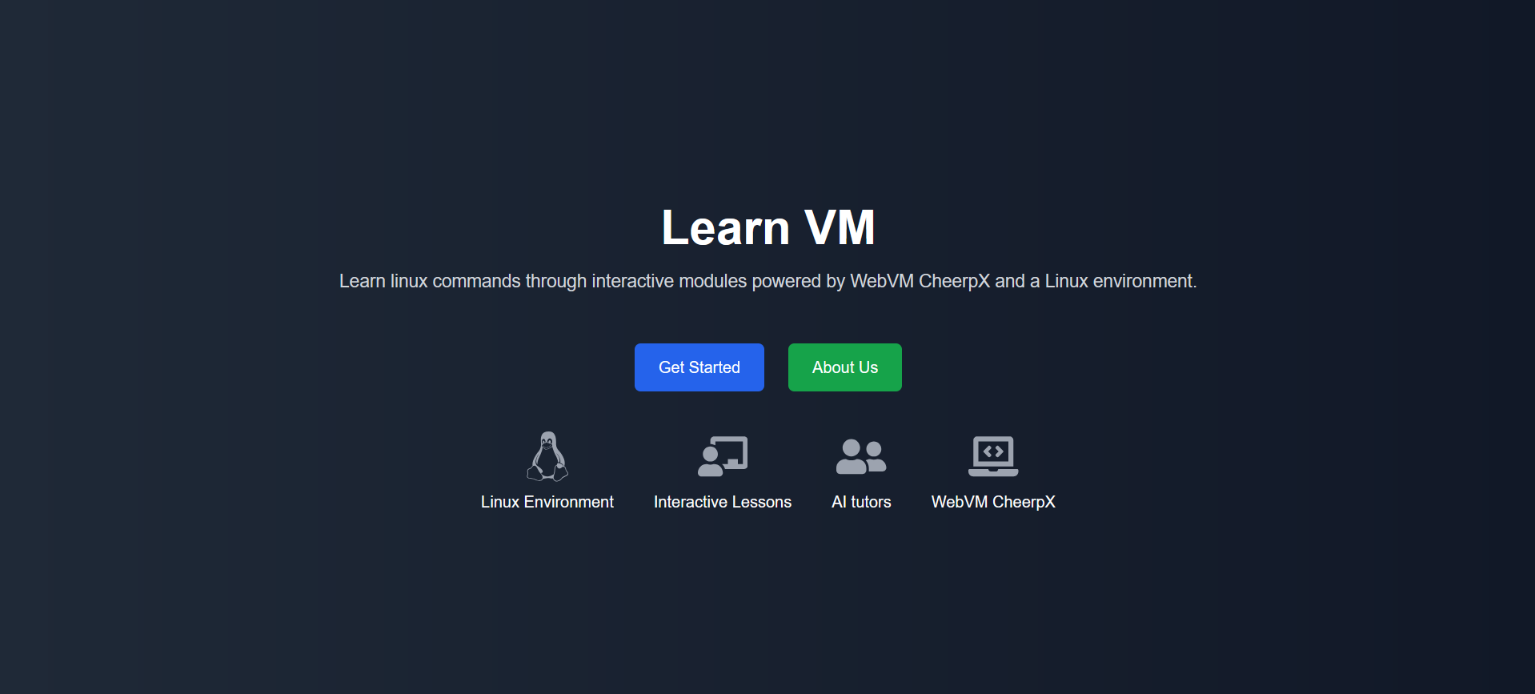

Slide 8
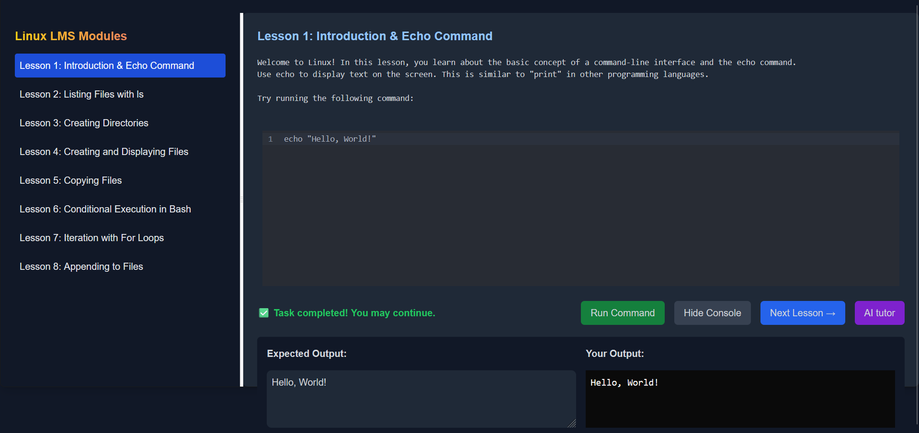

Slide 9
What’s next
🔜 More Modules – Bash scripting, networking, sysadmin
🏆 Quizzes & Certification
🧠 Smarter AI with personalized help
📚 Educator Portal for custom courses
📥 Offline Progress Tracking

