Slide 1
Maze runner
Mingze + Jerry cook.net

Slide 2
Jerry lead
Mingze WHY ARENT U HEREEE
I© am© now© :)© -© Mingze©
Ps©-© no© stealing© my© identity©.©

Slide 3
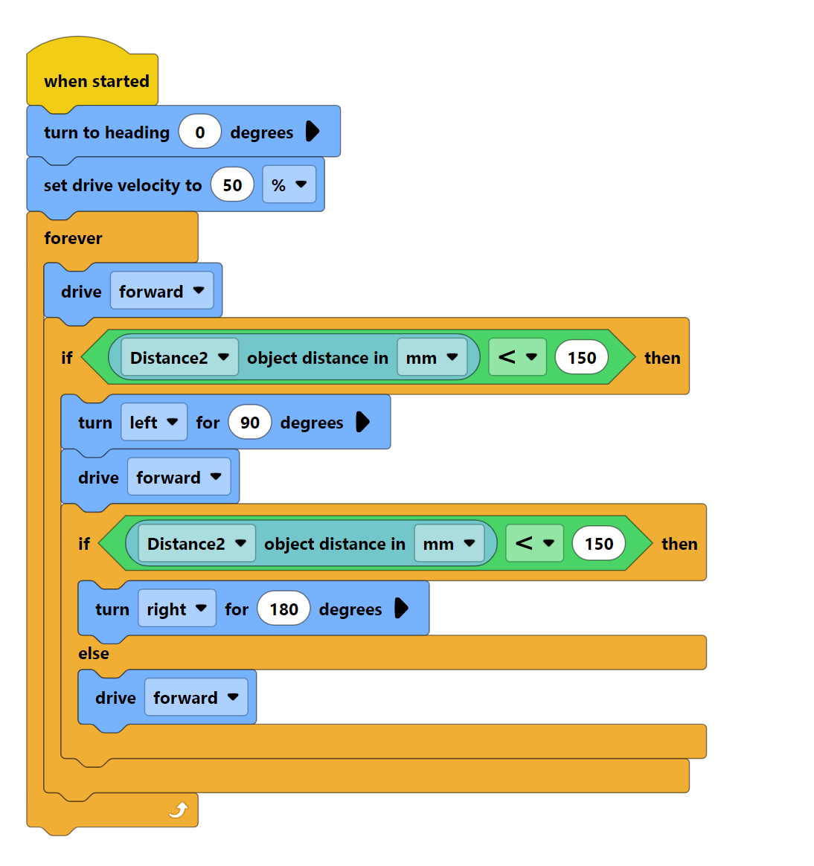
Pheodo
Start
Drive
If wall turn 90
If wall again turn 180
Drive
End

Slide 4
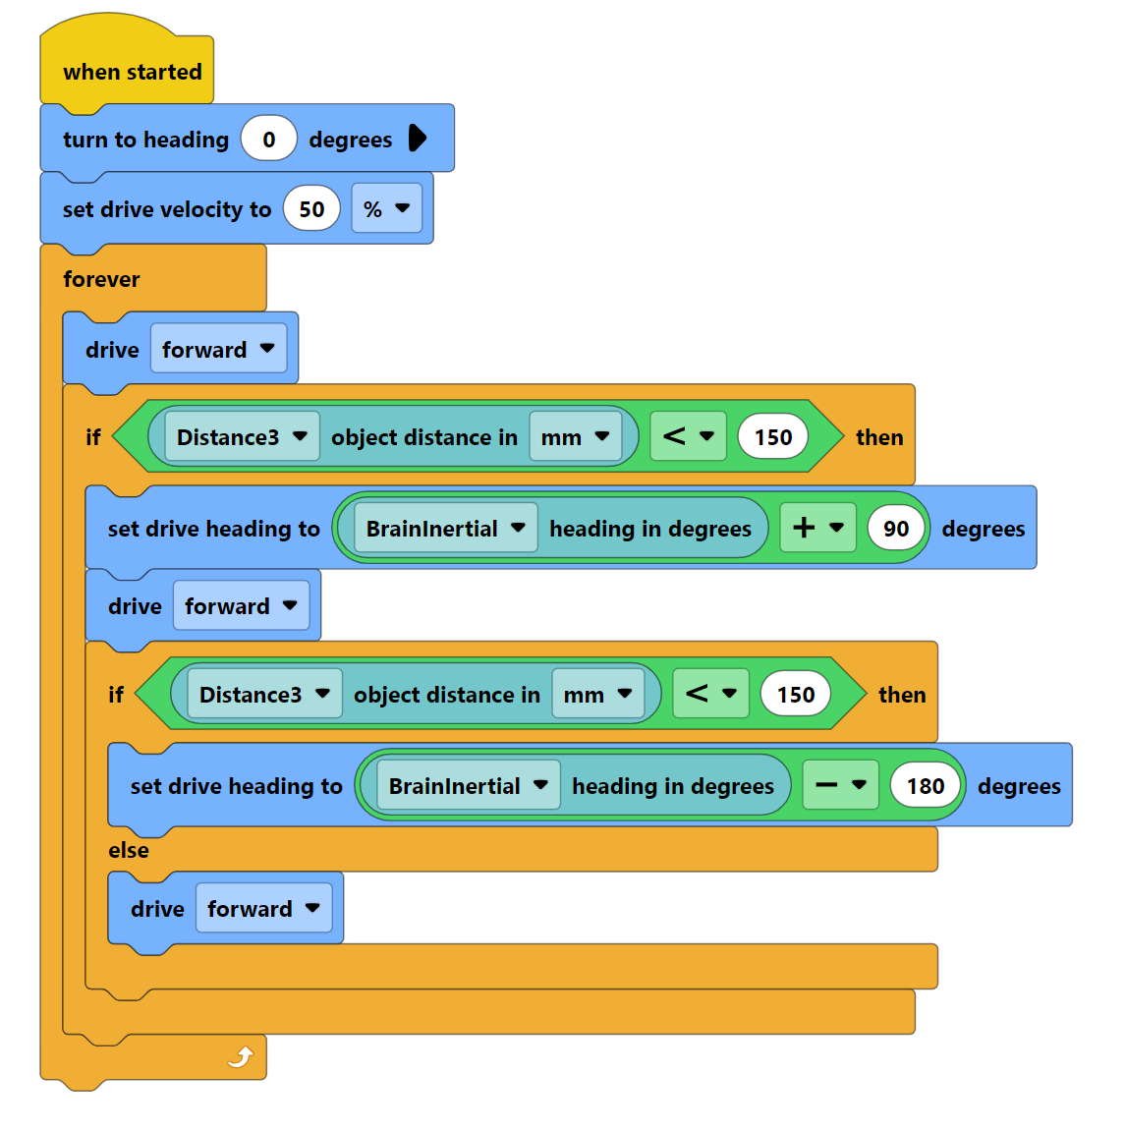
Photo
Start​
Drive ​
If wall turn 90​
If wall again turn 180​
Drive​
End ​
Because last code didn’t work as it didn’t turn exactly 90 degrees

Slide 5
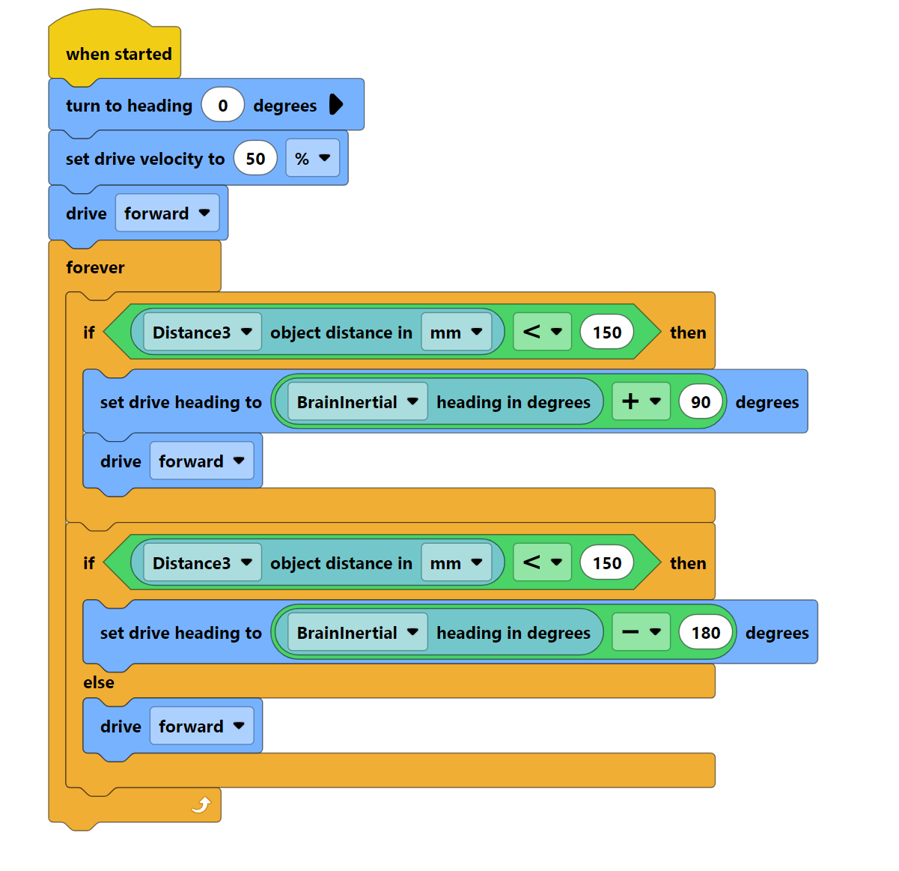
Photo
Start​
Drive ​
If wall turn 90​
If wall again turn 180​
Drive​
End ​
Because last code didn’t work as it didn’t turn exactly 90 degrees

Slide 6
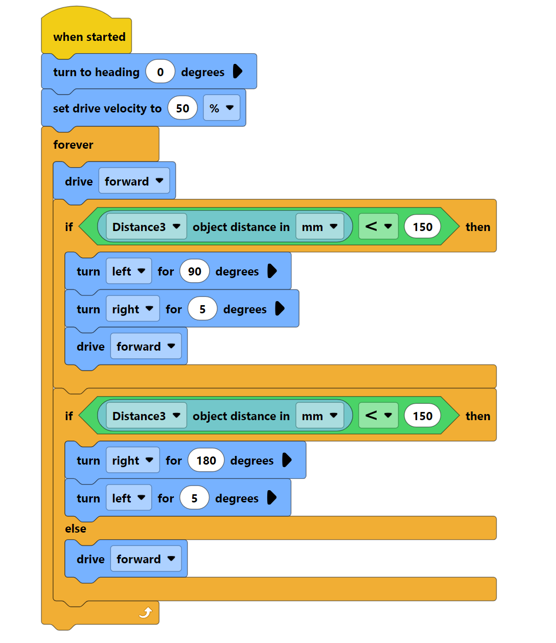
Photo
Start​
Drive ​
If wall turn 90​
If wall again turn 180​
Drive​
End ​
Because last code didn’t work as it didn’t turn

Slide 7
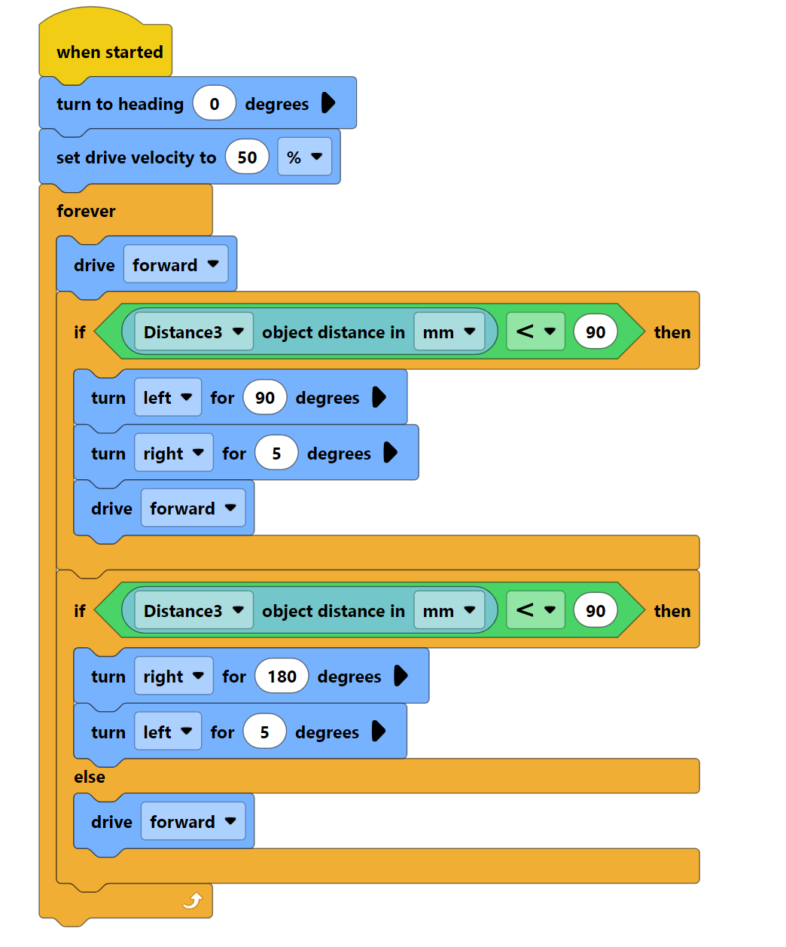
Photo
Start​
Drive ​
If wall turn 90​
Turn 90 will turn to much and turns 5 to go back
If wall again turn 180​
Turn 180 will turn to much and turns 5 to go back
Drive​
End ​

Slide 8
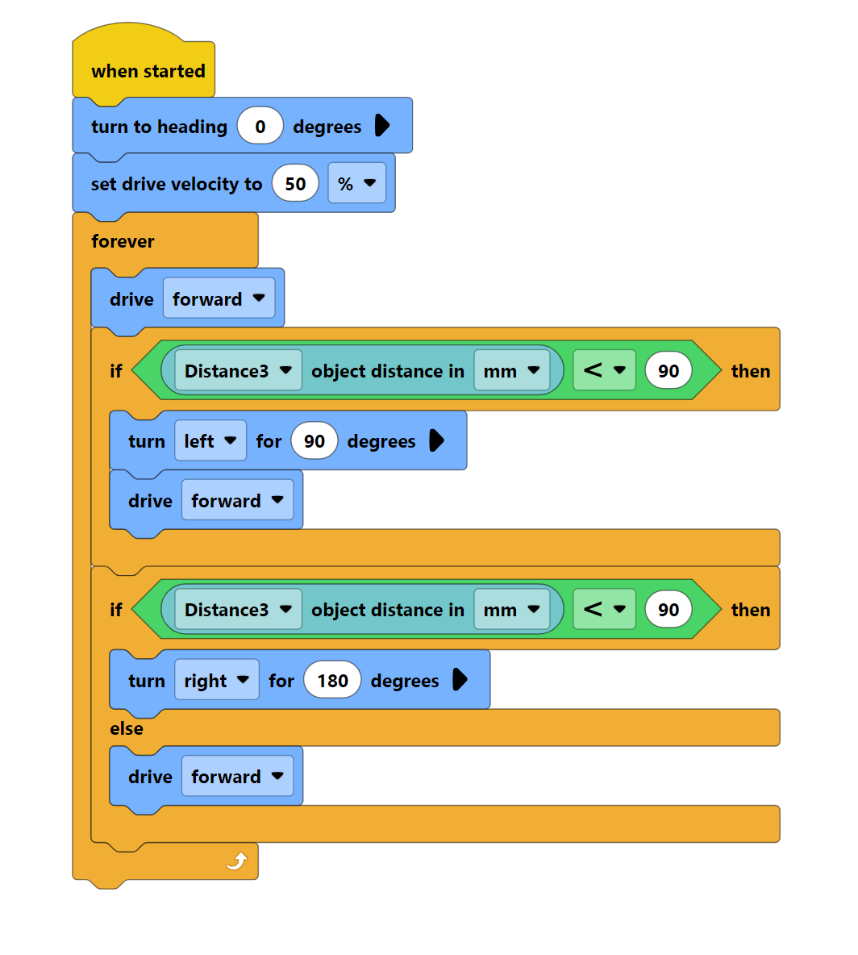
Photo
Start​
Drive ​
If wall turn 90​
If wall again turn 180​
Drive​
End ​

Slide 9
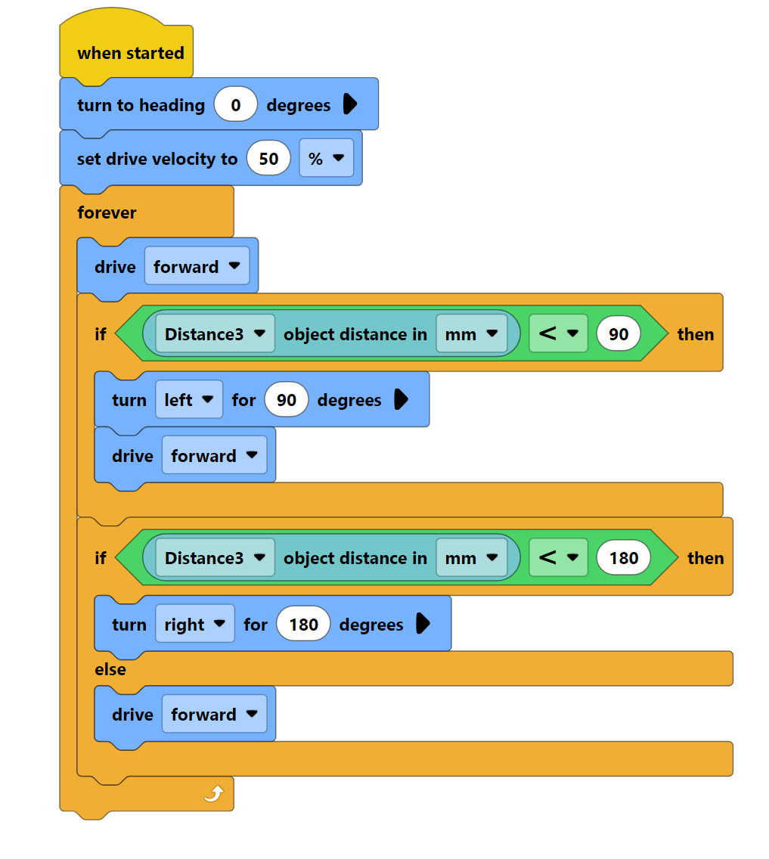
Photo
Start​
Drive ​
If wall turn 90​
If wall again turn 180​
Drive​
End ​

Slide 10
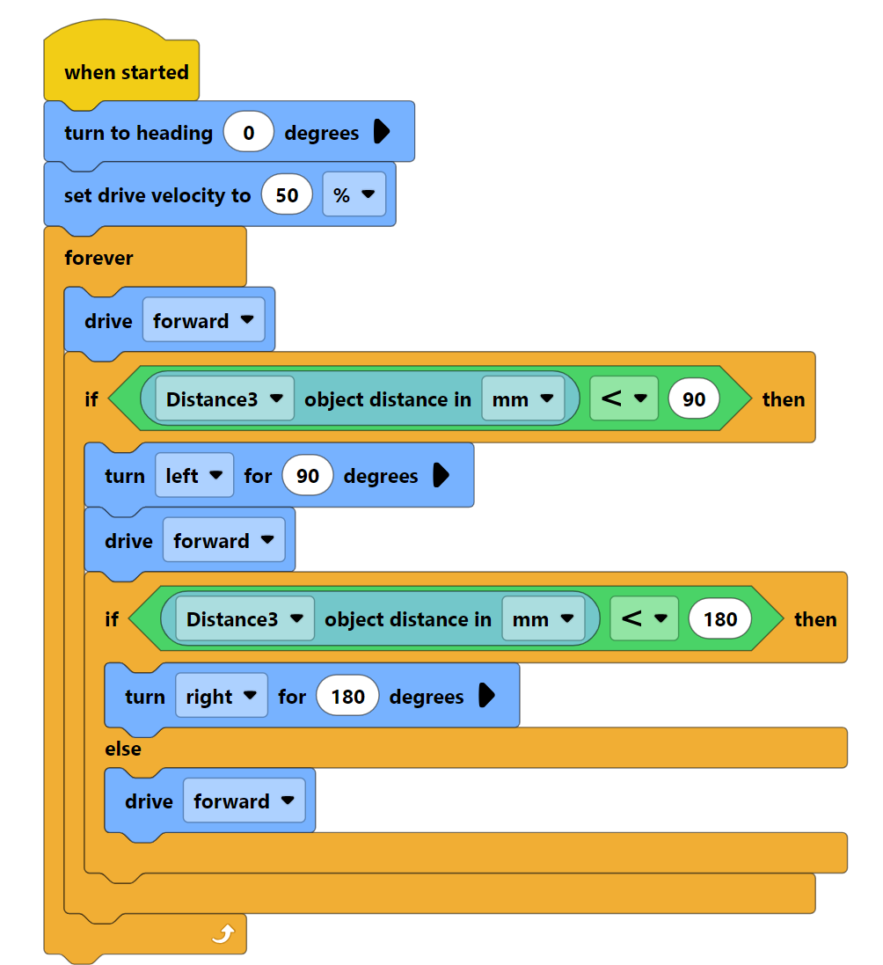
Photo
Start​
Drive ​
If wall turn 90​
If wall again turn 180​
Drive​
End ​

Slide 11
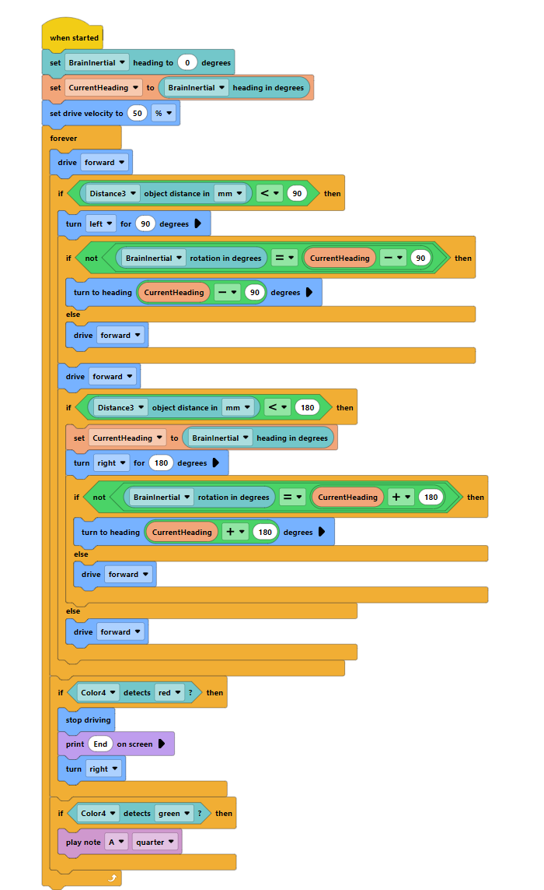
Photo
Start​
Drive ​
If wall turn 90​
If direction isn't direction before turning plus 90, turn to direction before turning plus 90
If wall again turn 180​
If If direction isn't direction before turning plus 180, turn to direction before turning plus 180
Drive​
End ​

Slide 12
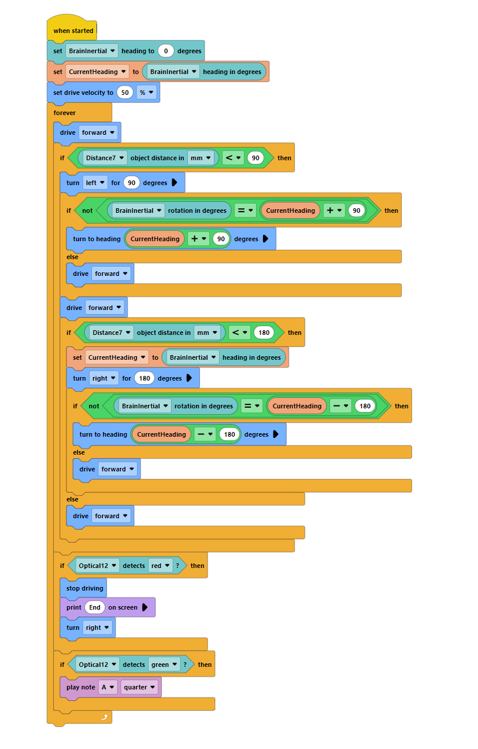
Photo
Start​
Drive ​
If wall turn 90​
If direction isn't direction before turning plus 90, turn to direction before turning plus 90
If wall again turn 180​
If If direction isn't direction before turning plus 180, turn to direction before turning plus 180
Drive​
End ​

Slide 13
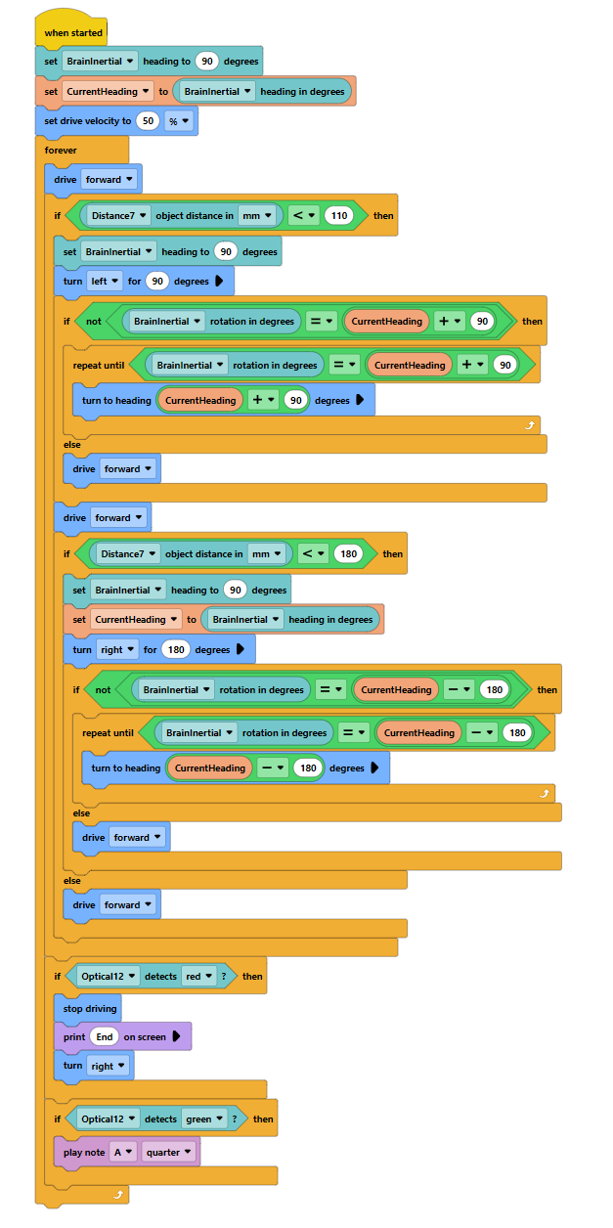
Photo
Start​
Drive ​
If wall turn 90​
If direction isn't direction before turning plus 90, turn to direction before turning plus 90
If wall again turn 180​
If If direction isn't direction before turning plus 180, turn to direction before turning plus 180
Drive​
End ​

Slide 14
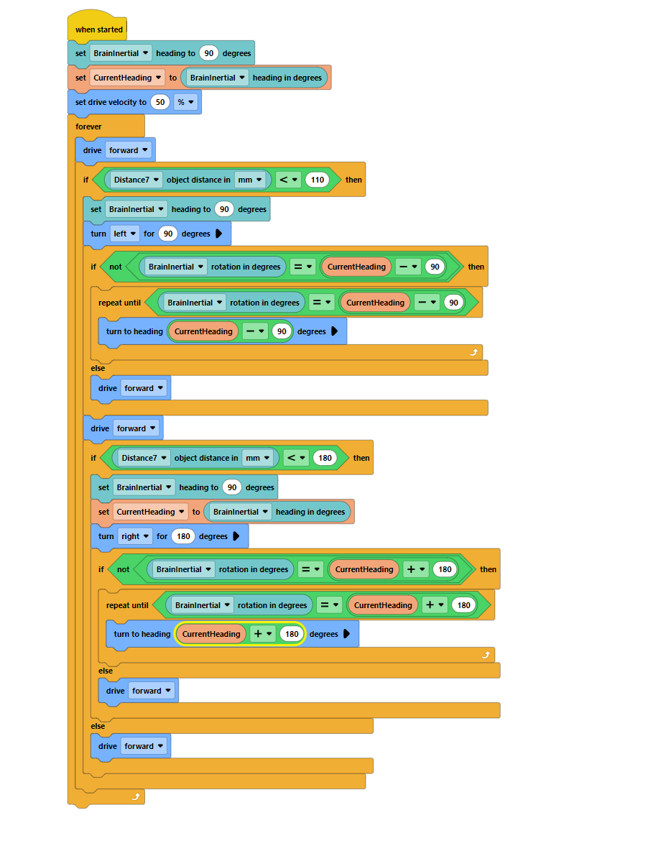
Photo
Start​
Drive ​
If wall turn 90​
If direction isn't direction before turning plus 90, turn to direction before turning plus 90
If wall again turn 180​
If If direction isn't direction before turning plus 180, turn to direction before turning plus 180
Drive​
End ​

Slide 15
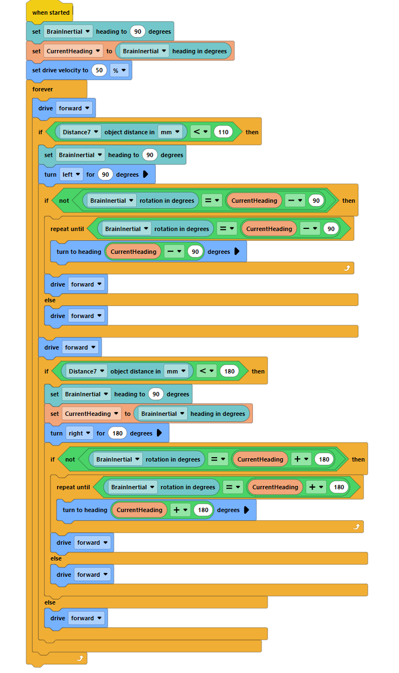
Photo
Start​
Drive ​
If wall turn 90​
If direction isn't direction before turning plus 90, turn to direction before turning plus 90
If wall again turn 180​
If If direction isn't direction before turning plus 180, turn to direction before turning plus 180
Drive​
End ​

Slide 16
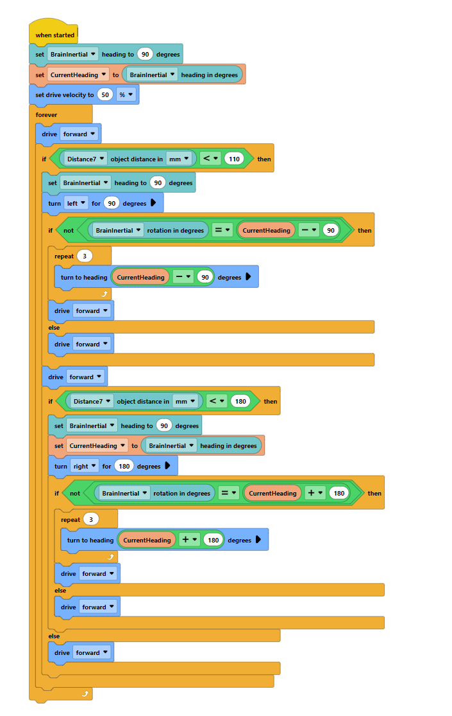
Photo
Start​
Drive ​
If wall turn 90​
If direction isn't direction before turning plus 90, turn to direction before turning plus 90
If wall again turn 180​
If If direction isn't direction before turning plus 180, turn to direction before turning plus 180
Drive​
End ​

Slide 17
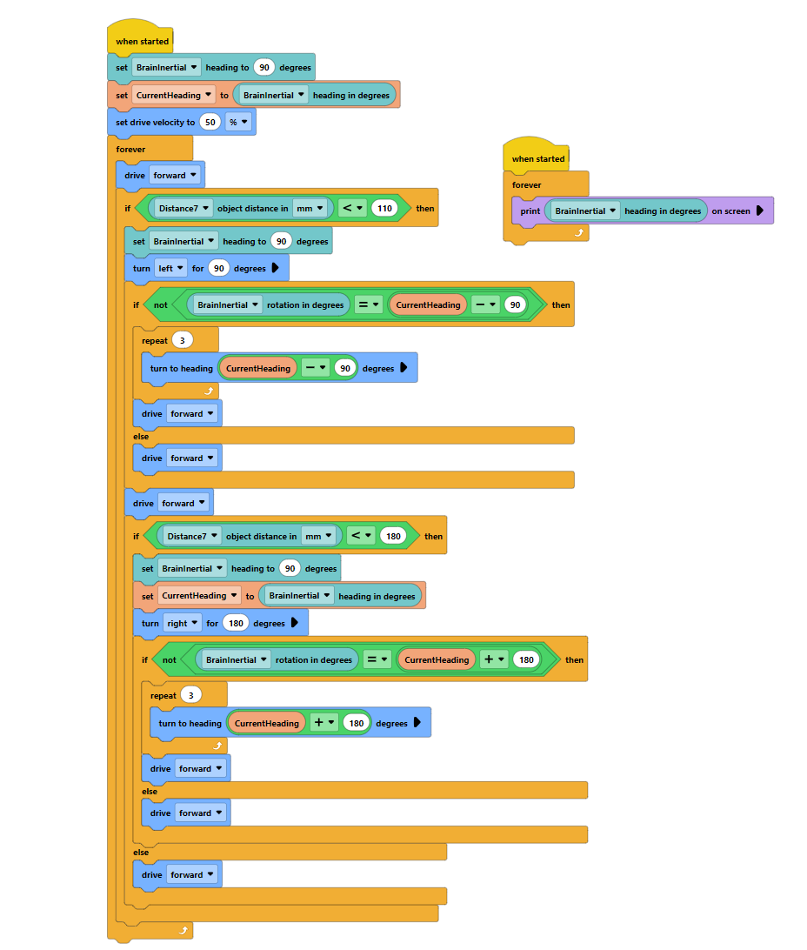
Photo
Start​
Drive ​
If wall turn 90​
If direction isn't direction before turning plus 90, turn to direction before turning plus 90
If wall again turn 180​
If If direction isn't direction before turning plus 180, turn to direction before turning plus 180
Drive​
End ​
Also printing current facing

Slide 18
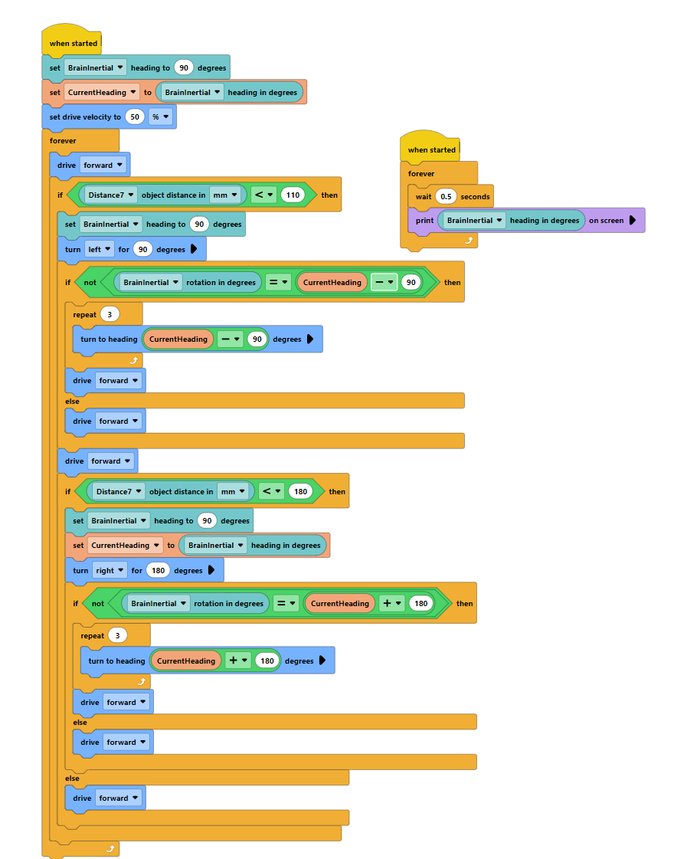
Photo
Start​
Drive ​
If wall turn 90​
If direction isn't direction before turning plus 90, turn to direction before turning plus 90
If wall again turn 180​
If If direction isn't direction before turning plus 180, turn to direction before turning plus 180
Drive​
End ​
Also printing current facing

Slide 19
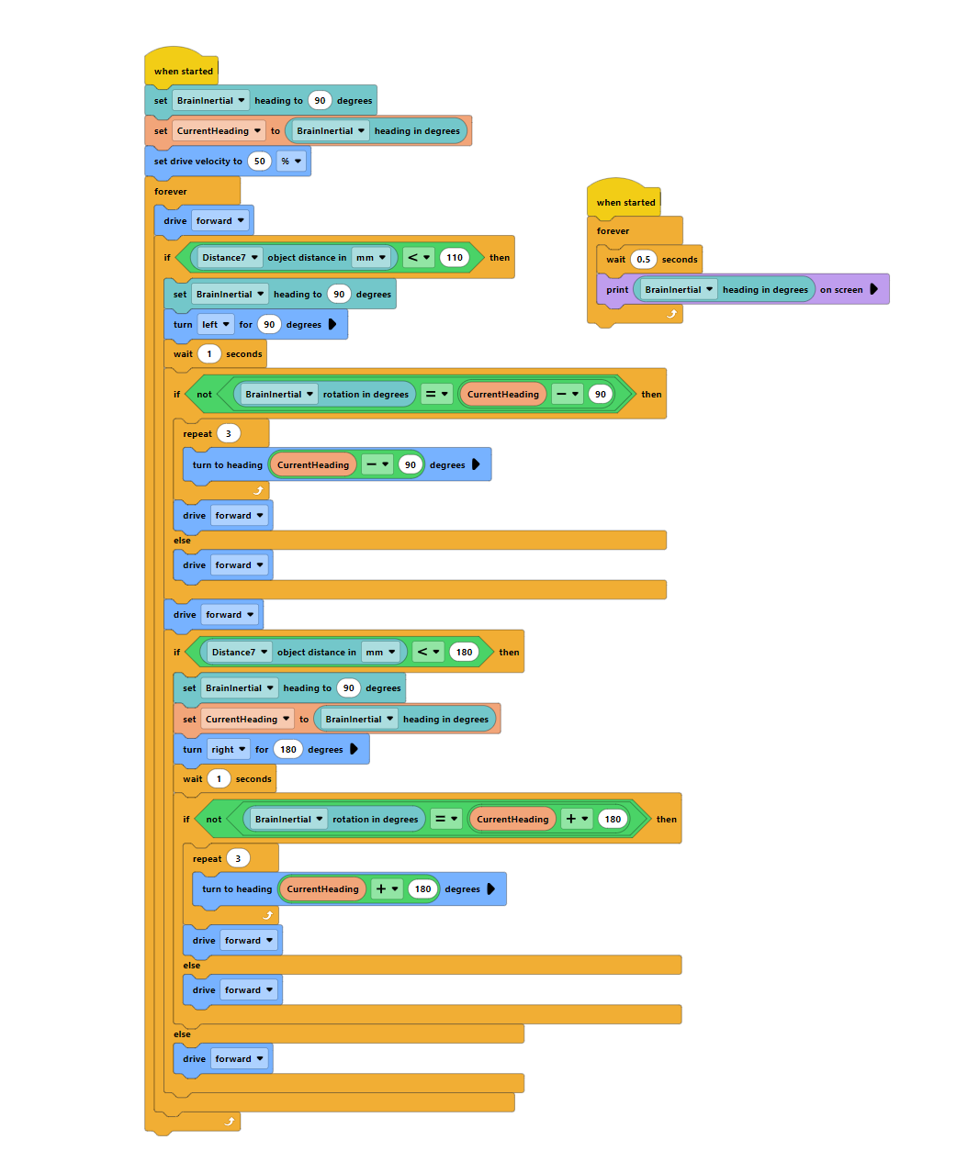
Photo
Start​
Drive ​
If wall turn 90​
If direction isn't direction before turning plus 90, turn to direction before turning plus 90
If wall again turn 180​
If If direction isn't direction before turning plus 180, turn to direction before turning plus 180
Drive​
End ​
Also printing current facing

Slide 20
Flowchart
MTU2MDQ1MDIzMzE3ODEyODQ3NA.G8XO82.kSMco_VZDAayWNe5piDYOxY5A_d4GWpO6oUK4U​

