Slide 1
MRI Segmentation & Analysis Project Final Report
Qingxuan CHEN
3.13

Slide 2
Project Intro
Build up a multi-task learning baseline for MRI segmentation with biased field correction preprocessing.
The processing of biased field correction is based on neural network.
For the image analysis work, U-Net is used for dealing with segmentation.
Key Words: Multi-Task Learning, U-Net, Biased Field Correction

Slide 3
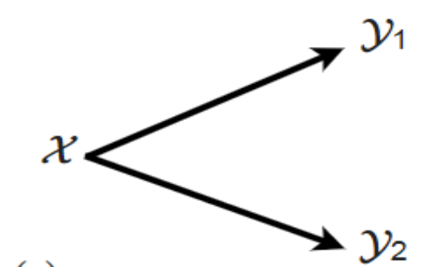
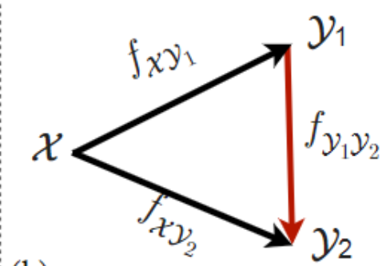
Prepare Work:
Robust Learning Through Cross-Task Consistency
Why Multi-task learning?
Visual perception entails solving a wide set of tasks, e.g., object detection, depth estimation, etc. The predictions made for multiple tasks from the same image are not independent, and therefore, are expected to be ‘consistent’. We would like to discover the consistency between specific preprocessing process of MRI and its segmentation analysis.
Understanding the workflow of multitask learning with cross task consistency constraint.
Simple task learning:
Loss function:
L = |𝑓(𝑥) - 𝑥|
Adding Constraints:
Loss function:
𝐿_𝑡𝑟𝑖𝑎𝑛𝑔𝑙𝑒 = |𝑓𝑥𝑦1(𝑥) - 𝑦1| + |𝑓𝑦1𝑦2 ∘ 𝑓𝑥𝑦1(𝑥) - 𝑓𝑥𝑦2(𝑥)| + |𝑓𝑥𝑦2(𝑥) - 𝑦2|

Slide 4
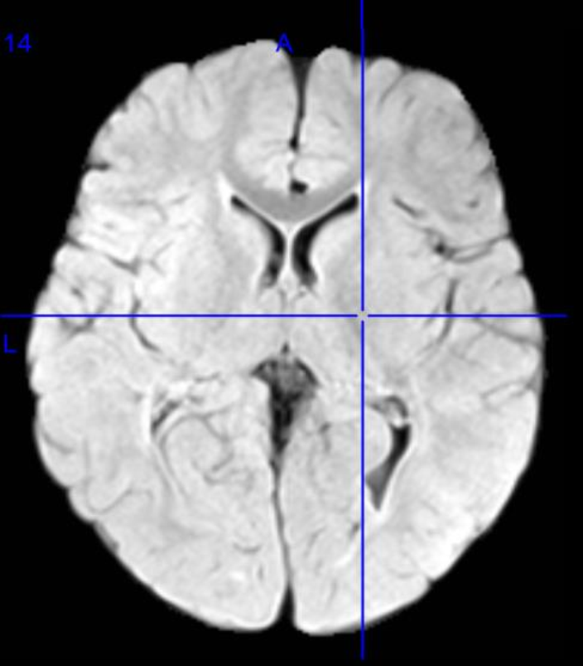
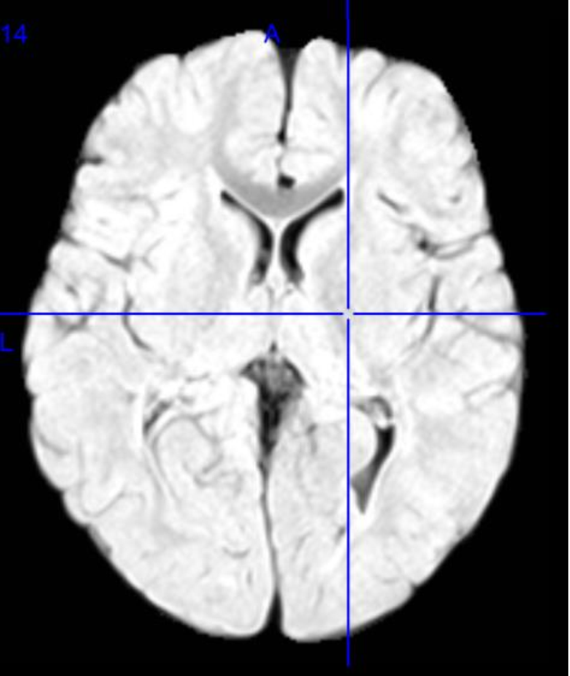
Biased Field Correction:
Realizing correction for arbitrary simple image. Trying to deal with the whole dataset and improving processing speed. What is Biased Filed Correction?
MR scans often display intensity non-uniformities due to variations in the magnetic field. So, one part of an image might appear lighter or darker when visualized, solely because of variations in the magnetic field. The map of these variations is called the bias field. The bias field can cause problems for a classifier as the variations in signal intensity are not due to any anatomical differences.
Left: MRI without correction
Right: MRI after correction
Package used: SimpleITK (Python)

Slide 5
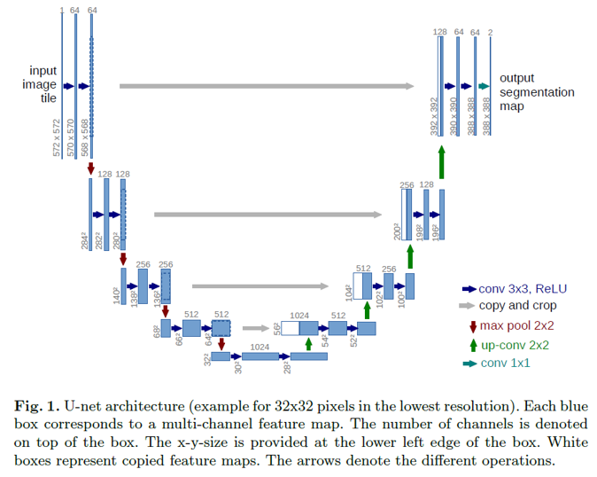
Segmentation Analysis
U-Net
Preprocessing
Extract dataset characteristics including image sizes, voxel spacings and intensity information and verify the integrity.
Why choose U-Net? have to filter useless information, which let U-Net have enough performance with large model.
MRI is hard to obtain and usually has small number for a specific project. Overfitting problems are easy to occur if large networks are applied.
MRI is simple in structure and information. Thus, we do not

Slide 6
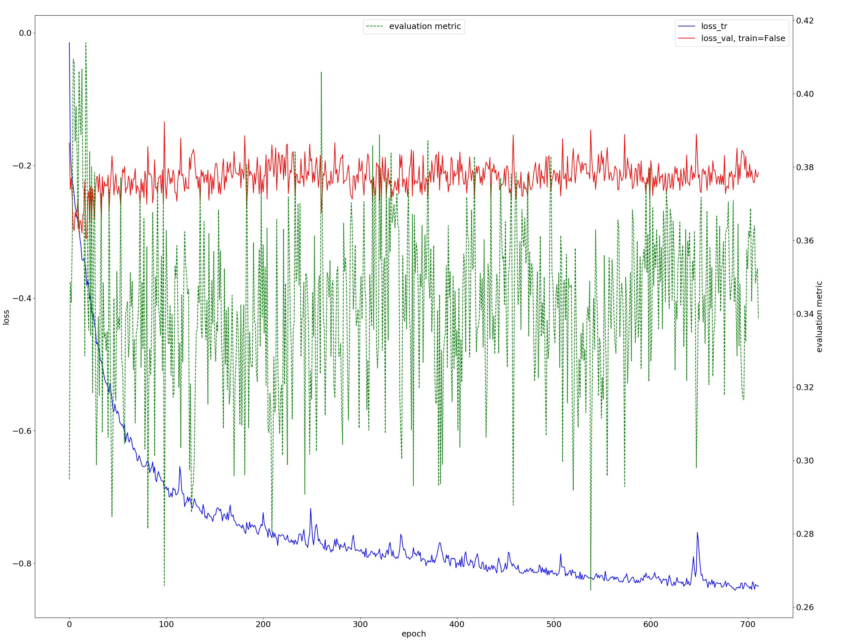
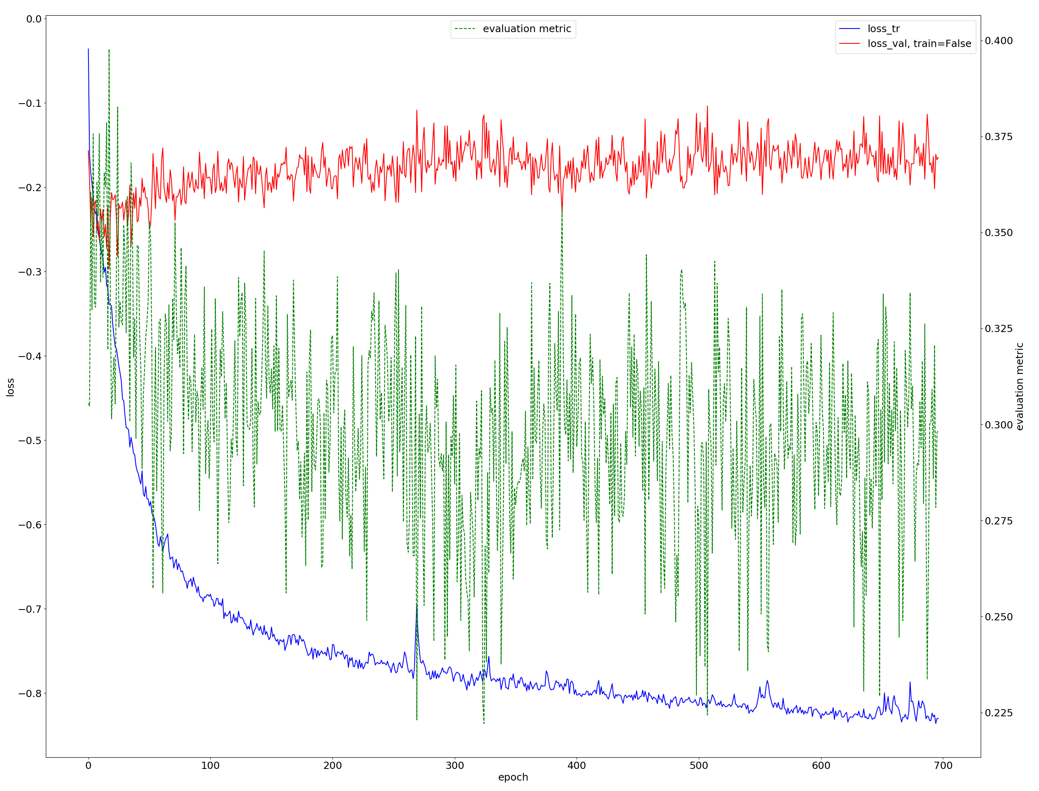
Network Analysis
1. Compare the result and performance of origin images and corrected images in the same U-Net training process. 2. Some questions about the performance of visualized plot. (Potential Overfitting problem)
Segmentation Result:
Left: Origin images set
Right: Corrected images set
Results
Compared with images without biased correction, the corrected images: 1. Perform better in training loss decrease (Reached around 0.24 after 500 epochs, the uncorrected image reached 0.28.) 2. Have relatively lower validation loss 3. Both corrected images and uncorrected image set's metric fluctuated a lot.
Questions: 1. Does it lead to overfitting since the training loss decrease while the validation loss seems to maintain in training sets. 2. The reason of evaluation metric, does it relate to the overfitting problem.

Slide 7
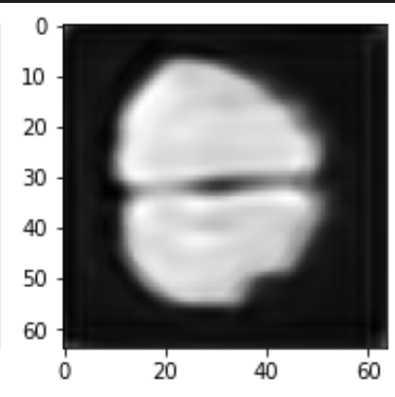
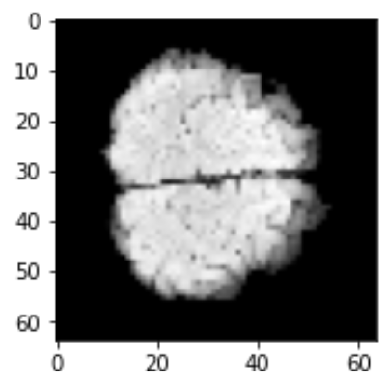
Biased Field Correction Network
Roughly accomplish a simple network for converting original MRI to corrected images.
Resize the image to lower size to reduce the work.
Covert the data divide into training set and validation set.
Method to extract each dimension and resize data: Bilinear interpolation.
Resize
Slicing
Raw data
182*218*182
64*64*13968
Encoder
Decoder
Model
Resize
Slicing
64*64*13968
Corrected Data
182*218*182
Ground Truth (Resized after correction using third packages)

Slide 8
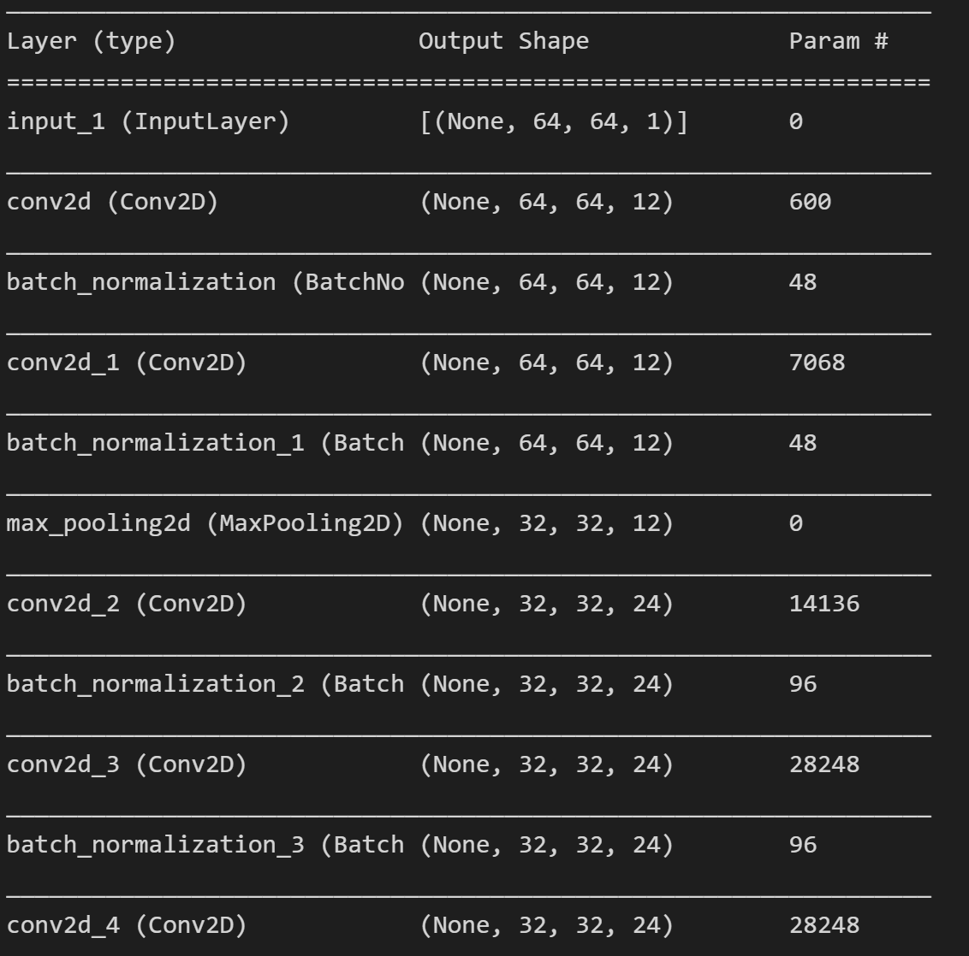
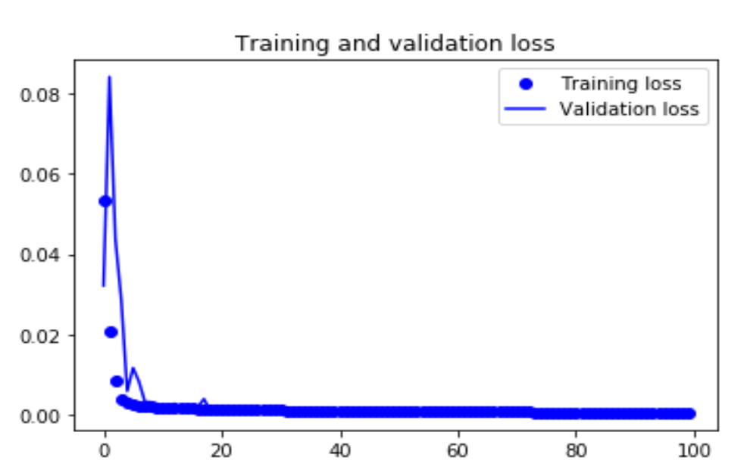
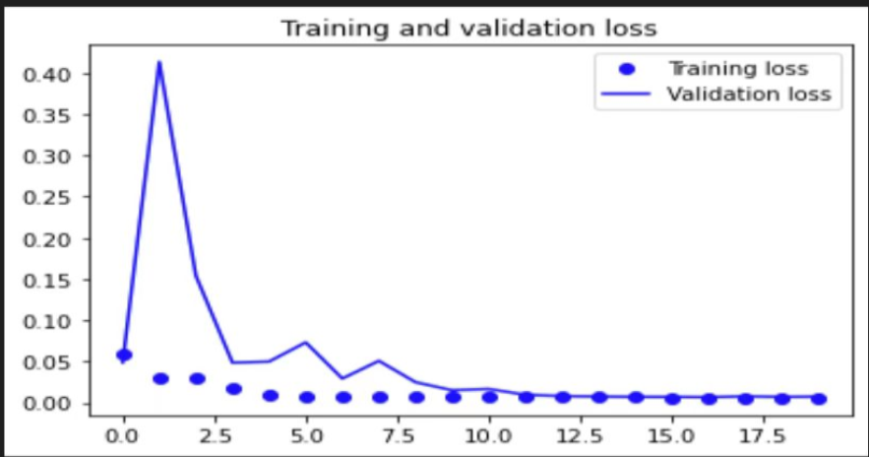
Biased Field Correction Network
Network Structure: (CNN)
Training Result
In the testing step of training, we select epochs = 100 and found out that the training loss has already converted after 20 steps. Thus, 20 epochs is our final choice.
Convolution kernel: 7*7
Epoch: 20
Batch size: 256

Slide 9
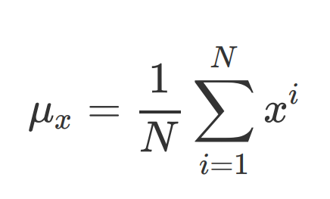
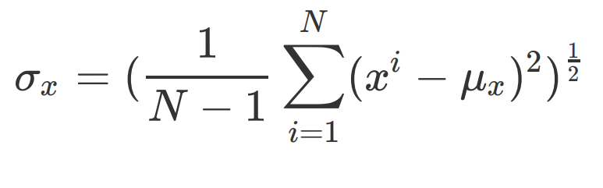
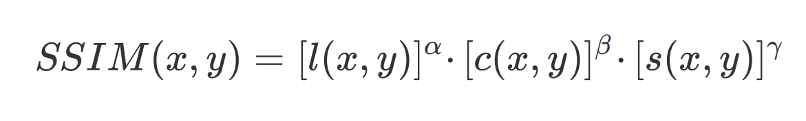
Biased Field Correction Network
Evaluation metric
SSIM (Structural Similarity Index)
Luminance Comparison
Contrast Comparison
Structure Comparison
P.S: x represents a pixel in an images with pixel number N.
Work-Flow | Resize -> Training | Direct Training*
SSIM | 0.78 | 0.88
* : The “direct training” mean we resize the data to 128*128, which is similar with the original size. However, the procedure is not identical to training with the raw data first.

Slide 10
Discussion
The baseline has basically achieved a multi-task learning in biased filed correction and MRI segmentation analysis. However, there are still some questions remain.
The potential overfitting problem may exist because the validation loss didn’t seem to decrease as the training loss decreased.
In the construction of biased field correction network, in order to reduce the complexity and time for computing, the sliced images were resized into smaller size for network construction. Overall, the training images went through a work-flow from resize to forming a neural network. Compared with the test images, the order of the work-flow opposite with test set. Hence, the reliability of the structure similarity between reconstructed images and test images is worth future optimization.
Thanks！

