Slide 1
Exploring the Astrospace: An Introduction to the Orrery Web App

Slide 2
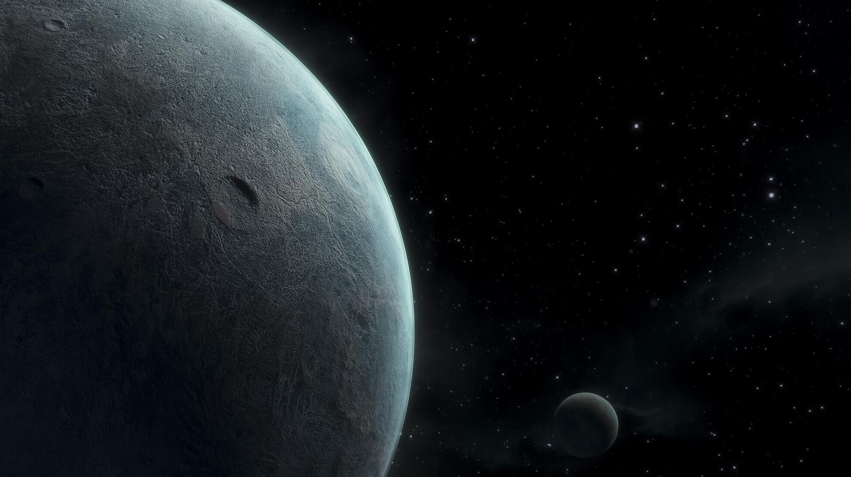
Welcome to the Orrery Web App! This presentation will guide you through its features and functionalities. The app guides users to an interactive orrery web app that is embedded in a webpage and displays celestial bodies such as planets, Near-Earth Asteroids, Near- Earth Comets, and Potentially Hazardous Asteroids.

Slide 3
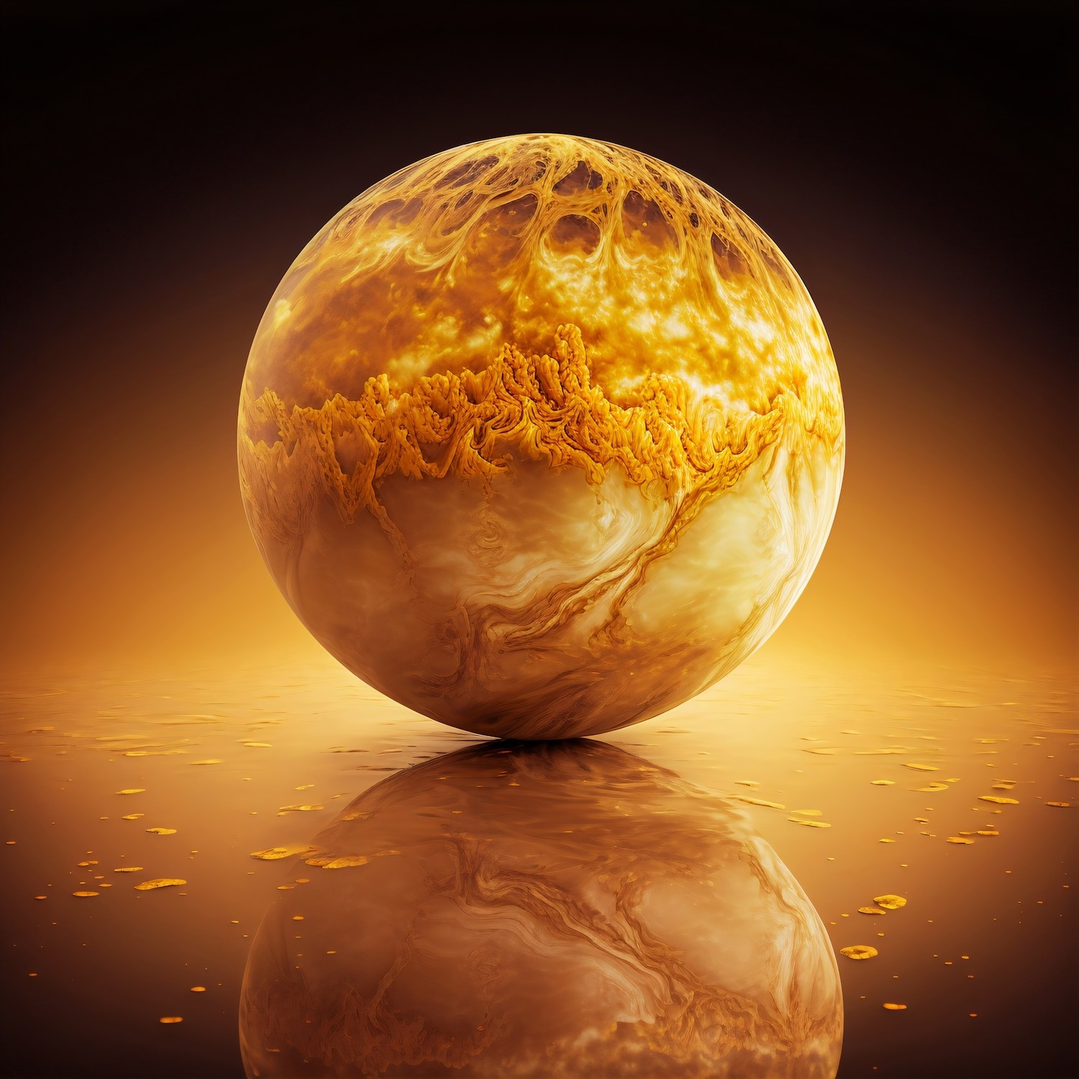



What is an Orrery?
An is a mechanical model of the solar system that illustrates the positions
and motions of the moons. The
and their simulates this
concept digitally, allowing users to visualize and understand the motion of various objects in space in a user-friendly manner.

Slide 4
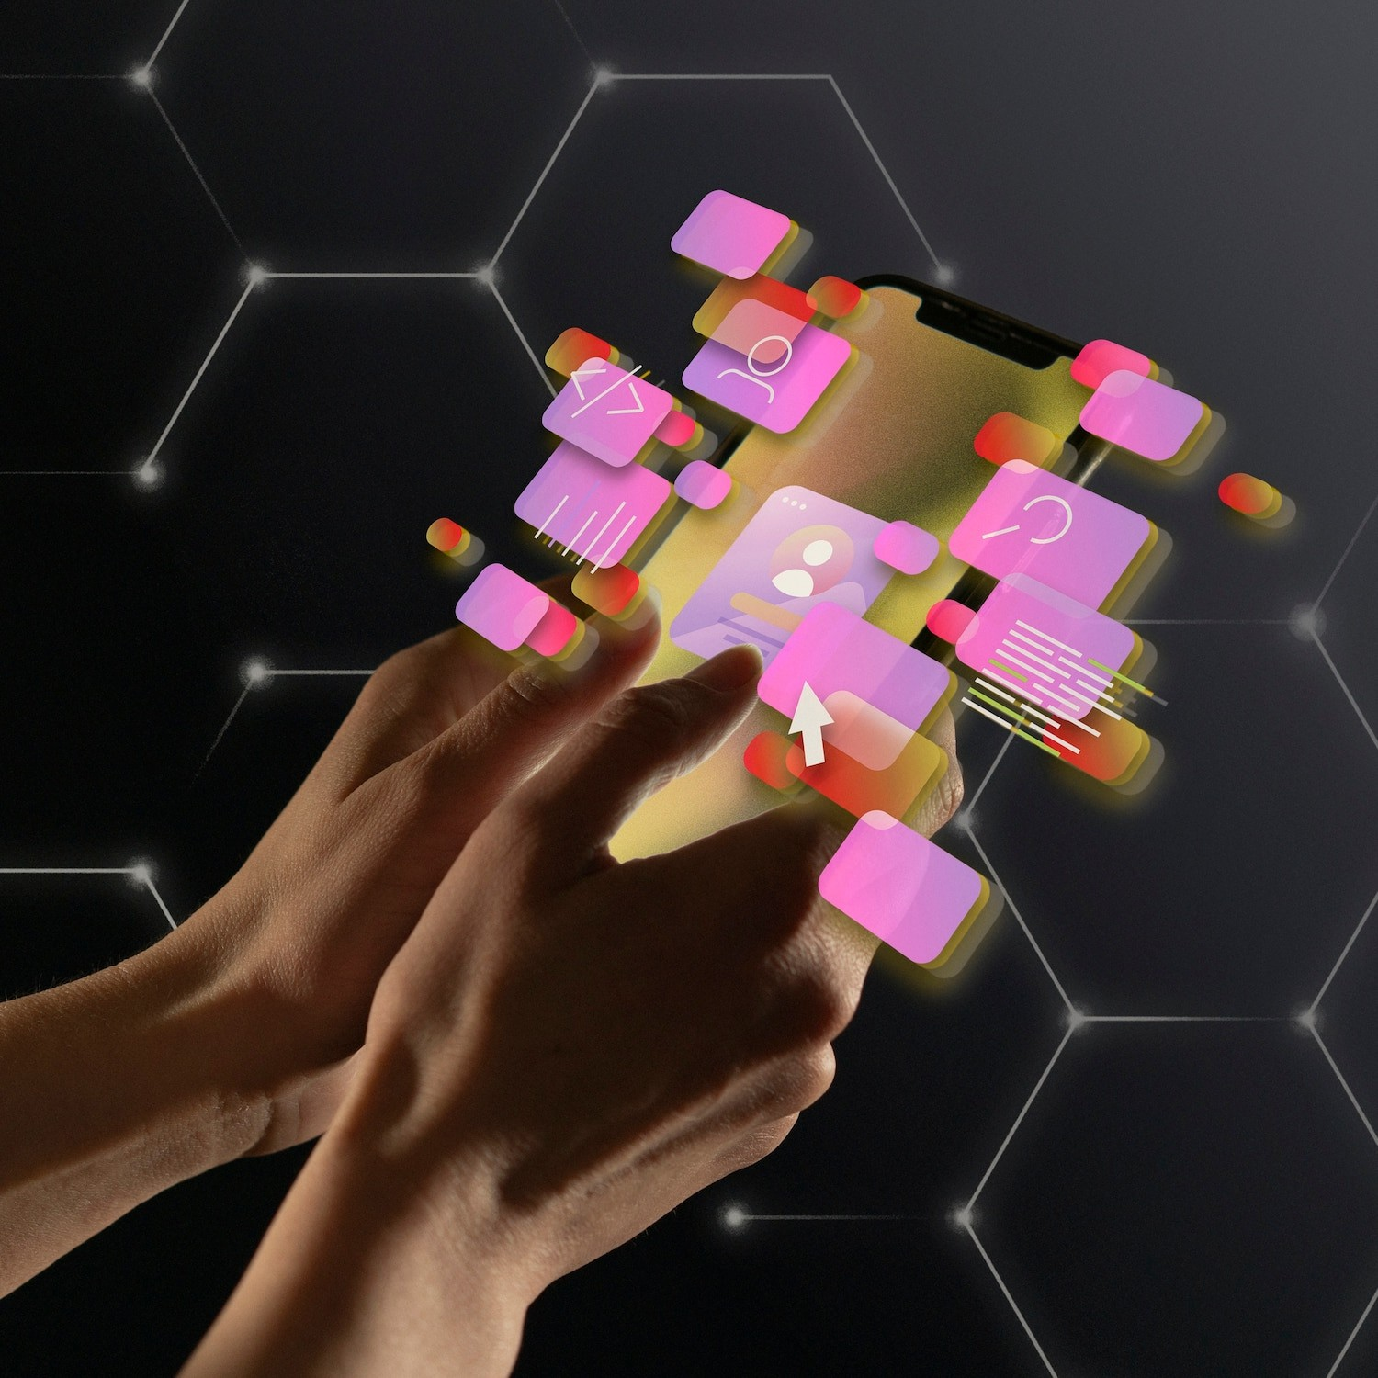




Key Features
This offers several key
features, including interactive real-time , and
educational resources. Users can use the
,
model to observe the of planets, enhancing their understanding of
phenomena and celestial
mechanics.

Slide 5
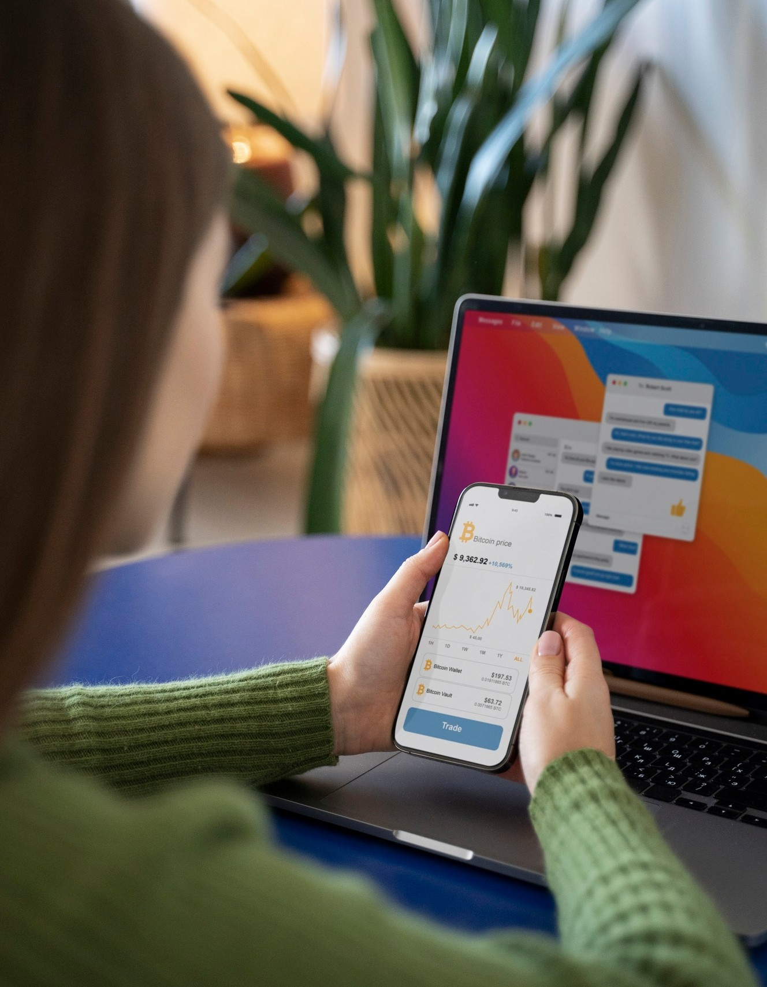


User Interaction and Experience
The app is designed for an engaging user experience. Users can easily
through different celestial systems, zoom in on , and change viewing angles.

Slide 6




Conclusion and Future Prospects
In conclusion, the is a powerful tool for exploring the As technology advances, future updates may include enhanced features like
and expanded celestial
data.

Slide 7
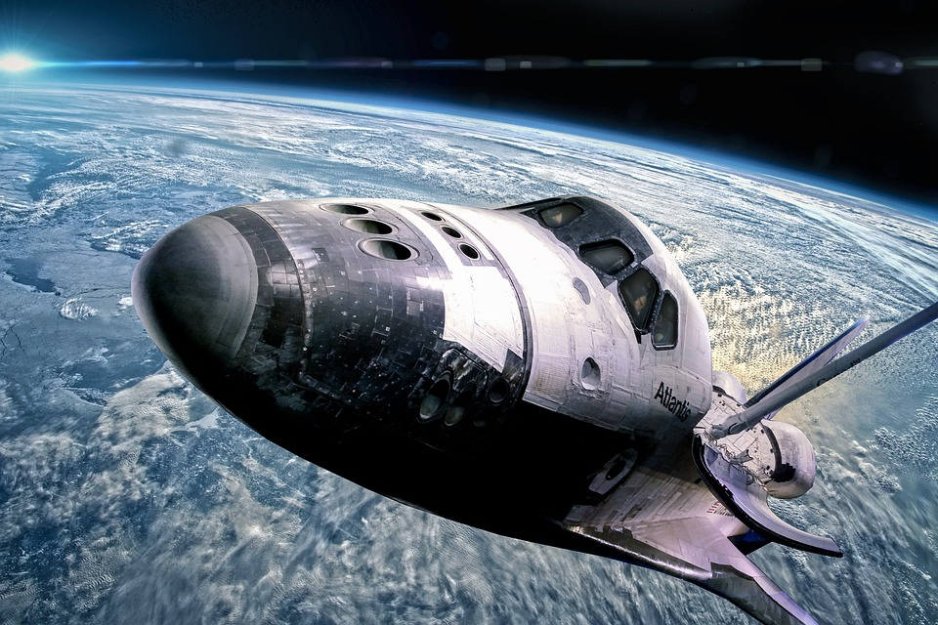
REFERENCES
ChatGPT
Chat Blackbox: AI Code Generation, Code Chat, Code Search
Make Website In just 15 Min 16x9 (youtube.com)
Amazing 3D Planets Orbit Effect Using Only CSS | Quick Tutorial (youtube.com)
Can GPT-4 Build a Solar System in Three.js? (youtube.com)

