Slide 1

SURF FINAL PRESENTATION
Teaching machines how atoms and electrons move together
A physics-guided machine-learning model for polar materials
Jeremiah Bailey
Bernardi Group · California Institute of Technology
SURF 2026
Notes:
0:00–0:35. Hello, my name is Jeremiah Bailey. This summer I worked in the
Bernardi Group on a question at the intersection of materials physics and
machine learning: can we teach a model not only the electronic state of a
material, but also how that state changes when the atoms move? I will focus on
magnesium oxide, a simple polar crystal that makes this challenge visible.

Slide 2
WHY THIS MATTERS
2
Atoms vibrate—and electrons must respond
This interaction helps determine:
A crystal is not static
1
How electrical energy is lost
Mg
O
Mg
resistance and heat
O
Mg
O
2
How carriers exchange energy
relaxation and transport
Mg
O
Mg
3
How materials respond to light
optical and polar behavior
atomic vibration
electronic response
Goal: predict the response without repeating an expensive quantum calculation for every motion.
JEREMIAH BAILEY · SURF 2026 · BERNARDI GROUP
2
Notes:
0:35–1:35. Atoms in a solid are always moving. When they move, the electrons
rearrange. That interaction affects resistance, energy relaxation, heat, and
optical behavior. Quantum-mechanical calculations can describe it accurately,
but repeating those calculations for every possible atomic motion is costly.
The opportunity is to learn this response from examples while keeping the
relevant physics in the model.

Slide 3
ROADMAP
3
Four questions guide the talk
1
What are we predicting?
A compact electronic description and how it changes when atoms move.
2
Why is magnesium oxide hard?
Its positive and negative ions create a long-range electric response.
3
What did I build and test?
A shared model with learned charge and screening outputs.
4
What do the results say?
The new outputs learn real signal, but have not changed the final response yet.
JEREMIAH BAILEY · SURF 2026 · BERNARDI GROUP
3
Notes:
1:35–2:05. I will first define the quantities in plain language. Then I will
explain why polar magnesium oxide needs special treatment, show the model and
training protocol I built, and finish with what the data support so far and
what experiment should come next.

Slide 4
BACKGROUND
4
Three ideas connect structure to response
1
2
3
DFT
Hamiltonian
Electron–phonon coupling
PHYSICS-BASED REFERENCE
ELECTRONIC RULEBOOK
THE LOCAL SLOPE
Solves an approximate quantum-mechanical problem for one atomic structure.
A matrix that summarizes the energies and interactions available to electrons.
Measures how the Hamiltonian changes when atoms are displaced.
change in electrons ────────────── change in atoms
accurate · expensive
Machine learning approximates the electronic rulebook; the response tests whether it learned the right behavior between examples.
JEREMIAH BAILEY · SURF 2026 · BERNARDI GROUP
4
Notes:
2:05–3:20. DFT is my physics-based reference: accurate, but expensive for
large numbers of structures. The Hamiltonian is a compact matrix that acts
like an electronic rulebook. Machine learning can predict that matrix from
atomic positions. Electron–phonon coupling is more demanding: it is the slope
of that prediction when an atom moves. A model can match many values and still
learn the wrong slope between them.

Slide 5
THE CHALLENGE
5
Polar crystals communicate over long distances
Four outputs in the comparison
Magnesium oxide
1
Actual DFT
physics reference
Mg²⁺
O²⁻
2
Direct Full-H
learn the complete electronic matrix
A displacement creates an electric field that reaches beyond nearby atoms.
3
LR-corrected SR
learn local part + fixed long-range physics
4
SR + predicted Z* + ε∞
learn local part + learned charge and screening
Local chemistry + long-range electrostatics
Z* = effective charge · ε∞ = electronic screening
JEREMIAH BAILEY · SURF 2026 · BERNARDI GROUP
5
Notes:
3:20–4:25. Magnesium and oxygen carry opposite ionic character. Moving one
atom creates an electric response that is not purely local. I compare four
things: the DFT reference, a model trained directly on the complete
Hamiltonian, a short-range model corrected with fixed reference physics, and
my new model whose effective charges and electronic screening are predicted
from the current geometry.

Slide 6
WHAT I BUILT
6
One structural encoder feeds three physical predictions
Short-range H
local electronic rulebook
Shared encoder
Reconstruct total H
Atomic structure
Born charge Z*
learns reusable structure features
local ML + analytic long-range physics
how motion polarizes the crystal
Screening ε∞
how electrons weaken the field
Built-in safeguards: charge balance · positive screening · no direct full-H shortcut
JEREMIAH BAILEY · SURF 2026 · BERNARDI GROUP
6
Notes:
4:25–5:25. I built one shared equivariant encoder, meaning its outputs transform
correctly when the crystal is rotated. It feeds three predictions: the local
Hamiltonian, an effective charge for every atom, and one screening tensor for
the structure. Those pieces are combined with an analytic long-range formula.
The model enforces overall charge balance and positive screening by design.

Slide 7
HOW I TESTED IT
7
Separate data answer separate questions
367 STRUCTURES
10 STRUCTURES
5 STRUCTURES
Hamiltonian data
Tensor training
Locked tensor test
Teach and monitor the electronic matrix
Teach effective charge and screening
Open once after every model choice is frozen
Selection rule
Hamiltonian, charge, and screening gates had to pass for ten consecutive validation checks.
The locked five were not used to select the architecture, learning rate, or checkpoint.
JEREMIAH BAILEY · SURF 2026 · BERNARDI GROUP
7
Notes:
5:25–6:20. Hamiltonians are large, so the model retained all 367 short-range
training and validation structures. The response tensors are expensive DFT
labels: ten trained the heads, two guided wiring and stability, and five were
locked. I opened those five only after freezing the architecture, learning
rates, and checkpoint. The accepted model had to pass all three validation
gates ten times in a row.

Slide 8
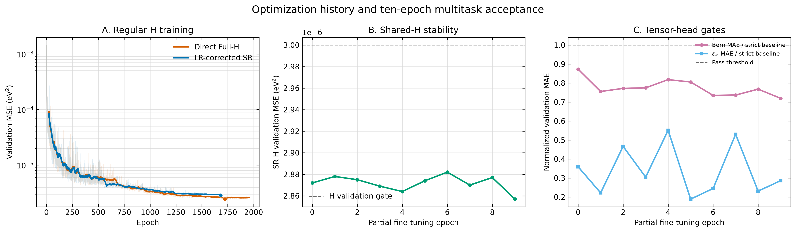
TRAINING OUTCOME
8
The new tasks did not destabilize the original model
All three gates passed for ten consecutive epochs · selected checkpoint: epoch 9
Read the center and right panels as stability checks; the detailed scales are less important than staying below each dashed threshold.
JEREMIAH BAILEY · SURF 2026 · BERNARDI GROUP
8
Notes:
6:20–7:15. The left panel gives the longer training context. The center asks
whether adding new tasks damages the original short-range Hamiltonian; it
stays below the dashed limit. The right asks whether the charge and screening
heads beat simple baselines; both stay below one. After ten consecutive passes,
training stopped and I froze the checkpoint.

Slide 9
FIRST RESULT
9
The learned tensors beat constant guesses on unseen structures
Effective charge (Born tensor)
Electronic screening (ε∞)
Constant baseline
Constant baseline
0.003201 e
0.001466
Learned model
Learned model
0.002369 e
0.000389
26%
73%
balanced
positive
LOWER CHARGE ERROR
LOWER SCREENING ERROR
TOTAL EFFECTIVE CHARGE
SCREENING EIGENVALUES
Interpretation: the heads learned geometry-dependent signal. Limitation: five test structures support a prototype result, not broad generalization.
JEREMIAH BAILEY · SURF 2026 · BERNARDI GROUP
9
Notes:
7:15–8:15. This is the first success criterion. On structures never used for
training or selection, the learned effective charges reduce mean absolute
error by about 26 percent compared with always predicting the training mean.
Screening error drops by about 73 percent. The outputs also satisfy the
physical constraints. This shows learned geometry-dependent signal, while the
small test set keeps the claim at prototype scale.

Slide 10
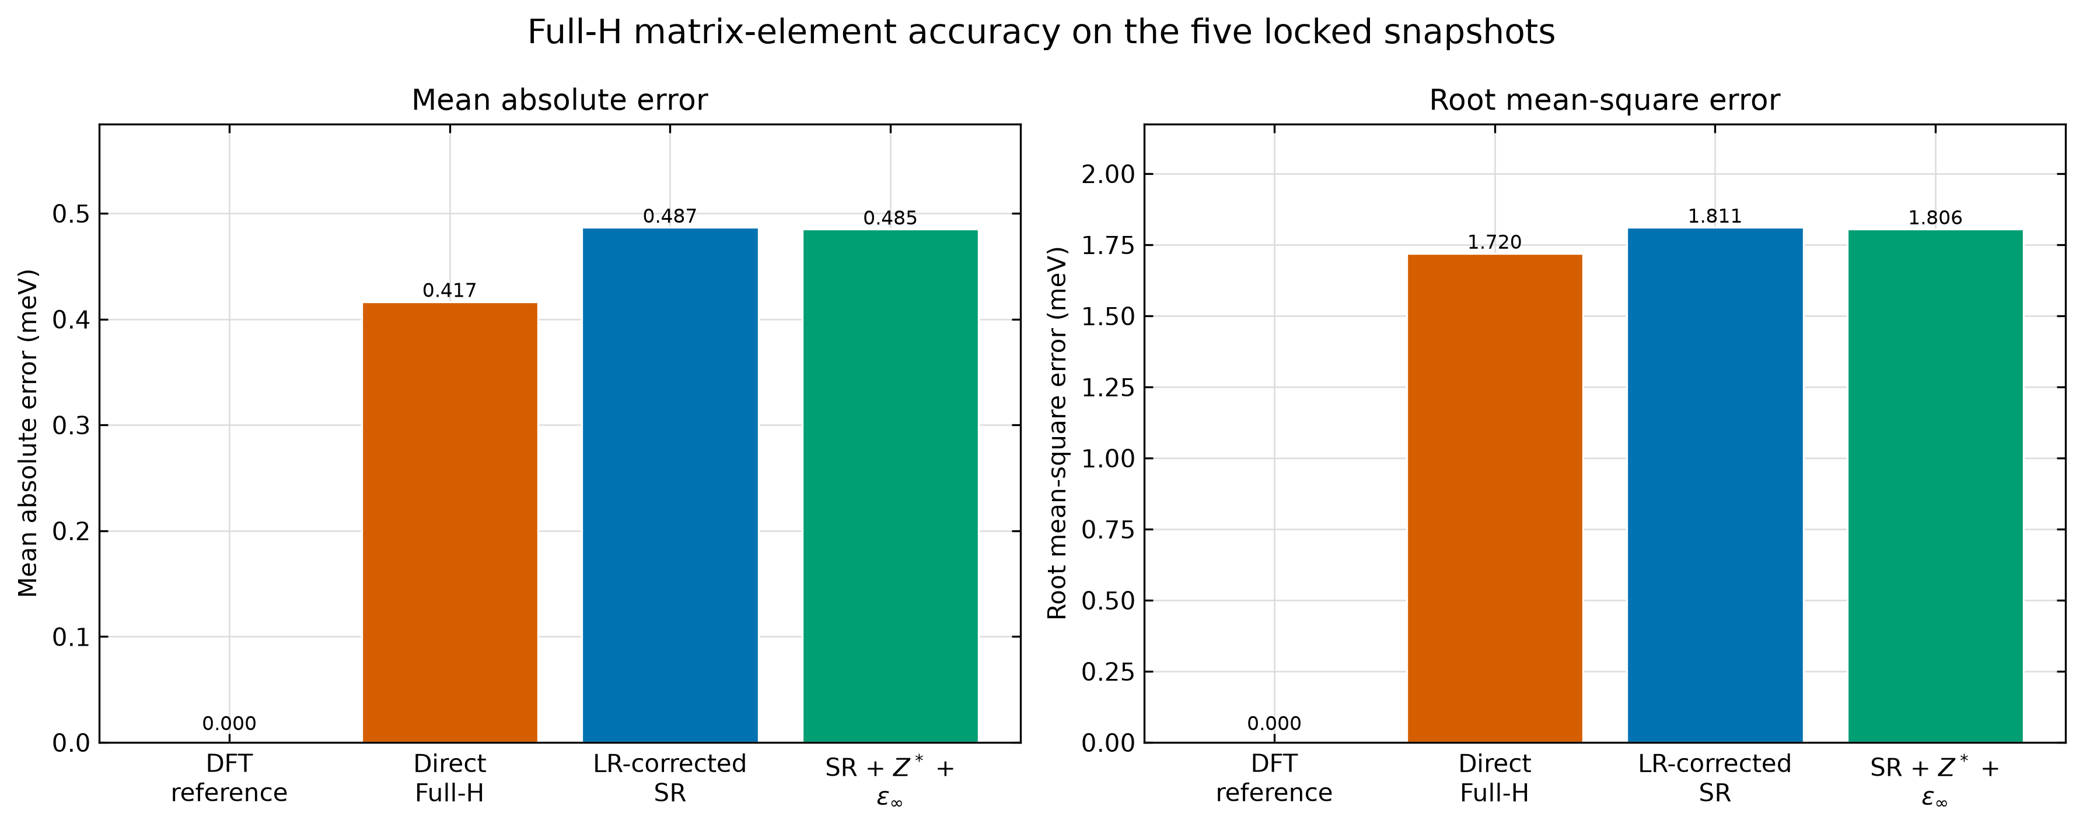
SECOND RESULT
10
For electronic values, direct Full-H still leads
0.417
DIRECT FULL-H MAE (meV)
0.487
FIXED-PHYSICS SR (meV)
0.485
LEARNED-TENSOR SR (meV)
Lower is better
The learned tensors slightly improve the SR reconstruction—but do not close the value gap.
JEREMIAH BAILEY · SURF 2026 · BERNARDI GROUP
10
Notes:
8:15–9:15. Next I compare matrix values on those same five structures. Zero is
the DFT reference. Direct full-H has the smallest mean error at 0.417
millielectron-volts. The fixed-physics SR result is 0.487, and learned tensors
slightly improve it to 0.485. So the composed model is complete and stable,
but the tensor heads do not close the value-accuracy gap.

Slide 11
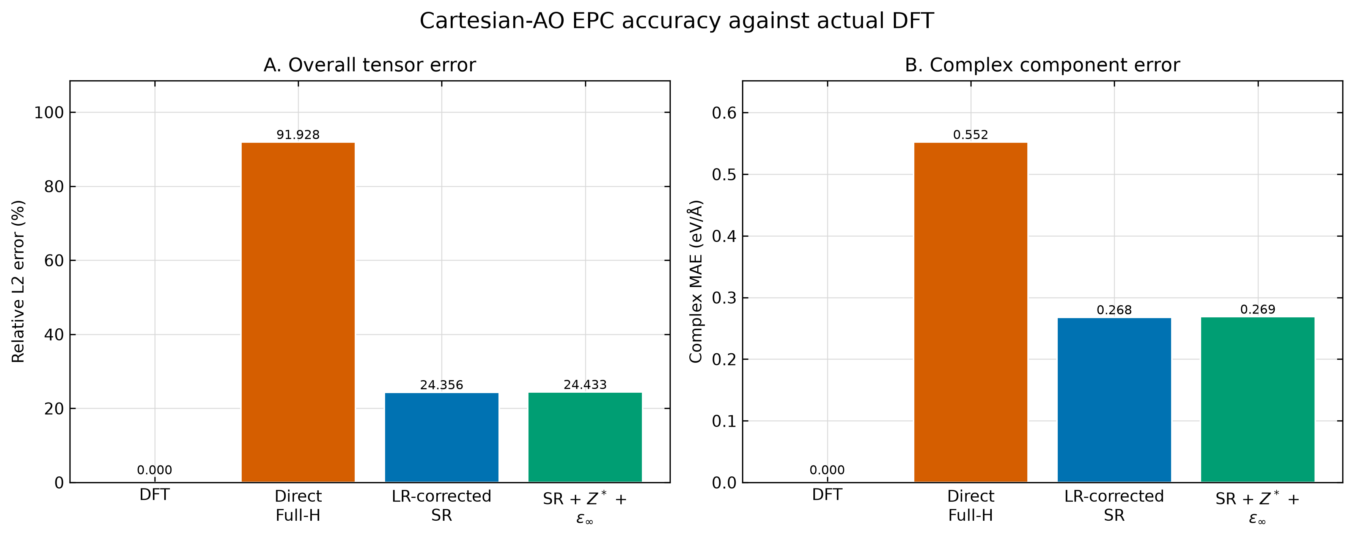
THIRD RESULT
11
For atomic-motion response, both SR models win
92%
DIRECT FULL-H ERROR
24.4%
FIXED-PHYSICS SR ERROR
24.4%
LEARNED-TENSOR SR ERROR
Matching values is not enough: the derivative exposes how the model behaves between examples.
JEREMIAH BAILEY · SURF 2026 · BERNARDI GROUP
11
Notes:
9:15–10:20. The ranking reverses for the response. Here lower is again better.
Direct full-H has about 92 percent relative error, while both short-range
pipelines are near 24 percent. This is the central lesson: a model can predict
Hamiltonian values well and still learn the wrong slope. Physics-guided target
design improves the derivative observable even when it does not win on values.

Slide 12
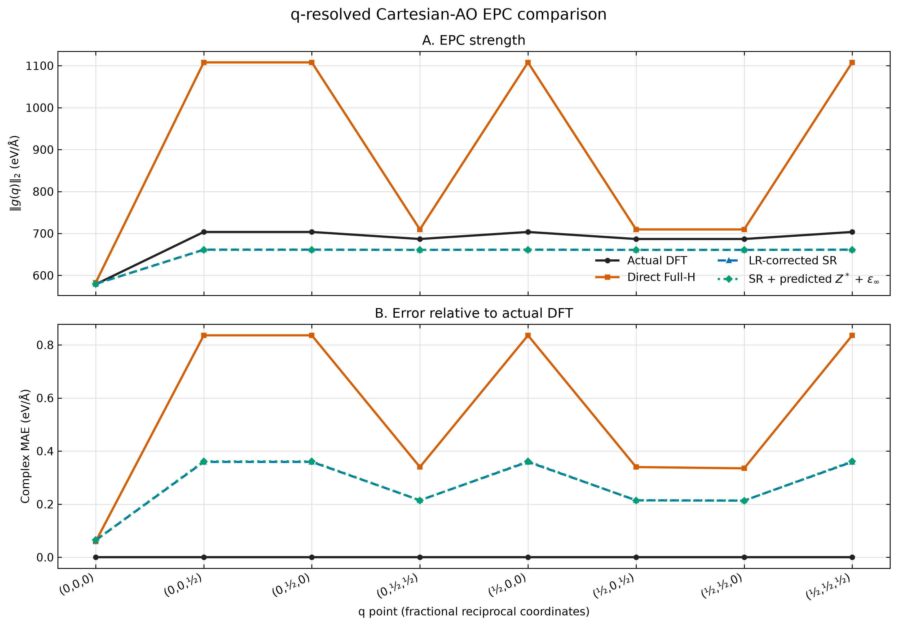
WHERE THE DIFFERENCE APPEARS
12
Longer-wavelength labels separate value and response quality
How to read this
Q
labels a vibration wavelength and direction
TOP
overall coupling strength
BOTTOM
error relative to DFT
Blue and green overlap; orange grows too strong away from q = 0.
JEREMIAH BAILEY · SURF 2026 · BERNARDI GROUP
12
Notes:
10:20–11:25. q is simply a label for a vibration's wavelength and direction.
The top panel shows coupling strength; the bottom shows error against DFT. At
q equals zero, all models are much closer. Away from zero, direct full-H
becomes too strong. The blue fixed-tensor and green learned-tensor curves
overlap across this grid, which leads to the final interpretation.

Slide 13
WHAT WE LEARNED
13
The new heads work—but their EPC effect is below present sensitivity
SUPPORTED
NOT YET SUPPORTED
✓
Charge and screening heads learn unseen variation.
?
Geometry-dependent tensors improve EPC at 5×10⁻⁶ Å.
✓
The reconstructed Hamiltonian is complete and physically constrained.
?
Ten tensor-training structures generalize broadly.
✓
Short-range target design improves EPC compared with direct Full-H.
?
A 2×2×2 q grid resolves the long-wavelength polar limit.
Frozen and geometry-dependent tensor EPC differ by only 4.3×10⁻¹⁰ eV/Å on average.
JEREMIAH BAILEY · SURF 2026 · BERNARDI GROUP
13
Notes:
11:25–12:30. The heads work as predictors, and the composed reconstruction is
correct. But the learned geometry dependence changes EPC by only about four
times ten to the minus ten electron-volts per ångström on average at this
finite-difference step. That does not prove the tensors are physically
irrelevant. It means this experiment cannot yet separate their effect from
near-neutrality. The dataset and q grid also limit the scope of the claim.

Slide 14
NEXT STEPS
14
Make the tensor effect measurable before scaling up
1
Displacement sensitivity
2
More informative labels
Repeat the response calculation over larger atomic steps to find where geometry-dependent tensors rise above numerical uncertainty.
Add structures selected for displacement type, amplitude, and predicted response variation—not simply more random snapshots.
3
Matched model comparisons
4
Denser vibration grid
Use the same initialization and split to isolate fixed physics, learned tensors, and direct Full-H training.
Resolve the long-wavelength polar limit after the tensor contribution is independently detectable.
Scientific decision gate: claim a tensor benefit only when learned − fixed exceeds finite-difference uncertainty reproducibly.
JEREMIAH BAILEY · SURF 2026 · BERNARDI GROUP
14
Notes:
12:30–13:35. My first next step would be a displacement-sensitivity ladder,
because the current five-microångström step may make geometry-dependent tensor
changes invisible. Then I would add response-diverse labels and repeat matched
ablations with the same initialization. A denser q grid is valuable, but only
after the tensor contribution is measurable independently of numerical noise.

Slide 15
SUMMARY
15
Physics-guided learning improves response—even before tensors help
1
I built a shared model for local electronic structure, effective charge, and screening.
Acknowledgments
2
The new response heads beat constant baselines on locked structures.
Prof. Marco Benardi Yao Luo, graduate mentor WAVE at Caltech
3
Direct Full-H wins on matrix values; both SR models win on atomic-motion response.
4
Learned tensors have not changed EPC at the present displacement sensitivity.
The broader lesson: evaluate a scientific model on the physical response you care about—not only the values it fits.
Thank you
JEREMIAH BAILEY · SURF 2026 · BERNARDI GROUP
15
Notes:
13:35–14:35. In summary, I built the intended three-output architecture and
verified it on locked data. The response heads learn real signal. Direct
full-H remains best for matrix values, but target design around short-range
physics produces far better atomic-motion response. Learned tensors have not
yet improved EPC at this sensitivity. Thank Prof. Marco Benardi, my graduate
mentor Yao Luo, and WAVE at Caltech for their support.

Slide 16

Thank you
Questions?
Jeremiah Bailey
Please scan the QR code to leave audience feedback for this talk.
Your feedback will be shared after the presentations.
Audience feedback
Notes:
14:35–15:00. Thank the audience and invite questions. Leave this final slide
displayed throughout the 2–3 minute Q&A so the QR code remains available.

