Slide 1
PROJECT UPDATE
MACE-H-LR
From validated machinery to a physics-correct full-H model
Gold machinery ✓ Cartesian EPC ✓ Learned Z* + ε∞ heads →
SURF 2026 · Bernardi Group, Caltech · August 13, 2026
Handoff milestone: August 20
Notes:
0:00–0:30. The project has moved through three layers: I first tested the
model machinery on bulk gold, then built and validated Cartesian
electron–phonon coupling, and the MgO results exposed an architecture issue.
The rest of the week is about correcting that issue with learned Born-charge
and dielectric heads and leaving a reproducible handoff by August 20.

Slide 2
PROJECT ARC
2
Three stages changed the question
1
2
3
Bulk Au
MgO Cartesian EPC
Composed full-H
MACHINERY TEST
PHYSICS TEST
CORRECTION IN PROGRESS
Model + data path exercised
301,056 complex AO components
Learn Z* and ε∞; reconstruct H
Outcome so far: the pipeline is real; the bottleneck is now the model objective.
MACE-H-LR · PROJECT UPDATE · 13 AUG 2026
2
Notes:
0:30–1:10. Stage one was the gold machinery test. Stage two was the first
end-to-end Cartesian-AO EPC calculation for MgO. That calculation did not
just produce a metric—it changed the question. The remaining problem is not
whether the plumbing runs; it is whether the training objective represents
the intended composed long-range model.

Slide 3
PHYSICS TARGET
3
The intended model is composed—not a direct full-H fit
Hfull(R) = HSR(R) + HLR[R; Z*(R), ε∞(R)]
Structure
MACE-H
HSR head
Z* + ε∞
HLR
positions + lattice
shared equivariant backbone
local Hamiltonian
tensor heads
analytic physics
Differentiate the reconstruction: ∂Hfull/∂τ → Cartesian EPC
The network learns chemistry; the analytic term carries the nonlocal polar physics.
MACE-H-LR · PROJECT UPDATE · 13 AUG 2026
3
Notes:
1:10–2:00. This is the target architecture. The short-range Hamiltonian and
the two response tensors depend on structure. The analytic long-range term is
then reconstructed from the predicted Born charges and electronic dielectric
tensor. Cartesian EPC is the derivative of this entire composition. A direct
full-H network is a useful baseline, but it is not this model.

Slide 4
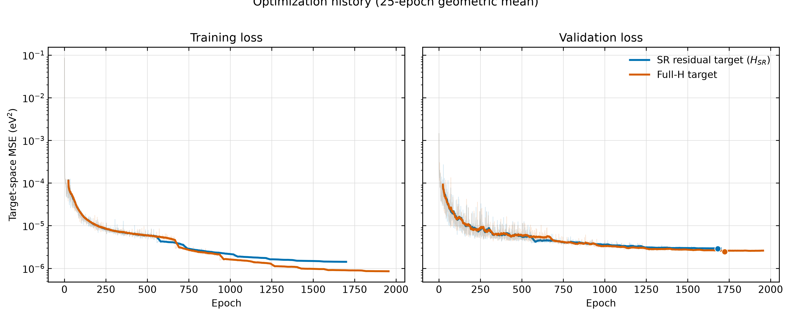
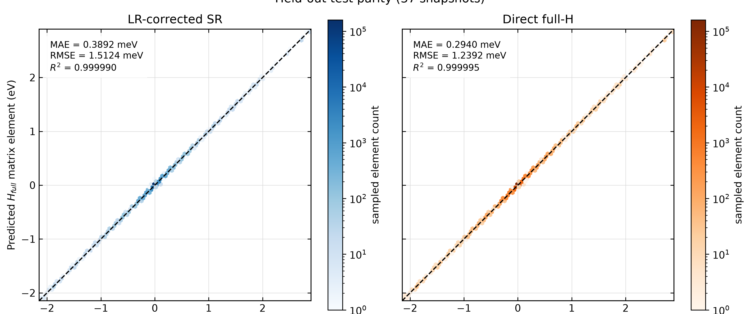
INITIAL TRAINING
4
Hamiltonian metrics looked excellent—and hid the response problem
0.294 meV
0.389 meV
≈ 0.99999
DIRECT FULL-H HELD-OUT MAE
LR-CORRECTED SR HELD-OUT MAE
R² FOR BOTH MODELS
A low value loss does not guarantee an accurate displacement derivative.
MACE-H-LR · PROJECT UPDATE · 13 AUG 2026
4
Notes:
2:00–2:45. Both runs converged cleanly. On 37 held-out snapshots, the direct
full-H model even had the lower matrix-element MAE, and both parity plots look
nearly perfect. If I had stopped at Hamiltonian values, I would have concluded
that the direct full-H baseline was better. EPC tests the local slope with
respect to atomic displacement, which is a stricter observable.

Slide 5
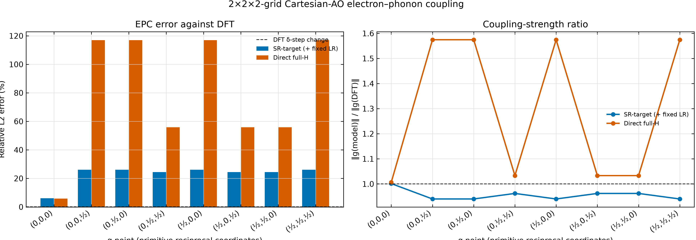
RESPONSE TEST
5
Cartesian EPC exposed a finite-q failure in direct full-H
24.36%
SR-TARGET (+ FIXED LR) REL. L2
91.93%
DIRECT FULL-H REL. L2
Γ is nearly tied
The separation appears at nonzero q.
MACE-H-LR · PROJECT UPDATE · 13 AUG 2026
5
Notes:
2:45–3:35. Across the full 2×2×2 Cartesian-AO tensor, the SR checkpoint is at
24.36 percent relative L2 while direct full-H is at 91.93 percent. At Gamma
they are essentially tied: 6.07 versus 5.82 percent. The failure appears at
nonzero q, where direct full-H both overestimates the coupling strength and
has much larger relative error. This is the central experimental result.

Slide 6
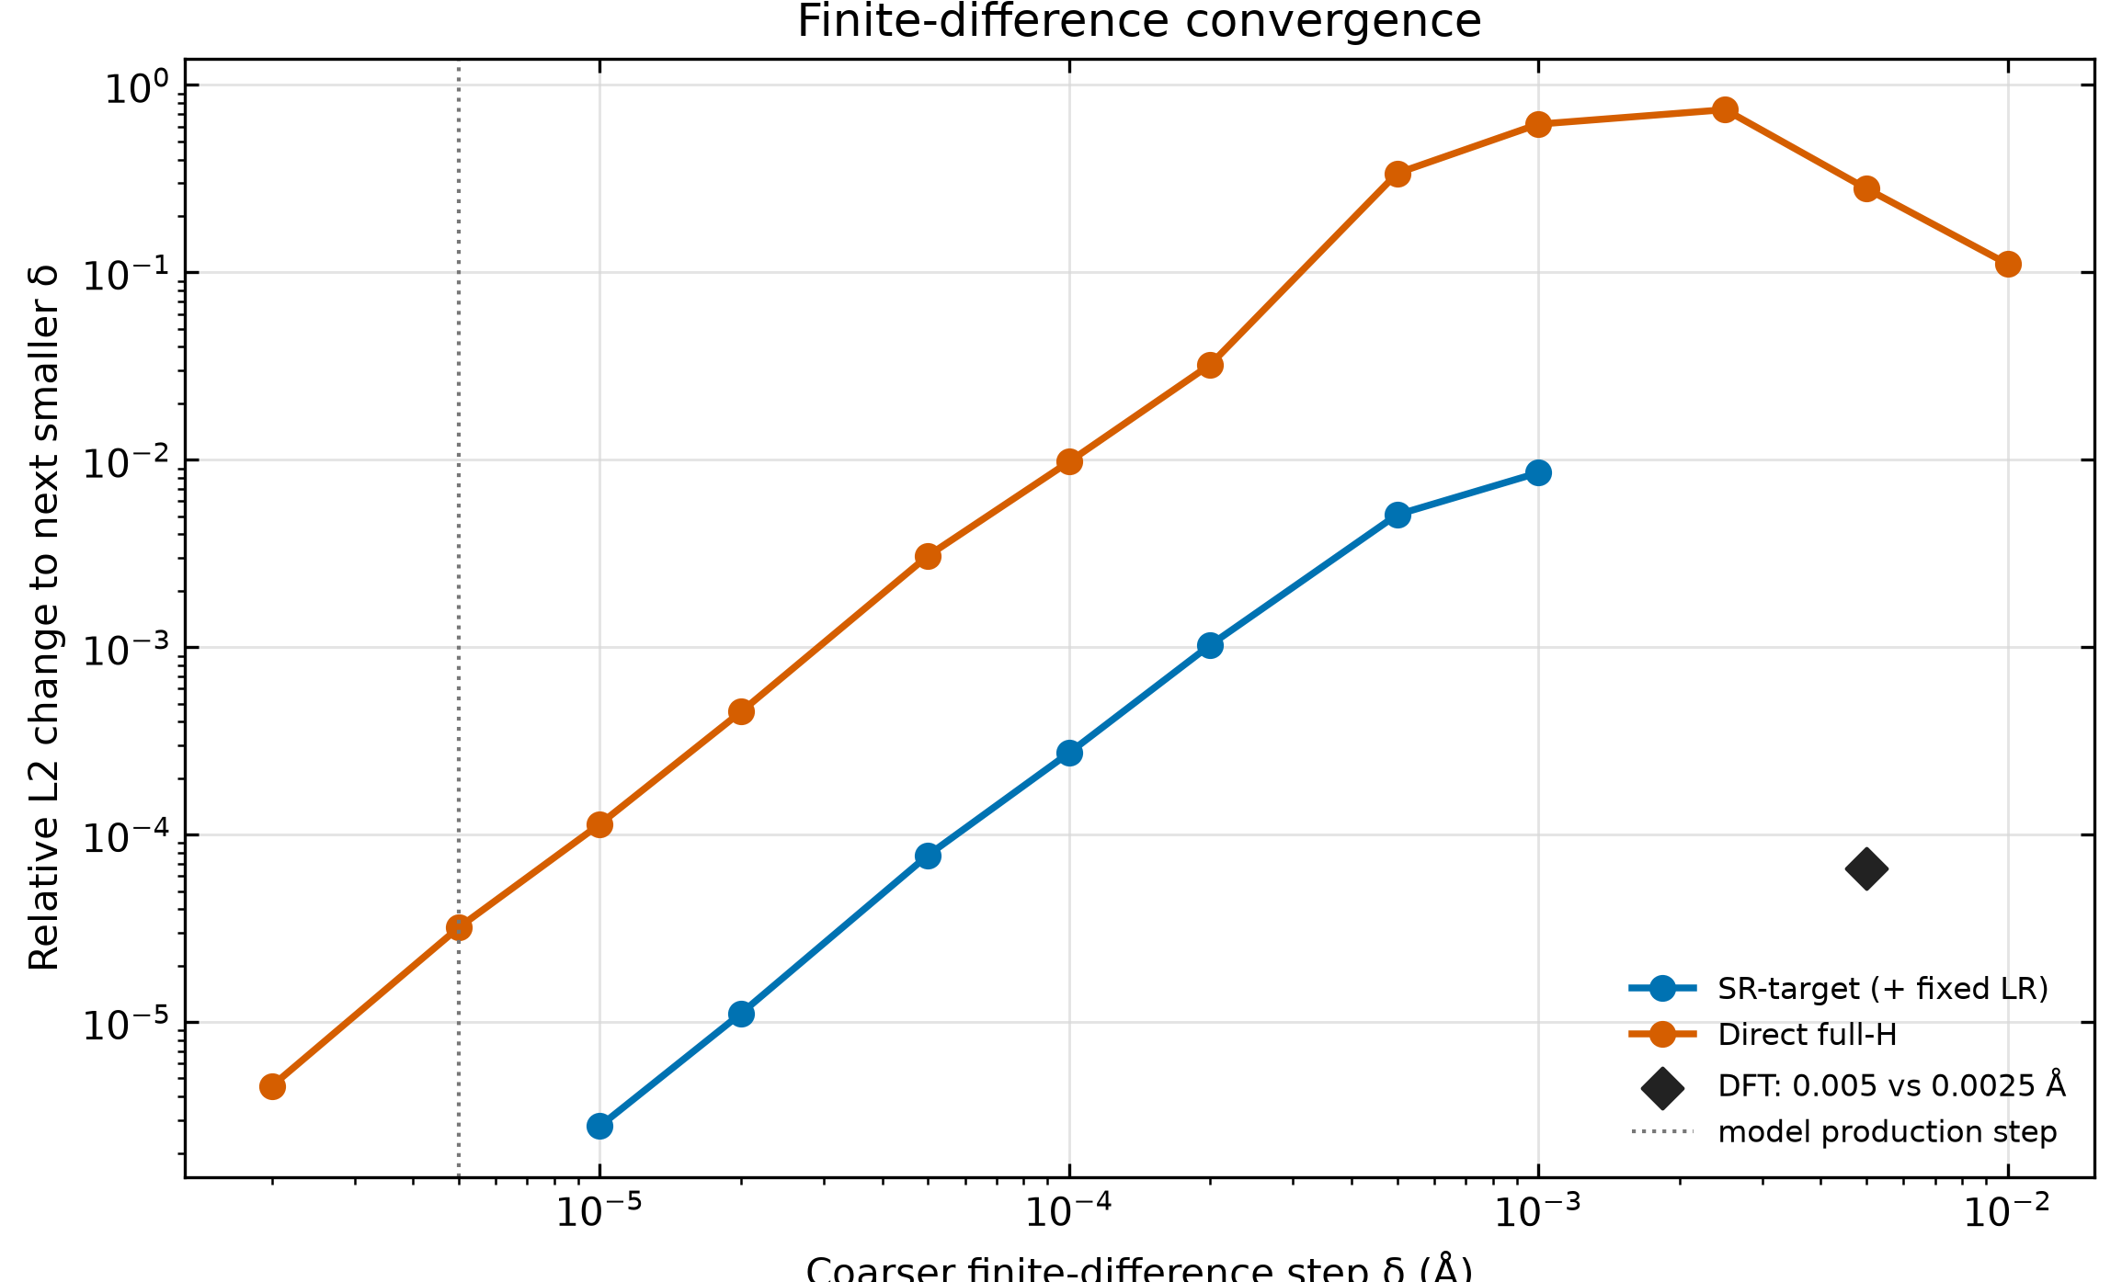
VALIDATION
6
The machinery is already tested: gold first, then Cartesian MgO EPC
COMPLETE
Bulk gold
• MACE-H machinery test completed • Nonpolar metallic case isolates implementation issues • Established a trusted starting point before MgO
0.00656%
2.9×10⁻¹¹
301,056
DFT STEP-SIZE CHANGE
WORST HERMITICITY / PEAK
COMPLEX EPC COMPONENTS
MACE-H-LR · PROJECT UPDATE · 13 AUG 2026
6
Notes:
3:35–4:20. I am not starting from an untested code path. Bulk gold exercised
the model machinery first. For MgO, the Cartesian EPC reference uses twelve
converged ABACUS calculations and contains 301,056 complex components. Doubling
the DFT displacement changes the tensor by only 0.00656 percent, and the
Hermiticity residual is 2.9 times 10 to the minus 11 of the tensor peak. These
checks support the finite-difference and indexing pipeline.

Slide 7
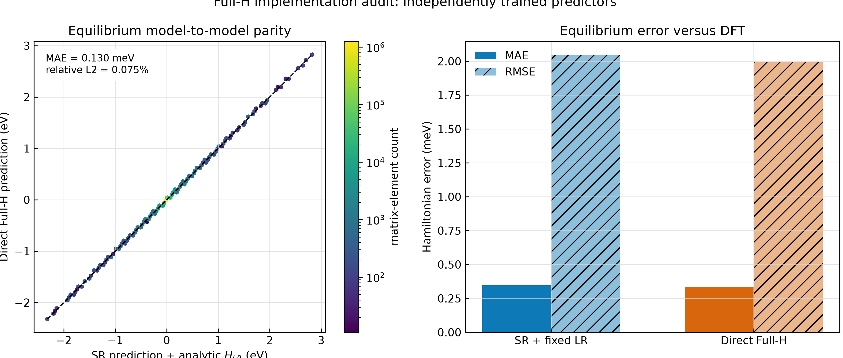
AUDIT
7
The previous “full-H” run was not the intended long-range model
Direct Full-H
predicts total H
SR checkpoint
predicts HSR
Z* head
absent
ε∞ head
absent
LR wrapper
fixed DFPT tensors
The learned-tensor case never existed in these checkpoints.
MACE-H-LR · PROJECT UPDATE · 13 AUG 2026
7
Notes:
4:20–5:05. The audit is decisive. Both checkpoints have the same parameter
count and neither contains a Born-charge or dielectric head. Direct full-H is
an independently trained total-H predictor. The SR model gets fixed DFPT
tensors through an external wrapper. Therefore the previous training did not
test the proposed learned-tensor architecture. That is the correction I am
making now.

Slide 8
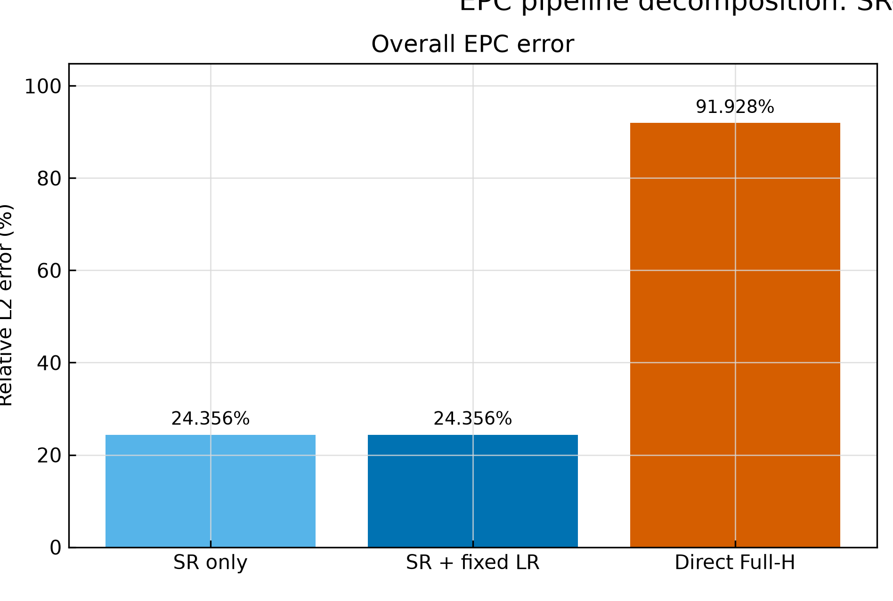
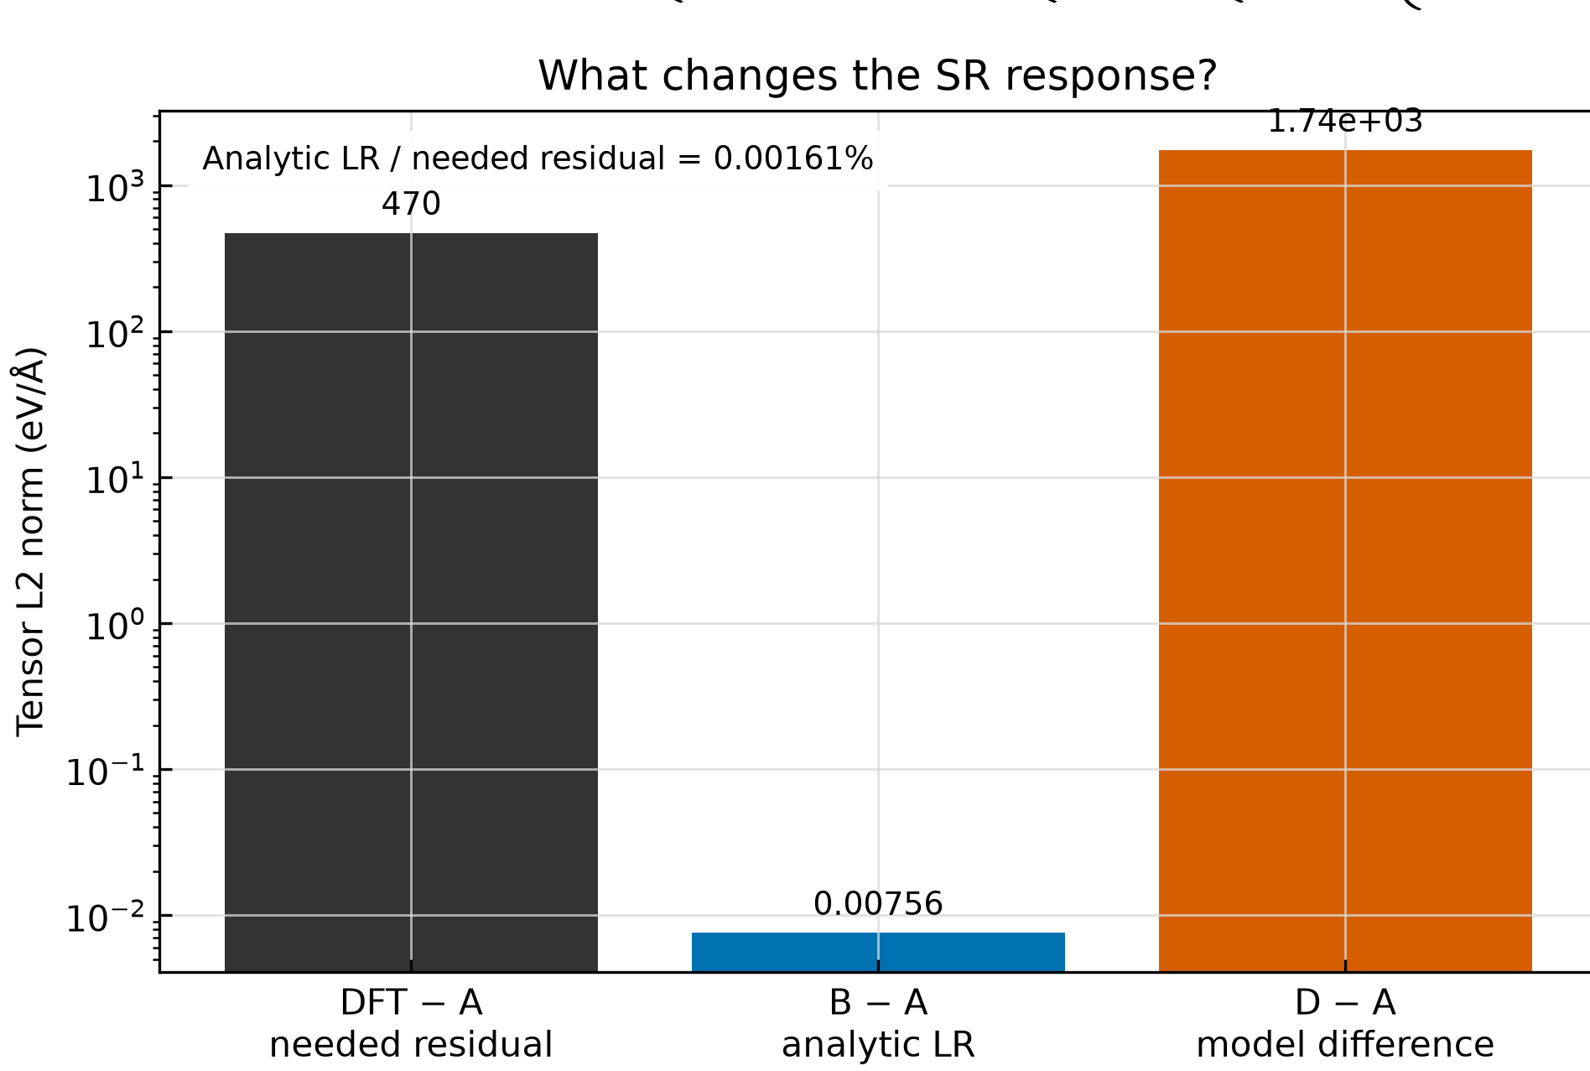
CONTROLLED DECOMPOSITION
8
The SR advantage is not yet an analytic long-range result
A → B: −0.000078 percentage points · analytic LR / needed residual: 0.001606%
MACE-H-LR · PROJECT UPDATE · 13 AUG 2026
8
Notes:
5:05–5:45. The controlled A/B/D decomposition prevents an incorrect causal
claim. A is the SR checkpoint alone, B adds fixed analytic LR, and D is direct
full-H. A and B are visually and numerically identical on this 2×2×2 grid.
The analytic correction is only 0.001606 percent of the residual needed to
match DFT. The current advantage belongs to the SR checkpoint, not yet to the
analytic correction.

Slide 9
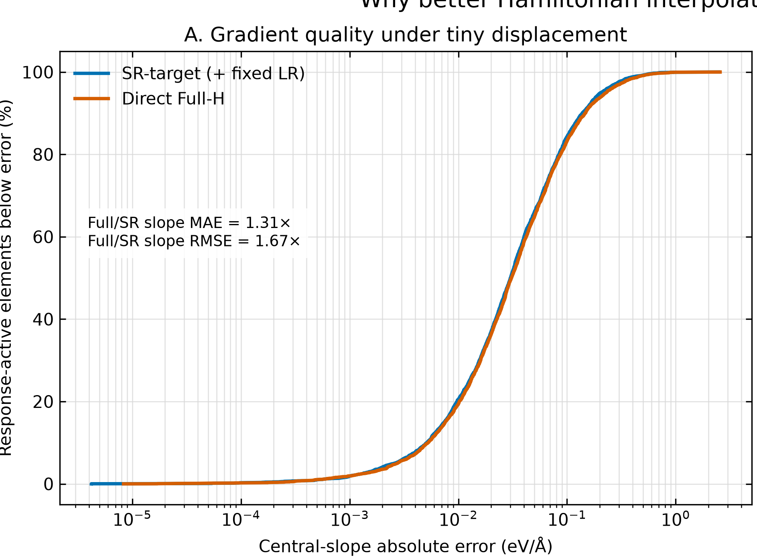
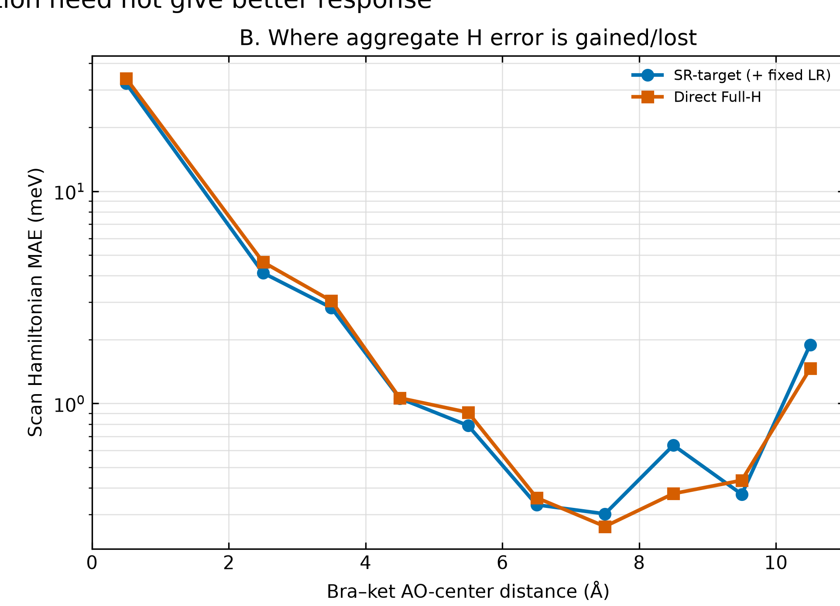
DIAGNOSIS
9
A model can match H while learning the wrong local slope
Direct full-H raw H MAE: 0.785 meV vs SR 0.842 meV · Full/SR slope RMSE: 1.67×
Matched-seed repeats or derivative-aware supervision are needed to separate target design from training variance.
MACE-H-LR · PROJECT UPDATE · 13 AUG 2026
9
Notes:
5:45–6:45. A continuous 25-point Mg-x scan explains the mismatch. Direct
full-H has slightly better raw Hamiltonian MAE, but its central-slope RMSE is
1.67 times worse. In 24.1 percent of matrix elements it is closer in H but
worse in slope. The mechanism is plausible, but because these are independent
training runs, matched-seed repeats or derivative-aware supervision are still
needed to distinguish target design from ordinary training variance.

Slide 10
CORRECTION IN PROGRESS
10
Train HSR, Z*, and ε∞ together—then reconstruct full H
HSR head
local edge output
MACE-H
Analytic HLR
Hfull
Structure
Z* head
R, lattice
shared equivariant backbone
per atom · ASR
differentiable reconstruction
+ Cartesian EPC
ε∞ head
global · SPD
Joint objective: LHSR + LZ* + Lε∞ + LHfull reconstruction + response consistency
MACE-H-LR · PROJECT UPDATE · 13 AUG 2026
10
Notes:
6:45–8:00. This is the corrected implementation. A shared MACE-H backbone
feeds three outputs: the short-range Hamiltonian, an atom-resolved Born-charge
head with the acoustic sum rule enforced, and a global symmetric
positive-definite electronic dielectric head. Those tensors feed a
differentiable analytic long-range reconstruction. The training objective
includes direct tensor supervision and full-H reconstruction; if schedule
allows, I also want a finite-difference response-consistency term. The key
ablation is A/B/C/D: SR only, fixed tensors, learned tensors, and direct full-H.

Slide 11
NEXT STEPS + HANDOFF
11
What I will finish before August 20—and what the group should decide
13
14–15
15–17
17–18
18–19
20
ALIGN
LABELS
BUILD
TRAIN
EVALUATE
HANDOFF
objective + success gates
54-atom Z*/ε∞ fast-vs-anchor gate
heads, loader, constraints, tests
joint smoke + matched-seed ablations
tensor → H → Cartesian EPC
refactor, provenance, runbook
LEAVE BEHIND
GROUP DECISIONS BEFORE AUG 20
Clean physics interfaces · tensor-head configs · A/B/C/D evaluation · tests · frozen provenance · restartable runbook
Paper result or reusable platform? · MgO-only or multi-material? · Denser-q EPC or more tensor labels? · Who owns the next campaign?
MACE-H-LR · PROJECT UPDATE · 13 AUG 2026
11
Notes:
8:00–9:15. The critical path is: validate the fast tensor-label profile against
the anchor, implement and test the two equivariant heads, run a joint-training
smoke and matched-seed ablations, then evaluate in the order tensor accuracy,
Hamiltonian reconstruction, Cartesian EPC. By August 20 I will leave clean
interfaces, configs, tests, provenance, and a restartable runbook. I need the
group to decide whether the continuation is primarily a paper result or a
reusable platform, whether scope stays MgO-only, and whether the next compute
budget goes to denser q or more tensor-labelled structures.

Slide 12
Takeaways
1
The model machinery has been tested on bulk gold.
2
Cartesian MgO EPC works—and revealed a finite-q response failure.
3
The old direct full-H run did not contain Z* or ε∞ heads.
4
The correction is a composed model: HSR + learned tensors + analytic HLR.
5
By Aug 20: tested MVP, refactored code, reproducible handoff, and an agreed next owner/scope.
Questions · priorities for the final week?
Notes:
9:15–10:00. The machinery and Cartesian EPC pipeline are complete. The key
learning is that the previous direct full-H training was not the proposed
long-range architecture. I am correcting that now with explicit Born-charge
and dielectric heads plus analytic reconstruction. Before I leave, I want to
deliver a tested minimum viable implementation and a handoff aligned with the
group's preferred scientific direction. Then stop and invite questions.

Slide 13
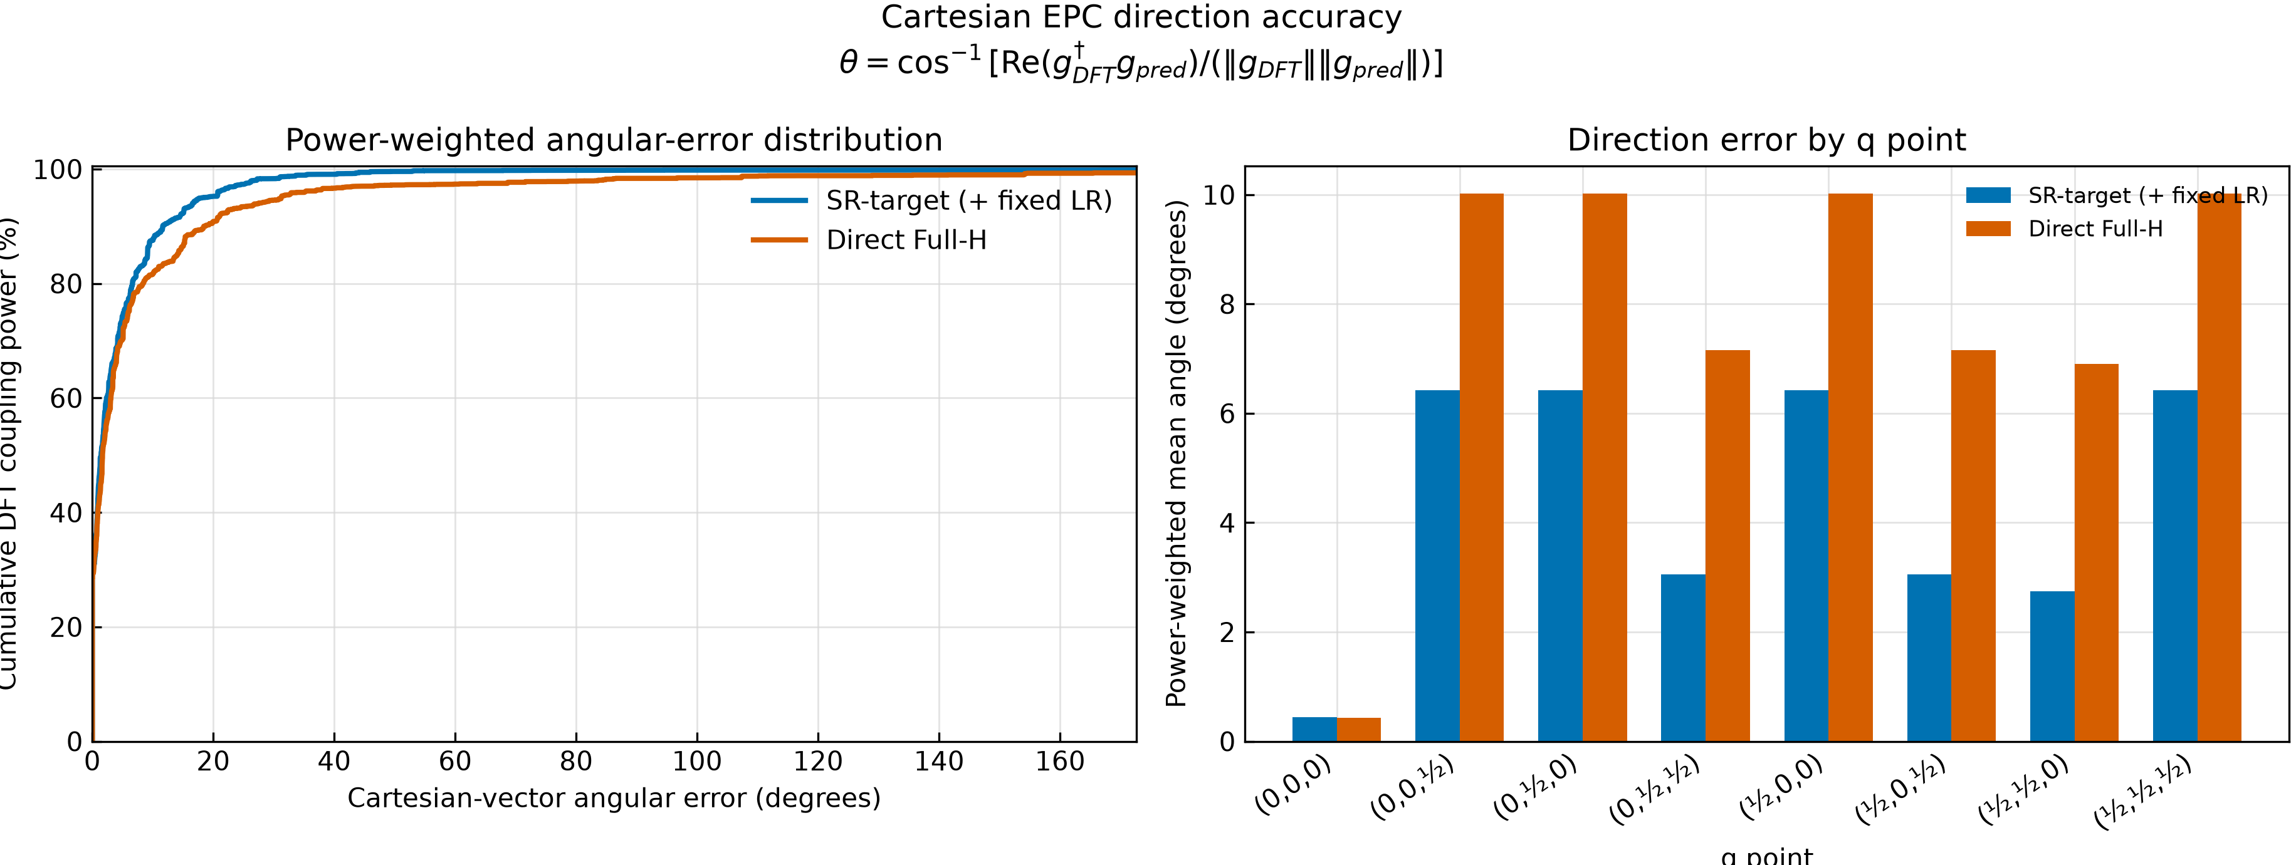
BACKUP · SCOPE
13
What the current EPC tensor does—and does not—establish
ESTABLISHED
• Cartesian AO dH/dτ • 2×2×2 k/q grid • 2 atoms × 3 directions • finite-difference + Hermiticity checks
NOT YET
• band/mode-resolved EPC • phonons + mass/frequency factors • dS/dτ contribution • converged small-q behavior
MACE-H-LR · PROJECT UPDATE · 13 AUG 2026
13
Notes:
Backup. The current result is a Cartesian atomic-orbital Hamiltonian
derivative. It does not yet include phonon eigenvectors and frequencies,
electronic eigenvectors, mass factors, or the overlap derivative, and the
2×2×2 q grid is not a converged small-q study. The direction metric still
shows a consistent checkpoint-level difference across Cartesian components.

Slide 14
BACKUP · EXPERIMENT DESIGN
14
The comparison that will isolate the learned-tensor contribution
A
B
C
D
SR only
SR + fixed LR
SR + learned LR
Direct full-H
CURRENT
CURRENT
NEXT
BASELINE
dHSR/dτ
uses DFPT Z*, ε∞
predicted Z*, ε∞
independent total-H fit
B − A isolates fixed analytic LR · C − A isolates learned tensors · C vs D tests the composed objective
MACE-H-LR · PROJECT UPDATE · 13 AUG 2026
14
Notes:
Backup. A and B exist now and show that fixed LR is negligible on this grid.
D is the current direct full-H baseline. C is the missing learned-tensor case.
B minus A isolates the fixed analytic contribution; C minus A measures the
effect of learned structure-dependent tensors; C versus D answers whether the
composed objective improves the physical response.

Slide 15
BACKUP · EXECUTION
15
If time compresses, preserve the causal test and the handoff
Priority
Must finish
Can defer
1
Tensor-label validity + constrained heads
Large tensor-label campaign
2
A/B/C/D matched comparison
Band/mode projection
3
Restartable code, tests, provenance
Converged dense-q production
Minimum viable handoff: one correct learned-tensor checkpoint + an experiment someone else can reproduce.
MACE-H-LR · PROJECT UPDATE · 13 AUG 2026
15
Notes:
Backup. If the week compresses, the minimum viable outcome is not the largest
campaign. It is valid tensor labels, constrained heads, one matched A/B/C/D
comparison, and a reproducible handoff. Band- and mode-resolved EPC, a large
tensor dataset, and dense-q production can follow after ownership is clear.

