Slide 1

Capital bikeshare demand forecast
A Forecast Analysis of Hourly Bike Rent Based On Historical Data
Jerry Jiang & Jiayi Xian
09/06/2014

Slide 2
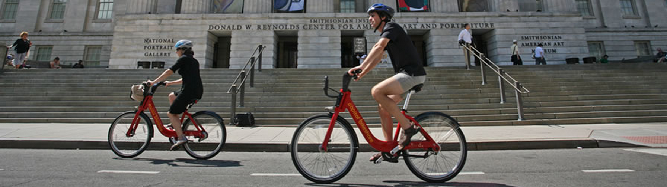
Background
Washington DC bike rental program
Hourly rent data for Year 2011 and 2012
Forecast hourly demand for days after 20th in each month

Slide 3
DATA source
Kaggle Analytics Competition (Due 05/29/2015)
Training set: 10,086 rows
Testing set: 6,493 rows
Variables: Weather Related + Datetime Related
Demand: # Bike Rents
Data Source: http://www.kaggle.com/c/bike-sharing-demand

Slide 4
Exploratory Analysis

Slide 5
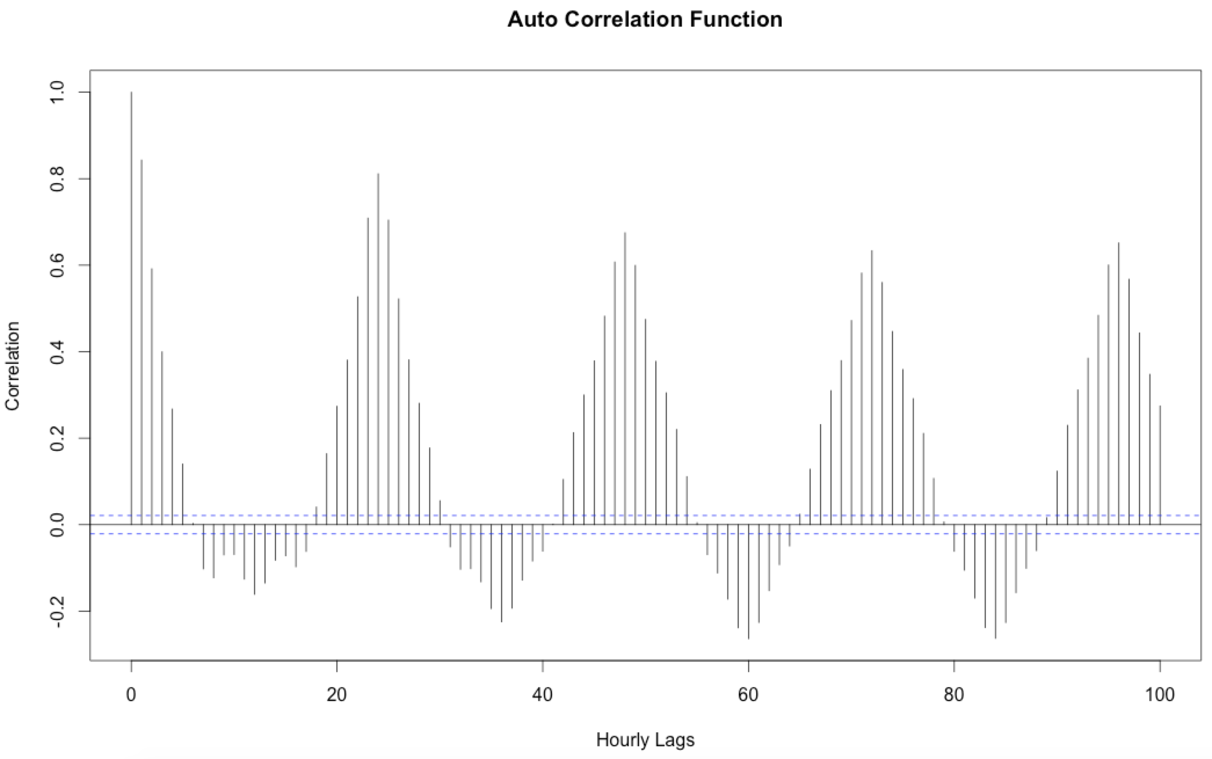
Hourly Rent is Auto-correlated and cyclic in hourly Time Series
5 lags auto correlation
~ 24 periods cycle
* Hourly Rent In Hourly Time Series

Slide 6
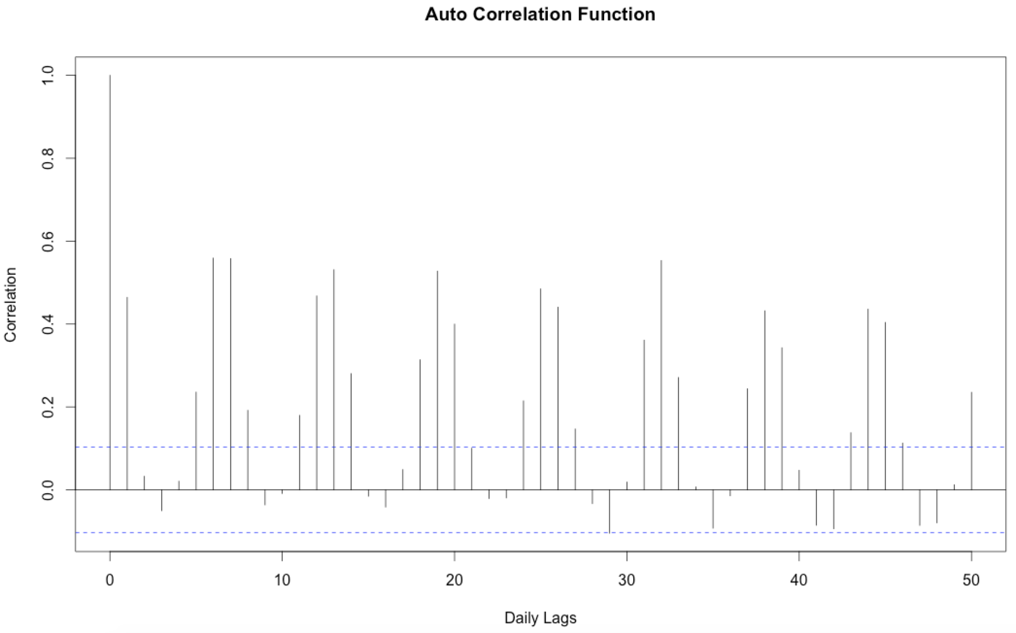
Hourly Rent is highly cyclic in daily Time Series
Data: Rent at 8 AM
~ 7 periods cycle
* Hourly Rent In Daily Time Series

Slide 7
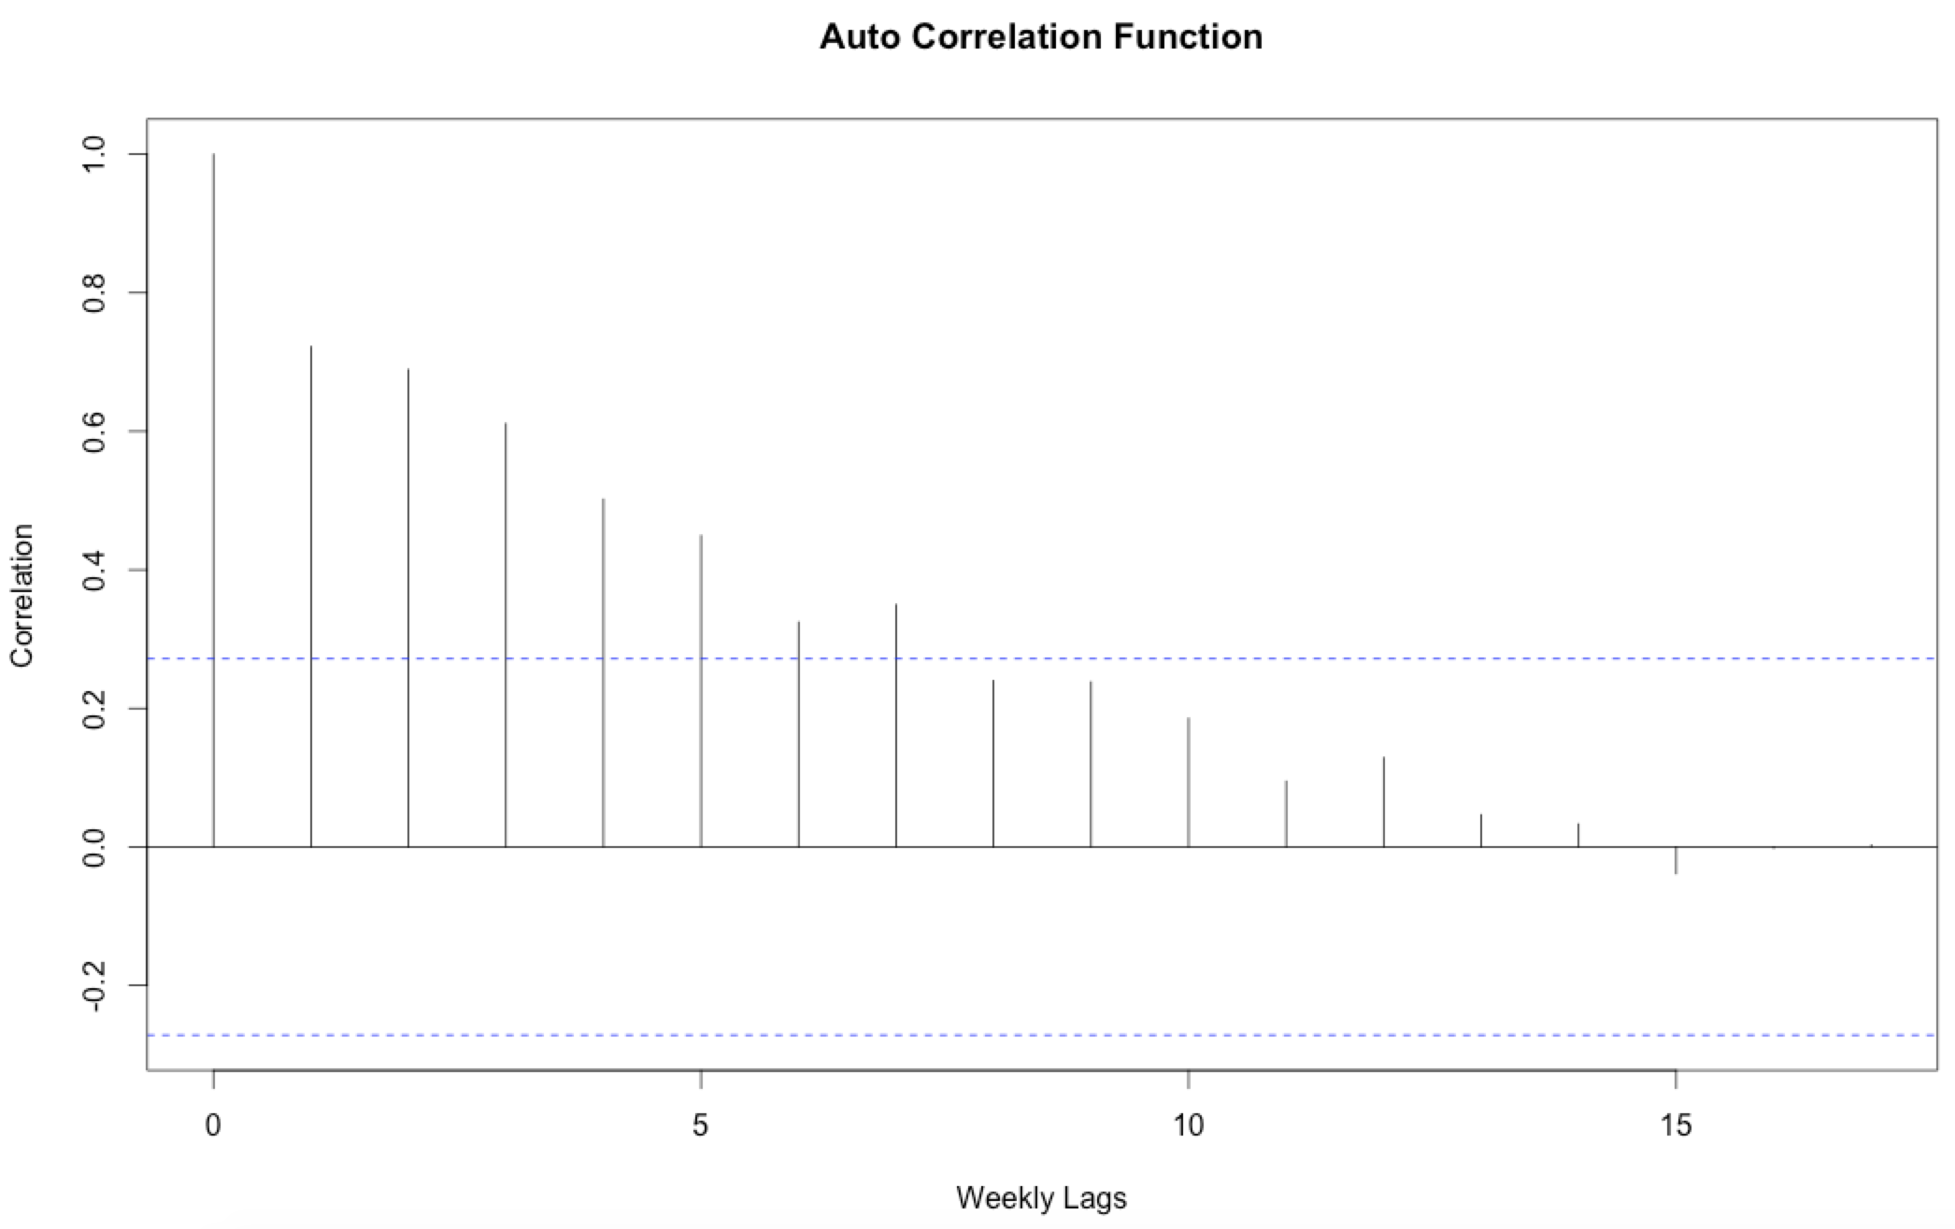
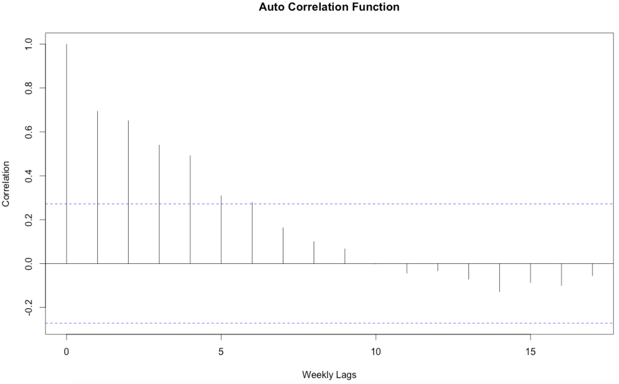
Hourly Rent is AUTO-correlated in weekly Time Series
~ 5 lags auto correlation
* Tuesday 4 PM Rent In Weekly Time Series
* Sunday 8 AM Rent In Weekly Time Series

Slide 8

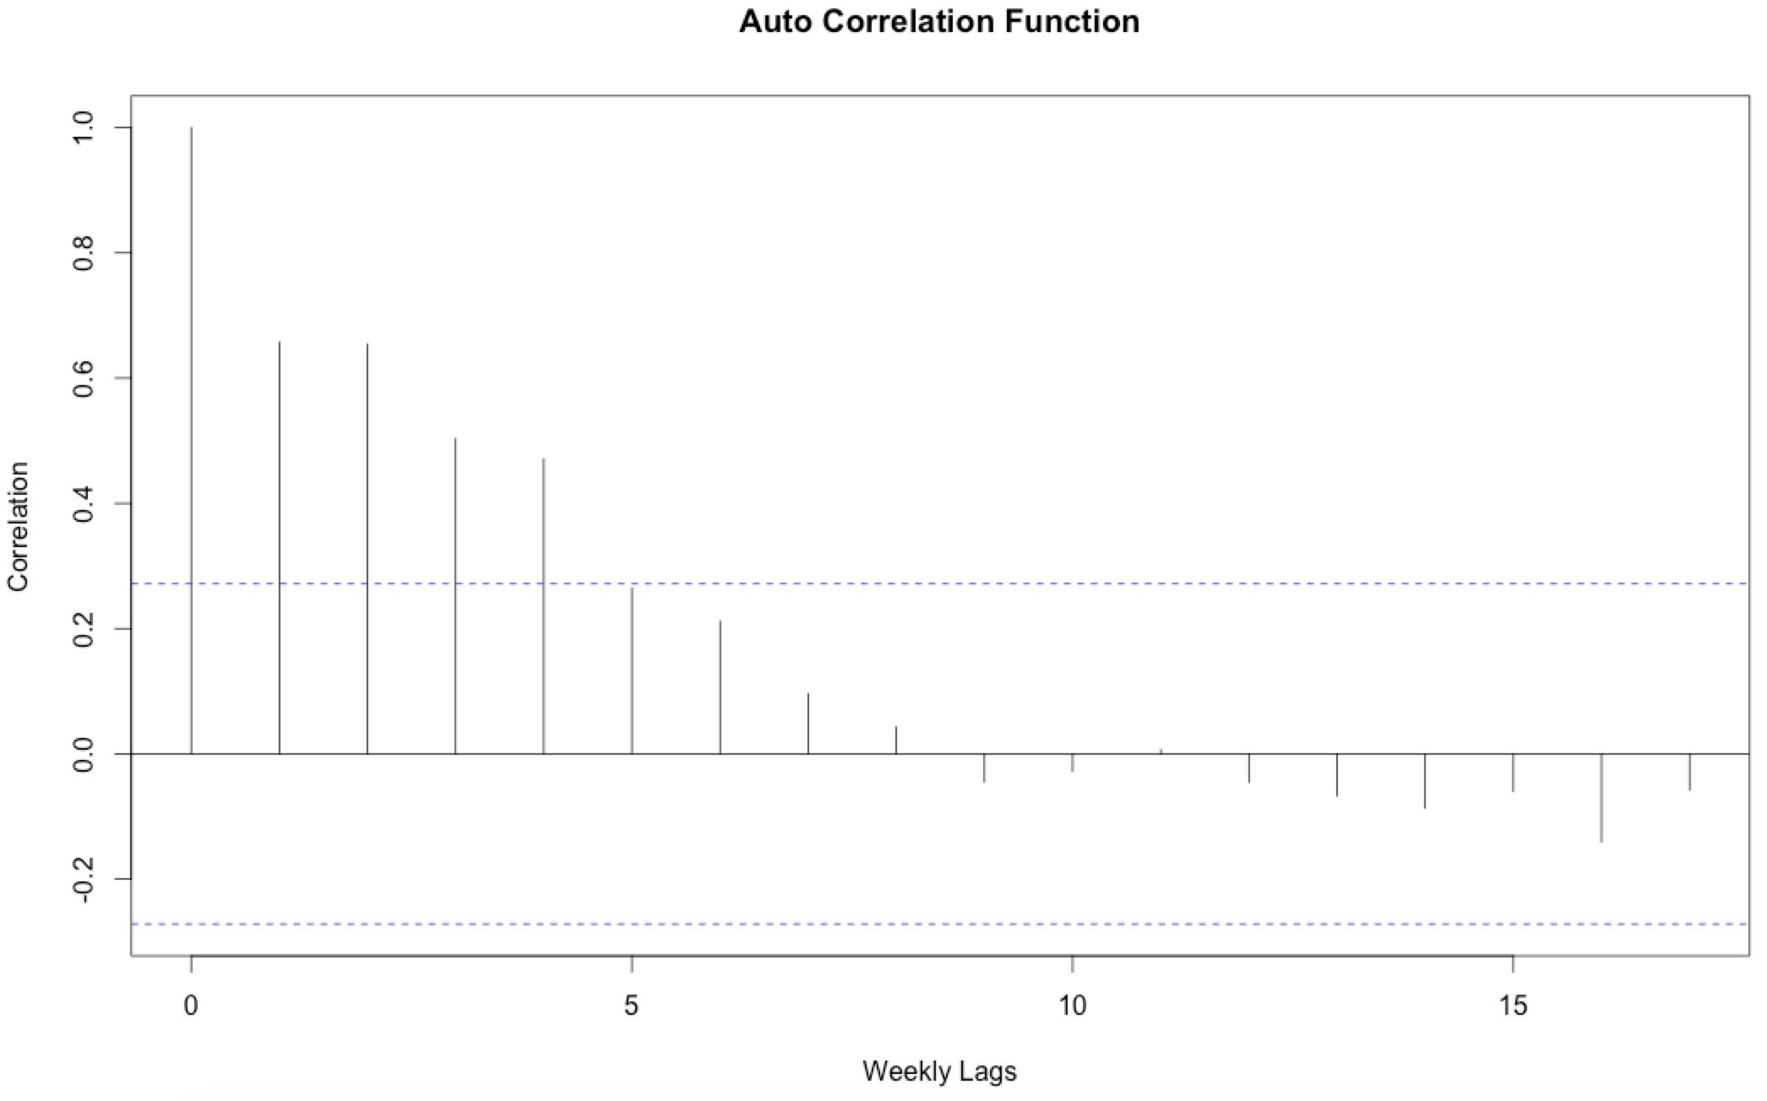
Daily Rent is AUTO-correlated in weekly Time Series
Left: Rent at Tuesday
Right: Rent at Sunday
1 lag auto correlation
~ 7 periods cycle
* Tuesday Rent In Weekly Time Series
* Sunday Rent In Weekly Time Series

Slide 9
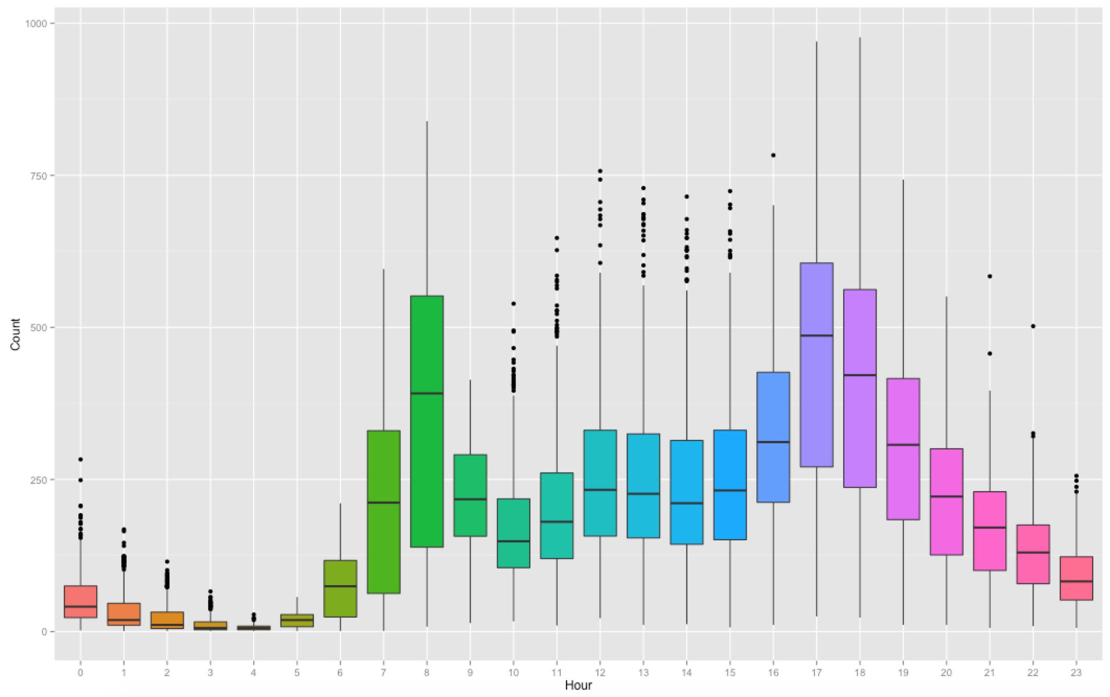
Significant Difference in hourly rent
* Rent of 24 Hours Over 2 Years

Slide 10
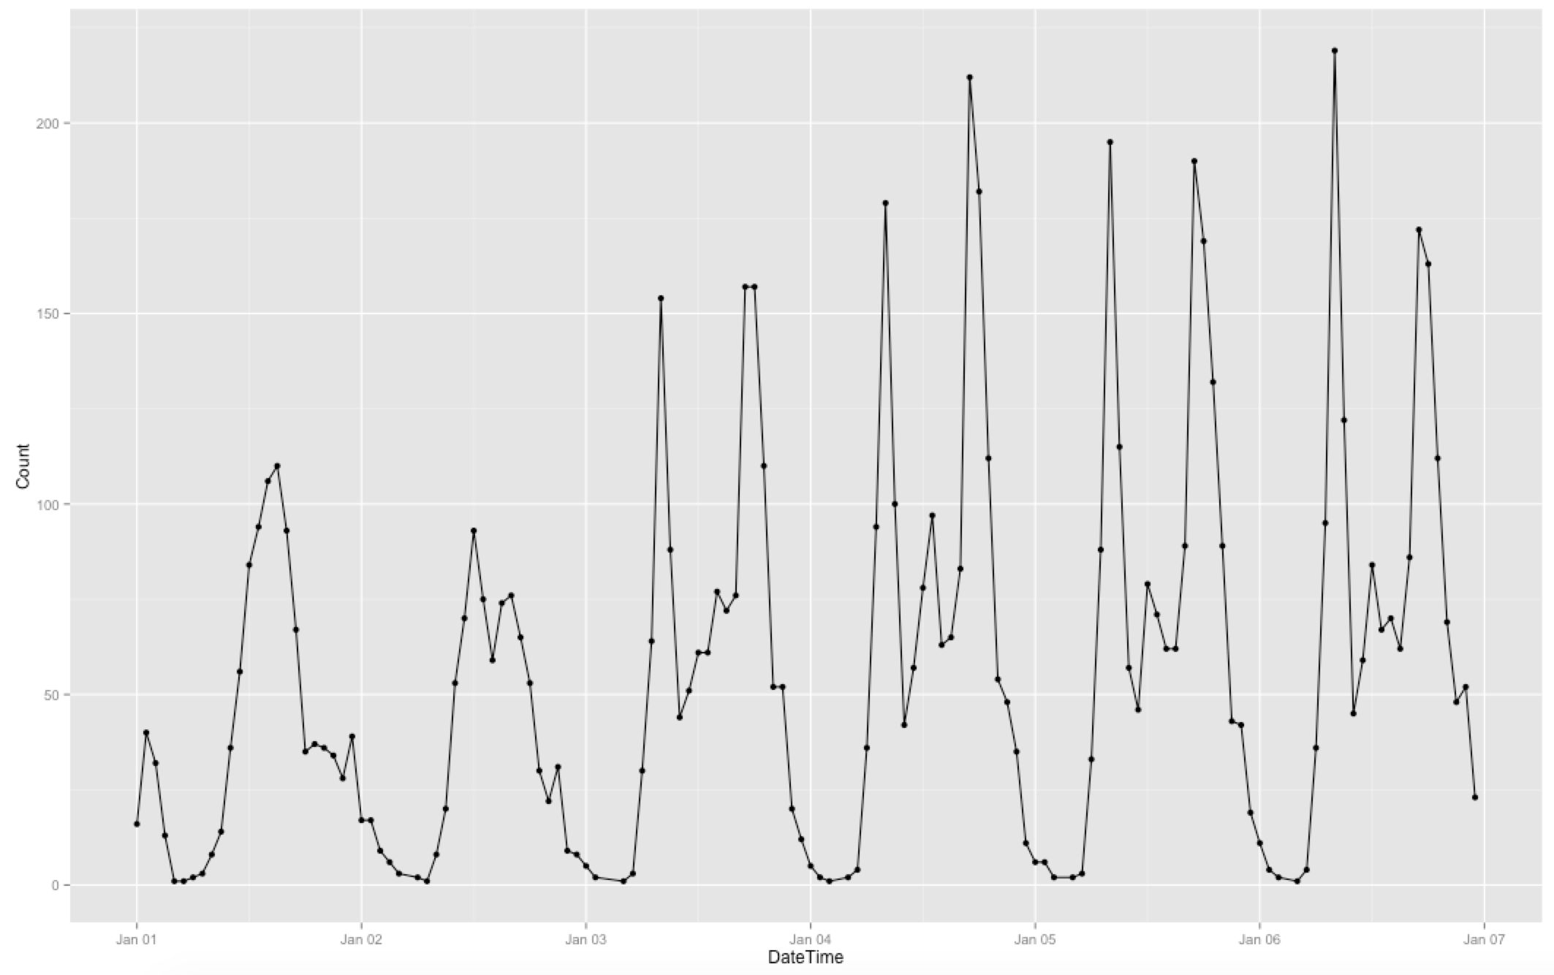
Daily peaks and trough
2 daily peaks at ~ 8 AM and 6 PM
1 daily trough at midnight
* Hourly Rent Between 01/01/2011 – 01/07/2011

Slide 11
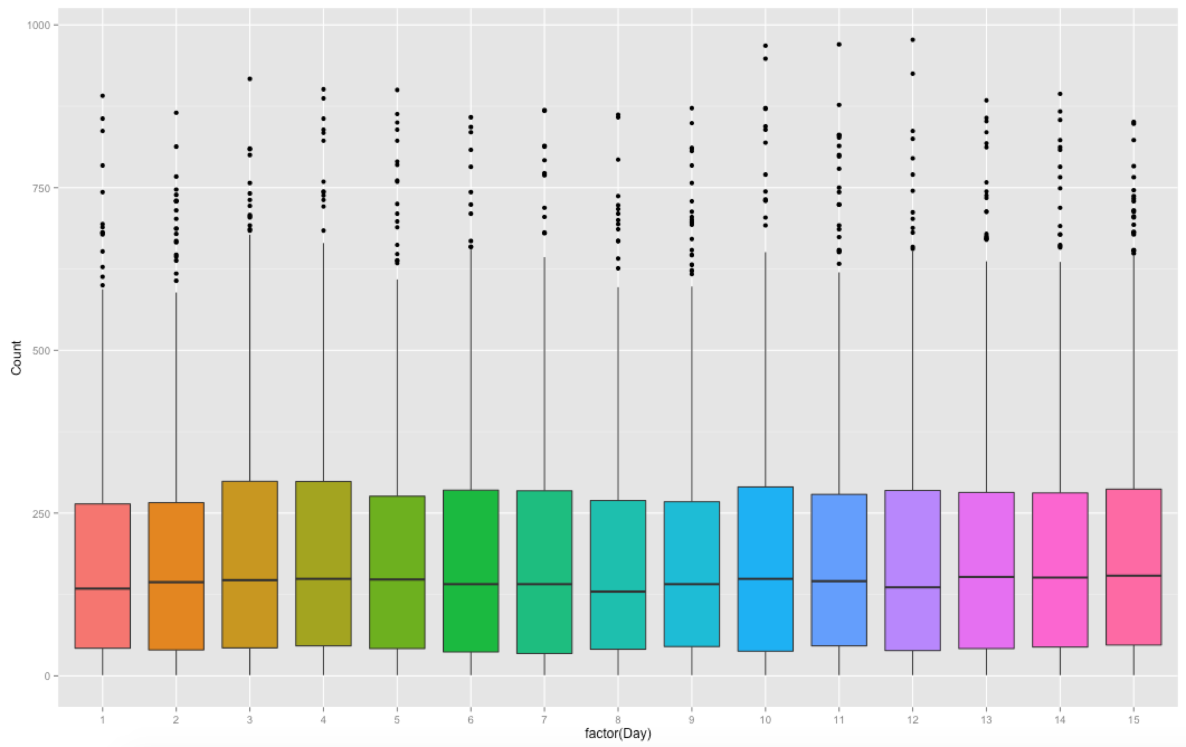
NO significant different in each day of a month
* Hourly Rent For Each Day In a Month

Slide 12
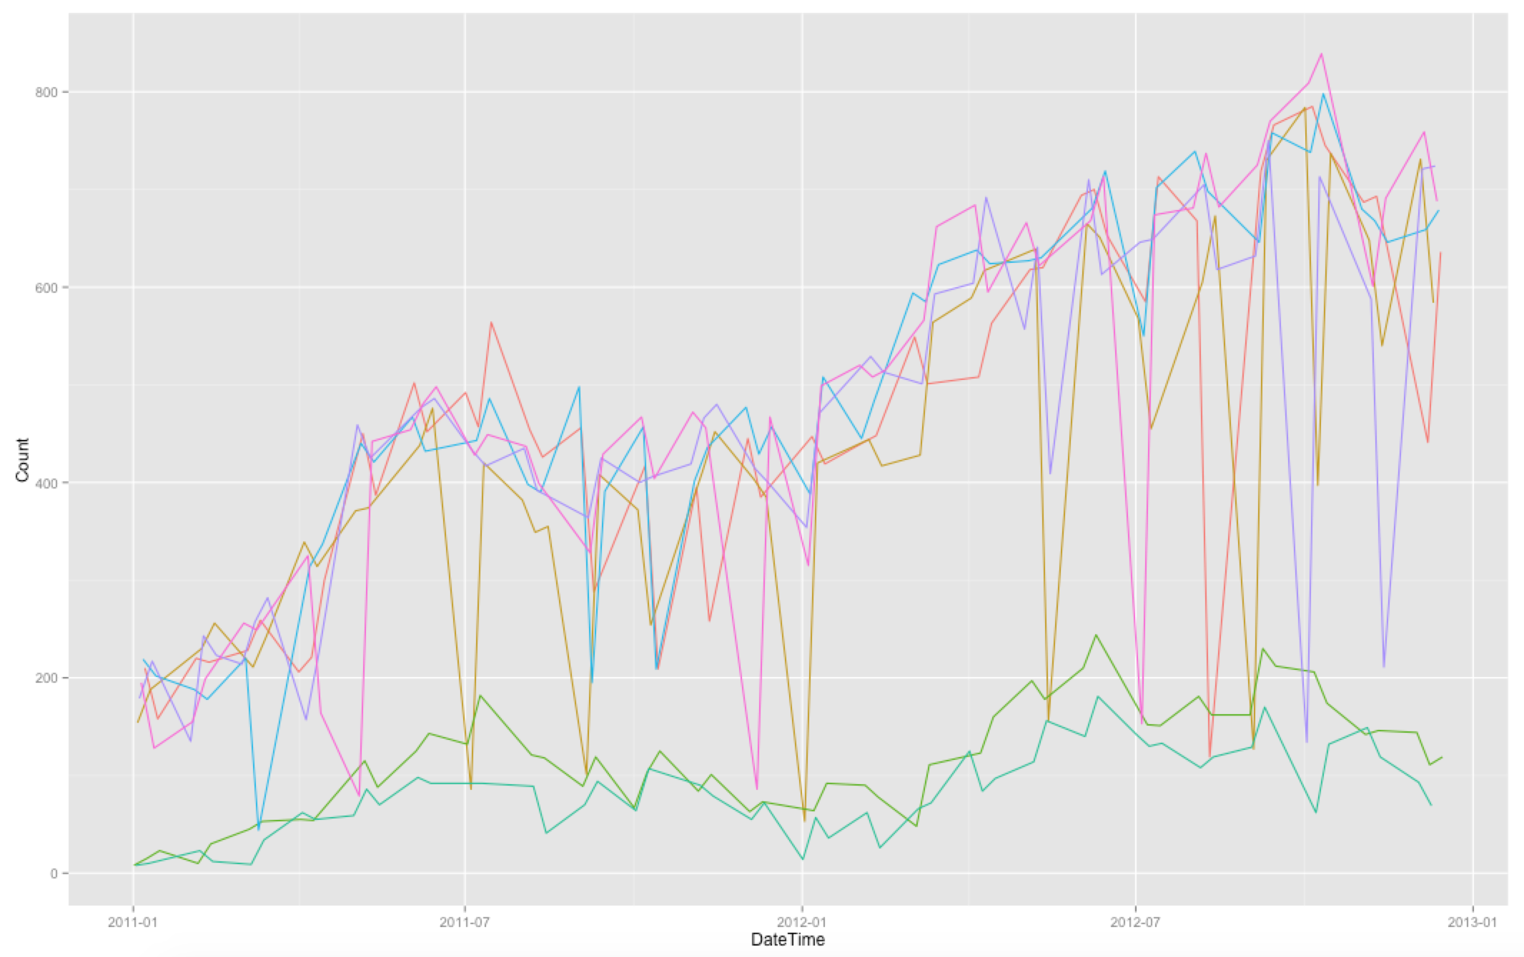
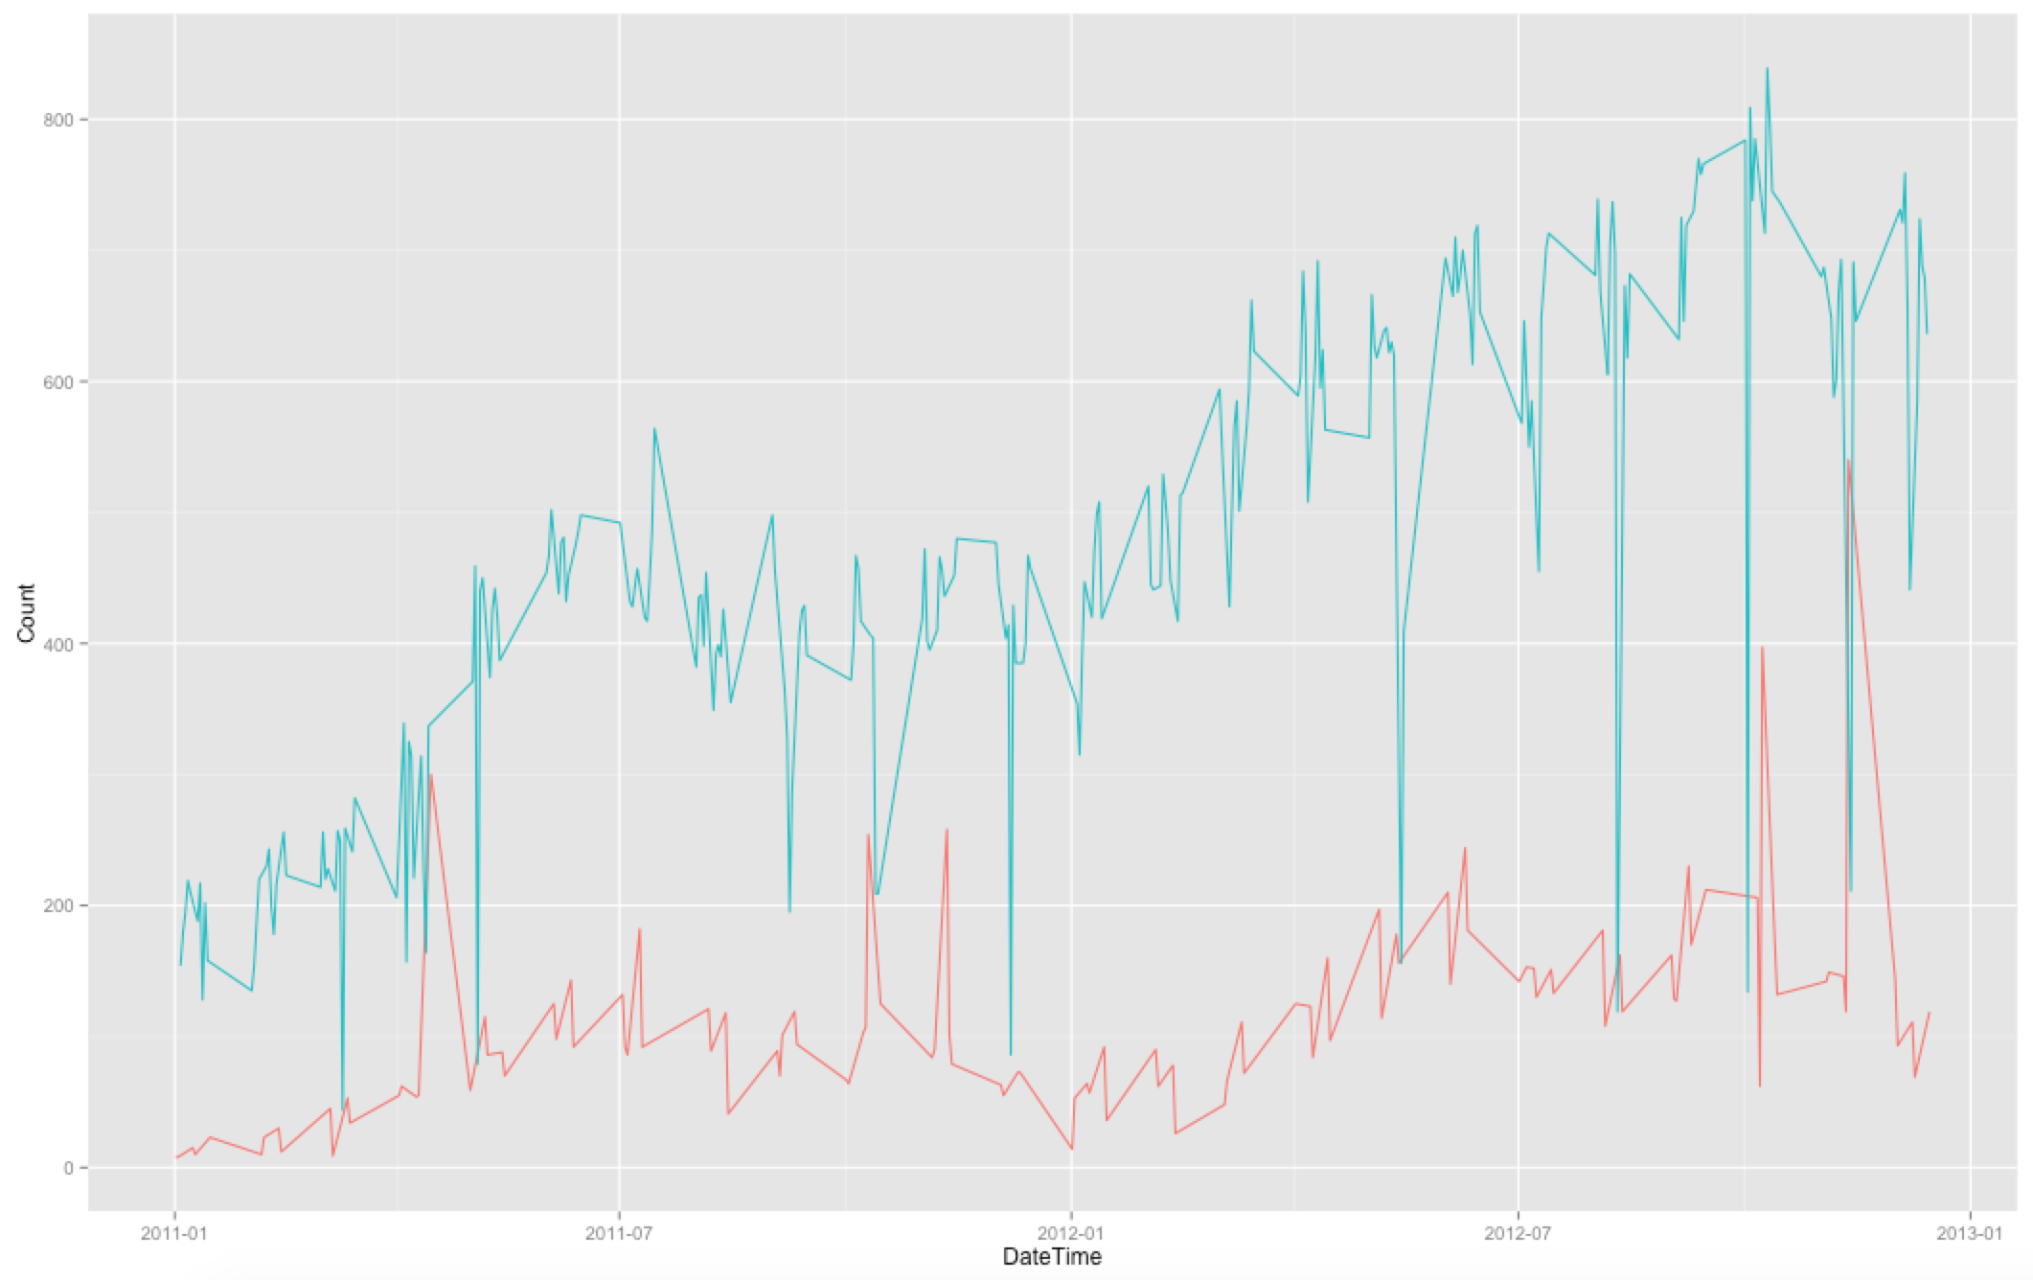
significant different in weekday and weekend
* 8 AM Rent For Each Day In a Week
* 8 AM Rent For Workday/Weekend

Slide 13
More slides on variable correlations

Slide 14
Influence From Exploration
Time Series Analysis: 5 Lags
Cycle: Hour + Weekday

Slide 15
Data
Validation

Slide 16
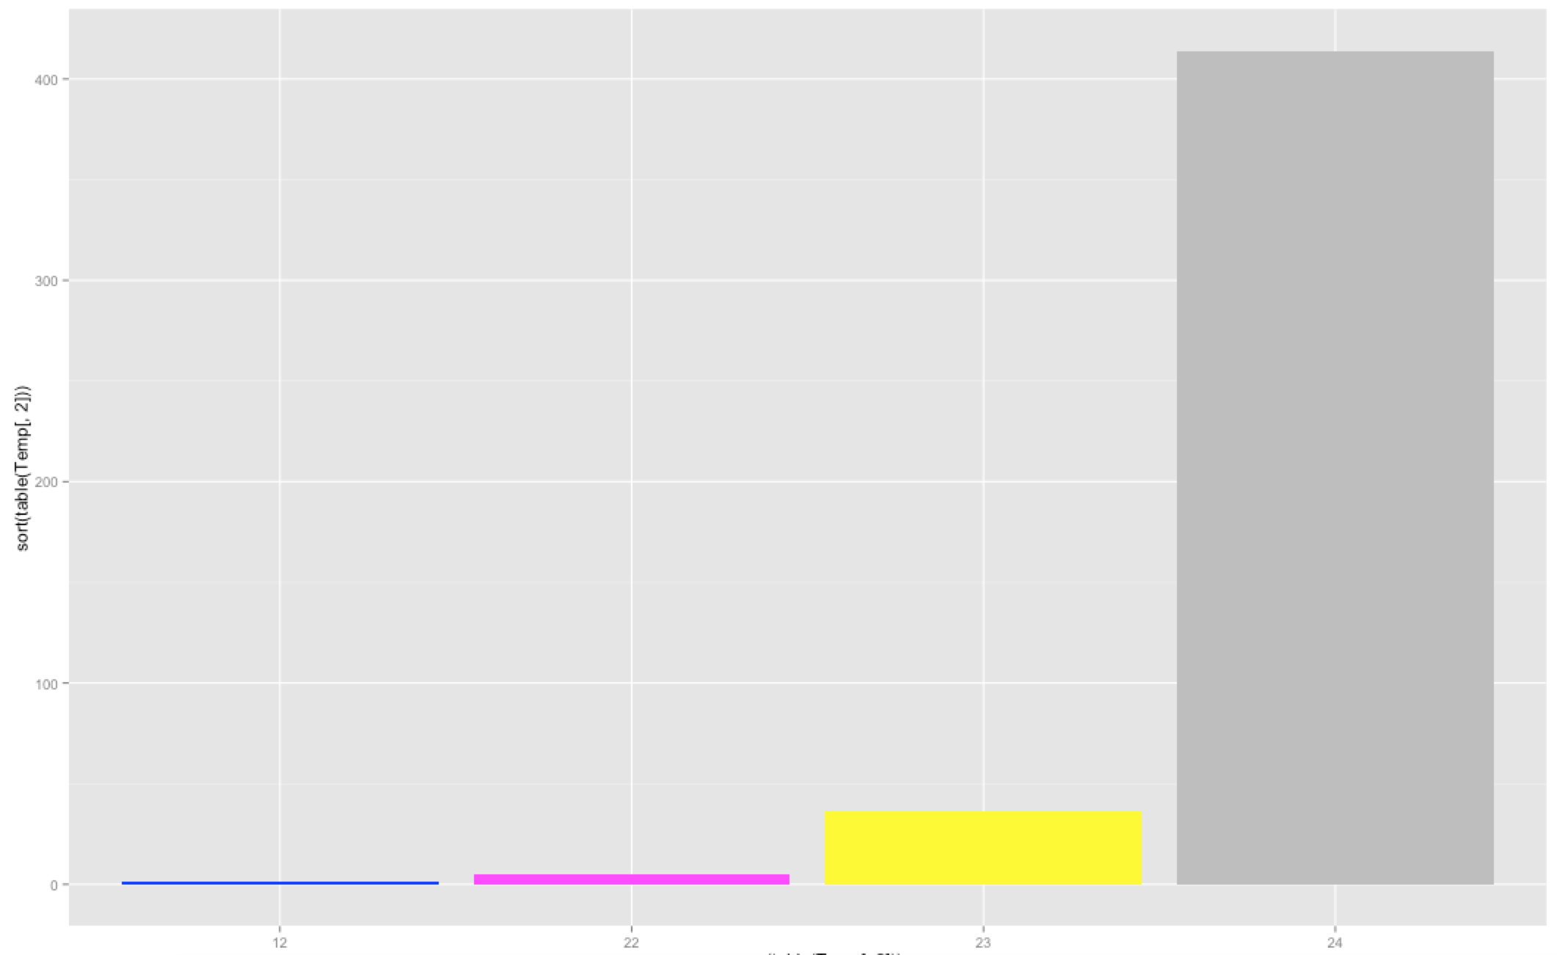
Non-continuous time series
10% of days do not have 24 hours data

Slide 17
Other Data Quality
No Zero-Variance Variable
One Near-Zero-Variance Variable (Categrical)
Temperature and temperature feeling are highly correlated
No Linear Combination

Slide 18
Variable
Transformation

Slide 19
Box-cox transformation

Slide 20
Logarithm transformation

Slide 21
Building
Models

Slide 22
Mixed Stepwise regression

Slide 23
Lasso models

Slide 24
other models

Slide 25
Prediction

Slide 26
Prediction Logics

Slide 27
In-sample vs. out-of-sample

Slide 28
Outlook

Slide 29
Potential issues and improvement

Slide 30
Implication

