Slide 1
DSS5105 · TRACK 1 · WEEK 9 · 5 MINUTES
SweaterCo -- your data companion
Sprint 1 review · Group 10 · 16 October 2026
One promise: the manager does not write SQL, and one question returns a result they can check. This is not a product launch. We are here to show the problem is worth solving, and that the first cut has already met a real question.
Group 10 · Sprint 1 · Edit the text in place
1 / 8

Slide 2
01 PROBLEM
One day at SweaterCo.
You are the GM.
7:00 AM
9:40 AM
11:15 AM
2:30 PM
5:00 PM
Anything wrong
yesterday?
Where is
the order?
800 hoodies
by the 25th?
It hasn't
moved
Still chasing
what's late
Five questions
One busy day
One common problem
Notes:
Imagine you're the General Manager of SweaterCo.
It's 7 AM. You want to know: "Did anything go wrong yesterday?"
At 9:40, you're checking the status of a customer order.
By 11:15, another customer wants 800 hoodies delivered by the 25th. Can your factory handle it?
And by 5 PM, you're still chasing delayed orders.
Five questions. One busy day. And one common problem.

Slide 3
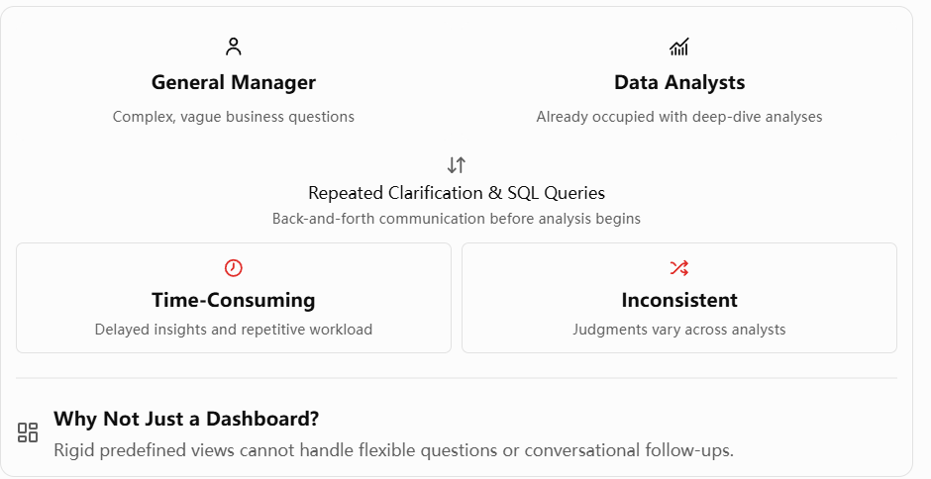

01 PROBLEM
You need answers.
You don't know SQL.
THE GM
THE ANALYST
GAP
Knows the business.
Cannot write the query.
Knows the data.
Already on harder work.
WHAT FOLLOWS
01 Wait
02 Clarify again
03 Query by hand
04 Answers differ
Not a dashboard. Only metrics chosen in advance.
Not a lack of data.
The gap between the question and the answer.
Notes:
You need answers, but you don't know SQL.
So, every question goes to your Data Analyst.
And here's the challenge.
The GM understands the business, but may not know how to translate a business question into a precise data query.
The analyst understands the data, but is already busy with more complex work.
What follows? Repeated clarification, manual queries, and waiting.
And sometimes, different analysts interpret the same question differently.
Could a dashboard solve this?
Not really. Dashboards can show predefined metrics, but business questions don't always follow predefined paths.
The real bottleneck isn't a lack of data. It's the gap between business questions and data-driven answers.

Slide 4
02 SOLUTION
Clarification is all you need.
Closing the gap between the business question and the answer.
SweaterCo
An AI-powered data companion.
FROM
TO
Everyday business questions
Actionable insights
Don't just answer the question.
First, make sure we understand it.
Notes:
And that's exactly the gap we're trying to close.
Introducing SweaterCo: an AI-powered data companion that turns everyday business questions into actionable insights.
Our key idea is simple:
Don't just answer the question. First, make sure we understand it.

Slide 5
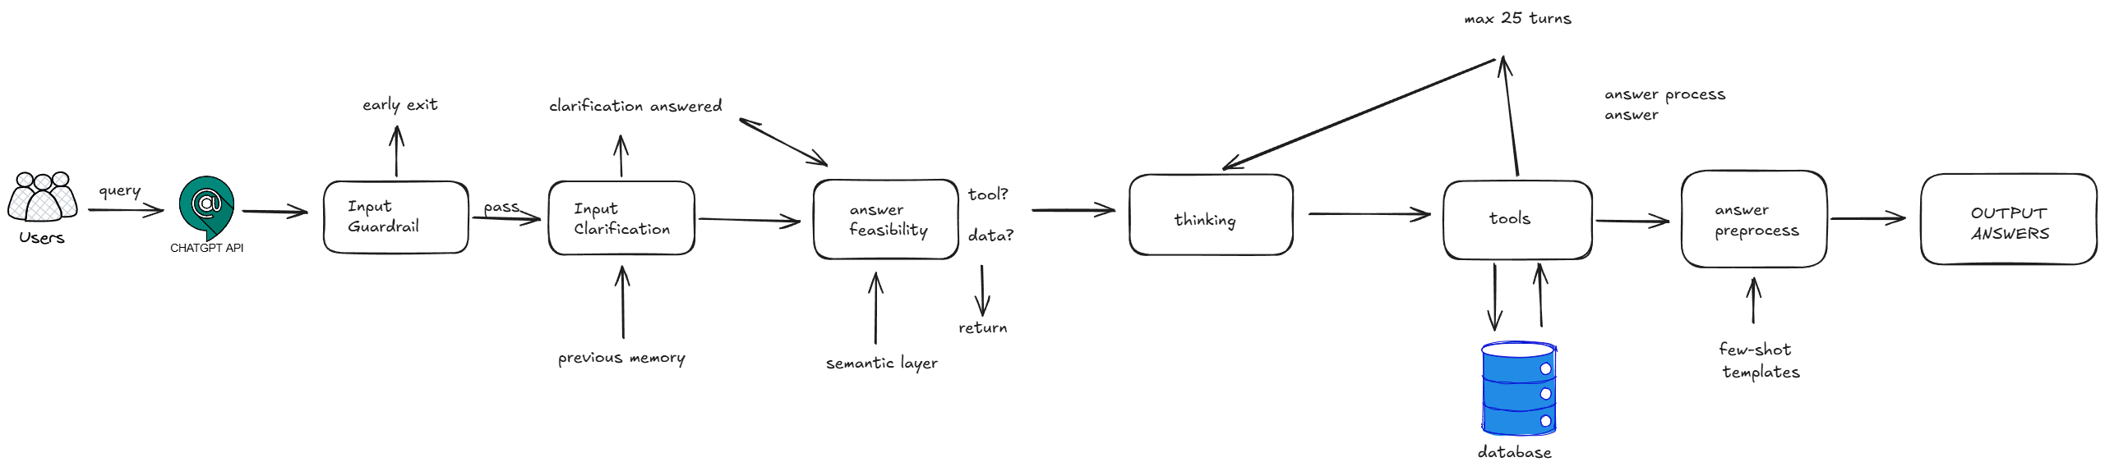
02 SOLUTION
How it works
01
Input guardrail
Is the request appropriate?
02
Clarification MOST IMPORTANT
Understand the question before answering.
03
Feasibility check
Can the available data answer it?
04
AI agent
Select tools. Retrieve. Analyze.
Architecture diagram
Place the figure here
05
Answer templates
Clear, business-friendly explanations.
THE GM ASKS
"How is the TrendCart order doing?"
We do not guess what "doing" means.
WE ASK
Are you concerned about...
Production progress · Delivery status · Potential delays
No database tables. No SQL.
Just the business.
Notes:
Here's how it works.
First, an input guardrail checks whether the request is appropriate.
Then comes the most important part: clarification.
Imagine the GM asks, "How is the TrendCart order doing?"
Instead of guessing what "doing" means, our system can ask: "Are you concerned about production progress, delivery status, or potential delays?"
Once the question is clear, a feasibility check determines whether the available data can answer it.
Then our AI agent selects the appropriate tools, retrieves information, and performs the necessary analysis.
Finally, standardized answer templates turn those results into clear, business-friendly explanations.
The GM doesn't need to understand database tables or write SQL.
They just need to understand their business.

Slide 6
03 VALUE
What changes?
Faster
Clearer
Sounder
Routine questions no longer wait in the analyst's queue.
The system helps the GM clarify vague questions, so less time goes to back and forth.
Grounded in predefined tools and explicit business logic. Every result is traceable and explainable.
Not replacing analysts. Freeing them for the deeper work.
Faster answers for managers. More time for analysts.
Notes:
So, what changes?
Three things: Faster. Clearer. Sounder.
Faster, because routine questions no longer need to wait in the analyst's queue.
Clearer, because the system helps the GM clarify vague questions, reducing the time spent on back-and-forth communication.
Grounded, because answers are built on predefined tools and explicit business logic, making every result traceable and explainable.
This isn't about replacing Data Analysts.
It's about freeing them from repetitive requests so they can focus on the deeper analysis where their expertise matters most.
We give managers faster access to answers, and analysts more time for meaningful work.

Slide 7
04 RISK
Four key risks.
Risk | Probability | Risk | What can go wrong | How we respond
Expense | High | High | Complex agent reasoning and frequent testing can drive high operating cost. | Stricter API usage rules for the team.
Hallucination | Medium | High | The agent may give an inaccurate answer, or misread an analytical result. | Python business rules, few-shot templates, and evaluation against verified answers.
Data quality | Low | Medium | Incomplete, outdated, or inconsistent data can mislead, or leave a question unanswered. | A data feasibility check, and a semantic layer that fixes the form of the data.
Adoption | Medium | Medium | GMs and analysts may hesitate, worried about accuracy, transparency, and the change in how they work. | Transparent explanations, traceable results, and gradual adoption with human oversight.
ASSUMPTIONS
For this first prototype
Full GM data access
The GM can see every record in the database. There is no extra permission gate.
Reliable database records
We treat the data as accurate, complete, and true to how the factory runs.
Fixed reference date
Every time-based answer uses 1 April 2026 as today.
Notes:
Of course, we've identified four key risks.
First, cost. Agentic reasoning can be expensive, so we've introduced tighter API usage controls to manage our budget.
Second, hallucination. AI may generate inaccurate answers, so we use predefined tools, explicit business logic, and structured prompts to reduce this risk.
Third, data quality. Poor data can undermine our analysis, so we've conducted data reviews, established a semantic layer, and expanded the dataset where necessary.
Finally, adoption. GMs may struggle to trust AI-generated answers, so we'll improve transparency and explainability in future sprints.
For this first prototype, we operate under several assumptions, including full GM data access, reliable database records, and a fixed reference date.

Slide 8
05 SPRINT 2
Three priorities.
From a full-team evaluation.
01
03
Core value
Trust
Sharpen the business logic.
Clarify the vague question.
Speed up the agent workflow.
Show the result, and why.
The why sits on the data and the tools.
02
The gaps we found
Interactive visuals for the result.
Memory that keeps the conversation.
SUCCESS
A vague question is clarified before the answer.
The conversation continues, and the result can be explored.
The reasoning is written out, from the data and the tools.
Beyond a working prototype.
Notes:
Looking ahead to Sprint 2, we've conducted a systematic internal evaluation, gathering feedback from every team member.
Based on this feedback and our project goals, we've identified three priorities for future development.
First, strengthening our core business value. We'll refine business logic for clearer insights, improve clarification to reduce ambiguity, and optimize agent workflows for faster responses.
Second, addressing gaps identified in our internal evaluation. We'll improve how results are presented through interactive visualizations and strengthen conversation memory to support more continuous and reliable interactions.
Finally, managing our key risks, especially trust. We'll make our answers more transparent and explainable, showing not just what the result is, but why, supported by underlying data and tools.
Our goal is to move beyond a working prototype toward a reliable, practical data companion for everyday business decisions.
Sprint 2 is a success when three things are true. A vague question is clarified before the answer. The conversation continues, and the result can be explored. The reasoning is written out, from the data and the tools.

Slide 9
7:00 AM · THE SAME QUESTION
"Did anything go wrong yesterday?"
This time, the GM asks SweaterCo.
Not a data fetcher.
A data companion.
Thank you.
Group 10 · Sprint 1
Notes:
It's 7 AM again.
The same question: "Did anything go wrong yesterday?"
But this time, instead of sending another request to an analyst, the GM simply asks SweaterCo.
And that is the future we're building.
Not just a data fetcher. A data companion.
Thank you.

