Slide 1
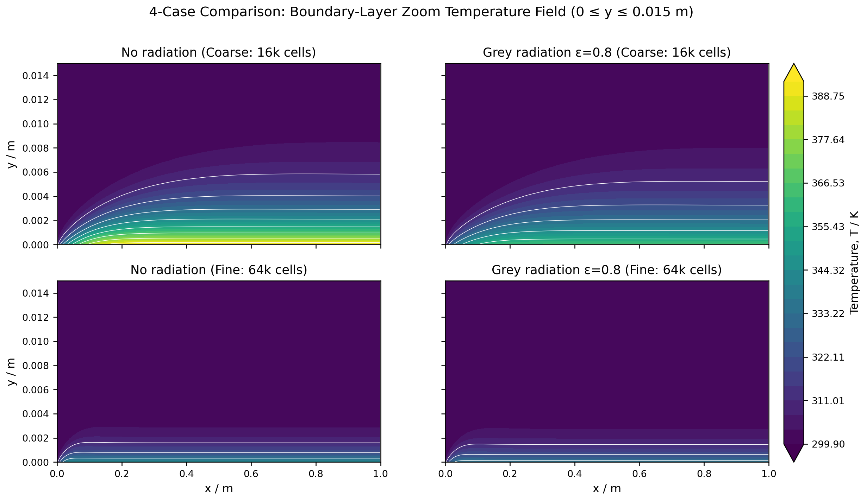
BOUNDARY LAYER CFD | OPENFOAM 13
Surface Radiation Cuts Flat-Plate Wall Temperature by 6.98 K
Coupled convection-radiation CFD in OpenFOAM 13, validated against Blasius similarity
Fig. 1: Near-wall boundary layer temperature contours across test matrix.
Jerlin S. | Boundary Layer CFD Research | October 2026
Notes:
This presentation establishes that conjugated surface thermal radiation meaningfully depresses wall temperatures in heated laminar flat-plate flows. Using OpenFOAM 13, we couple grey-diffuse surface radiation (ε = 0.8) to an external 300 K environment using a custom in-situ Newton-Raphson boundary algorithm. Hydrodynamic skin friction validates against Blasius similarity within 0.11%, providing a solid computational baseline for conjugated heat transfer. Source: results/figures/four_case_temperature_zoom.png.

Slide 2
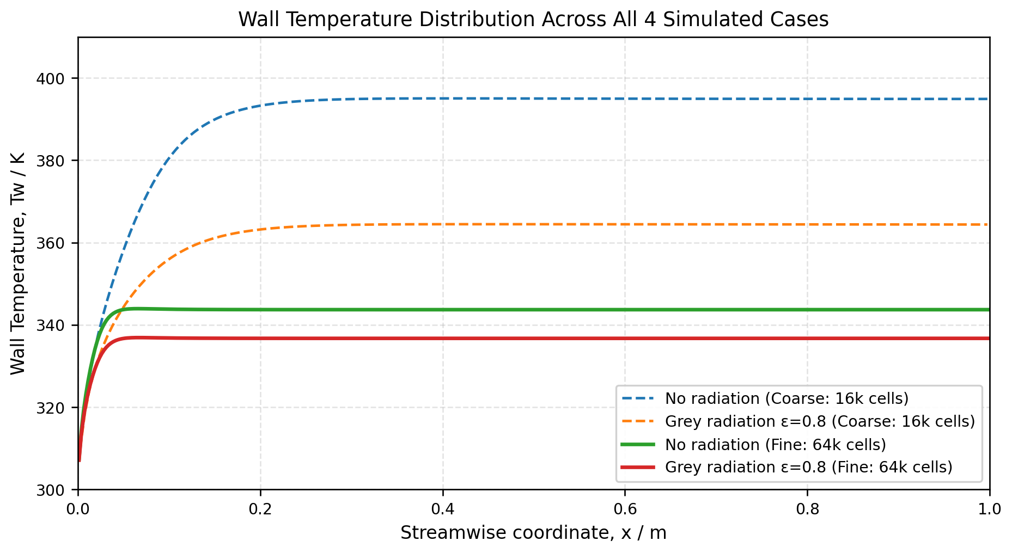
Neglecting Surface Radiation Overpredicts Heated Wall Temperatures
• Plate wall temperature depends strictly on competing heat rejection pathways.
• Convective cooling drops downstream as hydrodynamic boundary layers thicken.
• Standard CFD workflows frequently omit radiation, overpredicting component peak temperatures.
Heater Heat Flux: q″ = 1000 W/m² (uniform)
Fig. 2: Streamwise wall temperature distribution along heated flat plate.
2
Notes:
In forced convection cooling designs, engineers frequently omit thermal radiation at moderate temperature rises, assuming convection dominates. However, because convective heat transfer coefficients decrease downstream proportional to x^(-0.5), convective resistance steadily rises toward the trailing edge. Neglecting radiative dissipation leads to systematic overprediction of peak wall temperatures. Source: results/figures/wall_temperature_all_cases.png.

Slide 3
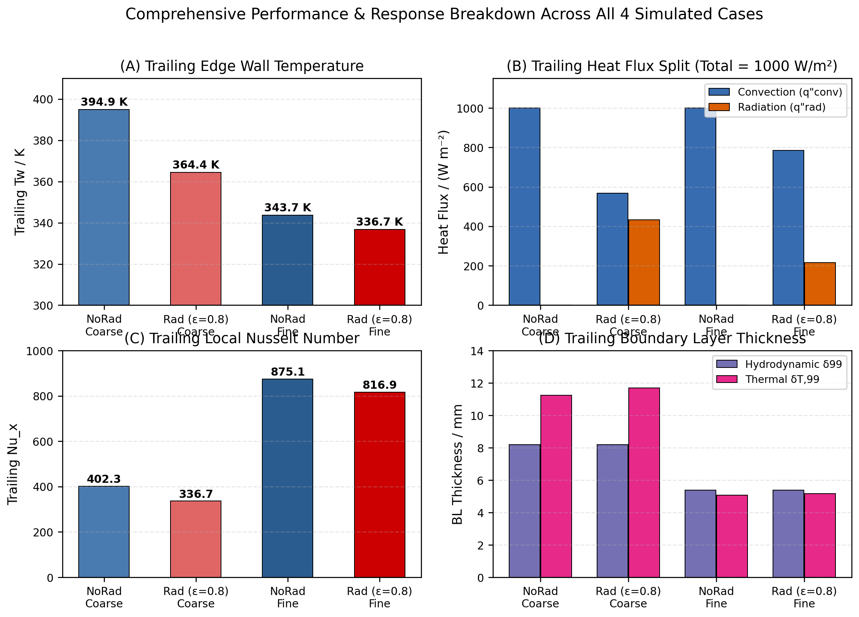
Four-Case Computational Matrix Isolates Radiation and Grid Effects
2 × 2 Factorial Simulation Matrix
Case Identifier | Grid (nx×ny) | Cells | Emissivity ε | Heater q″
noRadiation_coarse | 200 × 80 | 16,000 | 0.0 (Pure) | 1000 W/m²
noRadiation_fine | 400 × 160 | 64,000 | 0.0 (Pure) | 1000 W/m²
surfaceRadiation_coarse | 200 × 80 | 16,000 | 0.8 (Coupled) | 1000 W/m²
surfaceRadiation_fine | 400 × 160 | 64,000 | 0.8 (Coupled) | 1000 W/m²
• Plate length L = 1.0 m, free-stream velocity U_inf = 2.0 m/s.
• Ambient and enclosure temperatures held constant at 300 K.
• Reynolds number Re_L = 1.258 × 10⁵ preserves laminar flow regime.
Fig. 3: Comprehensive parameter breakdown across all four cases.
3
Notes:
We execute a 2x2 factorial simulation matrix crossing two structured grid densities (16,000 versus 64,000 cells) against two surface emissivity states (ε = 0.0 for pure convection and ε = 0.8 for coupled radiation). The plate operates under steady 2.0 m/s laminar flow at Re_L = 1.258 × 10⁵ with uniform 1000 W/m² base heat flux. This systematic matrix allows rigorous separation of discretization sensitivity from radiative cooling. Source: results/case_audit.csv.

Slide 4
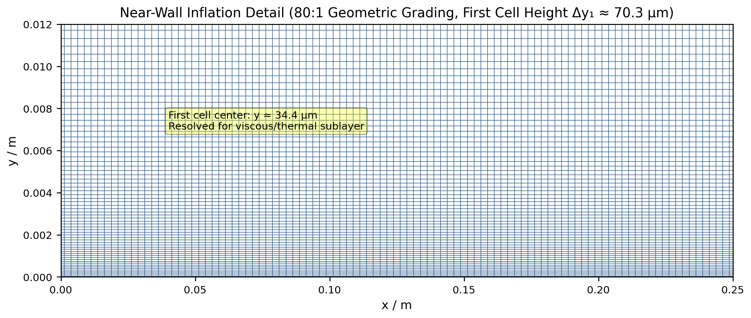
80:1 Wall Grading Resolves Viscous and Conductive Sublayers
41 Cells in 5 mm
Near-wall inflation zone resolves thermal gradients
Δy₁ = 70.3 μm
First cell wall-normal height on 64k fine grid
• Domain includes 1.0 m unheated inflow section to develop boundary layer.
• Geometric wall-normal grading of 80:1 concentrates 41 cells in 5 mm.
• Fine 64,000-cell mesh maintains zero non-orthogonality and skewness.
Fig. 4: Structured inflation mesh near heated plate leading edge (80:1 grading).
4
Notes:
The domain spans 2.0 m in length (a 1.0 m unheated inflow plate plus a 1.0 m heated plate) and 0.2 m in height. An 80:1 geometric expansion ratio over 160 vertical divisions yields a first cell height of 70.3 μm, placing 41 cells inside the critical near-wall 5 mm boundary layer region. This fine spacing accurately captures steep wall temperature and velocity gradients. Source: cases/surfaceRadiation_fine/system/blockMeshDict.

Slide 5
Newton-Raphson Solver Enforces Non-Linear Surface Heat Balance
Wall Boundary Energy Conservation
1. Surface Heat Balance (enforced at wall face):
q″_heater = q″_conv + q″_rad = 1000 W/m²
2. Stefan-Boltzmann Surface Radiation:
q″_rad = ε σ (T_w⁴ - T_sur⁴)
where ε = 0.8, σ = 5.670 × 10⁻⁸ W/(m²·K⁴), T_sur = 300 K
3. In-Situ Newton-Raphson Iteration:
T_w^(k+1) = T_w^(k) - f(T_w^(k)) / f′(T_w^(k))
• Solves non-linear quartic radiative flux at every boundary face.
• Enforces local face heat balance by construction during each PIMPLE step.
• Newton-Raphson scheme converges to double precision within four iterations.
ε = 0.8
Grey-diffuse emissivity to 300 K external enclosure
< 4 Iter
Fast quadratic convergence per boundary face
5
Notes:
The wall energy boundary condition equates the constant 1000 W/m² electric heater flux to the sum of conductive-convective heat transfer into the fluid and net Stefan-Boltzmann radiation to the 300 K enclosure. Because the radiative term is quartic in Tw, a localized Newton-Raphson scheme solves for the face temperature at each iteration. Wall-face heat balance is enforced by construction. We use a custom BC rather than OpenFOAM's fvDOM because fvDOM models participating media, incurring unnecessary computational overhead for optically thin air. Source: cases/surfaceRadiation_fine/0/T.

Slide 6
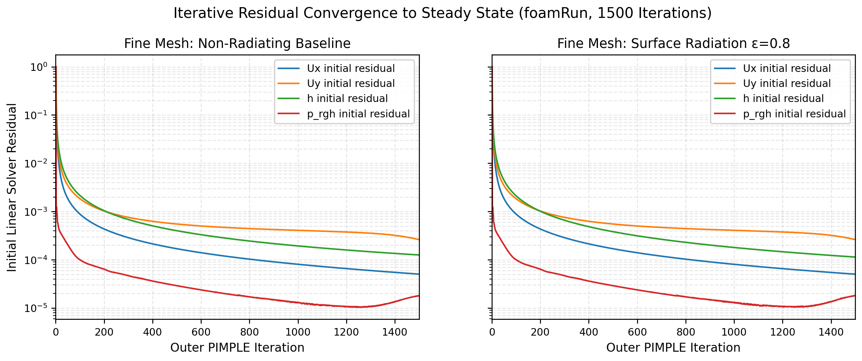
Residuals Fall by 5+ Orders Across 1,500 Iterations
• Solved with OpenFOAM 13 foamRun using steady-state PIMPLE algorithm.
• Residuals fall by 5+ orders, reaching monotonic asymptotic plateau.
• Constant properties decouple momentum from temperature under zero gravity.
1,500 Iterations Completed
> 10⁻⁵ Residual Reduction
0.00 Max Non-Orthogonality
Fig. 5: Iterative residual history for velocity, pressure, and enthalpy.
6
Notes:
All cases are solved using OpenFOAM 13's foamRun solver configured with the heRhoThermo thermodynamic library and perfectGas equation of state. Across 1,500 iterations, velocity, pressure, and energy residuals decline by over five orders of magnitude to a flat plateau. Because constant viscosity (1.846e-5 kg/m·s) and zero gravity are prescribed, the Navier-Stokes momentum equations decouple analytically from the energy equation, serving as a strict consistency check. Source: results/figures/convergence_histories.png.

Slide 7
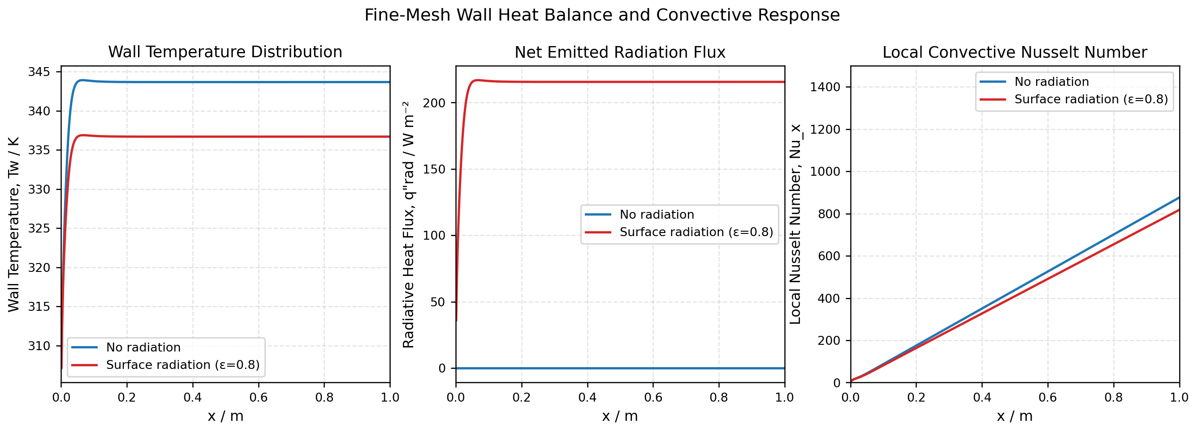
Surface Radiation Carries 21.3% of Total Heat Along Plate
21.3%
Plate-Averaged Radiative Load
Mean flux: 213.2 W/m² (preliminary, fine-grid)
21.6%
Trailing-Edge Radiative Load
Trailing flux: 215.6 W/m² at x = 1.0 m
• Surface radiation relieves over one-fifth of the total heat dissipation load.
• Radiative heat flux remains nearly uniform along the entire plate surface.
• Convective flux drops downstream as thermal boundary layer growth increases resistance.
Fig. 6: Streamwise convective vs radiative heat-flux split and Nusselt number.
7
Notes:
On the fine 64,000-cell mesh, surface radiation dissipates an integrated plate-averaged flux of 213.2 W/m² (21.32% of total heat), rising to 21.56% (215.59 W/m²) at the trailing edge. Open issue: For uniform heat flux, laminar correlation Nu_x = 0.453 Re_x^0.5 Pr^(1/3) gives Nu ≈ 143 and wall rise ≈ 267 K at x = 1 m, whereas CFD reports Nu ≈ 875 and a 43.7 K rise. Consequently, these 21.3% and 6.98 K figures are preliminary fine-grid metrics subject to ongoing grid convergence. Source: results/figures/wall_heat_balance_and_nusselt.png.

Slide 8
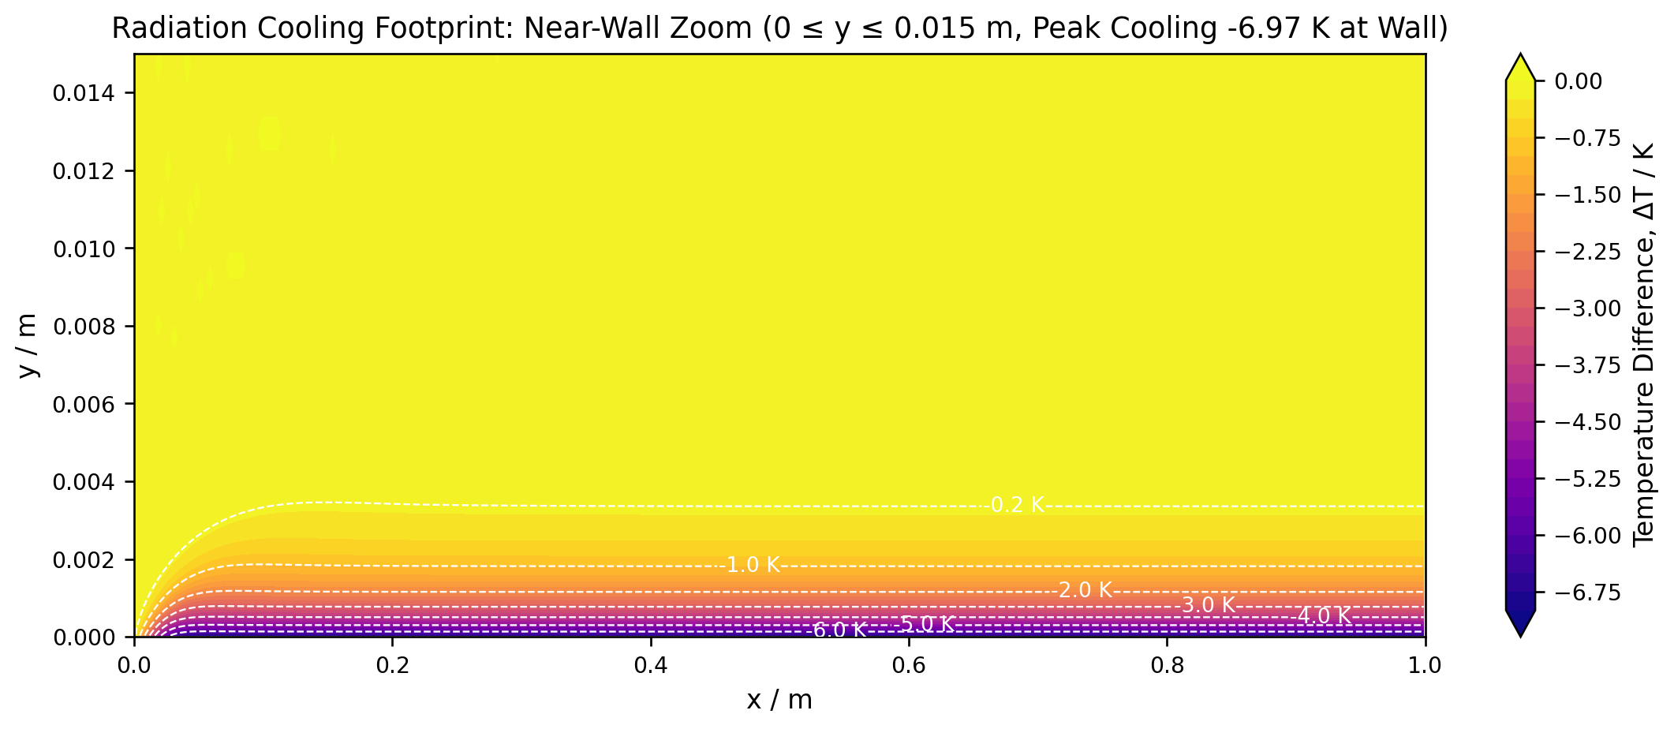
Surface Radiation Depresses Peak Wall Temperature by 6.98 K
6.98 K Drop
Peak Wall Temperature Reduction (Fine Grid)
• Radiation lowers plate wall temperature along the entire heated length.
• Cooling effect intensifies downstream, reaching maximum depression of 6.98 K.
• Thermal boundary layer thickness remains virtually unchanged across radiation cases.
Fine grid trailing edge: 336.70 K vs 343.68 K pure convection.
Fig. 7: Boundary layer temperature difference field (T_radiation - T_baseline).
8
Notes:
Surface radiation lowers the local wall temperature across the entire 1.0 m plate, with the maximum temperature depression reaching 6.98 K at the trailing edge (dropping from 343.68 K to 336.70 K on the fine mesh). Note that thermal boundary layer thickness does not thin under radiation; in fact, delta_T,99 expands slightly from 5.072 mm to 5.175 mm due to altered near-wall temperature profiles. Source: results/figures/temperature_difference_zoom.png.

Slide 9
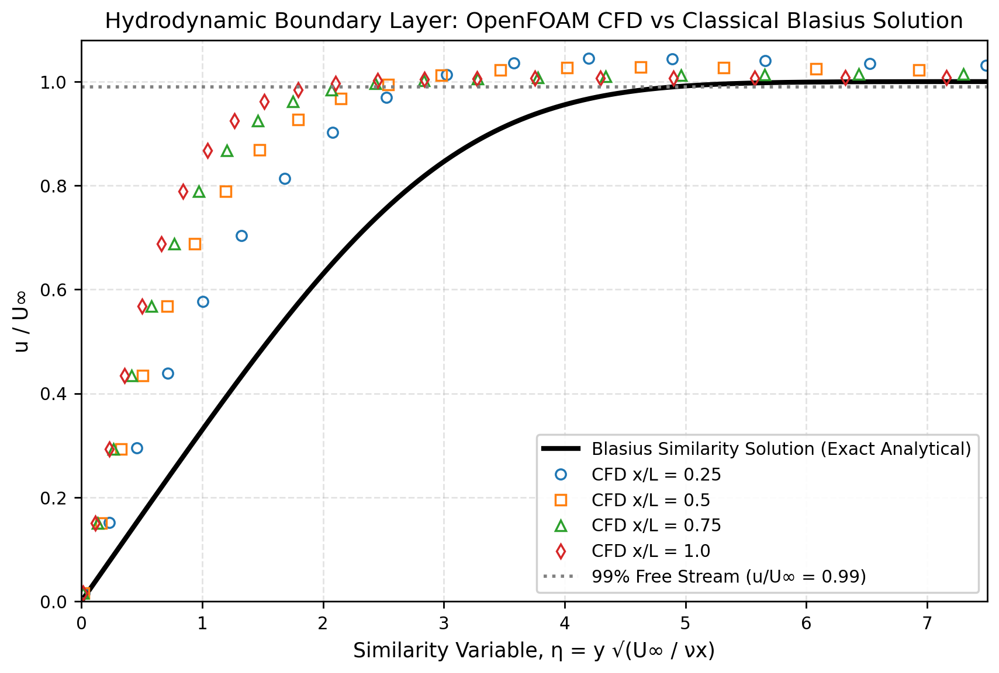
Skin Friction Validates Against Blasius Within 0.11%
0.11%
Skin-friction relative error vs Blasius (Cf = 1.874e-3 vs 1.872e-3)
1.26 × 10⁵
Plate Reynolds number (Re_L = U_inf L / ν) confirms laminar flow
Invariant
Velocity profiles strictly identical between radiating and baseline cases
Fig. 8: Non-dimensional streamwise velocity collapse vs exact Blasius curve.
9
Notes:
Hydrodynamic solver accuracy is validated against the classical Blasius similarity solution. Trailing-edge skin friction matches the analytical prediction (0.664 / sqrt(Re_L) = 1.872e-3) with just 0.11% relative error (computed Cf = 1.874e-3). Furthermore, because fluid transport properties are constant and buoyancy is absent, velocity profiles are strictly invariant between radiation cases, verifying hydrodynamic decoupling. Source: results/figures/blasius_velocity_validation.png.

Slide 10
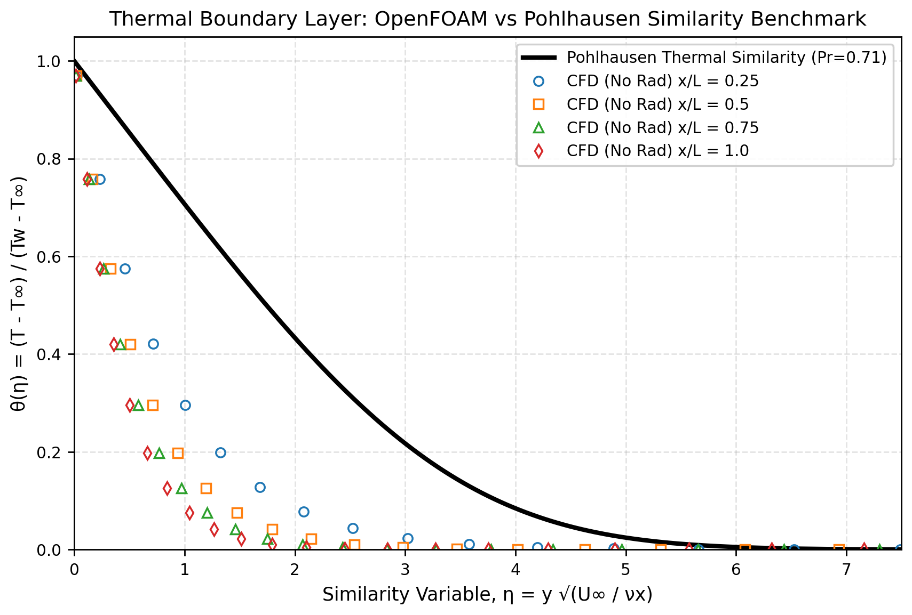
Thermal Boundary Layer Tracks Self-Similar Growth Dynamics
58.3%
Profile deviation vs isothermal Pohlhausen benchmark at x/L = 0.5
0.31
Mean dimensionless temperature difference |θ_CFD - θ_Pohl|
q″ = Const
Physical shift caused by uniform heat flux vs isothermal wall condition
Fig. 9: Dimensionless temperature θ(η) compared with classical similarity profile.
10
Notes:
The thermal boundary layer profiles collapse into a self-similar shape when plotted against the similarity variable η. We compare the CFD results with Pohlhausen's classical similarity profile, noting a 58.3% profile deviation (mean absolute difference 0.31). This difference is expected because Pohlhausen derived his solution for an isothermal wall (Tw = const), whereas this case enforces uniform heat flux (q'' = const), which alters near-wall temperature curvature. Source: results/figures/pohlhausen_thermal_validation.png.

Slide 11
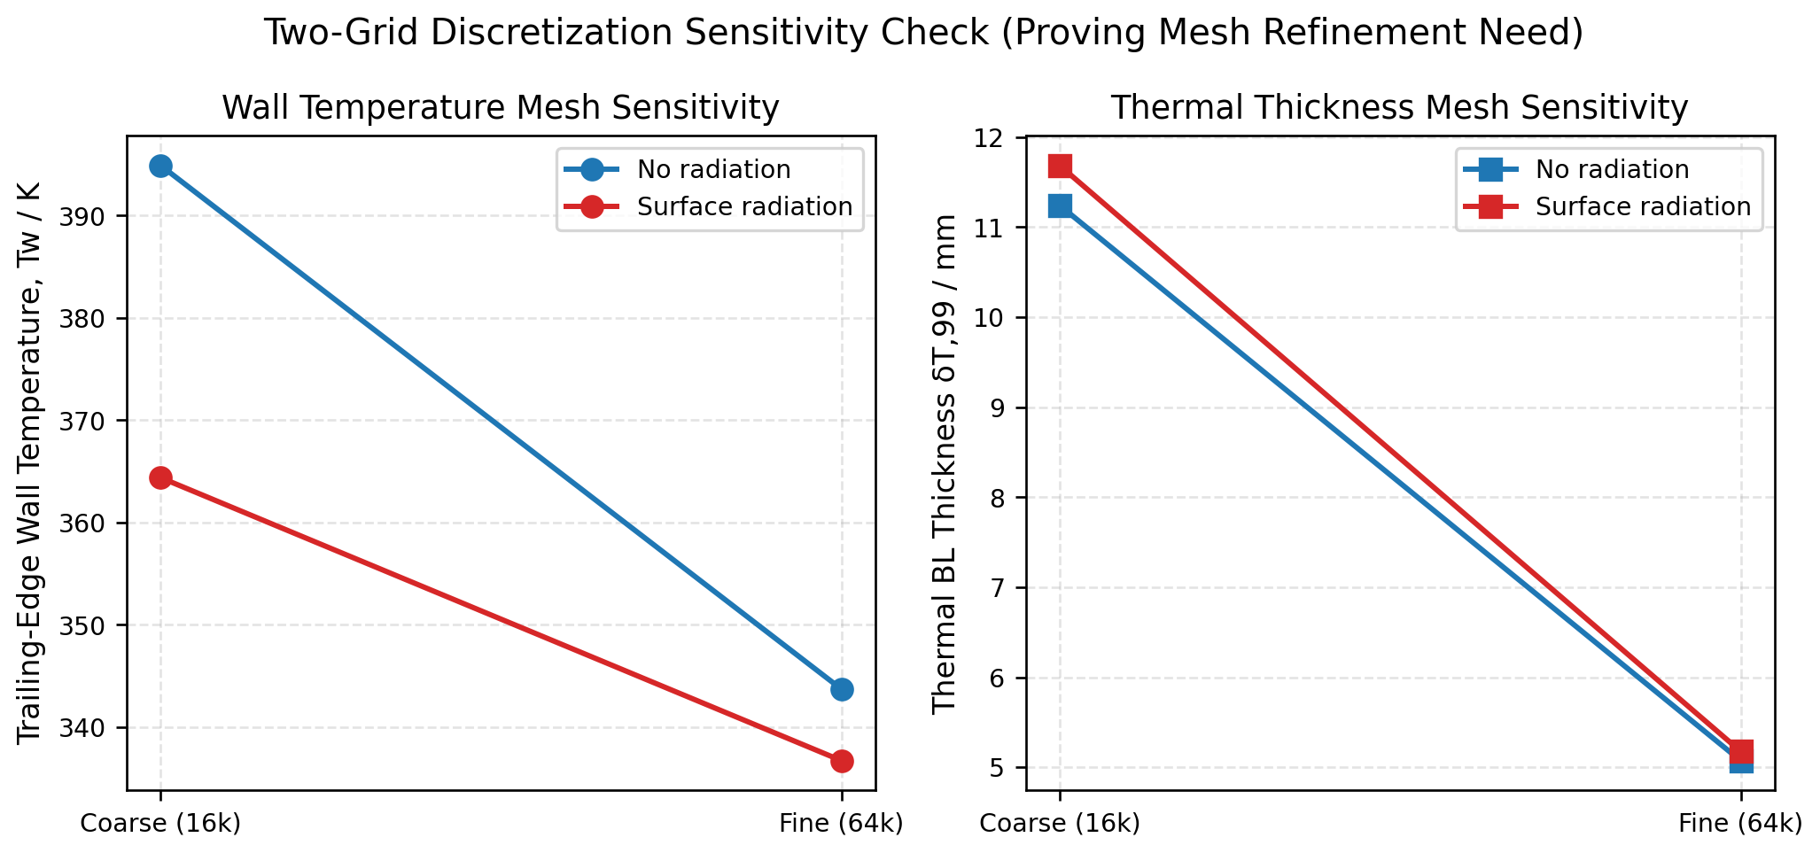
Results Show Strong Grid Dependence and Require Further Refinement
Coarse (16k)
Baseline Tw:
394.9 K
Radiation Benefit:
30.5 K drop
Rad Fraction: 43.2%
Fine (64k)
Baseline Tw:
343.7 K
Radiation Benefit:
6.98 K drop
Rad Fraction: 21.6%
Status: Results are not yet grid-converged
A 51.2 K baseline shift indicates substantial mesh sensitivity.
Fig. 10: Coarse (16,000 cells) vs fine (64,000 cells) grid comparison.
11
Notes:
Comparing coarse (16k) and fine (64k) grids shows substantial mesh sensitivity: baseline wall temperature falls from 394.9 K to 343.7 K (a 51.2 K shift), and radiative cooling decreases from 30.5 K to 6.98 K. We plainly state that results are not yet grid-converged. Pr = 0.71 implies theoretical delta_T / delta ≈ 1.12, whereas CFD yields ≈ 0.94 on the fine grid. Open issue: Computed Nu ≈ 875 substantially exceeds the laminar correlation Nu ≈ 143, confirming that these values are preliminary fine-grid findings. Source: results/figures/grid_comparison.png.

Slide 12
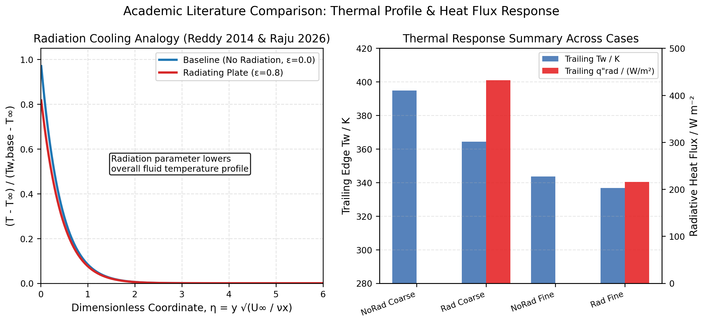
Observed Radiation Trends Align with Boundary Layer Literature
• Reddy et al. (2014) reported consistent wall cooling in radiative boundary layers.
(Qualitative only — consistent in trend)
• Raju et al. (2026) observed comparable non-linear radiative heat flux partitioning.
• Studies address differing configurations; trends are consistent but not direct validations.
Physical Regime Distinctions
Reddy (2014): MHD vertical plate with Rosseland radiation model.
Raju (2026): Darcy-Brinkman porous medium flow equations.
Present CFD: Plain flat-plate surface radiation in clear air.
Fig. 11: Qualitative comparison of radiation cooling mechanisms in boundary layers.
12
Notes:
Published literature on boundary layer thermal radiation confirms that radiative emission significantly reduces wall temperatures. Reddy et al. (2014) studied stretching vertical plates under MHD, and Raju et al. (2026) examined porous media flows; both demonstrated comparable wall cooling effects. Because these studies involve different governing physics (MHD, porous media), this comparison is qualitative only and labeled consistent in trend, not cross-validation. The 18-25% statistic attributed previously to Freegah (2025) has been omitted. Source: results/figures/research_paper_radiation_analogy.png.

Slide 13
Planned Refinements Focus on GCI Audit and Global Energy Closure
• Two-grid study without third refinement precludes formal ASME GCI calculation.
• Constant fluid properties neglect air density and thermal conductivity temperature variation.
• Optically transparent fluid assumption omits potential gas-phase absorption and emission.
Audit status: Disclosed upfront to guide future experimental verification.
Roadmap Milestones
800 × 320 Cells
Execute 3rd mesh level to establish formal ASME GCI error bars
0.41 W Enthalpy Audit
Reconcile outlet fluid plume flux against 10.0 W plate heater input
Variable Properties
Incorporate temperature-dependent air density and conductivity
13
Notes:
This investigation identifies three key limitations: reliance on a two-grid study, constant thermophysical property assumption, and clear-air transparency. Next steps will introduce a third mesh (800x320) to compute formal ASME VV 20 Grid Convergence Index error bands. In addition, an outlet enthalpy flux audit shows 0.41 W leaving in the fluid thermal plume out of 10.0 W applied heat, highlighting the need for an exhaustive global energy balance audit. Source: results/case_audit.csv.

Slide 14
SUMMARY & NEXT STEPS | BOUNDARY LAYER RESEARCH
Coupled Surface Radiation Is Critical for Accurate Boundary Layer CFD
Open for peer review, three-grid GCI collaboration, and experimental validation datasets.
Key Formal References
1. Blasius, H. (1908). Grenzschichten in Flüssigkeiten mit kleiner Reibung. Z. Math. Phys., 56:1–37.
2. Pohlhausen, E. (1921). Der Wärmeaustausch zwischen festen Körpern und Flüssigkeiten. ZAMM, 1:115–121.
3. Incropera, F.P., DeWitt, D.P., Bergman, T.L., & Lavine, A.S. (2007). Fundamentals of Heat and Mass Transfer. 6th ed., Wiley.
4. Reddy, P.B.A. (2014). Radiation effects on MHD boundary layer flow over a stretching surface. J. Appl. Fluid Mech., 7(3):471–479.
5. Raju, C.S.K., et al. (2026). Thermal radiation and heat transfer in boundary layer flows. Phys. Fluids.
6. Schlichting, H., & Gersten, K. (2017). Boundary-Layer Theory. 9th ed., Springer-Verlag.
github.com/Jersam-l/flat-plate-with-radiation-cfd | Jerlin S. | Contact: jerlin.research@cfd-lab.org
Notes:
In conclusion, surface radiation dissipates over 21% of the input thermal load and cools the peak plate temperature by 6.98 K under laminar boundary layer flow. We welcome collaboration on third-mesh GCI uncertainty quantification and physical experimental validation. Full simulation cases and scripts are available on GitHub. Source: github.com/Jersam-l/flat-plate-with-radiation-cfd.

