Slide 1
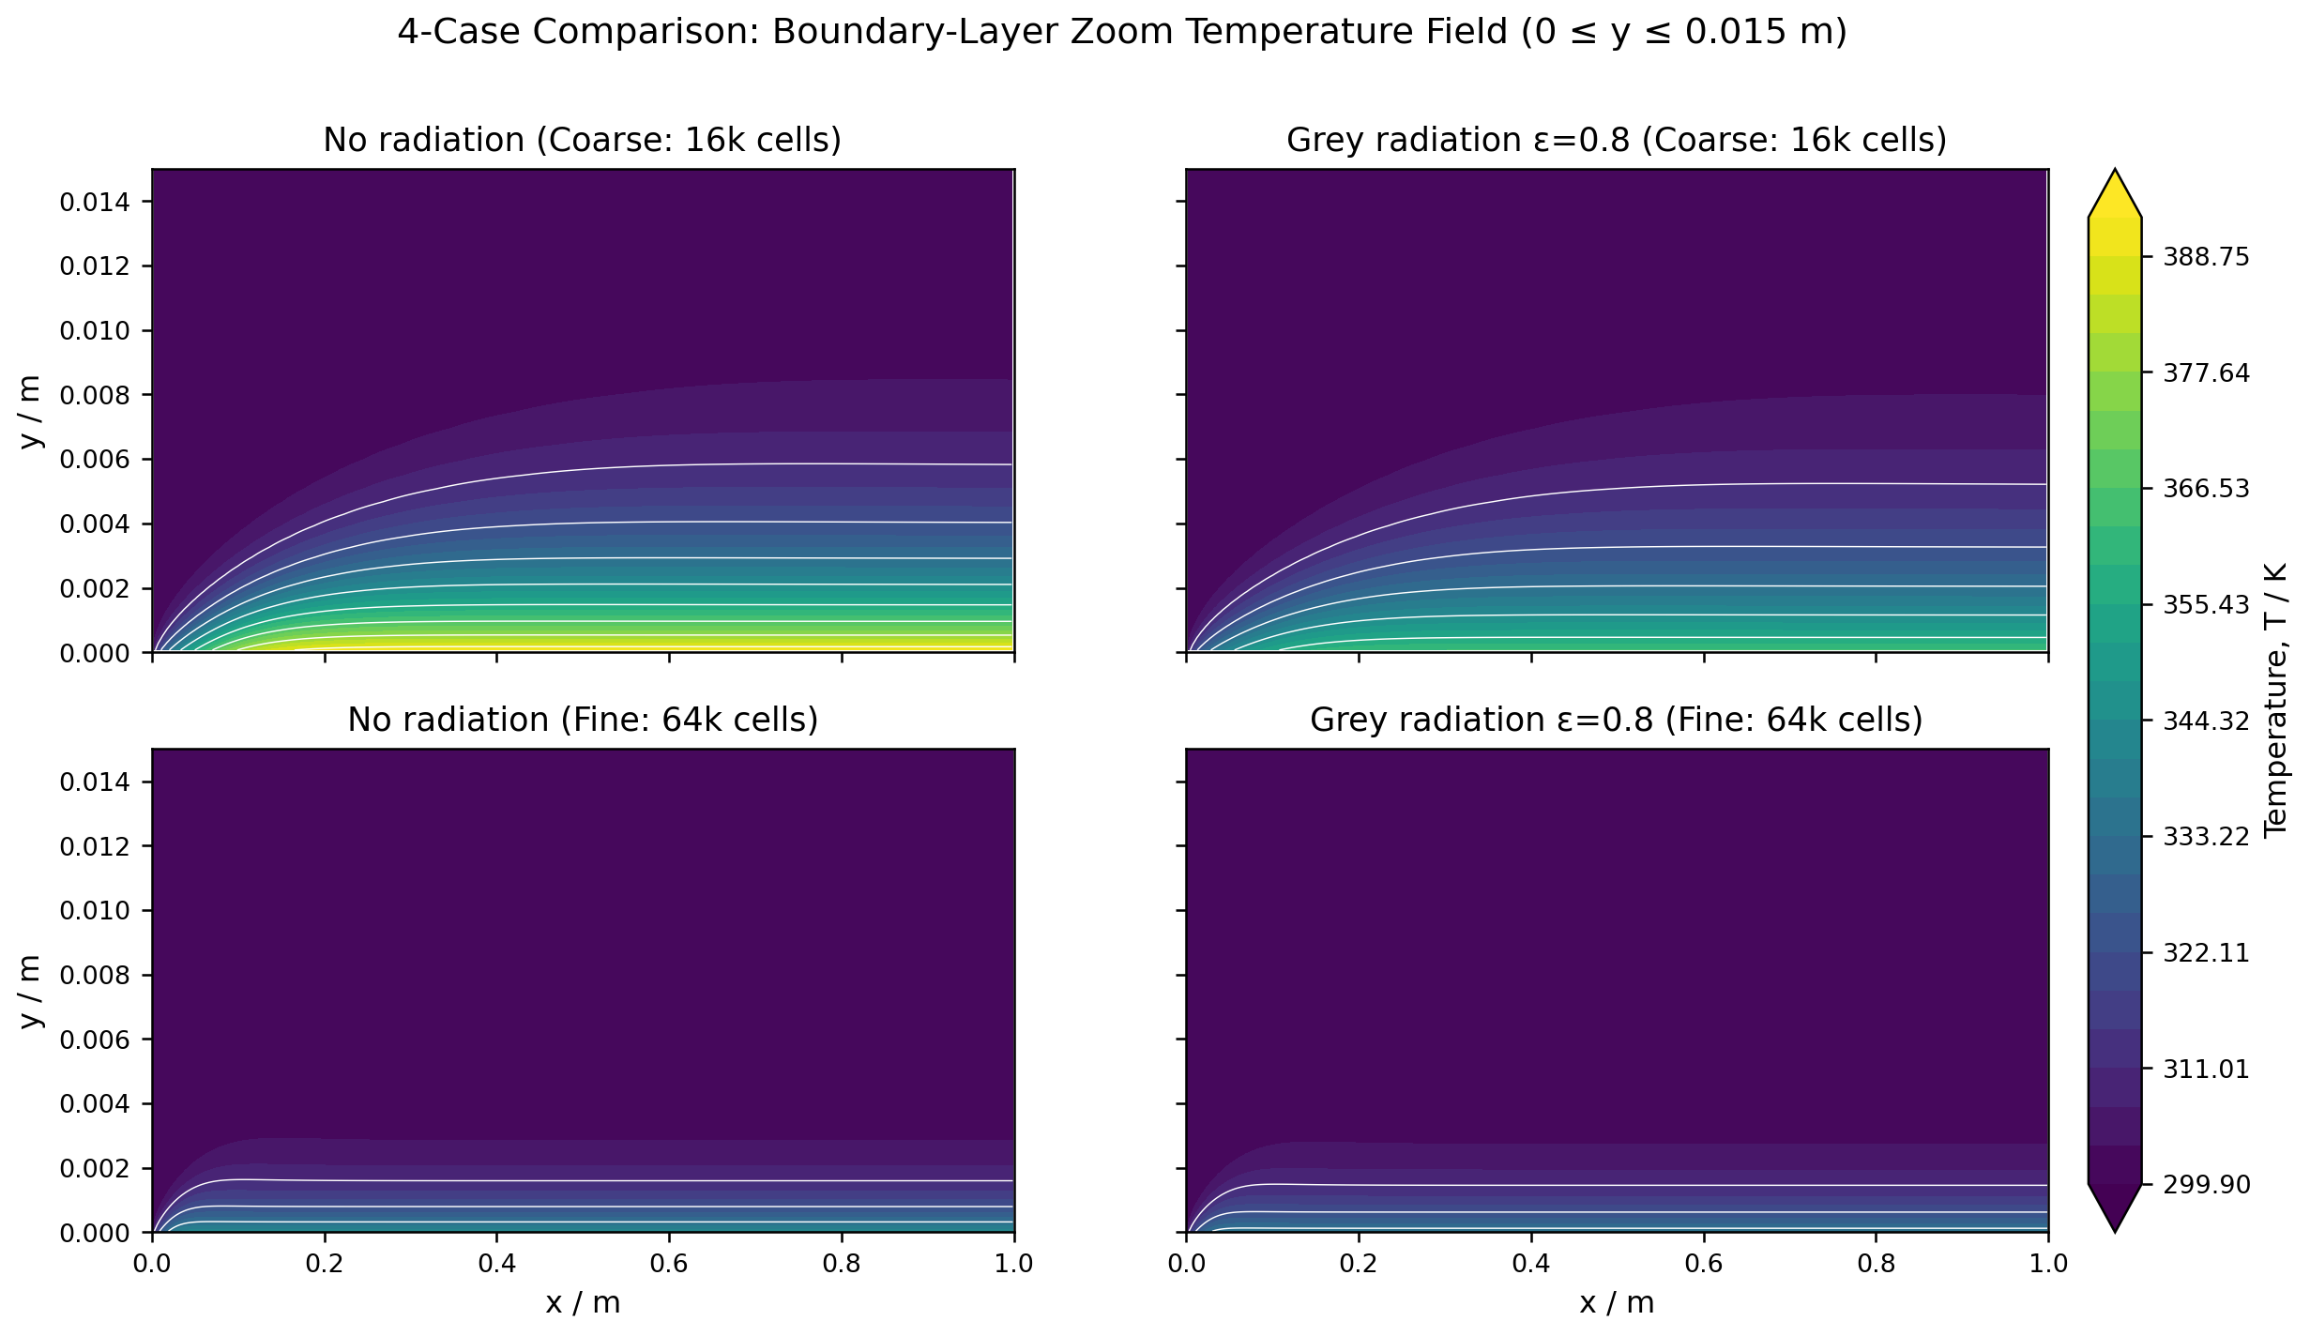
Surface Radiation Cuts Flat-Plate Wall Temperature
BOUNDARY LAYER CFD | OPENFOAM 13
Coupled convection-radiation CFD, validated against Blasius similarity
[Presenter name] | [Affiliation] | [Event / date]
Notes:
Title slide. Replace the hero figure with the best single visual.

Slide 2
One headline, four numbers
Re_L
64,000
ε = 0.8
[value]
1.26e5
hex cells
grey diffuse
[unit]
Laminar, zero pressure gradient
Fine grid, 80:1 wall grading
Plate radiates to 300 K enclosure
[caption: finalise after grid study]
Takeaway sentence goes here: one claim, one number, one reason to care.

Slide 3
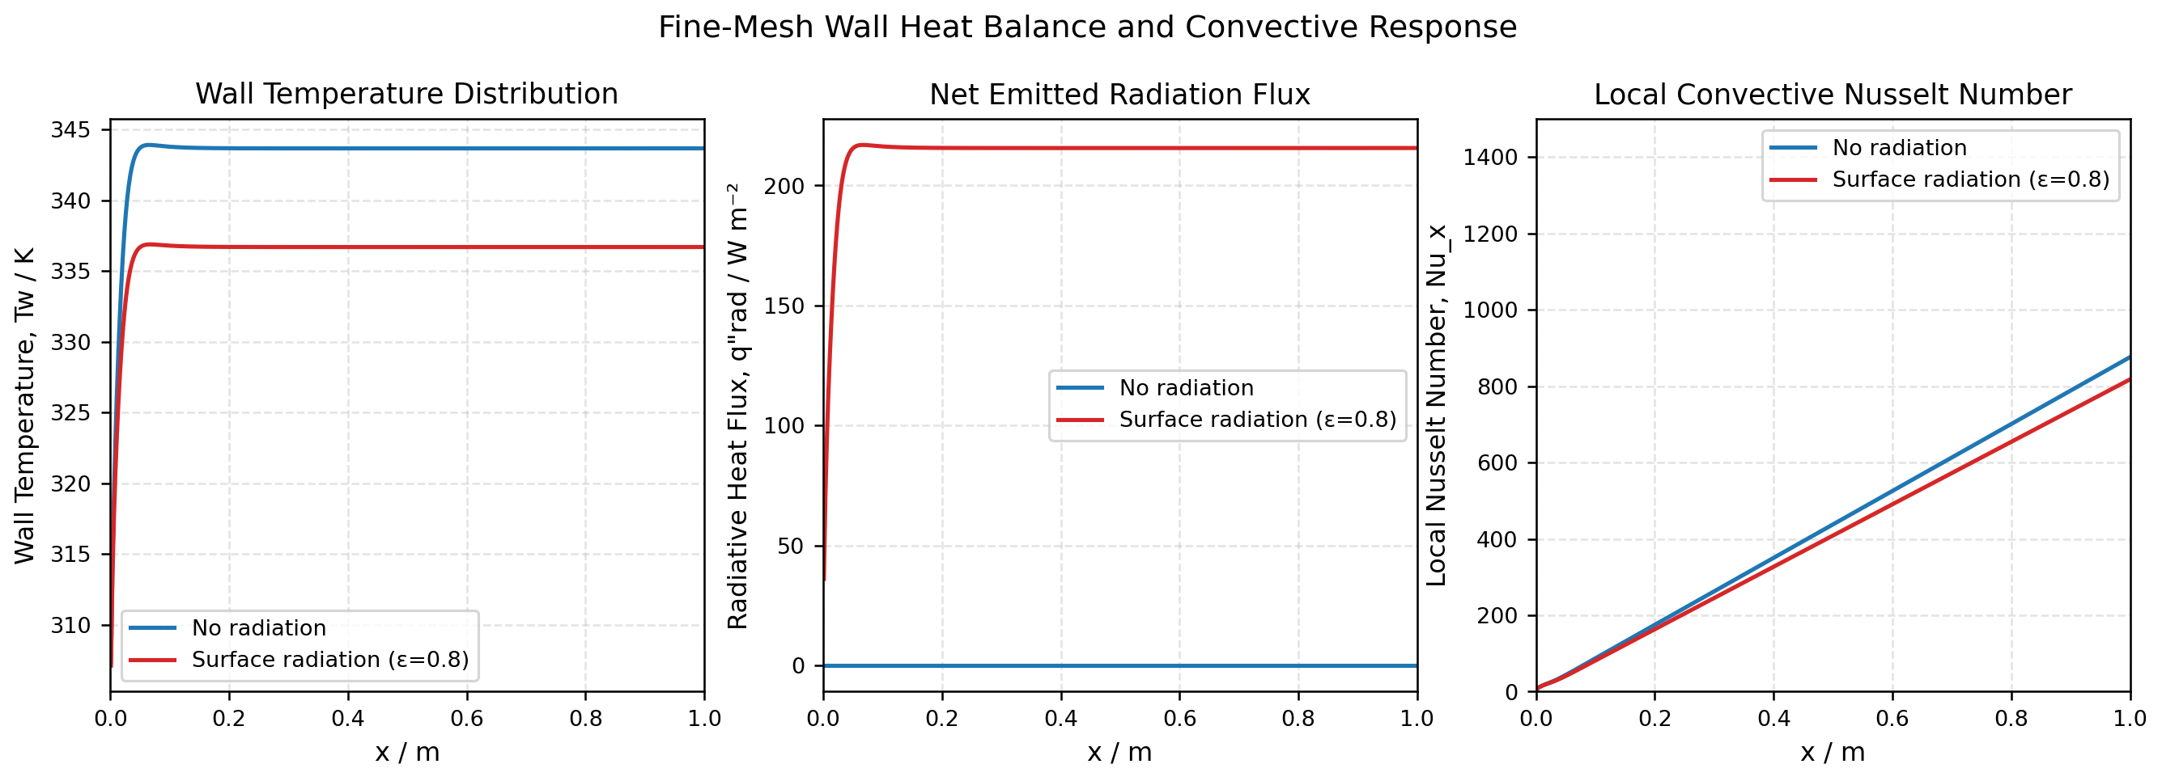
Figure left, claim right
Radiation sheds heat where convection weakens
Claim one, max 12 words
Claim two, max 12 words
Claim three, max 12 words
Fig. 1 Caption: what to look at, in one line.

Slide 4
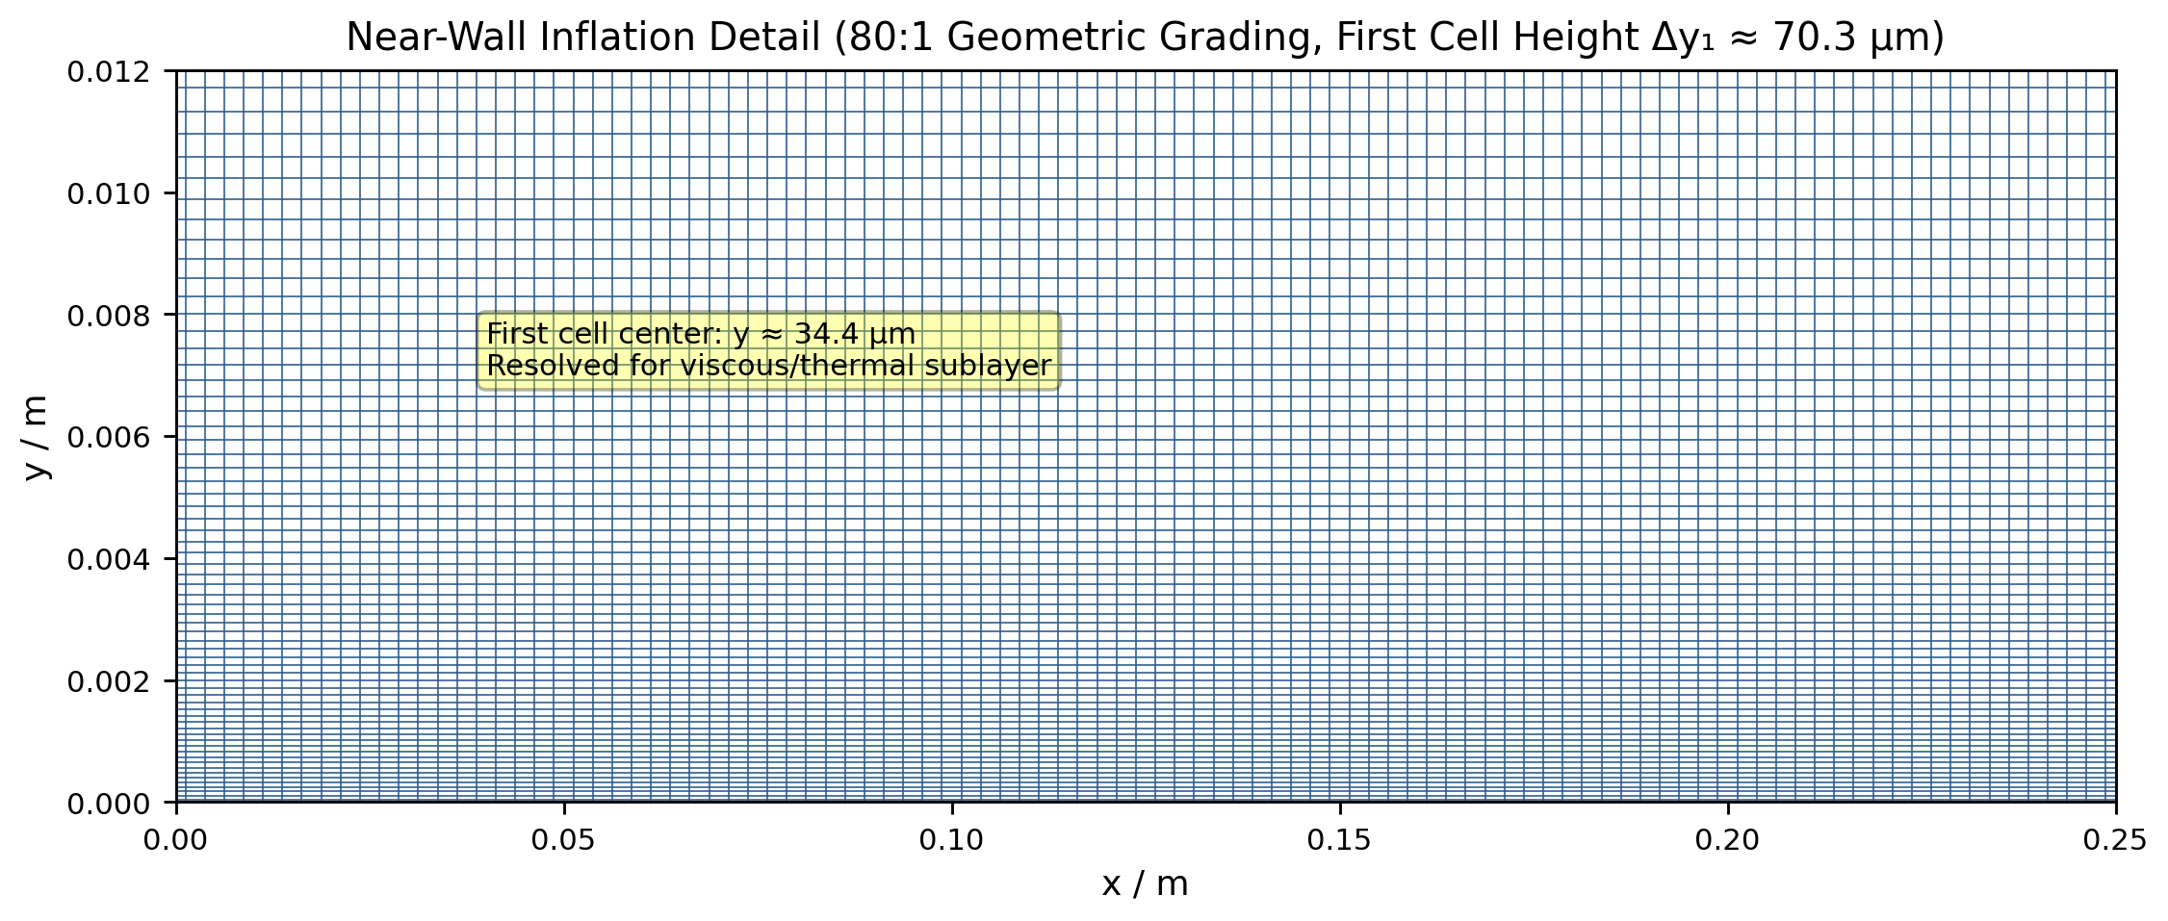
Setup table with mesh figure
Parameter | Value
Plate length | 1.0 m
Free stream | 2 m/s, 300 K
Heater flux | 1000 W/m²
Emissivity | 0 / 0.8
Grids | 200×80, 400×160

Slide 5
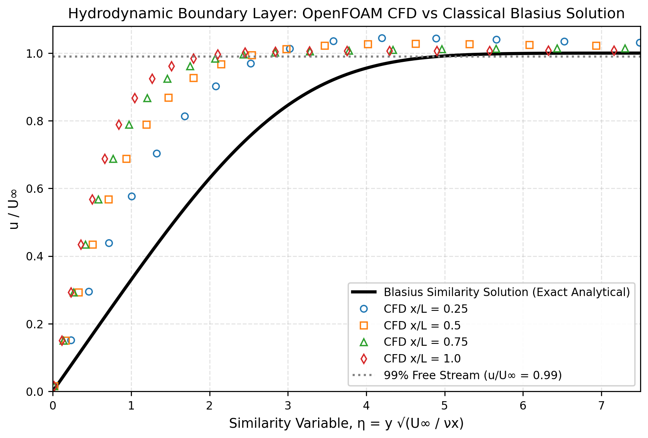
Validation slide on dark background
0.11%
skin-friction error vs Blasius
[x%]
thermal profile error (report it)
[x]
grids used (3 needed for GCI)

Slide 6
Before and after comparison
1
Without radiation (ε = 0)
2
With radiation (ε = 0.8)
All 1000 W/m² leaves by convection
Convection plus radiation share the load
[metric]
[metric]

Slide 7
Limits and next steps, stated up front
Known limits
Next steps
Two-grid study only
Constant properties
Air treated as transparent
Third mesh, GCI error bars
Global energy balance
Variable-property run

Slide 8
[One-sentence conclusion and the ask]
[What you want from the audience: funding, review, collaboration]
github.com/Jersam-l/flat-plate-with-radiation-cfd | [email]

