Slide 1
INDIVIDUAL IMPLEMENTATION PRESENTATION
Autonomous Academic Research Agent
A supervisor architecture over a blackboard hub — modelling research as an auditable, sequential pipeline.

Slide 2
01 / THE DESIGN MODEL
A structured process for an evolving understanding
01
Supervisor architecture
THE CORE QUESTION
Handles state of resolution
When is research sufficient?
02
Blackboard knowledge hub
Providing that resolution is the Supervisor's job.
Shared memory for multi-agent communication.
03
Sequential pipeline
Research modelled as an ordered workflow.
TODAY
1 How it was implemented
2 Challenges & resolutions
3 A demonstration

Slide 3
02 / THE STACK
Open-source, reproducible, minimal configuration
Chroma
Vector store — open source, native LangChain integration, no setup.
Ollama · Qwen3:4b
Fully local LLM — no keys, no cost; supports tool calling.
SQLite3
Blackboard persistence — ships with Python, no third-party install.
LangChain
Agent tooling — a widely used agent framework.
pypdf
PDF text extraction, open source.
LangGraph
The research pipeline graph and control flow.
OpenAlex
S2 · arXiv
Scholarly source discovery — open, no API key required.
Every dependency is open source and runs locally.

Slide 4
03 / THE RESEARCH PIPELINE
A LangGraph workflow
Not converged — run another loop from Research
▼
START
→
Research
→
Parse
→
Summarise
→
Rank
→
Index
→
Discover
→
Converge
decision
Converged — └▸
Publish
→
END
Convergence is deterministic code
A SOURCE COUNTS ONLY IF IT IS USEFUL
A pass stops when it yields no new useful sources and no new discovery terms or hits the loop limit.
Reputable
On topic
Collectable
Recent enough

Slide 5
04 / THE AGENTS
Each role carries a deliberate trade-off
AGENT
PURPOSE
DESIGN TRADE-OFF
Supervisor
Handles state of resolution.
The context window sets a hard limit on how much we can include, so a loop limit does the job. Model reasoning would not add much under that constraint.
Researcher
Finds & downloads relevant sources.
Leans on the search engine’s top results. It refines queries like a user instead of trawling, so it is only as good as that ranking and might miss what a deep trawl would find.
Parser
Extracts text from each document.
Simple. It picks the extraction tool from the file format.
Summariser
Judges topical relevance; writes a summary + up to 4 claims with evidence for each source.
Chunks and integrates to fit the small context. We may lose some detail, but a more powerful model that avoids this costs more and runs slower.
Ranking
Reputation tier + justification.
The vetted registry needs manual upkeep, but it gives us reliability.
Discovery
Mines keywords / related topics.
Capped suggestions. It might miss a keyword, but it protects against pulling in more less relevant sources and keeps latency down.
Publisher
Writes the final report (PDF + markdown).
Same chunking as the Summariser. We risk losing detail, but without it the report quality drops.
Trace
Records tool calls & decisions.
Busier blackboard, but the agent stays fully transparent. Noise for more transparency.

Slide 6
CHALLENGE 1
Restricted access
Some sources sit behind captchas or paywalls. Rather than crash — detect, skip, and leave a trace.
01
02
03
Detect & flag
Skip cleanly
Record the reason
Marked restricted / captcha.
The run continues; no crash, no stall.
Every omission is visible in the report.
Verified by test_fetch_captcha_is_recorded_on_the_source · real example in Appendix, evidence 4.

Slide 7

CHALLENGE 2
Context window size
A small local model can't fit one long paper. The pattern everywhere: chunk → summarise → integrate.
Summariser
Chunk (~12k tokens) → summarise each → merge. Before the fix, only the first slice was ever read.
TWO LEARNINGS
Prose vs structured output
Publisher
Structured output couldn't produce real analysis — each section is a plain chat call, gated against boilerplate (one run logged 12 rejections).
Summarises summaries — capped at 8 papers each, then integrated. Quality drops sharply past ~2,000 words.
Facts in code
~12k
8
~2k
Claims, sources, audit trail and appendix are deterministic — facts aren't left to a model.
tokens / chunk
papers / summary
word ceiling
These failures are in Appendix, evidence 1, 2 & 5.

Slide 8
CHALLENGE 3
Sources are endless
FOUR MECHANISMS KEEP IT SELECTIVE
LATENCY
5h 12m
for 30 sources
1
Trust the ranking. Take only top results — mirroring how users refine a query rather than trawl page after page.
7m 44s for one 22-page paper. (evidence 7)
2
Seek the minimum. Each loop, gather no more than the user's minimum number of sources.
GUARDRAILS
A loop limit on the workflow and a step limit on the researcher — never an unanalysable pile.
3
Select on criteria. With limited loops, keep only sources that meet its bar.
4
Judge topical relevance. Not just keyword overlap — a query needs two specific terms tied to the topic; shared-technique-only papers are flagged unrelated. (Appendix, evidence 3)
The relevance check is a judgement call — it catches most off-topic sources, not all. (evidence 6)

Slide 9
05 / AUDITABILITY & MEMORY
The blackboard is memory and audit trail at once
Agents never call each other — they read and write the same SQLite tables. Communication, memory and the audit trail are one mechanism.
Memory & communication
Audit trail
A source posted by the researcher is picked up by the summariser on its turn — no direct hand-off.
Every error, justification, decision and action is logged and appended to the report as a worklog.
On a retry loop, the researcher reads back the whole history, so it never repeats a query.
Because it is just SQLite, the whole run can be queried and reproduced afterwards.
Memory and auditability are the same mechanism — not two things we built.

Slide 10
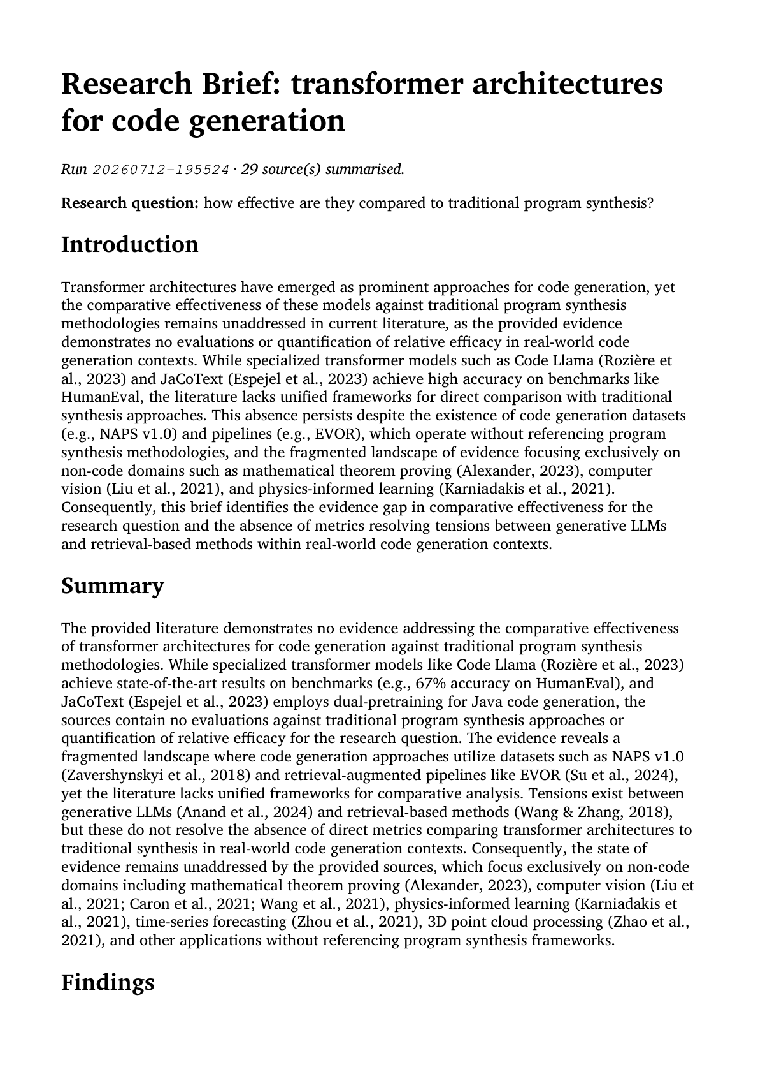
06 / DEMONSTRATION
A report the agent published
Summary · claims · ranked sources · worklog

Slide 11
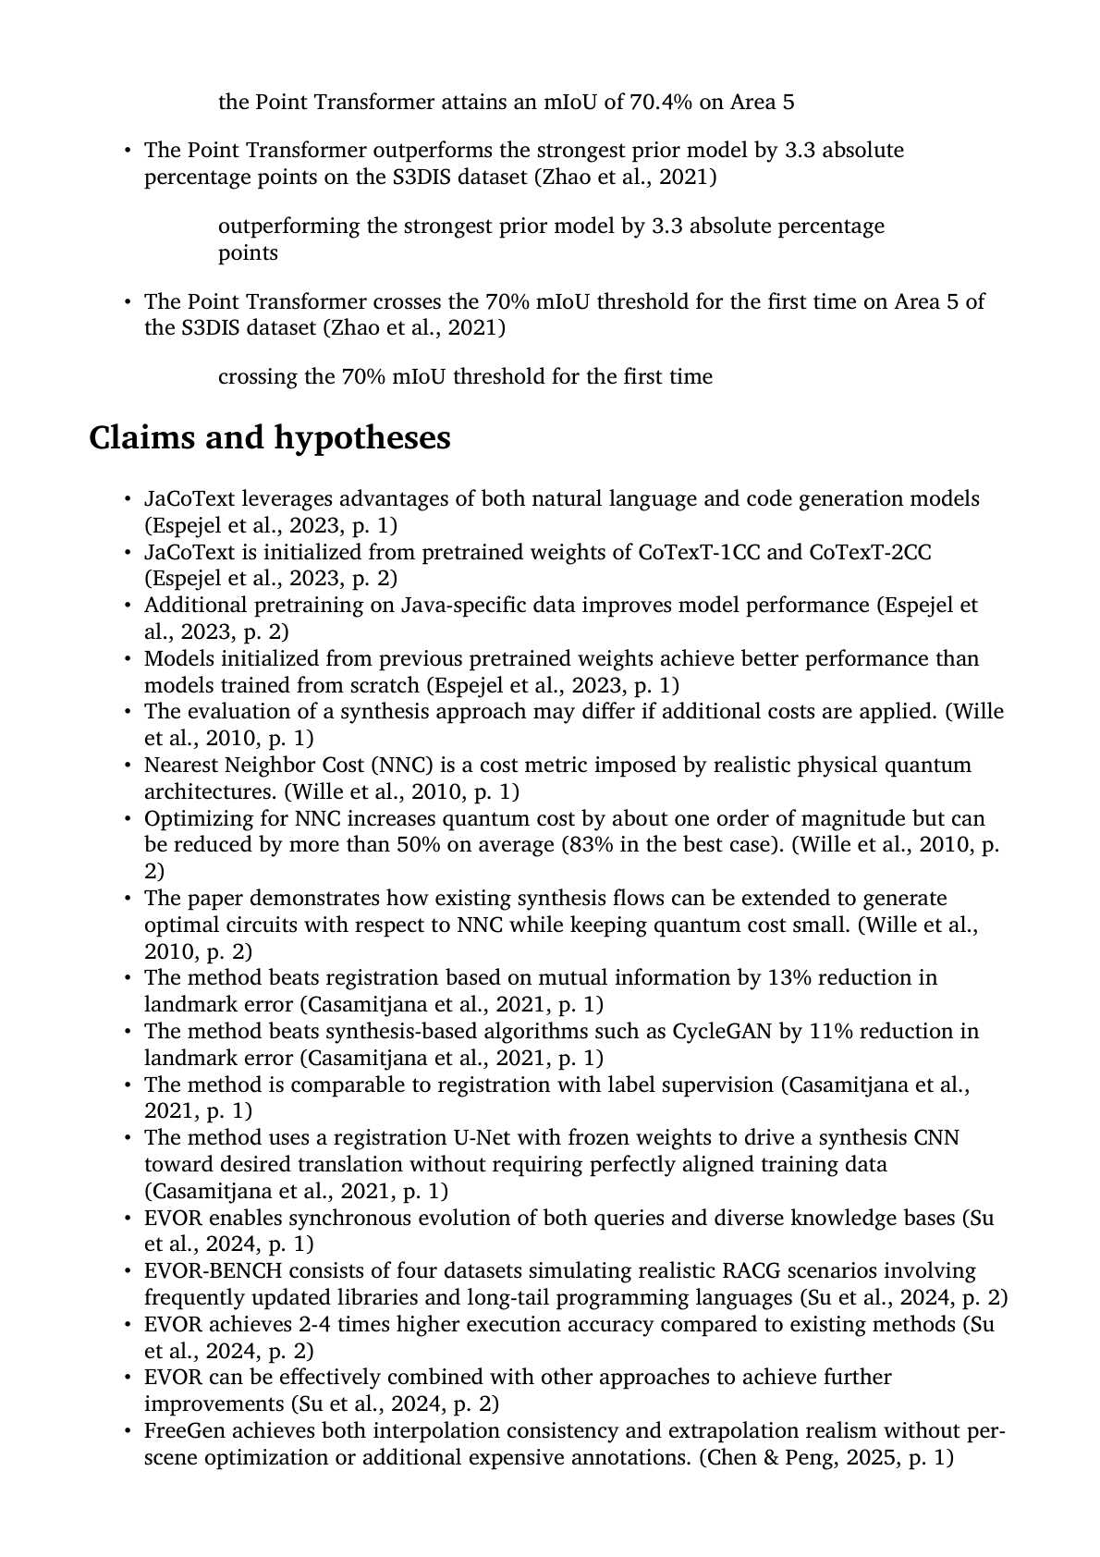
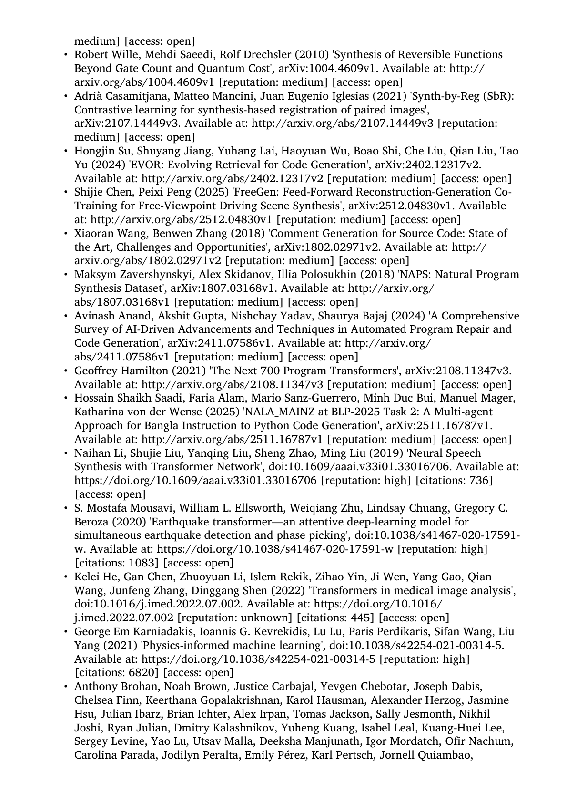
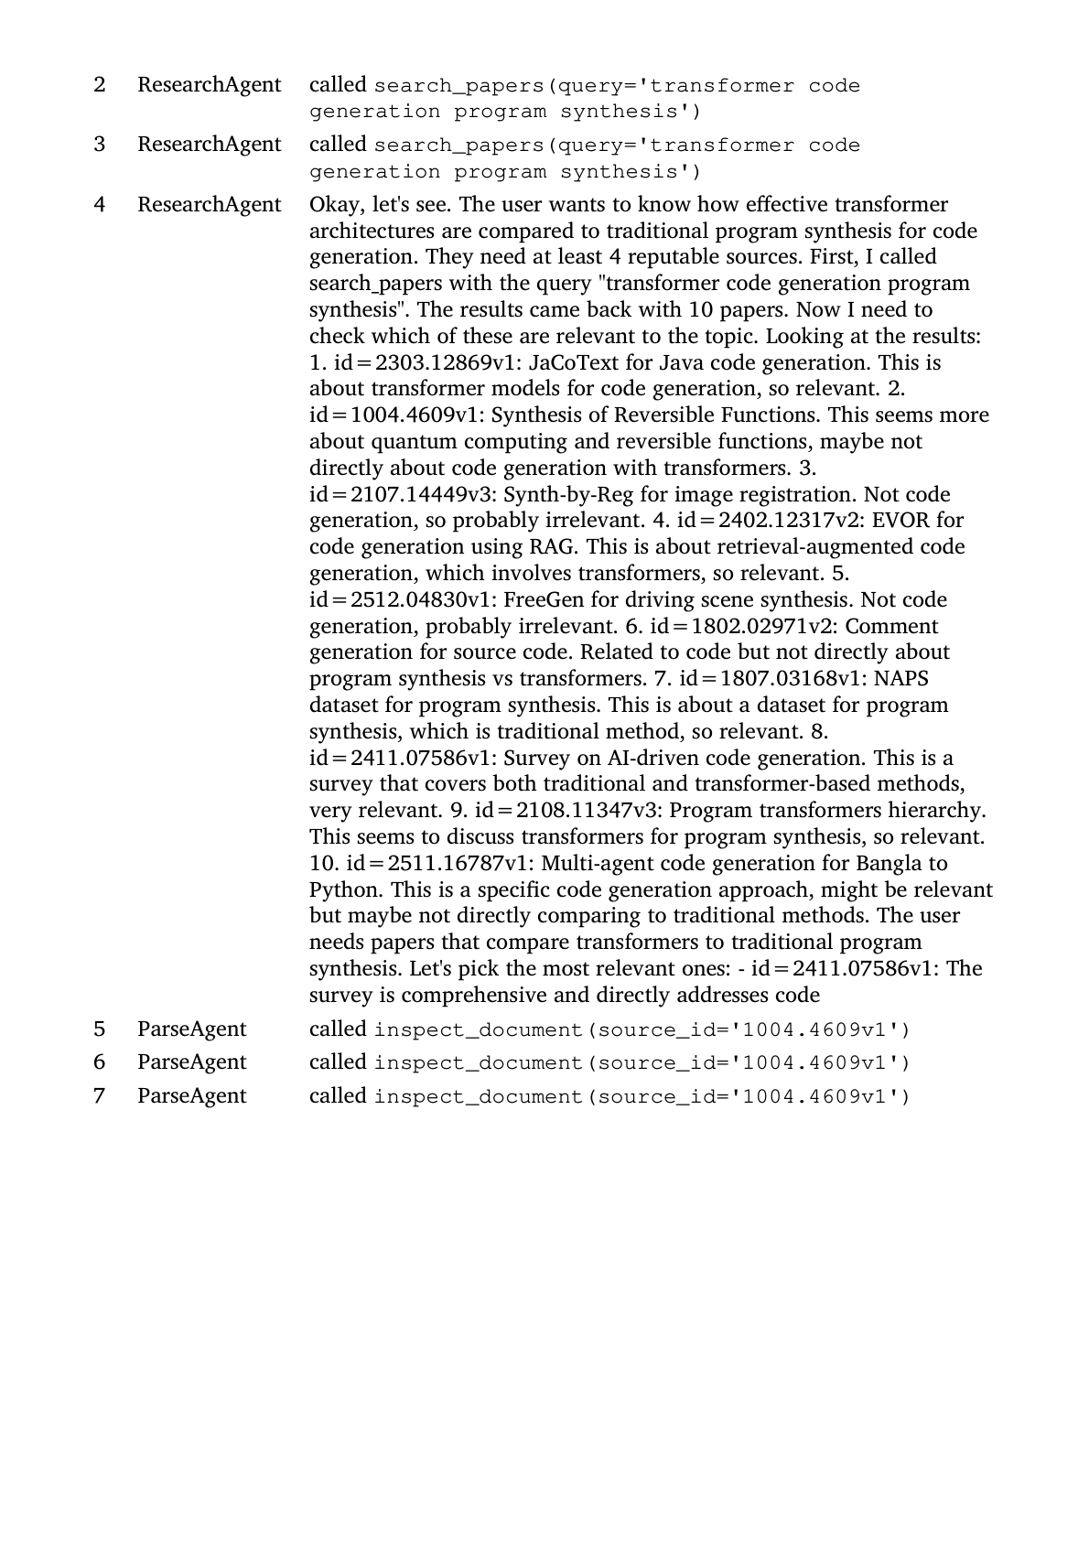
06 / DEMONSTRATION
The factual sections
Generated by code, not the model
Claims & hypotheses
Ranked sources
Audit trail / worklog

Slide 12
APPENDIX
Evidence from the blackboard
Seven problems, each provable straight from the SQLite blackboard or the report itself.
1
Short summaries on long papers
2
Sections describing themselves
Challenge 2 — context window
Challenge 2 — boilerplate gating
3
A generic query pulls unrelated fields
4
A CAPTCHA detected, not crashed on
Challenge 3 — relevance
Challenge 1 — restricted access
5
Narrative quality drops past 8 sources
6
The relevance check lets two through
Challenge 2 — 8-source cap
Challenge 3 — a judgement call
7
Run latency
Challenge 3 — time cost

Slide 13
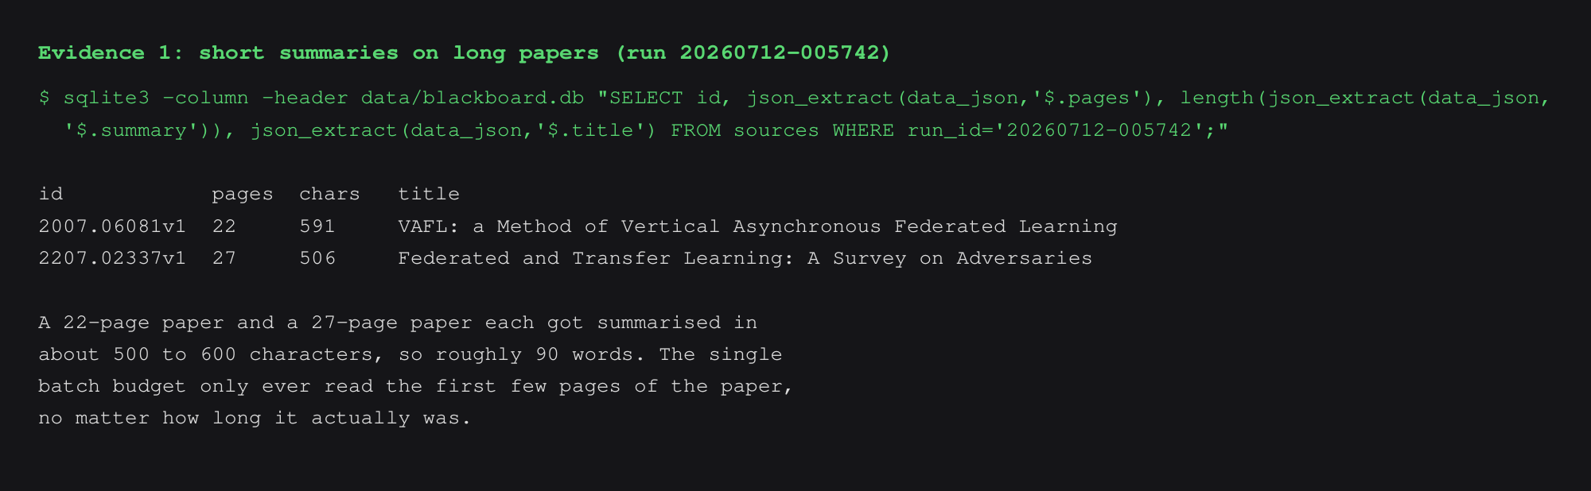
APPENDIX · EVIDENCE 1 · CHALLENGE 2
Short summaries on long papers
A 22- and a 27-page paper each summarised in ~90 words — only the first slice was ever read.

Slide 14
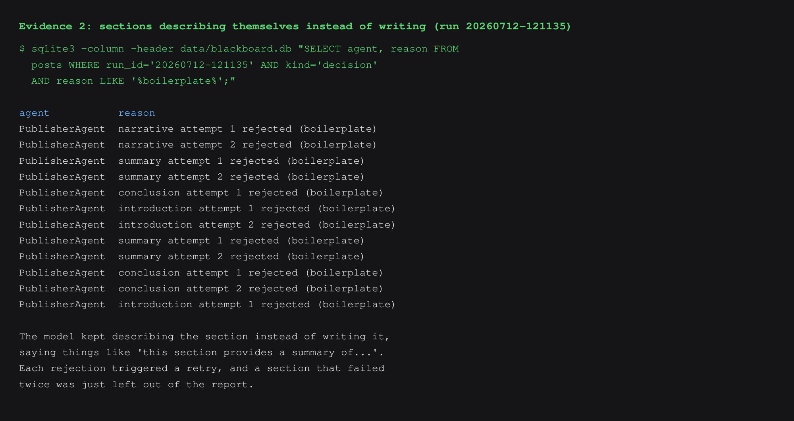
APPENDIX · EVIDENCE 2 · CHALLENGE 2
Sections describing themselves
12 rejections in one run — the boilerplate gate caught each and forced a retry.

Slide 15
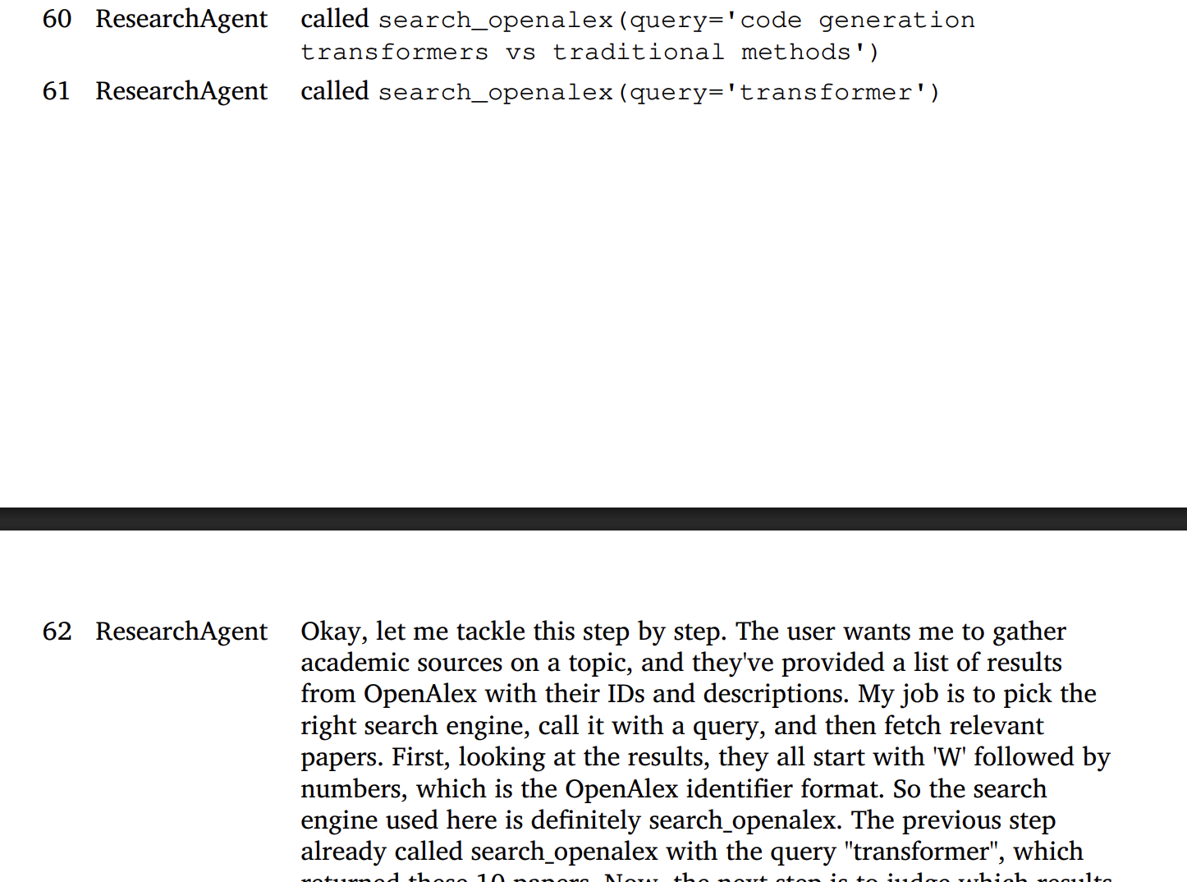
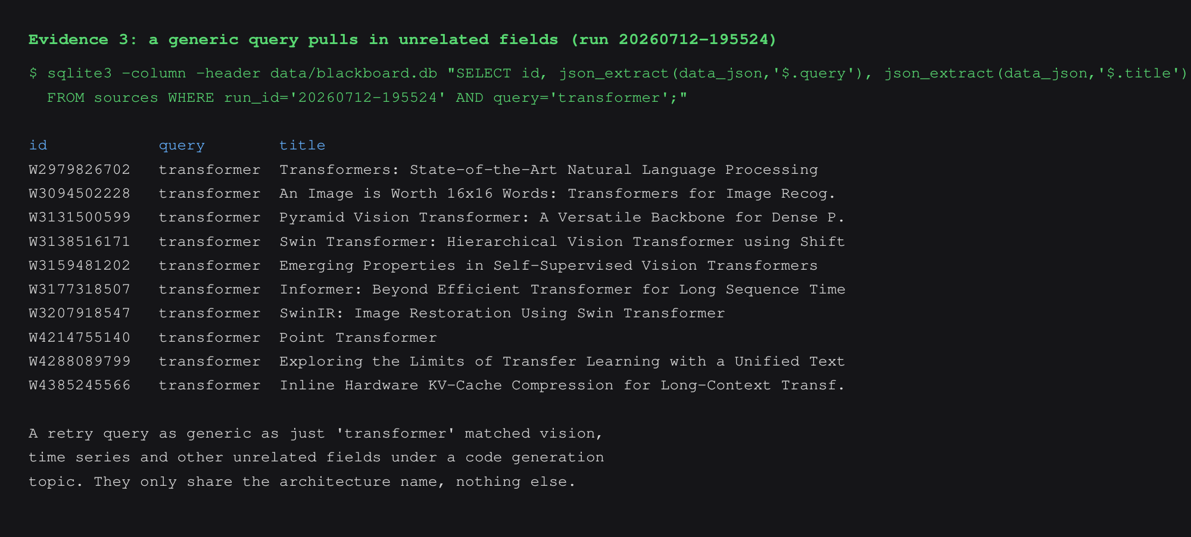
APPENDIX · EVIDENCE 3 · CHALLENGE 3
A generic query pulls unrelated fields
The worklog shows the query narrowing to just 'transformer' — which then over-included vision, time-series and hardware papers that share only the name.
Worklog — the query
Result — unrelated fields

Slide 16
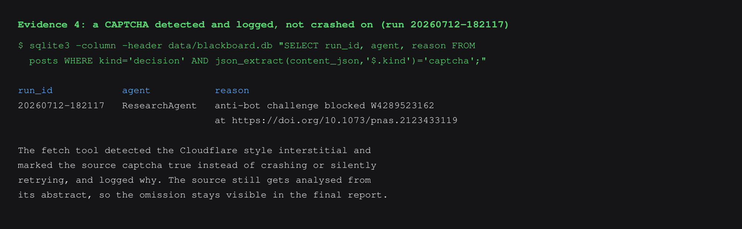
APPENDIX · EVIDENCE 4 · CHALLENGE 1
A CAPTCHA detected, not crashed on
An anti-bot challenge was flagged and logged — the run continued, the omission stays visible.

Slide 17
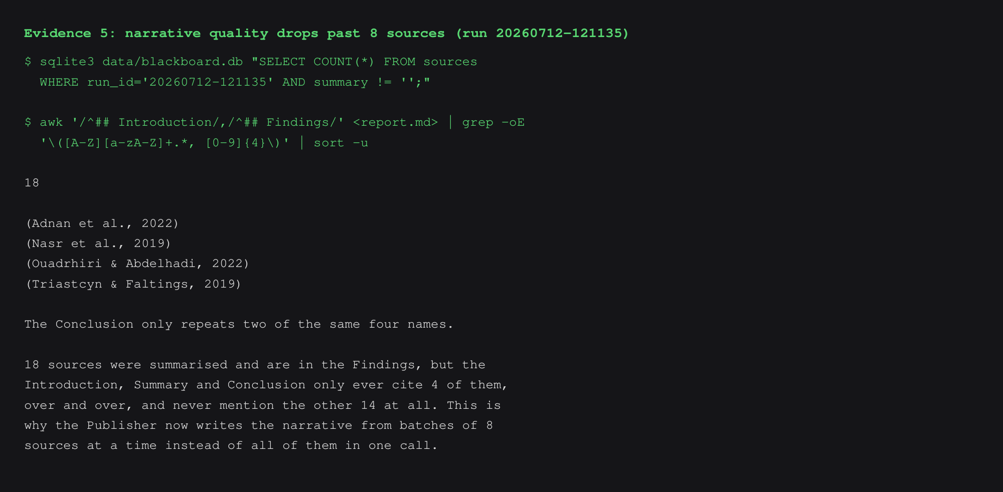
APPENDIX · EVIDENCE 5 · CHALLENGE 2
Narrative quality drops past 8 sources
18 sources summarised, but the narrative only ever cites 4 — the rest go unmentioned. Hence batches of 8.

Slide 18
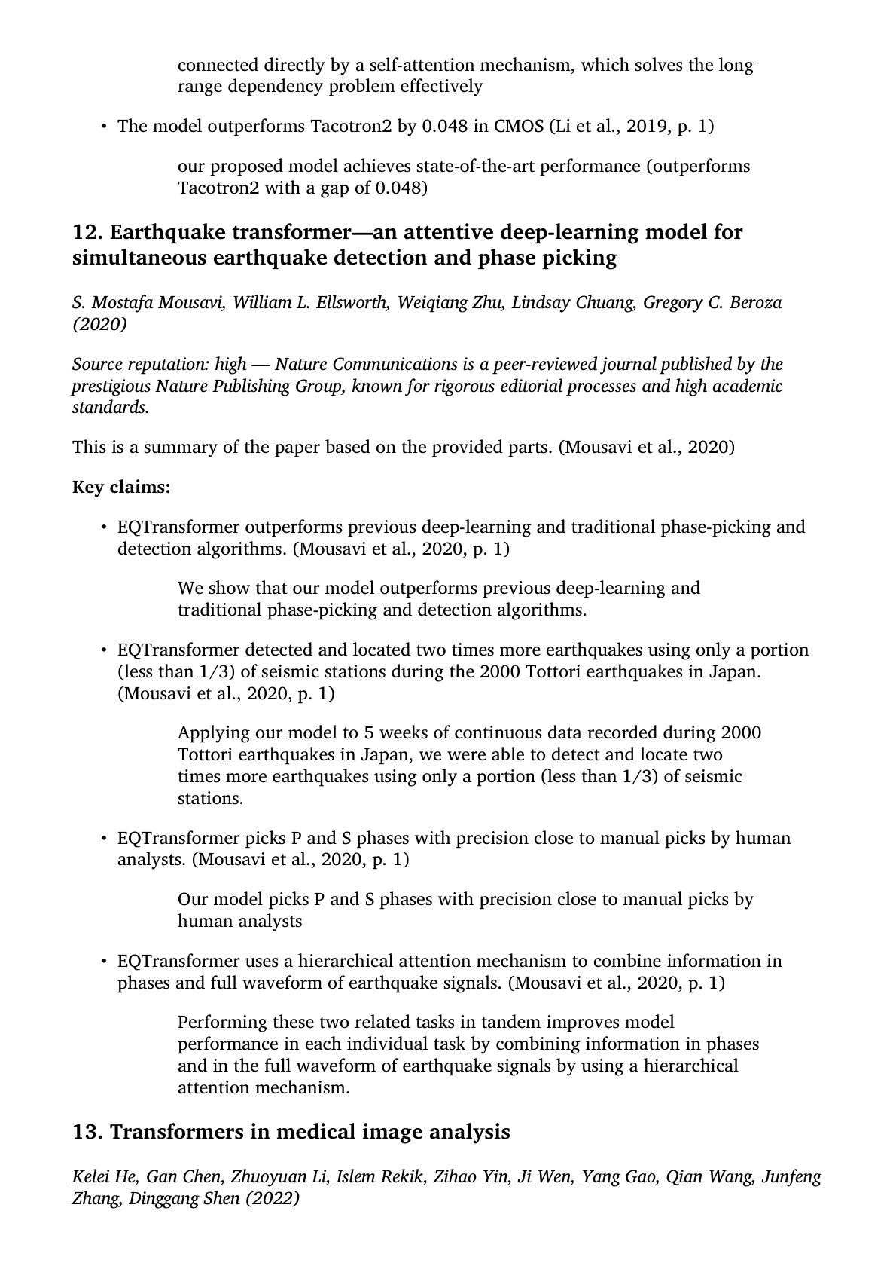
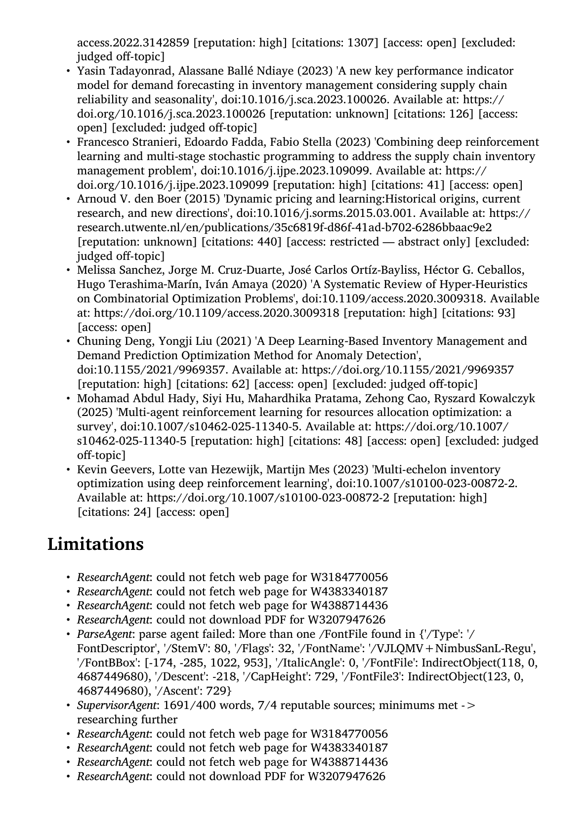
APPENDIX · EVIDENCE 6 · CHALLENGE 3
The relevance check lets two through
A judgement call, not a hard rule — but the filter turns a pile of unrelated papers into a single incidental miss.
Before
no relevance filter
After
relevance filter on
Filters out most seem-relevant-but-not papers; one incidental failure remains. Much better.
Pulled in earthquake detection and other completely unrelated papers.

Slide 19
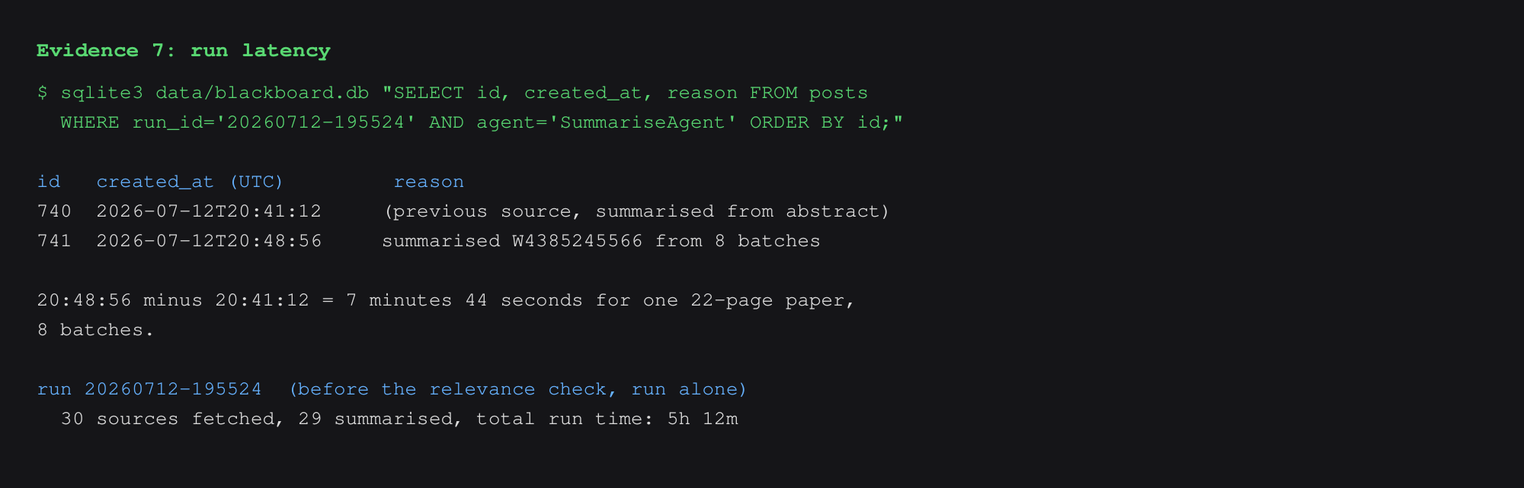
APPENDIX · EVIDENCE 7 · CHALLENGE 3
Run latency
7m 44s for one 22-page paper; 5h 12m for a 30-source run — local Ollama serves one request at a time.

Slide 20
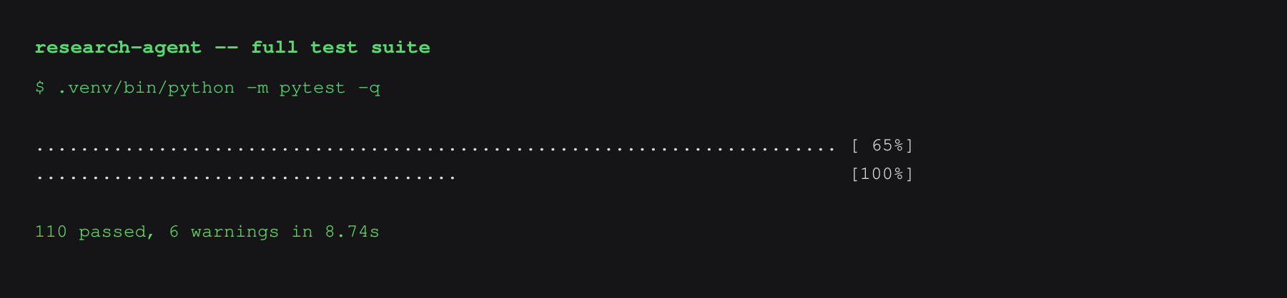
APPENDIX · TEST SUITE
The deterministic core is tested
110 tests passing — convergence, captcha handling and fact generation are all covered.

