Slide 1
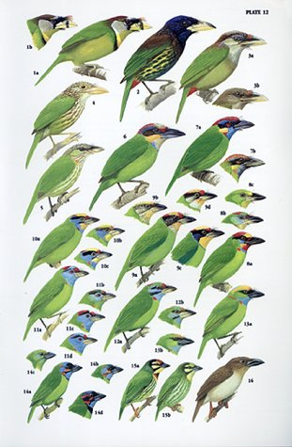
Evidence of Allen’s Rule Across Species of Aves
Jessica Rutten
Central Research Question: Can avian morphological proportions act as predictable indicators of climate for a given habitat?

Slide 2

Motivation and Background
Morphology as an indicator of habitat (form vs. function)
Is body size truly a function of environmental influence?
Notes:
Looking back at morphological data in the fossil record, its not uncommon for scientists to draw conclusions about characteristics surrounding an organisms habitat by looking at the organisms morphology.
Allen’s rule is a fairly common explanatory theory for why certain species body types reflect specific patterns according to their region of residence
these subtle variations in body sizes have taken many generations to evolve as adaptations for their environment
With rapid climate change, species may not manage to evolve these adaptations fast enough to keep up with the ever-changing environment
Red-queen hypothesis, the species die out.
The more we know about how a species is specialized for its niche, the more information we have to strengthen conservation efforts.

Slide 3
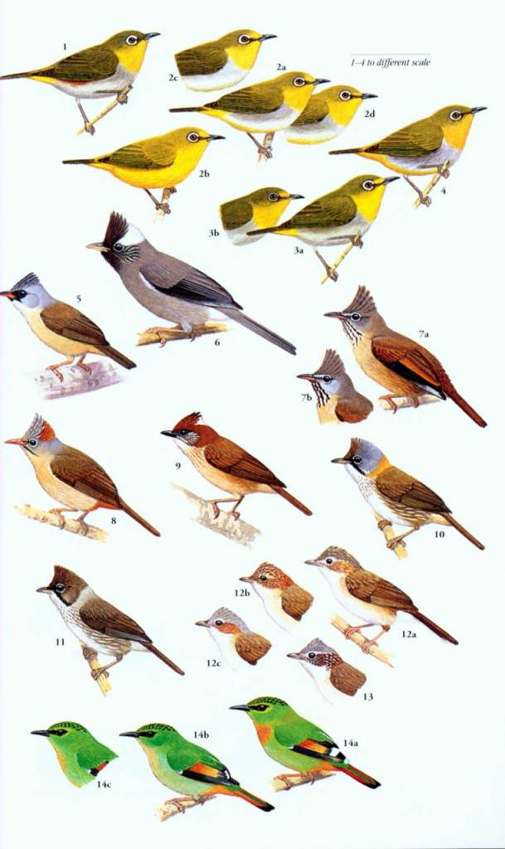
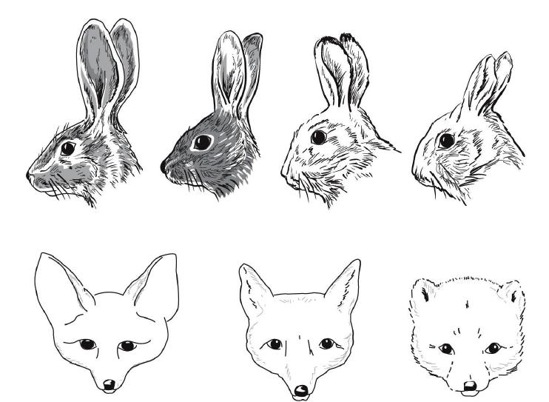
Approach
Data from: Geographical variation in bill size across bird species provides evidence for Allen’s rule

Slide 4
About the Data
Some specifics about the dataset:
69.0KB file, 214 species assessed
Data includes measurments of: Body mass, Bill length, Lengths of a variety of digits, Midpoint latitude and altitude, Minimum temperature at midpoint of range
Data somewhat patchy
May have to create an “if” statement that circumvents data that is incomplete

Slide 5
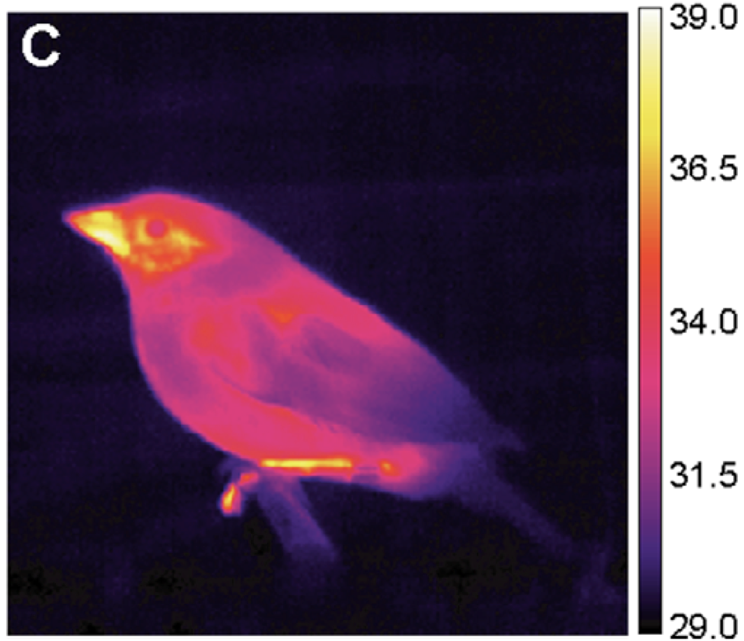
Anticipated Details
The analysis will involve three parts:
Create a value to describe body proportions
Ratio of bill to body
Compute how well body proportions correlate with temperature
Using a Poisson Distribution, create a function that will note the probability of a certain body size originating at a certain regional temperature
Notes:
Ratio of bill to body> smaller numbers describe a more “compact” body, I hypothesize will occupy colder environments
Correlation> simple regression line

Slide 6
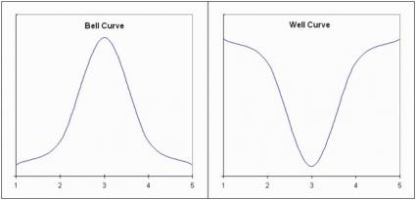
Anticipated Results
Allen’s Rule provides an anticipated hypothesis for the regression
“Well” curve probability distribution
Extremes have higher degree of certainty for certain body sizes existing at certain temperatures

Slide 7


Anticipated Results

