Slide 1
Alpiq challenge
Georg Brunner, Susanna Pesonen, Karin Nakanishi

Slide 2
Portfolio forecast

Slide 3

Factor 1: Customer acquisition

Slide 4
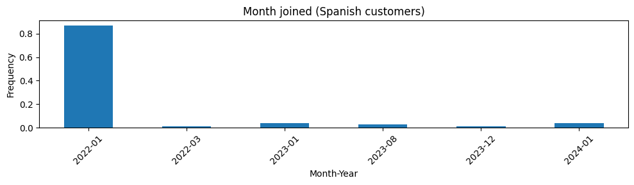
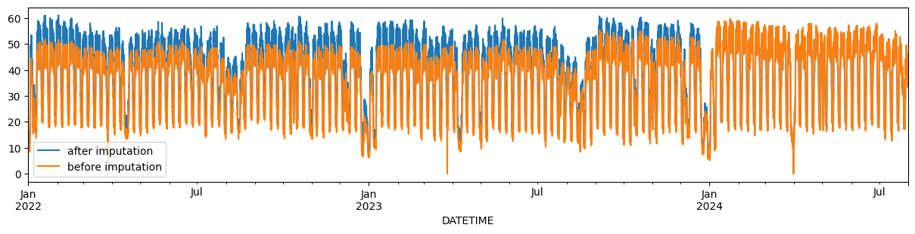
Spain: Impute missing data with “most correlated customer”
Portfolio consumption

Slide 5
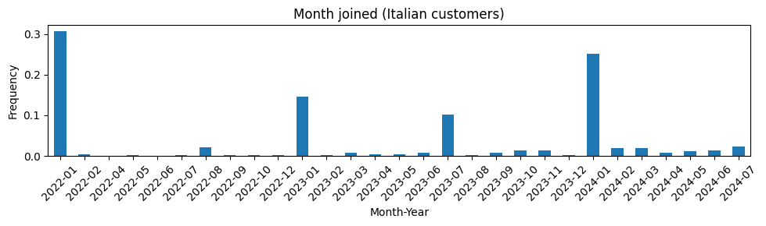
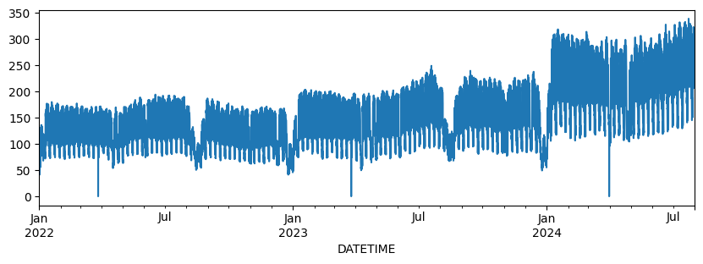
Italy: take median of customers
Portfolio consumption

Slide 6



Factor 2: Holiday

Slide 7
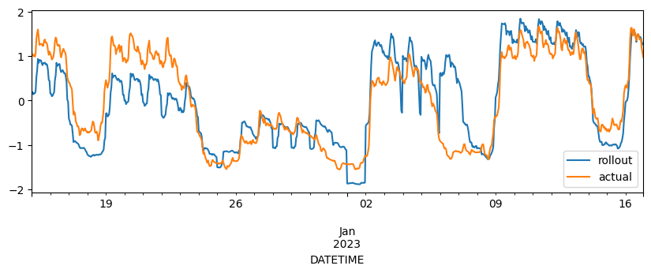
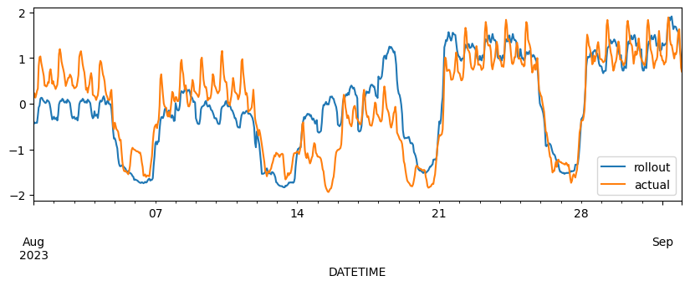
Spain

Slide 8
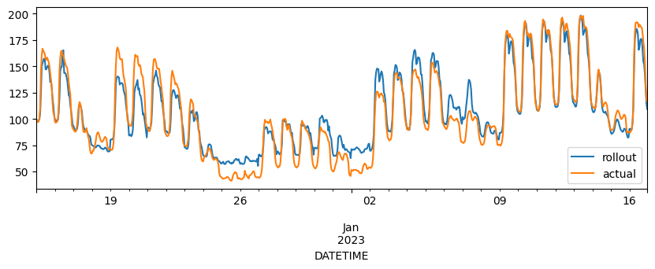
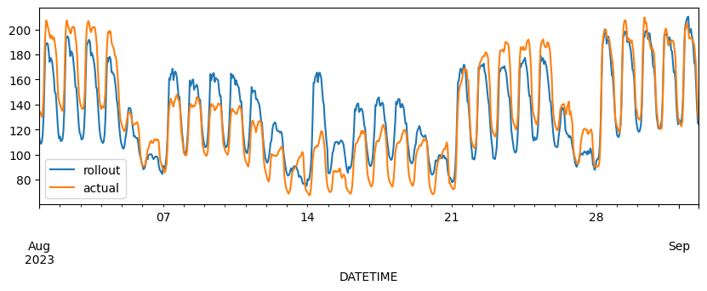
Italy

Slide 9
Individual forecast

Slide 10
Some customers left Alpiq
Only NaNs and/or zeros
1 in Spain, ~30 in Italy

Slide 11
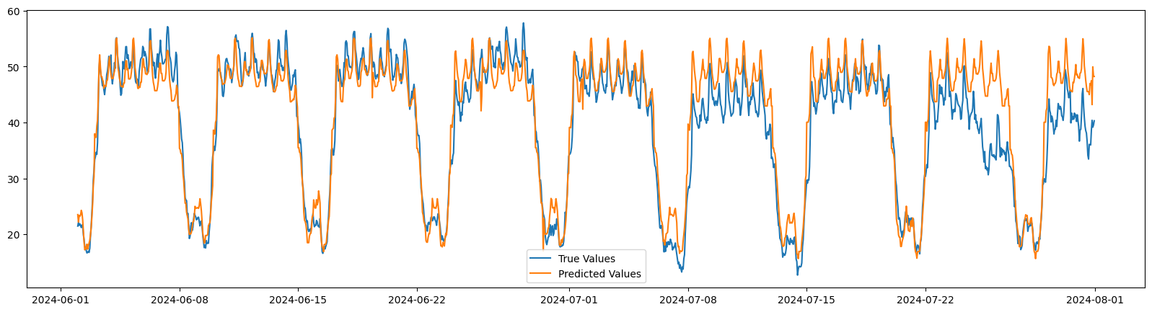
Location (local holiday) matters!

Slide 12
Results
Model: Gradient boosting regressor
Baseline | Portfolio | Portfolio + individual (linear model) | Portfolio + individual (tree model)
826344 | 681276 | 384063 | 354484

