Slide 1
Document scanner
Jerzy Pawlik

Slide 2
Problem definition
Creating a document scanner, that can use a laptop camera to find the document on the camera view, then extract it from there into the new file, and binarize it to make it easier to read. The output image is black and white.

Slide 3
The pipeline of the project (system architecture)
1 | Setting up the computer web camera to capture frames
2 | Detecting the document contours | Blurring the image with gaussian blur Detecting the edges with canny Edge detector Finding contours on the edges image with findContours function Finding the biggest contour with 4 vertexes
3 | cropping the image and transforming it into rectangle | Ordering the contour vertexes Computing the size of the output image Computing the transformation matrix with open CV
4 | Binarization of the image

Slide 4
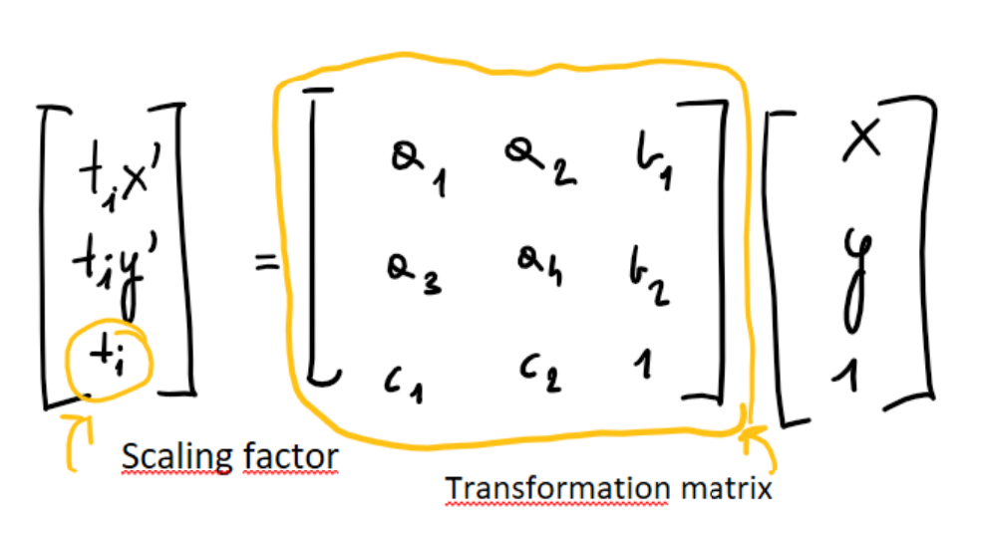
Perspective transformation
Transformation matrix is defined by 8 constants. If we know location of at least 4 the same points in both input and output images we get 8 equations and 8 unknowns, what can be easily solved

Slide 5
Input output samples

Slide 6
Future improvements
Applying better resolution camera
More accurate computation of the output image size (by now camera has to be on the plane parrarel to the document)
Creating a version for colour images

