Slide 1
Document scanner
Jerzy Pawlik

Slide 2
Problem definition
Creating a document scanner, that can use a laptop camera to find the document on the camera view, then extract it from there into the new file, and binarize it to make it easier to read.

Slide 3
The pipeline of the project
Setting up the computer web camera to capture frames
2 . Detecting the document contours
3 . cropping the image and transforming it into rectangle
4 . Binarization of the image

Slide 4
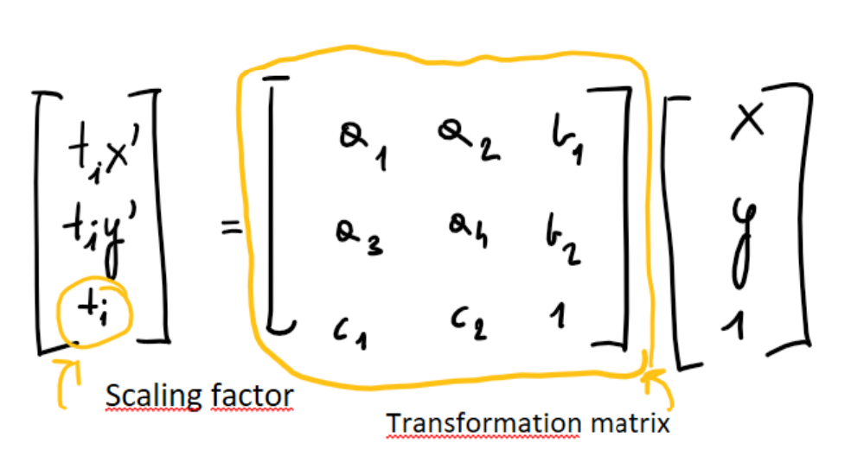
Perspective transformation
Transformation matrix is defined by 8 constants. If we know location of at least 4 the same points in both input and output images we get 8 equations and 8 unknowns, what can be easily solved

Slide 5
Input output samples

