Slide 1
Document scanner
Jerzy Pawlik

Slide 2
Problem definition
Creating a document scanner, that can use a laptop camera to find the document on the camera view, then extract it from there into the new file, and binarize it to make it easier to read. The output image is black and white.

Slide 3
The pipeline of the project (system architecture)
1 | Setting up the computer web camera to capture frames
2 | Detecting the document contours | Blurring the image with gaussian blur Detecting the edges with canny Edge detector Finding contours on the edges image with findContours function Finding the biggest contour with 4 vertexes
3 | cropping the image and transforming it into rectangle | Ordering the contour vertexes Computing the size of the output image Computing the transformation matrix with open CV
4 | Binarization of the image | Scaling image to be bigger Applying adaptive thresholding
5 | Restoration | Bolding the text with morphological operations Removing noise using erosion and median filtering

Slide 4
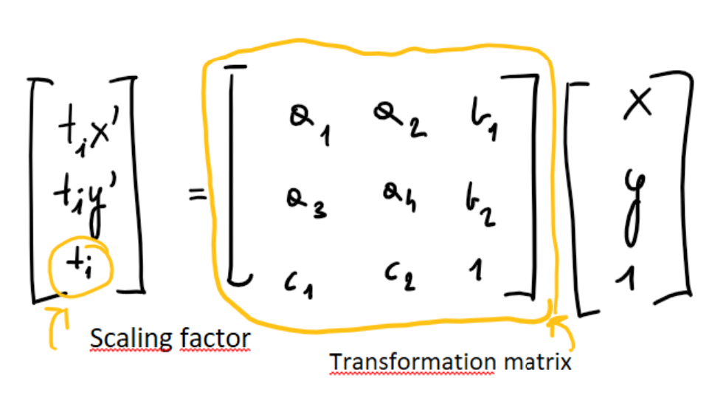
Perspective transformation
Transformation matrix is defined by 8 constants. If we know location of at least 4 the same points in both input and output images we get 8 equations and 8 unknowns, what can be easily solved
Notes:
The function four_point_transform, that I use orders contour points and computes transformation matrix

Slide 5
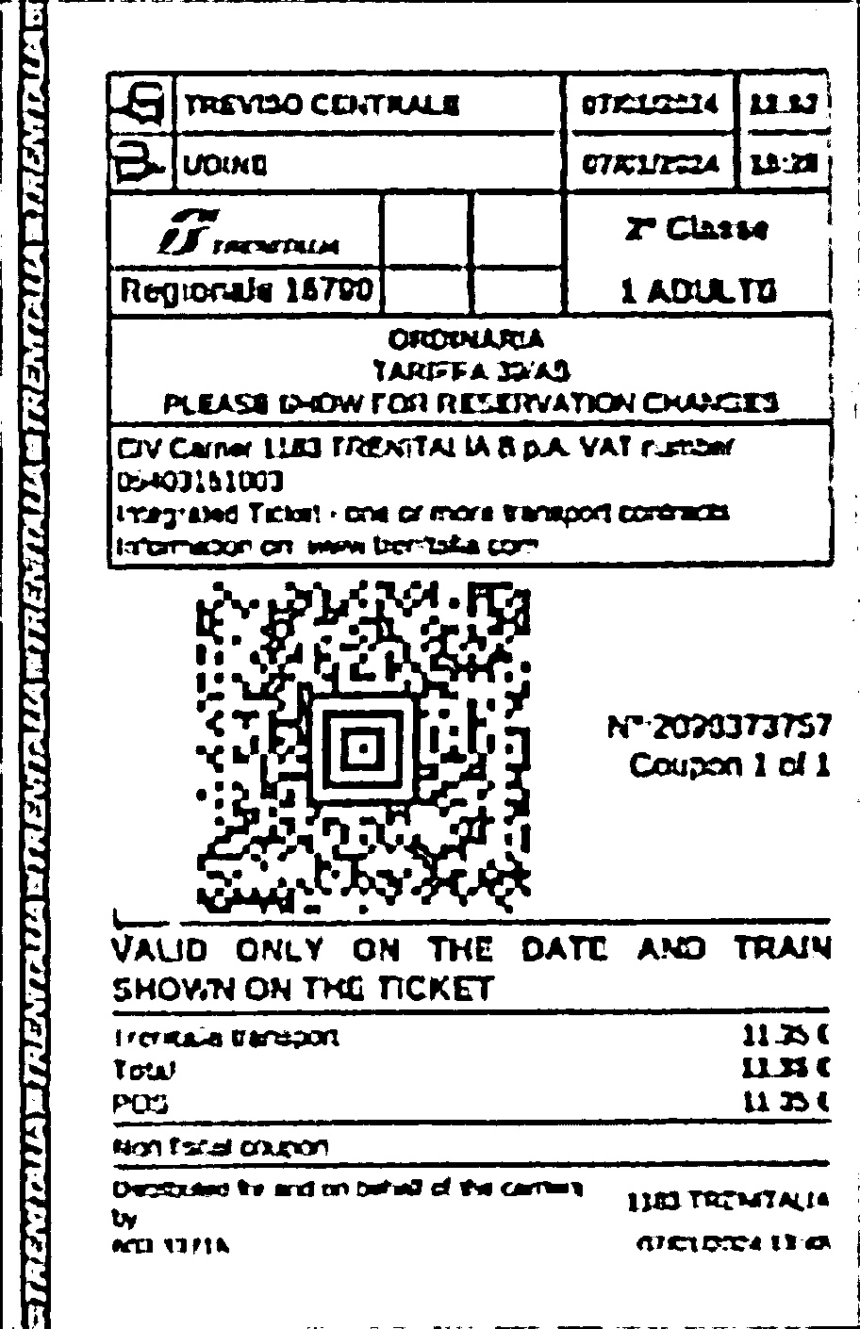
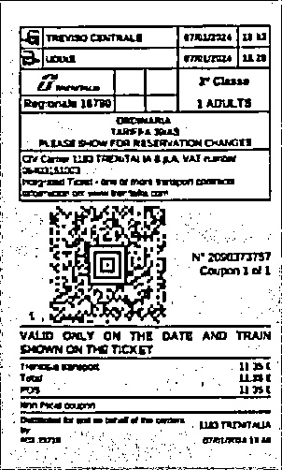
Why do I scale the image?
Thresholding with scaling
With no scaling

Slide 6
Input/output samples

Slide 7
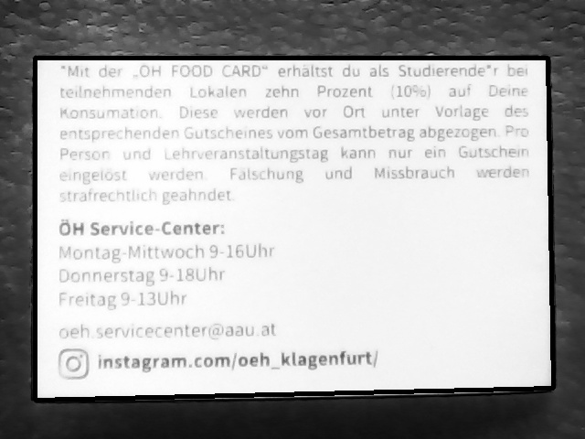
Input

Slide 8
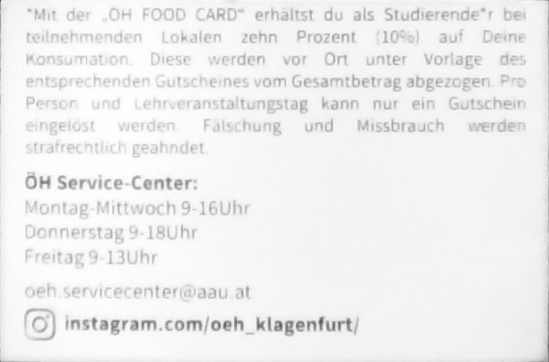
Cropped

Slide 9
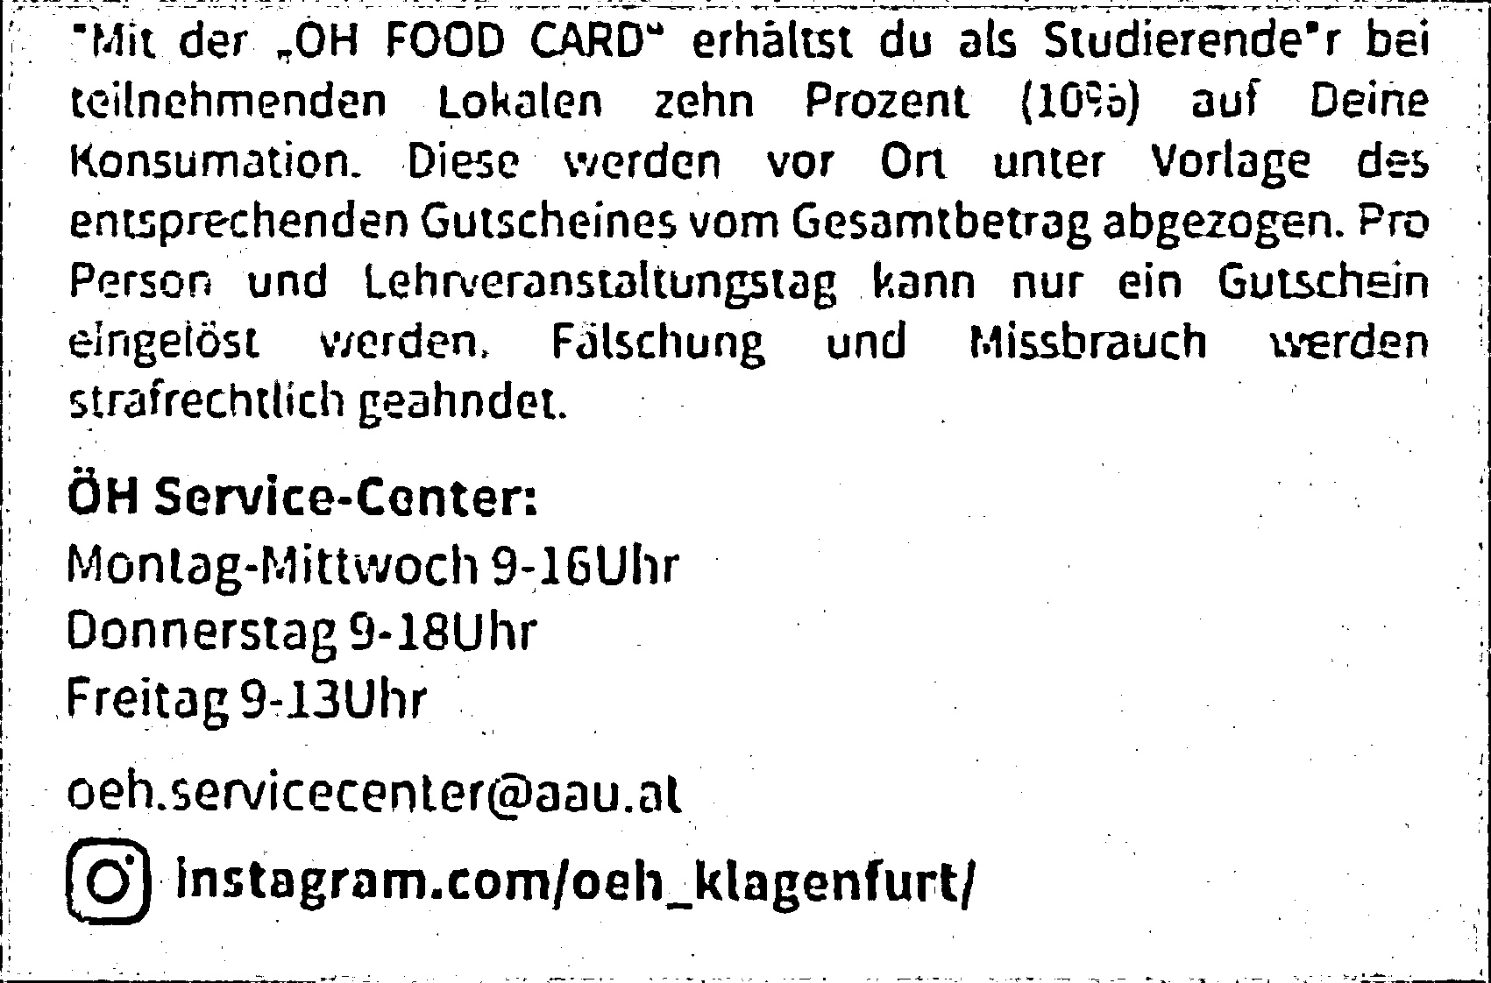
Thresholded

Slide 10
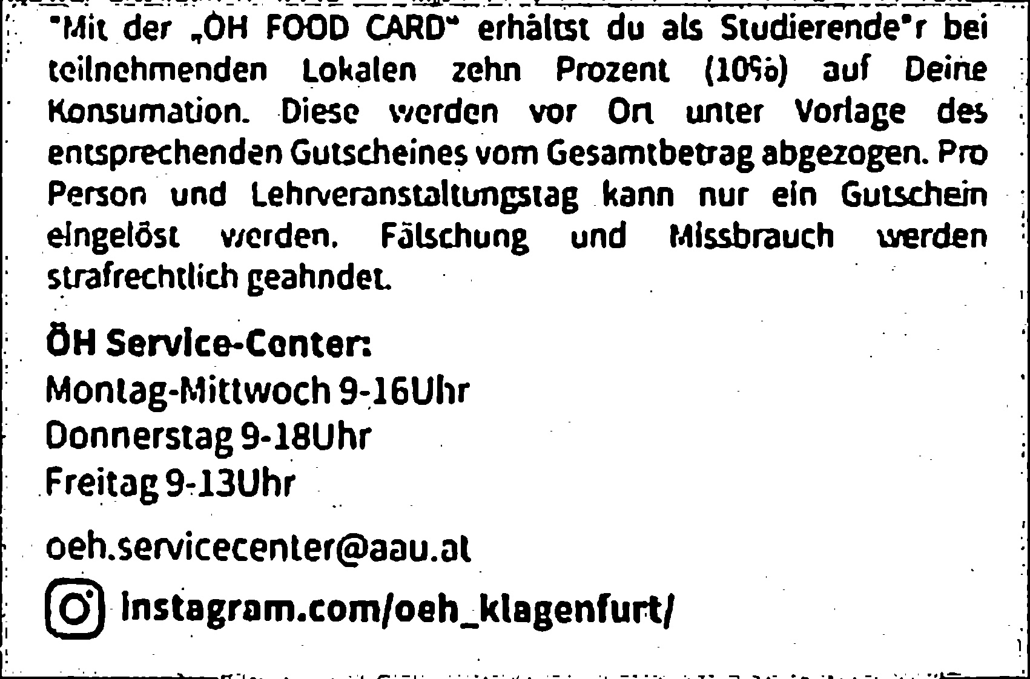
Bolded text

Slide 11

Denoised

Slide 12
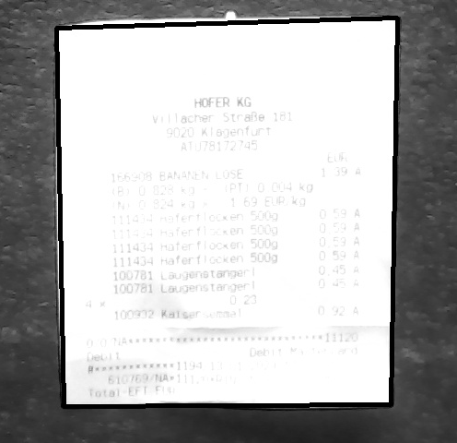
Input

Slide 13
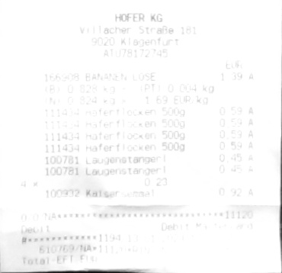
Cropped

Slide 14
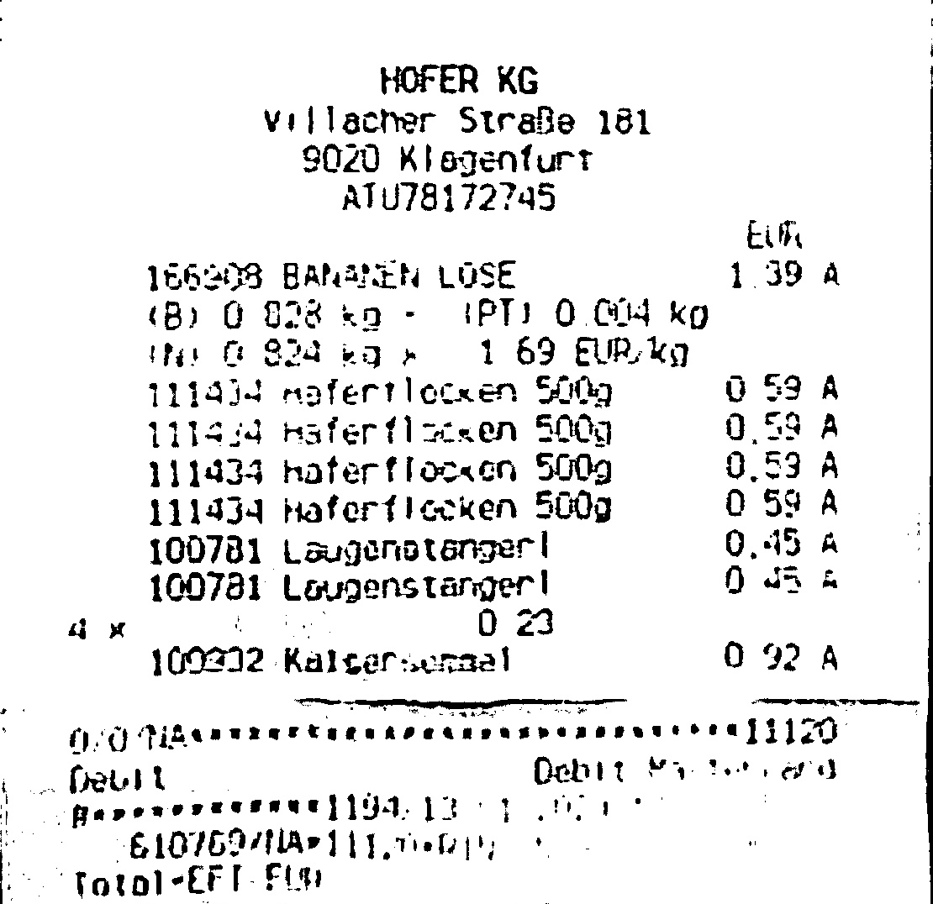
Thresholded

Slide 15
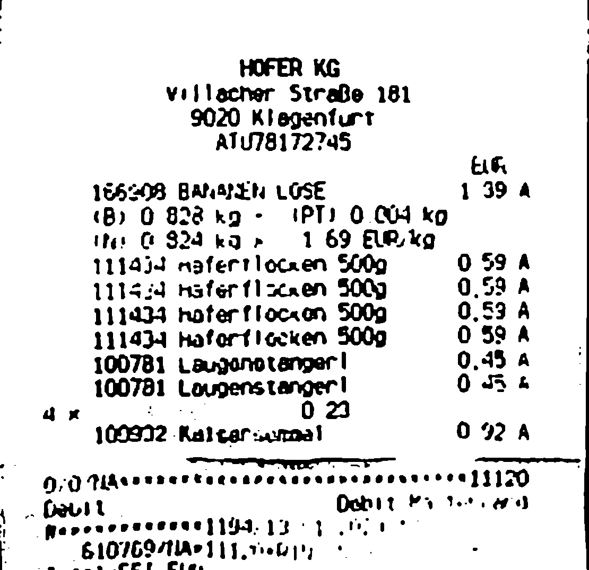
Bolded text

Slide 16

Denoised

Slide 17
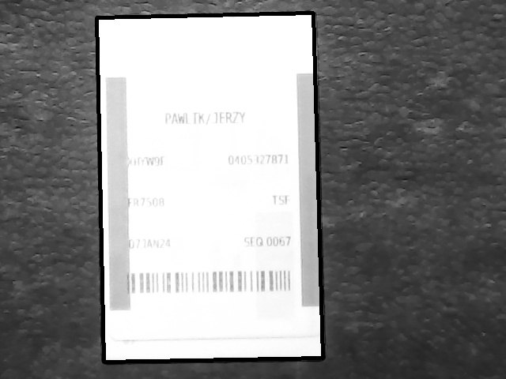
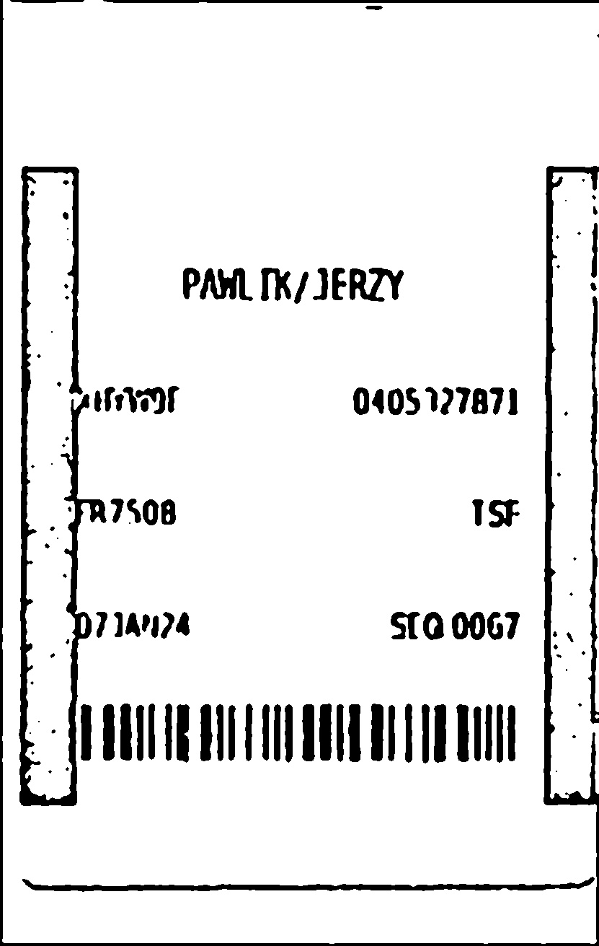
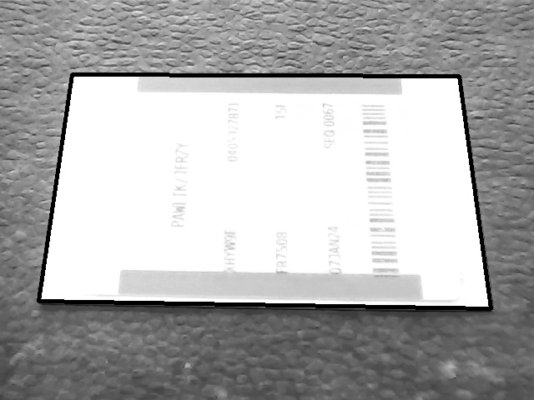
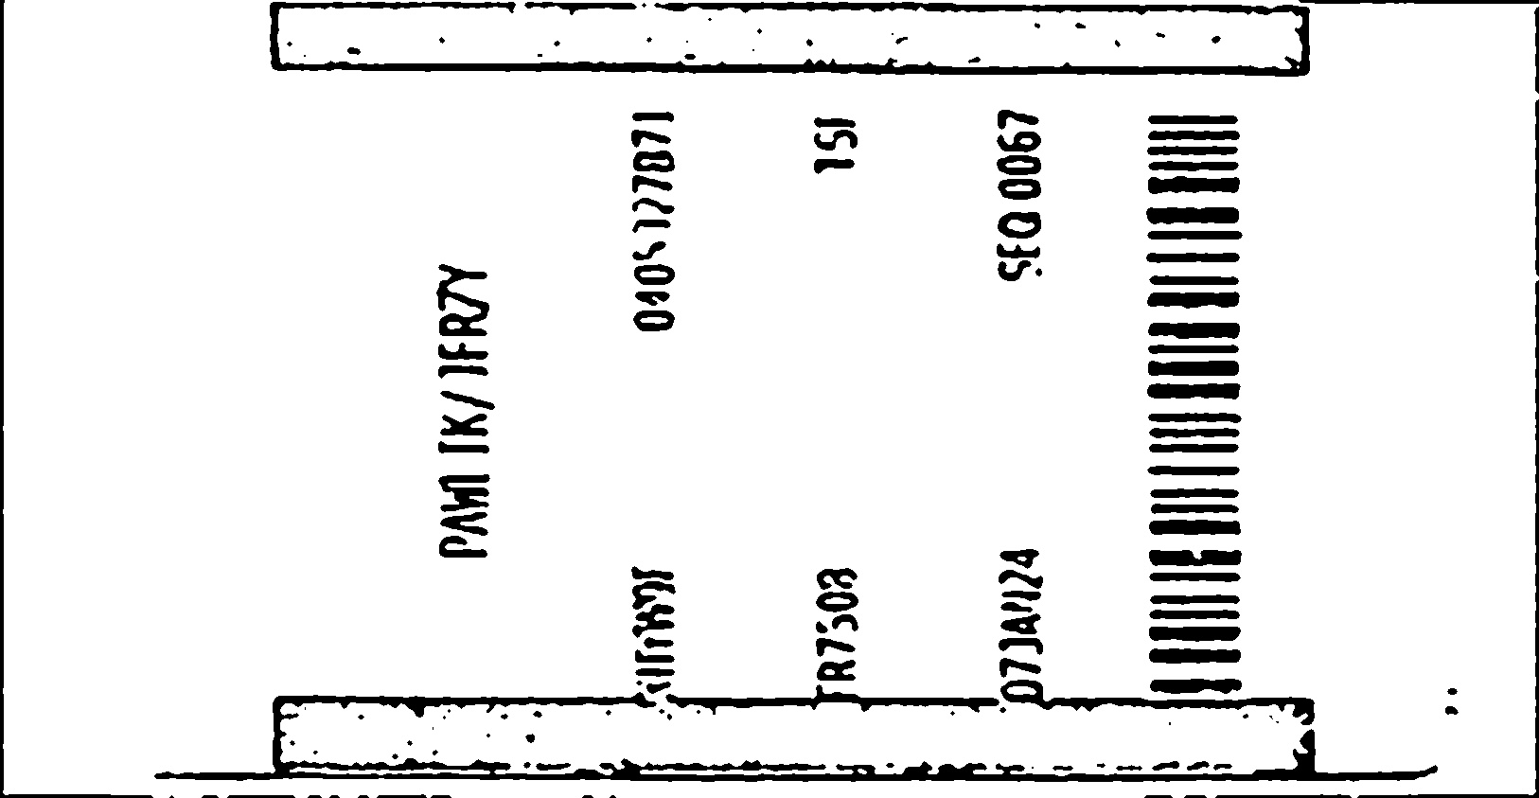
Limitations

Slide 18
Future improvements
Applying better resolution camera
More accurate computation of the output image size (by now camera has to be on the plane parrarel to the document)
Creating a version for colour images
Creating version to read from a folder
Adding functionality to rotate the frame

