Slide 1
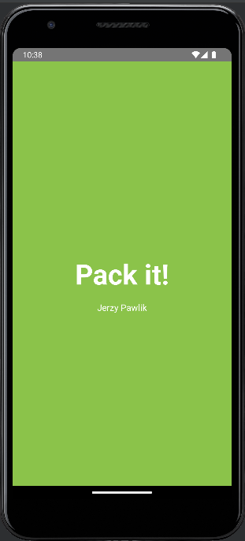
Pack It!
Jerzy Pawlik

Slide 2
The Idea:
The idea was to create an app for travellers to help them packing for their journeys. However contrary to ather apps that are available on play store, this app wasn’t only meant to be a simple „to do” list. I use to perceive packing as a process, where you not only have to put the item into a bag, but usually first find/buy/borrow it and prepare it. That’s why, I wanted to let uses assign a custom „tags” to each items and then see a lists of items with particular tag. Tags can be used to list items that we for example want „to buy” or the items that for some reason we must pack not earlier than before set off. I believe that this can help organising the packing a lot

Slide 3
The solution:
SQLite database!

Slide 4
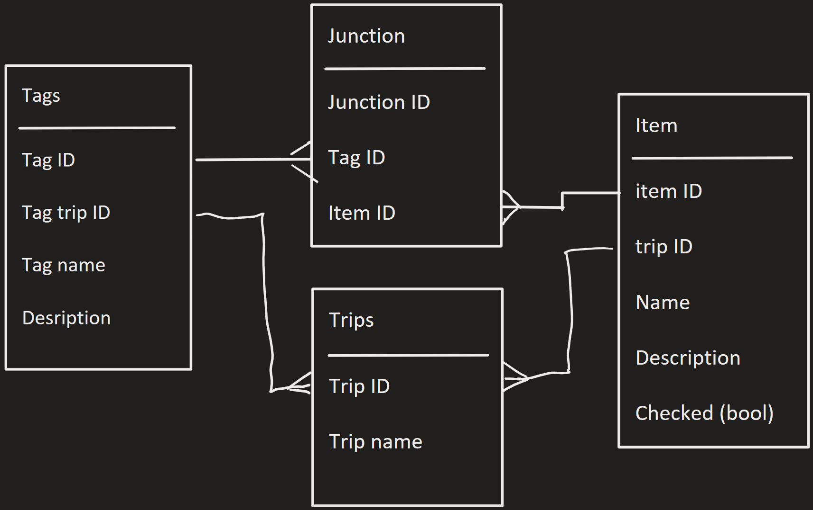
Database Diagram:

Slide 5
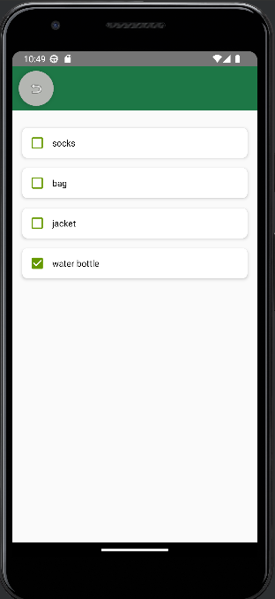
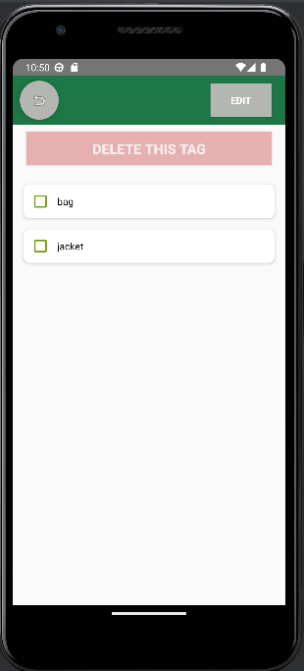
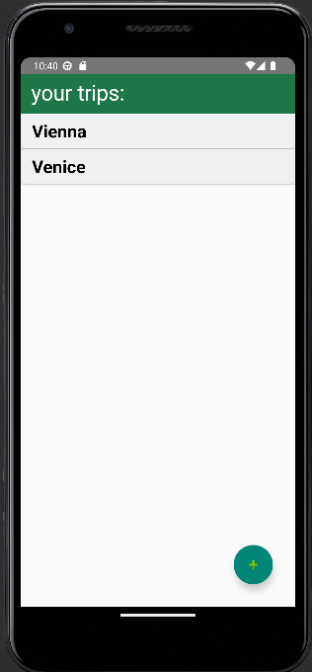
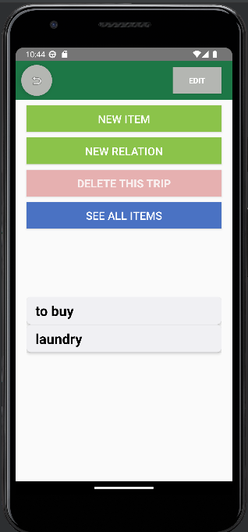
How it works?
3a main items list
3b items with tag list
1. trips list
2. Inside the trip
List of all tags in a trip

Slide 6
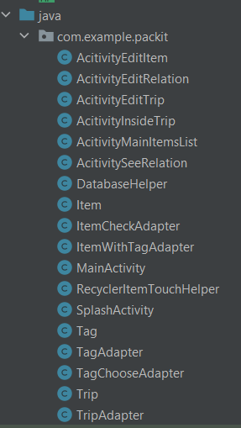
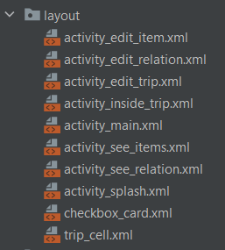
How it is coded?
All the classes
All the activities

Slide 7
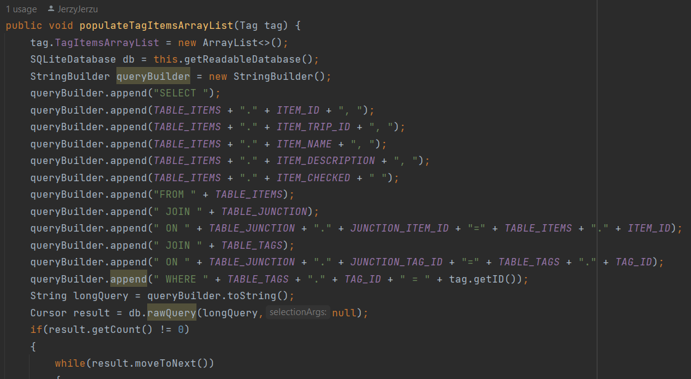
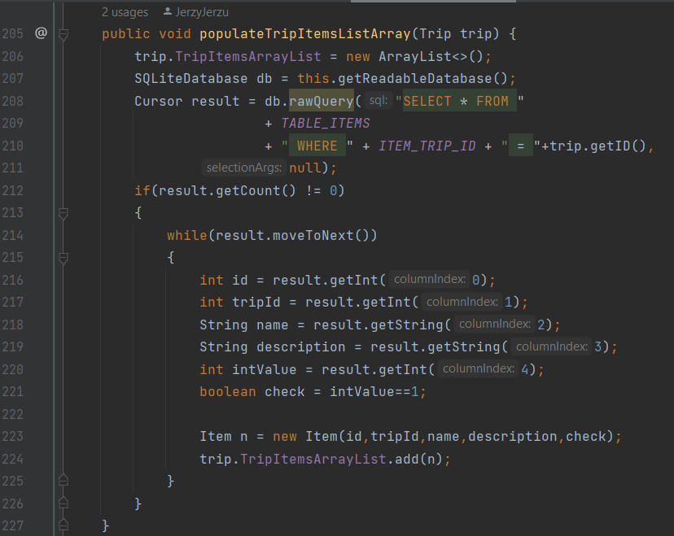
Some of a database queries:

Slide 8
Thank you for your attention!

