Slide 1
Manhattan vs. Paris
Jesús Ponce

Slide 2
Relationship between Paris and Manhattan
Generally, the main attraction of a city are their venues and point of interests.
People will visit a place, open a restaurant, study, the more attractive the city is.
Manhattan and Paris are places which are similar in a lot more ways than their culture is.
The differences between the two are about:
Quality of life
The way the people view their relationship to both others and the world.

Slide 3
Data acquisition and cleaning
New York data set obtained from Coursera’s json file
Paris data set scrapped from Wikipedia’s Arrondissements of Paris
Venues for both Paris and Manhattan obtained from Foursquare’s API explore endpoint
Geographical location was obtained form the Geopy Library
Irrelevant features as well as erroneous geographical information was dropped
Accurate information was added to get accurate insights

Slide 4
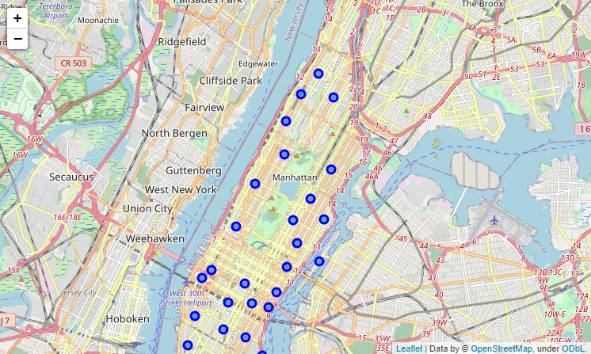
Manhattan Neighborhoods
Manhattan has 40 neighborhoods.
Each neighborhood has different type of venue depending the location

Slide 5
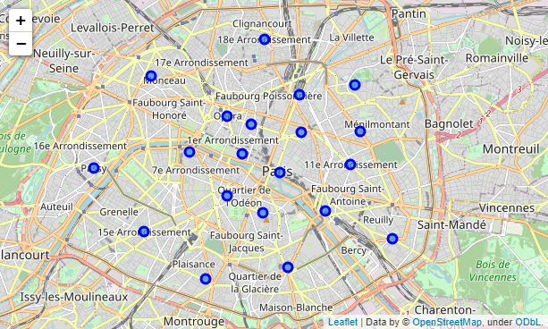
Paris Arrondissements
Paris is divided into 20 arrondissements.
Each arrondissement has a variety of venues depending the location

Slide 6
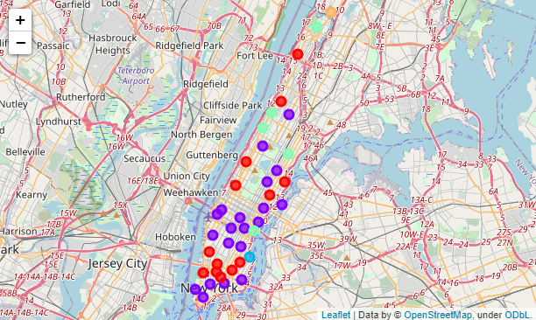
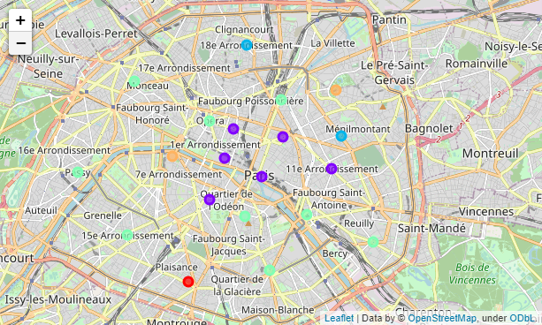
Clustering
I used 5 clusters for both maps in order to better visualize the different types of venues for each city.
Manhattan
Paris

Slide 7
Insights for Manhattan
Purple Cluster
This cluster include restaurants as well as bars.
The purple clusters are venues that hold the majority of the population of the borough.
You will find that work life as well as vacationers will be at that neighborhood their majority of their visit
 | 1st Most Common Venue | 2nd Most Common Venue | 3rd Most Common Venue | 4th Most Common Venue | 5th Most Common Venue
Chinatown | Chinese Restaurant | Bakery | Cocktail Bar | American Restaurant | Noodle House
Civic Center | Coffee Shop | Spa | Gym / Fitness Center | Yoga Studio | French Restaurant
Midtown South | Korean Restaurant | Hotel | Japanese Restaurant | Cosmetics Shop | Burger Joint
Flatiron | Italian Restaurant | Japanese Restaurant | New American Restaurant | Mediterranean Restaurant | Cycle Studio
Hudson Yards | Gym / Fitness Center | Hotel | Italian Restaurant | American Restaurant | Coffee Shop
Popular places include:
Central Park
Chinatown
Hudson Yards

Slide 8
Insights for Paris
Purple Cluster
This cluster include restaurants as well as small shops
It is common in Paris to have shops of different categories as popular spaces
Main work life and population will reside in this area
 | 1st Most Common Venue | 2nd Most Common Venue | 3rd Most Common Venue | 4th Most Common Venue | 5th Most Common Venue
Louvre | French Restaurant | Plaza | Coffee Shop | Hotel | Italian Restaurant
Bourse | French Restaurant | Wine Bar | Cocktail Bar | Bistro | Hotel
Temple | French Restaurant | Hotel | Wine Bar | Restaurant | Art Gallery
Hôtel-de-Ville | French Restaurant | Ice Cream Shop | Plaza | Art Gallery | Theater
Luxembourg | French Restaurant | Plaza | Italian Restaurant | Café | Chocolate Shop
Popular places include:
Louvre
Near Eiffel Tower

Slide 9
Final Insight
Both handle venues pretty similar, popular spaces are situated at the middle of the borough/city while the least attractive or less popular spaces wrapped around the purple cluster.
If you are looking to visit these places, you should make sure to have a visit at the purple clusters.
If you are looking to open a restaurant, you may want to stay close to a purple cluster
If you are planning to move, a green cluster might work better for you since green clusters appear to be more quiet

