Slide 1


​
KINETIC-INDUCTANCE TRAVELING-WAVE PARAMETRIC AMPLIFIERS
VENUE & DATE
EPFL — Neuchâtel
August 2026
​
PRESENTED BY
Jesus Urbaneja
E3 - Internship
Notes:
Good morning. Today I will present our work on kinetic-inductance traveling-wave parametric amplifiers. The goal was to understand whether we can reproduce a broadband amplifier using HFSS and TWPAlab. I will begin with the amplification physics, then follow the modelling workflow from geometry to gain, and finish with our results and the changes needed for the next design.

Slide 2

OUTLINE
→
01
REQUIREMENT
Low-noise, broadband first-stage amplification
02
MIXING
DC-biased kinetic inductance generates the idler
03
GAIN
Phase matching enables coherent accumulation
04
VALIDATION
Passive response precedes nonlinear comparison
05
INTERPRETATION
Frequency offset and reflection-induced ripple
Notes:
This is the outline. First, I will explain the requirement: low-noise, broadband first-stage amplification. Second, I will introduce three-wave mixing and the idler. Third, I will explain why phase matching is needed for gain. Then I will show the validation workflow, beginning with the passive HFSS response and ending with the nonlinear prediction. Finally, I will interpret the remaining frequency offset and reflection-induced ripple.

Slide 3
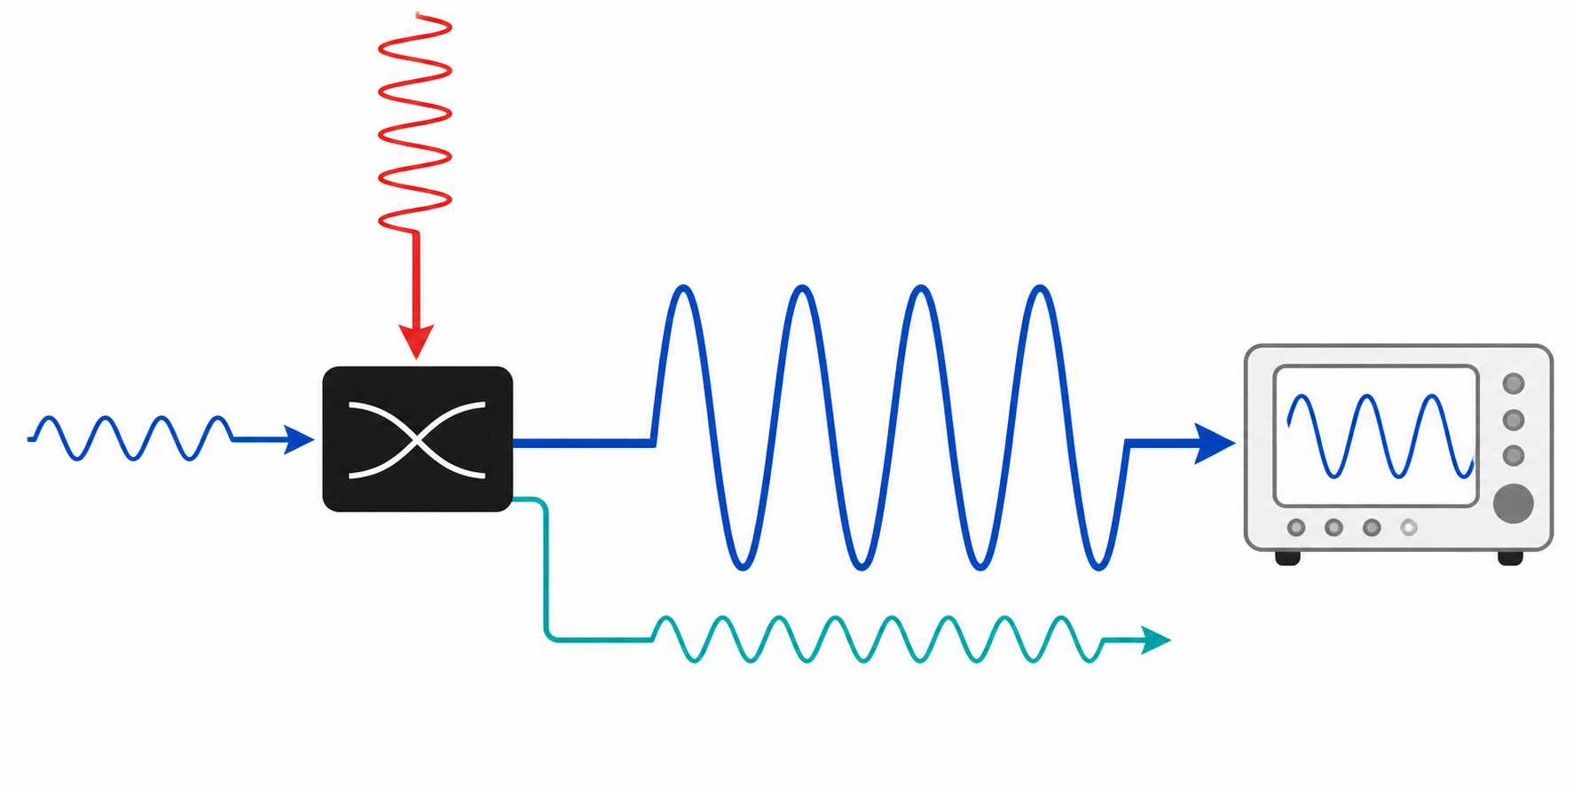
The KI-TWPA turns a weak signal into one we can measure
3
KI-TWPA • 3WM • VALIDATION
Jesus Urbaneja
The nonlinear KI-TWPA transfers pump energy into the signal, increasing its amplitude before measurement.
Weak input → pump-powered KI-TWPA → larger output → measurement
PUMP ADDS ENERGY
1 WEAK SIGNAL IN
A small microwave tone carries the qubit or detector information.
AMPLIFIED SIGNAL OUT
2 PUMP ADDS ENERGY
Nonlinear coupling transfers pump energy into the signal.
WEAK SIGNAL IN
3 AMPLIFIED SIGNAL OUT Its larger amplitude is easier for the measurement chain to distinguish from noise.
IDLER
Notes:
The KI-TWPA turns a weak signal into one we can measure. Reading the diagram from left to right, step one is the weak signal entering the device. It carries our information, but its amplitude is very small. In step two, we apply a strong pump, which supplies energy to the nonlinear KI-TWPA. In step three, the signal leaves with a larger amplitude and becomes easier to distinguish from noise. The teal wave is the idler, a companion wave created during this process.

Slide 4
Many readout tones need one wide, low-noise amplifier
Qubit Measurement Many qubits use different readout frequencies on one shared microwave line.
Bandwidth and the JPA Bandwidth is the frequency range with useful gain.
A JPA—Josephson parametric amplifier—is very low-noise, but typically narrowband.
Why a KI-TWPA A KI-TWPA spreads nonlinear amplification along a long 50 Ω line, giving GHz-scale bandwidth so many readout tones can be amplified together.
RESONANT JPA
≲ 100 MHz
typical bandwidth ceiling
KINETIC-INDUCTANCE TWPA
> 3 GHz
reported gain bandwidth • >25 dB gain
Notes:
Many readout tones need one wide, low-noise amplifier. At the top left, multiplexed readout means that many qubits use different frequencies on the same microwave line. Bandwidth is simply the frequency range over which the amplifier provides useful gain. On the right, a resonant JPA is very low-noise but typically covers only about one hundred megahertz. A KI-TWPA spreads the interaction along a transmission line and can cover more than three gigahertz, so it can amplify many readout tones together.

Slide 5

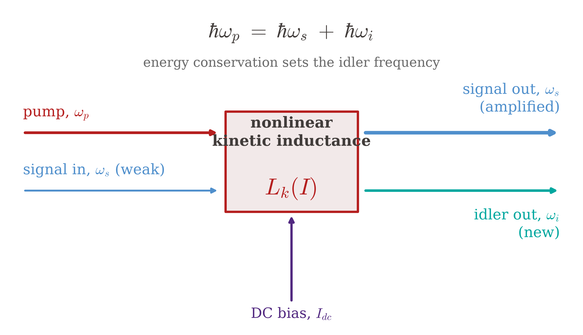
Nonlinear coupling lets pump energy amplify the signal
5
KI-TWPA • 3WM • VALIDATION
Jesus Urbaneja
Energy ωₚ = ωₛ + ωᵢ
Momentum Δβ = kₚ − kₛ − kᵢ ≈ 0
Why nonlinearity matters?
A linear element keeps the waves separate.
The nonlinear inductance couples them, so pump energy can flow into the signal and idler.
Phase matching keeps the transfer adding along the line.
PUMP
ωₚ
SIGNAL ωₛ
NONLINEAR
KINETIC
INDUCTANCE
IDLER ωᵢ
ωᵢ = ωₚ − ωₛ
Notes:
Nonlinear coupling lets pump energy amplify the signal. The diagram on the right shows the pump entering the nonlinear kinetic inductance and producing an amplified signal together with the idler. On the left, energy conservation is omega p equals omega s plus omega i. Momentum conservation appears as delta beta approximately equal to zero. The key sentence on the slide is that a linear element keeps the waves separate. The nonlinear inductance couples them, and phase matching keeps the energy transfer adding along the line.

Slide 6
Pump–signal multiplication creates the idler
6
KI-TWPA • 3WM • VALIDATION
Jesus Urbaneja
SIGNAL AND PUMP
s(t) = Aₛ cos(ωₛt)
p(t) = Aₚ cos(ωₚt)
A linear element only scales these waves.
It does not multiply them or create an idler.
NONLINEAR MIXING
The quadratic response contains the cross-term:
2s(t)p(t) = 2AₛAₚ cos(ωₛt)cos(ωₚt)
Use 2cos(a)cos(b) = cos(a−b) + cos(a+b)
= AₛAₚ[cos((ωₚ−ωₛ)t) + cos((ωₚ+ωₛ)t)]
Difference term: cos((ωₚ−ωₛ)t) → ωᵢ = ωₚ − ωₛ → IDLER
Notes:
Pump-signal multiplication creates the idler. On the left, the two inputs are the signal, A s cosine omega s t, and the pump, A p cosine omega p t. A linear element can only scale them. On the right, the nonlinear response contains their product. Applying the product-to-sum identity creates a difference term and a sum term. The result at the bottom highlights the important one: cosine of omega p minus omega s. Its frequency is omega i, so the idler is created inside the nonlinear device rather than supplied as another input.

Slide 7
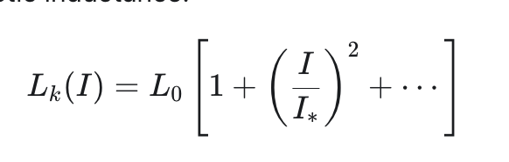
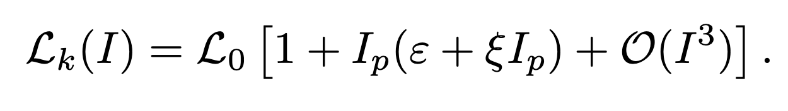
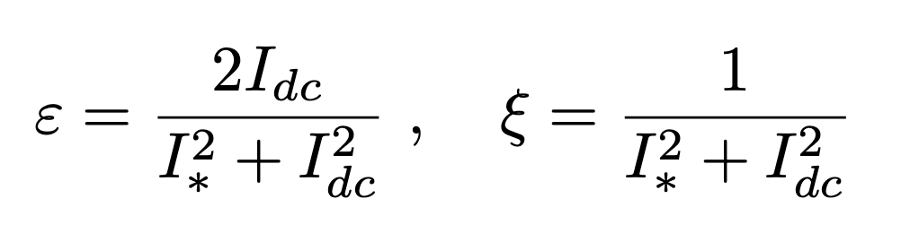
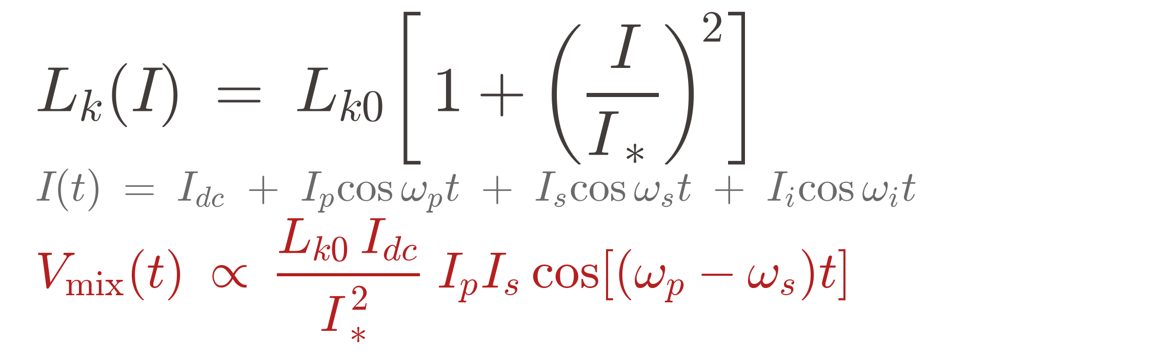
A DC bias activates three-wave mixing in the kinetic inductance
7
KI-TWPA • 3WM • VALIDATION
Jesus Urbaneja
CURRENT-DEPENDENT INDUCTANCE
L₀ zero-bias kinetic inductance per unit length
I* nonlinear scaling currents
Lowest order: Lₖ rises as I², an even nonlinearity.
Bias the line around a nonzero operating point
I = I_DC + Ip
Lₖ(I) ≈ L₀[1 + Iₚ(ε + ξIₚ)]
ε = 2I_DC / (I*² + I_DC²)
I_DC ≠ 0 ⇒ ε ≠ 0 ⇒ 3WM is allowed
Notes:
A DC bias activates three-wave mixing in the kinetic inductance.
On the left, kinetic inductance increases approximately with current squared, which is an even nonlinearity.
On the right, we bias the line around a nonzero operating point by writing the current as I DC plus the microwave current.
After expanding around that point, the coefficient epsilon becomes nonzero. The conclusion shown at the bottom is the important one: when I DC is not zero, epsilon is not zero, and three-wave mixing is allowed.

Slide 8
3WM separates the pump from the amplified signal band
8
KI-TWPA • 3WM • VALIDATION
Jesus Urbaneja
FOUR-WAVE MIXING
2ωₚ = ωₛ + ωᵢ
Signal and idler lie around ωₚ.
The pump is close to the amplified band.
THREE-WAVE MIXING
ωₚ = ωₛ + ωᵢ
Signal and idler can lie near ωₚ/2.
The pump is far from the amplified band.
3WM advantage: signal band near ωₚ/2 → lower pump frequency and easier filtering
Notes:
Three-wave mixing separates the pump from the amplified signal band. In the left column, one pump photon produces a signal and an idler, so omega p equals omega s plus omega i. The signal band can therefore lie near half the pump frequency. In the right column, four-wave mixing uses two pump photons, and the signal and idler lie around the pump itself. The takeaway at the bottom is that three-wave mixing permits a lower pump frequency for a given signal band and makes filtering the strong pump easier.

Slide 9
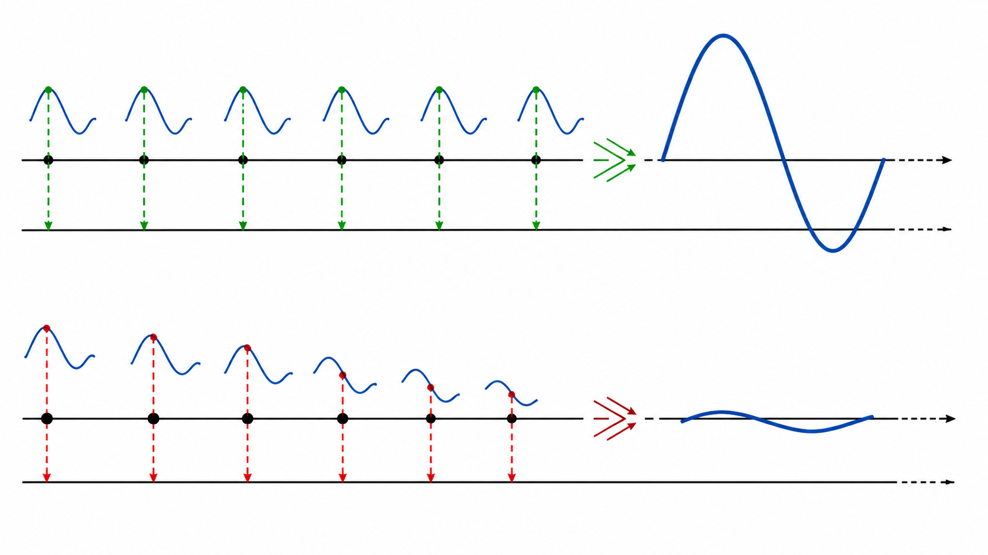
Phase matching keeps every small contribution adding to the signal
9
KI-TWPA • 3WM • VALIDATION
Jesus Urbaneja
Each section of the line generates a small signal contribution; their relative phase determines whether the total grows or cancels.
Aligned contributions build a large output; phase drift leaves a small output
MATCHED
Δβ ≈ 0 Crests stay aligned, so the contributions add.
PHASE MISMATCH
Δβ ≠ 0 The phase drifts, so crests and troughs partly cancel.
DESIGN GOAL Engineer the dispersion so Δβ stays near zero across the useful signal band.
Notes:
Phase matching keeps every small contribution adding to the signal. In the upper picture, delta beta is close to zero, the crests stay aligned, and each section adds constructively. In the lower picture, delta beta is not zero, the phase drifts, and later contributions partly cancel earlier ones. The design goal written on the right is therefore to engineer the dispersion so delta beta stays near zero across the useful signal band. That is what motivates the periodic structure on the next slide.

Slide 10
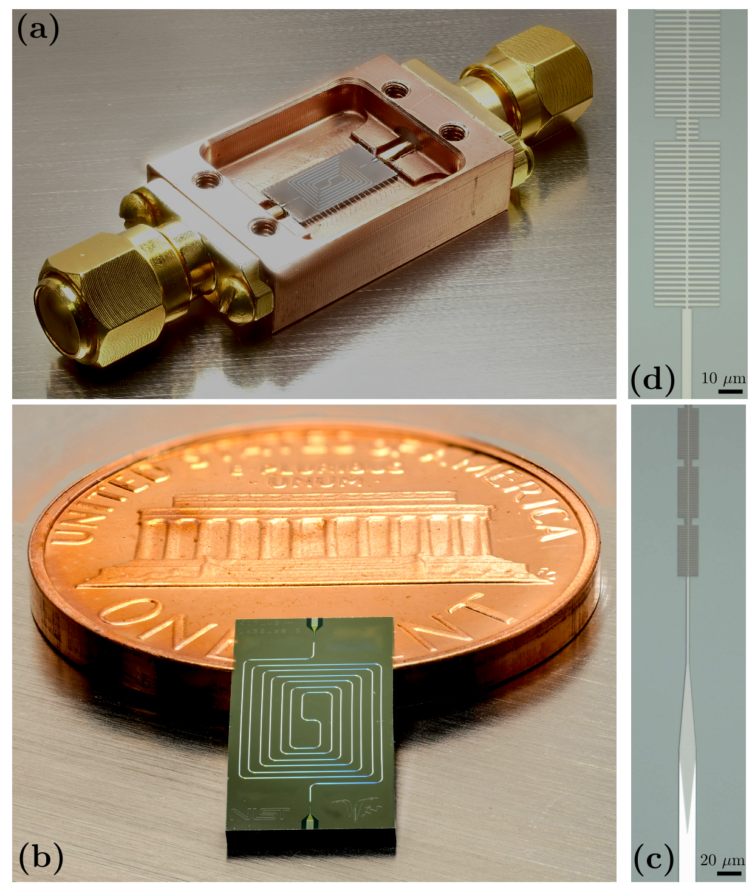
Periodic loading supplies the dispersion required for phase matching
9
KI-TWPA • 3WM • VALIDATION
Jesus Urbaneja
PERIODIC LINE GEOMETRY
loaded cells
unloaded cells
Paper design targets:
unloaded ≈48 Ω and loaded ≈78 Ω.
Notes:
Periodic loading supplies the dispersion required for phase matching. The geometry on the right alternates unloaded cells with a group of loaded cells.
The paper's design targets are about forty-eight ohms for the unloaded cells and seventy-eight ohms for the loaded cells. Repeating this impedance contrast opens a bandgap near the pump.
Around the bandgap edge, the propagation constant changes rapidly with frequency, providing the dispersion needed to compensate the phase mismatch.

Slide 11
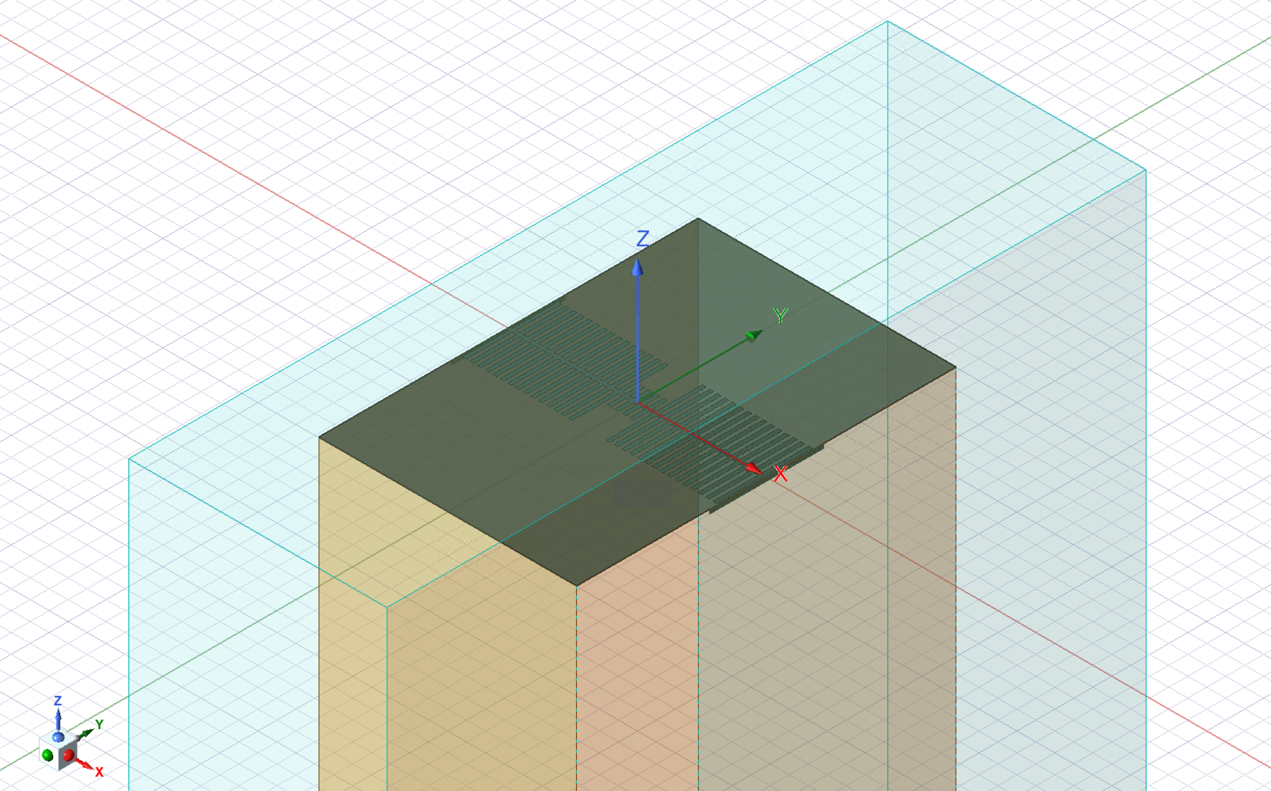
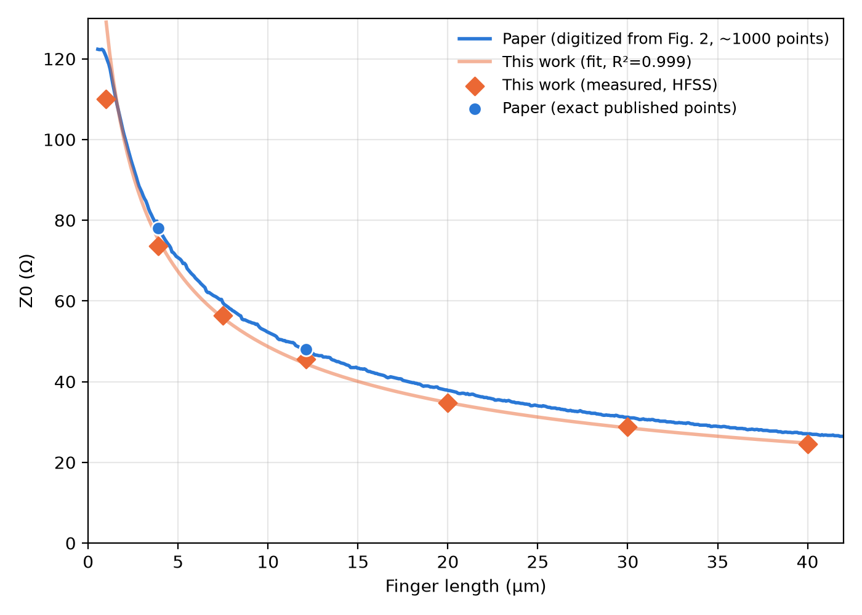
HFSS captures field coupling and the superconducting surface impedance
10
KI-TWPA • 3WM • VALIDATION
Jesus Urbaneja
HFSS MATERIAL STACK
Nb ground
100 nm
a-Si dielectric
100 nm | εᵣ 9.1
NbTiN signal Zₛ = Rₛ + jωLₖ,sq Rₛ=0; Lₖ,sq=30 pH/sq
Si substrate 500 µm | εᵣ 11.7
Nb ground
NbTiN signal
a-Si dielectric
Si substrate
Notes:
HFSS captures field coupling and the superconducting surface impedance. Starting with the stack on the left and reading from bottom to top, we have the silicon substrate, the NbTiN signal, the amorphous-silicon dielectric, and the niobium ground. The NbTiN is represented by the complex surface impedance shown on the slide. For our lossless baseline, R s is zero and the sheet kinetic inductance is thirty picohenries per square. At the top right is the extraction workflow: two-port HFSS gives S of f, we convert S to ABCD, fit L, C, and L f, calculate Z zero, and then select the stub lengths.

Slide 12
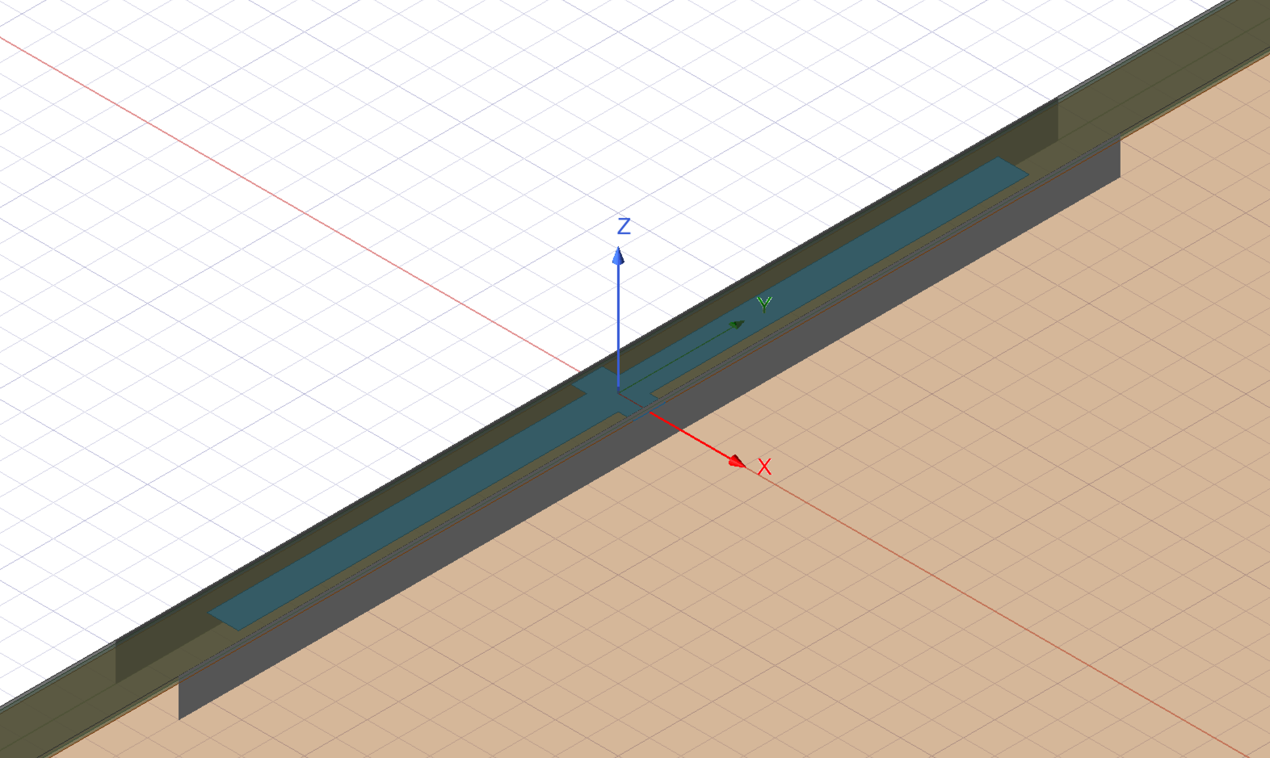
Capacitance and Impedance Extraction
11
KI-TWPA • 3WM • VALIDATION
Jesus Urbaneja
CAPACITANCE AND IMPEDANCE EXTRACTION
Single-cell simulation on HFSS
Two-port HFSS
S(f)
S → ABCD
fit L_cell, C, L_stub
Z₀ = √(L/C)
select lengths
Paper design targets:
unloaded ≈48 Ω and loaded ≈78 Ω.
HFSS-extracted sections:
unloaded ≈43.09 Ω and loaded ≈70.20 Ω.
HFSS-supercoductor:
Resistance = 0
Reactance = 2*pi*Lk_square
Notes:
This slide compares the paper targets with our HFSS extraction. The paper uses approximately forty-eight ohms for the unloaded section and seventy-eight ohms for the loaded section. With the same nominal geometry, our values are forty-three point zero nine and seventy point two ohms. On the right is the single-cell HFSS geometry and the lossless superconductor boundary. The chain at the bottom summarizes why this matters: geometry determines k of f, k determines delta beta, and delta beta determines the gain bandwidth.

Slide 13
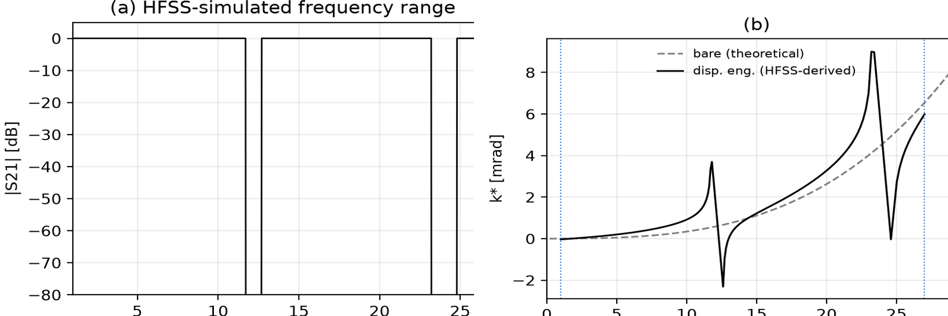
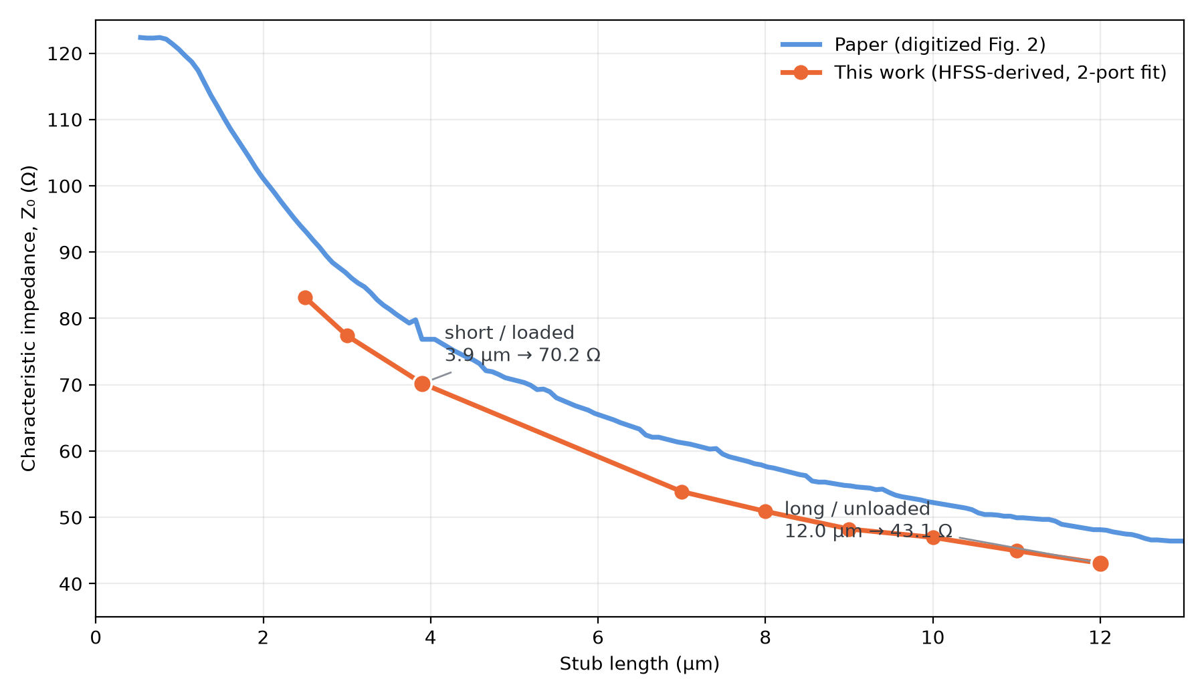
HFSS cell simulations link loading geometry to effective impedance
12
KI-TWPA • 3WM • VALIDATION
Jesus Urbaneja
Stub length and effective impedance
SHORT / LOADED
3.9 µm
HFSS-derived: 70.20 Ω
LONG / UNLOADED
12.1 µm
HFSS-derived: 43.09 Ω
Notes:
HFSS cell simulations link loading geometry to effective impedance.
In the graph, stub length is on the horizontal axis and effective impedance is on the vertical axis. The orange points are our HFSS samples, the orange curve is their fitted trend, and the blue curve is the reference from the paper. On the right, the two selected points are called out directly: three point nine micrometres gives seventy point two ohms for the short loaded cell, while about twelve micrometres gives forty-three point zero nine ohms for the long unloaded cell.

Slide 14
HFSS turns the device geometry into a microwave response
13
KI-TWPA • 3WM • VALIDATION
Jesus Urbaneja
HFSS: FROM GEOMETRY TO S-PARAMETERS
1 Model the cell between two 50 Ω ports
2 HFSS solves the
microwave fields
3 Export S(f)
over frequency
RAW HFSS OUTPUT S₁₁, S₂₁, S₁₂, S₂₂
WHAT WE EXTRACT FROM HFSS
SINGLE CELL
L_cell, C, L_stub and Z₀
SUPERCELL
kᴮ(f), αᴮ(f), Zᴮ(f) → Γᴮ(f)
kᴮ: Bloch phase constant
αᴮ: attenuation or evanescence
Zᴮ: Bloch impedance
Γᴮ: boundary reflection coefficient
Notes:
HFSS turns the device geometry into a microwave response.
First, we model the cell between two fifty-ohm ports.
Second, HFSS solves the microwave fields.
Third, we export all four S-parameters over frequency. That is the raw HFSS output.
Below, the single-cell response gives L, C, L(f), and the validation value Z zero. The supercell response gives k B, alpha B, Z B, and then Gamma B. The final sentence is important: HFSS remains passive. It predicts propagation and reflection, not parametric gain.
k^B(f): Bloch phase constant
how much phase the wave accumulates as it moves through each cell.
alpha^B(f): Bloch attenuation or evanescence:
This describes how the amplitude changes as the wave moves from cell to cell
Z^B(f): Bloch impedance
voltage-to-current ratio of the forward Bloch mode: Z^B=V/I
Gamma^B(f): boundary reflection coefficient
how much of the Bloch wave is reflected when it encounters a 50 Ω boundary

Slide 15
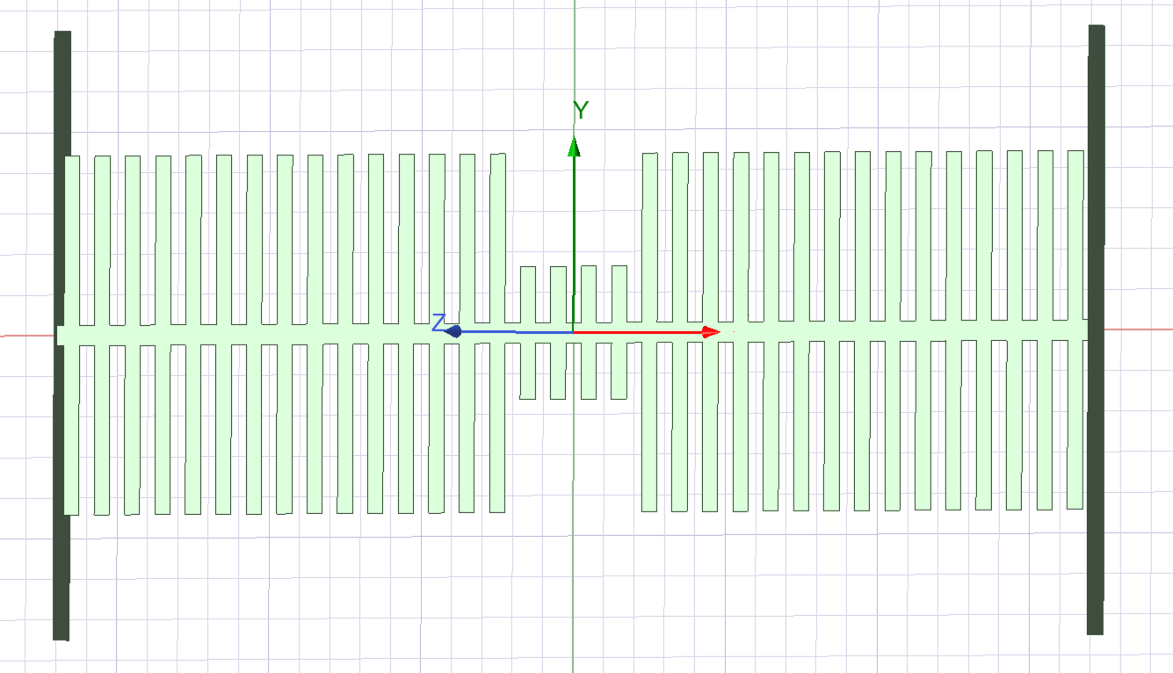
TWPAlab combines the HFSS data with the operating point to predict gain
14
KI-TWPA • 3WM • VALIDATION
Jesus Urbaneja
WHAT TWPALAB RECEIVES
HFSS PROPAGATION
kᴮ(f), Γᴮ(f)
CELL MODEL
L_cell, C and L_stub
OPERATING POINT
Iᴅᴄ, Iₚ, I*, N
TWPAlab / twpasolver
coupled-mode solver
WHAT TWPALAB PREDICTS
HFSS SUPERCELL MODEL USED TO EXTRACT THE INPUTS ABOVE
Gain versus signal frequency
Bandwidth and phase matching
Ripple from reflections
Notes:
TWPAlab combines the HFSS data with the operating point to predict gain.
The HFSS propagation input is k B together with Gamma B. The cell model supplies L, C, and L f. The operating point supplies I DC, pump current, I star, and the number of cells.
These enter the TWPAlab coupled-mode solver. The lower row then shows what we predict: gain versus signal frequency, bandwidth and phase matching, and ripple from reflections. Z B is already included through Gamma B, and because the HFSS baseline is lossless, the solver's dissipative alpha is set to zero.

Slide 16
The HFSS supercell places the engineered stopband near 12 GHz
15
KI-TWPA • 3WM • VALIDATION
Jesus Urbaneja
Passive evidence: transmission and Bloch dispersion
REFERENCE
Paper: bandgap near 12 GHz
OUR PASSIVE MODEL
HFSS–Bloch: 11.8–12.6 GHz edge brackets: 11.7–11.8 / 12.6–12.7 GHz
Notes:
The HFSS supercell places the engineered stopband near twelve gigahertz.
The transmission plot on the left shows the frequency region where propagation is suppressed.
The right graph, measures the deviation of the propagation phase per cell from an ideal linear transmission line; therefore, it directly shows the dispersion. The bare line has smooth dispersion, while periodic loading creates sharp changes near the stopbands around 12 and 24 GHz. The strong dispersion near the first stopband helps phase-match the pump, signal and idler, allowing gain to accumulate.

Slide 17
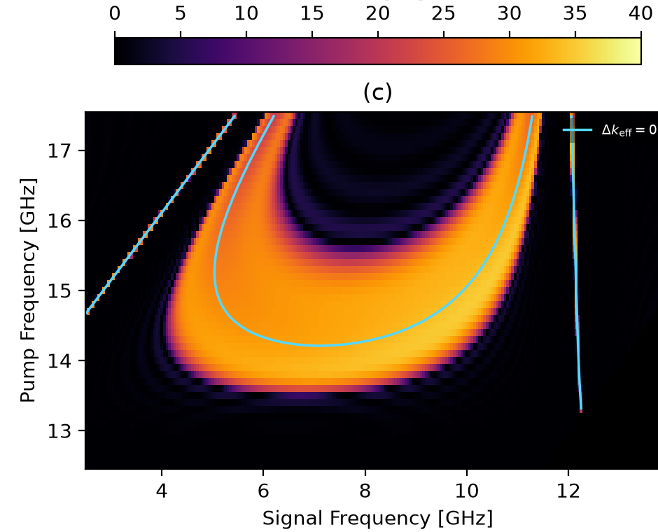
High predicted gain follows a U-shaped phase-matched region
16
KI-TWPA • 3WM • VALIDATION
Jesus Urbaneja
Predicted gain versus pump and signal frequency
COLOUR MAP
Bright region: high predicted gain Black: low gain or outside valid domain
PHASE MATCHING
Cyan contour: Δk_eff = 0 High gain follows the U-shaped contour
Notes:
High predicted gain follows a U-shaped phase-matched region. The horizontal axis of the colour map is signal frequency, the vertical axis is pump frequency, and the colour represents predicted gain. Bright colours mean high gain, while black means low gain or an invalid calculation region. The cyan line is the effective phase-matching contour, where delta k is zero. The bright region follows that contour, which connects phase matching directly to gain. The caveat on the right is that the narrow feature near twelve to twelve point five gigahertz is treated as an artifact, not validated physical gain.

Slide 18
Pump tuning brings our model to a 3.16 GHz 3 dB bandwidth
17
KI-TWPA • 3WM • VALIDATION
Jesus Urbaneja
OUR MODEL AT 13.865 GHz
Paper experiment peak: 27.65 dB
Our model peak: 33.74 dB (+6.09 dB)
Paper simulation peak: 39.55 dB (+5.81 dB vs model)
3 dB BANDWIDTH
Paper experiment: 3.15 GHz
Our model: 3.16 GHz (+0.01 GHz)
Gain after pump-frequency selection
Notes:
Pump tuning brings our model to a three point one six gigahertz bandwidth. The numbers on the left give the comparison. Our model peaks at thirty-three point seven four decibels, which is about six decibels above the experiment. For bandwidth, however, our three point one six gigahertz nearly matches the paper's three point one five. The graph on the right shows the three curves after selecting a pump at thirteen point eight six five gigahertz. The conclusion at the bottom is that pump tuning matches the width, while peak gain and absolute pump frequency remain offset.
In the paper, they sweep the pump frequency near the photonic-bandgap edge and measure the gain spectrum for every pump setting. For each spectrum they calculate the 3 dB bandwidth and the gain–bandwidth product, then select the pump that maximizes the gain–bandwidth product.

Slide 19
Our model matches the bandwidth, but overestimates the gain
18
KI-TWPA • 3WM • VALIDATION
Jesus Urbaneja
WHAT AGREES?
All three curves predict broadband, approximately flat gain.
Bandwidth: 3.16 GHz model vs. 3.15 GHz experiment.
Our peak gain lies between the paper’s experiment and simulation.
WHAT DOES NOT AGREE EXACTLY?
Peak gain: 33.74 dB model vs. 27.65 dB experiment.
Our amplified band is shifted slightly toward higher signal frequencies.
Our model has smoother, sharper edges than the experimental curve.
Pump frequency: 13.865 GHz model vs. 12.613 GHz experiment.

Slide 20
Several modelling uncertainties may explain the remaining offsets
19
KI-TWPA • 3WM • VALIDATION
Jesus Urbaneja
MATERIAL PROPERTIES
Some material properties are not fully specified in the paper.
The exact L_k, film thickness, dielectric loss, and surface impedance affect the phase velocity and gain.
HFSS MESH AND PORTS
The result may be sensitive to the HFSS mesh and wave-port definition.
Insufficient refinement near the thin films, stubs, or port interfaces can affect the extracted phase and impedance.
Differences in extraction method and experimental conditions
Parameter extraction, fabrication tolerances, loss, pump calibration, packaging, and reflections.
These uncertainties can shift the gain band and change the predicted peak gain.

Slide 21

Thank you for your attention! Do you have any questions?
QUESTIONS • DISCUSSION
PRESENTED BY
Jesus Urbaneja
E3 - Internship
Notes:
Thank you for your attention. The appendix contains the mathematical extraction and the exact HFSS-to-TWPAlab handoff. Do you have any questions?

Slide 22
Appendix: the single-cell S-matrix gives L, C and Lf
A1
KI-TWPA • APPENDIX
Jesus Urbaneja
1 S-PARAMETERS → ABCD
S(f) → [ A B ; C D ]
ω = 2πf
At low frequency, B ≈ jωL
L = ⟨Im(B)/ω⟩
2 FIT C AND Lf
Ceff(ω) = Im(C_ABCD)/ω
1/Ceff = 1/C − (Lf/2)ω²
Fit y = b + mx with x = ω²
C = 1/b Lf = −2m
intercept b = 1/C → C = 1/b | slope m = −Lf/2 → Lf = −2m | Z₀ = √(L/C)
Notes:
This appendix shows how the single-cell S-matrix gives L, C, and L f. Step one is on the left. We convert S of f into an ABCD matrix. At low frequency, B is approximately j omega L, so L is the average of the imaginary part of B divided by omega. Step two is on the right. We calculate an effective capacitance and fit its inverse against omega squared. The intercept gives C, and the slope gives L f. The bottom line then gives Z zero as the square root of L over C.

Slide 23
Appendix: the supercell eigenmode gives the Bloch quantities
A2
KI-TWPA • APPENDIX
Jesus Urbaneja
1 BLOCH CONDITION
TSC [V ; I] = λB [V ; I]
Λ_B = exp(αSC + j kSC)
K_B = arg(λB)/34
Α_B = ln|λB|/34
2 BLOCH IMPEDANCE FROM THE EIGENVECTOR
Z_B = V/I = B/(λ_B − A)
3 BOUNDARY REFLECTION
ΓB = (ZB − 50 Ω)/(ZB + 50 Ω)
ZB = 50 Ω ⇒ ΓB = 0 ⇒ no boundary mismatch
Notes:
This appendix shows how the supercell eigenmode gives the Bloch quantities. In step one, the ABCD matrix acting on voltage and current gives the Bloch eigenvalue lambda B. Its phase gives k B, and its magnitude gives alpha B; both are divided by the thirty-four cells in the supercell. In step two, the eigenvector gives the Bloch impedance Z B as voltage over current. In step three, we compare Z B with fifty ohms to obtain Gamma B. If Z B equals fifty ohms, Gamma B is zero and there is no boundary mismatch.

Slide 24
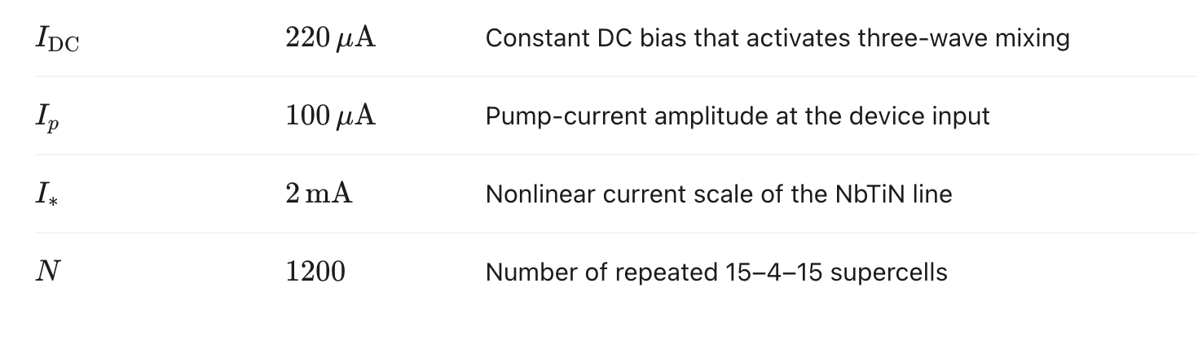
Appendix: the exact HFSS-to-TWPAlab handoff
A3
KI-TWPA • APPENDIX
Jesus Urbaneja
CELL MODEL
L, C, Lf → LCLfBaseCell
Z₀ = √(L/C) is a validation value
PROPAGATION ARRAYS
k(f) ← kB(f) Γ(f) ← ΓB(f)
ZERO-LOSS POLICY
αsolver(f) = 0
αB(f) is stored as
bloch_evanescence(f)
ZB enters through ΓB—not directly.
Then add Iᴅᴄ, Iₚ, I*, N and solve the pump–signal–idler coupled modes
Notes:
This final appendix shows the exact HFSS-to-TWPAlab handoff. In the left column, L, C, and L f create the cell model, while Z zero remains a validation value. The propagation arrays receive k B and Gamma B. In the right column, the zero-loss policy sets the solver's dissipative alpha to zero, while alpha B is stored separately as Bloch evanescence. Z B enters through Gamma B rather than directly. The line at the bottom gives the final step: add I DC, pump current, I star, and the number of cells, then solve the coupled pump, signal, and idler modes.

Slide 25
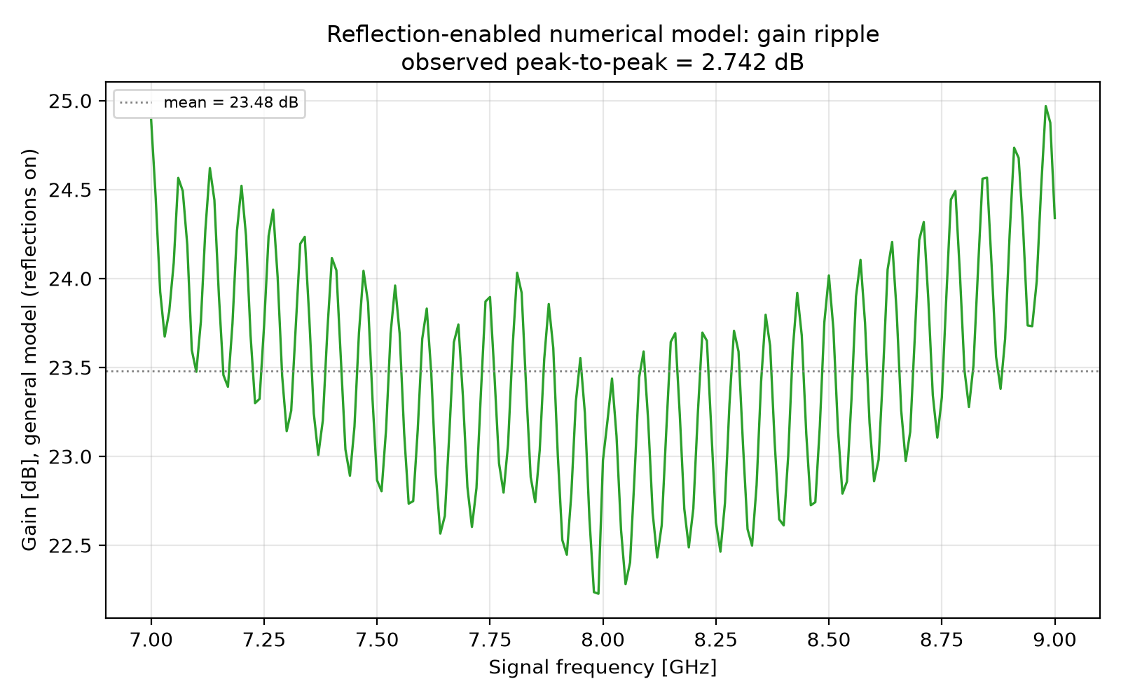
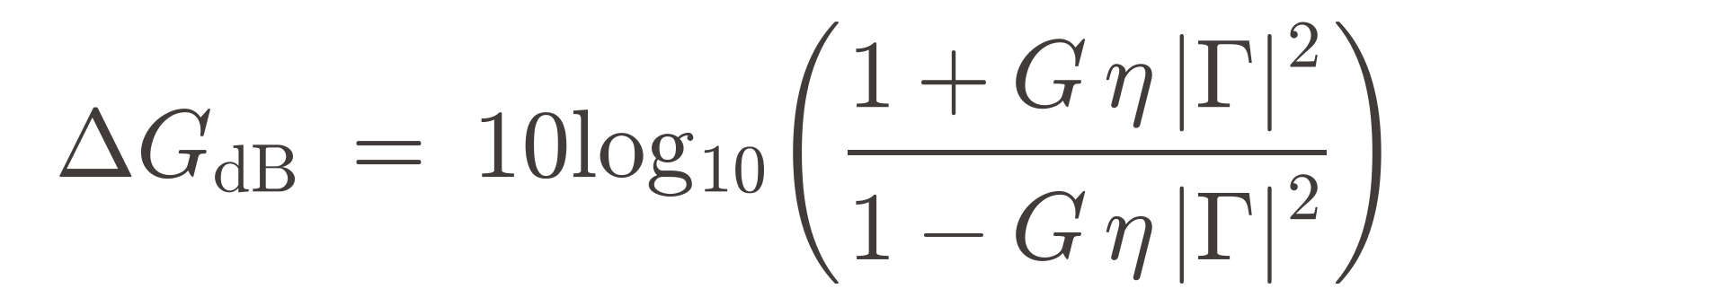
The reflection study shows that lower ripple does not guarantee better gain
19
KI-TWPA • 3WM • VALIDATION
Jesus Urbaneja
PROJECT RESULT • BASELINE VS STUB-ONLY REDESIGN
BASELINE DEVICE
|Γ| ≈ 0.019 • ripple 4.10 dB p-p • mean gain ≈ 32.4 dB
STUB-ONLY REDESIGN
|Γ| ≈ 0.073 • ripple 2.74 dB p-p • mean gain ≈ 23.5 dB
Lower ripple coincides with ≈ 9 dB less mean gain.
Γ_in
Γ_out
Frequency-dependent round trips modulate—and can suppress—the smooth gain envelope.
Notes:
The reflection study shows that lower ripple does not guarantee better gain. On the left, the baseline has Gamma near zero point zero one nine, four point one decibels of ripple, and about thirty-two point four decibels of mean gain. The stub-only redesign has a larger Gamma, around zero point zero seven three. Its ripple is lower, at two point seven four decibels, but its mean gain falls to twenty-three point five decibels. The plot on the right shows those frequency-dependent oscillations. The key result is the red sentence: lower ripple coincides with about nine decibels less mean gain.

