Slide 1

Team: ThriveToday
Members: Alan Luu(Team Lead), Jeremy Esch,
Henry Fan, Taylor Trinidad

Slide 2
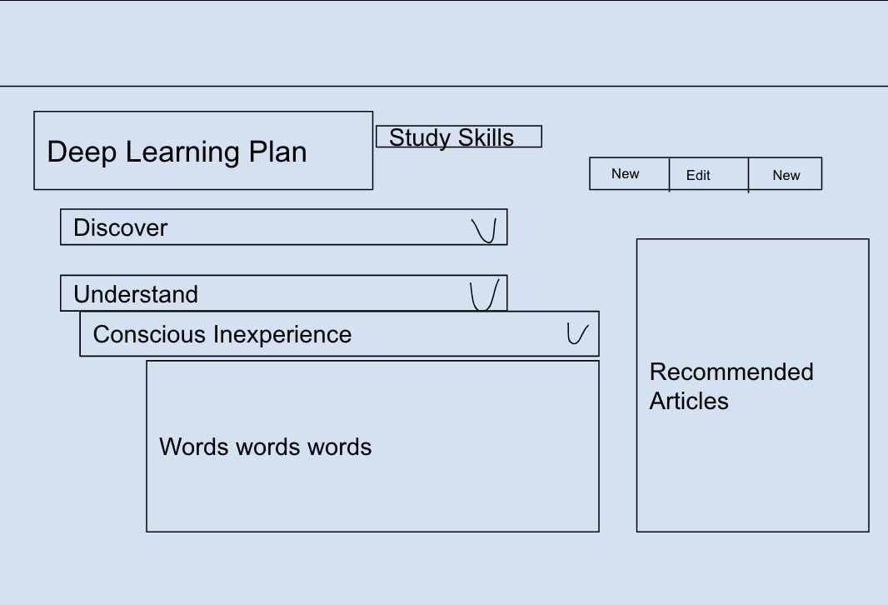
Week 4 Accomplishments
Set up backend and frontend
Set up database
Finalized UI mockups for logo and main page
Mockup of plans page
Notes:
Jeremy

Slide 3
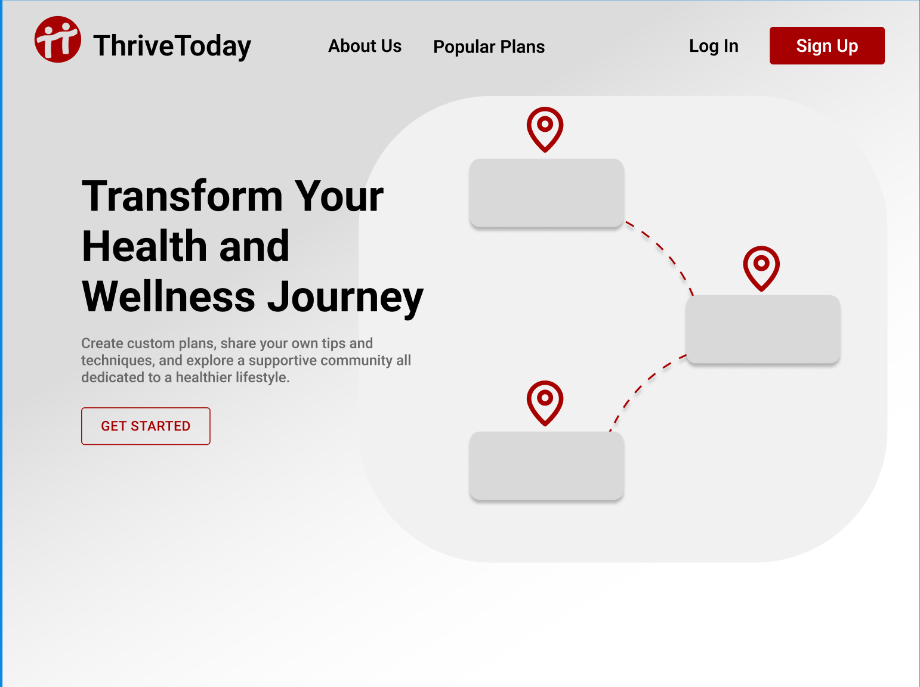
UI Website Mockup

Slide 4

Home page (so far)

Slide 5
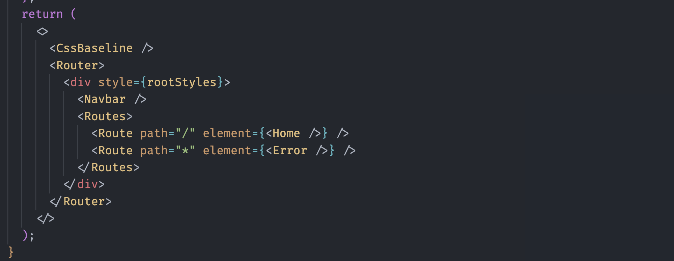
React-router-dom Routing

Slide 6
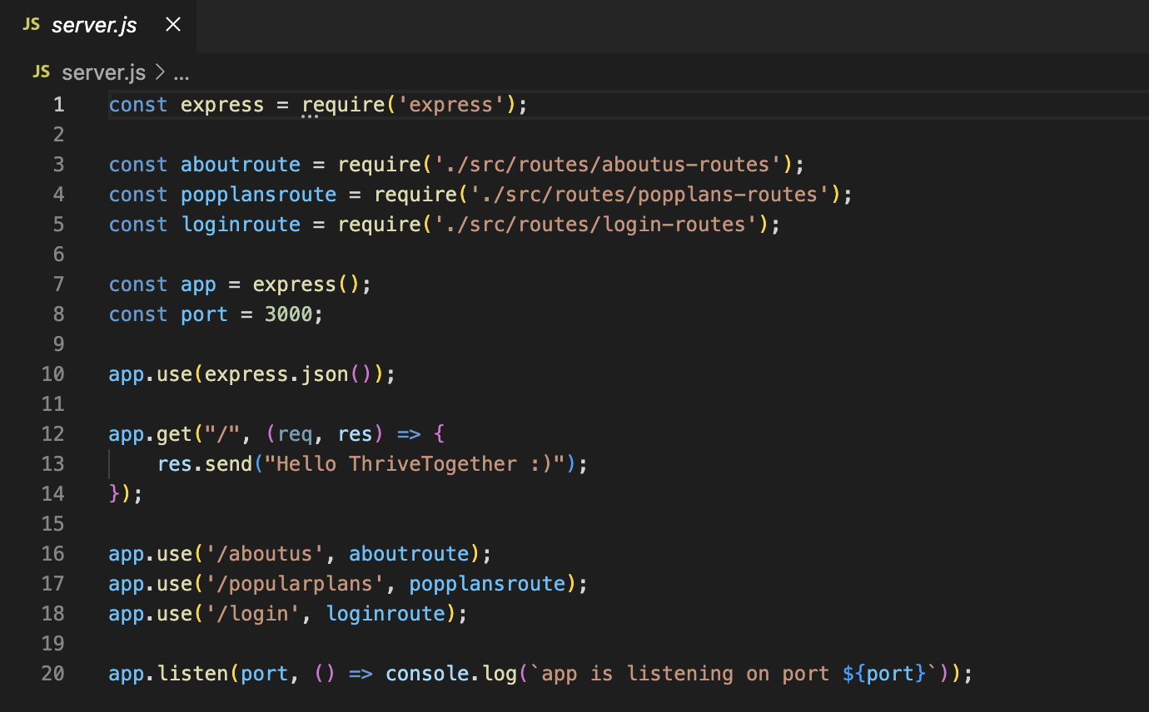
Backend Started

Slide 7
Project Plan
Henry: finished this nodeJS tutorial, and half way through this series
Jeremy: Finish home page and navbar with responsive styling.
Taylor: Backend setup
Alan: Backend/database setup
Milestones:
Week 4: Begin coding frontend and backend
Week 5: Start testing API and set up local hosting
Week 6: Connect database to backend and start on responsive frontend design
Week 7: Integrate frontend with backend through Axios API request library

