Slide 1

Team: ThriveToday
Members: Jeremy Esch, Henry Fan(Team Lead),
Taylor Trinidad, Alan Luu

Slide 2

Week 6 Accomplishments
Created new, simpler UI/theme
UML Diagram
Progress log in / sign up pages
Sessions working
Progress on API calls

Slide 3
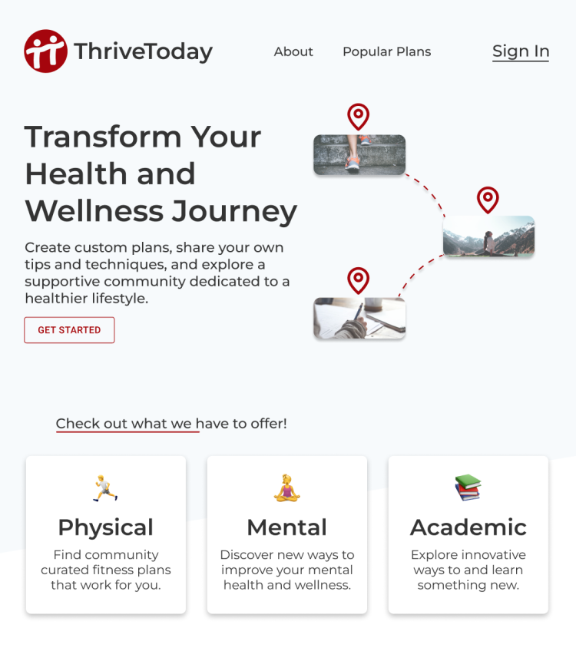
Features
Plans - Physical Mental Academic
Like and Unlike buttons
Navigation Bar
Sign in / Sign Up

Slide 4
Refining Project Vision
Our application is for learners who realize a thoughtful approach to living a healthy & rich life requires habits that support sustained learning and growth.
Our application will reduce the psychological and cognitive load to onboard users with life skills for success in education and beyond.
We focus our efforts in providing value for college students because we’re students.

Slide 5
Functional specifications
Users can sign up / sign in to their personal account on our website
Users will be able to customize plan templates
Users can post their plans and sub-plans
Users will be able to like / unlike posts
Users can filter and sort through varying topics

Slide 6
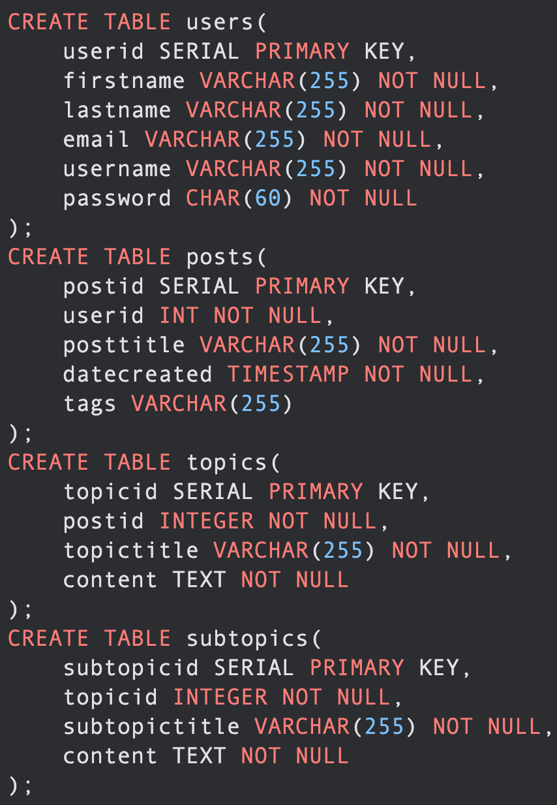
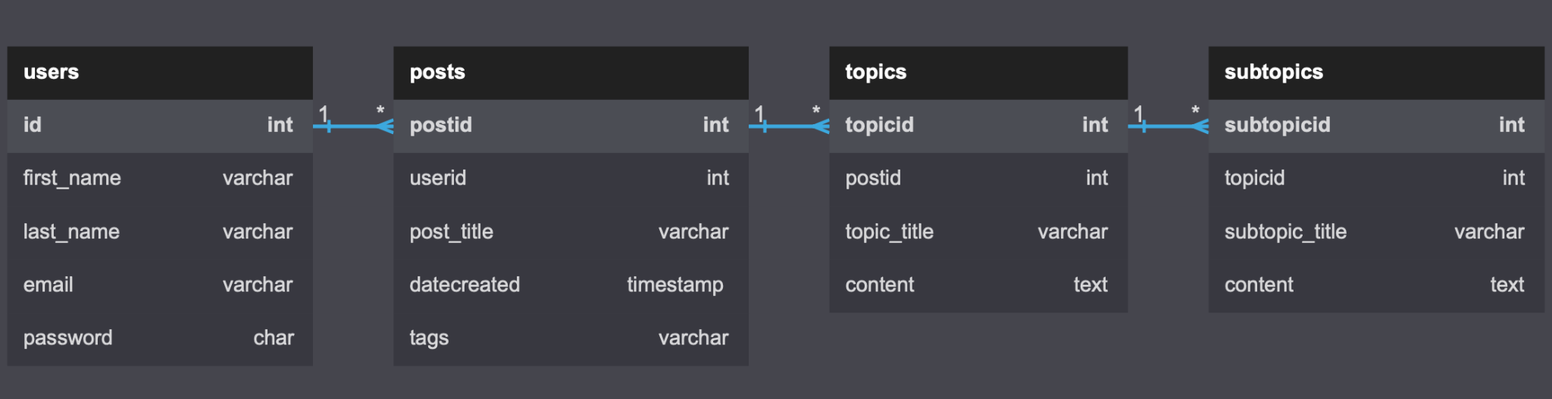
DB Schema

Slide 7
Progress

Slide 8
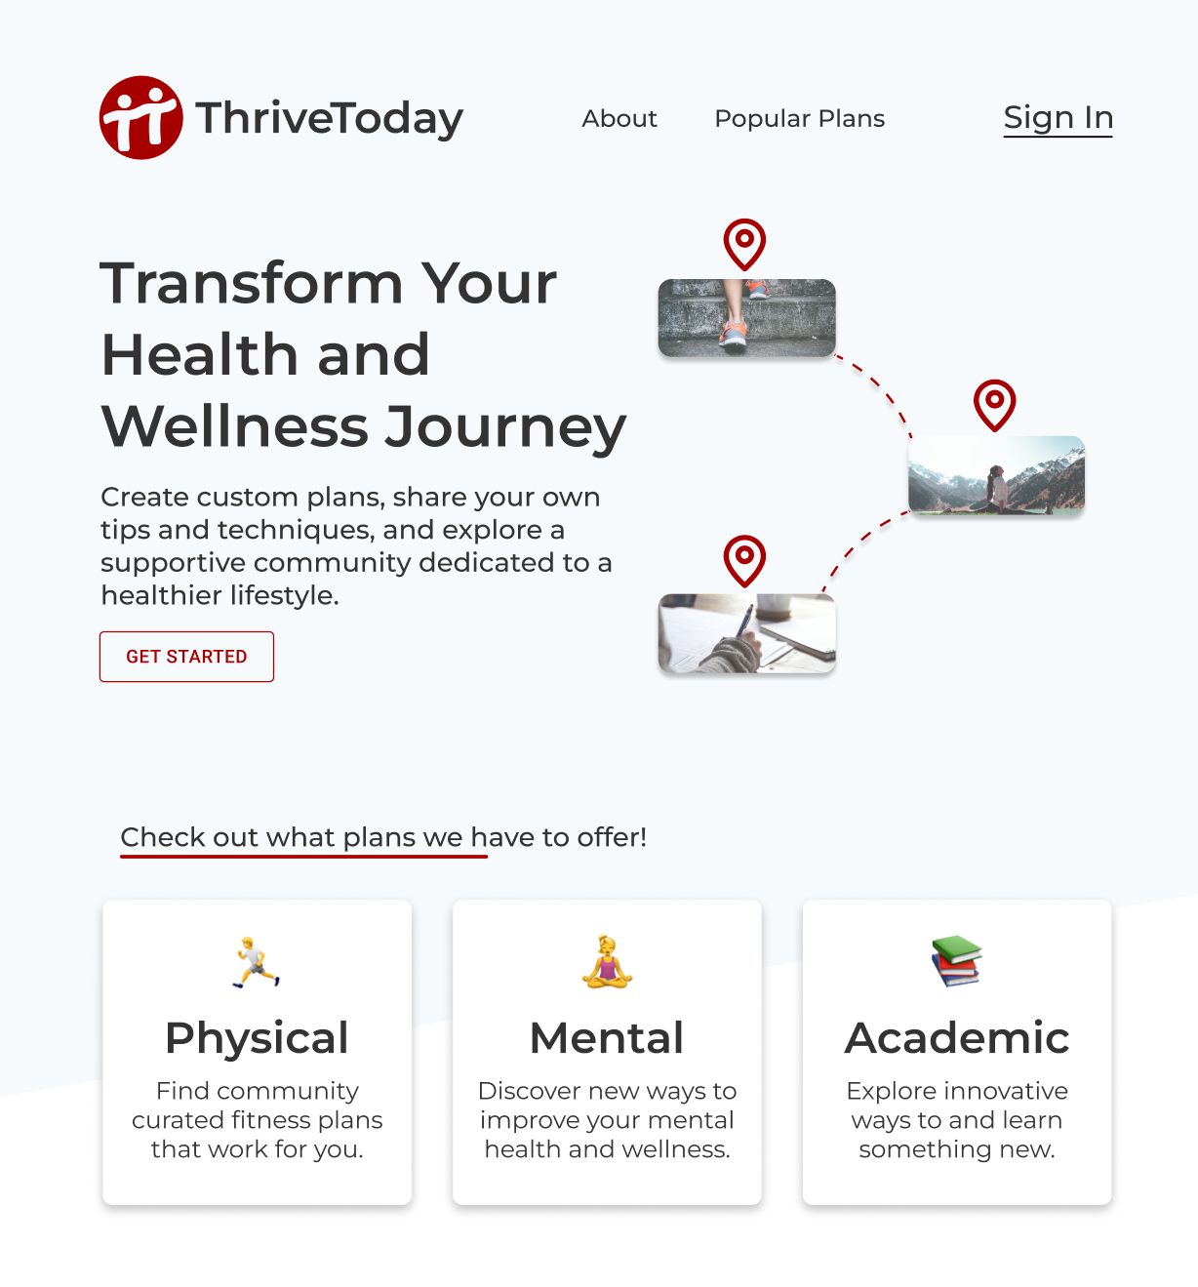
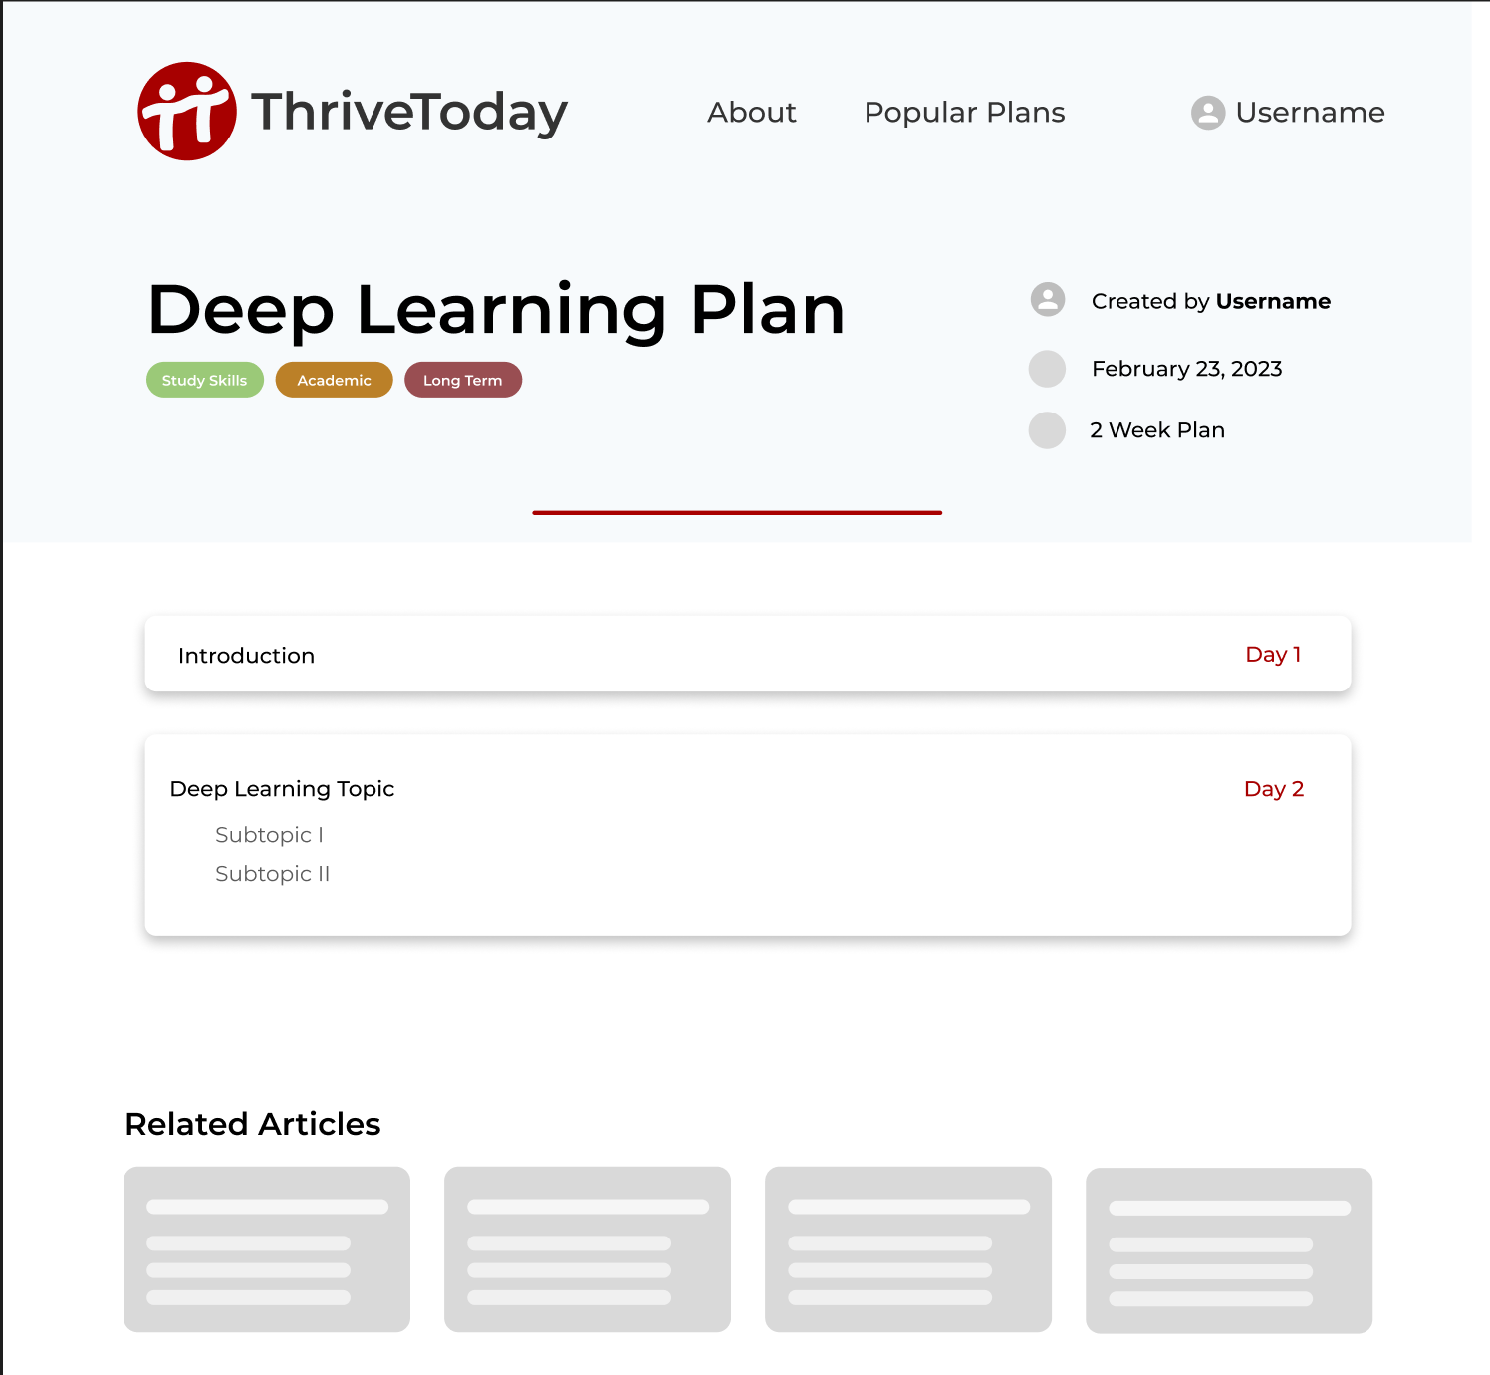

Slide 9
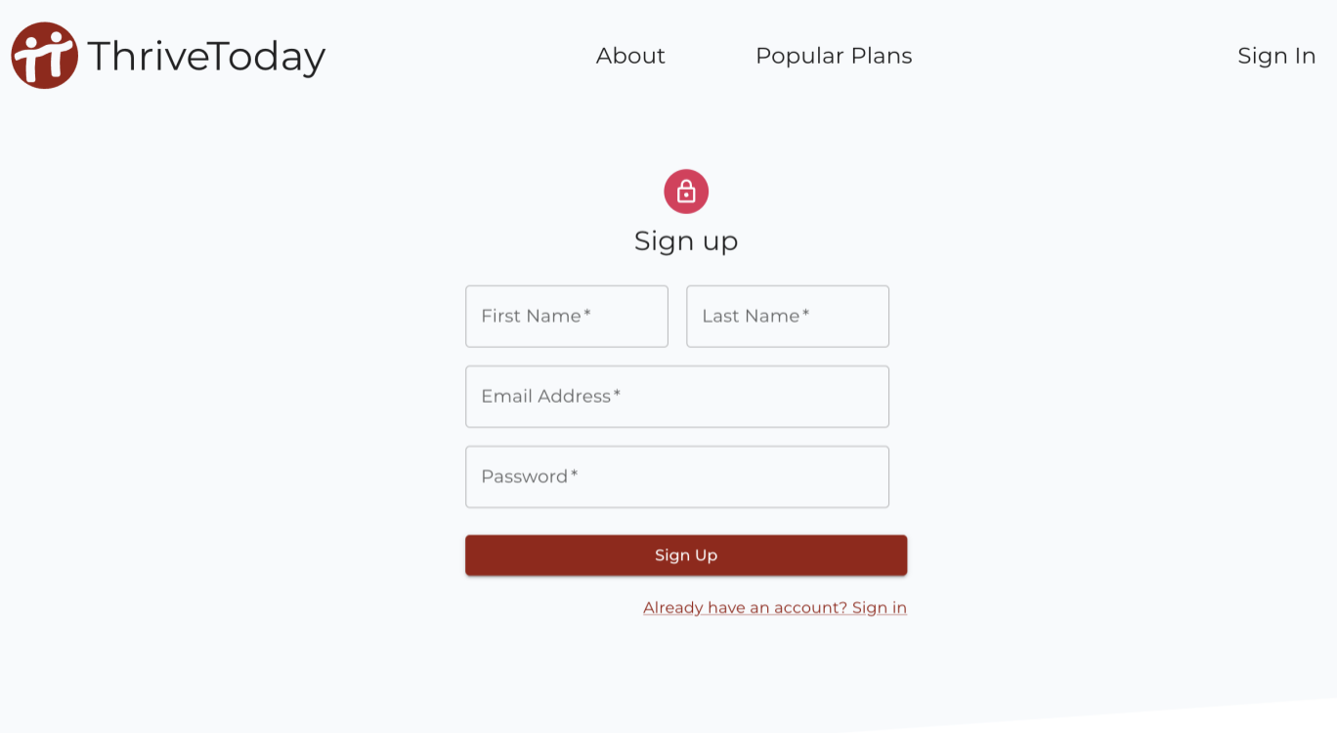
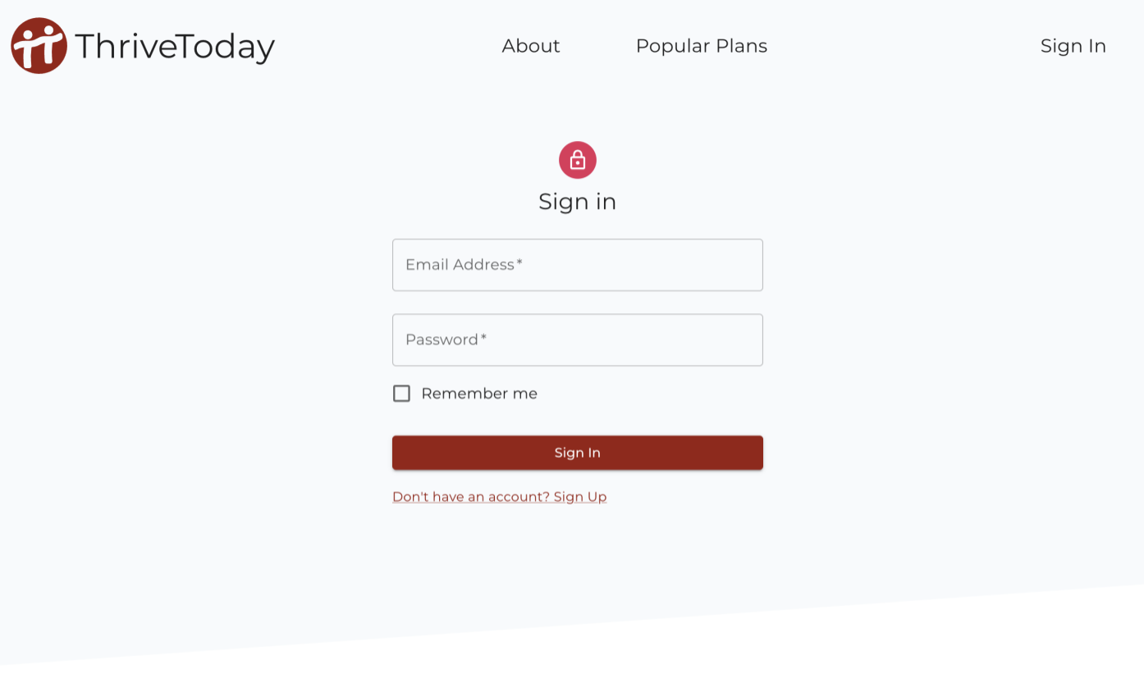
Sign Up / Sign In Pages

Slide 10
Diagrams

Slide 11
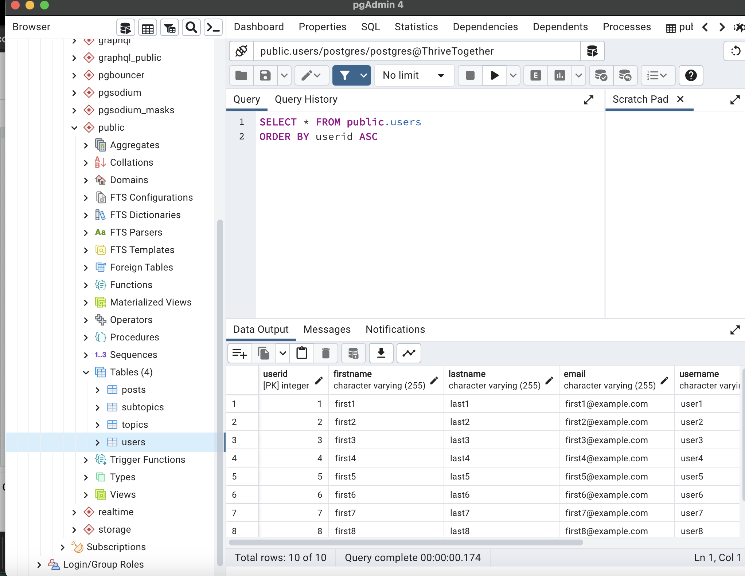
Created Tables
Tables created according to previous diagrams:
posts, subtopics, topics, users

Slide 12
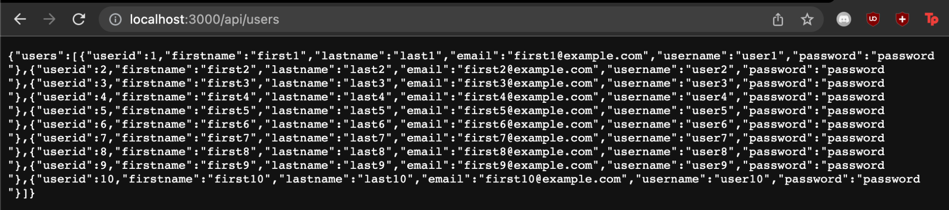
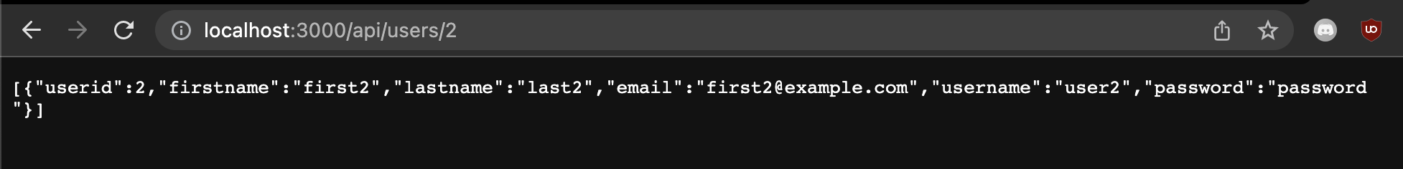
API Call Testing
Get users by user id

Slide 13
Team Codescapes Feedback
Was successfully able to test our product on both the front and backend
Documentation was clear
If possible, merge the 2 package-lock files in the front and backend
When running npm i, it should install all required packages for both front and backend
Took Codescapes lots of code restructuring to fix this problem, so recommended doing this sooner than later

Slide 14
ThriveToday’s Response
Ensure that documentation remains clear to novice and expert users
Will merge the 2 package-lock files in the front and backend
Continue to ensure learning is happening for all members on our team

