Slide 1
Team: ThriveToday
Members: Taylor Trinidad(Lead), Alan Luu, Jeremy Esch, Henry Fan
Presented by: Team Treehouse

Slide 2
Project Description : Thrive Today
Website where users apply research backed methods in
Study Skills
Physical & Mental Health
Lifestyle Habits
We’ll have workouts, health routines, and research based study skills for users to try and make their own.
Notes:
Henry
A website where users are incentivized to share their practices and methods in study skills, fitness, and lifestyle habits that promotes a healthier lifestyle.
We’ll have workouts, mental health routines, and healthy study skills for users to try out and make their own.

Slide 3
User Manual
Learners will be able to create, edit, and share custom plans related to study skills, physical exercise, or mental health. Users will be able to utilize plans created from others in the community.
An example manual for study skills could guide users to step through
How to tap into intrinsic motivations to achieve our SMART goals
Scheduling templates to see our progress towards goals
Organization and Construction of ideas
How to Navigate Office Hours

Slide 4



Technology Tools
PERN Tech Stack
Frontend:
React
Material UI for styling
Axios for API requests
Backend:
NodeJS and ExpressJS
Postgres database
Notes:
Alan

Slide 5
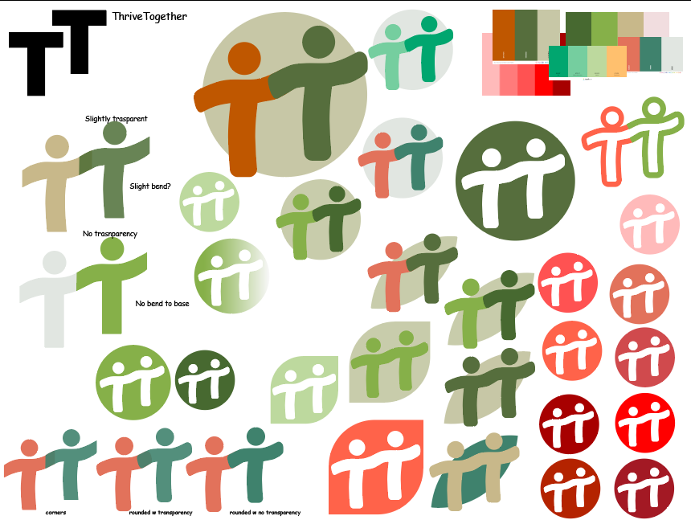
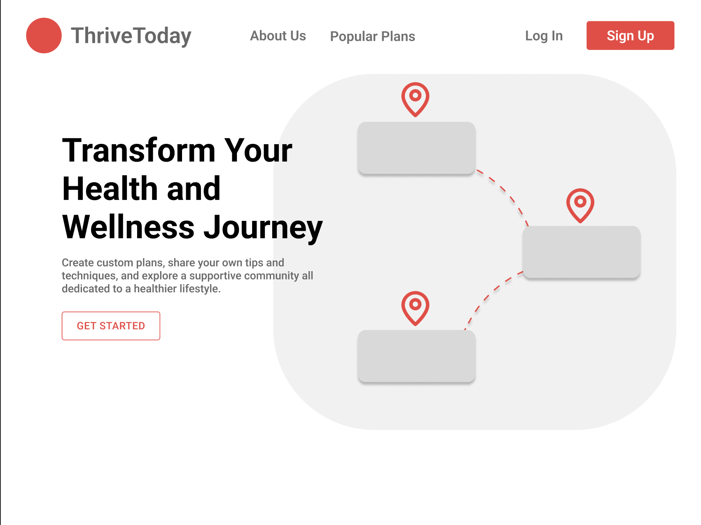
What we have accomplished so far
Created github repository
General understanding of project vision and technology stack
Wireframes for UI
Logo design mockups
Notes:
Jeremy

Slide 6
Project Plan
Henry: Use cases and study skills portion of the site, will work on backend development
Jeremy: Managing GitHub repo, as well as Frontend development
Taylor: Design logo and website UI, work on backend development
Alan: Responsible for Postgres database and its connection to the backend.
Milestones:
Week 3 (Next week): Finalized UI design, features list, database schema, learn about tech stack
Week 4: Begin coding frontend and backend
Week 5: Start testing API and set up local hosting
Week 6: Connect database to backend and start on responsive frontend design
Week 7: Integrate frontend with backend through Axios API request library

Slide 7
TreeHouse’s Thoughts
Inspiration from ThriveToday
We appreciate that they are trying to create an original idea and that there is a clear need for it
Would love to see it integrated with SJSU’s career center resource.
Team members are passionate and eager about their project, which motivates us to do the same.
Areas where we can collab?
Could help each other with front end (using similar technologies)
Bounce ideas off each other
Our suggestions for improvements?
Maybe implement like a progress feature, so that users will know which activities they’ve already completed
Add a badge system, so the more activities a user completes, the more badges they earn (gamification)
How would this website separate itself with more appeal compared to other self help websites?

