Slide 1

Team: ThriveToday
Members: Jeremy Esch, Henry Fan,
Taylor Trinidad, Alan Luu
Paired with team Gladiators

Slide 2
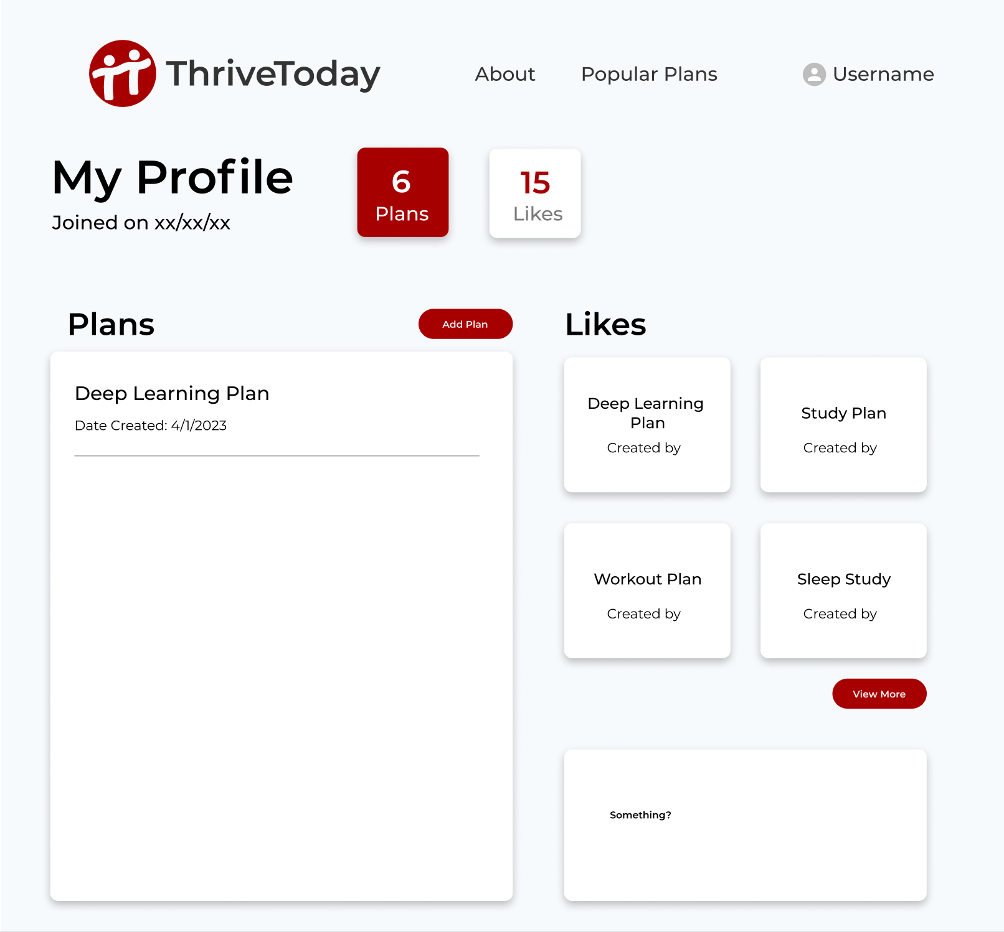
Progress Made
Created more plan API endpoints
Mocked up and begun implementation of user profile page.

Slide 3
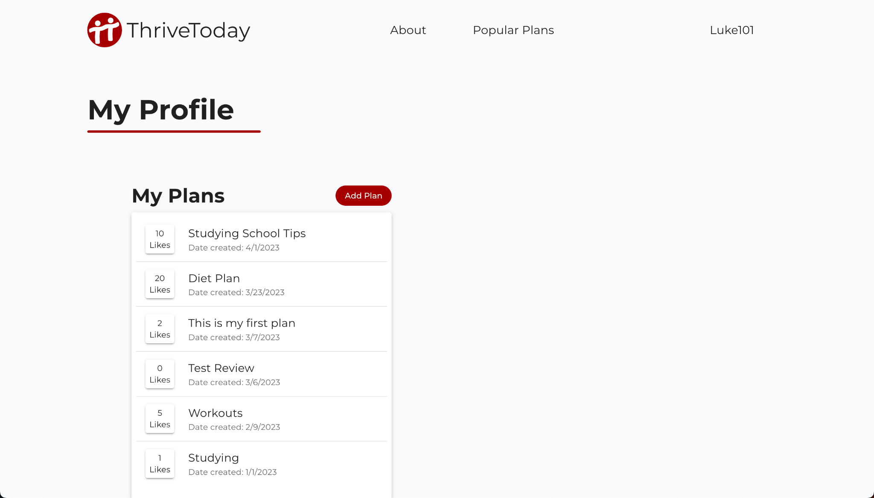
Next Steps
(Live profile page)
Finish profile page.
Populate site with plans.
“Add new plan” page.
Popular plans page.

Slide 4


Hosting Methods For Our Site
DigitalOcean + Docker container to run and host backend
(In the future) Netlify for hosting react frontend

Slide 5
Week 11 Feedback (Team Gladiators)
UI looks great
Need to remember to start the backend server - at first had trouble creating an account
Update the expert user guide to be more accurate (instructions outdated)

Slide 6
Response to Feedback
Thank you for your feedback
Team was able to run our project properly after we fixed user instructions and started up the backend
Changes to instructions have been pushed to our github

