Slide 1

Team: ThriveToday
Members: Jeremy Esch, Taylor Trinidad, Alan Luu, Henry Fan (lead)
Paired with team Gladiators
Week 12 - 4/20/23

Slide 2
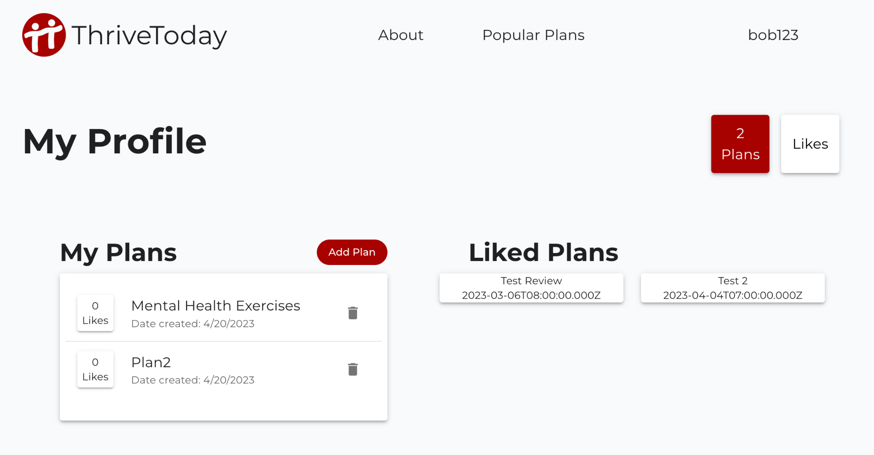
Progress Made
Created more plan API endpoints
Working on frontend implementations of completed backend code
Plan creation / deletion
Plan tags
Viewing plans

Slide 3


Hosting Methods For Our Site
DigitalOcean + Docker container to run and host backend
(In the future) Netlify for hosting react frontend

Slide 4
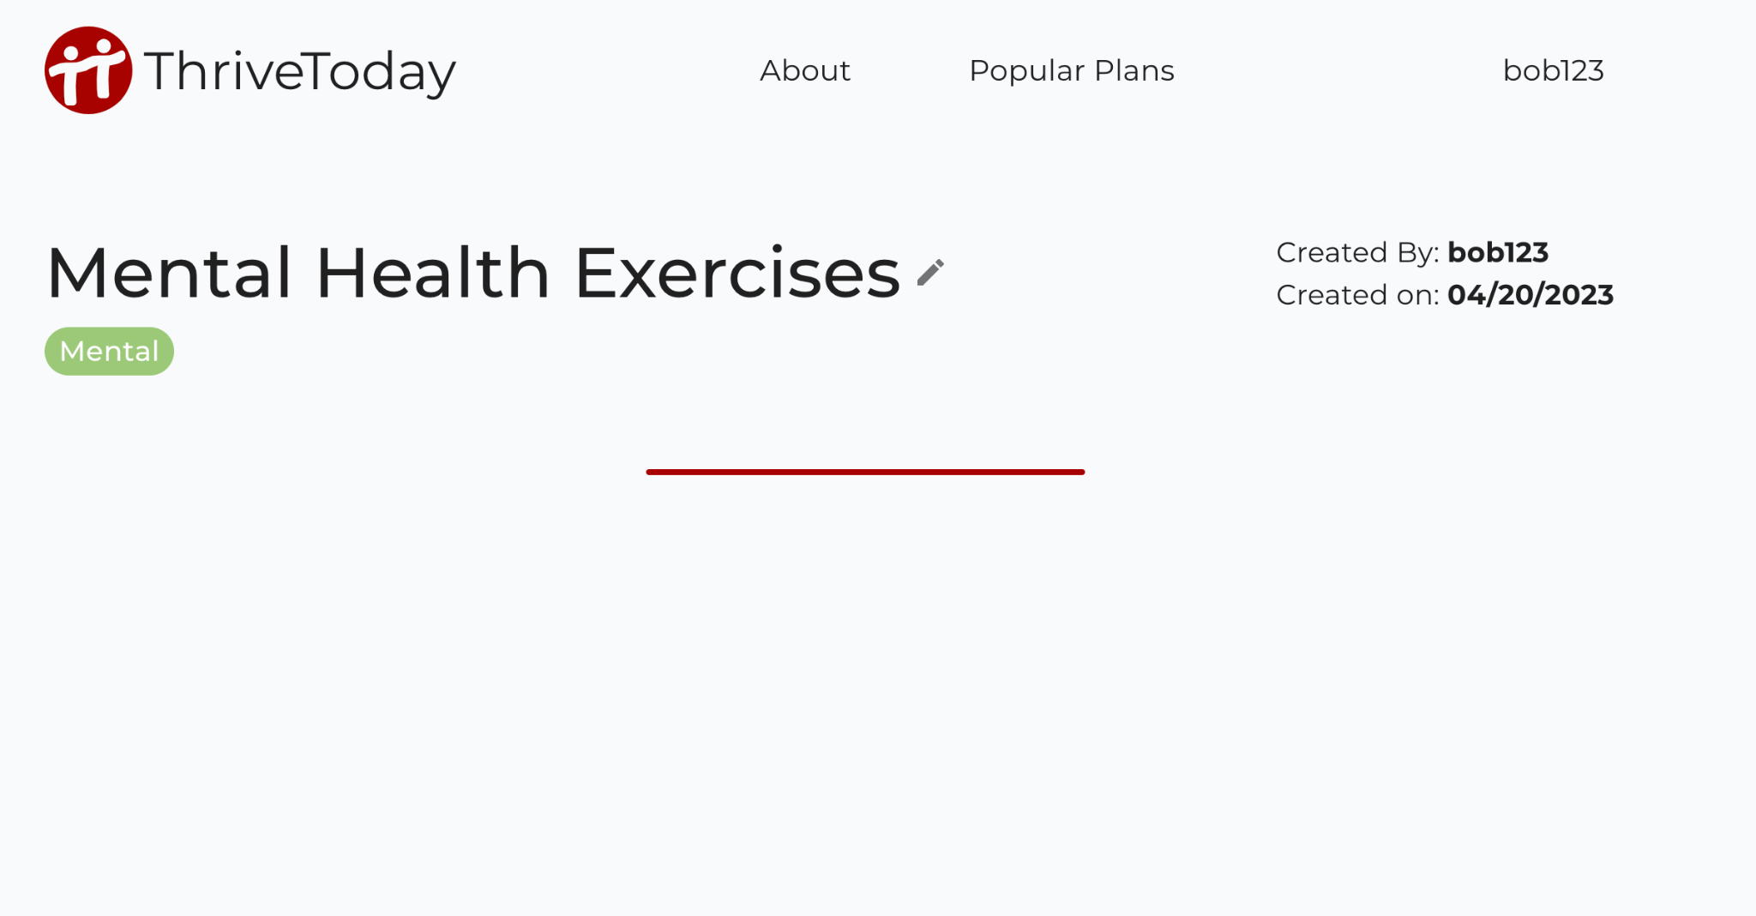
Next Steps
Front end To-Do’s
Display more details for plan listings
Add functionality for users to edit and add to plans
Add "like" functionality
Search bar
Backend
Creating more endpoints as needed

Slide 5
Week 12 Feedback (Team)
UI looks clean and crisp
Update the expert user guide to be more accurate (instructions outdated)
Backend and frontend working concurrently

Slide 6
Response to Feedback
Thank you we spent time making our UI look nice
From last week: We have updated our user instructions
Glad front and backend are working concurrently

