Slide 1

Team: ThriveToday
Members: Jeremy Esch, Taylor Trinidad, Alan Luu, Henry Fan
Paired with team LunaR
Week 13 - 4/27/23

Slide 2
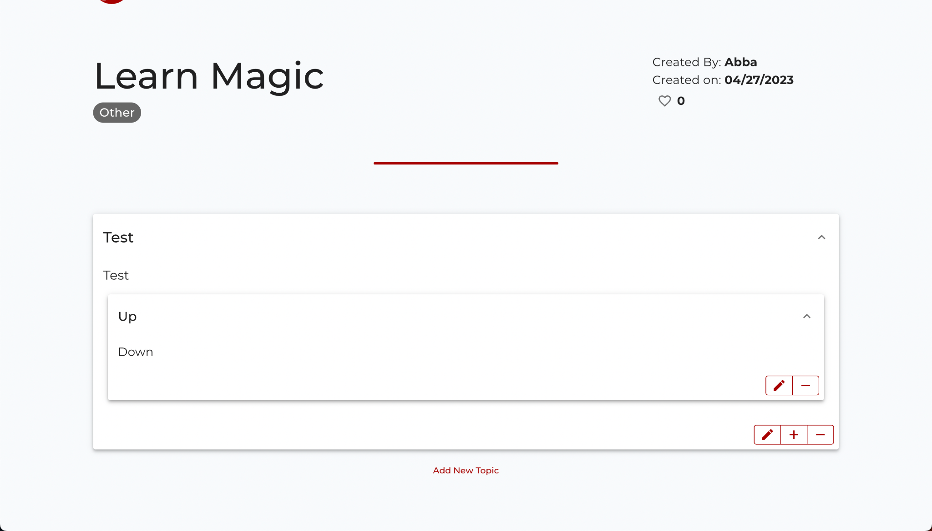
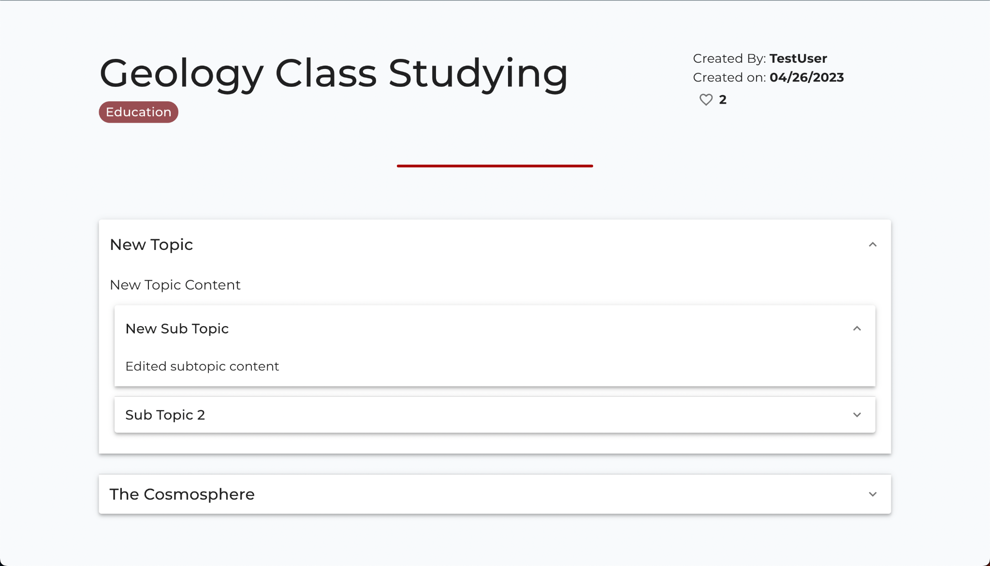
Progress Made
Example Plan editing page
Created more plan API endpoints
Implemented plan editing on frontend

Slide 3


Hosting Methods For Our Site
DigitalOcean + Docker container to run and host backend
(In the future) Netlify for hosting react frontend

Slide 4
Next Steps
Front end To-Do’s
Search bar
Backend
Creating more endpoints as needed
Updating hosting

Slide 5
Week 13 Feedback (Luna R)
1. The project was easy to build, instructions are neat and clear.
2. UI looks great.
3. Ran into issue of signing up account locally.

Slide 6
Response to Feedback
Issue relating to local sign-in is related to the user’s own ports being in use during the local testing, not because sign-in wasn’t working.

