Slide 1

Team: ThriveToday
Members: Jeremy Esch, Taylor Trinidad, Alan Luu, Henry Fan
Paired with team Audiovision
Week 14 - 5/7/23

Slide 2
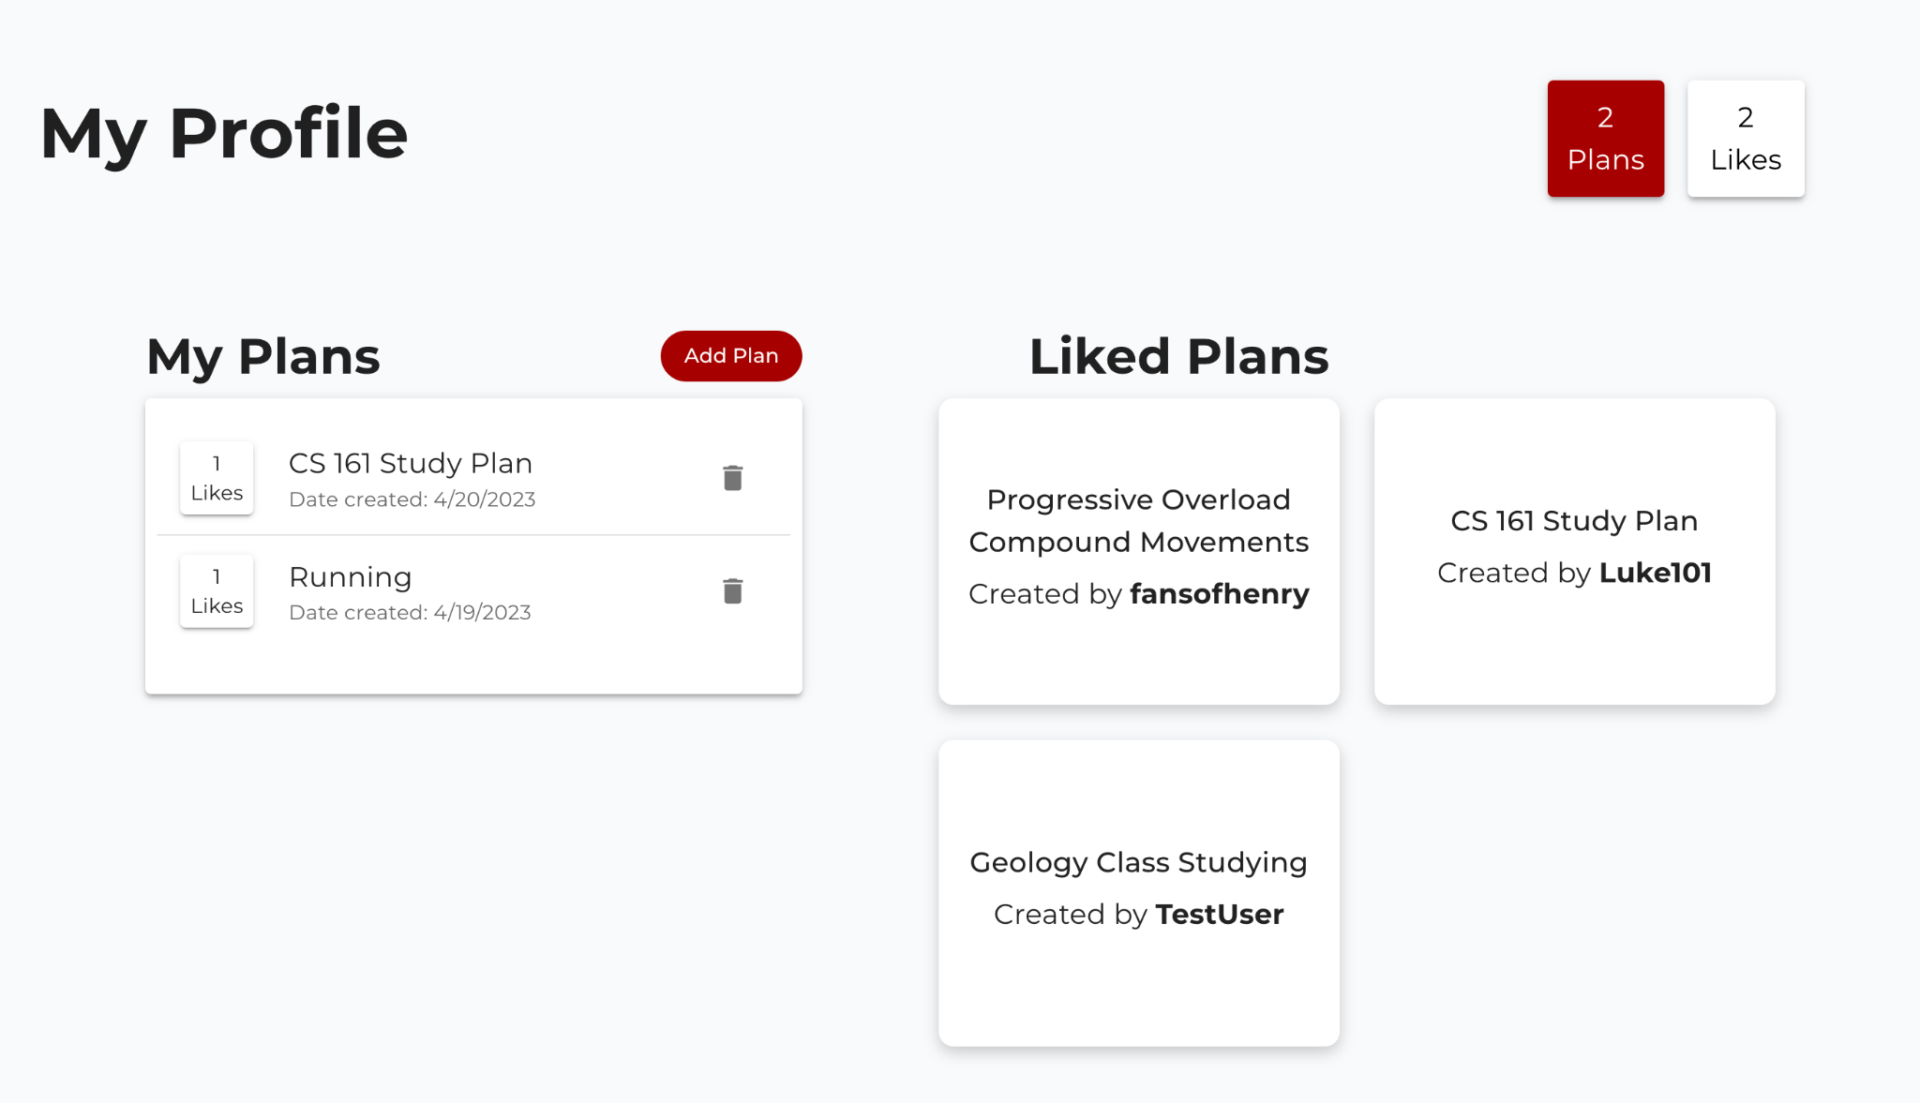
Progress Made
Liked Plans component
Fixed third party cookies Chrome hosting issue
Backend hosting
Added search bar
Added “liked plans” in profile page

Slide 3
Finished Features
Search bar with popup dialog window for results
Added plan tags to popular plans page for easy navigation
Liked plans component

Slide 4


Hosting Methods For Our Site
Heroku to run and host backend
Netlify for hosting react frontend

Slide 5
Next Steps
Polishing documentation

Slide 6
Week 13 Feedback
Feedback from Audiovision:
- Try using useEffect for heart button
- Nice UI and animations

Slide 7
Response to Feedback
Didn’t have time to work on the like button and useEffect with it, but we understand the use of the useEffect hook and how it would definitely help with some edge cases for the like button.

