Slide 1

Team: ThriveToday
Members: Jeremy Esch(Team Lead), Henry Fan,
Taylor Trinidad, Alan Luu

Slide 2

Week 5 Accomplishments
Successfully connected database to backend.
Reorganized GitHub repository.
Created new, simpler UI/theme.
Progress in navbar + home page development.

Slide 3
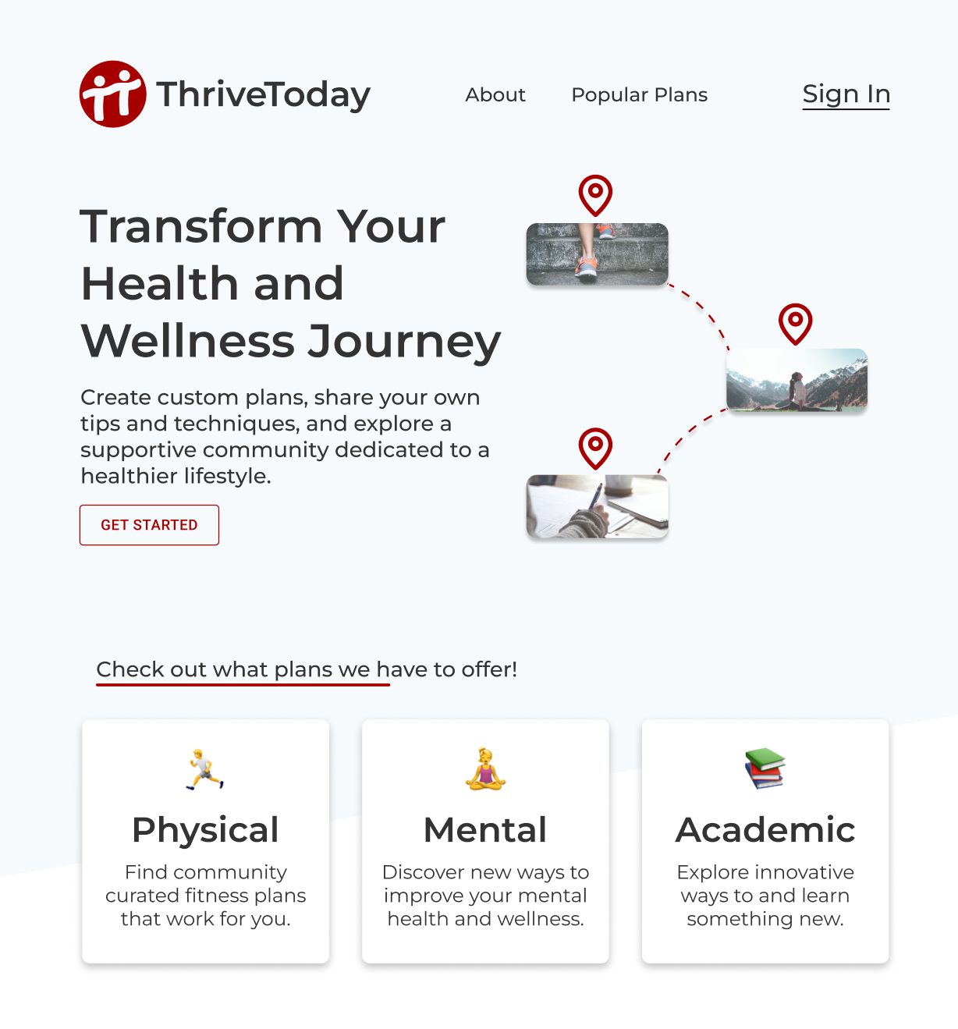
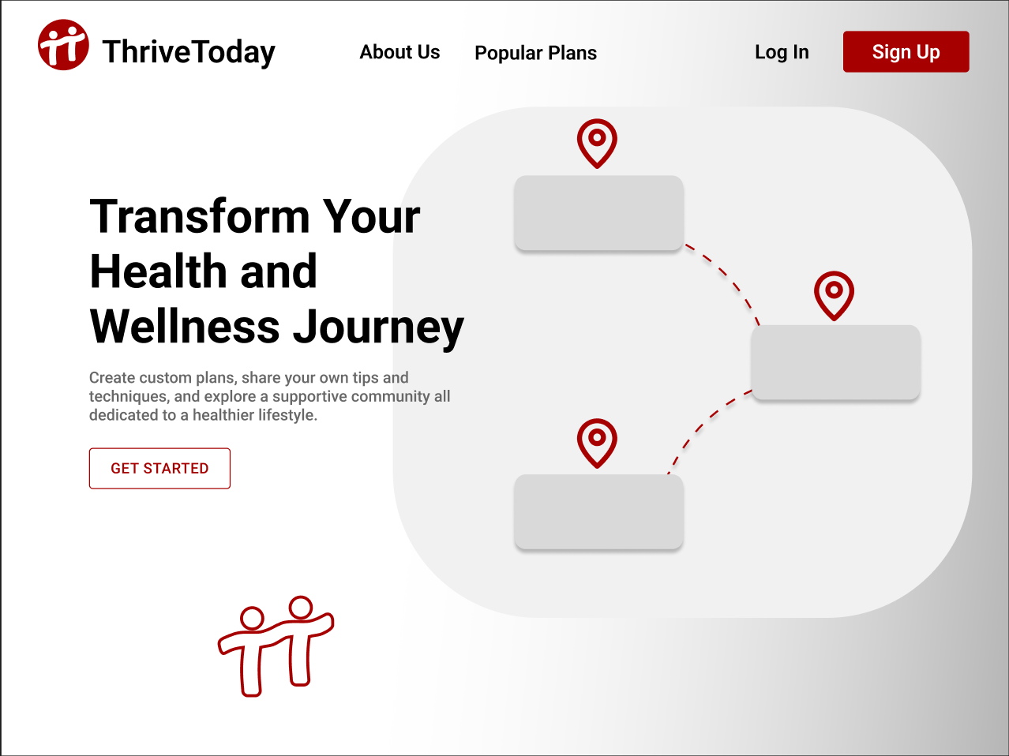

Slide 4
Documentation (For expert users)

Slide 5
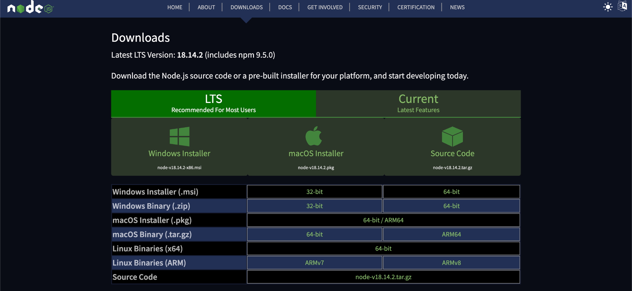
Install NodeJS (latest version)

Slide 6
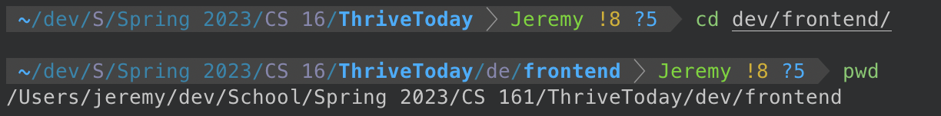
Clone Git Repository + CD to frontend directory

Slide 7
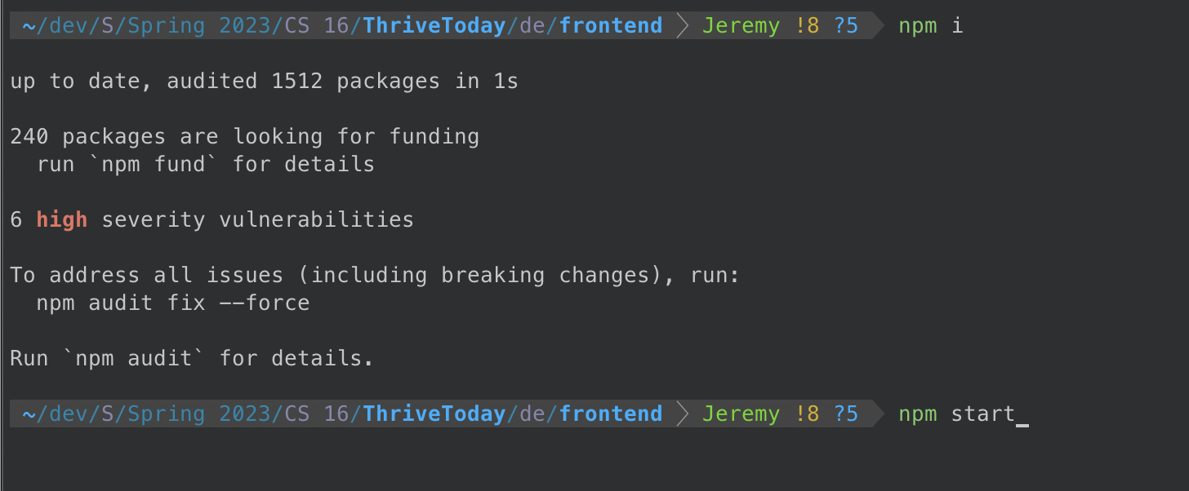
Install Node Packages + Run Project

Slide 8
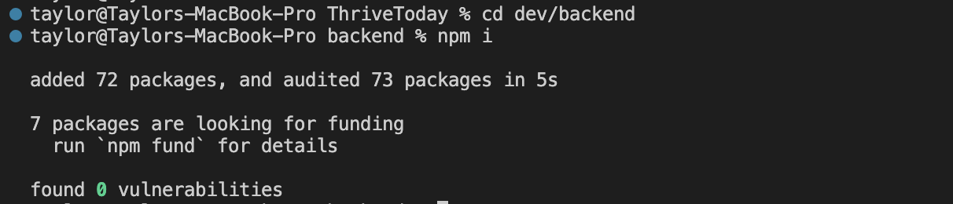
Testing the Backend
Navigate to backend and run npm i
Run server.js

Slide 9
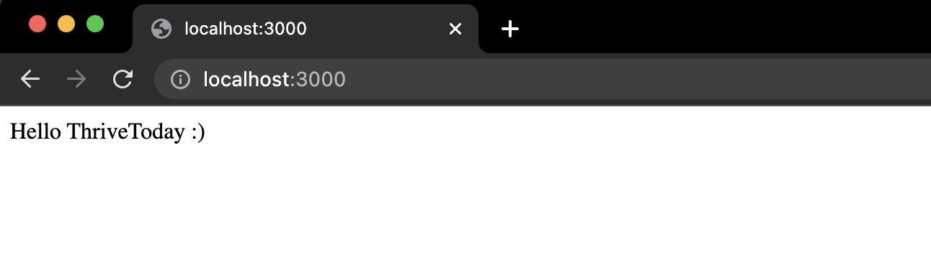
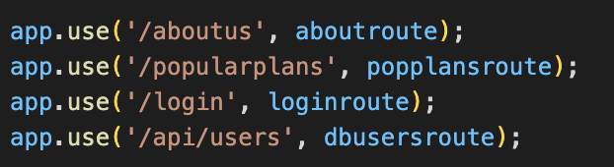
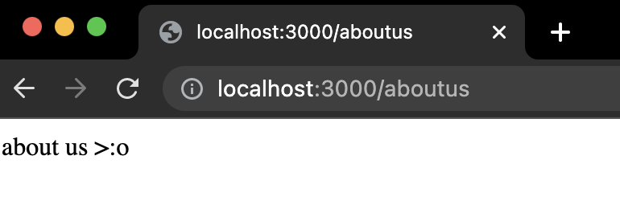
Go to your browser: localhost:3000
Test endpoints defined in server.js:
Note: api/users will be unavailable for you to test (secret db password required to access)

Slide 10
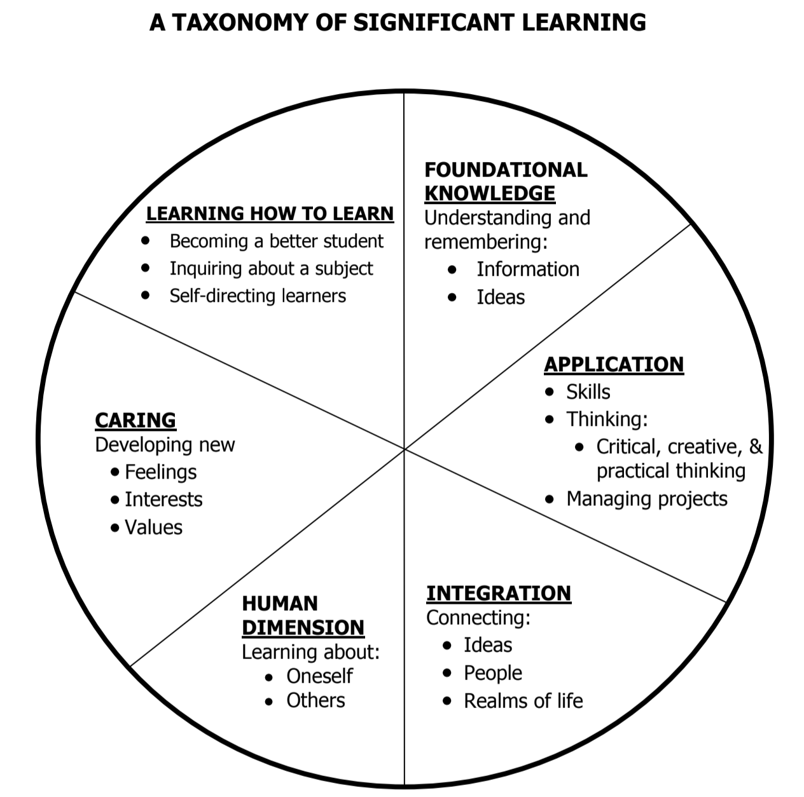
Use Case: Academic
Goal Setting
Scheduling
Lecture Note System
Navigating Office Hours
How Learning Works
Notes:
An intro regarding each of these topics, followed by templates for students to borrow and make their own

Slide 11
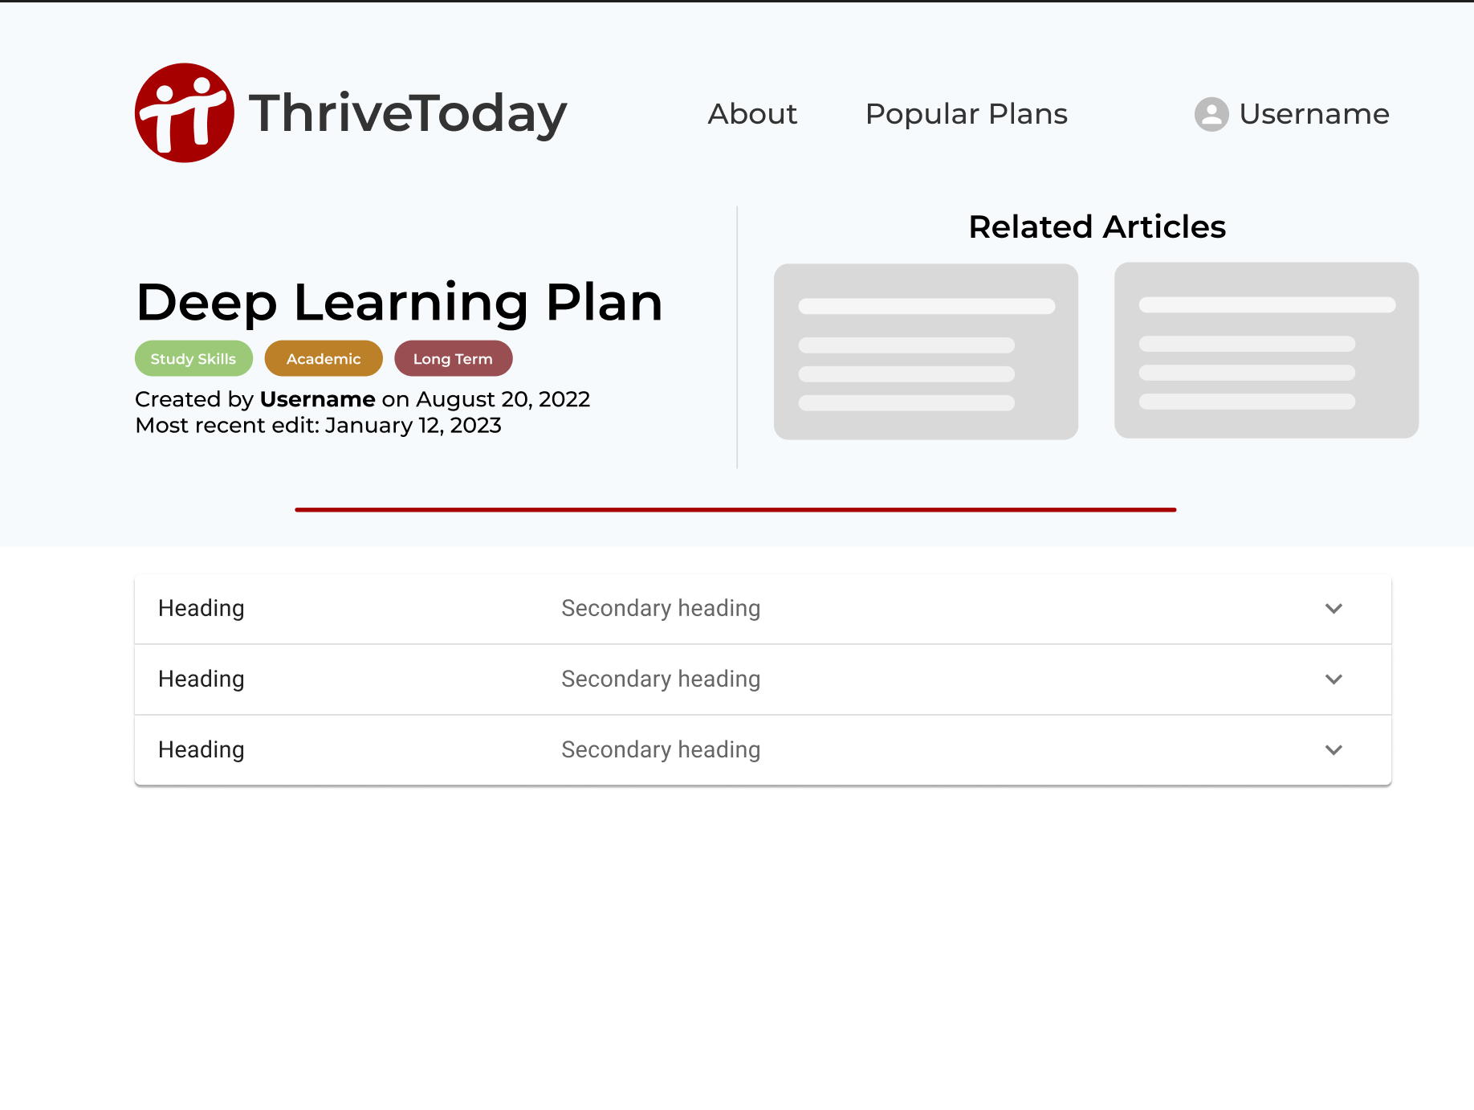

Slide 12
Milestones
Week 5 - Start testing API and set up local hosting
Week 6 - Connect database to backend and start on responsive frontend
Week 7 - Refine db models and finish testing to prepare for connecting to frontend.

Slide 13
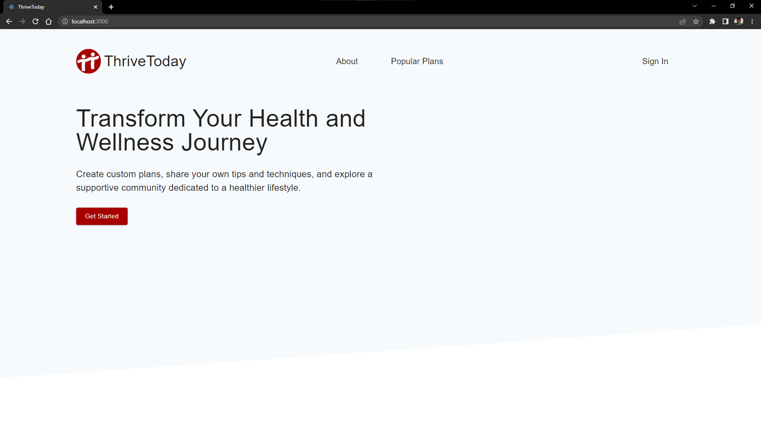
The Librarians’ Feedback
Instructions were detailed enough to get the program running on my machine

Slide 14
Response to feedback
Glad we were able to provide clear instructions
There’s not much up to test just yet for now so we understand that there’s not much to provide feedback on.

