Slide 1

Team: ThriveToday
Members: Jeremy Esch, Henry Fan,
Taylor Trinidad(Team Lead), Alan Luu

Slide 2

Week 7 Accomplishments
Alan: Experimented with Docker for future website hosting
Basic backend endpoints such as signing up, adding posts and topics have been written, currently working on improving the code behind them
Frontend state management system started

Slide 3

Feature List
Plans
Like / Unlike Button
Navigation Bar
Sign in / Sign up
We believe these features are doable within the time frame
We want to focus on making these work and then building more on them (if time allows)

Slide 4
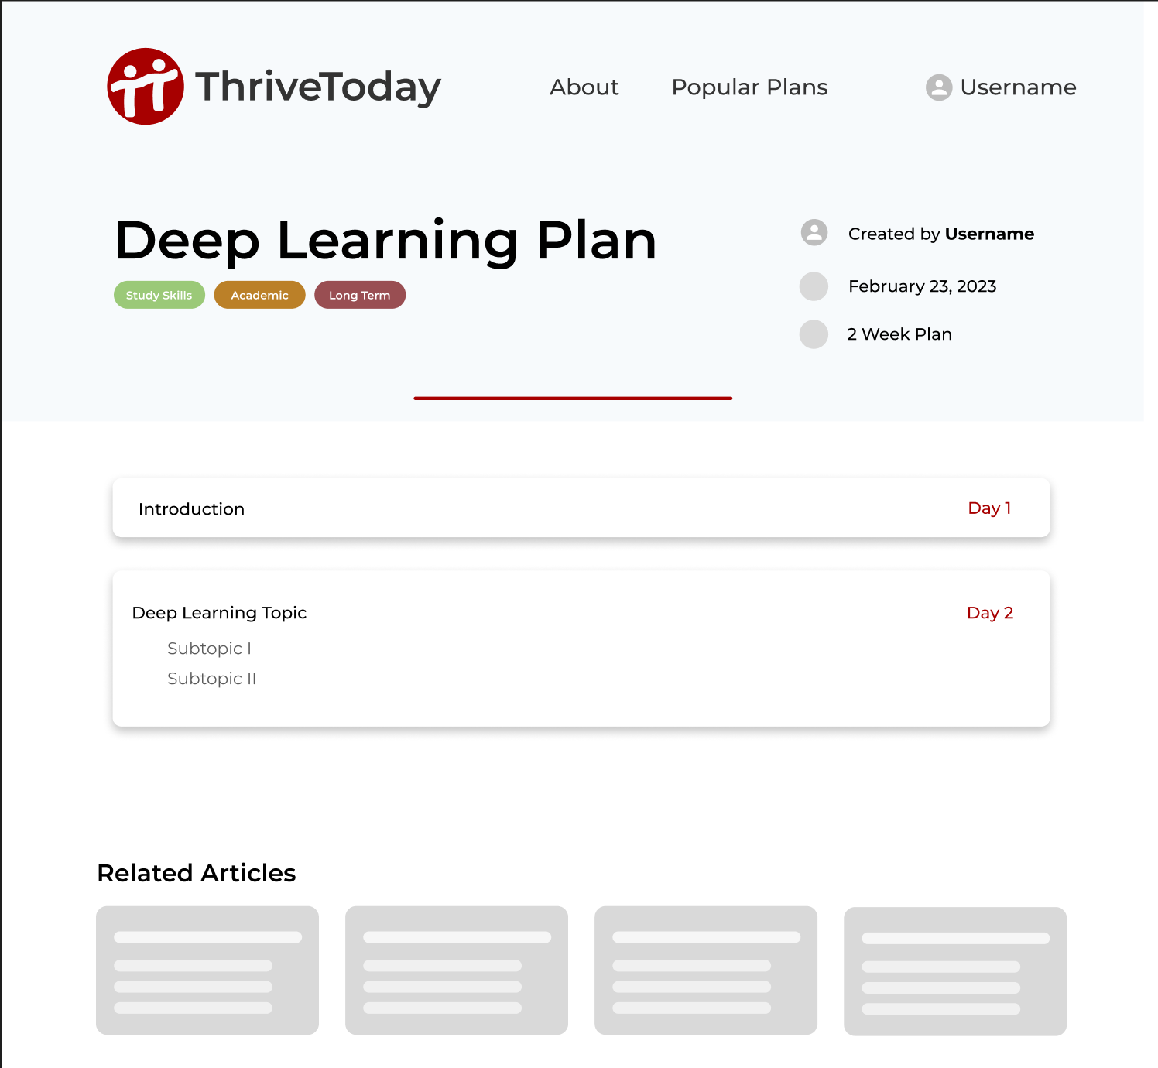
Plans / Like Features
Users will be able to create plans
Plans can have topics and subtopics
Can add text to their topics and subtopics
Users can “like” or “unlike” a plan by clicking the like button
Related articles will be featured at the bottom of the plan

Slide 5
Navigation Bar
User can click links on the nav bar to view different pages and sign in or view their account

Slide 6
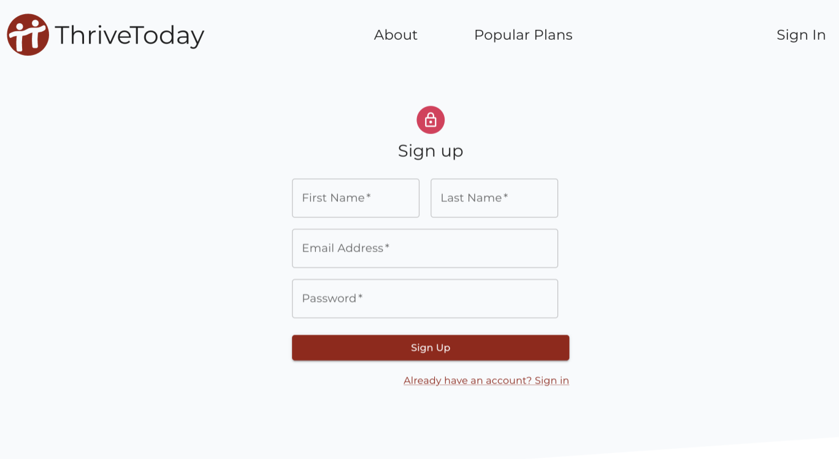
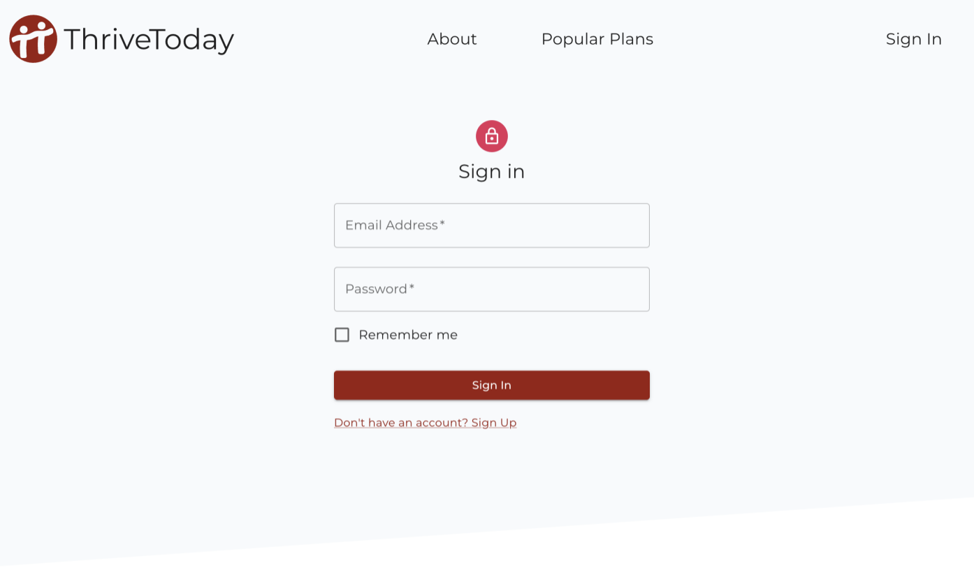
Sign Up / Sign In
Users can create a new account or sign in to an existing one

Slide 7
Testing Plan
Jest for testing, doing research right now
Testing rendering functionality

Slide 8
Superuser Thoughts
Can try to make 1 account with admin privileges
For now not a priority

Slide 9
Team Deepcourse Feedback
Nice UI Design
Recommendation
Make sure the backend port and frontend port are different

Slide 10
ThriveToday’s Response to Feedback
Will look into the port changing or logic to change the port if it’s already in use.

