Slide 1


Stock Price Prediction
Is it possible?

Slide 2
ASX Australian Investor Study 2020
Number of investors remained stable over the past 15 years
41% invest under $100k and 26% invest between $100k-$500k

Slide 3

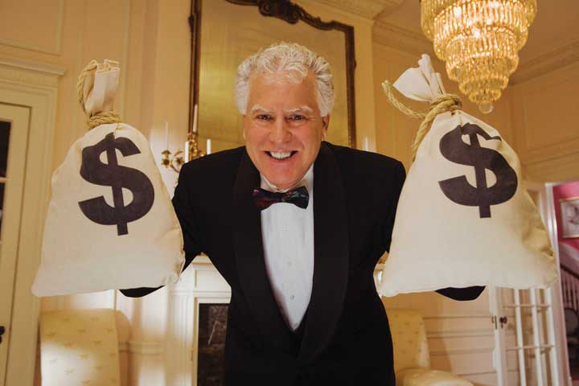

ASX Australian Investor Study 2020
High value investors
45% are women
Next generation investor starts from the age of 18

Slide 4
ASX Australian Investor Study 2020
65% consider potential return on investment when investing
86% invested within personal capacity

Slide 5


ASX Australian Investor Study 2020
41% prefer to receive investor education via YOUTUBE

Slide 6
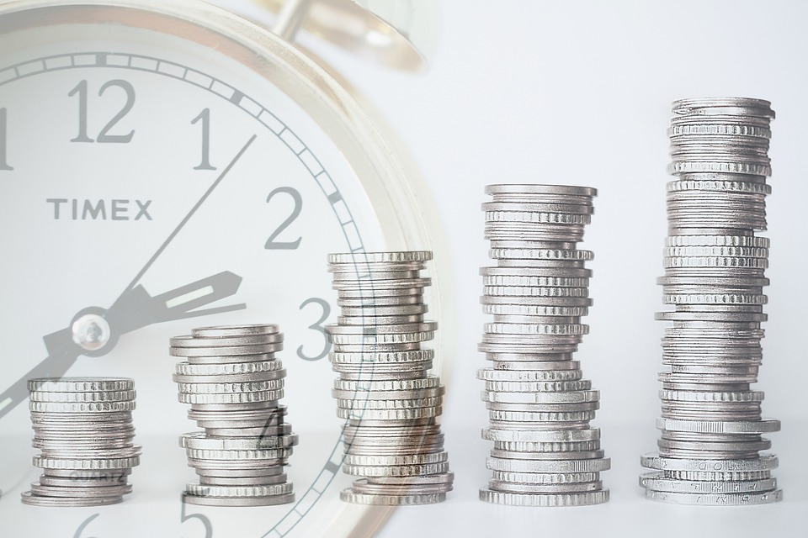
Business question
How to increase potential return on your investment?

Slide 7
Dataset
Commonwealth Bank of Australia stock price historical data from October 1991 to September 2022

Slide 8
Dataset

Slide 9
Data pipeline

Slide 10
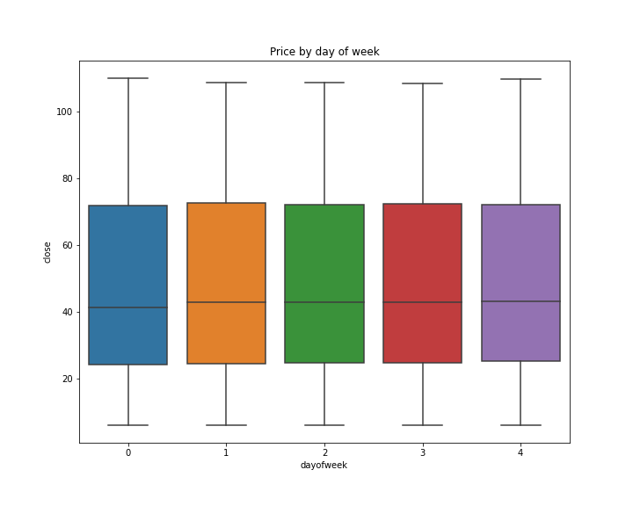
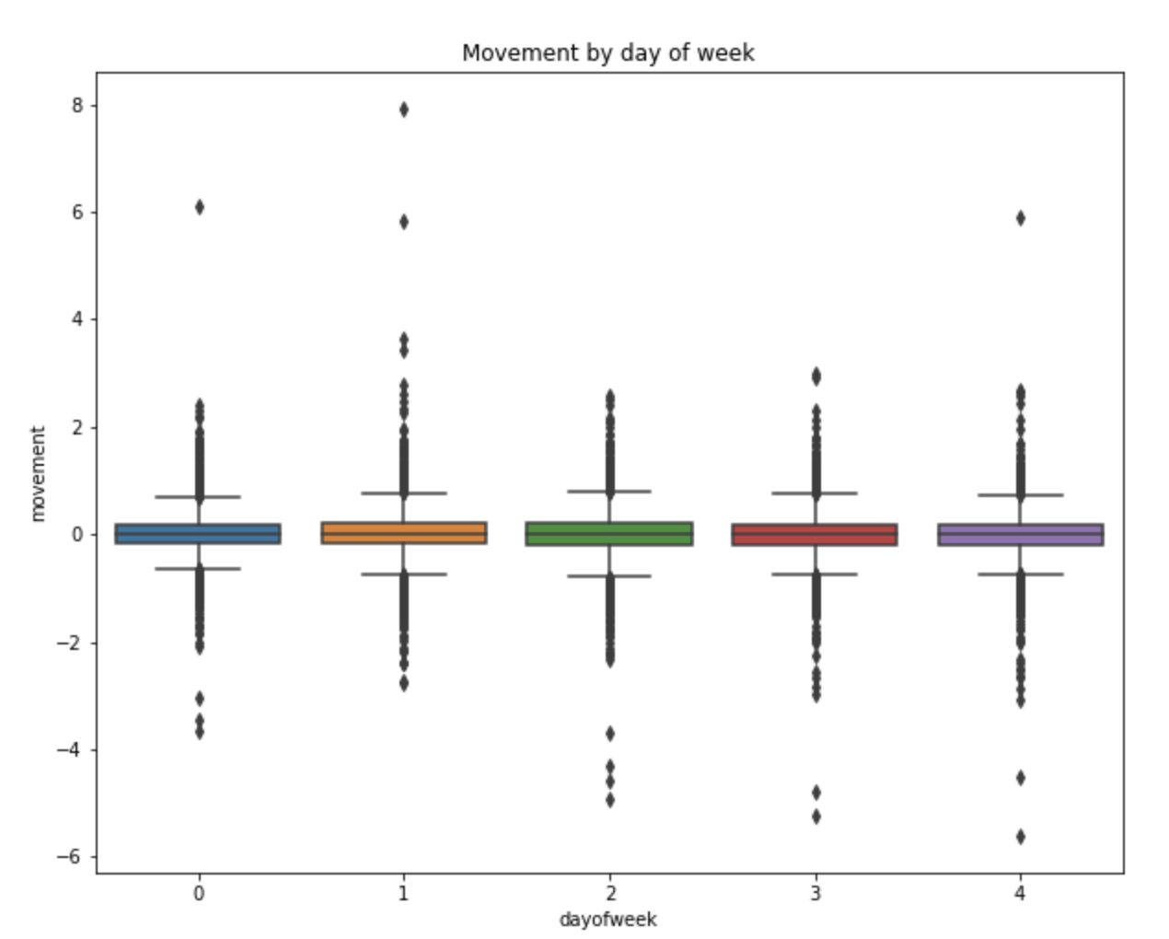
Key findings

Slide 11
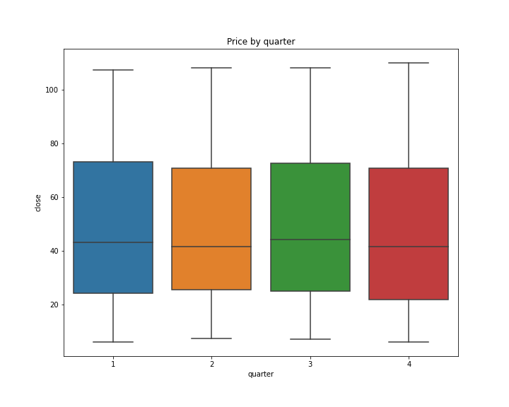
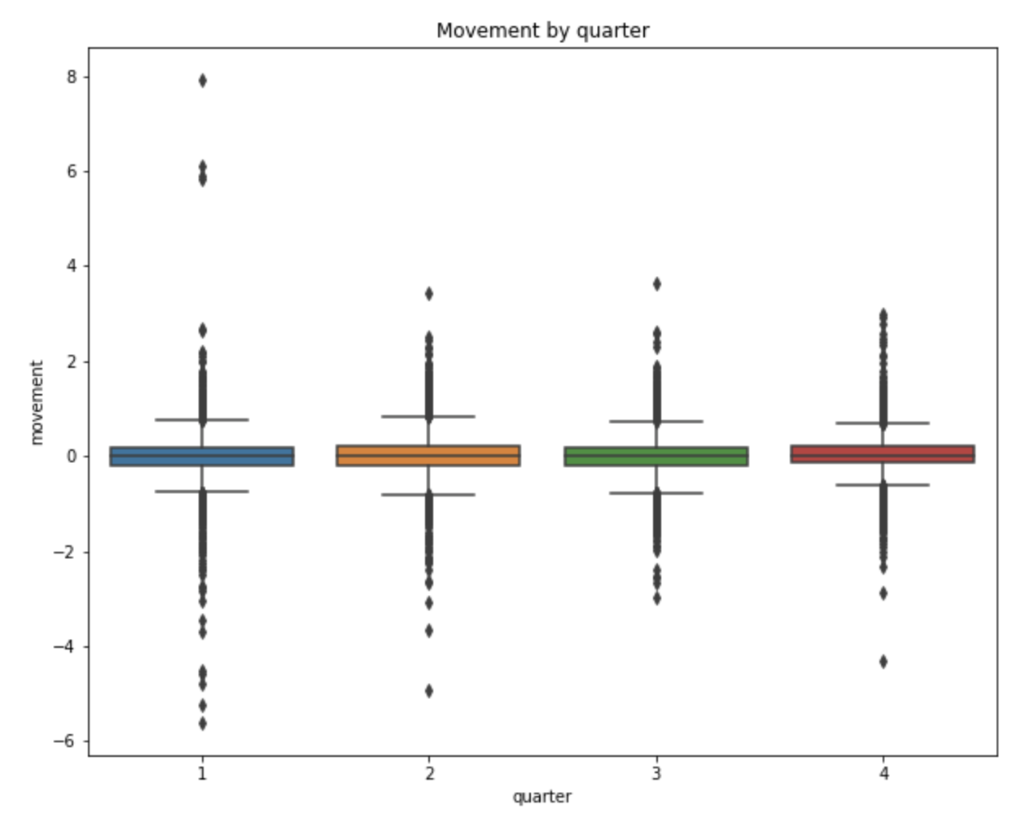
Key findings

Slide 12
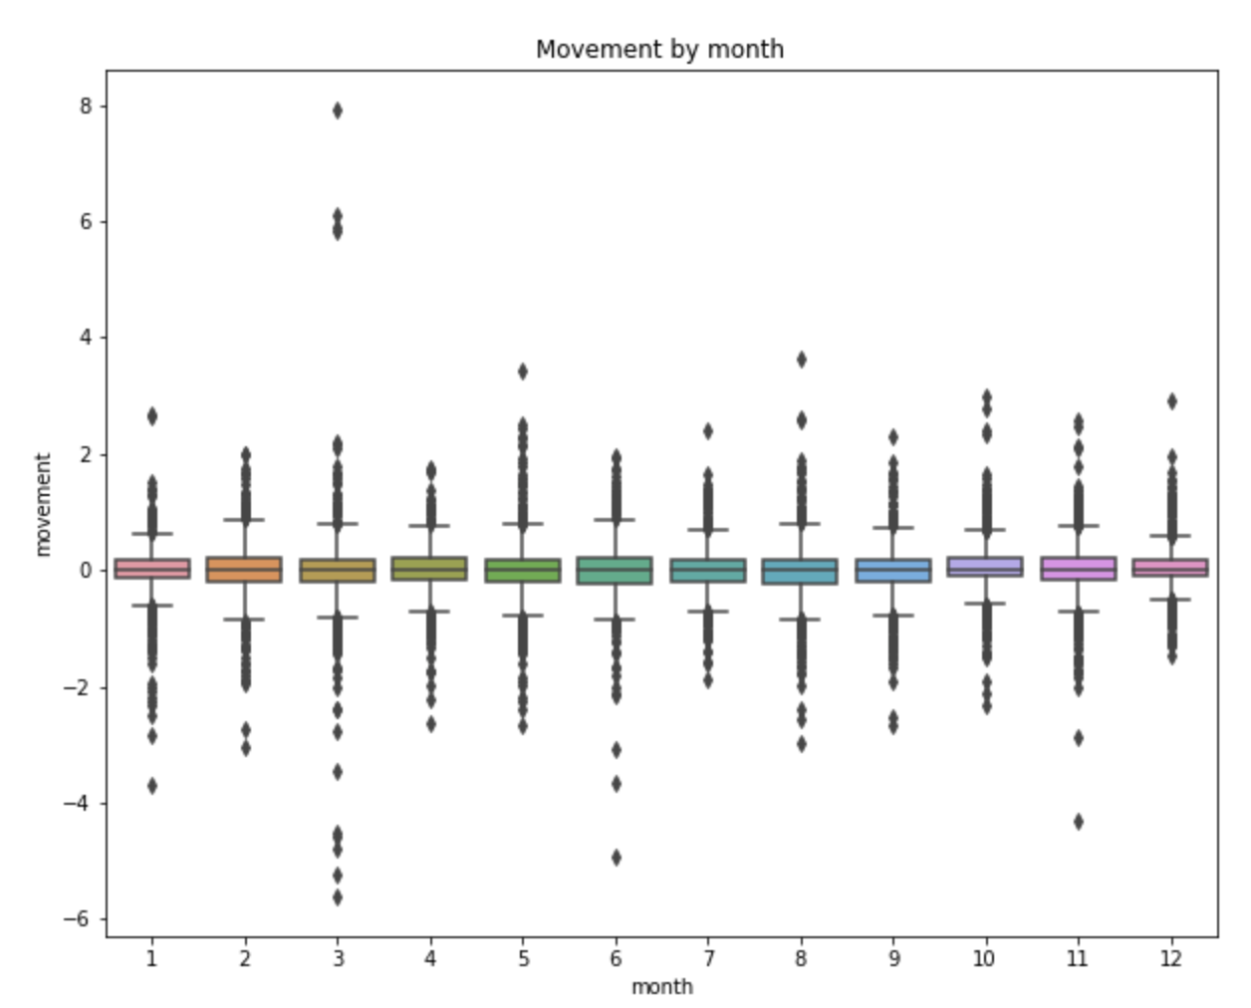
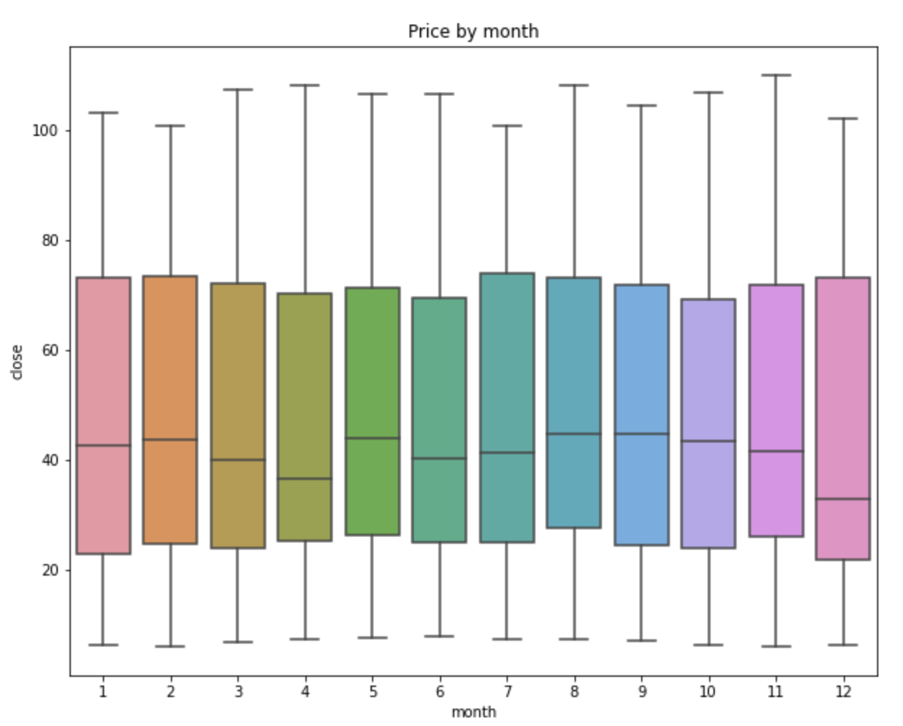
Key findings

Slide 13
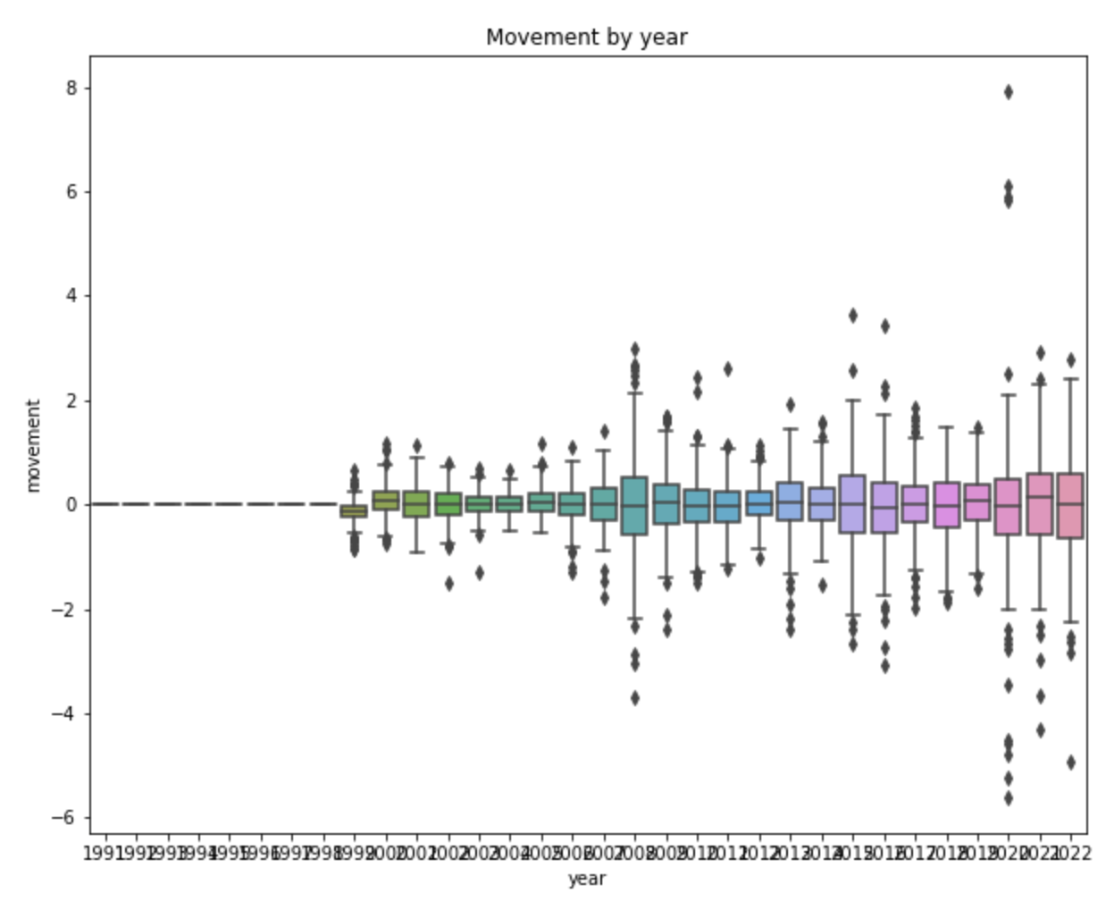
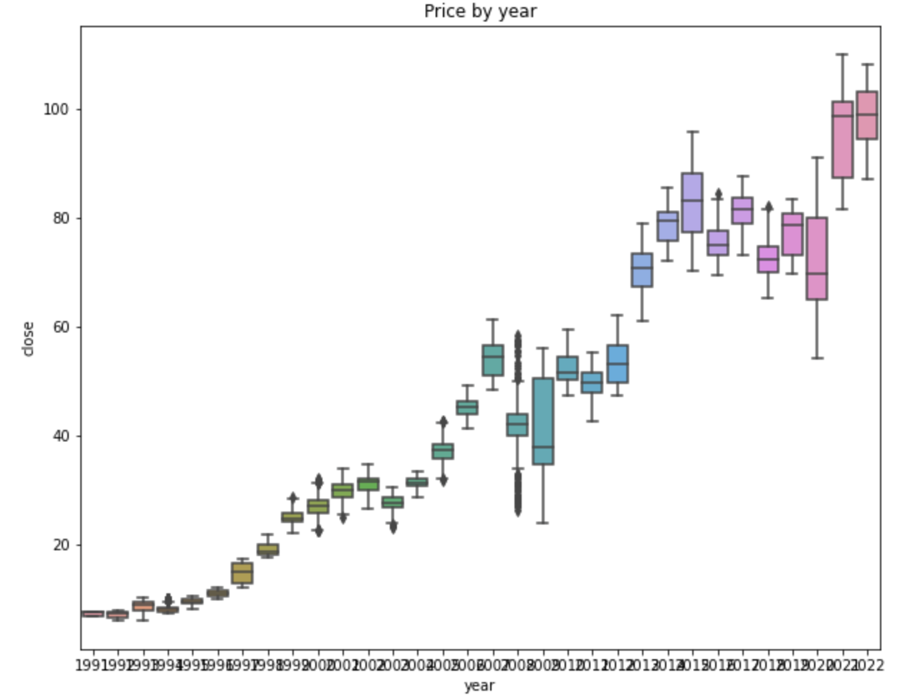
Key findings

Slide 14
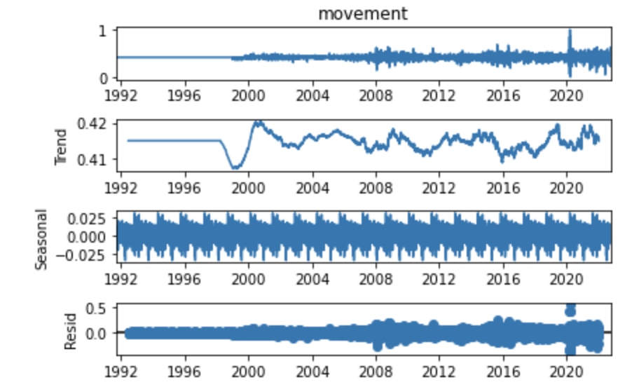
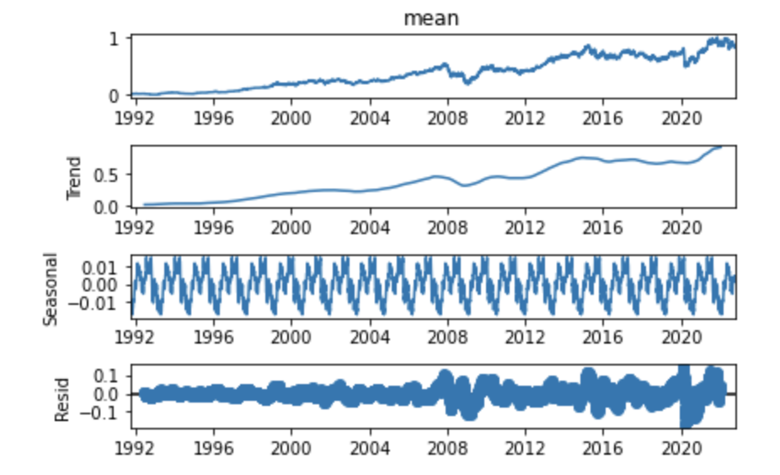
Model results: SARIMAX

Slide 15
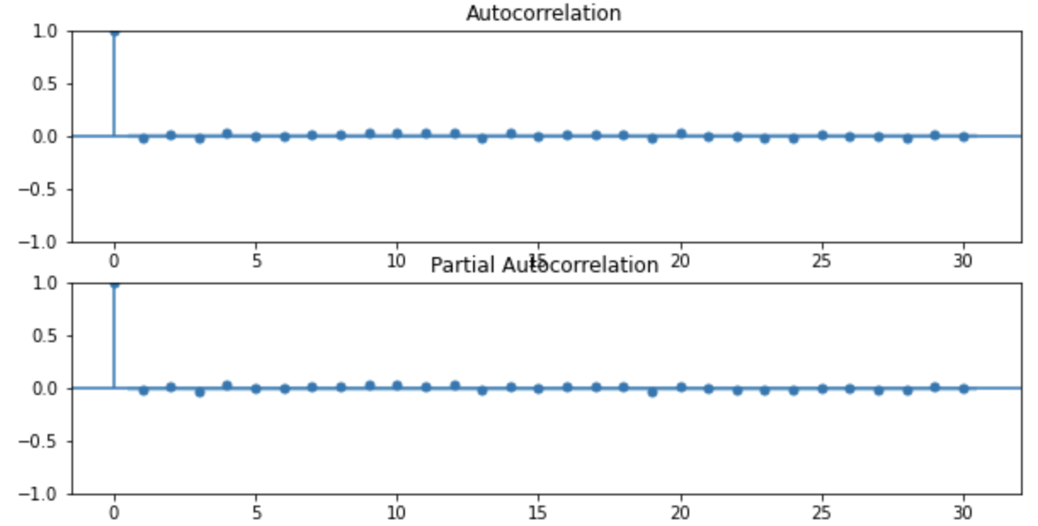
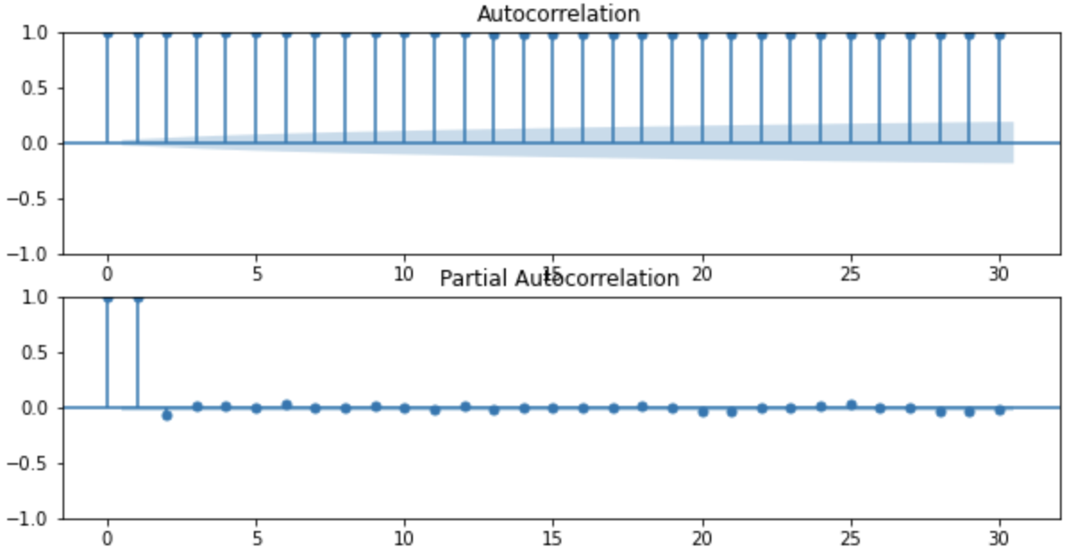
Model results: SARIMAX

Slide 16
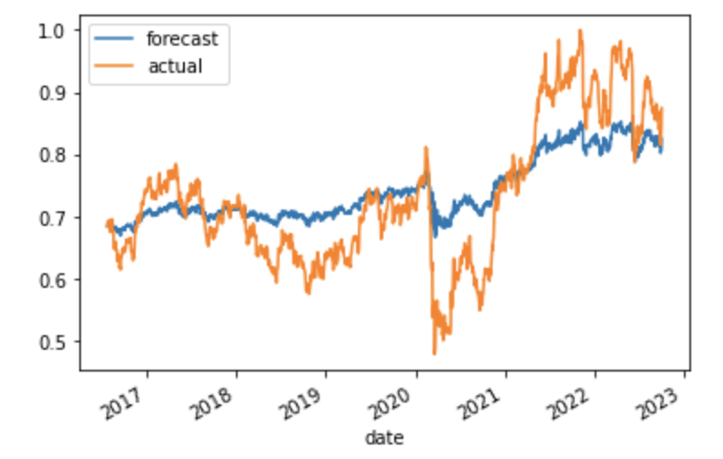
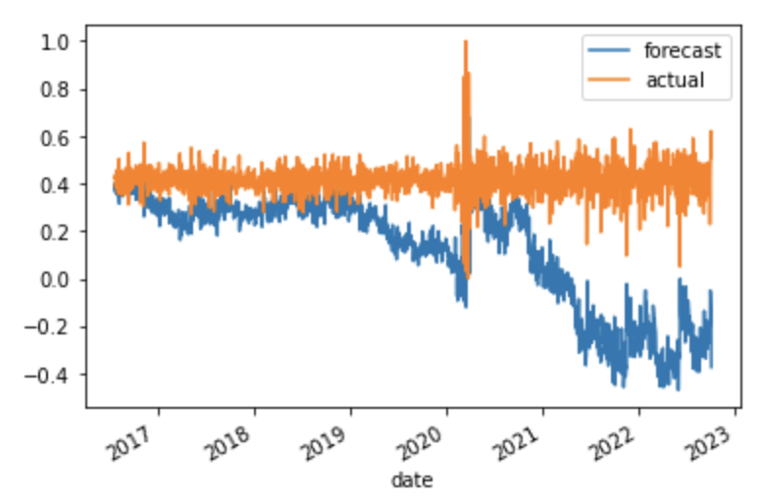
Model results: SARIMAX
Best model: ARIMA (2,1,4)
Total fit time: 224.887 seconds
Best model: ARIMA (0,1,2)
Total fit time: 161.45 seconds
RMSE = 0.0699
RMSE = 0.3793

Slide 17
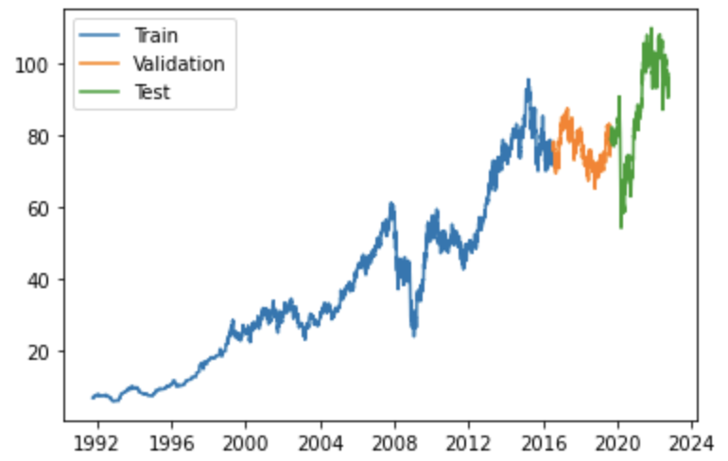
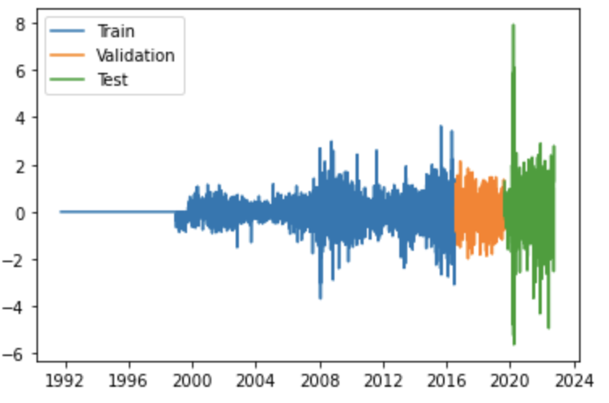
Model results: Long short-term memory

Slide 18
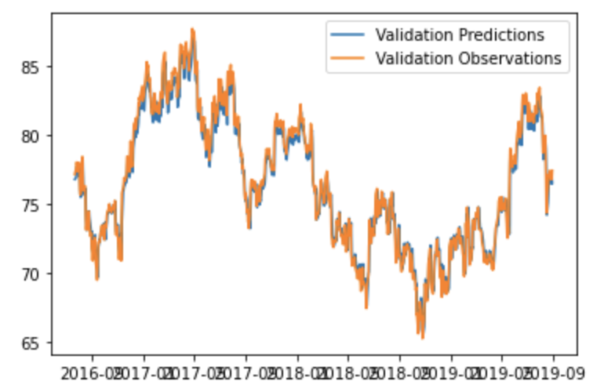
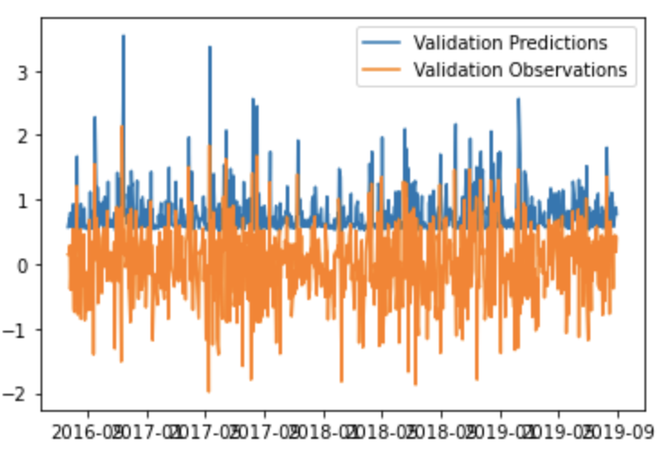
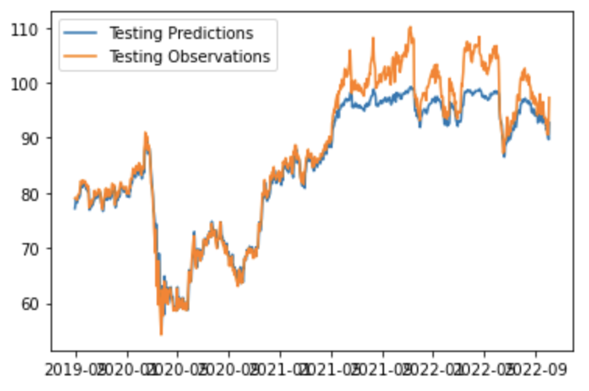
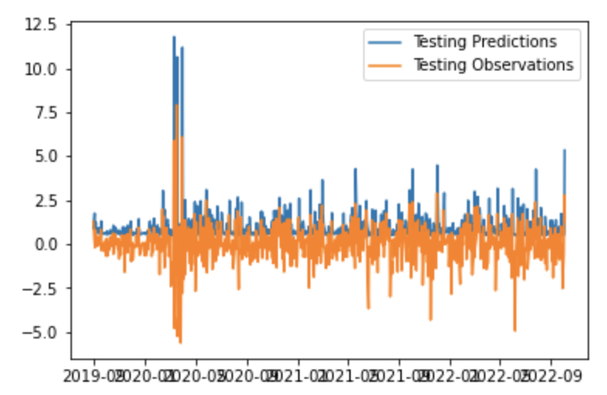
Model results: Long short-term memory

Slide 19
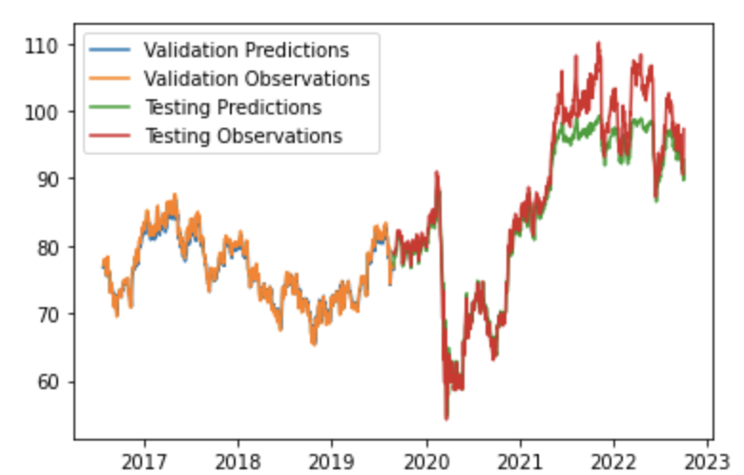
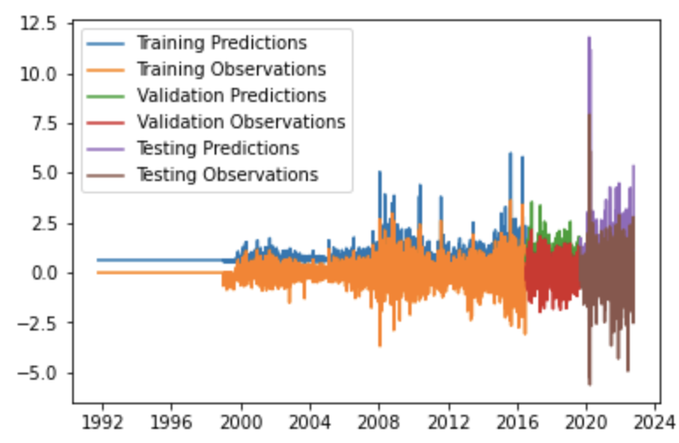
Model results: Long short-term memory
RMSE = 3.4819
RMSE = 1.8068

Slide 20
Summary
ARIMA model p

Slide 21
Next step

