Slide 1


Suicide Rate Analysis and Prediction
Presented By
ANJI
CHANDRADEEP

Slide 2
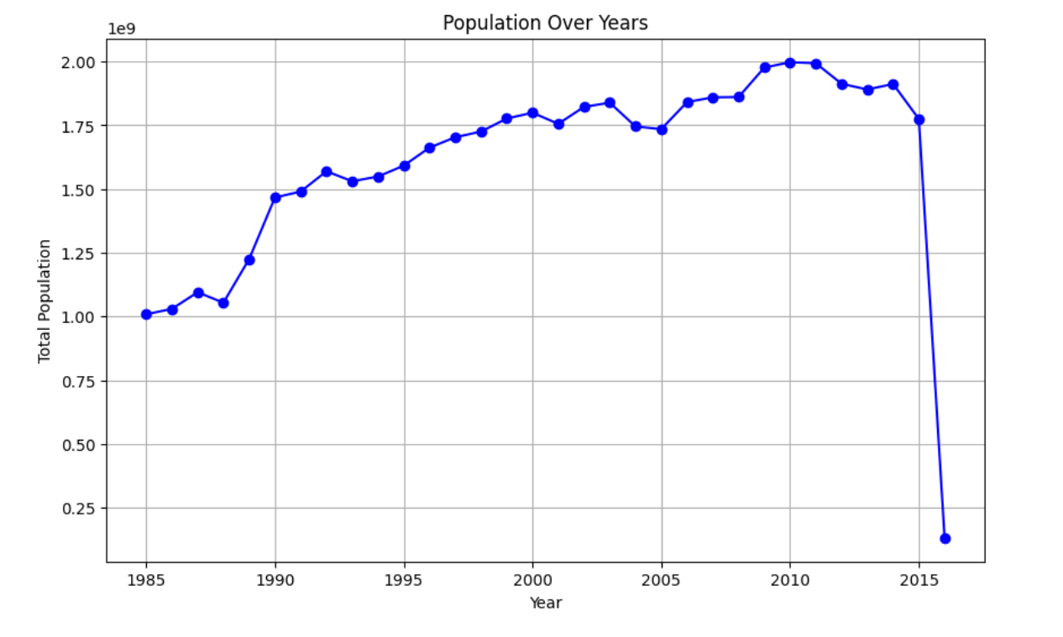
Sum of Population Over Years

Slide 3
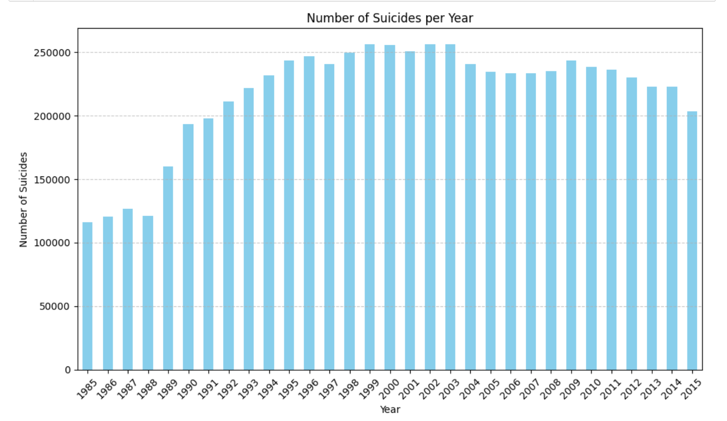
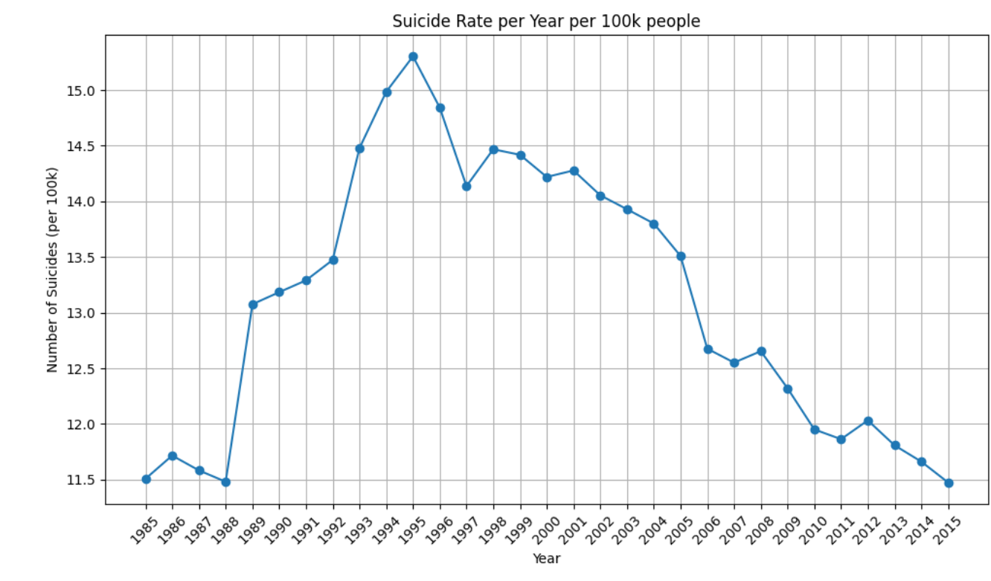
Number of Suicides & Suicide rate Over Years

Slide 4
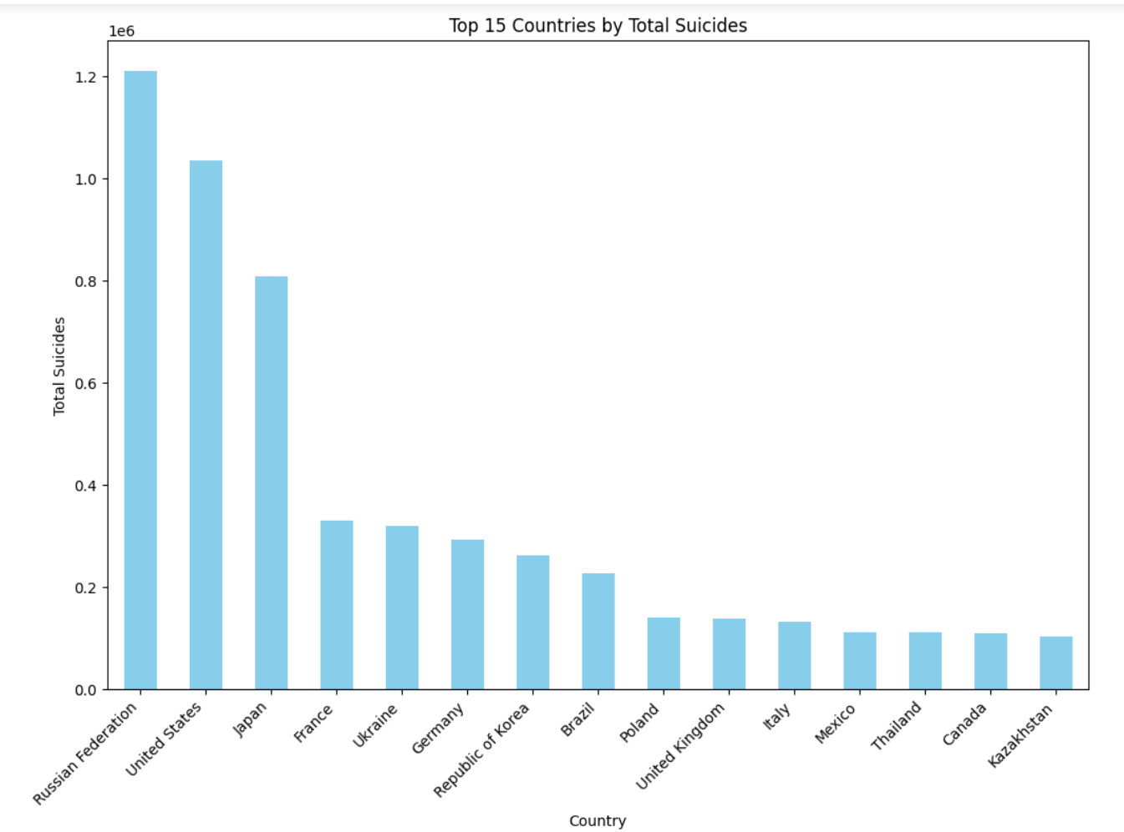
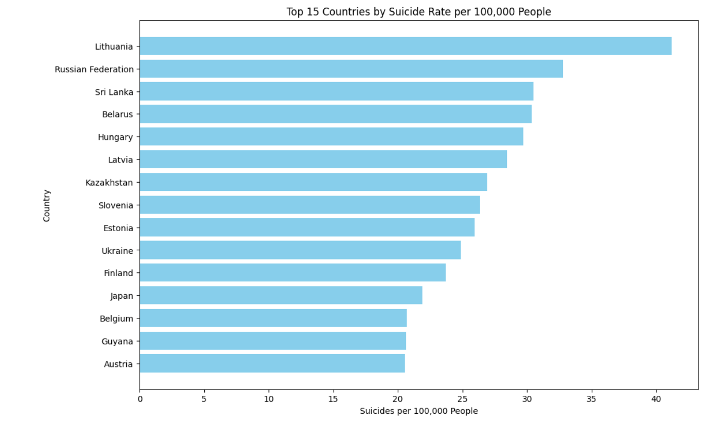
Top 15 countries by Number of Suicides & Suicide Rate

Slide 5
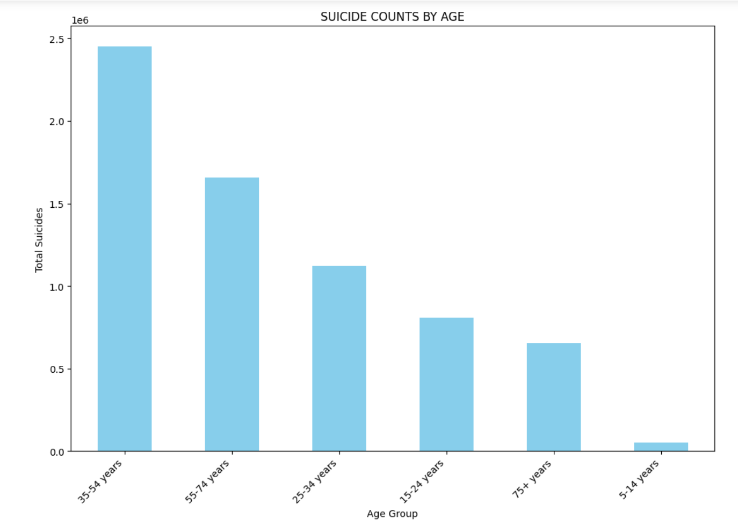
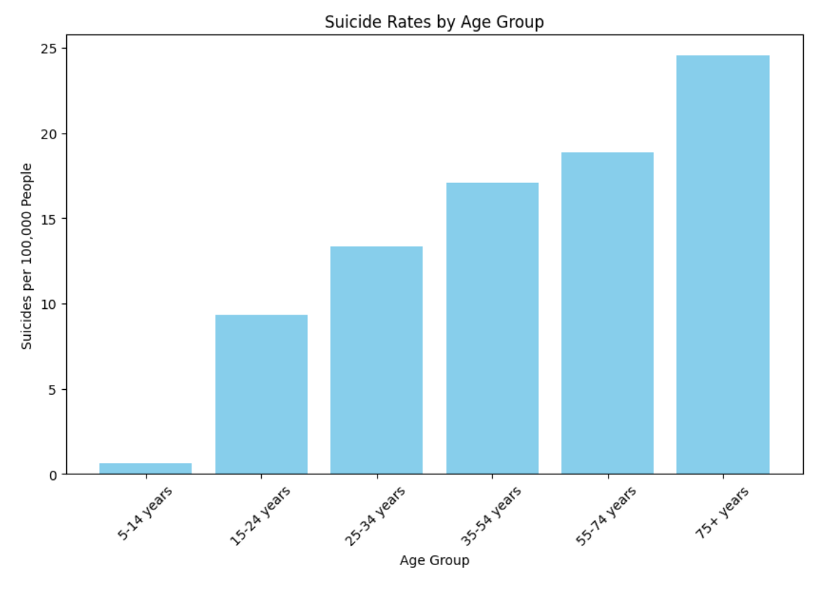
Number of Suicides & Suicide rate By Age group

Slide 6
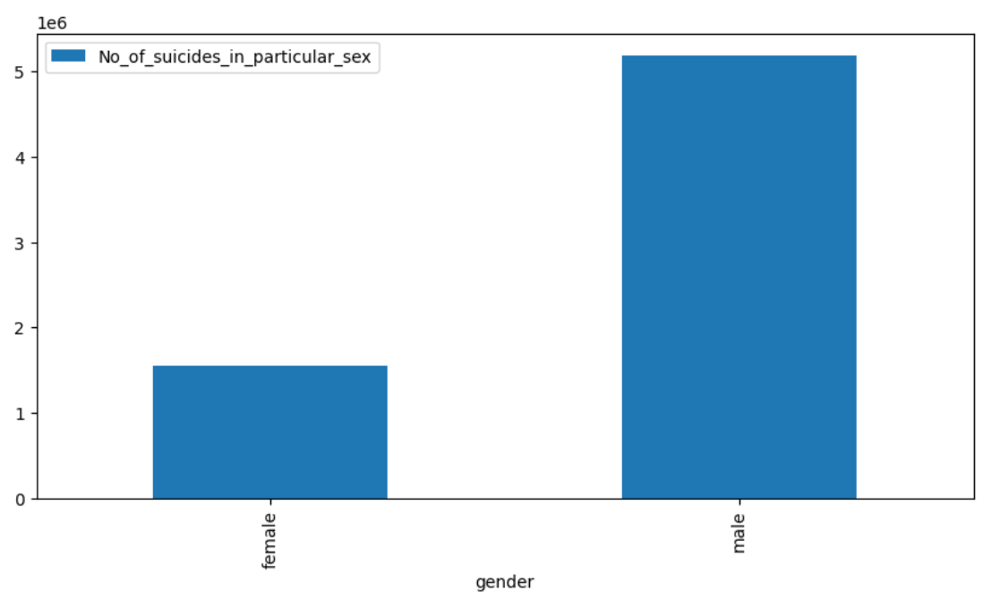
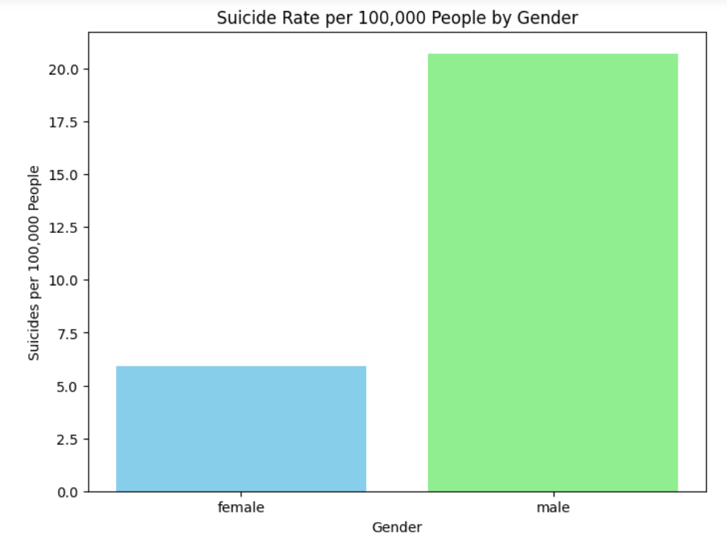
Number of Suicides & Suicide rate By Gender

Slide 7
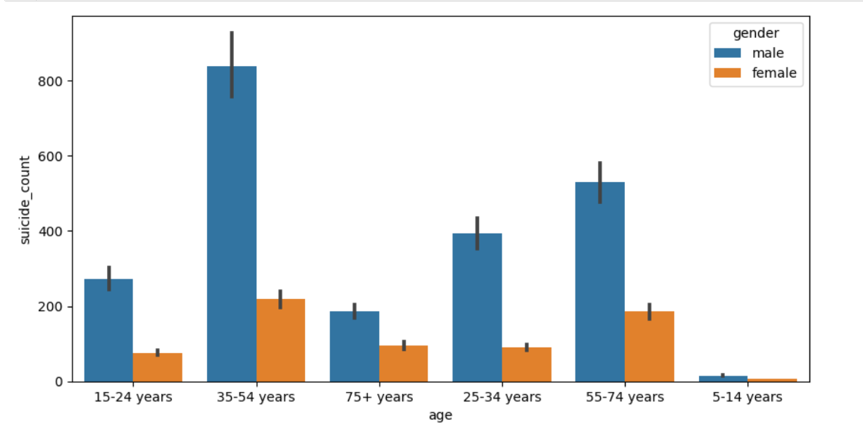
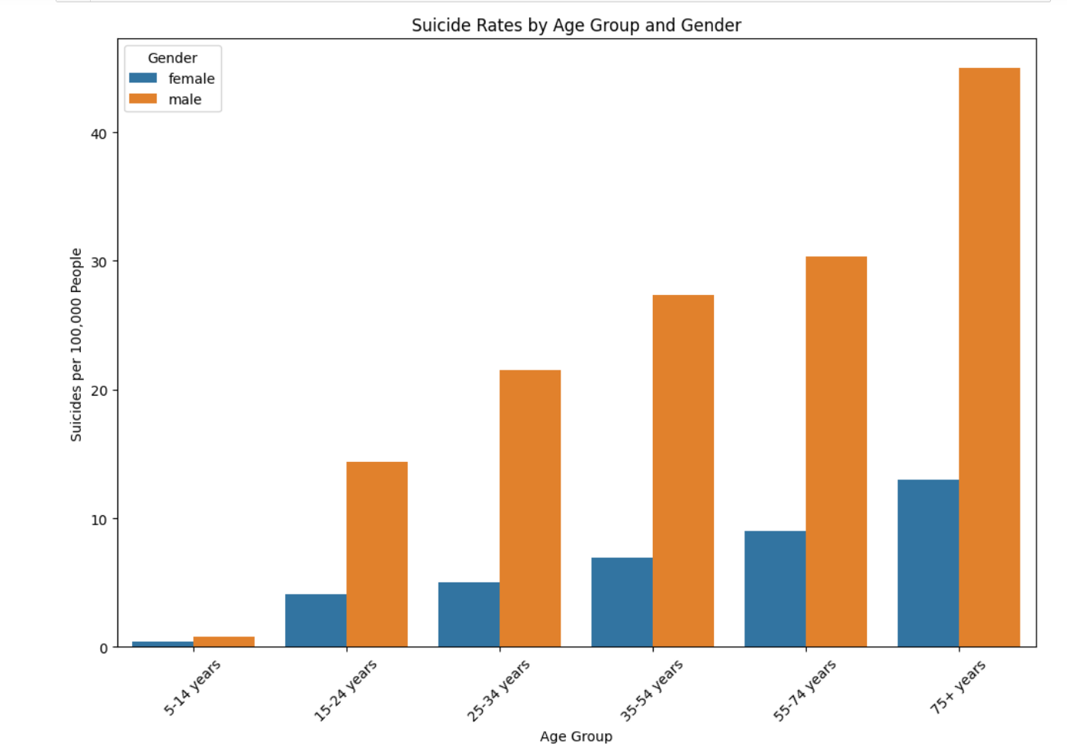
Suicide rate & Number of Suicides By Age & Gender

Slide 8
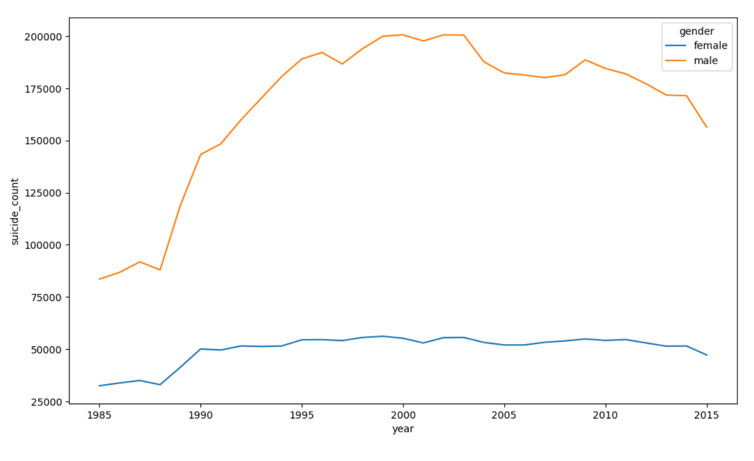
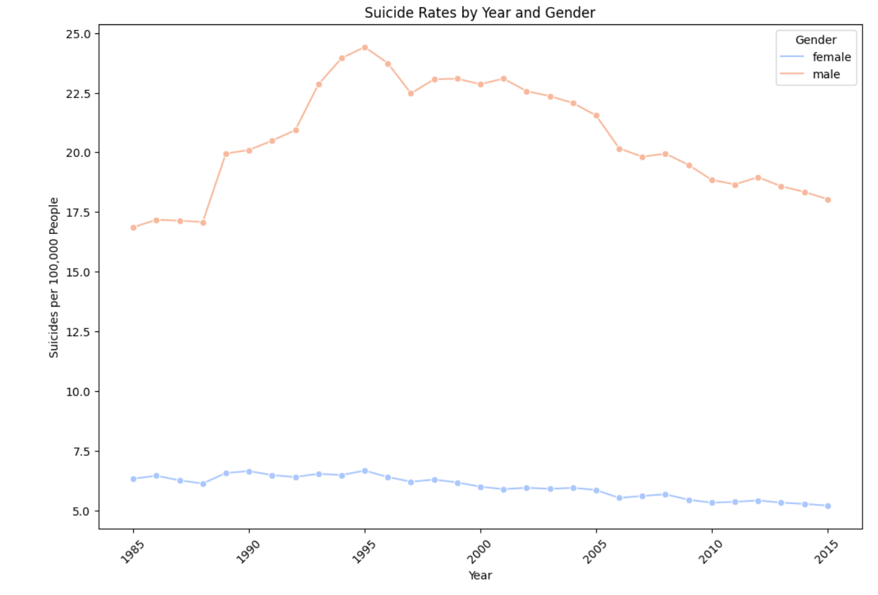
Suicide rate & Number of Suicides By Year & Gender

Slide 9
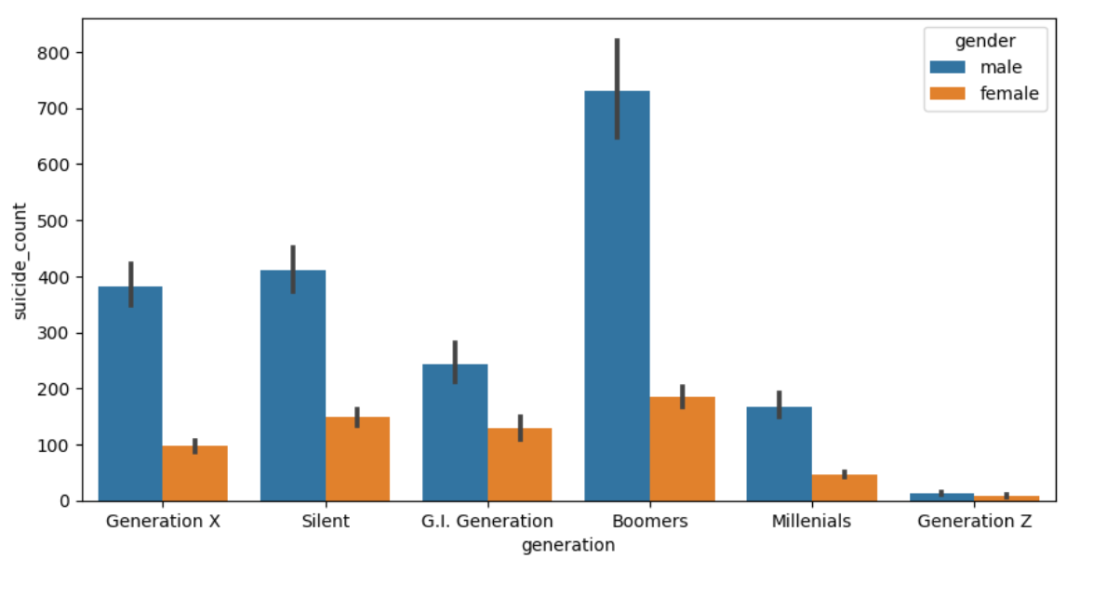
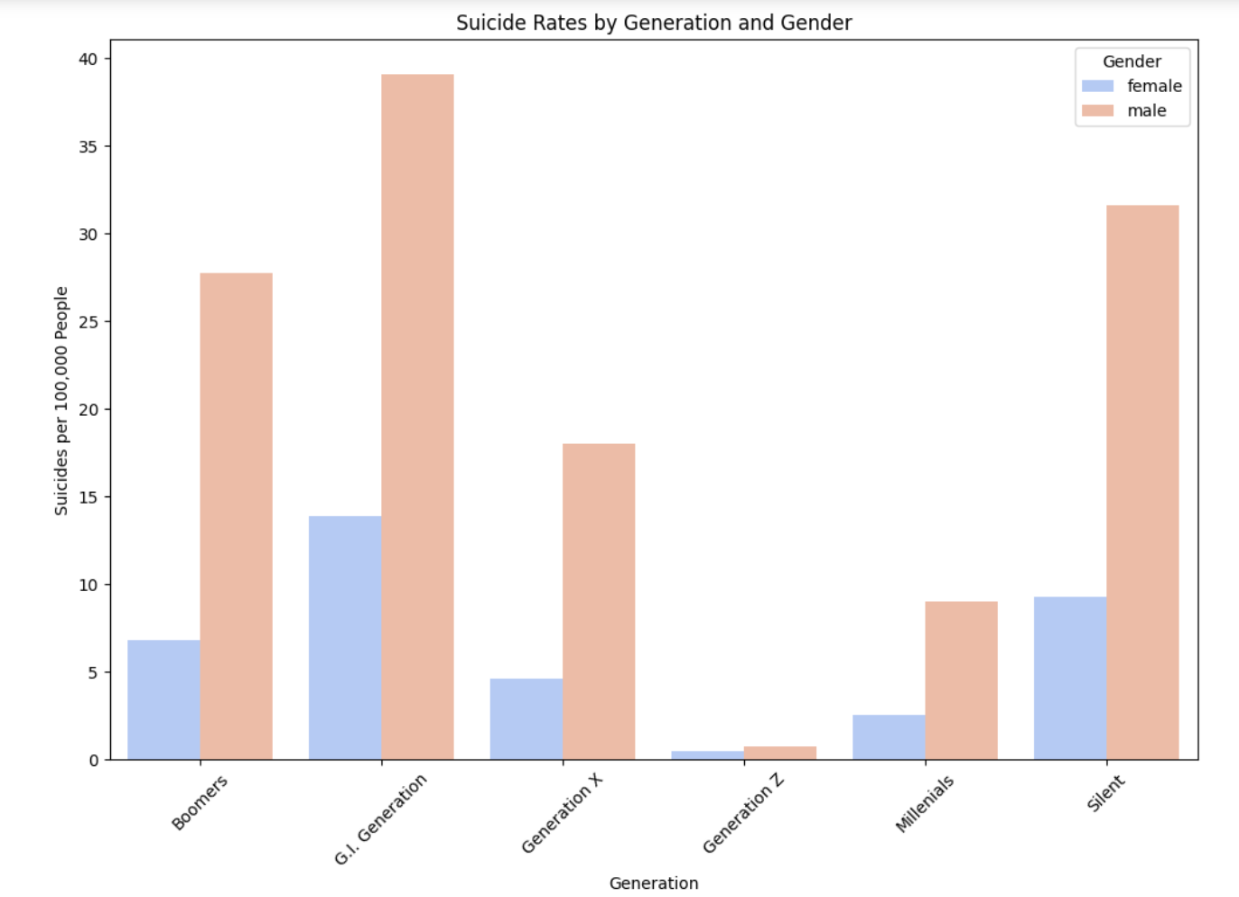
Number of Suicides & Suicide Rate By Generation & Gender

Slide 10
Suicide Rates By Gender & Generation

Slide 11
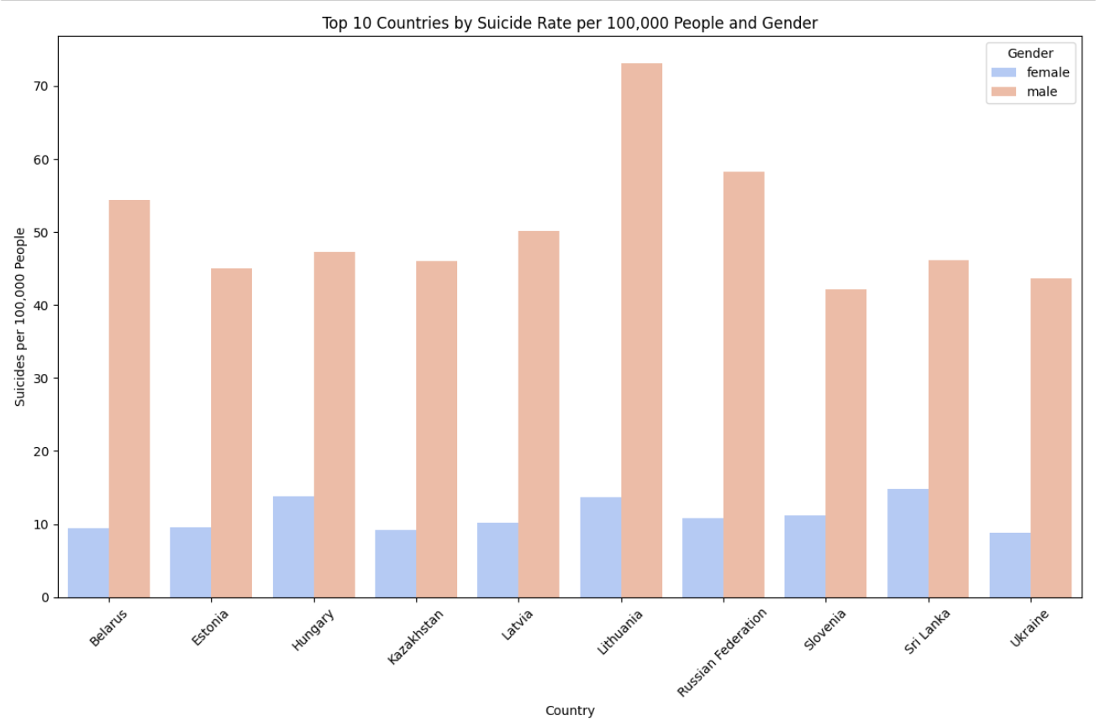
Top 10 Countries By Suicide rate by Gender

Slide 12
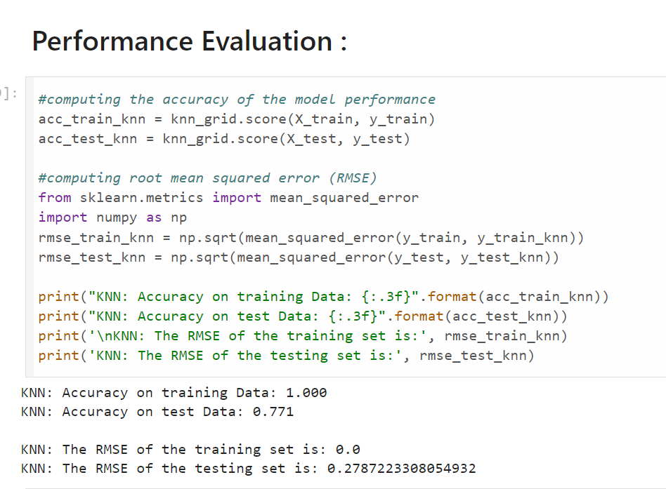
KNN ALGORITHM RESULTS

Slide 13
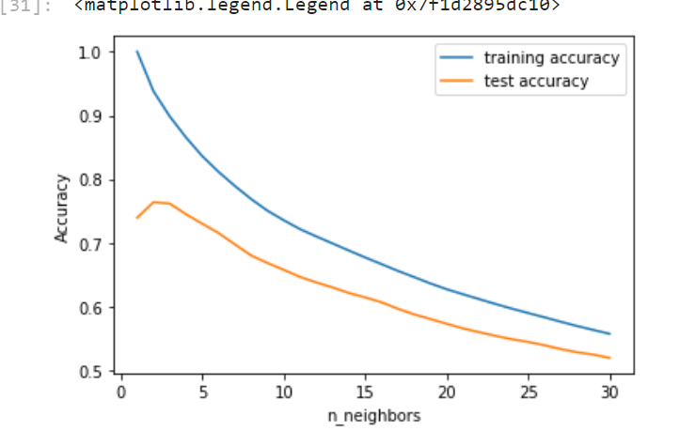
Training & testing accuracy for n_neighbours from 1 to 30
Overfitting is seen by the difference in performance between the training and testing sets.

Slide 14
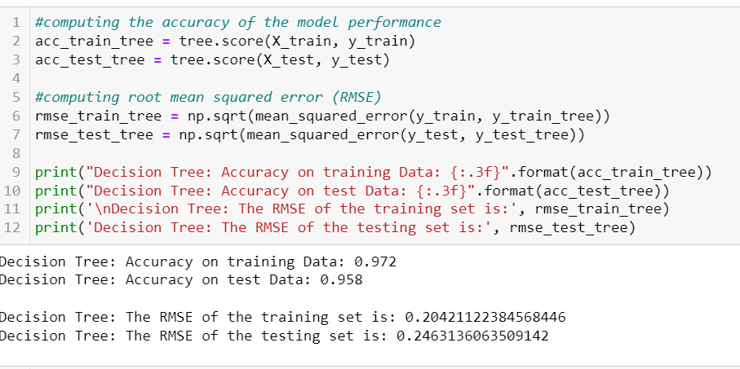
DECISION TREE MODEL

Slide 15
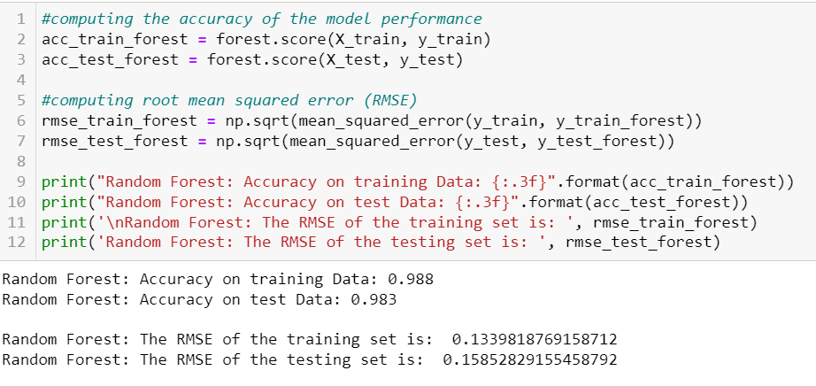
Random Forest Model

Slide 16
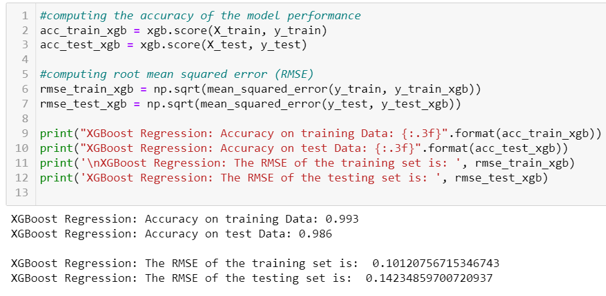
XGBOOST MODEL

Slide 17
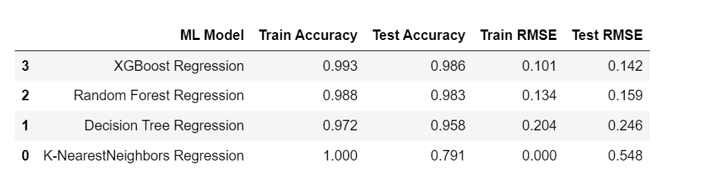
Comparison

Slide 18

NEXT STEPS

Slide 19
Thank You

