Slide 1
Weekly Thesis meeting
May 9th, 2022

Slide 2
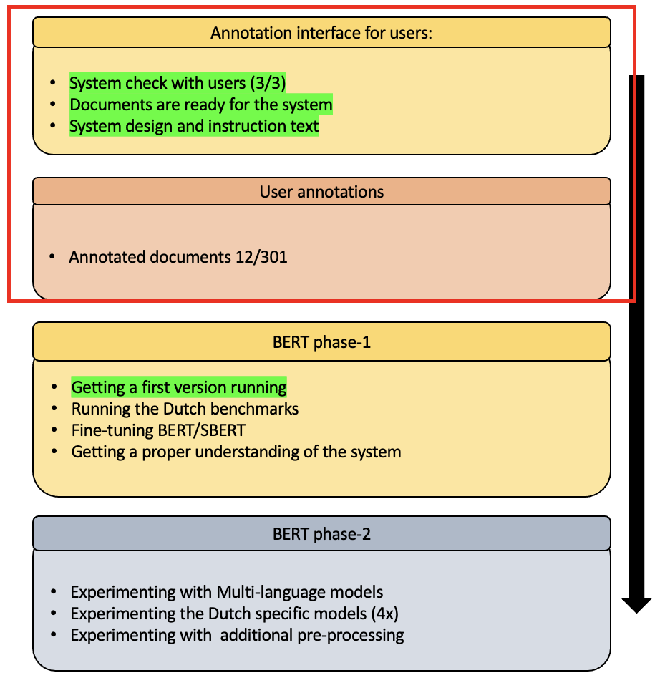
Items from last week
What I worked on:
Showed the system to two more users
Looked into extracting the annotations
Looked into fine-tuning BERT/SBERT
Questions
When can we get an overview of the system?

Slide 3
Items for next week
To do’s
Encourage people to annotate
Fine-tuning BERT
Creating a second Dutch data set? // use semi-supervised? // …
Pickup writing the methodology and introduction
Thesis session

Slide 4
Weekly Thesis meeting
May 3rd, 2022

Slide 5
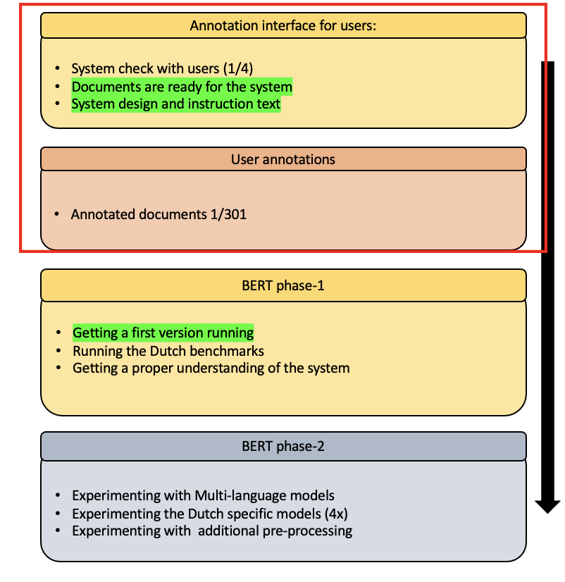
Items from last week
Questions
What do you mean with ‘Time-line?’
Missing letter (t) when calling scripts
One’ everyone gets the system working, is it possible to go over its workings one more time?
Completed Items
Wiki docs for the annotation system are clean and available on github
Evaluating the annotation system with the users
Experimenting with BERT

Slide 6
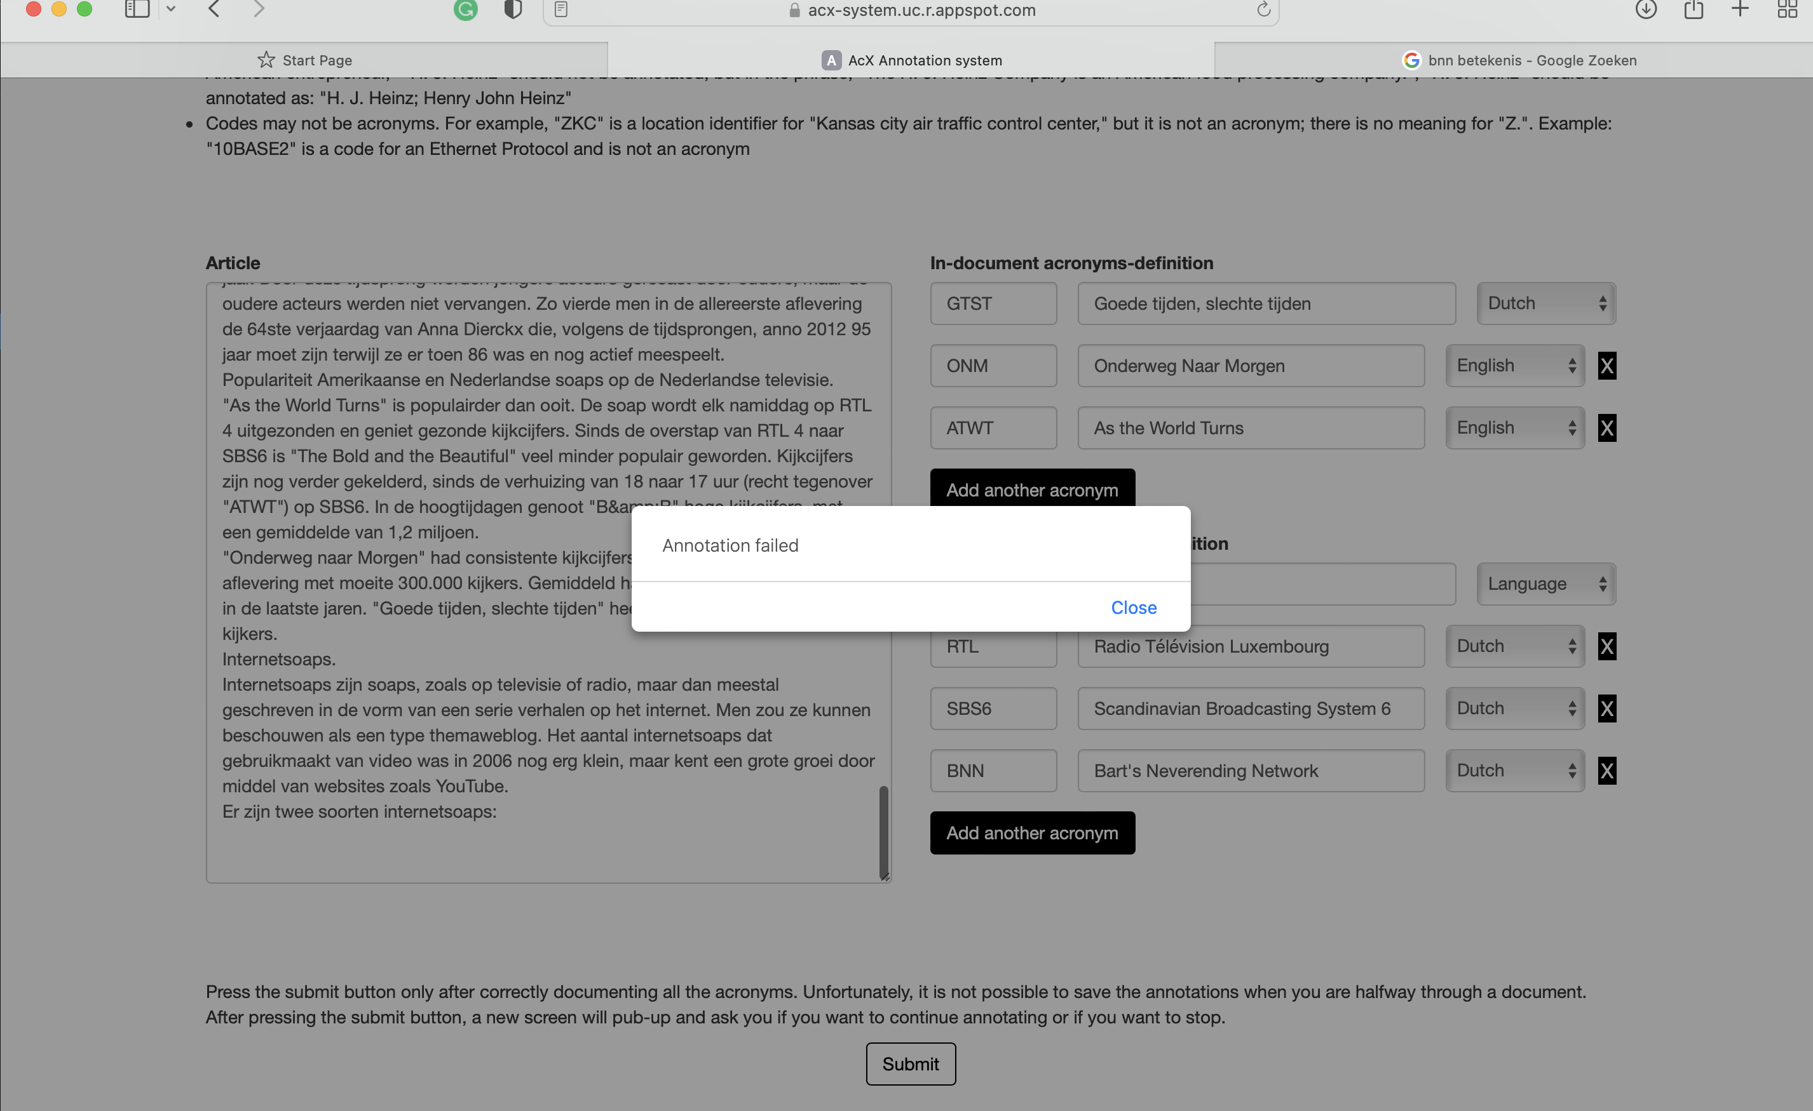
System feedback
Feedback annotation system (first user*)
Easy to use
Just copy and paste
Introduction text is a bit long (part of life)
Language selection a bit ambiguous
Some random & signs
Are EU and EU-member two different acronyms?

Slide 7
Items for next week
To do’s
Testing the system on 3 other users
Continue exploring the system
Explore T error
Make it running (and look at João’s code)
Run and eval multi-L
Show João Methodology
Thesis session

Slide 8
Weekly Thesis meeting
April13th, 2022

Slide 9
This Weeks Items
Questions
Which files do we need to create if we want to experiment with different models?
What should the data eventually look like??? (link follower, headers, titles etc.)
Is the aim to use BERT for text similarity purposes in the out expansion part?
The benchmarks seem to run (In expansion all good, out expansion → CSwiki is still and issue)
Almost done with finding documents (~80 to go)
Tried to map the system and all its requirements and dependencies
Playing around with BERT
Writing methodology for the thesis session (first version)

Slide 10
Weekly Thesis meeting
April 5th, 2022

Slide 11
Visual Overview Methodology
User
Document collection
Annotation interface for users
Data Annotation
Benchmarking (Dutch & English*)
Corpus evaluation
Annotation evaluation
Model building
- Pre-processing
- Bert-NL
Evaluation
Validation

Slide 12
Weekly Thesis meeting
March 25th, 2022

Slide 13
Last week
Gathering the first few documents
Wikipedia is very limited → acronyms are not very common
In-expansion sometimes include addition text (better known as)
Many English acronyms
Writing the app text
Writing the report for the first thesis session
EDA report
Question:
When do we call something an ‘in-expansion’
Issue with finding people for annotating the data

Slide 14
Next week
Lecture on literature review → there is also a deliverable
Preparations for the exams
Gathering the first few documents
Getting the AcX system running

Slide 15
Weekly Thesis meeting
March 18th, 2022

Slide 16
Last week
Tried to make Doccano work for acronyms
Tried out its different functions and created a general pipeline.
However, it turns out that it is not usable for out expansion, since it requires us to use a second framework.
Discussed the general idea about the data set and its requires
See Slack.
Started creating the main layout for the thesis introduction.
Discussed the general idea about annotating the data
The idea is to use Google forms

Slide 17
Next week
Work on the annotation tool/pipeline*
Creating an overview for the documents, Creating a google forms
Start gathering documents (and testing the google forms)
Start with the first sections of the introduction
* the focus will be on creating the annotation pipeline

Slide 18
Annotation interface for users:
User annotations
BERT phase-1
BERT phase-2
System check with users (1/4)
Documents are ready for the system
System design and instruction text
Annotated documents 1/301
Getting a first version running
Running the Dutch benchmarks
Getting a proper understanding of the system
Experimenting with Multi-language models
Experimenting the Dutch specific models (4x)
Experimenting with additional pre-processing

Slide 19
Annotation interface for users:
System check with users (3/3)
Documents are ready for the system
System design and instruction text
User annotations
Annotated documents 12/301
BERT phase-1
Getting a first version running
Running the Dutch benchmarks
Fine-tuning BERT/SBERT
Getting a proper understanding of the system
BERT phase-2
Experimenting with Multi-language models
Experimenting the Dutch specific models (4x)
Experimenting with additional pre-processing

