Slide 1
INTERNAL ASSESSMENT III • PROJECT PRESENTATION
Sensor Fault Detection
One sensor rule. Two possible diagnoses.
One quantum oracle query per execution.
CONSTANT → FAULTY
BALANCED → WORKING
Both inputs produce the same output.
The two inputs produce different outputs.
Deutsch’s Algorithm | Qiskit + Aer | Colab-compatible notebook
Jeshurun Pon McGrath V • URK24CS9047 • Quantum Computing
01
Notes:
Introduce the project as a simulation of a one-bit sensor. State that the main goal is to distinguish constant and balanced rules with one coherent oracle query per execution.

Slide 2
DEUTSCH’S ALGORITHM
1. Problem statement (PS)
The task
Decision rule
A single-bit sensor follows a hidden rule f.
Input: 0 or 1. Output: 0 or 1.
Determine whether f is constant or balanced.
Classify each rule with one quantum query.
f(0) = f(1) → Faulty
f(0) ≠ f(1) → Working
Scope: a simulated sensor with coherent oracle access; no physical sensor is connected.
Jeshurun Pon McGrath V • URK24CS9047 • Quantum Computing
02
Notes:
Explain f as a hidden input-output rule. Faulty is defined by the assignment, not by a universal engineering rule. The question is about the class, not reconstructing the exact function.

Slide 3
DEUTSCH’S ALGORITHM
2. All four possible sensor rules
Hidden rule | f(0) | f(1) | Class | Diagnosis
Always 0 | 0 | 0 | Constant | Faulty
Always 1 | 1 | 1 | Constant | Faulty
Return input x | 0 | 1 | Balanced | Working
Invert input 1 XOR x | 1 | 0 | Balanced | Working
Required answer: the class of the function, not its exact identity.
Jeshurun Pon McGrath V • URK24CS9047 • Quantum Computing
03
Notes:
Read the first row and the third row as examples. Constant zero and constant one are both faulty. Identity and inverted identity are both working. There are exactly four functions on this one-bit domain.

Slide 4
DEUTSCH’S ALGORITHM
3. Why use Deutsch’s algorithm?
CLASSICAL EXACT METHOD
DEUTSCH’S METHOD
Evaluate f(0).
Evaluate f(1).
Compare the two outputs.
Worst case: 2 oracle queries.
Prepare a quantum state.
Query the oracle coherently.
Interfere and measure the input.
Ideal: 1 oracle query.
The advantage concerns oracle calls; simulator runtime is not the benchmark.
Jeshurun Pon McGrath V • URK24CS9047 • Quantum Computing
04
Notes:
The comparison is exact classification. One classical observation is compatible with either class, so two evaluations are required. Deutsch uses a coherent query. This is a query advantage, not a claim about wall-clock speed.

Slide 5
DEUTSCH’S ALGORITHM
4. Methodology: from model to evidence
01
02
03
04
05
MODEL
BUILD
VALIDATE
CLASSIFY
ANALYSE
Define all four rules.
Construct reversible oracles.
Check truth mappings and unitarity.
Run one-query Deutsch circuits.
Compare theory, counts and noise.
Reproducible experiment: fixed seeds, recorded versions, assertions and saved outputs.
Jeshurun Pon McGrath V • URK24CS9047 • Quantum Computing
05
Notes:
Walk through these stages in order. First build four known test oracles, then classify them using one shared algorithm. Independent oracle checks are separate from classification queries. Finally compare ideal theory with sampled results and study synthetic readout noise.

Slide 6
DEUTSCH’S ALGORITHM
5. Architecture: two qubits, one measured output
PREPARE
SUPERPOSE
ORACLE
INTERFERE
MEASURE
q0 = |0⟩
q1 = |1⟩
H on q0
H on q1
One call
to U_f
H on q0
only
q0 → c0
0 or 1
RESULT 0
RESULT 1
Constant → faulty
Balanced → working
Jeshurun Pon McGrath V • URK24CS9047 • Quantum Computing
06
Notes:
This is the logical circuit architecture, not a physical sensor system. q0 is the input and q1 is the helper. X prepares the helper in one. H acts on both, then one oracle, then H only on q0, and q0 is measured. The helper is not the diagnostic output.

Slide 7
DEUTSCH’S ALGORITHM
6. How the algorithm works
SUPERPOSITION
PHASE KICKBACK
INTERFERENCE
H prepares the input in the plus state and the helper in the minus state.
The oracle creates equal or opposite signs on the input amplitudes.
The final H turns the sign difference into a definite 0 or 1.
Measured result = f(0) XOR f(1). Equal outputs → 0; different outputs → 1.
Jeshurun Pon McGrath V • URK24CS9047 • Quantum Computing
07
Notes:
Keep this explanation intuitive. H creates the plus input and minus helper. Since X acting on the minus state changes its sign, the oracle encodes the function into phase. Equal function outputs give equal signs; different outputs give opposite signs. The final H distinguishes these cases deterministically in the ideal model. Entanglement is not required for this instance.

Slide 8
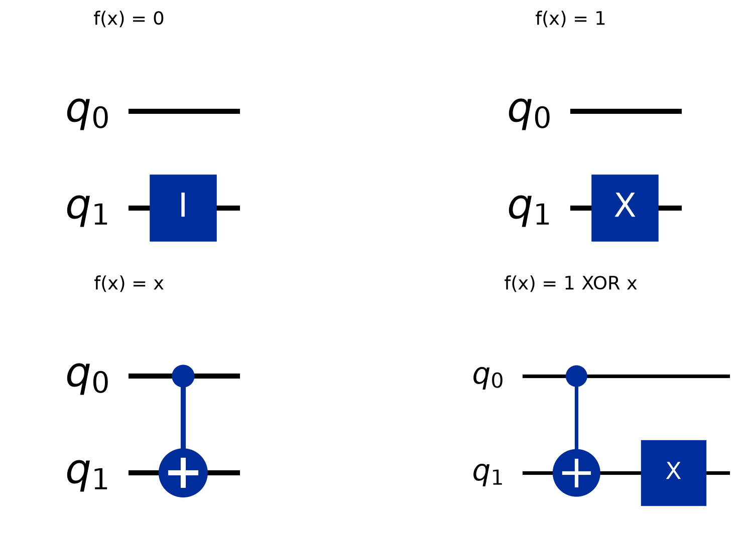
DEUTSCH’S ALGORITHM
7. Solution: build every oracle
ORACLE CONTRACT
Keep input x unchanged.
Change helper y to:
y XOR f(x).
This preserves reversibility.
Jeshurun Pon McGrath V • URK24CS9047 • Quantum Computing
08
Notes:
Explain that an oracle must be reversible. The target is changed by XOR rather than overwritten. For zero use identity, for one use X, for x use CNOT, and for inverted x use CNOT followed by X. q0 is always the input.

Slide 9
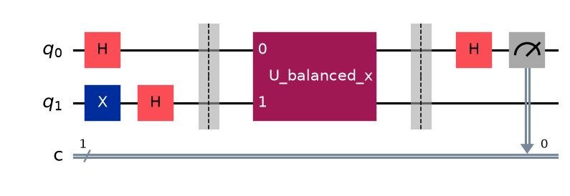
DEUTSCH’S ALGORITHM
8. Implemented circuit and simulation
QISKIT
AER SIMULATOR
IDEAL EXPERIMENT
Construct circuits and transpile.
2 qubits; 1 classical bit.
1,024 shots per oracle; seed 42.
Jeshurun Pon McGrath V • URK24CS9047 • Quantum Computing
09
Notes:
The figure is an actual diagram from the project notebook for the balanced identity oracle. The upper input is measured. The boxed U_balanced_x is one oracle call. Aer uses 1024 ideal shots per oracle, seed 42 and optimisation level zero. The notebook is Colab compatible, but the recorded validation was local.

Slide 10
DEUTSCH’S ALGORITHM
9. Results: all four diagnoses are correct
Rule | Count 0 | Count 1 | Measured bit | Diagnosis
0 | 1024 | 0 | 0 | Faulty
1 | 1024 | 0 | 0 | Faulty
x | 0 | 1024 | 1 | Working
1 XOR x | 0 | 1024 | 1 | Working
All ideal classifications matched the exact statevector predictions.
One query per shot × 1,024 shots × 4 oracles = 4,096 total ideal queries.
Jeshurun Pon McGrath V • URK24CS9047 • Quantum Computing
10
Notes:
Each expected result occurred in all 1024 ideal shots. Explain that this is deterministic for the ideal circuit. Shots are repetitions: each shot has one query, so this four-function experiment has 4096 queries overall. The experiment cannot identify which constant rule or which balanced rule was used from the final bit alone.

Slide 11
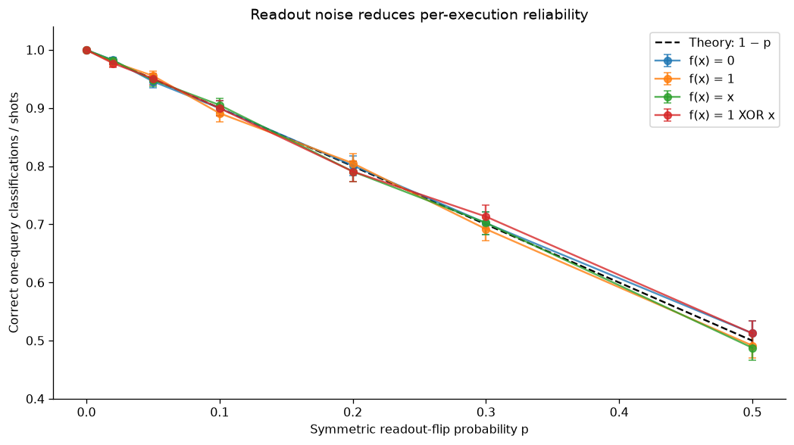
DEUTSCH’S ALGORITHM
10. Validation and measurement-noise study
CORRECTNESS CHECKS
16 basis mappings passed.
4 unitarity checks passed.
NOISE FINDING
Expected accuracy = 1 − p.
Only measurement errors are modelled.
Jeshurun Pon McGrath V • URK24CS9047 • Quantum Computing
11
Notes:
All sixteen basis mappings and four unitarity checks passed. The noise plot is a synthetic readout-only model: expected accuracy is one minus p. Gates remain ideal. The intervals are 95 percent Wilson binomial intervals. At p of one half the readout is uninformative. This is not calibrated hardware evidence.

Slide 12
DEUTSCH’S ALGORITHM
11. What the project demonstrates
ACHIEVED
LIMITATIONS
All four oracles implemented.
One-query ideal classification.
Theory agrees with simulation.
Noise effects visualised.
Simulated coherent sensor model.
No physical sensor or hardware run.
No gate-noise or decoherence model.
No practical runtime-speedup claim.
Next step: test calibrated device noise and account for all repeated queries.
Jeshurun Pon McGrath V • URK24CS9047 • Quantum Computing
12
Notes:
Summarise the solution and acknowledge the limitations. This is an educational property-testing model. Conventional sensors do not automatically provide coherent oracle access. No real hardware was run and no practical runtime speedup was demonstrated. Repetition can improve a noisy decision but uses more queries.

Slide 13
DEUTSCH’S ALGORITHM
12. Closing summary and questions
“One coherent query reveals whether the
sensor rule is constant or balanced.”
0 → FAULTY
1 → WORKING
Constant rule
Balanced rule
Project: github.com/Jeshurun-Pon-Mcgrath/Jeshurun_QC
References: Deutsch (1985), doi:10.1098/rspa.1985.0070; IBM Quantum learning;
Qiskit QuantumCircuit documentation; Qiskit Aer ReadoutError documentation.
Jeshurun Pon McGrath V • URK24CS9047 • Quantum Computing
13
Notes:
Finish with: I used Deutsch’s algorithm to distinguish constant and balanced sensor rules with one oracle query per ideal execution. State the output mapping again. Invite questions. The links identify the implementation and authoritative references.

