Slide 1
Team :29
Weekly Meal Planner & Grocery Generator
Java-based planning for seven days of meals, ingredients, and consolidated grocery needs.
Akash-2620090028 Harish-2620090027 Jeshith-2620030706

Slide 2
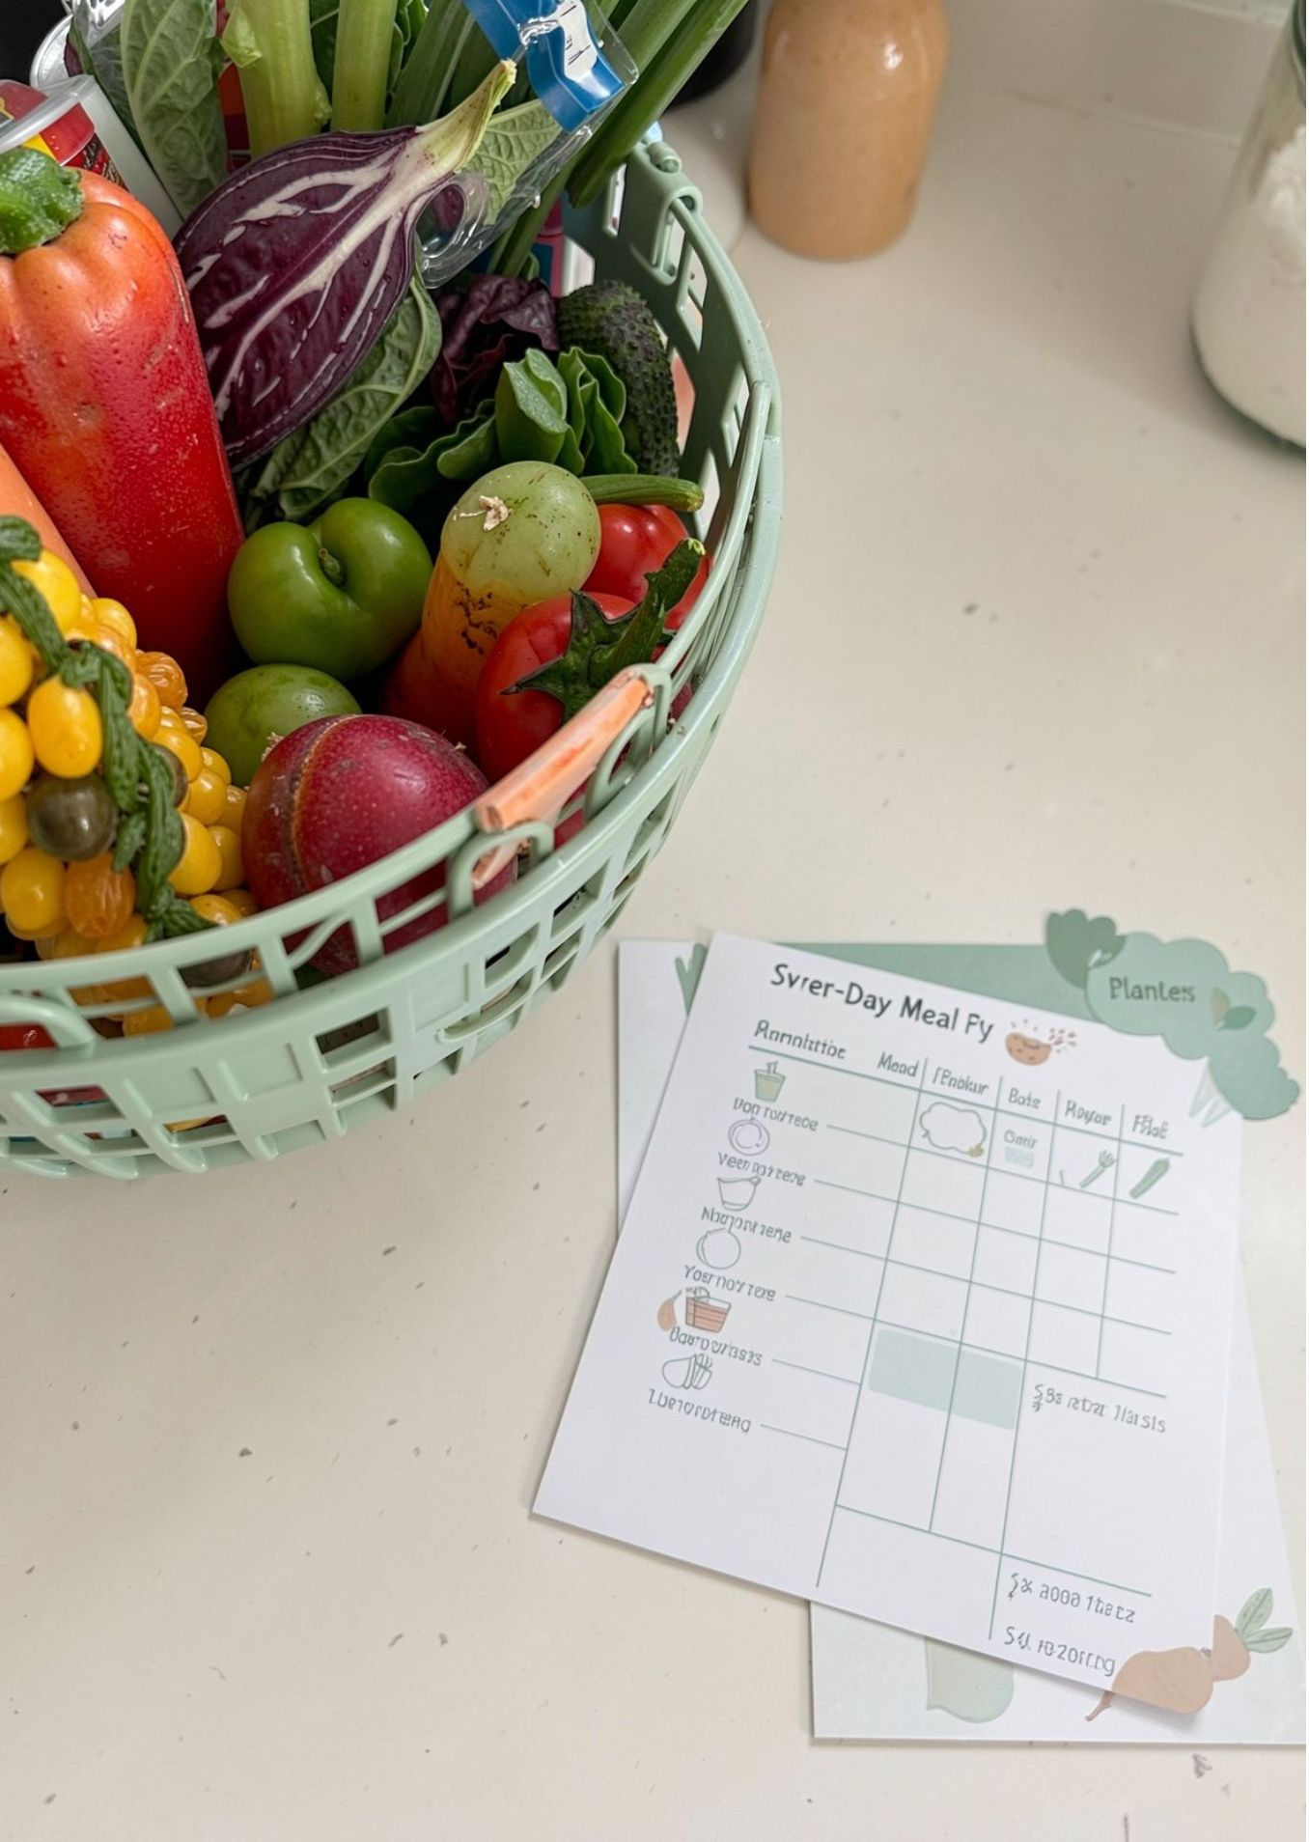


01 / PROJECT ABSTRACT
One weekly plan, one organized grocery view.
Weekly meal planning becomes easier when meal choices and ingredient needs are handled together.
Plan
Consolidate
Breakfast, lunch, dinner, and snacks across seven days.
Convert selected meals into one organized grocery checklist.
Benefits
Java foundation
Reduce forgotten items, repeated manual work, and unnecessary purchases.
Apply Java fundamentals, control flow, methods, arrays, object-oriented design, file handling, collections, and streams.
The workflow connects planning to purchasing.

Slide 3
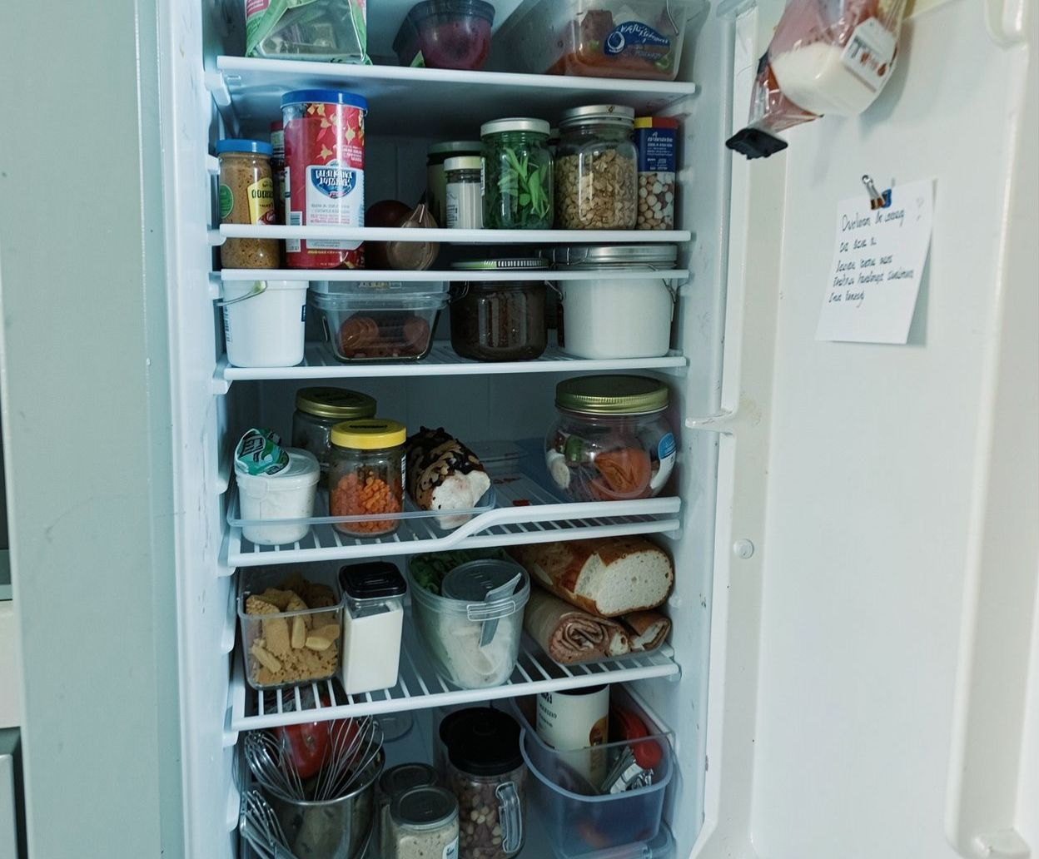



02 / PROBLEM MODEL
From scattered choices to a usable grocery checklist.
Daily meal decisions and ingredient tracking are difficult to organize when choices, quantities, and days remain separate.
Input
Process
Preferences, meals, days, ingredients, and quantities.
Validate choices, store the weekly plan, and aggregate duplicate ingredients.
Output
Meal schedule, ingredient summary, grocery checklist, and optional total when prices are supplied.

Slide 4




03 / FOUNDATIONS
CO 1 Topics
Start with a clear problem model, then express it as structured Java logic.
Think
Represent
Computational thinking, problem analysis, algorithms, pseudocode, and flowcharts.
Java structure, variables, constants, identifiers, data types, operators, and expressions.
Read
Apply
Use Scanner input to capture meal and ingredient details.
Process the project through an Input → Process → Output model and display the plan and grocery requirements.

Slide 5
04 / CONTROL FLOW
Co 2 TOPICS
Selection and iteration control how the weekly input is collected and checked.
WEEKLY INPUT EXECUTION FRAME
MON
TUE
WED
THU
Validate
Repeat
Check
Store
FRI
SAT
SUN
Loop
Continue
Finish
Decisions: if, if-else, nested if, else-if ladders, and switch.
Loops: for and while iteration with break and continue.
Validate meal selections, repeat entry operations, process seven days, and flag missing selections or invalid quantities.

Slide 6
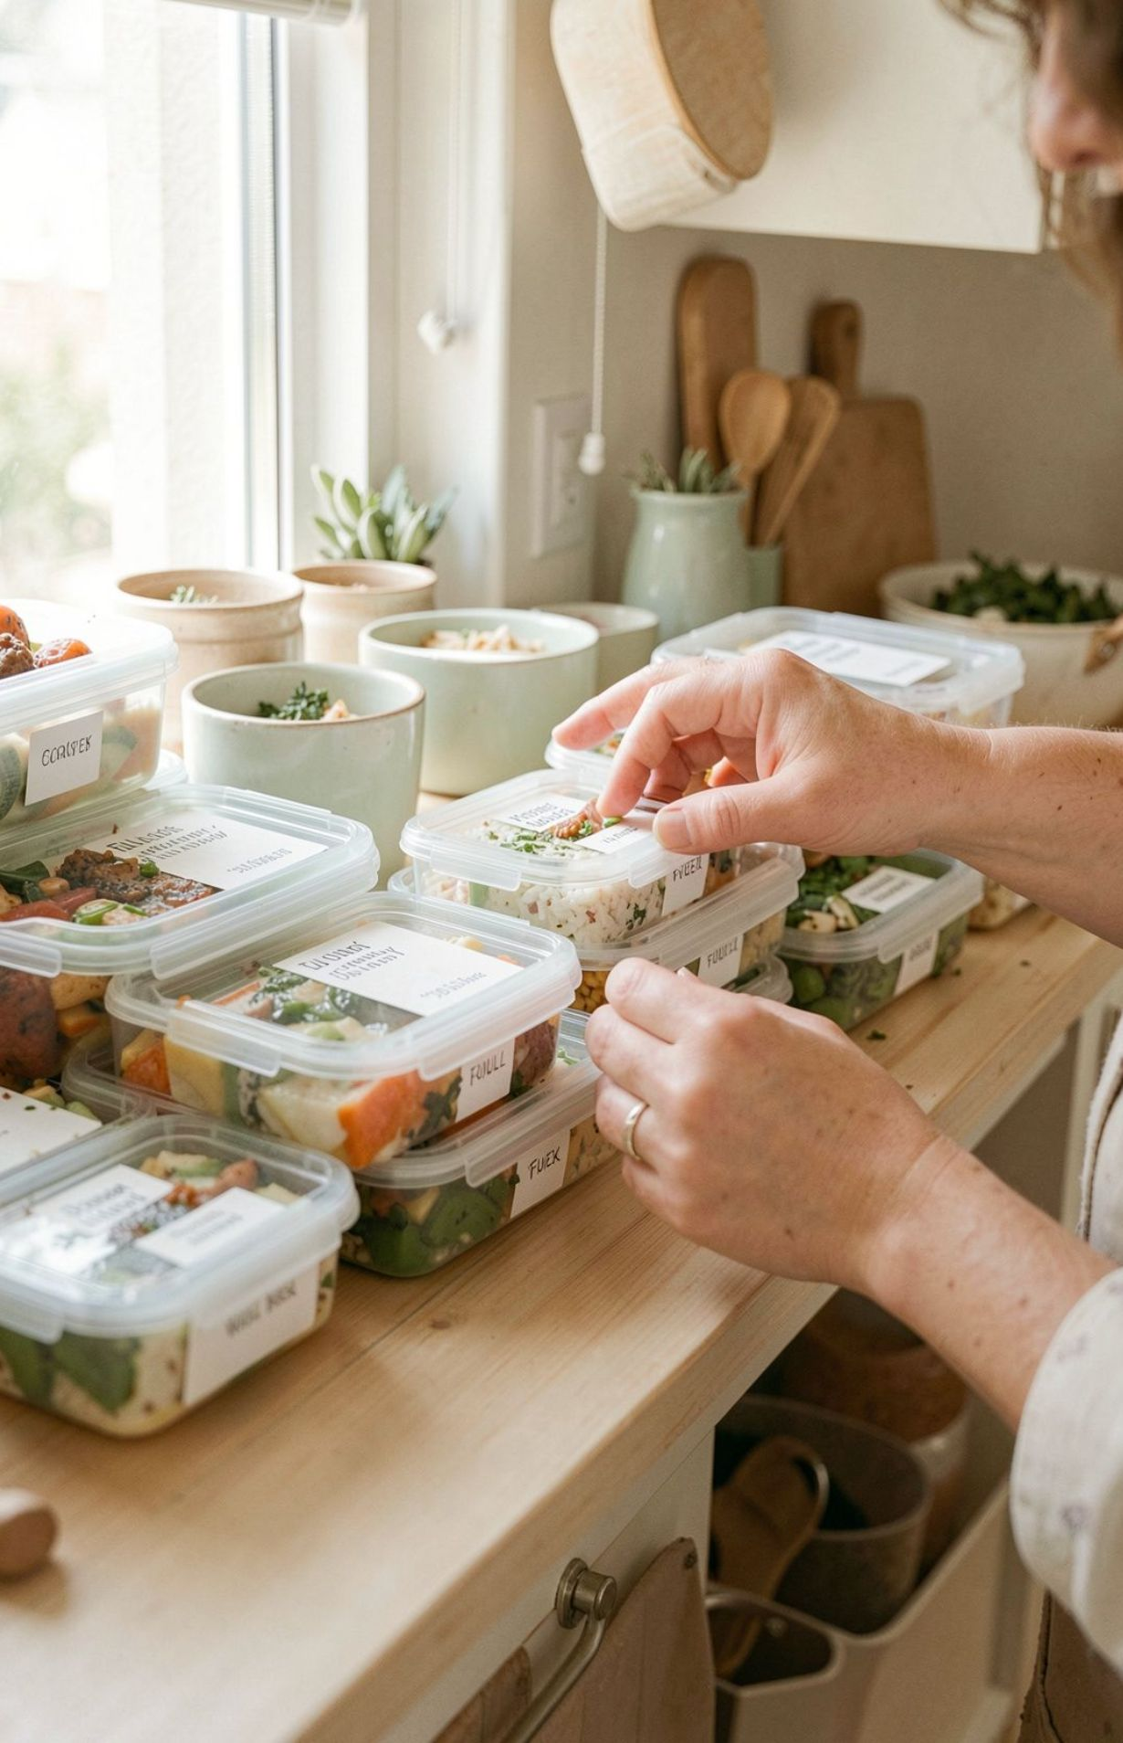
05 / MODULAR DATA
CO 3 Topics
Methods divide the project into clear responsibilities, while arrays hold the weekly structure.
Methods
Arrays
Parameter passing, return values, overloading, recursion, and enhanced for-each loops.
One-dimensional arrays store schedules and ingredients; two-dimensional arrays represent the weekly meal table.
Application
Separate meal planning from grocery generation, then traverse, search, count, and sum ingredient data.
Methods turn repeated work into reusable actions.

Slide 7




06 / OBJECT DESIGN
CO 4
Object-oriented design gives each part of the planner a clear responsibility and protects its data.
Meal
Ingredient
WeeklyPlan
Recipe details and required ingredients.
Name, quantity, and input validation.
Daily meal choices across seven days.
GroceryItem
GroceryGenerator
Consolidated shopping requirement.
Processes the plan into grocery output.
Application: private fields, accessors, mutators, constructors, inheritance, interfaces, and exception handling protect data and handle invalid quantities or input errors with try, catch, finally, throw, and throws.

Slide 8
07 / TEXT, SEARCH & FILES
CO 5
Text processing and file handling turn a working plan into a reusable record.
Text Processing
Search & Sort
File I/O
Use String operations, equals() versus ==, StringBuilder, StringBuffer, split(), join(), trimming, and searching. Key methods: equals() · trim().
Search meals and ingredients, format grocery reports, and sort items with custom Comparators, including Collections.sort().
Save or load weekly plans as text records and handle missing files or malformed data with buffered processing using BufferedReader / Writer.

Slide 9
08 / COLLECTIONS & STREAMS
CO 6
Collections and functional pipelines make grouping, filtering, and reporting easier to express.
Collect
Transform
Report
Use ArrayList, HashMap, HashSet, generics, and iterators to organize meals and ingredients.
Group duplicate ingredients, filter meals by category, and sort the working list with lambdas and streams.
Collect the results into a consolidated grocery report.
Only features planned for the project are presented. Advanced capabilities remain implementation choices, not completed results.

Slide 10
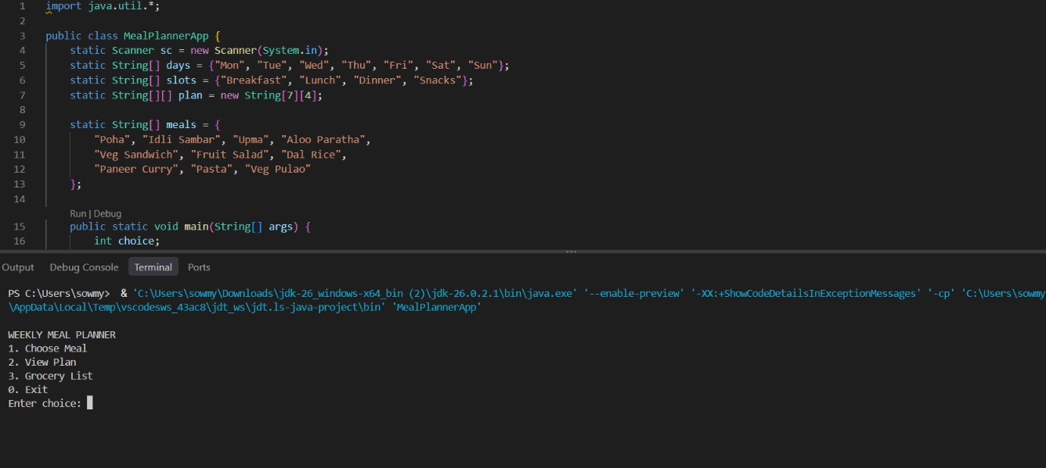
Output:

Slide 11
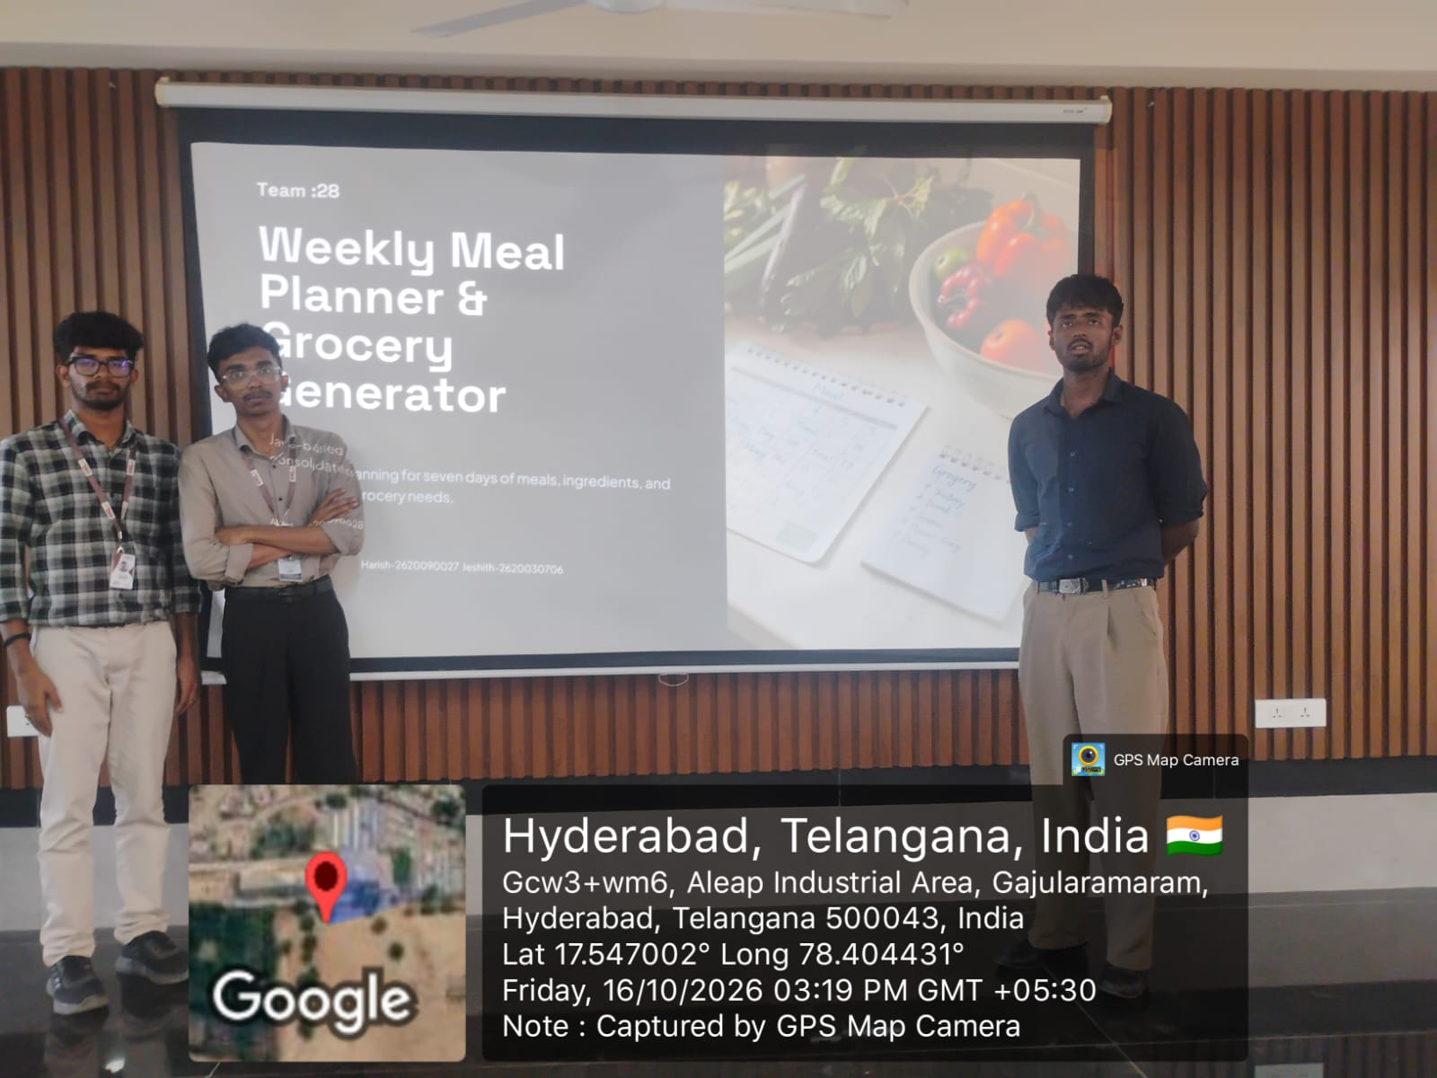
09 / PROJECT DETAILS
Geo-tag and repository
GEO-TAG
https://github.com/Jeshvithabushi/java-project-expo-code-/upload
Geotag picture-

Slide 12


