Slide 1
Presentation
On
Blood Donation App
Mst. Jesiara Khatun
Roll:1907011

Slide 2
Objectives:
An application exclusively for kuetians
To manage blood and make blood donation easier in emergency situation.
To provide a reliable platform to connect blood donors with patients.

Slide 3
Intoduction
This Blood donation app is for the students of KUET.
It will make easiar for finding the donors for the students while emergency.
Recipients will able to contact with donor easily as well as the donors through this app as we will get the all informations of the donors and recipients .

Slide 4
Modules
Donor Module
Recipient Module
There will be two modules.Donors need to have account for donating blood and Recipients need account for requesting for required blood group.

Slide 5
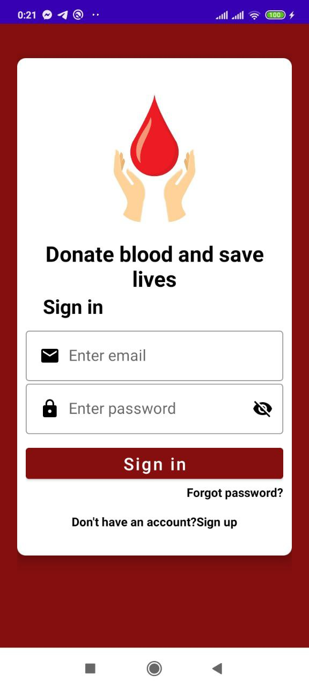
Login Page
If donor or recipient has already an account then they will sign in otherwise they will register.

Slide 6
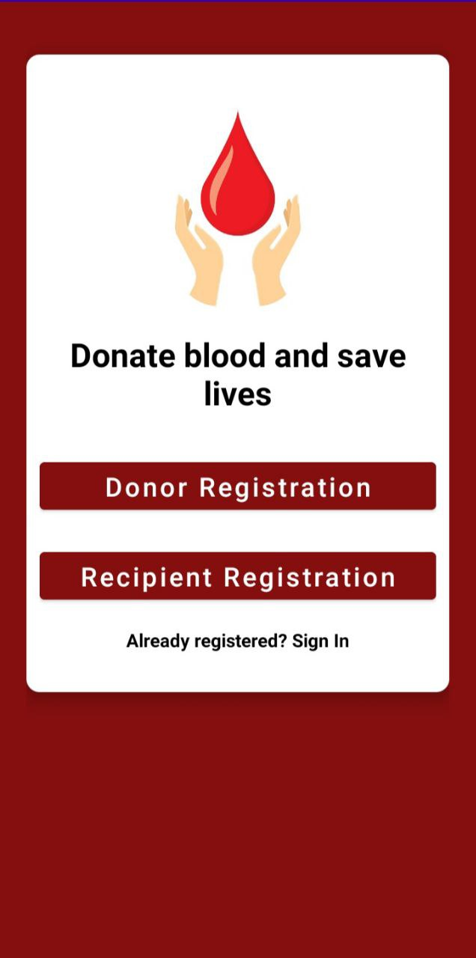
Donor or Recipient
Student will select to be donor or recipient or both with different email id.

Slide 7
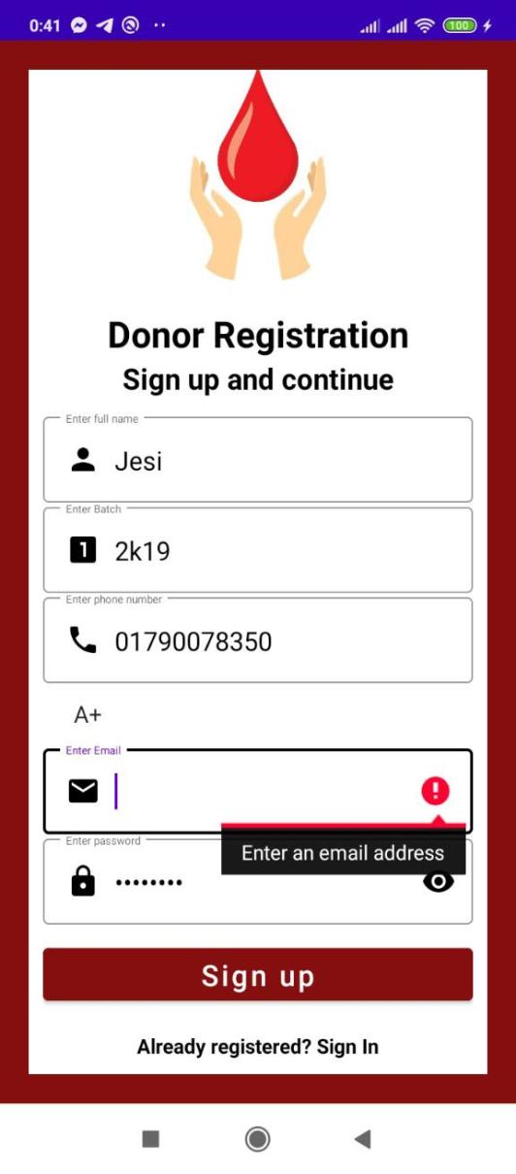
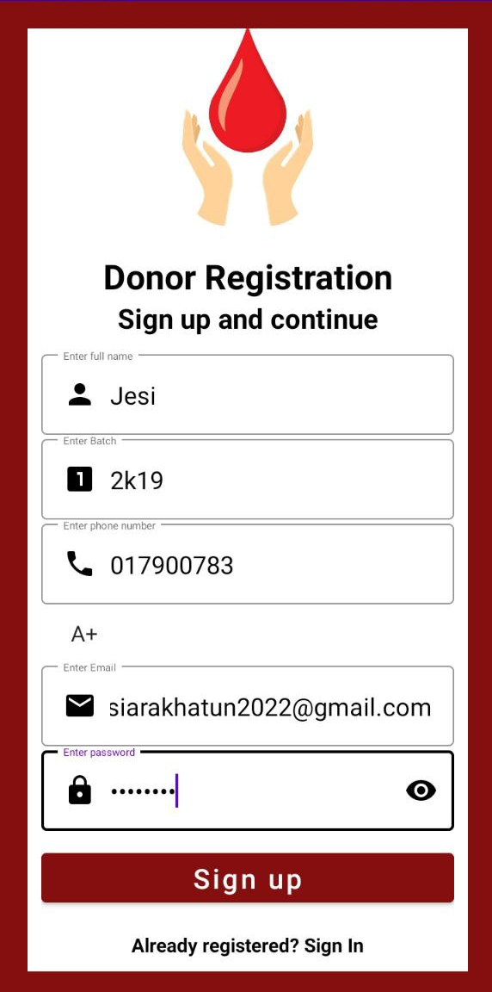
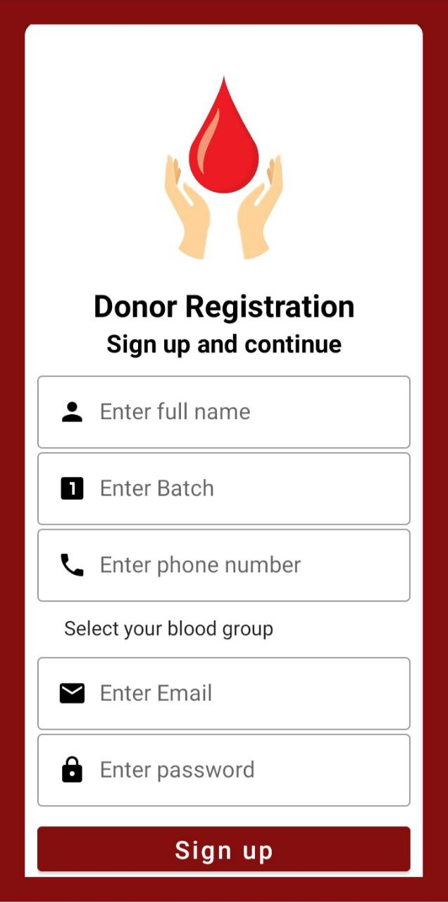
Donor Registration

Slide 8
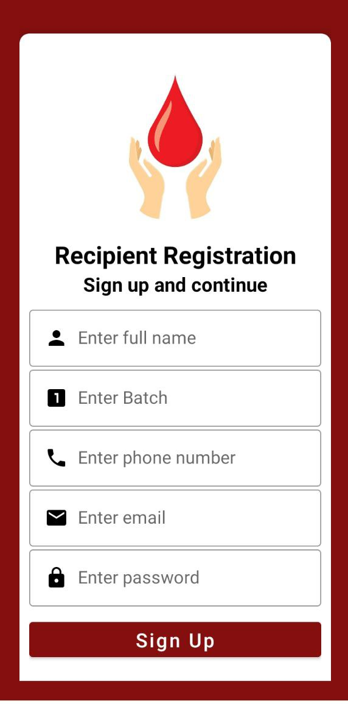
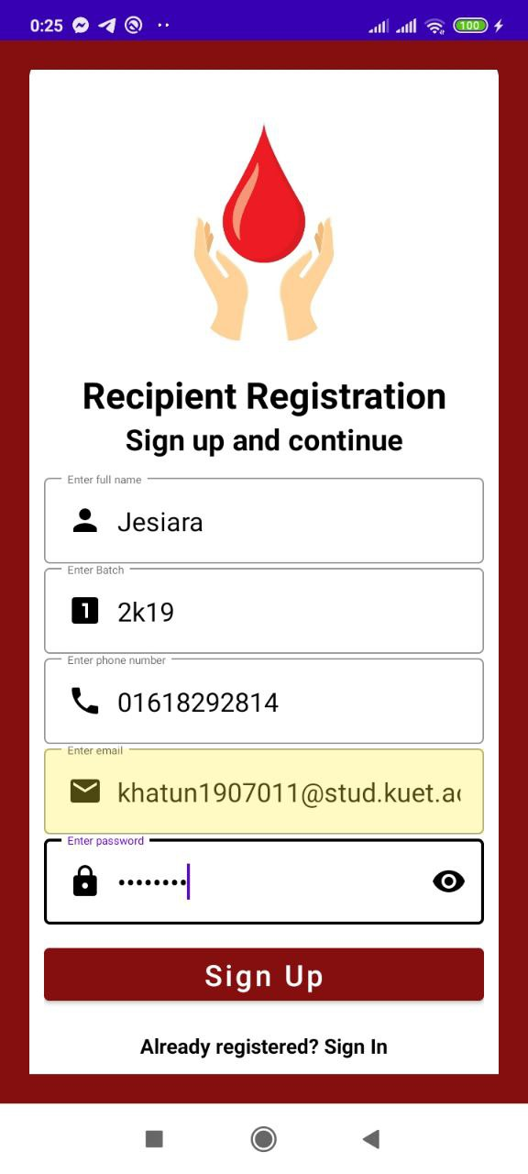
Recipient Registration

Slide 9
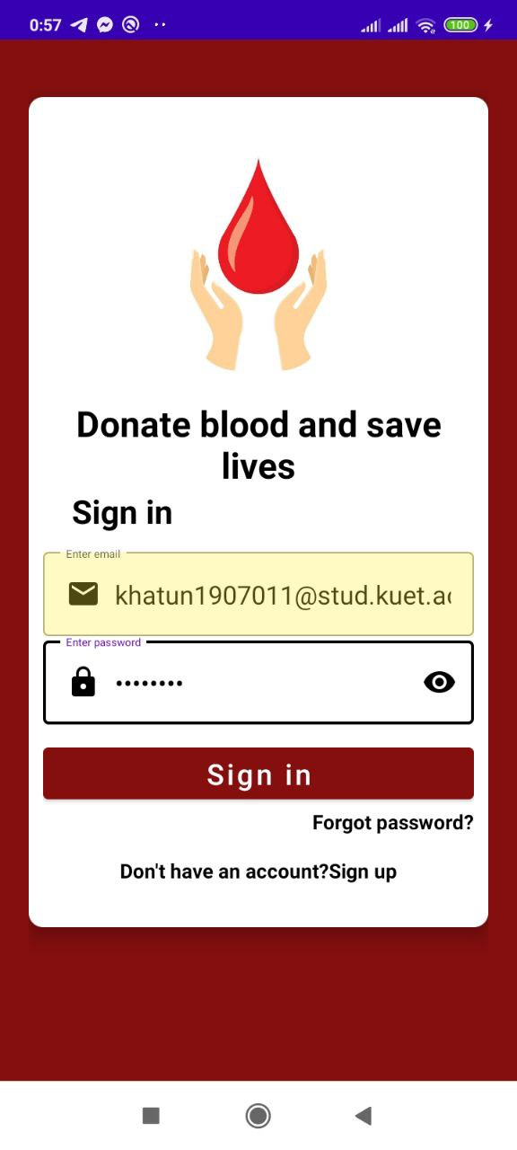
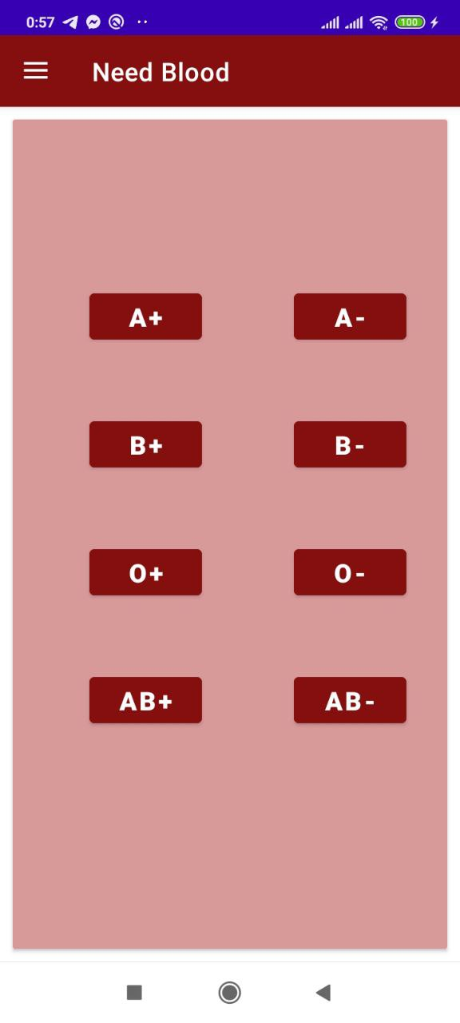
Login as Recipient
Cont

Slide 10
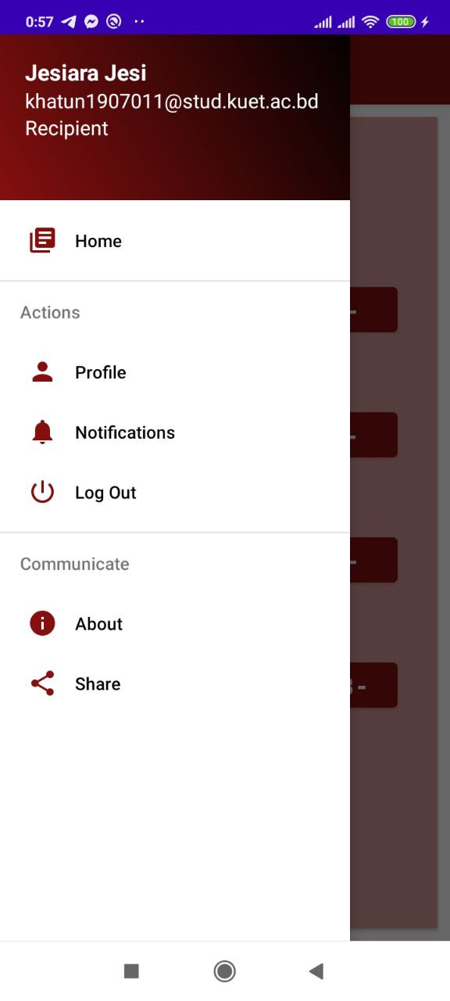
Main Page for Recipient
Click
Menu
Cont

Slide 11
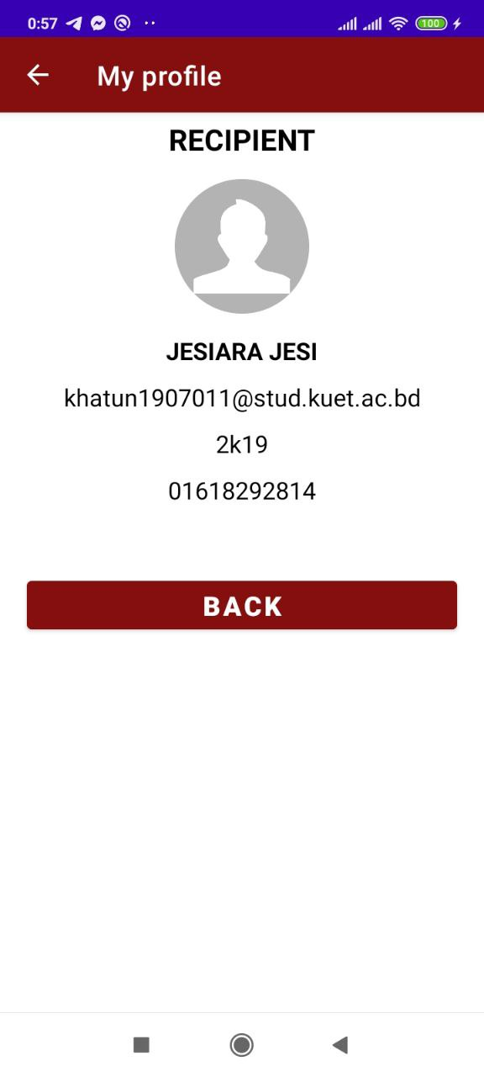
Navigation bar
Profile
Cont

Slide 12
Navigation bar
Log Out
Cont

Slide 13
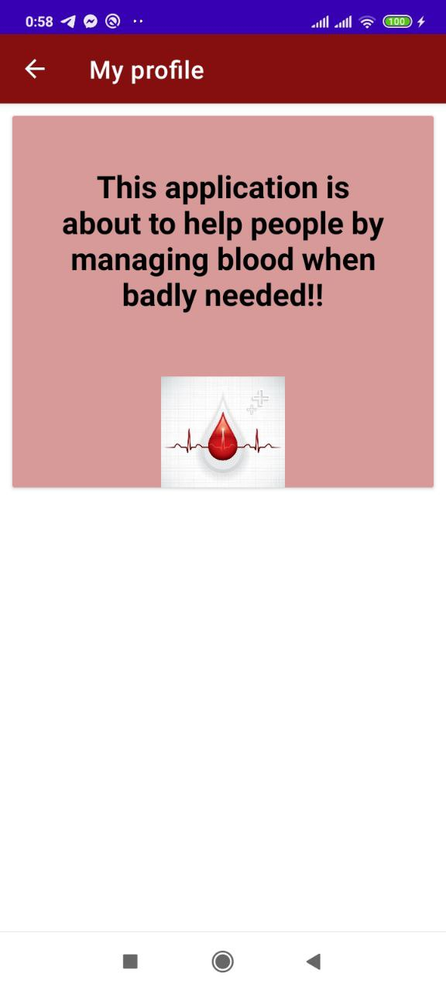
Navigation bar
About
Cont

Slide 14
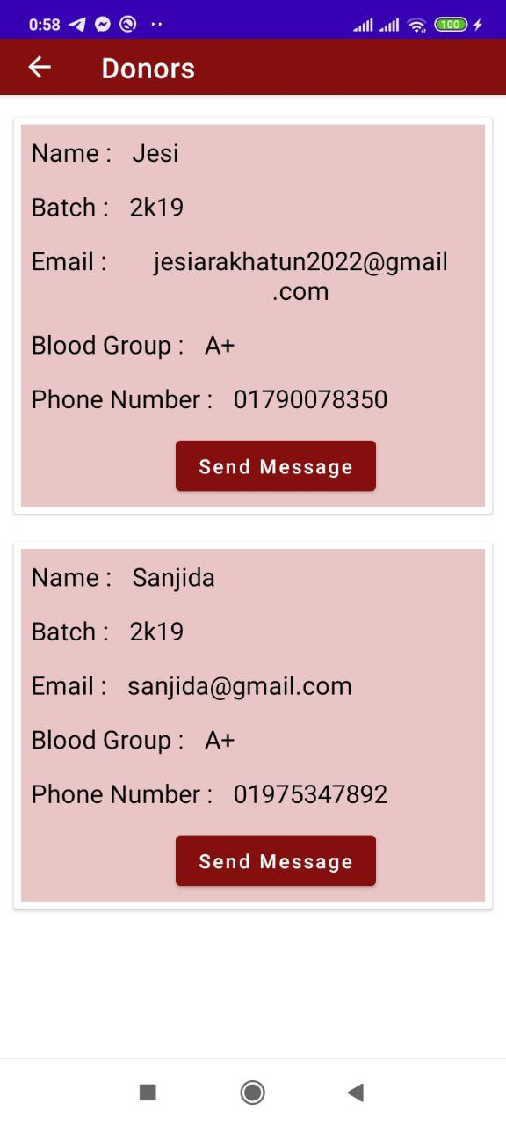
Main Page for Recipient
Recipient will click the blood group which is needed.
He will be able to see all the donors matching to the blood group.
Cont

Slide 15
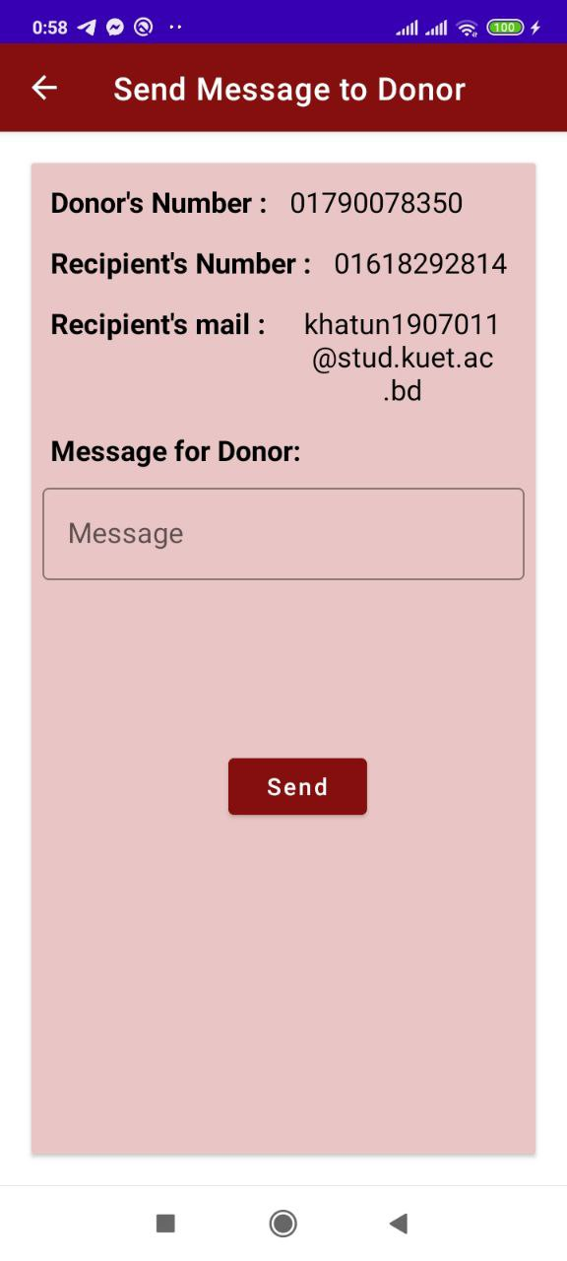
Send SMS to Donors
Recipient can send sms with all informations of patients .
Cont

Slide 16
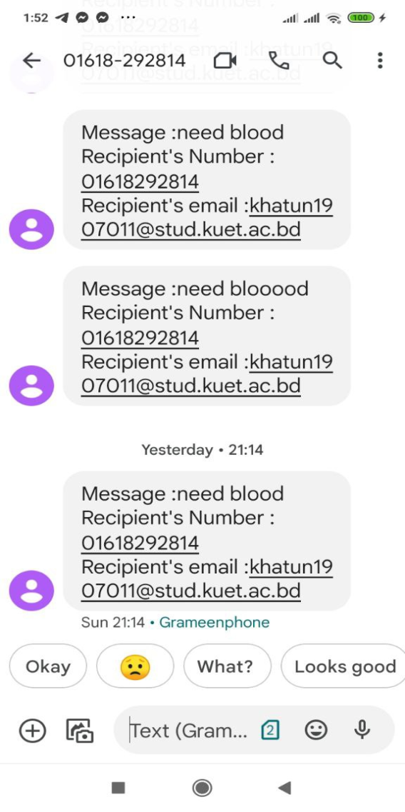
Send SMS to Donors
If we send message “need blood”,then donor will receive the sms with recipient’s mail and number .
Then he can contact or email the recipient.

Slide 17
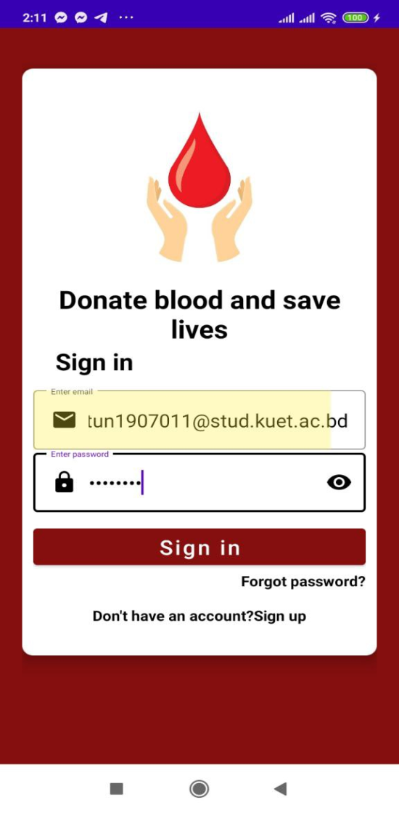
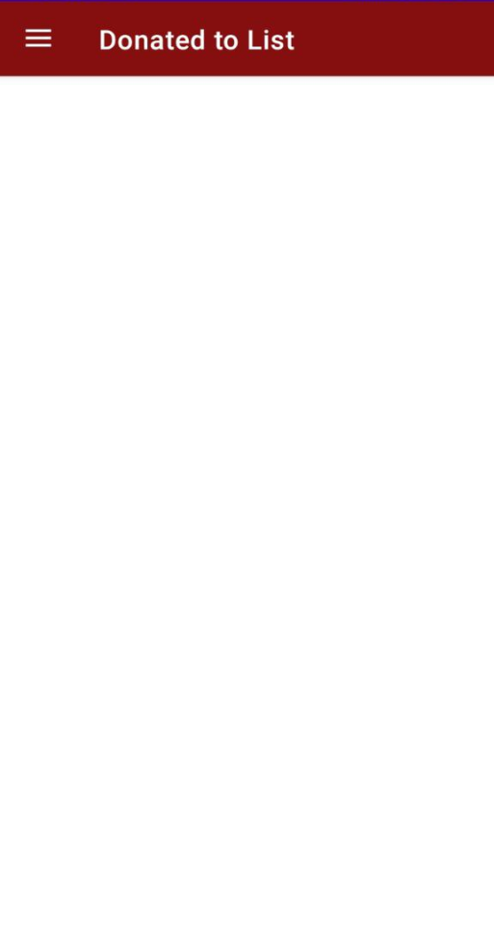
Login as Donor
Here,
All the ID of recipients will be added to whom the donor has donated blood.
Cont

Slide 18
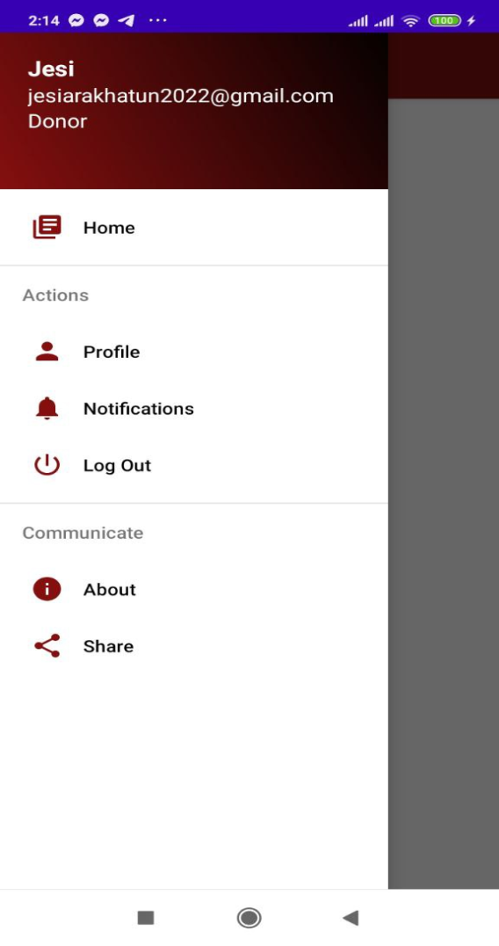
Navigation bar
Cont

Slide 19
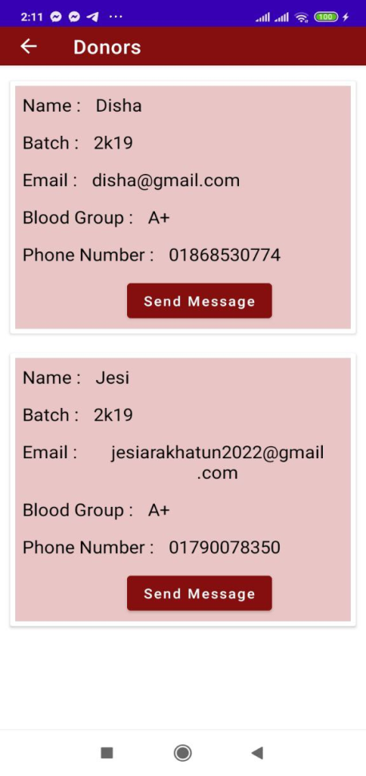
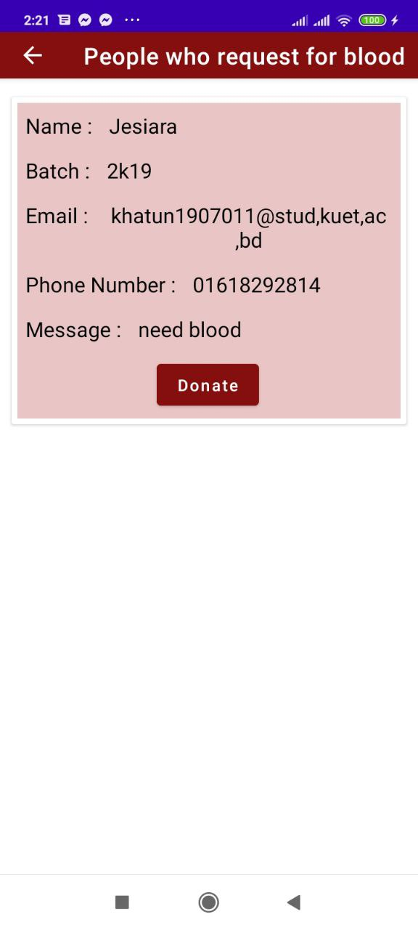
Navigation bar
Notifications
If recipients send message to donor then the id’s of recipients will be added to notifications

Slide 20
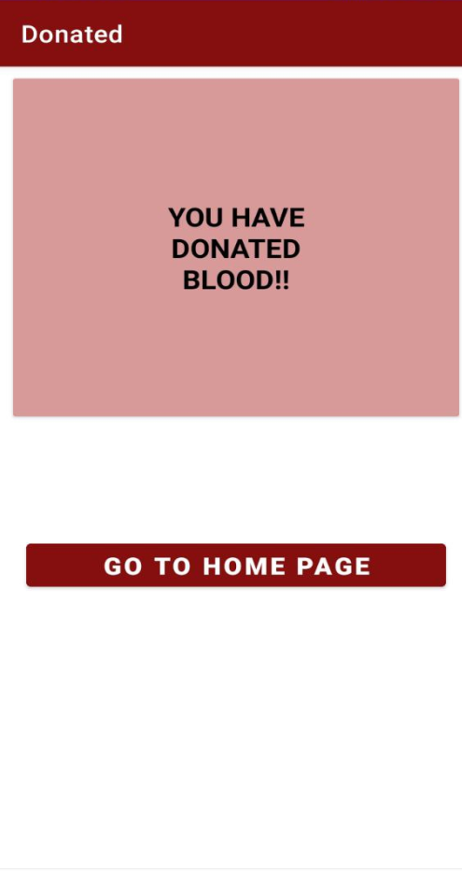
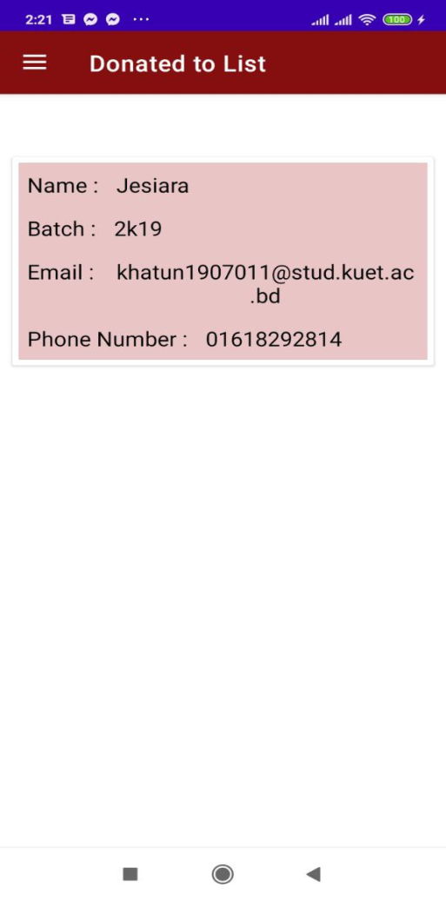

Notifications
If donor clicks on donate then the recipients will be added to the donated list.

Slide 21

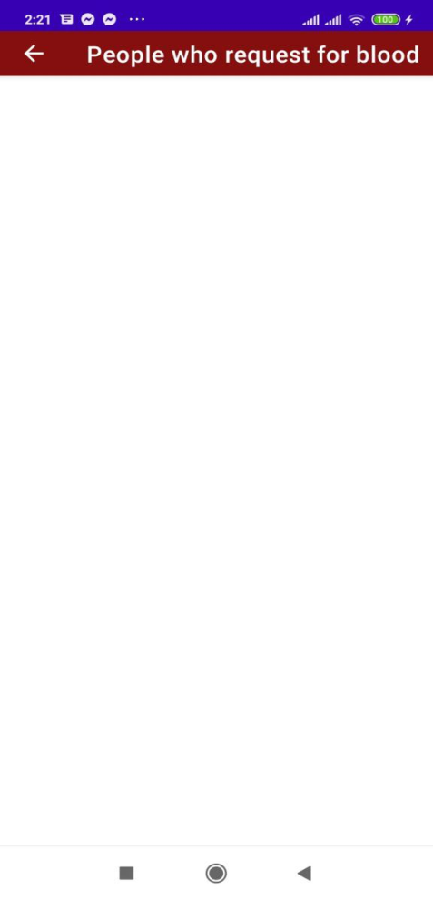
Notifications
If donor click on donate then the requested recipient will be removed from notifications.

Slide 22
Why users should use my app?
Students don’t have to bother too much for finding blood.
Donors and Recipients can easily contact to each other.
It will be very helpful in emergency .

Slide 23
References:
https://firebase.google.com/
https://www.youtube.com/
https://www.youtube.com/@anisul-islam

Slide 24
Thank you !!!

