Slide 1
Fingerprint Matching Using Morphological Operations
Presented to:
Dr. Sk. Md. Masudul Ahsan
Professor,
Department of Computer Science and Engineering
Dipannita Biswas
Lecturer,
Department of Computer Science and Engineering
Presented By:
Mst. Jesiara Khatun
Roll: 1907011
4th year
1st semester
Khulna University of Engineering & Technology, Khulna-9203
Bangladesh

Slide 2
Contents
Introduction
Problem Statement
Objective
Methodology
Result Analysis
Limitations
Conclusion
References

Slide 3
Introduction
Fingerprint Matching
A technique specifically refers to the process of comparing and analyzing fingerprint images through various image processing operations.
It decides if fingerprints are the same, ensuring accurate identification in security and biometric systems.
This matching is done by extracting the features of fingerprints and find out the percentage of matching

Slide 4
Problem Statement
Fingerprints can vary significantly in terms of orientation, pressure, distortion, and quality, making it challenging.
Fingerprints captured may contain noise, artifacts, or poor image quality due to sensor limitations or environmental factors.
Fingerprint features are highly orientation-dependent.

Slide 5
Objective
To develop a method that can:
Filter the fingerprint images.
Extract features of the images
Evaluate the result on matching the features.

Slide 6
Methodology
The steps of fingerprint matching using morphological operations are:
Image acquisition
Preprocessing
Feature extraction
Matching

Slide 7
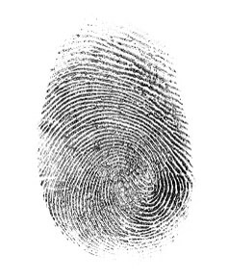
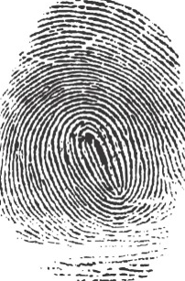
Methodology (Cont’d)
Image acquisition:
(a)
(b)
Figure 1: Input images shown in (a),(b).

Slide 8
Methodology (Cont’d)
Preprocessing:
The steps of preprocessing for two fingerprint images matching:
Image rotation
Filtering
Thresholding
Morphological operations

Slide 9
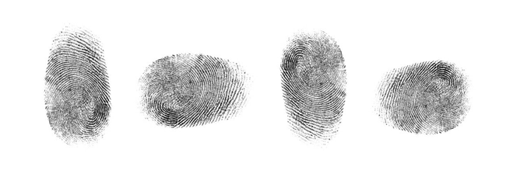
Methodology (Cont’d)
Image Rotation:
Rotate the 2nd input image 90 degree clockwise.
The highest percentage of matching will be in the same direction.
Figure 2: Image Rotation

Slide 10
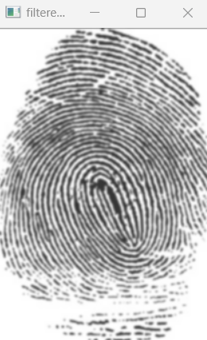
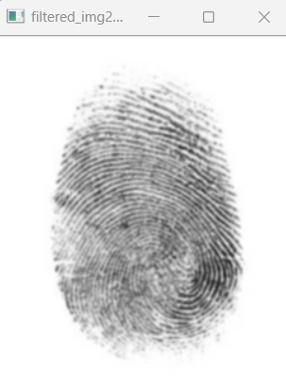

Methodology (Cont’d)
Filtering:
Gaussian filter works by smoothing the image and reducing noise.
(a)
(b)
Figure 3: Filtered image; input image1 (a),input image2(b).

Slide 11
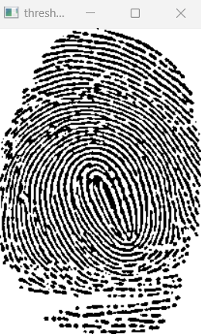
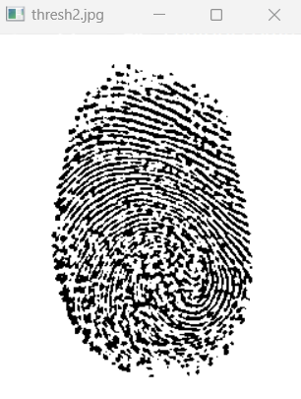
Methodology (Cont’d)
Thresholding:
Threshold value is determined based on the local mean of the pixel values in the neighborhood of each pixel.
(a)
(b)
Figure 4: Thresholded image; input image1 (a),input image2(b).

Slide 12
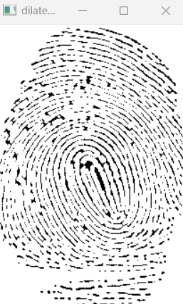
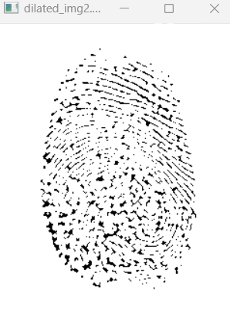
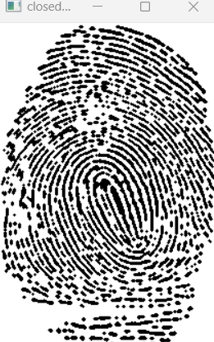
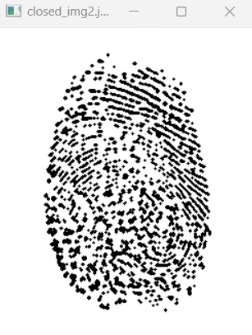

Methodology (Cont’d)
Morphological Operations: Closing
A combination of dilation followed by erosion using the same structuring element.
Used to close small holes and gaps of a binary image and to connect disjointed elements.
(a)
(b)
(c)
(d)
Figure 5: Dilated images(a),(b); closed images(c),(d).

Slide 13
Methodology (Cont’d)
Morphological Operations: Skeletonization
It transforms a binary image into a skeleton in one pixel wide.
The Zhang-Suen Thinning Algorithm is an iterative algorithm.
It progressively removes edge pixels while preserving their topological structure.
Let P(i,j) be a pixel in the binary image. The 8 neighbors of P(i,j) are labeled as follows:
P9 P2 P3
P8 P1 P4
P7 P6 P5

Slide 14
Methodology (Cont’d)
Morphological Operations: Skeletonization
In the first sub-iteration, the contour point p1 is deleted from the pattern, if it satisfies the following conditions:
(a) 2 ≤ B(p1) ≤ 6
(b) A(p1)=1
(c) p2 × p4 × p6 = 0
(d) p4 × p6 × p8 = 0
In the second sub-iteration, the contour point p1 is deleted from the pattern, if it satisfies the following conditions:
(a) 2 ≤ B(p1) ≤ 6
(b) A(p1)=1
(c’) p2 × p4 × p8 = 0
(d’) p2 × p6 × p8 = 0

Slide 15
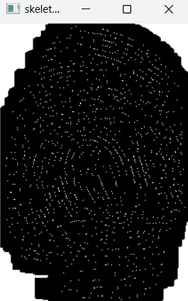
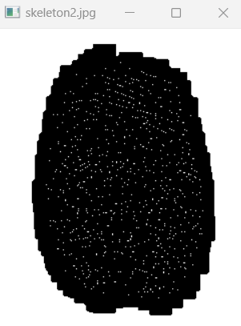
Methodology (Cont’d)
Morphological Operations: Skeletonization
A(p1) is the number of ”0-1” (white-black, in this order) pairs in the clock-wise traversal of the 8-neighborhood of p1, i.e. p2,p3,p4,...,p8, p9.
B(p1) is the number of non-zero 8-neighbors
(a)
(b)
Figure 6: Skeletonized images(a),(b).

Slide 16
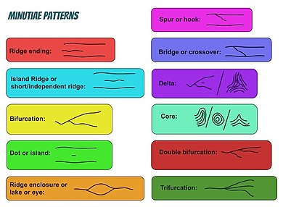
Methodology (Cont’d)
Feature Extraction
Minutiae features, are the specific, detailed characteristics of fingerprint ridges and their structures.
This method is using bifurcation and ridge ending.
Figure 7: Minutiae features.

Slide 17
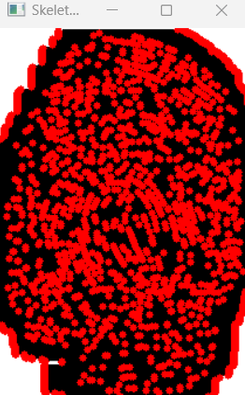
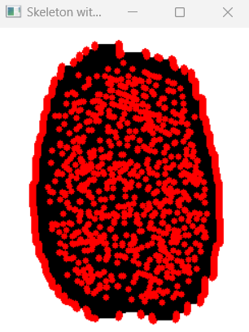
Methodology (Cont’d)
Feature Extraction:
Ridge Ending: If a pixel has exactly one neighbor that is a ridge pixel, it is classified as a ridge ending.
Bifurcation: If a pixel has more than two transitions from ridge to non-ridge pixels, it is classified as a bifurcation.
(b)
(a)
Figure 8: Minutiae Points),(b).

Slide 18
Methodology (Cont’d)
Matching:
Euclidean Distance: For each minutiae point in the first set (image 1), the function calculates the Euclidean distance to every minutiae point in the second set (image 2).
A Distance Threshold: A maximum distance threshold (e.g., 10 pixels) is defined. If the Euclidean distance between a pair of minutiae points is less than or equal to this threshold, the points are considered a match.
Matched Points and percentage: The function counts the number of matched minutiae points between the two images. Percentage of matching is calculated

Slide 19
Methodology (Cont’d)
Programming environments-
Programming language: Python
IDE: Vs code

Slide 20
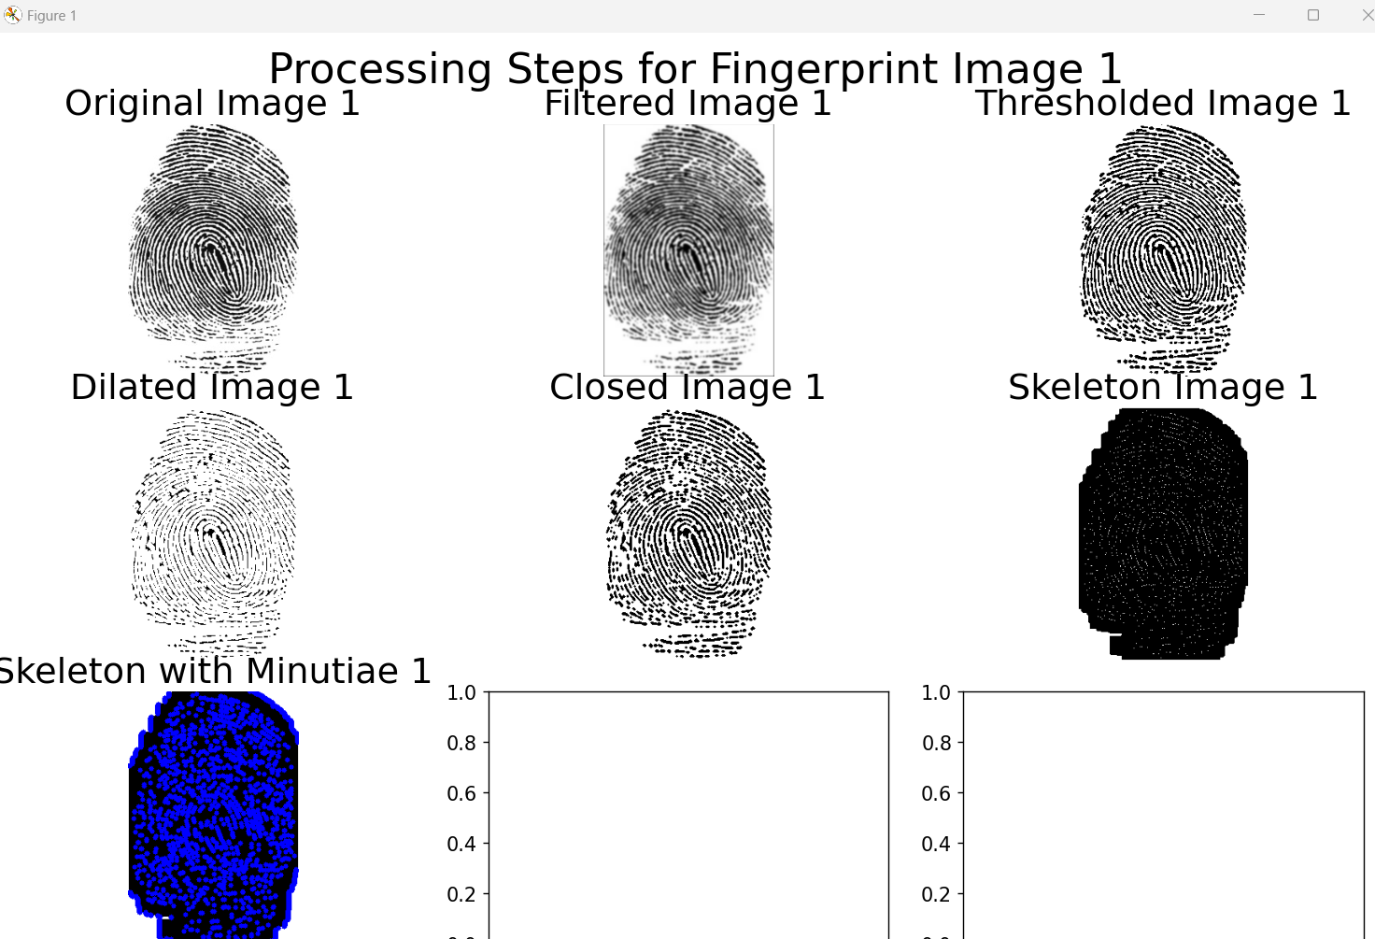
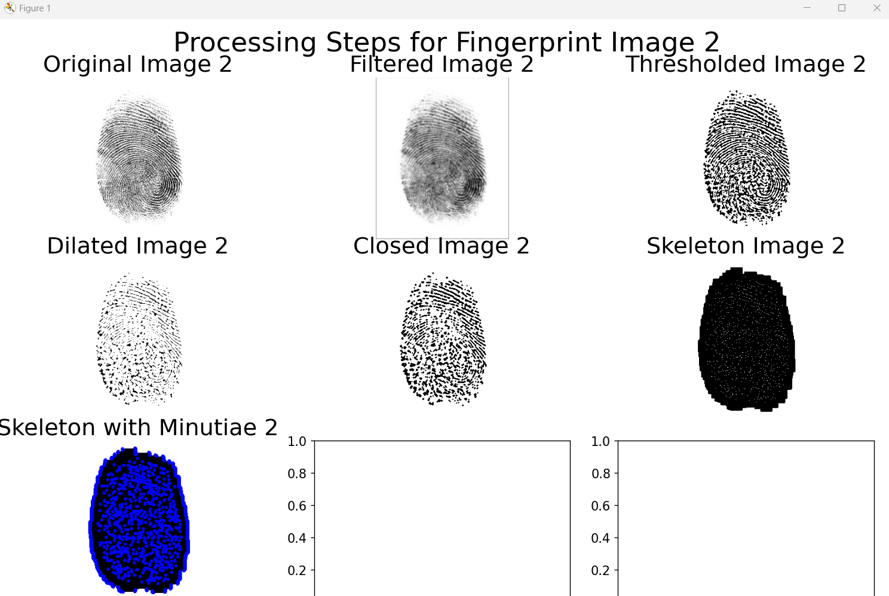
Result Analysis
(a)
(b)
Figure 9:Result of two images(a),(b).
The match percentage has been found out 77.75%

Slide 21
Limitations
This method is not fully rotation invariant.
It works only if the image is given 90 degree rotated.
Evaluation of result is very slow.
The system will not perform well with partial fingerprints, which are common in real-world scenarios.

Slide 22
Conclusions
This fingerprint matching efficiently utilizes image processing techniques to highlight the importance of preprocessing and minutiae extraction.
Its effectiveness is limited by factors such as image quality, processing time.
In future, will try to make scale and rotation invariant fully and optimize the fingerprint matching.

Slide 23
References
https://www.researchgate.net/publication/308822048_A_new_thinning_algorithm_for_binary_images
https://en.wikipedia.org/wiki/Closing_(morphology)
https://www.researchgate.net/publication/281449451_Performance_Improvement_for_Fingerprint_Recognition_System_using_Shape_and_Orientation_Descriptors
https://en.wikipedia.org/wiki/Gaussian_blur
https://www.mathworks.com/help/images/morphological-dilation-and-erosion.html

Slide 24
Thank You

