Slide 1
Smart Intelligence Compliance Monitoring
Presented by
S.SRIRAM

Slide 2
Team Name : SVS
Team Leader : S.Sriram

Slide 3
Smart Intelligence Compliance Monitoring
It leads to compare the two images which given by the user (just click and drag)
It reports the Image Matching Pattern with highlighting color that fulfill the Monitoring Process.
User friendly Access

Slide 4
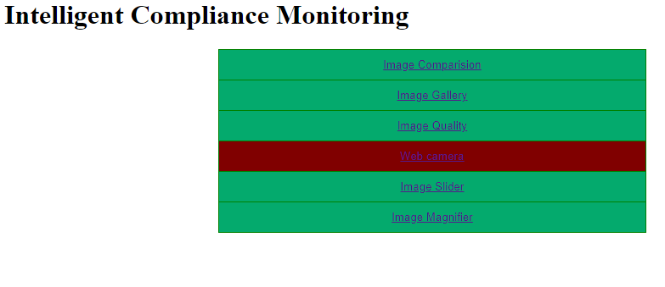
Front Screen portal

Slide 5


Image comparision
The user can drag the two select images for
Comparison.

Slide 6
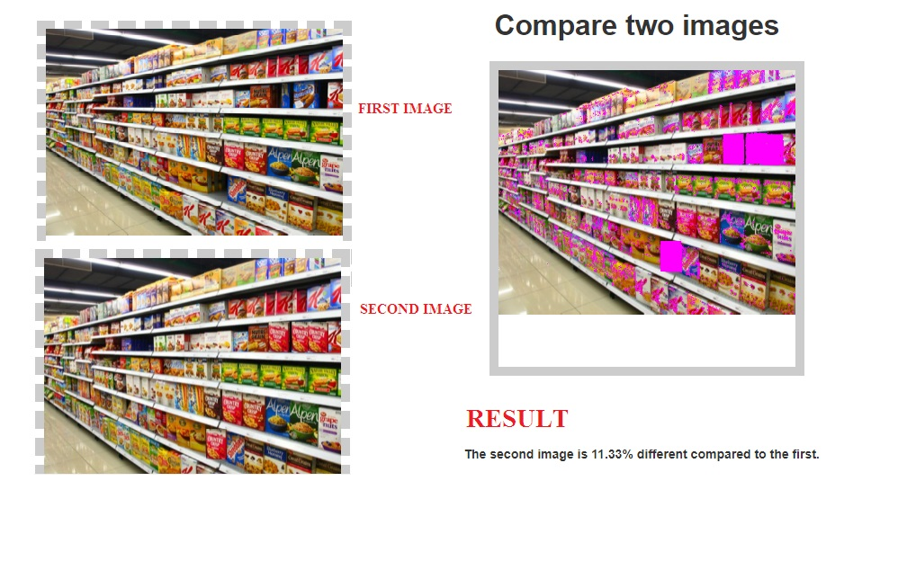

Slide 7
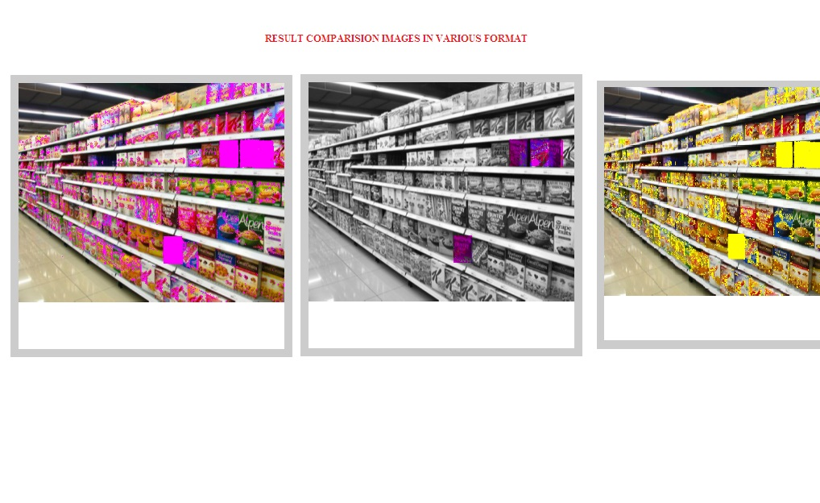
Result comparision

Slide 8

Image upload to Database

Slide 9
Choose Web camera option to take current image screen shot to compare the images for monitoring process

Slide 10
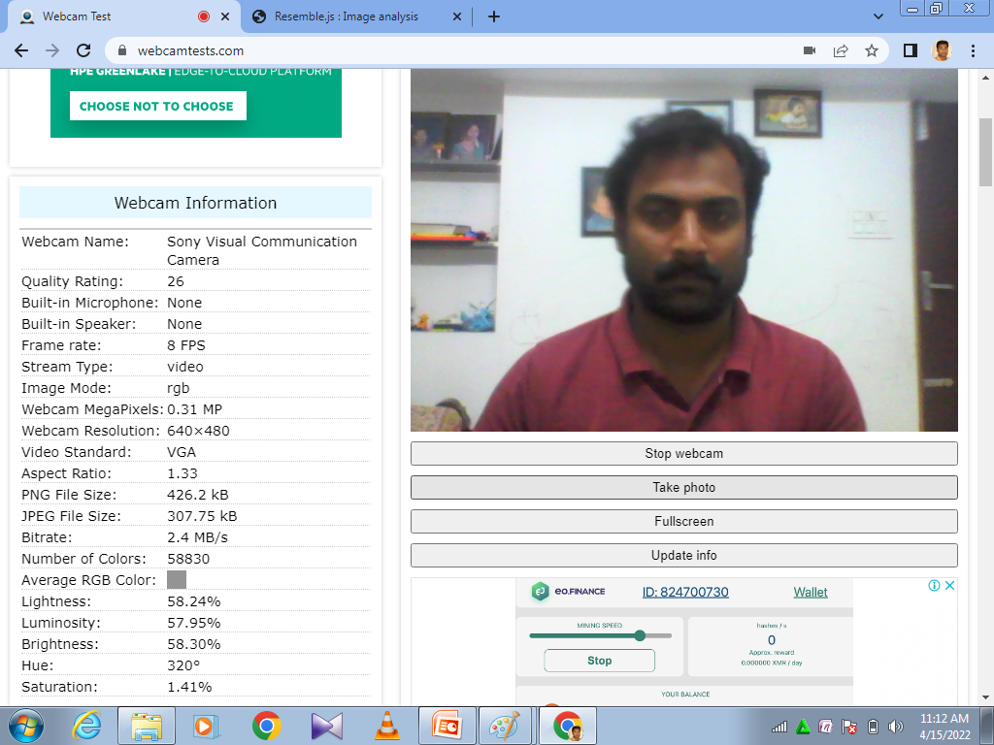
Sample web cam

Slide 11
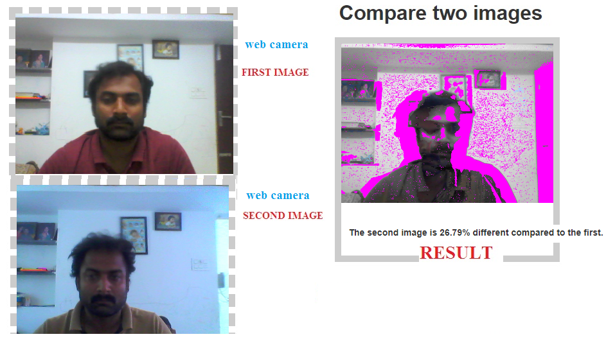
Web camera Test

Slide 12
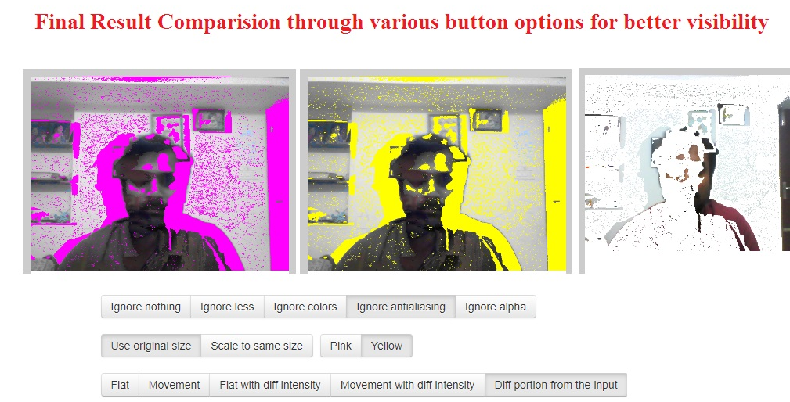
Web Camera Samples

Slide 13
Image Slider option
Easy to access
Fast comparision

Slide 14
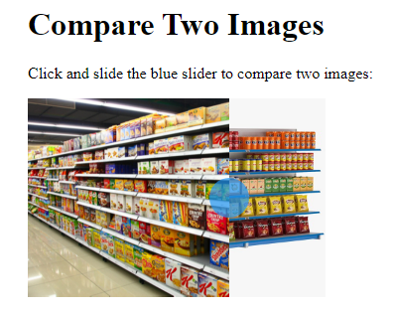
Image Slider

Slide 15
Image Magnifier option
Zoom in the Selected portion of image which done by the user.

Slide 16
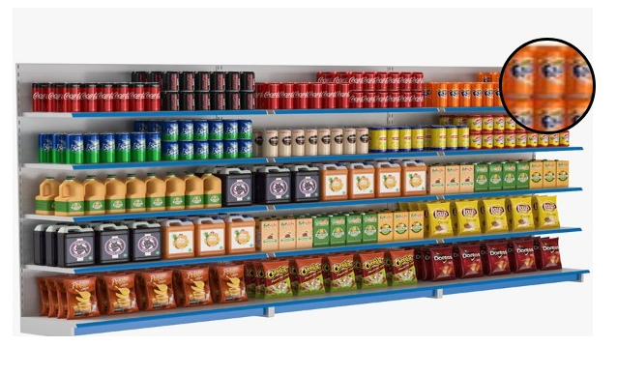
Image Magnifier

