Slide 1
Analysis of Cognitive Behavioural Patterns Among Students Using Data Analytics
Team Members:
Jeslyn Nivedhitha S (22x020)
Richa Infanta J (22x037)
Faculty Guidance:
Dr. S. Poomagal
1

Slide 2
AGENDA
01
02
03
05
06
08
2
04
Abstract
Related
Works
Proposed
System
Technology
Used
07
Timeline
References
Requirement
Analysis
System
Design

Slide 3
01
ABSTRACT
3

Slide 4
4
Objective:
  Analyse students' cognitive-behavioural patterns using data analytics.
  Identify thought distortions linked to Cognitive Behavioural Therapy (CBT).
  Assess anxiety and depression levels.
Problem Statement:
  Cognitive distortions like overgeneralization and catastrophizing contribute to student anxiety and depression.
  Limited data-driven insights hinder effective intervention.
  This study leverages analytics to quantify and categorize these patterns for better understanding.

Slide 5
02
Related
Works
5

Slide 6
Key Insights from Research Papers:
Paper 1: Cost-Effectiveness of Internet-supported Cognitive Behavioral Therapy for University Students with Anxiety Symptoms: A Markov Model Analysis (Published: May 5, 2022)
  Internet-based CBT (i-CBT) is more cost-effective than face-to-face CBT (f-CBT), improving Quality-Adjusted Life Years (QALYs) at lower costs.
Paper 2: CBT for Academic Burnout, Procrastination, Self-handicapping Behaviour and Test Anxiety : Random Control Trail (Published: 3 February, 2025)
  CBT significantly reduces procrastination, burnout, self-handicapping behavior, and test anxiety among adolescents, leading to better school performance.
Paper 3: AI-Enhanced Cognitive Behavioral Therapy: Deep Learning and Large Language Models for Extracting Cognitive Pathways from Social Media Texts (Published: April 17, 2024)
  AI-enhanced CBT using deep learning models and LLMs improves cognitive pathway analysis but may introduce inaccuracies (hallucinations).
6

Slide 7
7
Paper 4: A Transformer-CNN Hybrid Model for Cognitive Behavioral Therapy in Psychological Assessment and Intervention for Enhanced Diagnostic Accuracy and Treatment Efficiency (Published: 2023)
  Transformer-CNN hybrid model achieves 97% accuracy in psychological assessment, enhancing diagnostic precision and treatment recommendations.
  The research highlights how the model enhances contextual understanding by leveraging the hierarchical feature extraction of CNNs with the sequential processing power of Transformers. The study compares the Trans-CNN model with existing techniques such as CNN-GloVe, SBERT-CNN, and AiME-LSTM, demonstrating superior accuracy (above 86%) and improved performance across precision, recall, and F1-score metrics. The results indicate that Trans-CNN effectively captures intricate sentiment patterns, making it a robust solution for applications in cognitive behavioral therapy (CBT) and psychological diagnostics.

Slide 8
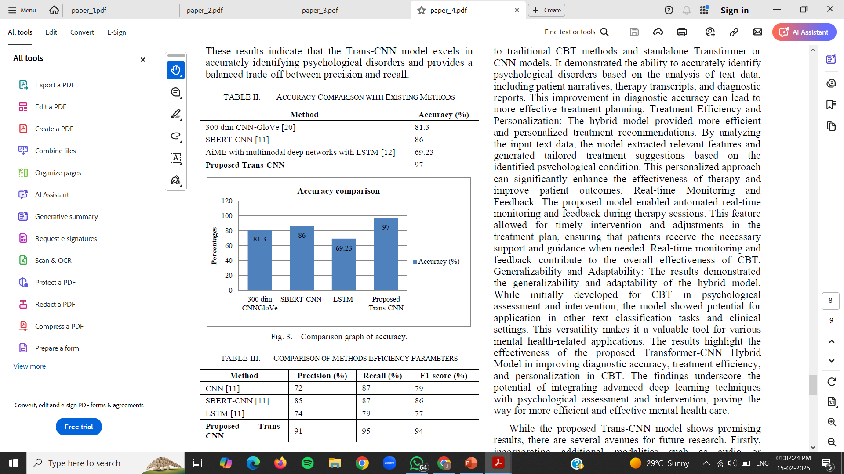
8

Slide 9
03
PROPOSED
SYSTEM
9

Slide 10
10
Our system integrates NLP and K-Means clustering to analyze cognitive patterns in students, standing out from previous research by:
Psychological Analysis – Detects anxiety and thought distortions from student responses.
Unsupervised Clustering – Groups students based on cognitive risk levels for early intervention.
Multi-Source Data Processing – Analyzes both open-ended responses and structured data for better insights.
Actionable Visualizations – Generates heatmaps and cluster profiles for easy interpretation.

Slide 11
04
TECHNOLOGY
USED
11

Slide 12
12
Data Collection:
Google Forms
Development Environment:
Spyder (IDE)
Data Preprocessing & Analysis:
Python
Pandas
NumPy
Scikit-learn
Hugging Face Transformers
Matplotlib
Seaborn
Machine Learning & NLP:
BERT
K-Means

Slide 13
05
REQUIREMENT
ANALYSIS
13

Slide 14
  1. Algorithmic Requirements
Natural Language Processing (NLP) – BERT
Clustering Algorithm - K-Means
Regression Analysis
Preprocessing Techniques
2. Data Sources & Collection
The primary source of data comes from Google Forms
Demographic Information: Age, gender, academic year.
Cognitive Behavior Questions: Multiple-choice and Likert scale responses to measure cognitive distortions.
Open-Ended Questions: To allow detailed student insights for NLP processing
Data Format: Google Forms responses are stored in CSV format, which is exported for analysis.
3. Data Storage & Processing
Google Sheets/Drive for initial form response collection.
Requirements for Efficient Storage:
      Data Normalization
      Indexing & Retrieval
      Security Measures
4. Software Dependencies
Python (for analysis & modelling)
Pandas & NumPy (for data handling)
NLTK / Transformers (for NLP-based cognitive pattern analysis)
Scikit-learn (for K-Means and Regression modelling)
Matplotlib / Seaborn (for visualizing results)
14

Slide 15
06
SYSTEM DESIGN
15

Slide 16
  .
16
Algorithm Performance:
BERT (Bidirectional Encoder Representations from Transformers):
  A deep learning-based Natural Language Processing (NLP) model that understands the context of words in a sentence.
  Uses bidirectional attention to capture meaning from both previous and next words in a text.
  Analyzes student responses to extract key cognitive themes and emotional tones.
  Identifies patterns in thought processes, enabling early detection of cognitive distortions and psychological stress.
K-Means Clustering:
  A machine learning algorithm that groups data points into clusters based on their similarity.
  Helps in identifying patterns by assigning each data point to the closest cluster center.
  Groups students into clusters based on cognitive response patterns, distinguishing different levels of cognitive distortions.
  Helps in personalizing interventions, ensuring targeted recommendations based on students' psychological profiles.

Slide 17
Flow graph
Data Collection
Data Preprocessing
Feature Extraction & Clustering
Statistical Analysis
Visualization & Interpretation
Final Report &
Recommendations
17

Slide 18
07
TIMELINE
18

Slide 19
Dec-Apr
19
DECEMBER | JANUARY | FEBRUARY | MARCH | APRIL
Project Domain and Requirements Initiated | Analysis on various Research papers related | Implementation on data gathering and preprocessing started | Testing and Deployment | Documentation

Slide 20
08
REFERENCES
20

Slide 21
  .
21
Joyce H. S. You , Scotty W. C. Luk, Dilys Y. W. Chow, Xinchan Jiang, Arthur D. P. Mak, Winnie W. S. Mark
Efficacy and Cost-Effectiveness Analysis of Internet-Based Cognitive Behavioral Therapy for Obsessive-Compulsive Disorder: Randomized Controlled Trial (Published: May 5, 2022 )
Khizra Khurshid1, Rabia Mushtaq2, Umara Rauf3, Nida Anwar4, Qasir Abbas1*, Sumayah Aljhani5, Zoobia Ramzan4 and Mafia Shahzadi6CBT’s Impact on Procrastination, Burnout, and Anxiety in Adolescents (Published: 3 February, 2025)
Meng Jiang, Yi Jing Yu, Qing Zhao, Jianqiang Li, Changwei Song, Hongzhi Qi, Wei Zhai, Dan Luo, Xiaoqin Wang, Guanghui Fu, Bing Xiang Yang*AI-Enhanced Cognitive Behavioral Therapy: Deep Learning and Large Language Models for Extracting Cognitive Pathways from Social Media Texts (Published: April 17, 2024 )
Veera Ankalu Vuyyuru, G Vamsi Krishna, S. Suma Christal Mary, S. Kayalvili, Abraheem Mohammed Sulayman Alsubayhay, Title: A Transformer-CNN Hybrid Model for Cognitive Behavioral Therapy in Psychological Assessment and Intervention for Enhanced Diagnostic Accuracy and Treatment Efficiency (Published: 2023)
https://bmcpsychology.biomedcentral.com/articles/10.1186/s40359-025-02371-2
https://positivepsychology.com/cbt-cognitive-behavioral-therapy-techniques-worksheets/
https://www.perplexity.ai/search/best-algorithm-for-extraction-ml-sz_LfFLsRmaWkumwEyja6A

Slide 22
THANK YOU
22
Any Questions?

