Slide 1
Analysis Of Cognitive Behavioural Patterns Among Students
1
Team Members:
Jeslyn Nivedhitha S (22x020)
Richa Infanta J (22x037)
Faculty Guidance:
Dr. S. Poomagal

Slide 2
AGENDA
Overview
Data Cleaning and Processing
Identifying Mental Health Profiles with k-means
NLP Models: BERT and RNN
Comparative Study
Conclusion

Slide 3
Overview
Goal
Use machine learning to identify patterns in student mental health data for early intervention.
Key Objectives
Data: Collect & preprocess student survey data.
Clustering: Segment students using K-Means for distinct mental health profiles.
Modeling: Develop BERT & RNN models for risk assessment.
Comparison: Evaluate models to inform support programs.
Methodology
Data: Acquire survey data, preprocess for consistency.
K-Means: Cluster students based on mental health traits.
Models: Implement BERT & RNN for text-based sentiment analysis.
Evaluate: Compare model performance using metrics.

Slide 4
Data Cleaning And Processing
Steps in Processing:
Loading the Dataset
  Imported the CSV file using pandas.
  Handled potential file errors with exception handling.
  Stripped column names of extra whitespace.
Renaming Columns
  Renamed lengthy or ambiguous column names for easier handling.
  Example: "Timestamp" → "timestamp", "I feel , things in my life are either totally good or totally bad." → "thinking_good_or_bad“
  .
Handling Missing Values
  Categorical Columns: Filled with mode or "Missing".
  Numerical Columns: Filled with median values.

Slide 5
Data Cleaning And Processing
Steps in Processing:
Mapping Ordinal and Agreement Responses
  Standardized responses to numerical values:
    Agreement Scale: Strongly Disagree (0) to Strongly Agree (4).
    Frequency Scale: Never (0) to Always (4).
    Yes/No: No (0), Maybe (1), Yes (2).
Text Cleaning
  Converted text columns (e.g., College, Course) to lowercase.
  Removed punctuation and stripped extra spaces
Extracting Year of Study
  Extracted numeric values from the "year_of_study" column (e.g., "2nd Year" → 2).
Encoding Gender and CBT Awareness
  Gender: Female (0), Male (1), Other (2).
  CBT Awareness: Encoded Yes/No responses numerically.

Slide 6
Identifying Mental Health Profiles With K-means
Objective: To uncover distinct groups of students based on shared mental health characteristics and cognitive distortions.
Method: K-Means clustering is an unsupervised learning algorithm ideal for identifying patterns in unlabeled data.
Features Considered: Cognitive Distortions (Black & White Thinking, Overgeneralization, Personalization, Catastrophizing, Should Statements), Anxiety, and Depression scores.
Feature Selection & Scaling:
  Selected relevant features for clustering: CBT distortions, Anxiety, and Depression scores.
  Scaled the data using StandardScaler to normalize the feature ranges.

Slide 7
Identifying Mental Health Profiles With K-means
Determining the Optimal Number of Clusters (K):
  Used the Silhouette Score method to evaluate clustering performance for different values of K (2 to 10).
  Silhouette Score Plot: The plot clearly indicated that K=2 had the highest silhouette score, indicating the most distinct clusters.
K-Means Application:
  Applied K-Means clustering with the optimal n_clusters=2.
  Assigned cluster labels to each student in the dataset.
Saving Clustered Data:
  Added the cluster labels as a new column (Cluster) to the main DataFrame.
  Saved the final clustered dataset to clustered_student_mental_health_data.csv.

Slide 8
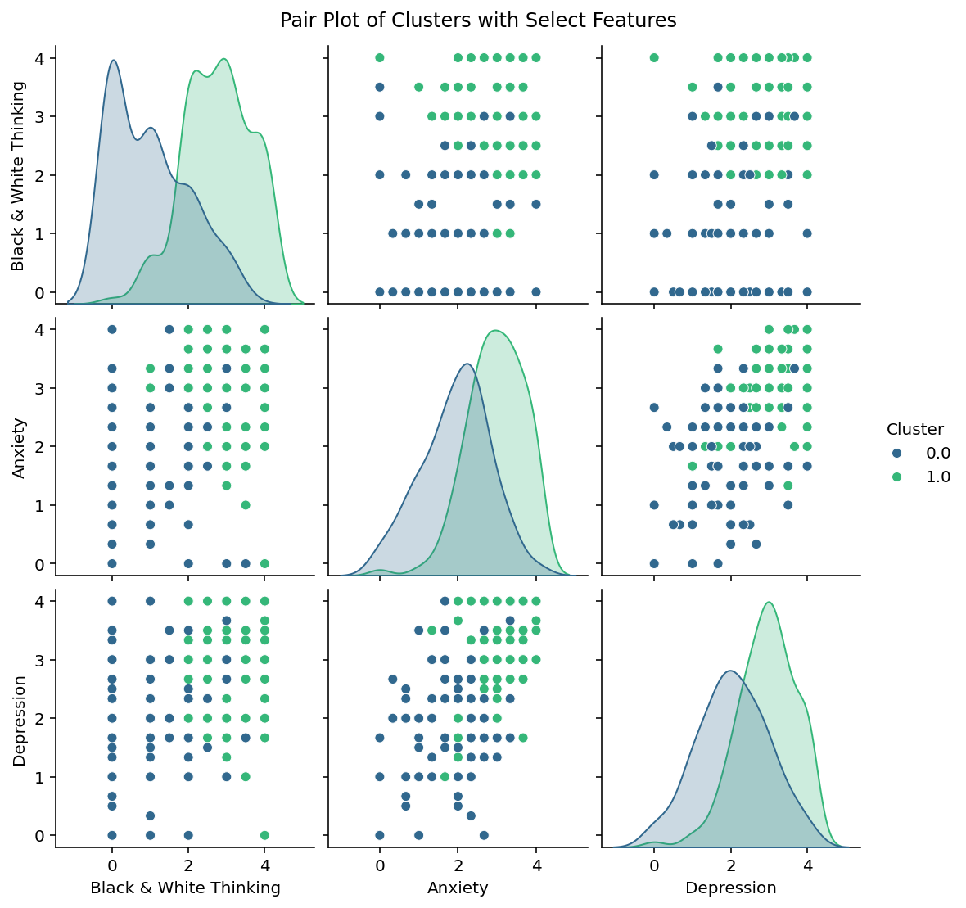
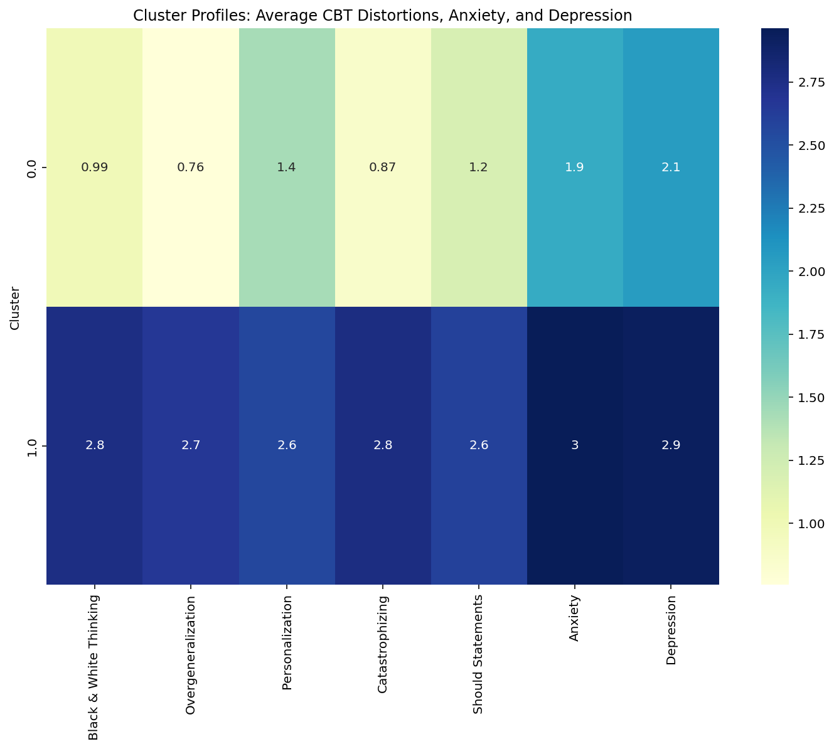

Slide 9
NLP Models: BERT And RNN In Action
Enhanced Model Training: Training BERT and RNN models on clustered data can improve their performance.
Targeted Insights: Clustered data allows models to learn patterns specific to different mental health profiles, leading to more accurate and relevant insights.
Performance Improvements: By leveraging the cluster labels as additional features, the models can better understand the relationships between responses and outcomes.
in Q4

Slide 10
  Model Implementation:
  BERT:
    Fine-tuned a pre-trained BERT model on the dataset.
    Added a classification layer on top of BERT for sentiment analysis.
    Evaluated model performance using metrics such as accuracy, precision, recall, and F1-score.
  RNN:
    Built an RNN model with embedding, LSTM, and dense layers.
    Trained the model on the dataset.
    Evaluated model performance using metrics such as accuracy, precision, recall, and F1-score.

Slide 11
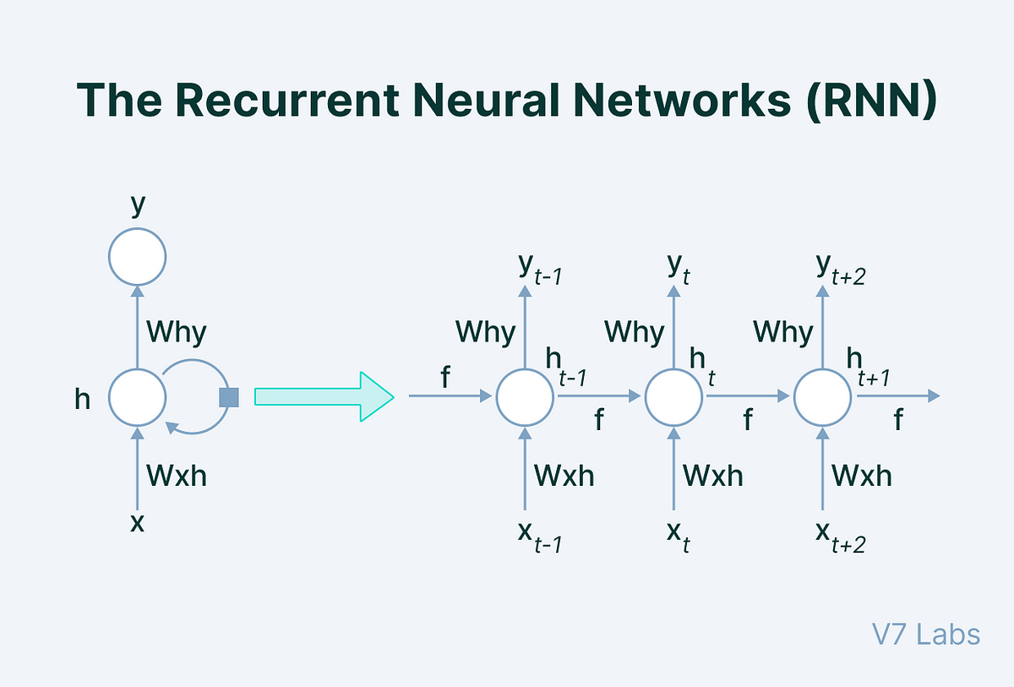
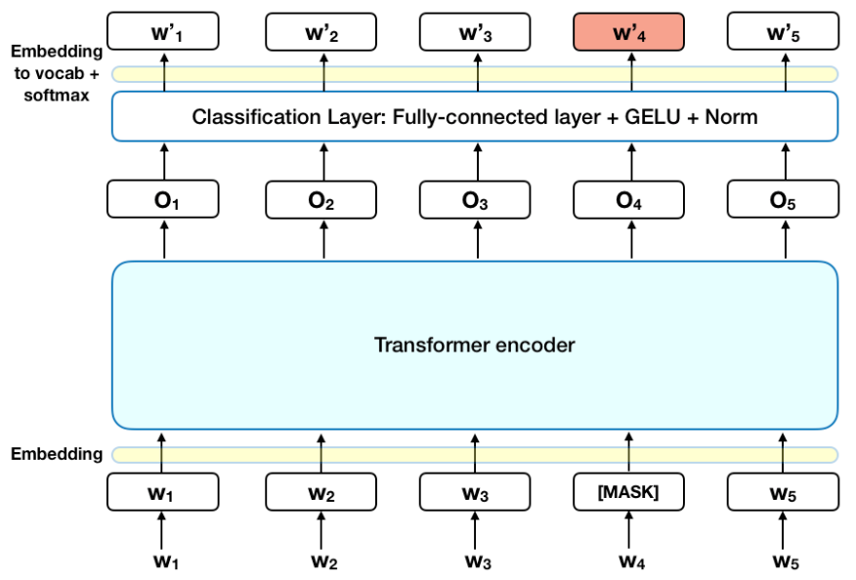

Slide 12
Comparative Study
In this study, we compare the performance of Recurrent Neural Networks (RNN) and Bidirectional Encoder Representations from Transformers (BERT) on [your dataset/task]. Both models are widely used for sequential data processing but differ in their approach to handling contextual information.
🔹 RNN processes input sequentially, making it suitable for time-dependent patterns but prone to vanishing gradient issues.
🔹 BERT, a transformer-based model, captures deep bidirectional context, leading to improved language understanding.
To evaluate their effectiveness, we trained both models on 80% of the dataset and tested them on 20% unseen data. The comparison is based on:

Slide 13
Comparative Study - BERT
  Epoch-1
  Training Loss:0.6920
  Epoch-10
  Training Loss: 0.2979
 | Metric | Score
1 | Loss | 0.678312
2 | Accuracy(%) | 52.45901
3 | Precision(%) | 45.85342
4 | Recall(%) | 52.45901
5 | F1-score | 46.37002
 | Metric | Score
1 | Loss | 1.614791
2 | Accuracy(%) | 59.01634
3 | Precision(%) | 62.98360
4 | Recall(%) | 59.01639
5 | F1-score | 59.01639
  CONFUSION MATRIX
 | 0 | 1
0 | 29 | 7
1 | 22 | 3
 | 0 | 1
0 | 18 | 18
1 | 7 | 18

Slide 14
Comparative Study – RNN
  Epoch-1
  Epoch-10
 | Metric | Score
1 | Loss | 0.3315
2 | Accuracy(%) | 78.688
3 | Precision(%) | 78.934
4 | Recall(%) | 78.688
5 | F1-score | 78.619
 | Metric | Score
1 | Loss | 0.0734
2 | Accuracy(%) | 98.360
3 | Precision(%) | 98.413
4 | Recall(%) | 98.360
5 | F1-score | 98.360
  CONFUSION MATRIX
 | 0 | 1
0 | 26 | 5
1 | 8 | 22
 | 0 | 1
0 | 30 | 1
1 | 0 | 30

Slide 15
Conclusion
In this project, we successfully implemented and evaluated two machine learning models—RNN and BERT—to analyze student mental health data. The results demonstrated that the RNN model outperformed BERT in terms of accuracy, precision, recall, and F1-score, achieving nearly perfect classification on the validation set. This indicates that the RNN was able to effectively learn the underlying patterns in the dataset.
To enhance predictive performance, we will explore Bidirectional LSTM (Bi-LSTM) for capturing context from both past and future states, and Gated Recurrent Unit (GRU) for faster training with fewer parameters
By comparing these models, we aim to identify the most effective approach for detecting mental health risks among students. Our ultimate goal is to develop a robust predictive system that can inform timely interventions and support strategies for at-risk individuals.
This conclusion effectively summarizes your project while outlining future directions for model exploration and improvement. It emphasizes your commitment to enhancing the predictive capabilities of your analysis.

Slide 16
THANK YOU

