Slide 1
Analysis of Cognitive Behavioural Patterns Among Students Using Data Analytics
Team Members: Project Guidance:
Jeslyn Nivedhitha S (22x020) Dr. S. Poomagal
Richa Infanta J (22x037)

Slide 2
AGENDA
Abstract
Related Work
Methodology
Experimental Analysis and Results
Conclusion
References

Slide 3
Objective:
  -> Analyse students' cognitive-behavioural patterns using data analytics.
  -> Identify thought distortions linked to Cognitive Behavioural Therapy (CBT).
  -> Assess anxiety and depression levels.
Problem Statement:
  -> Cognitive distortions like overgeneralization and catastrophizing contribute to student anxiety and depression.
  -> Limited data-driven insights hinder effective intervention.
  -> This study leverages analytics to quantify and categorize these patterns for better understanding.
ABSTRACT

Slide 4
Cost-Effectiveness of Internet-supported Cognitive Behavioral Therapy for University Students with Anxiety Symptoms: A Markov Model Analysis
  The study aimed to assess whether guided low-intensity internet-based CBT (i-CBT) is cost-effective compared to traditional face-to-face CBT (f-CBT) for university students with mild anxiety symptoms in Hong Kong.
  A five-year Markov model was used with inputs from literature and local data to compare total costs and QALYs between i-CBT and f-CBT; sensitivity analyses tested robustness.
  i-CBT was found to be both more effective (higher QALYs) and less costly than f-CBT, and was cost-effective 99.9% of the time at the standard willingness-to-pay threshold.
  The effectiveness of i-CBT depended heavily on student acceptance and adherence; results are based on modeled data and future work should focus on real-world evaluations.
RELATED
WORK

Slide 5
CBT for Academic Burnout, Procrastination, Self-handicapping Behavior and Test Anxiety : Random Control Trail
  The study evaluated the impact of CBT on reducing emotional and academic problems among adolescents such as procrastination, burnout, self-handicapping, and test anxiety.
  A randomized controlled trial was conducted with 129 participants in Pakistani schools; CBT was delivered over 6–8 sessions and compared to a waitlist control using repeated measures ANOVA.
  CBT significantly reduced procrastination, test anxiety, and burnout, improved academic performance, and helped manage unrealistic parental expectations with large effect sizes.
RELATED
WORK

Slide 6
AI-Enhanced Cognitive Behavioral Therapy: Deep Learning and Large Language Models for Extracting Cognitive Pathways from Social Media Texts
  The study investigates how deep learning and large language models (LLMs) can be used to extract cognitive pathways (Activating Event, Belief, Consequence, Disputation – ABCD model) from social media texts to support psychotherapists in CBT.
  The research involved hierarchical text classification and text summarization using models like ERNIE 3.0 and PEGASUS, along with GPT-3.5 and GPT-4. A dataset of 555 social media posts was annotated by psychologists for training and testing.
  ERNIE 3.0 achieved a micro-F1 score of 62.34% in hierarchical classification, outperforming LLMs which struggled with precision. However, GPT-4 excelled in summarization with higher ROUGE and BLEU scores, despite occasional hallucinations.
RELATED
WORKS

Slide 7
RELATED WORK
A Transformer-CNN Hybrid Model for Cognitive Behavioral Therapy in Psychological Assessment and Intervention for Enhanced Diagnostic Accuracy and Treatment Efficiency
  Transformer-CNN hybrid model achieves 97% accuracy in psychological assessment, enhancing diagnostic precision and treatment recommendations.
  The research highlights how the model enhances contextual understanding by leveraging the hierarchical feature extraction of CNNs with the sequential processing power of Transformers.
  The study compares the Trans-CNN model with existing techniques such as CNN-GloVe, SBERT-CNN, and AiME-LSTM, demonstrating superior accuracy (above 86%) and improved performance across precision, recall, and F1-score metrics.
  The results indicate that Trans-CNN effectively captures intricate sentiment patterns, making it a robust solution for applications in cognitive behavioral therapy (CBT) and psychological diagnostics.

Slide 8
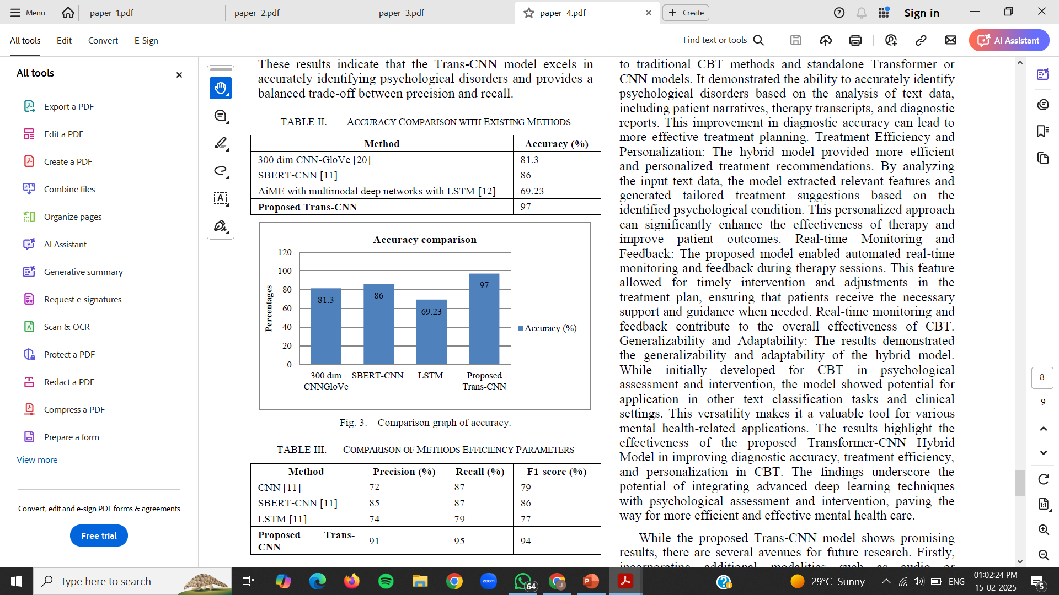
RELATED WORK

Slide 9
1. DATASET DESCRIPTION
The dataset contains 303 student responses collected via Google Forms, focused on mental health.
It was saved in CSV format (original_student_gform.csv) for easy analysis and processing.
It includes demographic details like age, gender, and course, along with Likert-scale responses.
Psychological features captured include five cognitive distortions, anxiety, and depression.
Most responses are on a 5-point Likert scale, making the data suitable for numerical analysis.
92.1% of participants are aged 18–21, with 54.1% female and 45.9% male
METHODOLOGY

Slide 10
2. DATASET PREPROCESSING
Handled missing values with SimpleImputer to ensure complete data for clustering and model training.
Cleaned text fields (age, course names) using re (regex) and string modules for valid, structured data.
Encoded categorical data (gender, course) using label encoding or one-hot encoding based on variable type.
Standardized numerical features with StandardScaler to ensure fair feature contribution during clustering.
Used pandas, numpy, re, string, scikit-learn, matplotlib, and seaborn for efficient data handling, transformation, and visualization.
METHODOLOGY

Slide 11
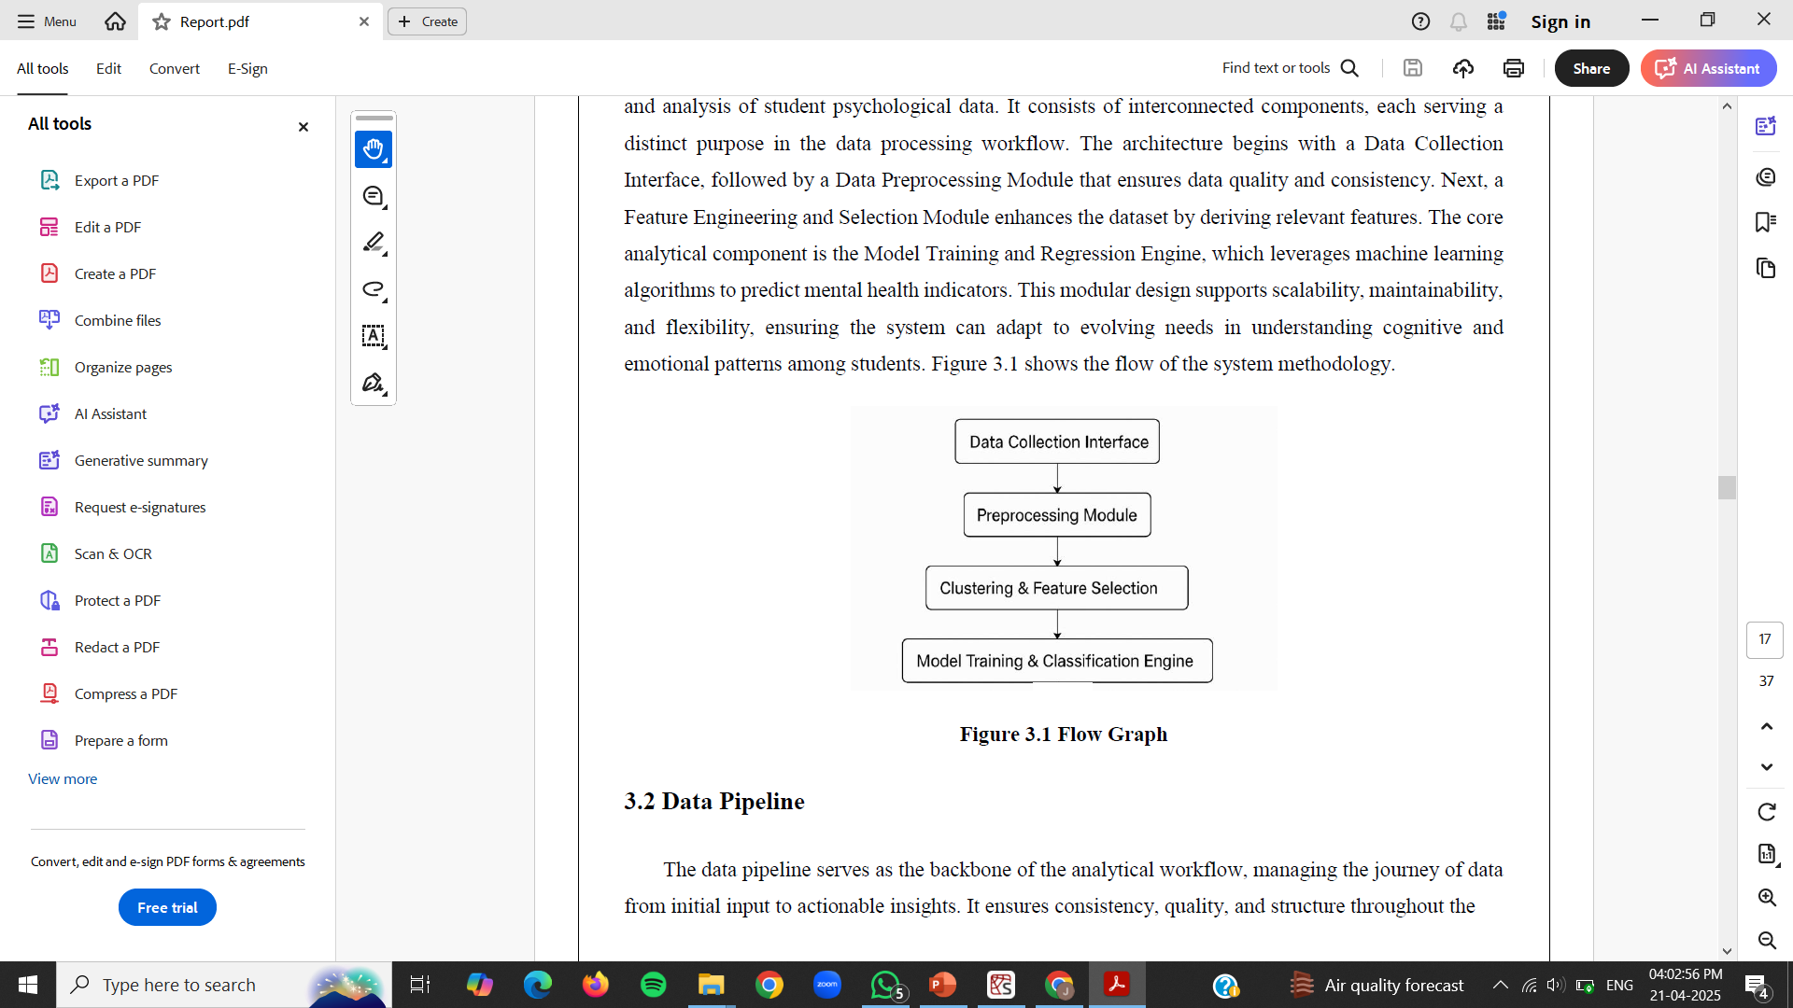
3. WORK FLOW
METHODOLOGY

Slide 12
4. K-MEANS CLUSTERING
K-Means clustering was chosen to uncover inherent groupings among students without requiring predefined labels, making it suitable for exploring patterns in psychological traits such as anxiety, depression, and cognitive distortions.
This unsupervised learning method was ideal for identifying natural segments within the data, especially in the early stages of analysis where labeled outcomes were not available.
Clustering helped reveal underlying behavioral groupings, such as students experiencing high versus low levels of psychological distress, which could inform targeted interventions.
StandardScaler was applied to normalize features, ensuring fair contribution of all variables, as K-Means is sensitive to varying data scales.
METHODOLOGY

Slide 13
5. CLASSIFICATION MODELS
Classification models were chosen because the dataset contains labeled categories indicating different mental health states or the presence of cognitive distortions, making it a supervised learning problem where the goal is to predict or classify these predefined categories.
The dataset is derived from structured questionnaires or survey responses, with each record representing a student and including features such as symptoms, demographic data, and responses related to mental health, which are suitable for classification tasks.
Using classification models allows for the extraction of hidden patterns and rules that can predict whether a student needs further psychological consultation, which is not feasible with conventional statistical methods due to the high volume and complexity
of the data.
METHODOLOGY

Slide 14
Classification models like Logistic Regression, Decision Tree, Random Forest, and XGBoost were selected for their ability to handle multidimensional data, provide interpretable results, and deliver high accuracy in predicting mental health categories.
The dataset was split into training and testing sets, typically using an 80:20 ratio, to ensure that model performance is evaluated on unseen data.
The workflow involved data collection through structured questionnaires, preprocessing (handling missing values, encoding, scaling), initial clustering to find patterns, training classification models, evaluating their performance and visualizing results to derive actionable insights.
METHODOLOGY

Slide 15
EXPERIMENTAL ANALYSIS AND RESULTS
Evaluation Metrics
To assess the predictive performance of each classification model in accurately assigning mental health clusters, the system utilizes a combination of core evaluation metrics.
Confusion Matrix – A square matrix that visualizes actual vs. predicted cluster labels, highlighting each model’s strengths and misclassifications in mental health risk prediction.
Accuracy - measures the proportion of correctly classified instances but can be misleading in the presence of class imbalance.

Slide 16
EXPERIMENTAL ANALYSIS AND RESULTS
Evaluation Metrics
Precision - indicates how well the model minimizes false positives by measuring the proportion of correct positive predictions out of all predicted positives.
Recall - indicates the model's ability to correctly identify all actual positive instances and how effectively the model captures true positives while minimizing false negatives.
F1-score - the harmonic mean of precision and recall, providing a balanced measure when both false positives and false negatives are important useful in cases of class imbalance.

Slide 17
EXPERIMENTAL ANALYSIS AND RESULTS
K- Means Clustering
K-Means clustering was used to segment students based on mental health traits.
Features selected included anxiety, depression, and cognitive distortions like “Black & White Thinking”.
Data was standardized using StandardScaler to ensure equal feature contribution.
Silhouette scores were calculated for cluster values from 2 to 10.
The highest silhouette score (~0.3) was observed at K=2, indicating optimal clustering.

Slide 18
EXPERIMENTAL ANALYSIS AND RESULTS
K- Means Clustering
Scatter plots (e.g., pair plots) visualized student groupings in reduced dimensions.
Cluster 0 showed higher levels of anxiety and distortions than Cluster 1.
Distribution plots showed clear separation in key variables across clusters.

Slide 19
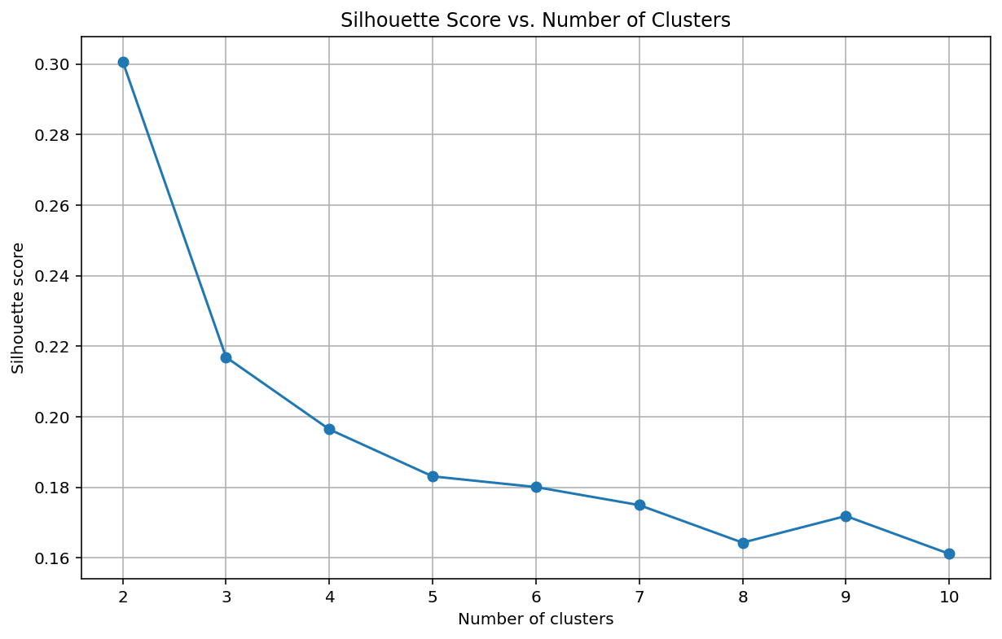
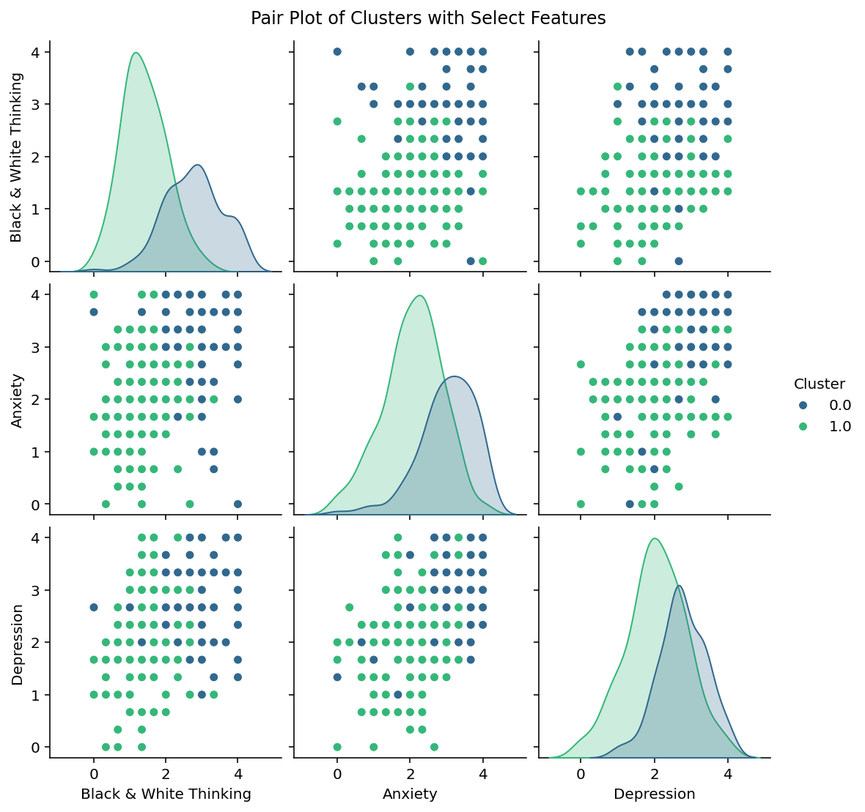

Slide 20
EXPERIMENTAL ANALYSIS AND RESULTS
Logistic Regression achieved 98.36% accuracy, with only 1 false negative; excellent for simplicity and reliability. Cluster 0 had a recall of 95.65%, and Cluster 1 had 100% recall, indicating strong balance.
Decision Tree achieved 91.80% accuracy, with 4 false negatives for Cluster 0, showing a slight bias. Cluster 0 recall dropped to 81.82%, though precision remained high at 95%.
Random Forest matched Logistic Regression with 98.36% accuracy, also misclassifying only 1 instance. Achieved 100% recall for Cluster 1, showing strong generalization via ensemble learning. Cluster 0 had 95.65% recall, the same as Logistic Regression, ensuring consistency.

Slide 21
EXPERIMENTAL ANALYSIS AND RESULTS
XGBoost achieved a perfect 100% accuracy, with no misclassifications in either cluster. Both precision and recall were 100% for both clusters, suggesting flawless learning.

Slide 22
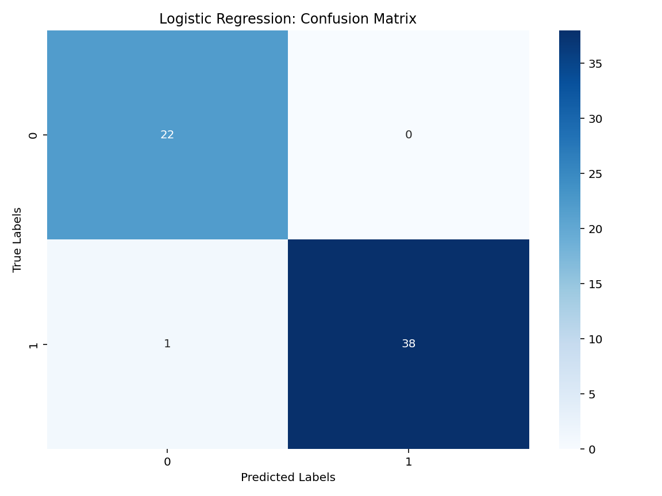
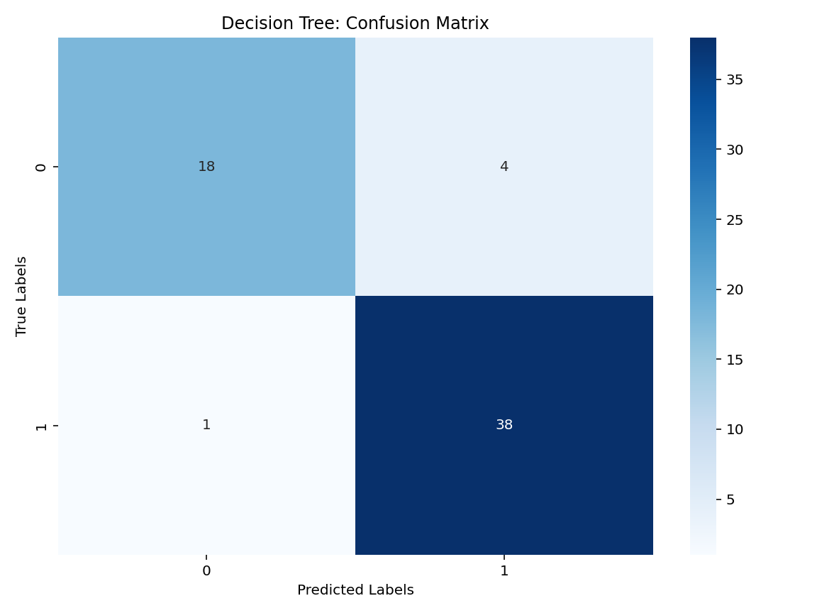

Slide 23
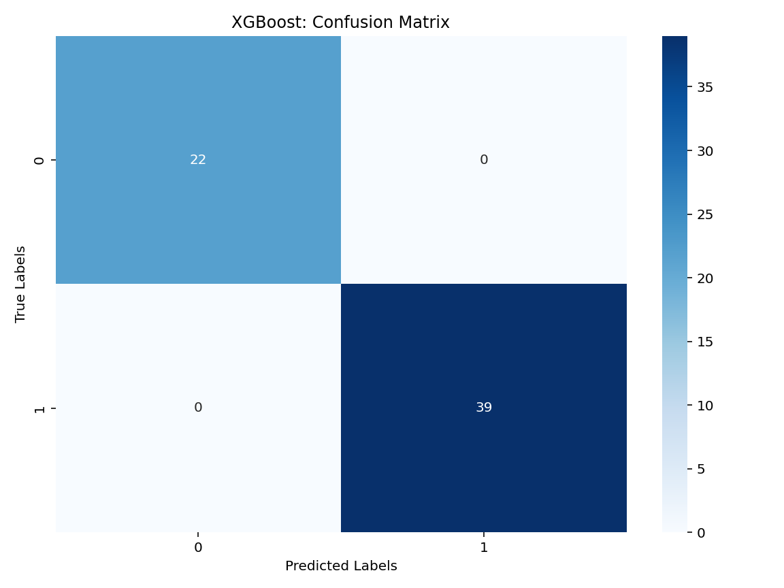


Slide 24
EXPERIMENTAL ANALYSIS AND RESULTS
To understand students' cognitive patterns, average scores for five major CBT distortions were analyzed.
Black & White Thinking had the highest average score (1.92), indicating a common tendency to view situations in extremes.
Other distortions like Personalization and Should Statements followed closely.
Cluster 0 showed the highest frequency of Black & White Thinking, along with elevated anxiety (3.01) and depression (2.77) scores.
This identifies Cluster 0 as a high-risk group needing focused mental health support.

Slide 25
This study aimed to explore mental health patterns among students using CBT-based insights and machine learning techniques.
Black & White Thinking emerged as the most common cognitive distortion, with an average score of 1.92. Such distortions are linked to heightened anxiety and depression symptoms in students.
K-Means clustering effectively grouped students into distinct mental health clusters.
XGBoost achieved perfect classification accuracy, showing strong potential for real-world use. Cluster 0 was identified as a high-risk group with severe emotional distress and distortions.
CONCLUSION

Slide 26
CBT-based interventions like cognitive restructuring and thought journaling are recommended.
Mindfulness workshops and regular mental health screenings can enhance emotional resilience.
Collaboration with mental health professionals is essential for personalized student care. The study supports a data-driven approach for early detection and targeted support in educational settings.
CONCLUSION

Slide 27
Research Papers
Joyce H. S. You , Scotty W. C. Luk, Dilys Y. W. Chow, Xinchan Jiang, Arthur D. P. Mak, Winnie W. S. Mark , Efficacy and Cost-Effectiveness Analysis of Internet-Based Cognitive Behavioral Therapy for Obsessive-Compulsive Disorder: Randomized Controlled Trial (Published: May 5, 2022 )
Z. Chen, R. Yang, S. Fu, and N. Zong, ―Detecting Reddit Users with Depression Using a Hybrid Neural Network, 2023.
Khizra Khurshid1, Rabia Mushtaq2, Umara Rauf3, Nida Anwar4, Qasir Abbas1*, Sumayah Aljhani5, Zoobia Ramzan4 and Mafia Shahzadi6CBT’s Impact on Procrastination, Burnout, and Anxiety in Adolescents (Published: 3 February, 2025)
REFERENCES

Slide 28
Research Papers
Meng Jiang, Yi Jing Yu, Qing Zhao, Jianqiang Li, Changwei Song, Hongzhi Qi, Wei Zhai, Dan Luo, Xiaoqin Wang, Guanghui Fu, Bing Xiang Yang*AI-Enhanced Cognitive Behavioral Therapy: Deep Learning and Large Language Models for Extracting Cognitive Pathways from Social Media Texts (Published: April 17, 2024 )
Veera Ankalu Vuyyuru, G Vamsi Krishna, S. Suma Christal Mary, S. Kayalvili, Abraheem Mohammed Sulayman Alsubayhay, Title: A Transformer-CNN Hybrid Model for Cognitive Behavioral Therapy in Psychological Assessment and Intervention for Enhanced Diagnostic Accuracy and Treatment Efficiency (Published: 2023)
REFERENCES

Slide 29
Website Links
https://bmcpsychology.biomedcentral.com/articles/10.1186/s40359-025-02371-2
https://positivepsychology.com/cbt-cognitive-behavioral-therapy-techniques-worksheets/
https://www.cambridge.org/core/journals/european-psychiatry/article/effectiveness-of-cbt-for-children-and-adolescents-with-depression-a-systematic-review-and-metaregression-analysis/D1D82E21388A16EB077D02A24366F689
https://neurolaunch.com/bipolar-black-and-white-thinking/
https://zionpsychology.wordpress.com/2024/08/17/exploring-black-and-white-thinking-in-mental-health-4-examples-and-5-effective-approaches/
REFERENCES

Slide 30
THANK YOU

