Slide 1
Challenge 1: Can we predict speech intelligibility from EEG signals?
Jessica Monaghan and JoRGE MeiJA

Slide 2
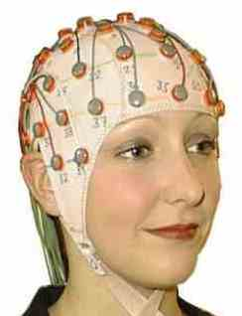
Introduction to EEG
The electroencephalogram (EEG) measures the activity of large numbers (populations) of neurons.
First recorded by Hans Berger in 1929.
EEG recordings are noninvasive, painless, do not interfere much with a human subject’s ability to move or perceive stimuli, are relatively low-cost.
Voltage-traces are recorded with millisecond resolution – great advantage over brain imaging (fMRI or PET).

Slide 3
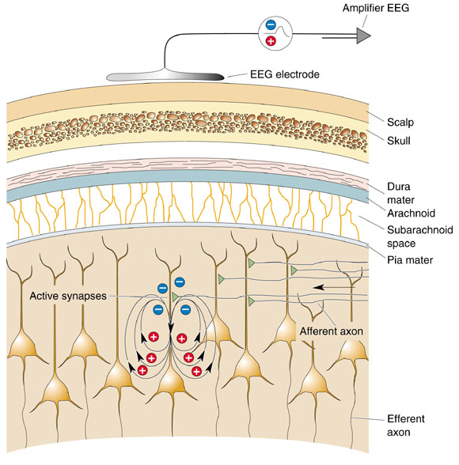
Introduction
EEG
EEG signal is the summation of post-synaptic potentials from the cortical pyramidal cells
Electrodes measure voltage-differences at the scalp in the microvolt (μV) range.

Slide 4
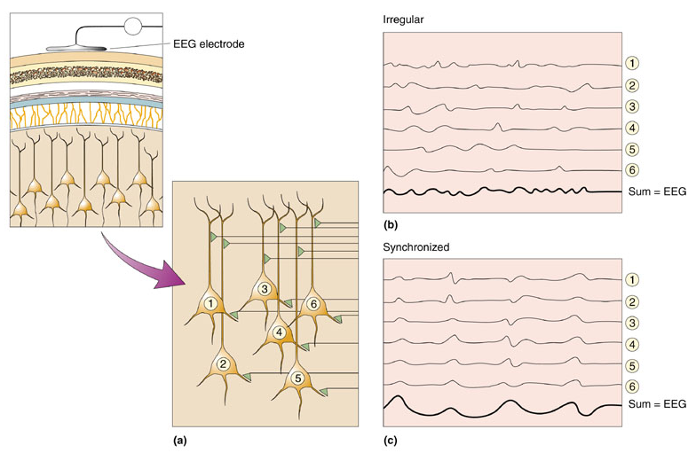
Introduction
EEG
Many neurons need to sum their activity in order to be detected by EEG electrodes.
The timing of their activity is crucial. Synchronized neural activity produces larger signals.

Slide 5
EEG
Oscillations
EEG rhythms correlate with patterns of behavior (level of attentiveness, sleeping, waking, seizures, coma).
Rhythms occur in distinct frequency ranges:
Gamma: 20-60 Hz
Beta: 14-20 Hz
Alpha: 8-13 Hz
Theta: 4-7 Hz
Delta: less than 4 Hz (sleep stages, especially “deep sleep”)
Higher frequencies: active processing, relatively de-synchronized activity (alert wakefulness, dream sleep).
Lower frequencies: strongly synchronized activity (non-dreaming sleep, coma).

Slide 6
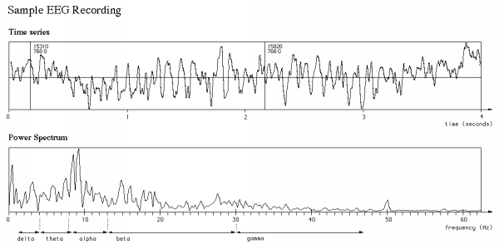
EEG
Power spectrum

Slide 7
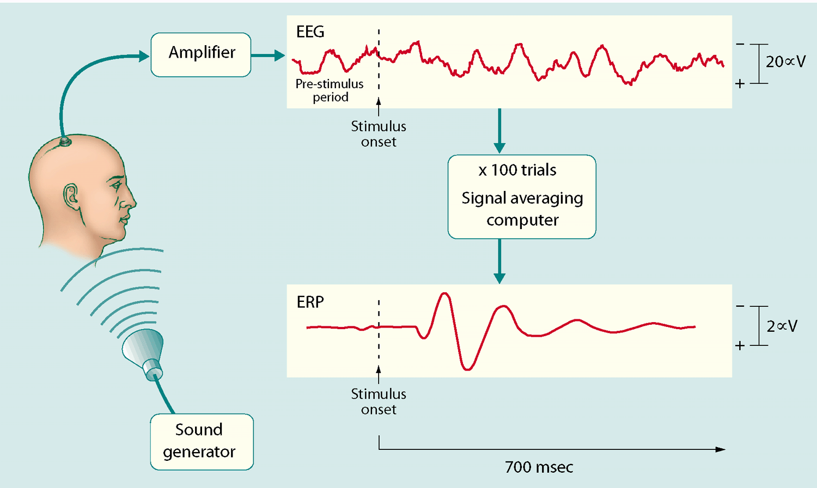
EEG
Power spectrum
ERPs are obtained after averaging EEG signals obtained over multiple trials (trials are aligned by stimulus onset).

Slide 8
Experiments
‘Listening Effort’
Listening to speech in noise is difficult, especially for people with a hearing impairment
Listening effort is the level of cognitive resources that a listener has to devote to speech understanding in challenging environments. Sustained mental exertion is linked to numerous adverse health outcomes
The studies these data come from were investigating listening effort in these noisy situations and how it is reflected in physiological measures – particularly neural oscillations
Interventions such as hearing aids and background noise reduction algorithms reduce listening effort for hearing impaired people
Here we are using speech understanding (percentage of words/parts of words recognised) as a proxy for listening effort (but this isn’t always applicable)

Slide 9
Predicting intelligibility
motivation
Being able to determined the degree of difficulty a listener is having in a particular situation would be useful for allowing smart hearing aids to adapt to a user’s needs
Neural oscillations can be measured in minimally invasively ways (behind/in ear electrodes)
Another potential application would be clinically as a method of measuring listening difficulty in children or adults with communication difficulties
The shorter the testing period the better so ideally a system would only require a few sentences to determine the listener’s listening effort

Slide 10
Dataset 1
Miles et al. 2017
https://www.ncbi.nlm.nih.gov/pmc/articles/PMC5536372/.
23 participants
Simple sentences in four different conditions in background babble noise
Vocoded with either 8 or 16 channels
High or low noise level – previously chosen adaptively for each participant to give 50% or 80% correct performance

Slide 11
Dataset 1
Stimuli
EEG was recorded while the participants listened to 220 sentences – four conditions were interleaved
After each sentence the participant reported back as much of the sentence as they understood
Actual performance differed from the 50% and 80% nominal values

Slide 12
Dataset 1
Trials (epochs)
Alpha power in the encoding window (1 s, 0.2 seconds before sentence offset) was calculated. It was compared (%change) with power in a baseline window before the sentence began.
0.5 s
1 s
0.2 s
Baseline window
Encoding window
sentence ended at the same time in every trial

Slide 13
Dataset 1
Miles et al. Results
Change in alpha power in the encoding window relative to baseline was significantly higher in the 16 channel compared to the 6 channel conditions
No difference in alpha power change between noise levels
No significant correlation of alpha power with performance
68%
61%
53%
39%
Performance scores

Slide 14
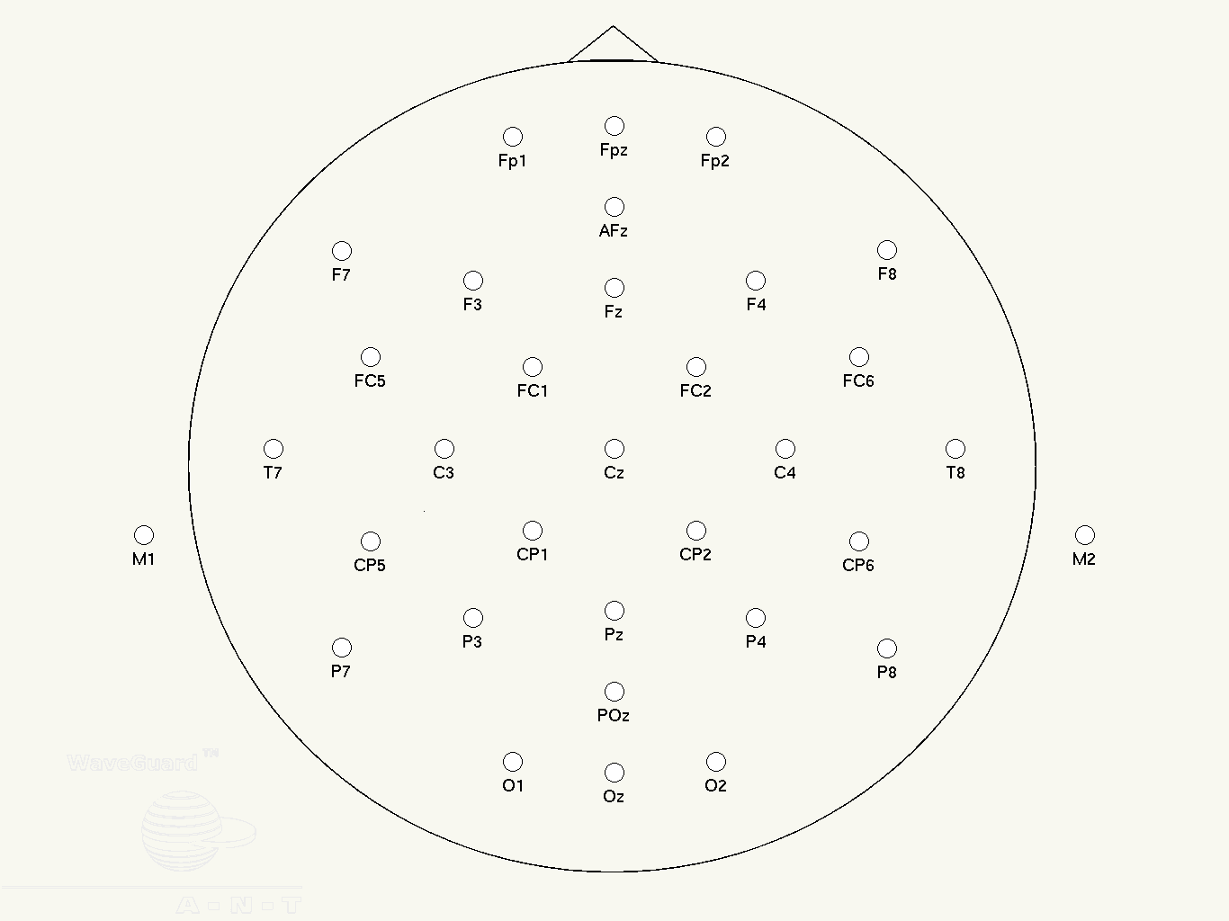
Dataset 1
Electrode locations
27 electrodes in dataset:
Miles et al. used only P3, Pz, P4 for alpha power analysis
1 | 'F3' |  | 15 | 'FZ'
2 | 'F4' |  | 16 | 'CZ'
3 | 'C3' |  | 17 | 'PZ'
4 | 'C4' |  | 18 | 'OZ'
5 | 'P3' |  | 19 | 'FC3'
6 | 'P4' |  | 20 | 'FC4'
7 | 'O1' |  | 21 | 'CP3'
8 | 'O2' |  | 22 | 'CP4'
9 | 'F7' |  | 23 | 'FT7'
10 | 'F8' |  | 24 | 'FT8'
11 | 'T7' |  | 25 | 'TP7'
12 | 'T8' |  | 26 | 'TP8'
13 | 'P7' |  | 27 | 'FCZ'
14 | 'P8'

Slide 15
Dataset 1
Data structure
'eegwholetrial' – filtered EEG data (0.5 Hz – 45 Hz) – 6 seconds duration, 27 channels
'fs' – sampling rate (= 500 Hz)
'eeg_Alpha_Active' – 27 dimensions (channels) per trial
'eeg_Alpha_Baseline'– 27 dimensions (channels) per trial
'eeg_Beta_Active'– 27 dimensions (channels) per trial
'eeg_Beta_Baseline'– 27 dimensions (channels) per trial
'eeg_Delta_Active'– 27 dimensions (channels) per trial
'eeg_Delta_Baseline'– 27 dimensions (channels) per trial
'eeg_Theta_Active'– 27 dimensions (channels) per trial
'eeg_Theta_Baseline'– 27 dimensions (channels) per trial
'eeg_Gamma_Active'– 27 dimensions (channels) per trial
'eeg_Gamma_Baseline'– 27 dimensions (channels) per trial
'SpeechRecall' – number of words correctly identified per trial
'ToSpeechItems' – total number of words per trial
'condition' – 1 to 4: 16 channel low noise; 16 channel high noise; 6 channel low noise; 6 channel high noise
'siglen' – sentence durations (ms)
'sigonset' – sentence onset relative to trial start (ms)
'sex' – 1 or 0
'age’

Slide 16
Dataset 2
MeJia et Al. 2017
56 participants from 3 studies including Mejia et al. 2017: http://www.hearingreview.com/2017/01/listening-effort-speech-intelligibility-narrow-directionality/#
In all studies, the target stimuli selected were simple sentences presented in speech babble background noise
The signal to noise ratios used were 0, -3.5 and -5 dB SNR for the different studies. Participants were asked to repeat what they heard.
The performance measure to be predicted is percentage of morphemes (parts of words) correctly identified in each sentence.

Slide 17
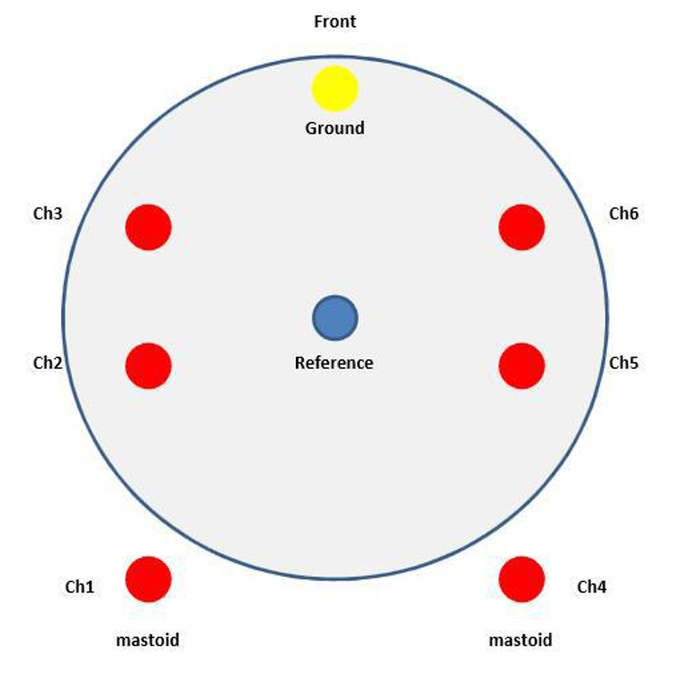
Dataset 2
Electrode Locations
6 channel EEG recording

Slide 18
Dataset 2
Trials (epochs)
Alpha power in the encoding window (2 s, before and after the sentence offset) was calculated.
BASELINE
ACTIVE
2 s
2 s
>> 2 s
N
N + S
N
N + S
Onset Trigger
Onset Trigger

Slide 19
Dataset 2
Data structure
Data fields:
'eegwholetrial' – unfiltered EEG data – 6 seconds duration, 6 channels
'fs' – sampling rate (= 500 Hz)
'eeg_Alpha_Active' – 6 dimensions (channels) per trial
'eeg_Alpha_Baseline'– 6 dimensions (channels) per trial
'eeg_Beta_Active'– 6 dimensions (channels) per trial
'eeg_Beta_Baseline'– 6 dimensions (channels) per trial
'eeg_Delta_Active'– 6 dimensions (channels) per trial
'eeg_Delta_Baseline'– 6 dimensions (channels) per trial
'eeg_Theta_Active'– 6 dimensions (channels) per trial
'eeg_Theta_Baseline'– 6 dimensions (channels) per trial
'eeg_Gamma_Active'– 6 dimensions (channels) per trial
'eeg_Gamma_Baseline'– 6 dimensions (channels) per trial
'SpeechRecall' – number of words correctly identified per trial
'ToSpeechItems' – total number of words per trial
'sex' – 1 or 0
'age'

Slide 20
Example models
Tensorflow and Sklearn
See Jupyter Notebook examples
Run by typing ‘conda jupyter notebook’ in anaconda prompt and opening notebook in navigator
Sci-kit learn has lots of useful approaches for selecting features and modelling

Slide 21
Evaluation
Criteria
Training sets will be released now – test set features will be released Friday 9 am
Each team will need to submit a csv file with your predictions (see notebook for example) for the test sets Friday at 12 noon. You can get feedback once on the performance of your model by submitting it before 10 am on Friday
Each team will present a 3 min presentation about your model describing the features and the modelling approach that you used

Slide 22
Evaluation
Criteria
Either regression or classification can be attempted – either predicting performance or condition
Team scoring:
50% Accuracy –rank mean absolute error performance across entries
10% Bonus added to the regression challenge
15% Block size required - 50 scores 0%, 1 scores 20%
25% Presentation
50% Innovation
50% Quality of presentation

Slide 23
Questions?

Slide 24
Data
Download the data, information, and Jupyter notebooks here:
Link to be added

