Slide 1
Locking Phenomena
Reproducing shear locking & volumetric locking
(PowerPoint lay-out made with the help of AI.)

Slide 2
What is Locking?
Shear Locking
Volumetric Locking
Occurs in bending-dominated problems
Low-order elements (Q1) cannot represent pure bending without spurious shear strains
Element behaves too stiffly — deflection is severely underestimated
Worsens as L/h increases (more slender beam)
Occurs in nearly-incompressible materials (ν → 0.5)
Incompressibility constraint (εᵥₒₗ ≈ 0) cannot be satisfied element-by-element
Pressure field becomes oscillatory (checkerboard pattern)
Worsens as Poisson's ratio approaches 0.5
Common cause: element formulation cannot represent the true deformation field

Slide 3
Volumetric Locking —Triangle Setup
t(x) = 20000·x₁
Parameter | Value
Element type | T3 Linear Triangle
Mesh | 4×2 elements (12 triangles)
Domain | 1.5 × 1.0 mm
Young's modulus | 200 000 MPa
Poisson's ν | 0.3 → 0.49999999
BCs | Fixed left + bottom; traction top
Traction | t(x) = 20 000·x₁
1.0
m
1.5 m
4×3 T3 mesh
(12 triangles)

Slide 4




Volumetric Locking - Background
$$K=\frac{E}{3∗(1− 2ν)}$$
$$ϵ_{dil}=ϵ_{11}+ϵ_{22}+ϵ_{33}$$
$$−p=K∗ ϵ_{dil}$$
$$Ku=f$$

Slide 5
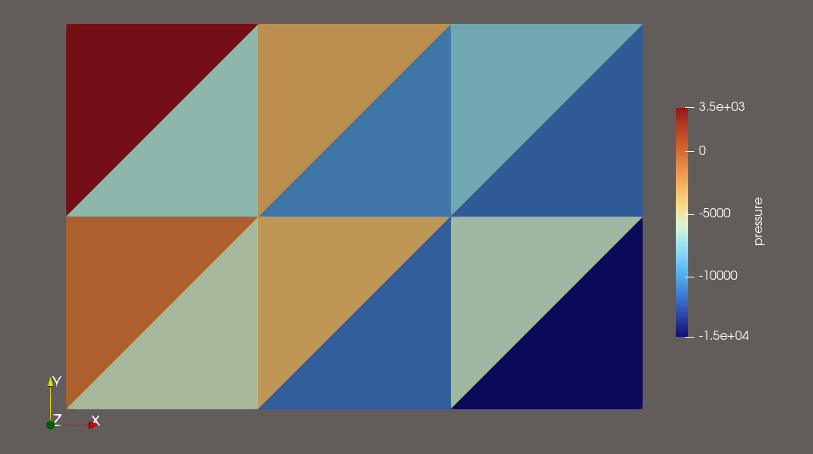
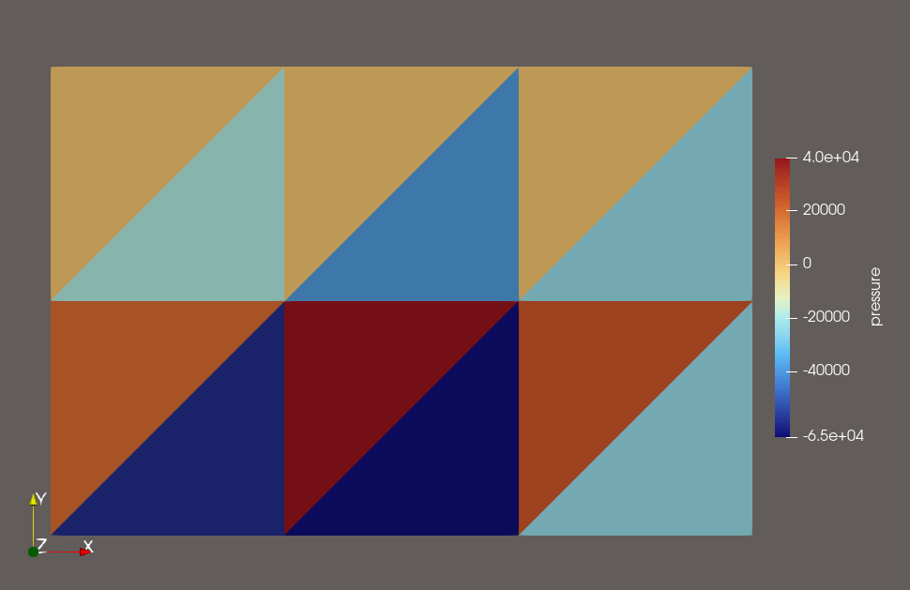
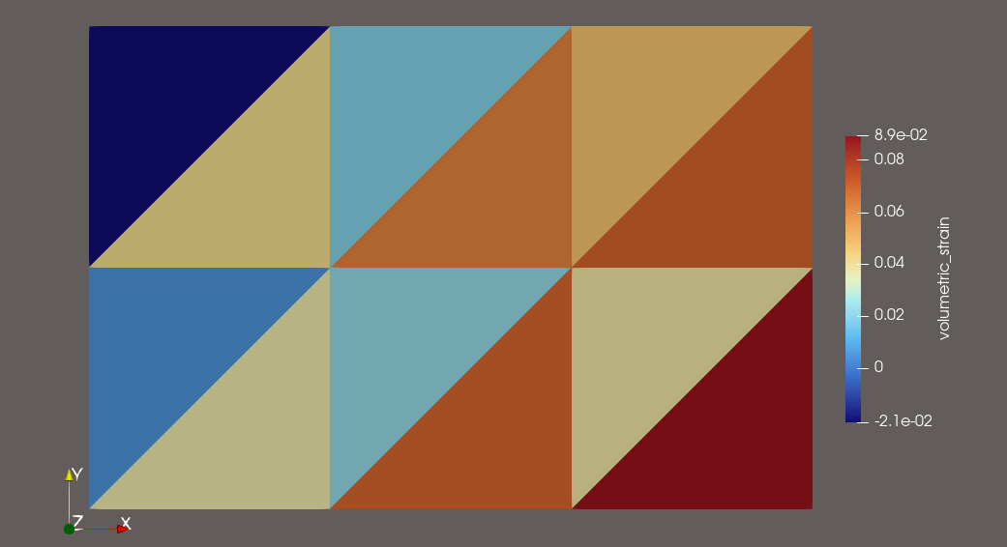
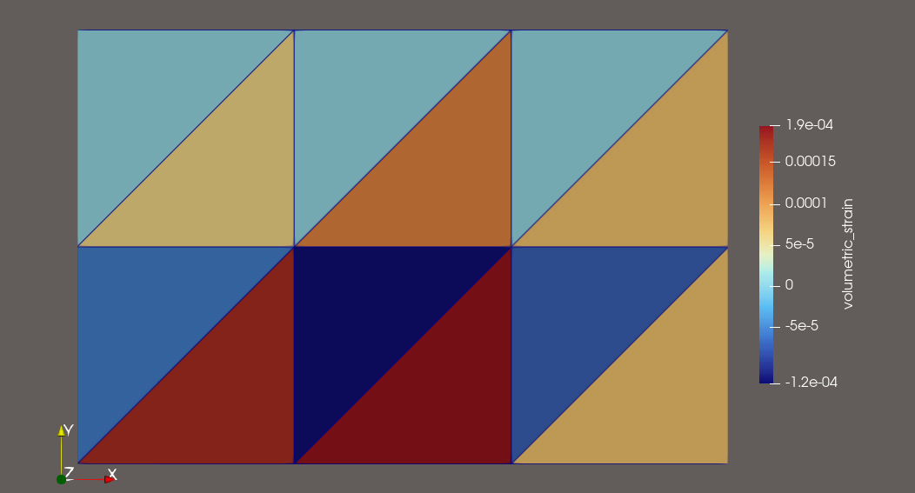


$$ν=0.3$$
$$ν=0.4999$$
Pressure
Volumetric Strain

Slide 6
Volumetric Locking — Max Displacement vs ν
-1
-1.0
-1.1
Raw Results
-1.3
-1.7
-2.5
ν | Max δ (mm)
0.3 | 9.57 × 10⁻²
0.4 | 7.18 × 10⁻²
0.45 | 4.97 × 10⁻²
0.49 | 1.95 × 10⁻²
0.499 | 2.95 × 10⁻³
0.4999 | 3.13 × 10⁻⁴
0.49999 | 3.15 × 10⁻⁵
0.499999 | 3.15 × 10⁻⁶
-2
-3.5
-4.5
log₁₀(δ)
-3
-5.5
-4
-5
-6
0.3
0.4
0.45
0.49
0.499
0.4999
0.49999
0.499999
X-axis: Poisson ratio ν. Y-axis: log₁₀(max displacement).

Slide 7
Problem Setup: Cantilever Beam
Beam (L × h = L × 1)
P = 1000 N
(tip load)
L (varies: 1, 2, 4, 8, 12, 16, 20 mm)
Parameter | Value
Element type | Q1 Quadrilateral
Mesh | 4 × 1 elements
Height h | 1 mm
Young's modulus E | 200 000 MPa
Poisson's ν | 0.3 / 0.4 / 0.45 / 0.49 / 0.4999
BCs | Fully fixed left end

Slide 8

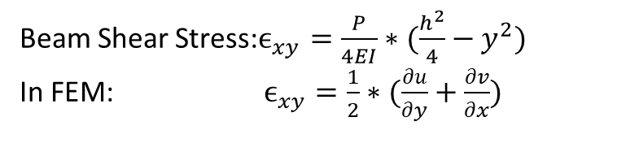




Shear Locking — Background
=== L = 20.0 | Bottom nodes (y=h/2) ===
x | σ_xx FEM | σ_xx Exact | σ_12 FEM | σ_12 Exact
0.0 | 110874.3 | -120000.0 | 1064.0 | 0.0
5.0 | 91684.5 | -90000.0 | 976.6 | 0.0
10.0 | 59701.6 | -60000.0 | 1000.0 | 0.0
15.0 | 27718.6 | -30000.0 | 993.6 | 0.0
20.0 | 8528.8 | -0.0 | 995.7 | 0.0
Beam Shear Stress:$ϵ_{xy}=\frac{P}{4EI}∗(\frac{h^{2}}{4}−y^{2})$
In FEM: $ϵ_{xy}=\frac{1}{2}∗(\frac{∂u}{∂y}+\frac{∂v}{∂x})$

Slide 9
Shear Locking — Tip Deflection vs Beam Length
Key Observations
Ratio = 1.0
(perfect accuracy)
Ratio drops sharply as L/h increases
At L=20, ν=0.3: only 9% of correct deflection captured
This is shear locking: bending activates spurious shear strains
Effect present even at ν=0.3
Y-axis: FEM tip deflection / Analytical (Euler-Bernoulli). Value = 1 → exact. Value < 1 → locking.

Slide 10
Locking Severity Map — FEM/Analytical Ratio
L / h | ν=0.30 | ν=0.40 | ν=0.45 | ν=0.49 | ν=0.4999
L = 1 | 1.368 | 1.155 | 0.983 | 0.802 | 0.750
L = 2 | 0.845 | 0.616 | 0.435 | 0.243 | 0.188
L = 4 | 0.609 | 0.438 | 0.283 | 0.103 | 0.048
L = 8 | 0.351 | 0.287 | 0.202 | 0.065 | 0.012
L = 12 | 0.209 | 0.189 | 0.148 | 0.054 | 0.006
L = 16 | 0.134 | 0.128 | 0.109 | 0.047 | 0.004
L = 20 | 0.091 | 0.091 | 0.081 | 0.041 | 0.003
≥ 0.9 Accurate
0.5–0.9 Moderate locking
0.2–0.5 Severe locking
< 0.2 Extreme locking

Slide 11
Why Does Locking Occur? The Mechanism
Shear Locking Mechanism
Volumetric Locking Mechanism
Q1 element has linear displacement field in each parametric coordinate
Nearly incompressible: εᵥₒₗ = ε_xx + ε_yy ≈ 0 everywhere
Bending requires quadratic terms
Each element must independently satisfy εᵥₒₗ ≈ 0
Q1 can only represent linear terms
With n elements: n constraints on limited DOFs
The missing quadratic terms appear as parasitic shear ε_xy
System becomes overconstrained (too many constraints)
→ Element cannot bend without being 'pulled' by shear
Displacement field becomes artificially stiff (locking)
→ Structure appears artificially stiff
→ Pressure field oscillates wildly (checkerboard)

Slide 12
Volumetric Locking — Effect of Poisson's Ratio
Key Observations
Ratio collapses as ν → 0.5
At ν=0.4999, L=16: only 0.35% of correct deflection
Incompressibility constraint over-stiffens element
Shear & volumetric locking act simultaneously
Y-axis: FEM / Analytical deflection ratio. Both axes show that locking worsens in combination.

