Slide 1
Statistical simulations and considerations
jesper fischer ehmsen

Slide 2
Outline
Regression as distributions
Parameterization of parameters in distributions
Heteroscedasticity
Hierarchical / multilevel models / mixed effects models.
Statistical significance of models with and without and of coefficients

Slide 3
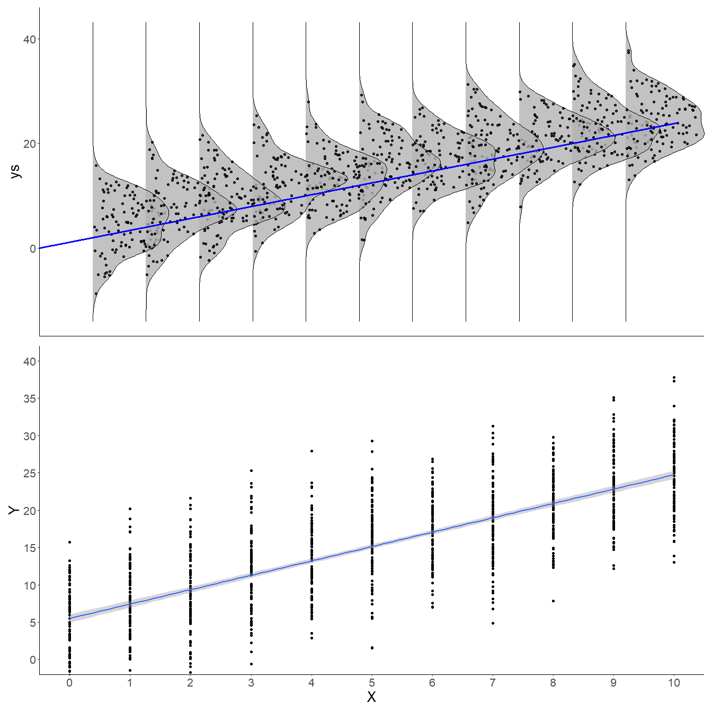
Multi-column Layout
$$y_{i}∼N\left(μ_{i},σ\right)$$
$$μ_{i}=β_{0}+β_{1}*X_{i}$$

